Slide 1
University of Wisconsin-Madison
Satisfiability Modulo Abstraction for Separation Logic with Linked Lists
Aditya Thakur, Jason Breck, and Thomas Reps

Slide 2
Satisfiability Modulo Abstraction for Separation Logic with Linked Lists

Slide 3
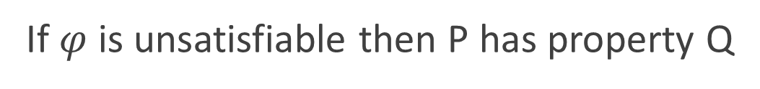

Satisfiability Modulo Abstraction for Separation Logic with Linked Lists
(program P, property Q)
$$φ∈ ℒ$$
Satisfiability Solver
If $φ$is unsatisfiable then P has property Q

Slide 4
Satisfiability Modulo Abstraction for Separation Logic with Linked Lists
(program P, property Q)
using linked lists
$$φ∈ ℒ$$
?
Satisfiability Solver
If $φ$is unsatisfiable then P has property Q

Slide 5

Satisfiability Modulo Abstraction for Separation Logic with Linked Lists
(program P, property Q)
using linked lists
$$φ∈SL$$
$$φ∈ ℒ$$
Satisfiability Solver
?
If $φ$is unsatisfiable then P has property Q

Slide 6
Satisfiability Modulo Abstraction for Separation Logic with Linked Lists
(program P, property Q)
using linked lists
$$φ∈SL$$
Satisfiability Solver
using concepts from abstract interpretation
If $φ$is unsatisfiable then P has property Q

Slide 7
Contributions
We check the unsatisfiability of separation logic formulas using concepts and tools (ITVLA) from abstract interpretation
We use an abstract domain of sets of shape graphs to over-approximate the set of heaps that satisfy a separation logic formula
Our technique can handle some formulas that cannot be handled by previous techniques

Slide 8
Separation Logic
Store
Heap
x
y
z
Notes:
(x points to y) describes a sub-heap (a subset of the heap) that consists of a single pointer, at the address x, whose pointer value is equal to y.
ls(x,y) describes a sub-heap that consists of a single list starting at x, and reaching y after some number of linked list steps.

Slide 9
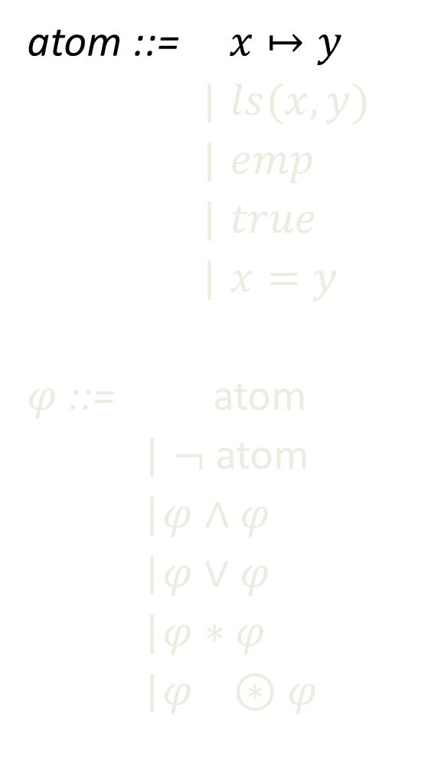
Separation Logic
atom ::= $x↦y$
| $ls(x,y)$
| $emp$
| $true$
|$x=y$
$φ$ ::= atom
| $¬$ atom
|$φ∧φ$
|$φ∨φ$
|$φ∗φ$
|$φ ⊛φ$
Store
Heap
x
y
z
Notes:
(x points to y) describes a sub-heap (a subset of the heap) that consists of a single pointer, at the address x, whose pointer value is equal to y.
ls(x,y) describes a sub-heap that consists of a single list starting at x, and reaching y after some number of linked list steps.

Slide 10
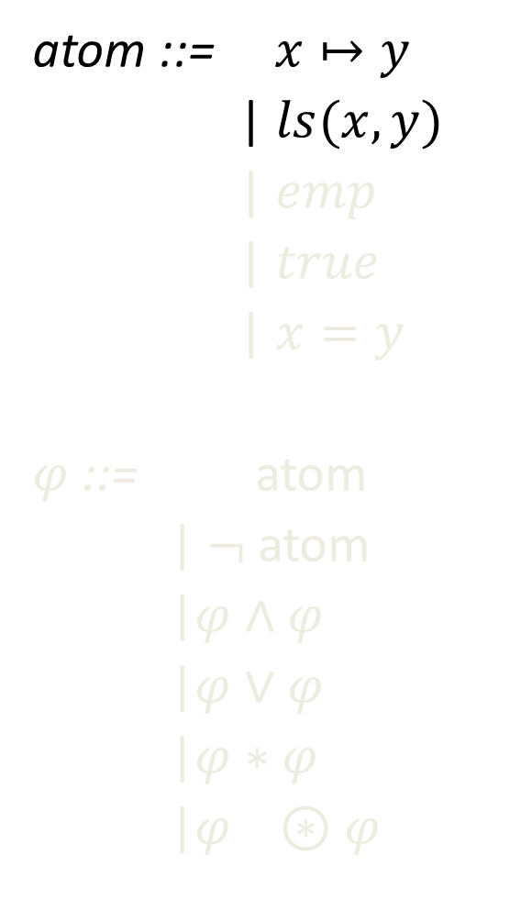
Separation Logic
atom ::= $x↦y$
| $ls(x,y)$
| $emp$
| $true$
|$x=y$
$φ$ ::= atom
| $¬$ atom
|$φ∧φ$
|$φ∨φ$
|$φ∗φ$
|$φ ⊛φ$
Store
Heap
x
y
z
Notes:
(x points to y) describes a sub-heap (a subset of the heap) that consists of a single pointer, at the address x, whose pointer value is equal to y.
ls(x,y) describes a sub-heap that consists of a single list starting at x, and reaching y after some number of linked list steps.

Slide 11
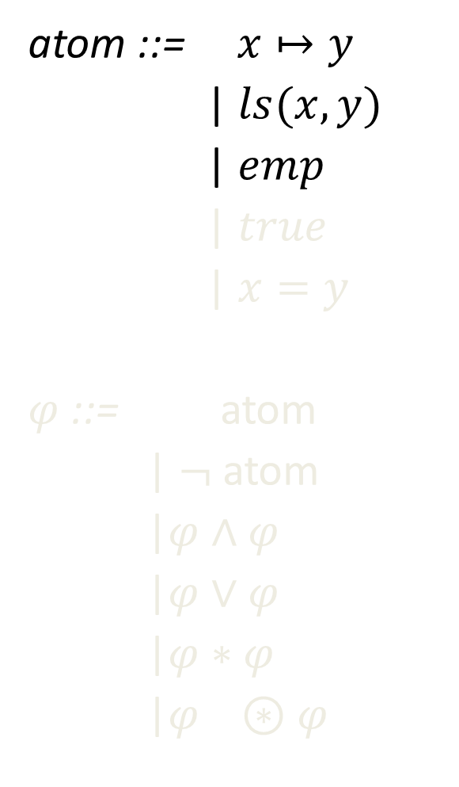
Separation Logic
atom ::= $x↦y$
| $ls(x,y)$
| $emp$
| $true$
|$x=y$
$φ$ ::= atom
| $¬$ atom
|$φ∧φ$
|$φ∨φ$
|$φ∗φ$
|$φ ⊛φ$
Store
Heap
x
y
z
Notes:
(x points to y) describes a sub-heap (a subset of the heap) that consists of a single pointer, at the address x, whose pointer value is equal to y.
ls(x,y) describes a sub-heap that consists of a single list starting at x, and reaching y after some number of linked list steps.

Slide 12
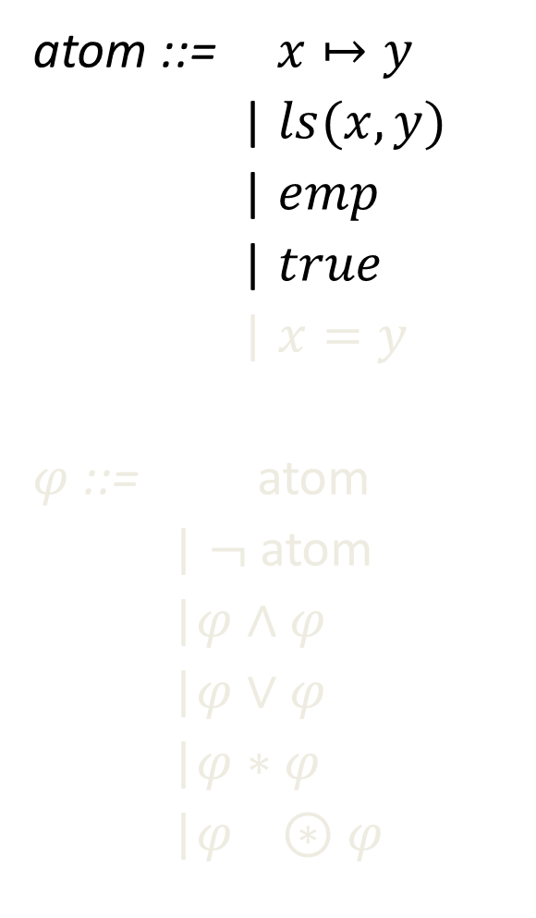
Separation Logic
atom ::= $x↦y$
| $ls(x,y)$
| $emp$
| $true$
|$x=y$
$φ$ ::= atom
| $¬$ atom
|$φ∧φ$
|$φ∨φ$
|$φ∗φ$
|$φ ⊛φ$
Store
Heap
x
y
z
Notes:
(x points to y) describes a sub-heap (a subset of the heap) that consists of a single pointer, at the address x, whose pointer value is equal to y.
ls(x,y) describes a sub-heap that consists of a single list starting at x, and reaching y after some number of linked list steps.

Slide 13
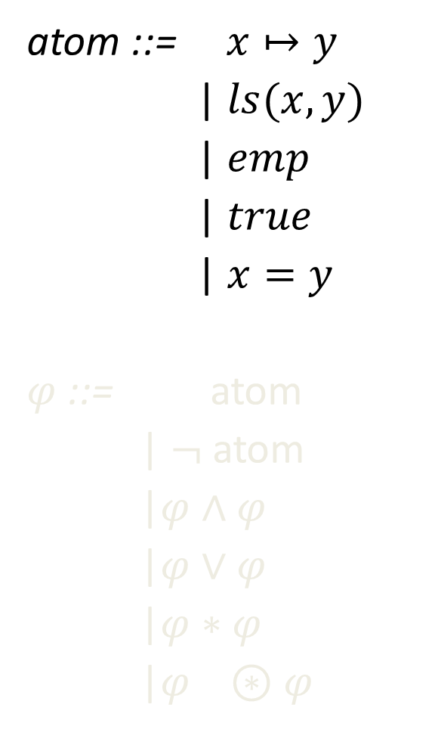
Separation Logic
atom ::= $x↦y$
| $ls(x,y)$
| $emp$
| $true$
|$x=y$
$φ$ ::= atom
| $¬$ atom
|$φ∧φ$
|$φ∨φ$
|$φ∗φ$
|$φ ⊛φ$
Store
Heap
x
y
z
Notes:
(x points to y) describes a sub-heap (a subset of the heap) that consists of a single pointer, at the address x, whose pointer value is equal to y.
ls(x,y) describes a sub-heap that consists of a single list starting at x, and reaching y after some number of linked list steps.

Slide 14
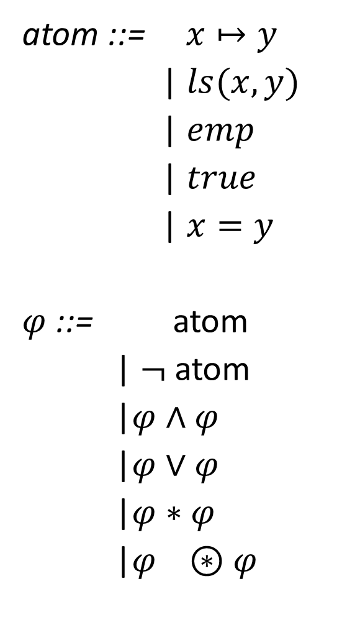

Separation Logic
atom ::= $x↦y$
| $ls(x,y)$
| $emp$
| $true$
|$x=y$
$φ$ ::= atom
| $¬$ atom
|$φ∧φ$
|$φ∨φ$
|$φ∗φ$
|$φ ⊛φ$
Store
Heap
x
y
z
$$−$$
Notes:
(x points to y) describes a sub-heap (a subset of the heap) that consists of a single pointer, at the address x, whose pointer value is equal to y.
ls(x,y) describes a sub-heap that consists of a single list starting at x, and reaching y after some number of linked list steps.

Slide 15





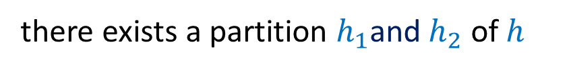
Separation Logic
heap $h⊨φ_{1}∗φ_{2}$ iff
there exists a partition $h_{1}$and $h_{2}$ of $h$
such that $h_{1}⊨φ_{1}$and $h_{2}⊨φ_{2}$
h
$$⊨φ_{1}∗φ_{2}$$
$$h_{1}$$
$$⊨φ_{1}$$
$$h_{2}$$
$$⊨φ_{2}$$
Example: $ls(x,y)∗ls(a,b)∗w↦z∗c↦d$

Slide 16




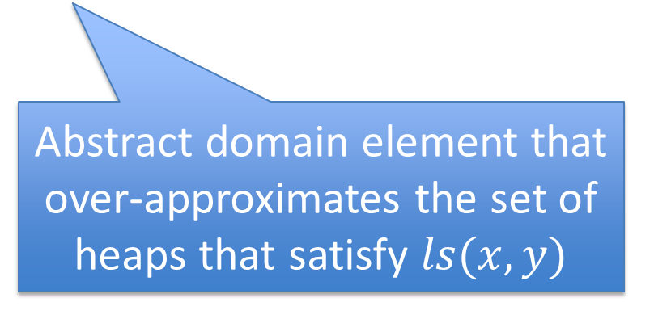




Strategy: Bottom-Up Evaluation
$\left(ls\left(x,y\right) ∧ ¬\left(x↦y\right)\right)∧(x↦y∗x↦y)$
$$∧$$
$$⊓$$
$$∧$$
$$∗$$
$$ls(x,y)$$
$$¬(x↦y)$$
$$x↦y$$
$$x↦y$$
Abstract domain element that over-approximates the set of heaps that satisfy $ls(x,y)$
If this is the bottom element, the formula is unsatisfiable

Slide 17
Strategy: Bottom-Up Evaluation
$\left(ls\left(x,y\right) ∧ ¬\left(x↦y\right)\right)∧(x↦y∗x↦y)$
$$∧$$
$$∧$$
$$∗$$
$$ls(x,y)$$
$$¬(x↦y)$$
$$x↦y$$
$$x↦y$$

Slide 18
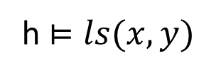
Shape Graphs
x
y
r[x]
r[x]
r[x]
Abstract
h $⊨ls(x,y)$
Concrete
y
x
y
x
r[x]
r[x]
r[x]
r[x]
r[x]
r[x]
r[x]
r[x]
x
y
r[x]
r[x]
r[x]
r[x]

Slide 19

Shape Graphs
x
y
$$h⊨ls(x,y)$$
r[x]
x
y
r[x]
r[x]
x
y
r[x]
r[x]
r[x]

Slide 20
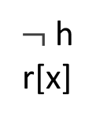

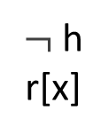
Shape Graphs
x
y
$$h⊨ls(x,y)$$
$\text{¬}$ h
r[x]
x
y
h
r[x]
$\text{¬}$ h
r[x]
x
y
h
r[x]
h
r[x]
$\text{¬}$ h
r[x]
Notes:
one more complication: the subheap described by ls(x,y) typically does not contain the final element (pointed to by y) of the linked list. So, we introduce a predicate, “h” for “domain” to indicate which nodes in the shape graph are actually part of the subheap of interest, and which are not.

Slide 21

Strategy: Bottom-Up Evaluation
$\left(ls\left(x,y\right) ∧ ¬\left(x↦y\right)\right)∧(x↦y∗x↦y)$
$$∧$$
$$∧$$
$$∗$$
$$ls(x,y)$$
$$¬(x↦y)$$
$$x↦y$$
$$x↦y$$
x
y
$\text{¬}$h
x
y
$\text{¬}$h
x
y
$\text{¬}$h

Slide 22

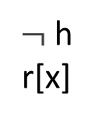
Shape Graphs
$$h⊨x↦y$$
x
y
h
r[x]
$\text{¬}$ h
r[x]

Slide 23

Strategy: Bottom-Up Evaluation
$\left(ls\left(x,y\right) ∧ ¬\left(x↦y\right)\right)∧(x↦y∗x↦y)$
$$∧$$
$$∧$$
$$∗$$
$$ls(x,y)$$
$$¬(x↦y)$$
$$x↦y$$
$$x↦y$$
x
y
x
y
$\text{¬}$h
$\text{¬}$h
x
y
$\text{¬}$h
x
y
$\text{¬}$h

Slide 24
Strategy: Bottom-Up Evaluation
$\left(ls\left(x,y\right) ∧ ¬\left(x↦y\right)\right)∧(x↦y∗x↦y)$
$$∧$$
$$∧$$
$$∗$$
$$ls(x,y)$$
$$¬(x↦y)$$
$$x↦y$$
$$x↦y$$
x
y
x
y
x
y
$\text{¬}$h
$\text{¬}$h
$\text{¬}$h
x
y
$\text{¬}$h
x
y
$\text{¬}$h

Slide 25

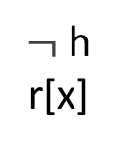
Shape Graphs
$$h⊨¬(x↦y)$$
x is not in the sub-heap
the sub-heap is empty
h
x
y
x
y
h
r[x]
$\text{¬}$ h
r[x]
h
h
successor to x is not y
sub-heap has >1 node

Slide 26
Strategy: Bottom-Up Evaluation
$\left(ls\left(x,y\right) ∧ ¬\left(x↦y\right)\right)∧(x↦y∗x↦y)$
$$∧$$
$$∧$$
$$∗$$
$$ls(x,y)$$
$$¬(x↦y)$$
$$x↦y$$
$$x↦y$$
x
y
x
y
x
y
$\text{¬}$h
$\text{¬}$h
$\text{¬}$h
x
y
x
y
x
y
$\text{¬}$h
$\text{¬}$h
x
y
$\text{¬}$h

Slide 27



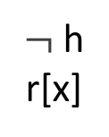


Meet: Inputs
$$ls(x,y)$$
$$¬(x↦y)$$
x
y
$\text{¬}$ h
r[x]
h
x
y
x
y
x
y
h
r[x]
$\text{¬}$ h
r[x]
h
r[x]
$\text{¬}$ h
r[x]
h
h
x
y
h
r[x]
h
r[x]
$\text{¬}$ h
r[x]

Slide 28
Meet: Outputs
$$ls(x,y)$$
$$¬(x↦y)$$
x
y
$\text{¬}$ h
r[x]
h
x
y
x
y
x
y
h
r[x]
$\text{¬}$ h
r[x]
h
r[x]
$\text{¬}$ h
r[x]
h
h
x
y
h
r[x]
h
r[x]
$\text{¬}$ h
r[x]

Slide 29


Strategy: Bottom-Up Evaluation
$\left(ls\left(x,y\right) ∧ ¬\left(x↦y\right)\right)∧(x↦y∗x↦y)$
$$∧$$
$$∧$$
$$∗$$
$$ls(x,y)$$
$$¬(x↦y)$$
$$x↦y$$
$$x↦y$$
x
y
x
y
x
y
$\text{¬}$h
$\text{¬}$h
x
y

Slide 30



Separating Conjunction
x
y
x
y
$$∗$$
h
r[x]
$\text{¬}$ h
r[x]
h
r[x]
$\text{¬}$ h
r[x]

Slide 31
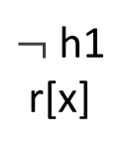
Separating Conjunction
x
y
x
y
$$∗$$
h1
r[x]
$\text{¬}$ h1
r[x]
h
r[x]
$\text{¬}$ h
r[x]

Slide 32
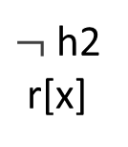
Separating Conjunction
x
y
x
y
$$∗$$
h1
r[x]
$\text{¬}$ h1
r[x]
h2
r[x]
$\text{¬}$ h2
r[x]

Slide 33
Separating Conjunction
h is the disjoint union of h1 and h2
h1
¬ h2
h
¬ h1
h2
h
h1
¬ h2
h
¬ h1
h2
h

Slide 34
Separating Conjunction
x
y
x
y
$$∗$$
h1
r[x]
$\text{¬}$ h1
r[x]
h2
r[x]
$\text{¬}$ h2
r[x]
h1
¬ h2
h
¬ h1
h2
h
h1
¬ h2
h
¬ h1
h2
h

Slide 35


Separating Conjunction
x
y
x
y
h1
r[x]
$\text{¬}$ h1
r[x]
h2
r[x]
$\text{¬}$ h2
r[x]
$$⊓$$
$$⊓$$
h1
¬ h2
h
¬ h1
h2
h
h1
¬ h2
h
¬ h1
h2
h
Result: the empty set of shape graphs

Slide 36


Strategy: Bottom-Up Evaluation
$\left(ls\left(x,y\right) ∧ ¬\left(x↦y\right)\right)∧(x↦y∗x↦y)$
$$∧$$
$$∧$$
$$∗$$
$$ls(x,y)$$
$$¬(x↦y)$$
$$x↦y$$
$$x↦y$$
x
y
x
y

Slide 37
Strategy: Bottom-Up Evaluation
$\left(ls\left(x,y\right) ∧ ¬\left(x↦y\right)\right)∧(x↦y∗x↦y)$
$$∧$$
$$∧$$
$$∗$$
$$ls(x,y)$$
$$¬(x↦y)$$
$$x↦y$$
$$x↦y$$
x
y
x
y
Final result: the formula is unsatisfiable

Slide 38
Experiments
Designed to investigate:
  Speed
  Precision
  Formulas not handled by other tools
Setup
  Three groups of unsatisfiable formulas
    Group 1
      23 formulas
      Included some not handled by other tools
    Groups 2, 3
      64 and 512 formulas
      Built from templates taken from the literature

Slide 39
Experiments: Group 1
(a1 ⟼ a2 ∗ ls(e1,e2)) ∧
(a2 ⟼ a3 ∗ ¬ emp) ∧
(a3 ⟼ a1 ∗ ¬ (a5 ⟼ a6) ∗ true)

Slide 40
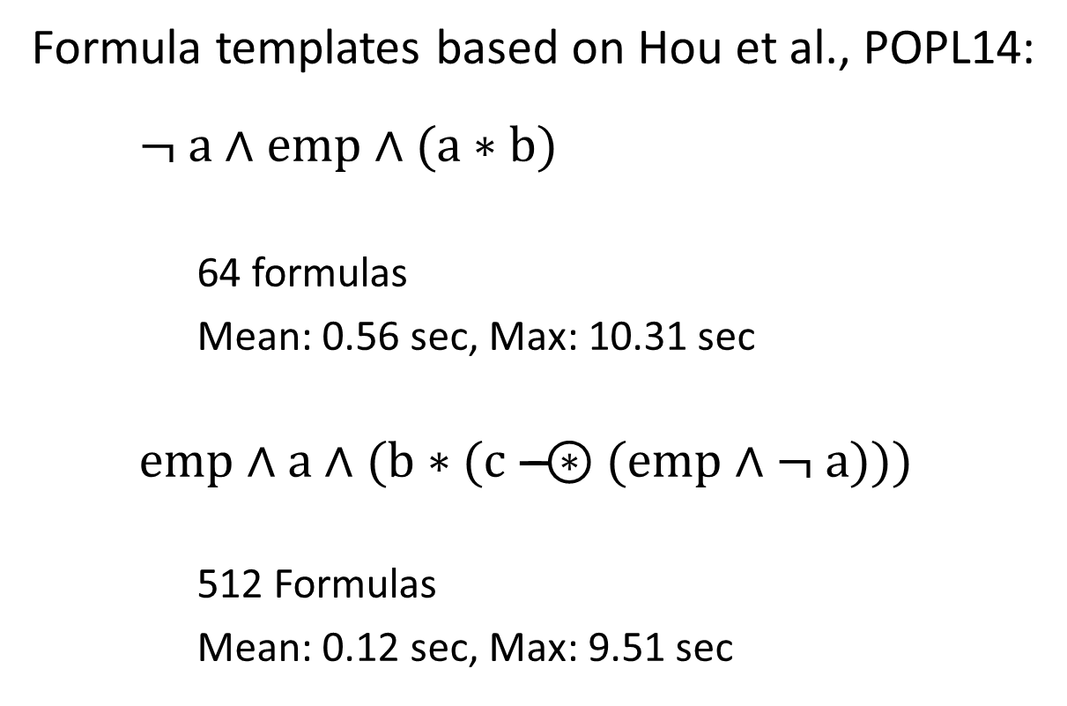
Experiments: Groups 2 and 3
Formula templates based on Hou et al., POPL14:
  ¬ a ∧ emp ∧ (a ∗ b)
    64 formulas
    Mean: 0.56 sec, Max: 10.31 sec
  emp ∧ a ∧ (b ∗ (c –$⊛$ (emp ∧ ¬ a)))
    512 Formulas
    Mean: 0.12 sec, Max: 9.51 sec

Slide 41
Summary
We implemented a tool called SMASLTOV (based on ITVLA)
https://www.github.com/smasltov-team/SMASLTOV
SMASLTOV checks the unsatisfiability of separation logic formulas using concepts from abstract interpretation
SMASLTOV uses an abstract domain of sets of shape graphs to over-approximate the set of heaps that satisfy a separation logic formula
SMASLTOV can handle some formulas that cannot be handled by previous techniques
Thank you!
Any questions?

