Slide 1
Specialization Slicing
A Polyvariant Approach for
Generating Program Slices
Min Aung | Susan Horwitz
Rich Joiner | Tom Reps

Slide 2
PReview
HIGH-LEVEL TAKEAWAY
Generate optimal specialization slices
to retain calling-context info
HIGH-LEVEL TAKEAWAY
Potential exponential output size
is not observed in practice
TECHNICAL TAKEAWAY
Solve the coarsest partition problem
on a certain class of infinite graphs

Slide 3
Program Slicing Overview
Weiser 1984
Ottenstein & Ottenstein 1984
Horwitz, Reps, Binkley 1990
BACKWARD INTERPROC.
CLOSURE SLICE
Isolate program elements that can affect the slice criterion
Use System Dependence Graph (SDG) as the program model
CFL reachability restricts dependence flow to paths that match call to return
int g1, g2, g3;
void p(int a, int b) {
g1 = a;
g2 = b;
g3 = g2;
}
int main() {
g2 = 100;
p(g2, 2);
p(g2, 3);
p(4, g1 + g2);
printf("%d", g2);
}
FORWARD SLICE
Same concept, replacing “can effect” with “can be affected by”
Notes:
Weiser developed the notion of a slice in 1984
Ottenstein & Ottenstein developed a method using Program Dependence Graphs

Slide 4
Specialization Slicing: High-Level IDEA
MOTIVATION
Information about procedure calling context can be useful for applications of slicing
int g1, g2, g3;
void p(int a, int b) {
g1 = a;
g2 = b;
g3 = g2;
}
int main() {
g2 = 100;
p(g2, 2);
p(g2, 3);
p(4, g1 + g2);
printf("%d", g2);
}
GOAL
Specialize procedures to each combination of parameters that are in the slice at each call-site
Notes:
As with polyvariant partial evaluation…

Slide 5
Specialization Slicing: High-Level IDEA
MOTIVATION
Information about procedure calling context can be useful for applications of slicing
int g1, g2;
void p_1(int b) {
g2 = b;
}
void p_2(int a, int b) {
g1 = a;
g2 = b;
}
int main() {
p_1(2);
p_2(g2, 3);
p_1(g1 + g2);
printf("%d", g2);
}
GOAL
Specialize procedures to each combination of parameters that are in the slice at each call-site
Notes:
As with polyvariant partial evaluation…

Slide 6
INSPIRATION FROM Partial EvaluatioN
Bulyonkov 1993
Jones et al. 1993
Slicing algorithms have traditionally
been syntax-preserving
INSIGHT
We can create a
polyvariant slicing algorithm
This corresponds to a monovariant algorithm
in Partial Evaluation: each program element
generates at most one element in the result
With polyvariance, one original
program element can generate multiple
elements in the specialized program
Notes:
As seen on the previous slide, …, element only disappeared, they didn’t change or rearrange.

Slide 7
Strawman Algorithms
BRUTE FORCE
int g1, g2, g3;
void p(int a, int b) {
g1 = a;
g2 = b;
g3 = g2;
}
int main() {
g2 = 100;
p(g2, 2);
p(g2, 3);
p(4, g1 + g2);
printf("%d", g2);
}
Notes:
%%% Fix wording for clarity
%%% Example of 2nd approach
%%% Animate rollout

Slide 8
Strawman Algorithms
int g1, g2, g3;
void p_1(int a, int b) {
g1 = a;
g2 = b;
g3 = g2;
}
void p_2(int a, int b) {
g1 = a;
g2 = b;
g3 = g2;
}
void p_3(int a, int b) {
g1 = a;
g2 = b;
g3 = g2;
}
int main() {
g2 = 100;
p_1(g2, 2);
p_2(g2, 3);
p_3(4, g1 + g2);
printf("%d", g2);
}
BRUTE FORCE
1) Recursively generate a procedure copy for each call-site
BRUTE FORCE
1) Recursively generate a procedure copy for each call-site
2) Generate the closure slice
BRUTE FORCE
1) Recursively generate a procedure copy for each call-site
2) Generate the closure slice
3) Merge identical procedures
Notes:
%%% Fix wording for clarity
%%% Example of 2nd approach
%%% Animate rollout

Slide 9
Strawman Algorithms
May not
terminate!
BRUTE FORCE
1) Recursively generate a procedure copy for each call-site
2) Generate the closure slice
3) Merge identical procedures
int g1, g2;
void p_1(int b) {
g2 = b;
}
void p_2(int a, int b) {
g1 = a;
g2 = b;
}
int main() {
p_1(2);
p_2(g2, 3);
p_1(g1 + g2);
printf("%d", g2);
}
Notes:
%%% Fix wording for clarity
%%% Example of 2nd approach
%%% Animate rollout

Slide 10
Strawman Algorithms
May not
terminate!
BRUTE FORCE
1) Recursively generate a procedure copy for each call-site
2) Generate the closure slice
3) Merge identical procedures
int g1, g2, g3;
void p(int a, int b) {
g1 = a;
g2 = b;
g3 = g2;
}
int main() {
g2 = 100;
p(g2, 2);
p(g2, 3);
p(4, g1 + g2);
printf("%d", g2);
}
USE EXISTING TECHNIQUES
Notes:
%%% Fix wording for clarity
%%% Example of 2nd approach
%%% Animate rollout

Slide 11
Strawman Algorithms
May not
terminate!
BRUTE FORCE
1) Recursively generate a procedure copy for each call-site
2) Generate the closure slice
3) Merge identical procedures
int g1, g2, g3;
void p(int a, int b) {
int tmp = 5; // slight
g1 = a + tmp;// change
g2 = b;
g3 = g2;
}
int main() {
g2 = 100;
p(g2, 2);
p(g2, 3);
p(4, g1 + g2);
printf("%d", g2);
}
USE EXISTING TECHNIQUES
1) Generate the closure slice
USE EXISTING TECHNIQUES
1) Generate the closure slice
2) Copy each procedure for each combination of parameters found in call-sites
Notes:
%%% Fix wording for clarity
%%% Example of 2nd approach
%%% Animate rollout

Slide 12
Strawman Algorithms
int g1, g2, g3;
void p_1(int a, int b) {
int tmp = 5;
g1 = a + tmp;
g2 = b;
}
void p_2(int a, int b) {
int tmp = 5;
g1 = a + tmp;
g2 = b;
}
int main() {
p_1(2);
p_2(g2, 3);
p_1(g1 + g2);
printf(“%d", g2);
}
May not
terminate!
//spurious
BRUTE FORCE
1) Recursively generate a procedure copy for each call-site
2) Generate the closure slice
3) Merge identical procedures
USE EXISTING TECHNIQUES
1) Generate the closure slice
2) Copy each procedure for each combination of parameters found in call-sites
3) Remove the mismatched parameters and everything in their forward slice
Not
optimal!
Notes:
%%% Fix wording for clarity
%%% Example of 2nd approach
%%% Animate rollout

Slide 13
INSPIRATION FROM Model Checking
Bouajjani et al. 1997
Finkel et al. 1997
Concept | Slicing | Model checking
Program model | SDG | PDS
Context-sensitive | Unrolled SDG | Transition system
Context-sensitive reachability | CFL reachability | pre* and post* operations
Stack-configuration partitioning | ??? | Standard automaton operations
INSIGHT
PDS allows us to
represent and manipulate
an infinite unrolled SDG
INSIGHT
The pre* operation captures exactly
all stack configurations in an
interprocedural backward slice
Notes:
%%% Unrolled SDG not defined until next slide
%%% Table comparing approaches

Slide 14
PUSHDOWN SystemS Overview
States:
{ σ₁, σ₂, σ₃, σ₄ }
Stack symbols:
{ A, B, C, D }
Transition rules:
<σ₁, A>  <σ₂, ϵ>
<σ₁, A>  <σ₂, B>
<σ₁, A>  <σ₂, B C>
TERMINOLOGY
Pushdown system: a pushdown automaton with no input tape
Configuration: <control state, stack> pair comprising a state of the PDS, e.g. <σ₂, A C B>.
Transition relation: c  c’ denotes that configuration c’ follows from c by a transition rule
*: reflexive transitive closure of 
A

A
B
α

B
σ₁
σ₂
α
A
C
σ₁
α

σ₂
α
σ₁
α
σ₂
α

Slide 15
Specialization Slicing: The Algorithm
INPUT:
Program P
Slice criterion <q, u>, program element q and stack configuration u
1) Generate the SDG of P (à la HRB ’90)
2) Encode the SDG as a PDS:
PDS Rule | SDG edge
<p, u>  <p, v> | Flow-dependence or control-dependence edge u  v
<p, c>  <p, e C> | Call edge c  e (call vertex c, entry vertex e, call-site C)
<p, ai>  <p, fi C> | Parameter-in edge ai  fi (actual-in vertex ai, formal-in vertex fi, call-site C)
<p, fo>  <p_{fo}, ϵ> <p_{fo}, C>  <p, ao> | Parameter-out edge fo  ao (formal-out vertex fo, actual-out vertex ao, call-site C)
3) Perform pre*(<q, u>) to generate the stack-configuration slice
Notes:
pre*(q, u) generalizes to pre*(C), where C is a set of P-configurations (where a P-configuration is a (q, u) pair).
%%% Number steps, animate rollout
%%% Diagram of query automaton

Slide 16
Specialization Slicing: The Algorithm
From pre*, we get an FSA that accepts the language of all
stack configurations in the slice rooted at criterion <q, u>
<m1,ϵ>, <m10,ϵ>, <m19,ϵ>, <p1,C1>, <p1,C2>, <p1,C3>,
<m3,ϵ>, <m11,ϵ>, <m21,ϵ>, <p3,C1>, <p2,C2>, <p3,C3>,
<m5,ϵ>, <m13,ϵ>, <m22,ϵ>, <p5,C1>, <p3,C2>, <p5,C3>,
<m7,ϵ>, <m14,ϵ>, <m23,ϵ>, <p8,C1>, <p4,C2>, <p8,C3>,
<m9,ϵ>, <m15,ϵ>, <p5,C2>,
<m17,ϵ>, <p8,C2>,
<p9,C2>,
NOW
WHAT?
Notes:
%%% Number steps, rollout animation
We can extract a set of unique variants Specializations(p) for each procedure p by solving a configuration-partitioning problem.
Motivation: search for Specializations(p) must be done symbolically because of the infinite/exp-large search space

Slide 17
Specialization Slicing: The Algorithm
From pre*, we get an FSA that accepts the language of all
stack configurations in the slice rooted at criterion <q, u>
<m1,ϵ>, <m10,ϵ>, <m19,ϵ>, <p1,C1>, <p1,C2>,
<m3,ϵ>, <m11,ϵ>, <m21,ϵ>, <p3,C1>, <p2,C2>,
<m5,ϵ>, <m13,ϵ>, <m22,ϵ>, <p5,C1>, <p3,C2>,
<m7,ϵ>, <m14,ϵ>, <m23,ϵ>, <p8,C1>, <p4,C2>,
<m9,ϵ>, <m15,ϵ>, <p1,C3>, <p5,C2>,
<m17,ϵ>, <p3,C3>, <p8,C2>,
<p5,C3>, <p9,C2>
<p8,C3>
Coarsest Configuration-Partitioning Problem
Notes:
%%% Number steps, rollout animation
We can extract a set of unique variants Specializations(p) for each procedure p by solving a configuration-partitioning problem.
Motivation: search for Specializations(p) must be done symbolically because of the infinite/exp-large search space

Slide 18
Specialization Slicing: The Algorithm
A minimal reverse-deterministic automaton will allow us
to read off each partition-element in the desired partition
pre*(<q, u>)
p1,p3,
p5,p8
p_{p8}
C1,C2,C3
p
m1,m3,m5,m7,m9,m10,m11,m13
m14,m15,m17,m19,m21,m22,m23
z
p1,p2,
p4,p9
p_{p9}
C2
Notes:
%%% Explain why MRD
%%% Explain ordering of steps
%%% Need to mention eps-transition step?

Slide 19
Specialization Slicing: The Algorithm
A minimal reverse-deterministic automaton will allow us
to read off each partition-element in the desired partition
pre*(<q, u>)  reverse
p1,p3,
p5,p8
p_{p8}
C1,C2,C3
p
m1,m3,m5,m7,m9,m10,m11,m13
m14,m15,m17,m19,m21,m22,m23
z
p1,p2,
p4,p9
p_{p9}
C2
Notes:
%%% Explain why MRD
%%% Explain ordering of steps
%%% Need to mention eps-transition step?

Slide 20
Specialization Slicing: The Algorithm
Partitions PDS
configurations based on stack configuration
A minimal reverse-deterministic automaton will allow us
to read off each partition-element in the desired partition
pre*(<q, u>)  reverse  determinize
p1,p3,
p5,p8
p_{p8}
C1,C3
p
m1,m3,m5,m7,m9,m10,m11,m13
m14,m15,m17,m19,m21,m22,m23
z
p1,p2,
p3,p4,
p5,p8,p9
p_{p9}
C2
Notes:
%%% Explain why MRD
%%% Explain ordering of steps
%%% Need to mention eps-transition step?

Slide 21
Specialization Slicing: The Algorithm
Results in the coarsest partition.
(No change from previous step occurs in this example.)
A minimal reverse-deterministic automaton will allow us
to read off each partition-element in the desired partition
pre*(<q, u>)  reverse  determinize  minimize
p1,p3,
p5,p8
p_{p8}
C1,C3
p
m1,m3,m5,m7,m9,m10,m11,m13
m14,m15,m17,m19,m21,m22,m23
z
p1,p2,
p3,p4,
p5,p8,p9
p_{p9}
C2
Notes:
%%% Explain why MRD
%%% Explain ordering of steps
%%% Need to mention eps-transition step?

Slide 22
Specialization Slicing: The Algorithm
A minimal reverse-deterministic automaton allow us
to read off each partition-element in the desired partition
pre*(<q, u>)  reverse  determinize  minimize  reverse
( convert back to SDG … details in paper)
p1,p3,
p5,p8
1
C1,C3
p
m1,m3,m5,m7,m9,m10,m11,m13
m14,m15,m17,m19,m21,m22,m23
3
p1,p2,
p3,p4,
p5,p8,p9
2
C2
Notes:
%%% Explain why MRD
%%% Explain ordering of steps
%%% Need to mention eps-transition step?

Slide 23
Monovariant Executable Slices
Binkley 1993
A closure slice may not be executable
int g1, g2, g3;
void p(int a, int b) {
g1 = a;
g2 = b;
g3 = g2;
}
int main() {
g2 = 100;
p(g2, 2);
p(g2, 3);
p(4, g1 + g2);
printf("%d", g2);
}
Binkley [LOPLAS 1993]
Include additional actuals (and slices) to avoid parameter mismatches
Monovariant result
Adds spurious program elements
“spurious” =_{df} statement or condition that is not in the closure slice somewhere

Slide 24
Monovariant Executable Slices
A closure slice may not be executable.
Binkley [LOPLAS 1993]
Include additional actuals (and slices) to avoid parameter mismatches
Monovariant result
Adds spurious program elements
“spurious” =_{df} statement or condition that is not in the closure slice somewhere
Our algorithm [TOPLAS 2014]
Creates specialized callee for each pattern of needed formal parameters
Polyvariant result
Never adds spurious program elements
Produces an optimal polyvariant result
“optimal” =_{df} sound, complete, and minimal

Slide 25
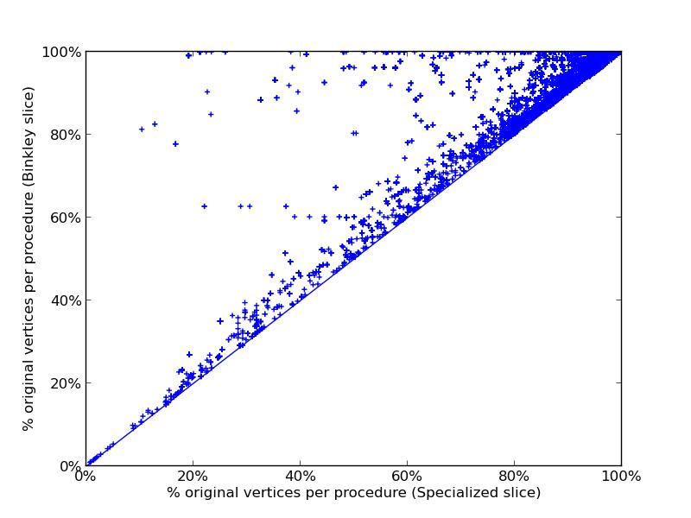
Implementation, ExperimentS and Results
Extended CodeSurfer™ interprocedural-slicing capabilities
Implemented polyvariant specialization slicing and monovariant executable slicing (Binkley ‘93) for comparison
Generated 378 slices in 133 distinct versions of 12 applications
Slice type | Slice elements / closure elements
Closure slice | 1.0
Monovariant | 1.046
Polyvariant | 1.055*
* replicated, not additional!
Max. specializations of
a given procedure: 4

Slide 26
Other Topics Covered
A notion of slicing
idempotence
Proofs of completeness,
soundness, minimality
Indirect calls via
function pointers
Modelling
library calls
Example of slicing a
recursive program
Slicing for
feature removal
Slicing time/memory
measurements
A pathological
exp. example
Optimization using
summary edges
I/O and memory
layout dependences
Pretty-printing
the result
Notes:
%%% Fill out more, animation to have each one pop out

Slide 27
SlicING Algorithm Summary
Slice type | Complete all relevant elements | Sound only relevant elements | Minimal minimum number of specializations | Executable
Weiser | ✓ |  | N/A | ✓
Closure | ✓ | ✓ | N/A
Binkley monovariant | ✓ |  | N/A | ✓
Strawman 2 existing methods | ✓ |  |  | ✓
Specialization polyvariant | ✓ | ✓ | ✓ | ✓

Slide 28
Specialization Slicing: The End
Questions?

Slide 29
SlicING Experimental Corpus

Slide 30
SlicING TIME Measurements

Slide 31
SlicING SPACE Measurements

Slide 32
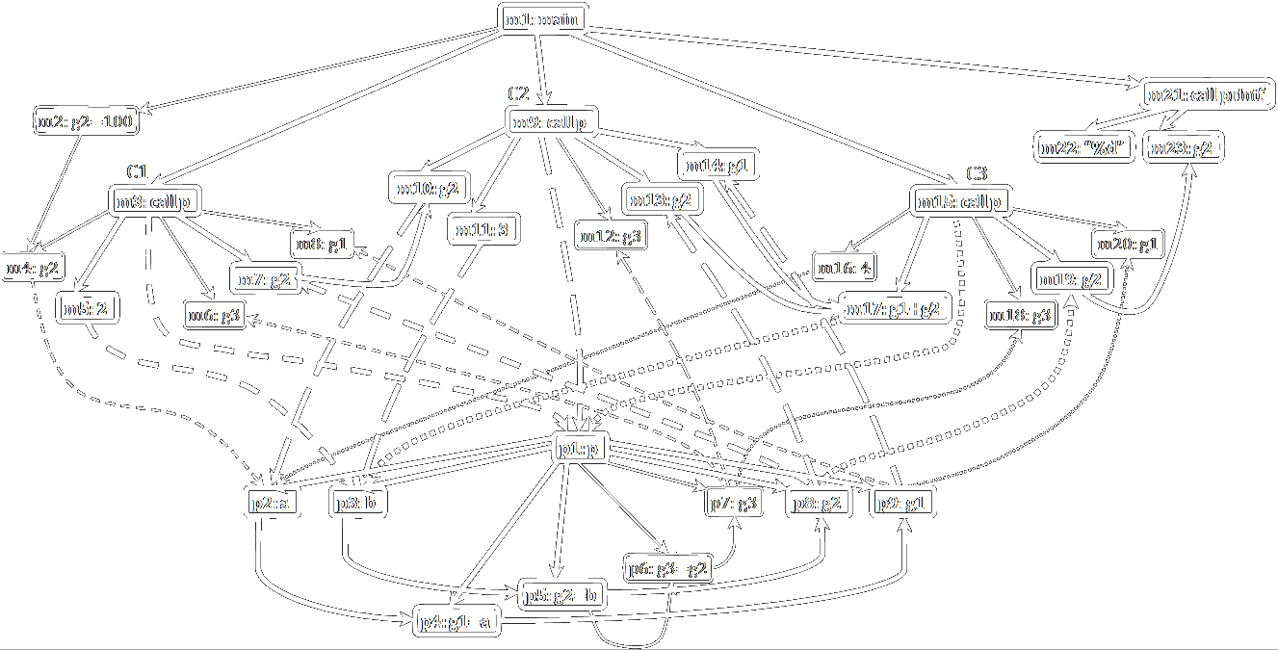
Specialization Slicing: The Algorithm
Notes:
%%% Explain why MRD
%%% Explain ordering of steps
%%% Need to mention eps-transition step?

Slide 33
Executable Slicing
A closure slice may not be executable
At some call-sites, #actuals in slice < #formals in slice
Binkley [LOPLAS 1993]
Our algorithm [TOPLAS 2014]
Include additional actuals (and slices) to avoid parameter mismatches
Monovariant result
Adds spurious program elements
“spurious” =_{df} statement or condition that is not in the closure slice somewhere
Creates specialized callee for each pattern of needed formal parameters
Polyvariant result
Never adds spurious program elements
Produces an optimal polyvariant result
“optimal” =_{df} sound, complete, and minimal

Slide 34
Specialization Slicing: The Algorithm
1
p1,p3,
p5,p8
p_{p8}
p1,p3,
p5,p8
C1,C3
C1,C2,C3
p
p
3
m1,m3,m5,m7,m9,m10,m11,m13
m14,m15,m17,m19,m21,m22,m23
z
m1,m3,m5,m7,m9,m10,m11,m13
m14,m15,m17,m19,m21,m22,m23
p1,p2,
p3,p4,
P5,p8,p9
p1,p2,
p4,p9
2
p_{p9}
C2
C2
A minimal reverse-deterministic automaton enables us to read off each partition-element in the desired partition
Reverse  Determinize  Minimize  Reverse
Notes:
%%% Explain why MRD
%%% Explain ordering of steps
%%% Need to mention eps-transition step?

Slide 35
Specialization Slicing
Min Aung | Susan Horwitz
Rich Joiner | Tom Reps
Original program
Closure slice
Executable slice
Specialization slice
slice here
won’t compile!
extra junk!
minimal
☺

Slide 36
IS a Specialization Slice Minimal?
NO | YES
Weiser showed that finding a statement-minimal slice is undecidable. | We define minimality relative to the available static information.
Program elements are duplicated. | Every element in a specialization slice corresponds to an element in the closure slice.
 | Each procedure specialization is minimal for the calling context.
Proc. specializations can be syntactically identical, due to external parameter mismatch. | This effect can be utilized in compile-time optimization!
Notes:
%%% Merge with prior slide?

Slide 37
Outline
Inspiration
Goals
Methods
Results
Questions?

Slide 38
A Brief History of Slicing
PDG SLICING
State projection requirement
formalized as a PDG problem.
Program elements that
Weiser ‘84: Static backward slicing
1. Slice S is obtained from P by deleting zero or more
statements
2. The state of S, projected onto slice criteria C = <q,V>,
is equal that of P. (q: statement, V: set of variables)
STATIC BACKWARD SLICE
Delete 0 or more statements s.t.
the program state projected onto
the slice criteria is equal in the
original program and the slice.
Ottenstein & Ottenstein ‘84: Slicing with PDGs
1. Slicing becomes a graph reachability query.
Horwitz, Reps, Binkley ‘90: Interprocedural SDG slicing
1. Slicing becomes a CFL reachability query, ensuring
matched calls and returns
2. Forward slicing introduced

