Slide 1
Some Reflections
Thomas Reps
University of Wisconsin and GrammaTech, Inc.

Slide 2
Don't look back. Something might be gaining on you.
Satchel Paige
Notes:
On the assumption that a 60th birthday is the right time for an academic to reflect, I’ll ignore Satchel Paige’s advice. Like Tim this morning, my thoughts went back to my beginnings, but actually a little further to “Reps at 17, 20, and 21” before catching up with Tim’s story. In particular, when I graduated from college in 1977, I swore to myself that I would never go to grad school. I’ve now been in academia for 38 years – what happened?
I took just two computer classes as an undergrad at Harvard. As a 17-year old freshman, I took Applied Math 110, which was an odd duck of a class: 4 weeks of PDP-10 assembly language; 4 weeks of Lisp 1.5, and 3 weeks in which the programming assignment was to modify a Lisp 1.5 interpreter – written in PDP-10 assembly language – to change some Lisp features. (So I really had known what an interpreter was in my first conversation with Tim in 1978; it is just that I had forgotten in the intervening 4 years.) The other computing class I took, as a senior, was numerical analysis, which I really enjoyed.

Slide 3
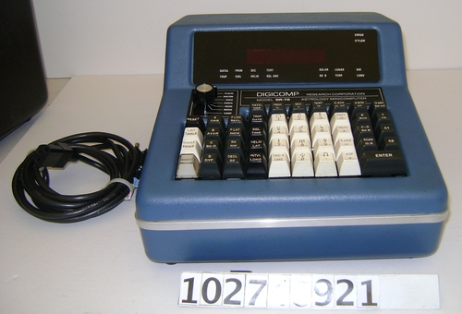
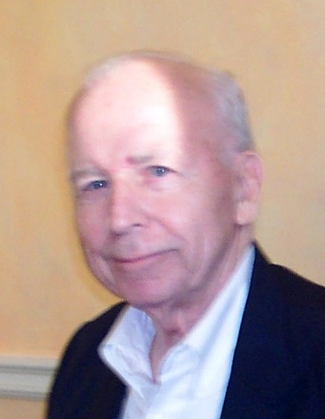
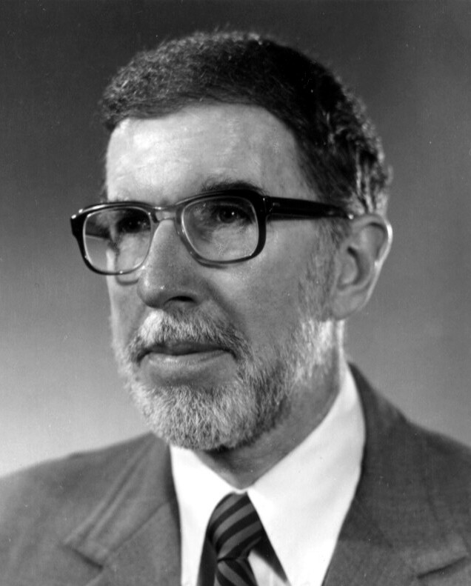
Digicomp (Fall 1977)
Ray Van Houtte
John Reps
http://www.computerhistory.org/collections/catalog/102746921
Digicomp DR-70 Astrology Minicomputer
Notes:
But I was really at sea after graduation. I returned to Ithaca, where my parents were in despair about my future. My father talked to friend of his, Ray Van Houtte, the president of one of the Ithaca banks, who had just given a loan to Digicomp Research so that they could build a computer aimed at the 6,000 professional astrologers their business plan said were working in the US. Digicomp needed a programmer, and hired me in November 1977. I’ll tell you all I remember about astrology. First, there are seven schools of astrology, which were addressed by that knob in the upper-left corner of the keyboard. You were supposed to set it to the school that you believed in.

Slide 4
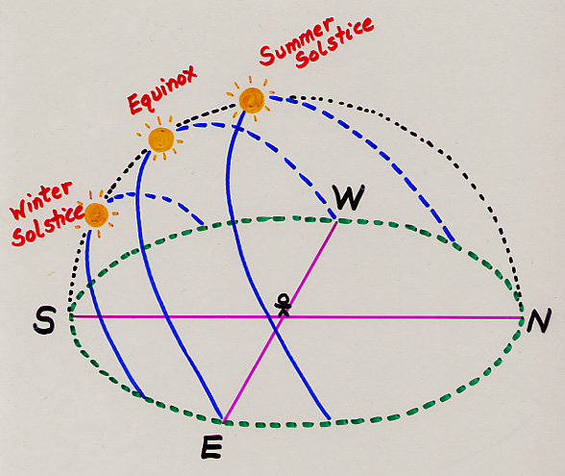
Twelve Stations of the Sun Path
http://www.umass.edu/sunwheel/images/diagram1.jpg
Notes:
A key calculation in all seven schools is based on the twelve stations of the sun path. You take the path that the sun follows from horizon to horizon on a given day, and then divide it into 12 equal parts. These are then used somehow in the rest of the calculations.
I was given the task of debugging the code that implemented this sun-path calculation. I was given a punch-card deck for their current version of the program, and sent up to use the open computing facility for Cornell’s introductory-programming class, CS 100 (which, unbeknownst to me, Tim was teaching at the time). They said, “You look like an undergraduate; no one will be the wiser.”

Slide 5
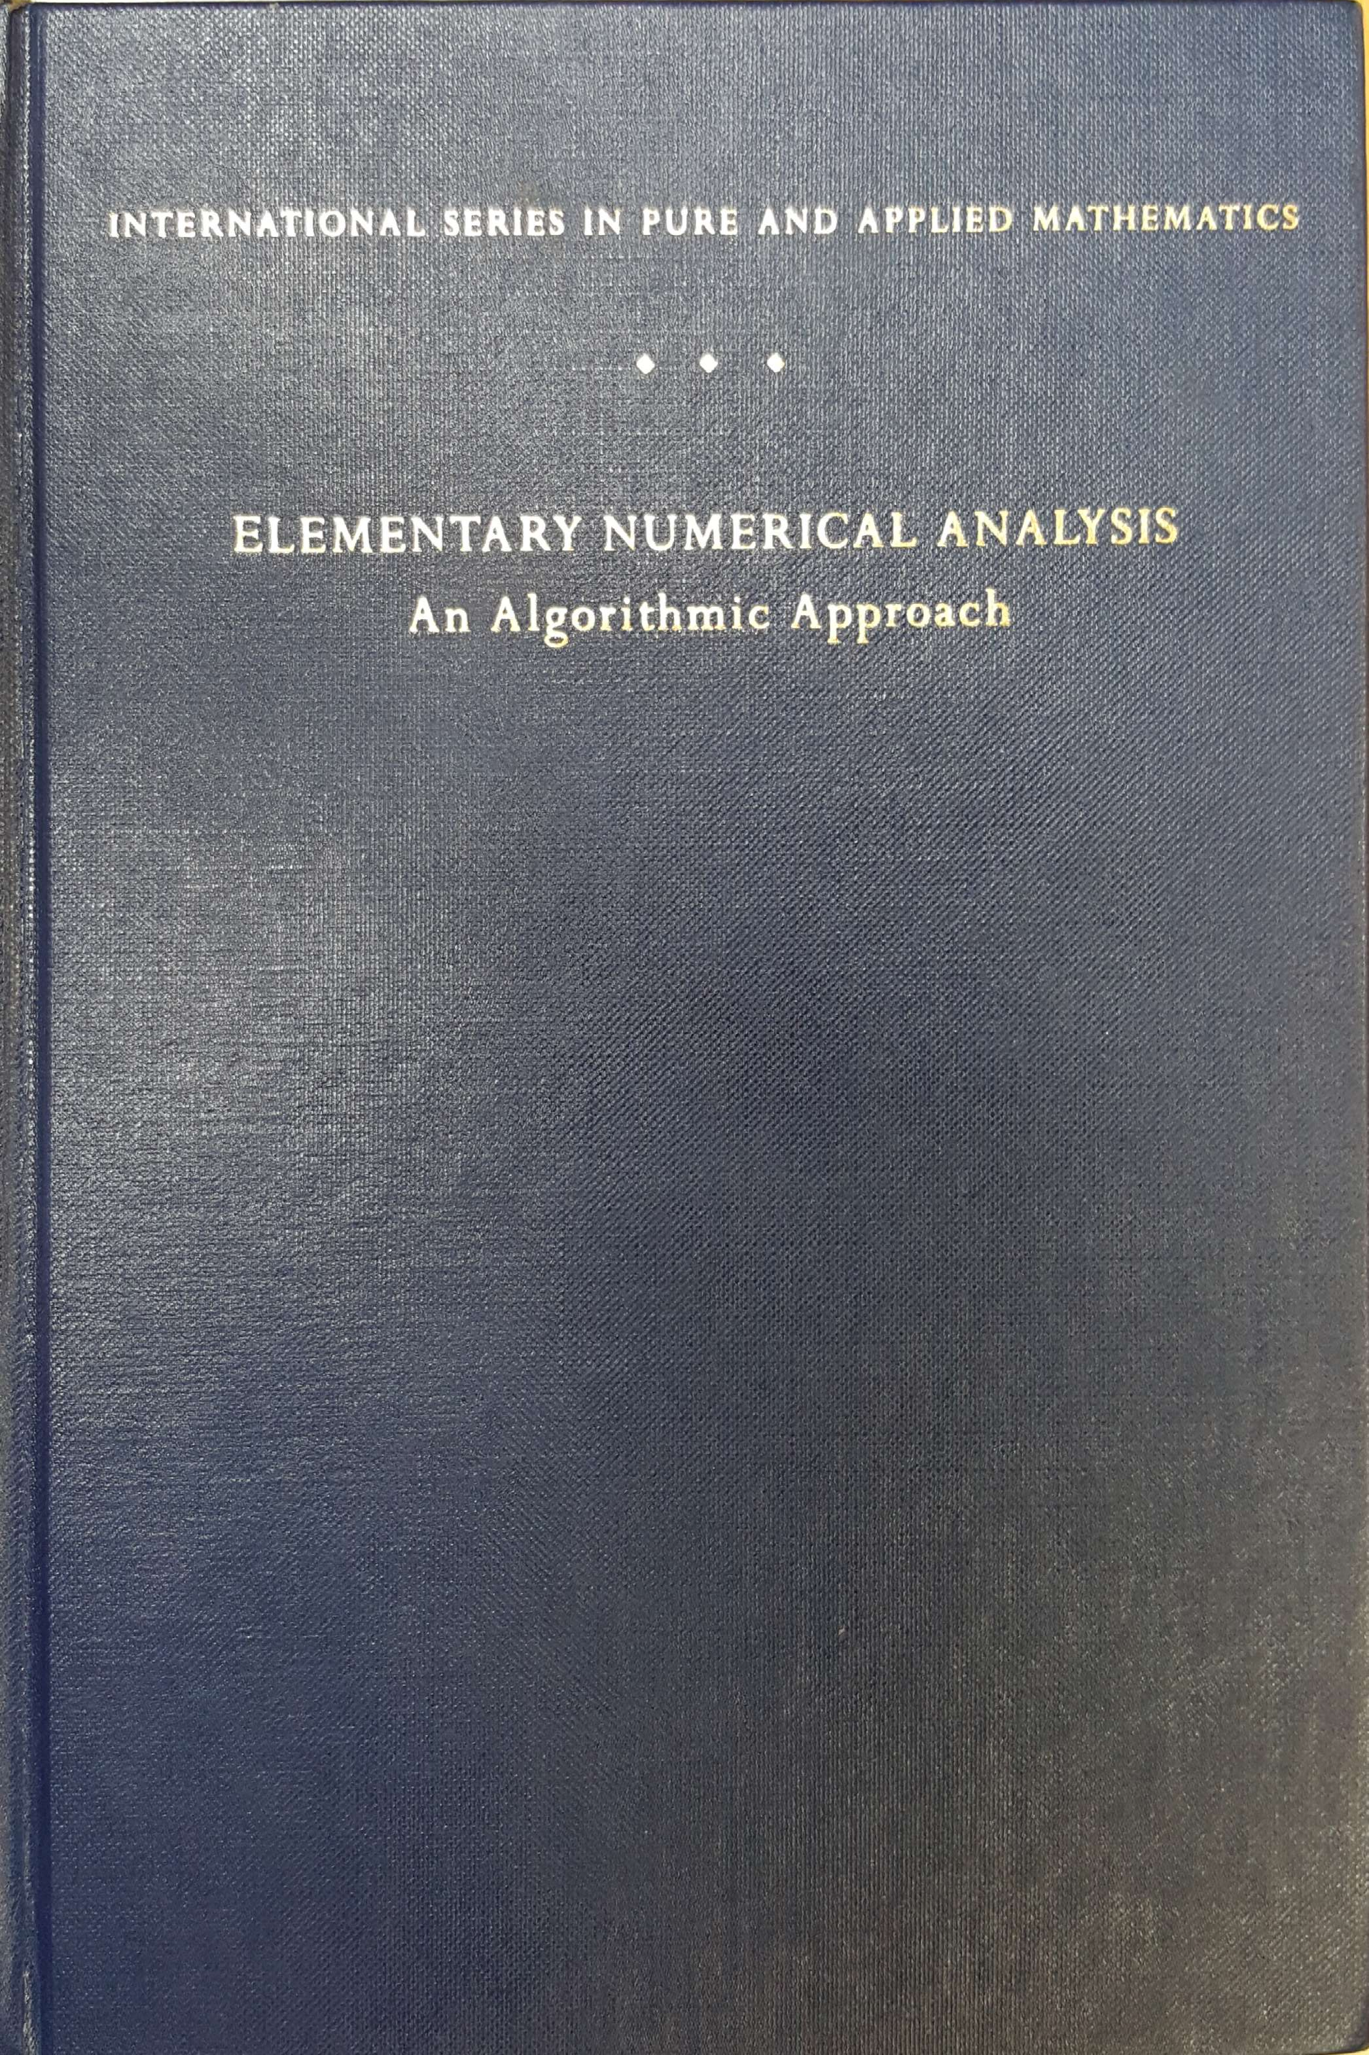
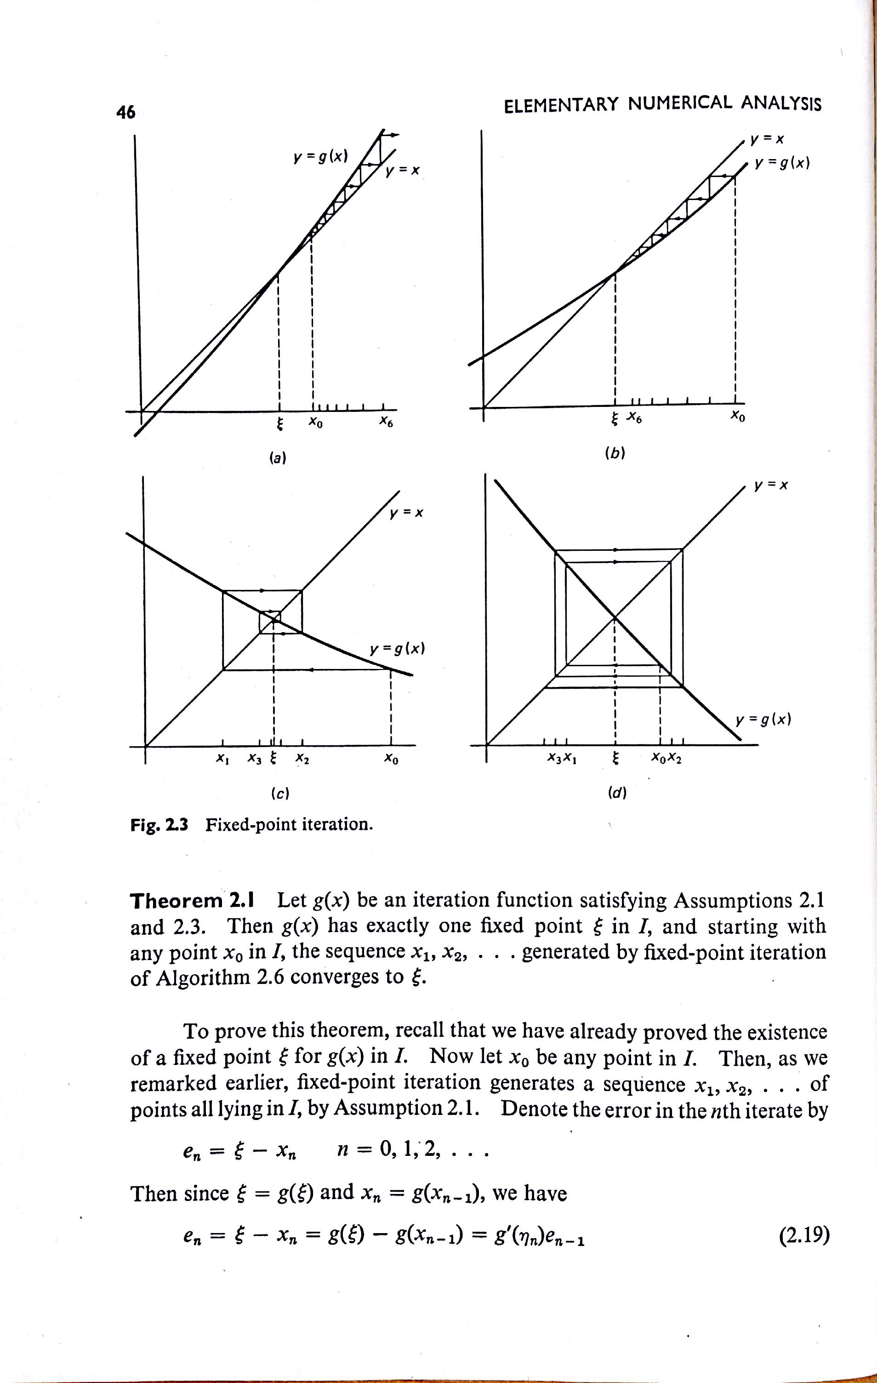
Iterative
method
converges
Iterative
method
diverges
Notes:
The problem required solving an equation using an iterative method (another connection with my future career!). I remembered from the numerical-analysis course that I had taken that there were some convergence issues with iterative methods. I pulled out my copy of Conte & de Boor (later, Carl de Boor was a colleague at Wisconsin, and had the office next door to mine), and started thinking about the figure that illustrated why an iterative method could diverge. Hmm, “Could this program ever diverge?” I wondered. I was pleased when I worked it out – yes, indeed, it could diverge!

Slide 6
Twelve Stations of the Sun Path
Tom, we don’t have to worry about Laplanders and Eskimos
Sun path during
“midnight sun”
http://www.umass.edu/sunwheel/images/diagram1.jpg
Notes:
The physical manifestation is that if you are interested in a point above the arctic circle for a date during the period of the midnight sun, you get into trouble because the sun never hits the horizon! Very proudly, I reported this to my supervisor, who at first was extremely concerned until I explained about the arctic circle and the midnight sun – at which point, he remarked, “Look, Tom. Our market is not Laplanders and Eskimos.”

Slide 7
Travel to Europe (Freddie Laker and Eurail Pass) [Jan.-April 1978]
Notes:
After six not too-exciting weeks at Digicomp, I quit and flew off to Europe with a friend via Freddie Laker Airlines – an airline which would fly you from Kennedy Airport to London for $212. We took a train to Paris and traveled around France, Italy, and Greece by Eurail Pass on a “grand tour” to the tune of $6/day.

Slide 8
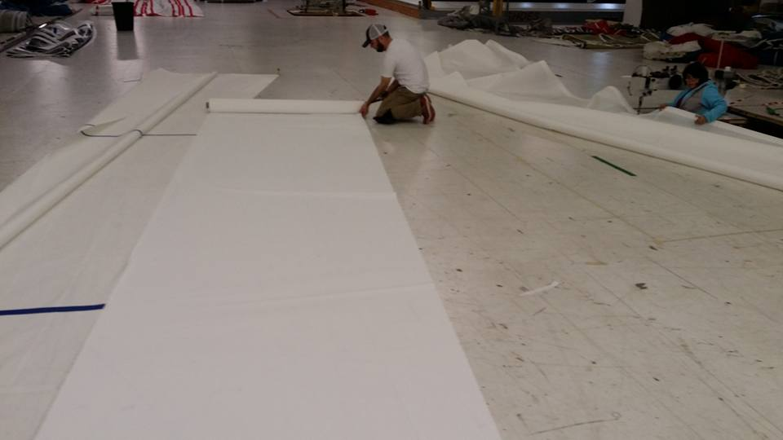
Haarstick Sailmakers
[April-May 1978]
Notes:
After three months, when I returned to the US, I filled in as a sailmaker at a local sail-loft – a job I had done the three previous summers during college – during their Spring rush season. Basically, like the fellow shown in the picture, I was crawling around on my knees, rolling out panels of cloth. In other words, sweat-shop labor.

Slide 9
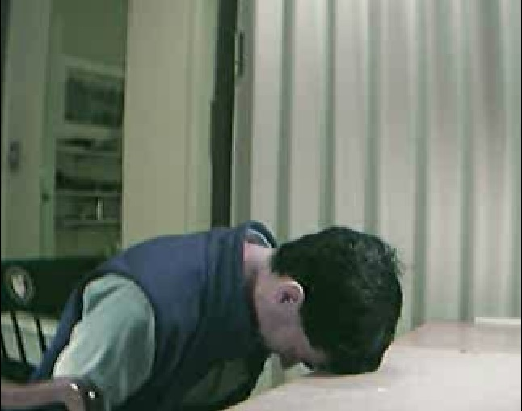
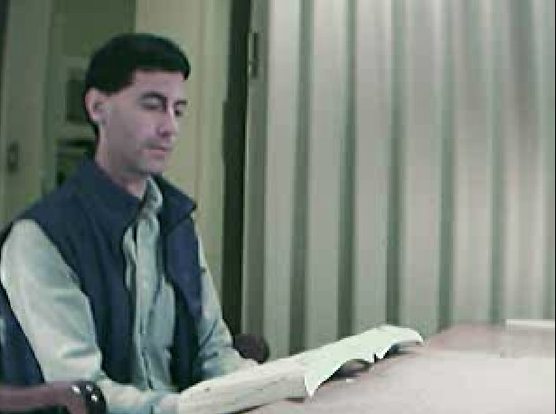
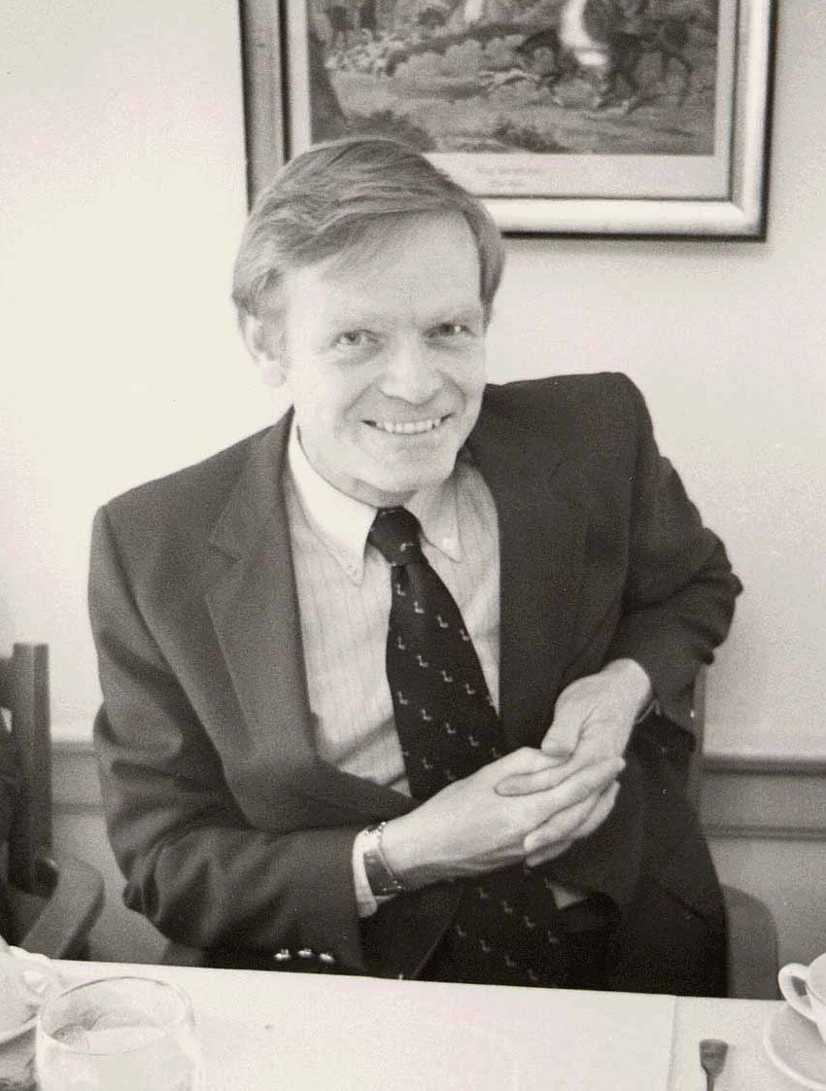
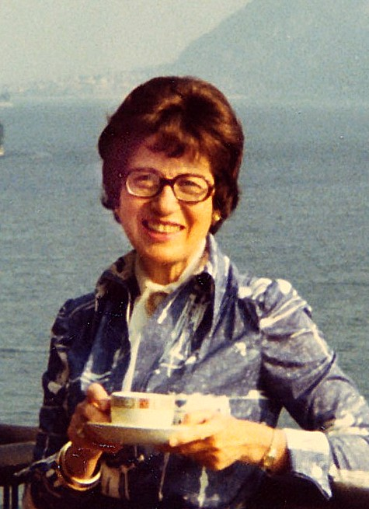
PL/C Group [5/31/78 – 6/2/78]
Dick Conway
Constance Reps
Notes:
My parents were still in despair. They did not think that this job was a good way to use an expensive Harvard education. One evening in the spring of 1978, my mother was at a cocktail party at which she talked to Dick Conway, then a Cornell CS professor. Dick asked her how I was doing, and I picture my mother unloading all of her frustrations on him. He said, “Send Tom up to me, and I’ll see what I can find for him.” He hired me to work in his PL/C group, maintaining the PL/C compiler, which was an implementation of (most of) PL/I used at that time in many universities around the world. The compiler was implemented in IBM 360 assembly language, so after giving me a tour of the department (small – there were only 14 CS professors at Cornell in those days), he asked whether I knew IBM 360 assembly language. I said I had used PDP-10 assembly, but not IBM 360 assembly. Dick gave me two large manuals, and said to come back and talk to him after I’d finished reading them. As you can imagine, they were dead boring. My first morning looked something like this <CLICK>. After an hour, I made the mistake of putting the manual on my lap, and my head down on the table <CLICK> – and promptly went to sleep, which was where my office-mate found me when he came back from lunch.

Slide 10
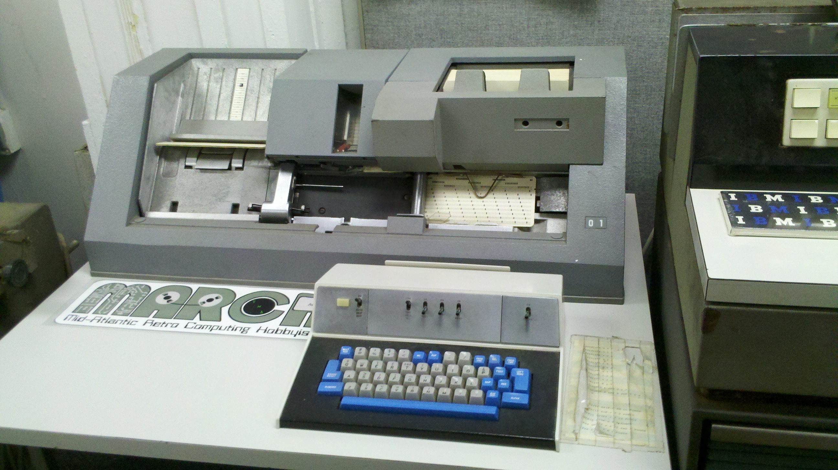
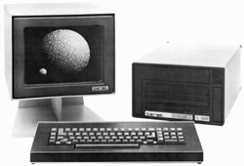
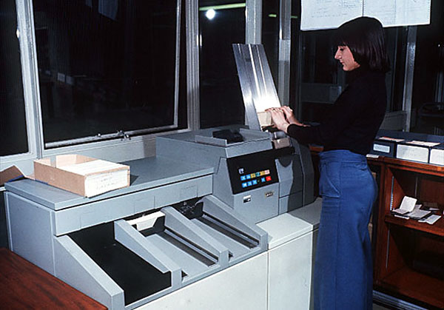
Cornell Program Synthesizer
https://wincsc.files.wordpress.com/2012/05/2012-05-06_15-22-53_464.jpg
Terak 8510/a
Graphics Computer System
https://c1.staticflickr.com/3/2647/3904970406_a779176c13.jpg
https://www.staff.ncl.ac.uk/roger.broughton/museum/iomedia/images/rdr.jpg
Notes:
Earlier that year, the fabled Cornell Computer Science Department, apparently after endless discussions, had decided that they were willing to sully themselves by actually purchasing their own computer. They bought a PDP-11/60, and earlier in the year one of the graduate students had written a very nice screen-oriented text editor. At that time, Tim had not done very much research, had no students working with him, but had started teaching the introductory CS class, CS 100. Tim was very effective and very popular with the 500+ students who were taking the class each semester. All of the programming exercises were done using punch cards – the facility that Digicomp had sent me over to Cornell to use. Tim had a dream one night in which the idea came to him for an integrated system in which one could create, edit, run, and debug programs. At the time, there were a few such systems – InterLisp for Lisp, and the SmallTalk system – but apparently people thought that that kind of interactive capability wasn’t possible for imperative, statically typed programming languages. (Communication of scientific results was a lot harder in those days, and he had not heard of the Mentor system of Kahn, Huet, Lang, and Donzeau-Gouge.)
My very first week in the PL/C group (a group of about 7), Tim gave a presentation in which he described the vision, and said that he was looking for help. Conway said, “Tom just joined us; he’s not doing anything yet; so let’s have him work with you.” Tim and I went to his office, where our first conversation went something like the following:
Tim: OK, we need to write an editor and an interpreter. I’ll start on the editor and you implement the interpreter.
Tom: What’s an interpreter?
Tim described the notion of a tree for representing an expression, and told me to go off and think about how one could obtain the value of the expression. So that was how we got started. What was important for me was that I had fallen into an incredibly interesting research project – the Cornell Program Synthesizer – right as it got off the ground, and because Tim was jazzed about it and had no students, I had 100% of the mindshare of a private tutor!
Within about 18 months, all of CS100 had been converted to use the Cornell Program Synthesizer, running on 27 Terak microcomputers. In essence, the Cornell students jumped in 1979 or 1980 from a stone-age computing method to the rough equivalent of Eclipse or VisualStudio.

Slide 11
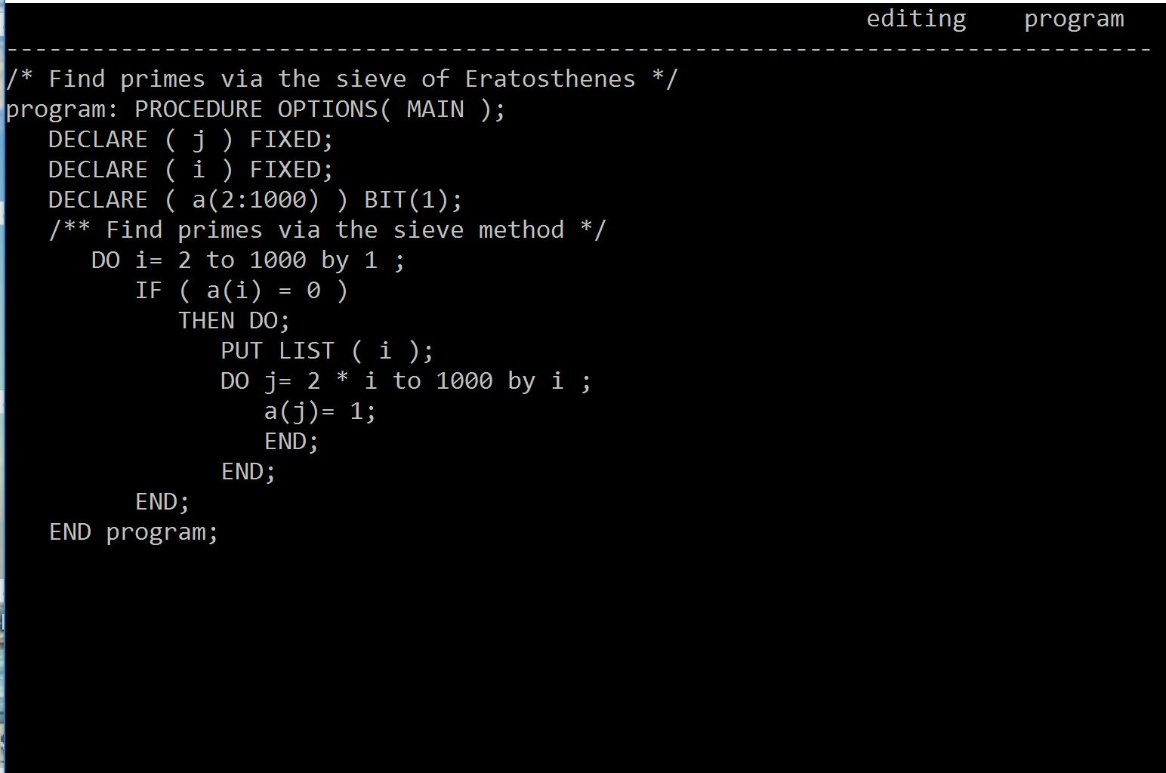
Cornell Program Synthesizer
Notes:
A screen-shot of a program written using the Cornell Program Synthesizer.

Slide 12
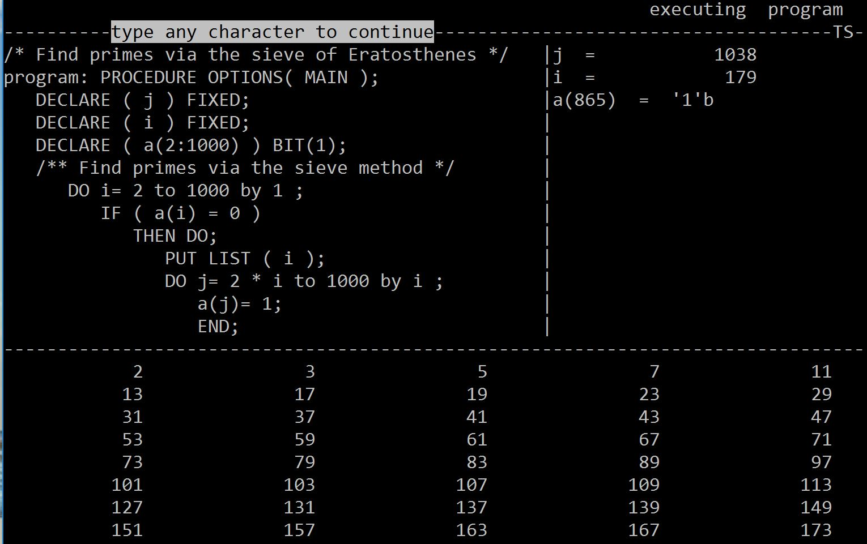
Cornell Program Synthesizer
Notes:
The slides illustrates execution with all debugging aids turned on. The cursor shows the location of the program counter; variable values are shown in the right-hand pane; and the output is shown in the bottom pane.

Slide 13
Cornell Program Synthesizer
Notes:
On-the-fly, the Cornell Program Synthesizer also performed what used to be called static-semantic analysis. For instance, here the cursor is at the identifier “j” in the first declaration statement. When the identifier is deleted <CLICK> . . .

Slide 14
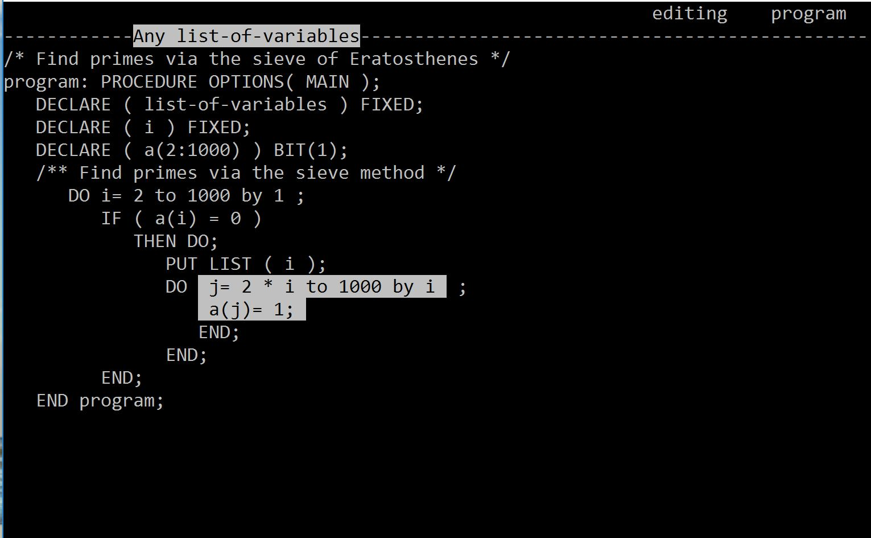
Cornell Program Synthesizer
Notes:
. . . the places where “j” is used light up to show that they are uses of a variable that has not been declared. When “j” is declared, <CLICK> . . .

Slide 15
Cornell Program Synthesizer
Abstract. Programs are not text; they are hierarchical compositions of computational structures and should be edited, executed, and debugged in an environment that consistently acknowledges and reinforces this viewpoint. . . .
Notes:
. . . the highlighting goes away. The paper about the Cornell Program Synthesizer appeared in the September 1981 issue of CACM <CLICK>, where it started with the ringing slogan that Tim composed: “Programs are not text,” and went on to elaborate, “they are hierarchical compositions of computational structures and should be edited, executed, and debugged in an environment that consistently acknowledges and reinforces this viewpoint.”

Slide 16
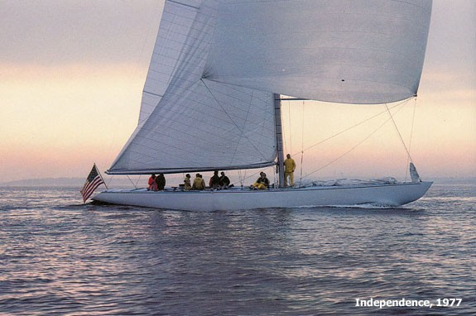
Russ Long’s America’s Cup Campaign [Fall 1979]
Thanks for asking, Russ, but I’m having too much fun doing research at Cornell
Notes:
After about a year working with Tim, he pointed out, “What you are doing is not that much different from what the graduate students are doing, but when they finish they will have a degree, and you won’t. Why don’t you enroll in the graduate program.” After much hemming and hawing – I went and interviewed with a very good DEC compiler group in Tewksbury, MA, where my heart sank as I entered a building with thousands of cubicles – I agreed to have Tim pull strings so that I could be a student in Fall 1979, with the intention of doing a master’s degree in CS.
Shortly afterwards, I got a call from Russ Long, a friend from the Harvard Sailing Team, who was organizing an America’s Cup campaign. <CLICK> He had been recruited by Ted Turner to steer the pace boat, Independence, and was looking for a navigator. My response was <CLICK>

Slide 17
Incremental Attribute Updating in O($||$AFFECTED$||$) Time [POPL 1982]
$||$AFFECTED$||$
T
AFFECTED
T
+
+
U
U’
U’
U
Notes:
The plan was that for my master’s degree, I would implement a system to generate systems like the Cornell Program Synthesizer from some kind of formal specification. Obviously one would use a context-free grammar for the basic language part, but it wasn’t at all clear what kind of specification to use for static-semantic checks. Eventually, I learned what an attribute grammar was, and we decided to adopt them as the mechanism for the new system, the Synthesizer Generator.
A key moment was the realization that there was an optimal method to update the attributes in an attributed tree after some subtree U is replaced by some other subtree U’. By optimal, we meant that after the new tree has been updated, there is some set (which we called the AFFECTED set) that actually needed new values – as opposed to the attributes that an algorithm might choose to give new values – possibly only temporarily, until it can establish what the final correct value is. The algorithm actually has to go one step beyond the AFFECTED set to be able to determine that updating has quiesced.
This algorithm was so unexpected that Tim said, “Forget about writing a master’s thesis; write it up for a Ph.D.,” which I did, and ended up finishing my Ph.D. three years after enrolling in the Cornell CS graduate program. I was still very green: I’d only taken two CS courses as an undergrad, and I only took about seven courses as a Cornell grad student. Fortunately, I had met Susan, who was still in the process of searching for a Ph.D. topic when I finished, and Tim had gotten tenure, was ready for a sabbatical, and offered to take us to INRIA, outside of Paris, for a year. After that, I came back to Cornell for two years as a post-doc, still working with Tim, until Susan finished her Ph.D. and we both took faculty positions at Wisconsin.

Slide 18
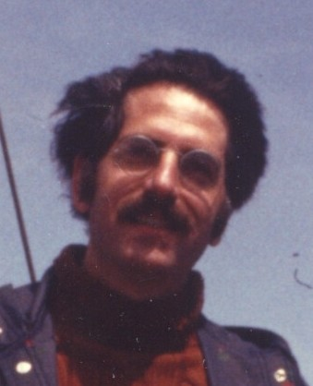
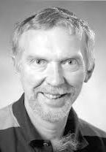
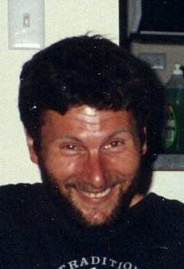
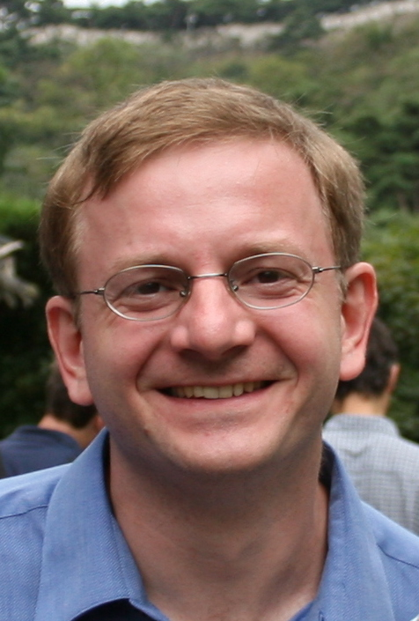
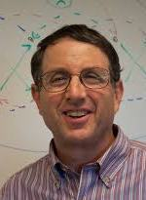
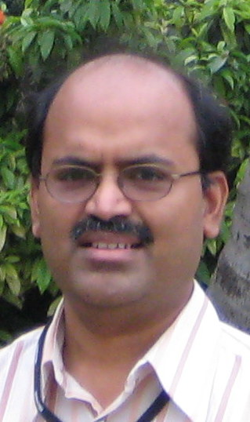
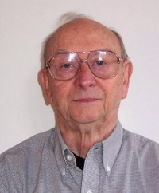
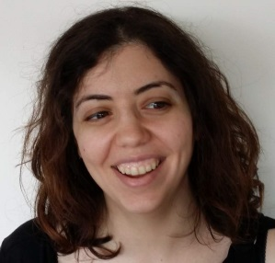
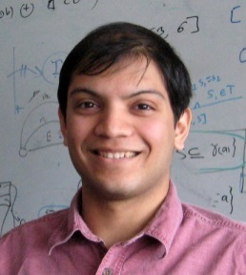
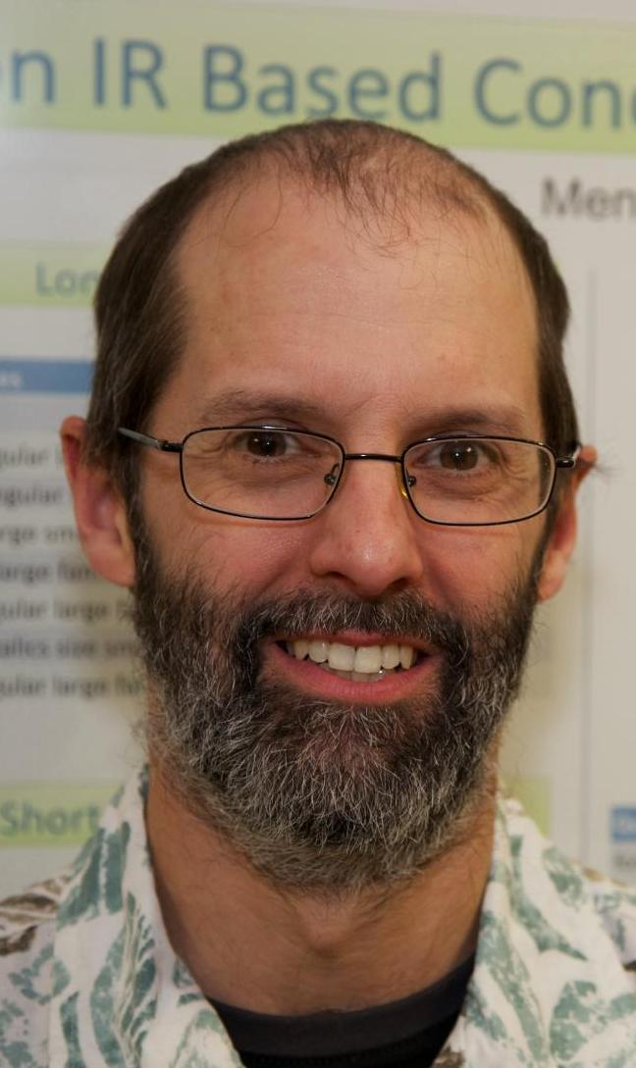
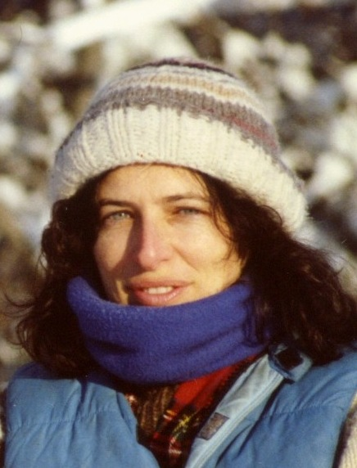
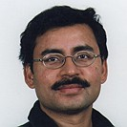
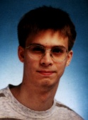
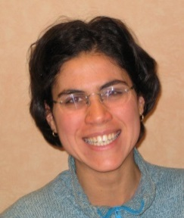
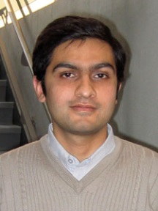
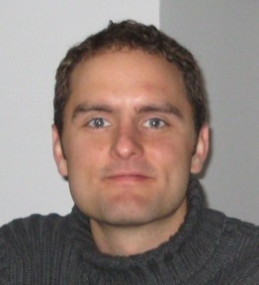
Tim
Teitelbaum
Alan
Demers
Mooly
Sagiv
Alexey
Loginov
Neil
Immerman
Incremental
attribute
updating
[POPL81,82]
Ramalingam
Louis Rall
Incremental graph
algorithms [JAlg96]
Divided-difference
arithmetic [HOSC03]
Finite differencing
of formulas [ESOP03]
Emma
Turetsky
Prathmesh
Prabhu
NPA-TP
[POPL16]
Interprocedural
slicing [PLDI88]
Shape analysis
[POPL96,99]
Reinhard
Wilhelm
Mooly
Sagiv
Context-
bounded
analysis
[TACAS08]
Interprocedural
dataflow analysis
using Datalog
[CC94]
IFDS framework
(CFL-reachability)
[POPL95]
IDE
framework
[FASE95]
Error
propagation
[SAS07]
David
Binkley
Susan
Horwitz
WPDSs
[SAS03]
Mooly
Sagiv
Susan
Horwitz
Somesh Jha
Stefan
Schwoon
Tayssir
Touili
Akash
Lal
Nick
Kidd
Notes:
The experience with Tim at Cornell had a huge impact on my life. The interests I developed there had a lot to do with a number of the things I’ve worked on ever since. For instance, incremental attribute updating is an example of an incremental-computing problem, and Incremental computing is something I’ve come back to at several different periods. <EXPLAIN> Also, the background on attribute grammars led directly to the work on interprocedural slicing, which then got me interested in using Datalog for interprocedural dataflow analysis. . . . <EXPLAIN>

Slide 19
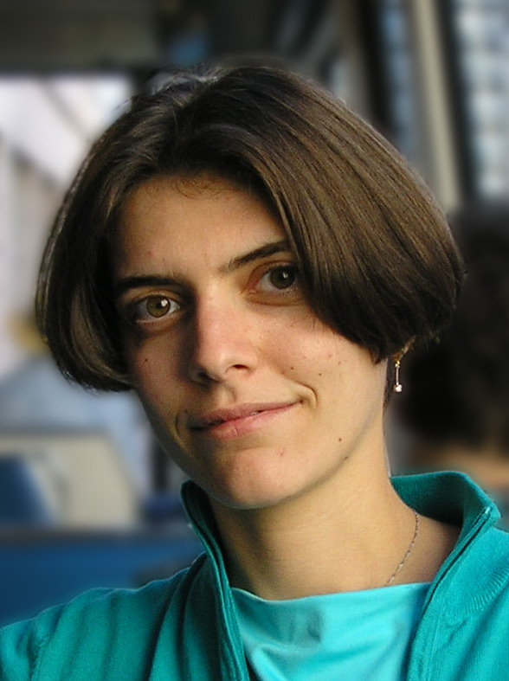
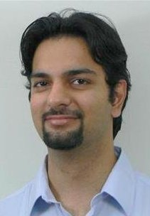
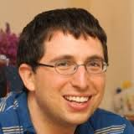
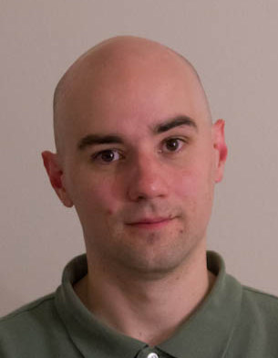
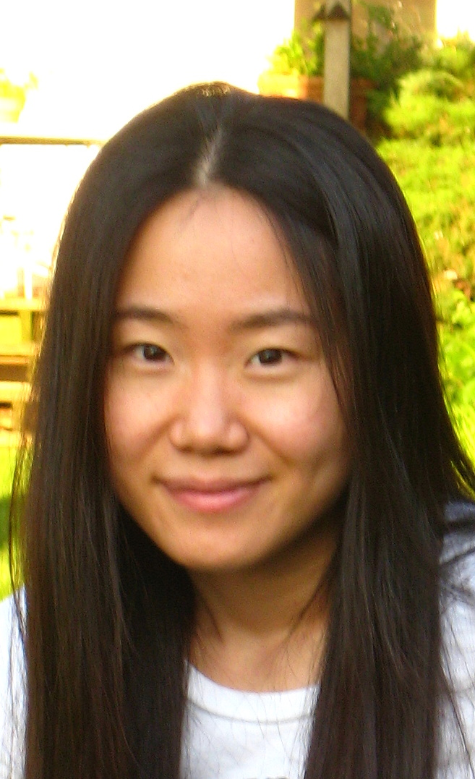
Frameworks and Generators
Reinhard
Wilhelm
Mooly
Sagiv
Somesh Jha
Stefan
Schwoon
Tim
Teitelbaum
Akash
Lal
Mooly
Sagiv
Greta
Yorsh
Aditya
Thakur
Tal
Lev-Ami
Alexey
Loginov
Nick
Kidd
Evan
Driscoll
Junghee
Lim
The
Synthesizer
Generator
(1982-89)
WPDS++, WALi,
OpenNWA
(2003-13)
Symbolic
Abstraction
(2003- )
TVLA
(1999-2007)
TSL
(2006-2012)
Notes:
A different slice of the problems on which I’ve worked shows another theme that goes back to the work with Tim on the Synthesizer Generator, namely, an emphasis on creating frameworks and generators that apply to whole classes of problems. I think of these as “let’s create a Yacc for X” – an idea that was applied to program-development environments, shape analyzers, equation solvers, machine-code analyzers, and a general attempt at abstract interpretation in general.

Slide 20
[Hamming 1986]: How to Address All of Next Year’s Problems?
“. . . in the early days, I was solving one problem after another after another; . . . I was depressed. I could see life being a long sequence of one problem after another after another. After quite a while of thinking I decided, `No, I should be in the [business of] mass production of a variable product. I should be concerned with all of next year's problems, not just the one in front of my face.‘
You should do your job in such a fashion that others can build on top of it . . .
Instead of attacking isolated problems, I made the resolution that I would never again solve an isolated problem except as characteristic of a class.”
Notes:
A few years ago, I discovered that the case for creating frameworks and generators had been summed up nicely by Richard Hamming in a talk in which he reflected on his own career. In a nutshell, he said that it answered the question “How can I address all of next year’s problems.” He related how, when he was running the computing center at Bell Labs . . .

Slide 21
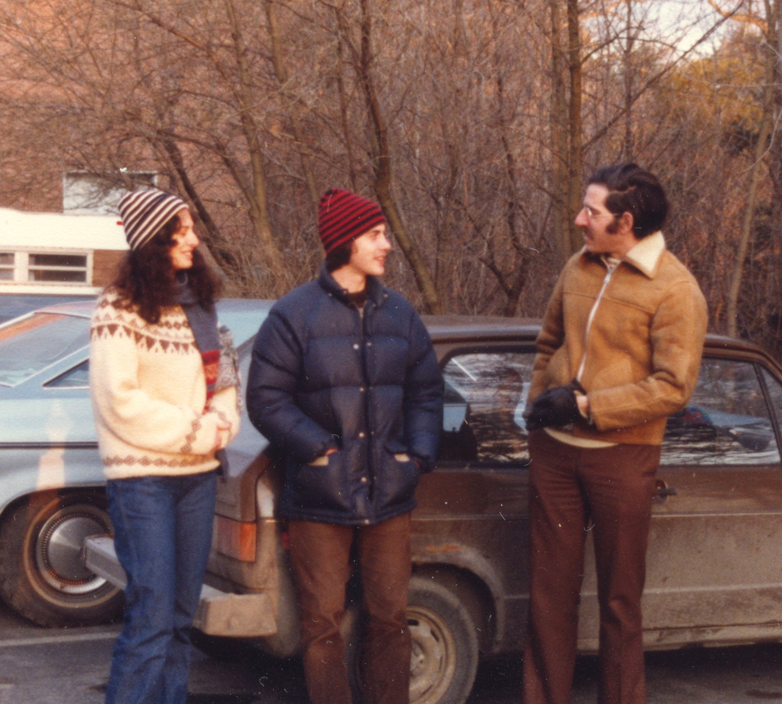
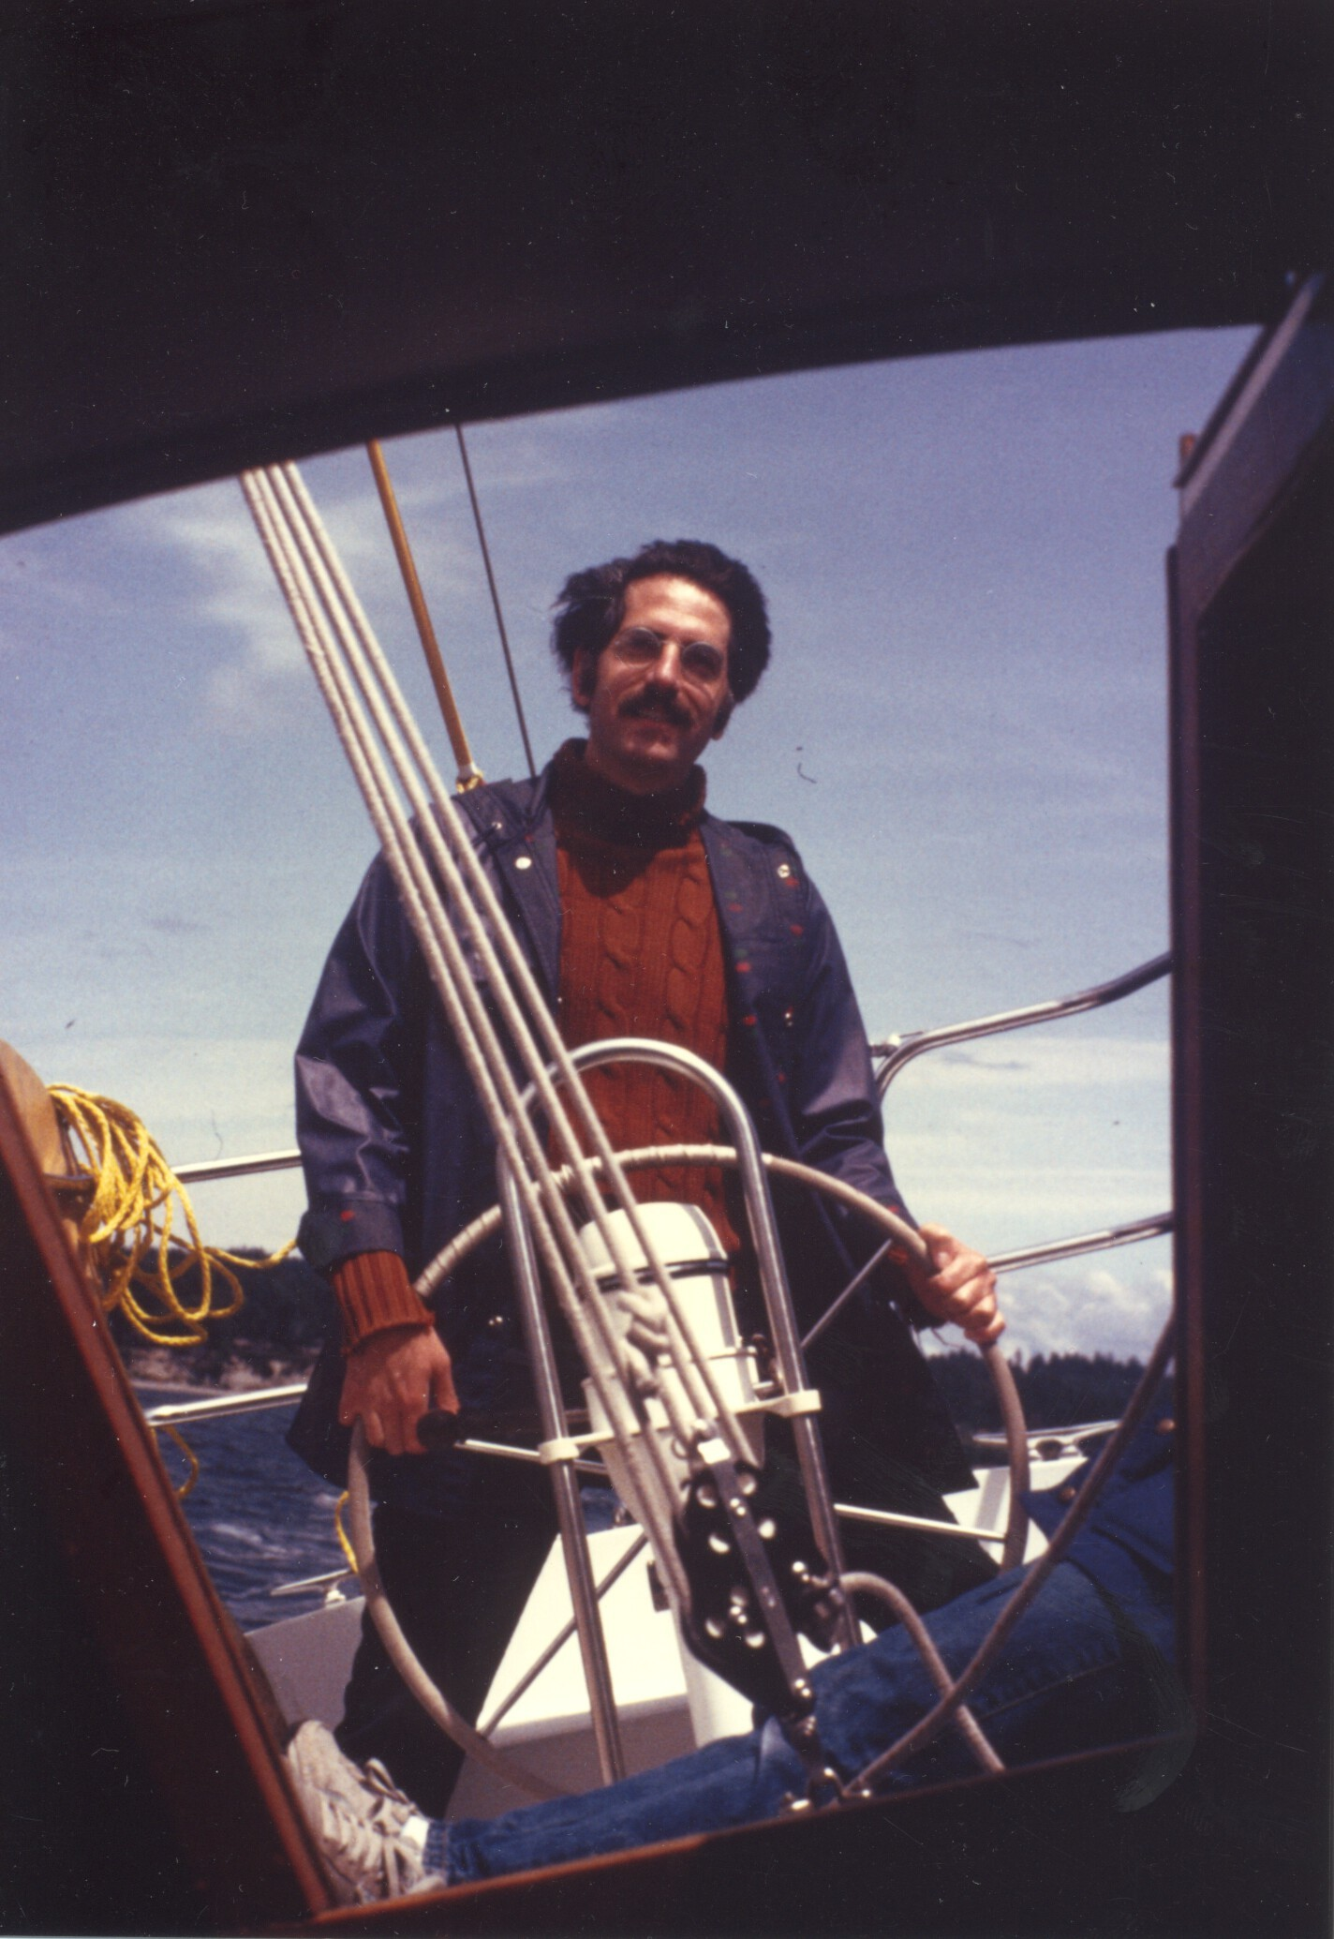
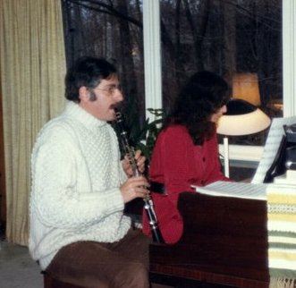
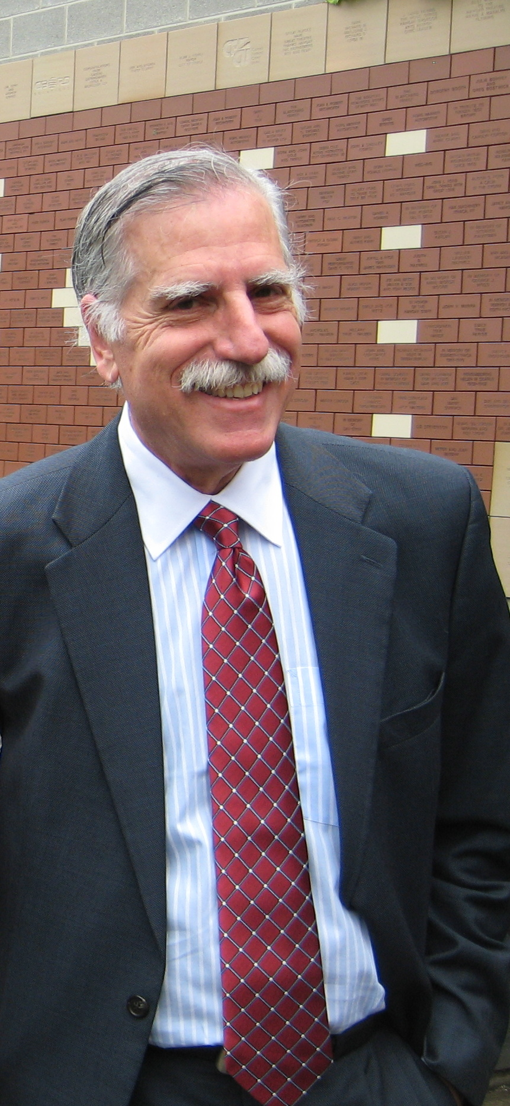
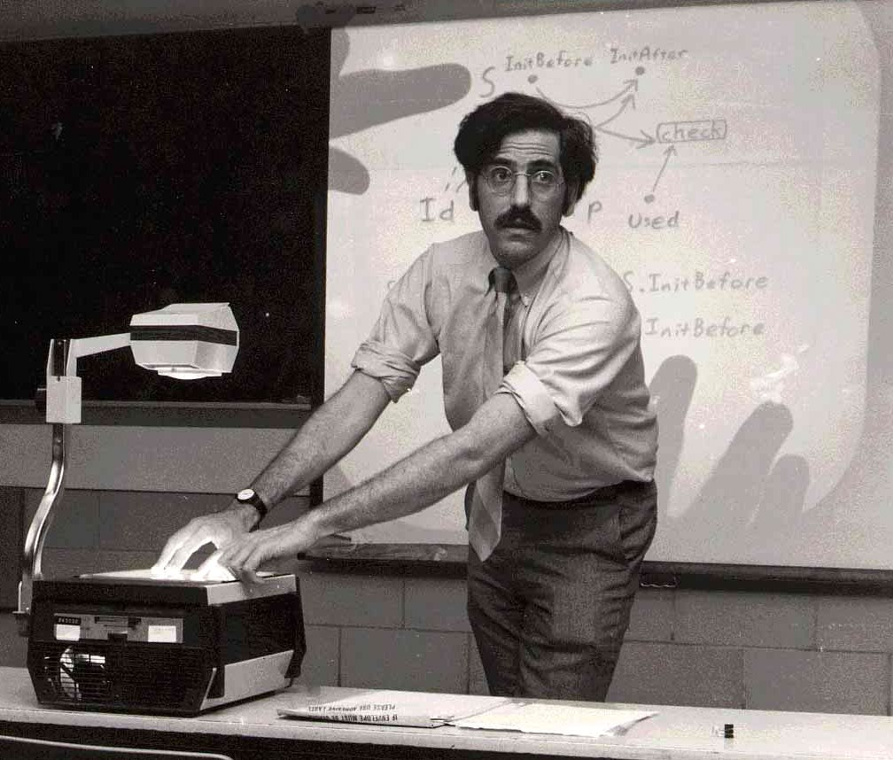
Tim Teitelbaum
Notes:
A number of thank yous are in order. It should be clear that Tim has had a huge influence on me. I have to say that starting out with him was the very best thing that happened to me – or ever will happen to me – in my intellectual/professional life. And it led to a deep friendship that has lasted more than 38 years.

Slide 22
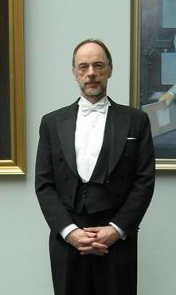
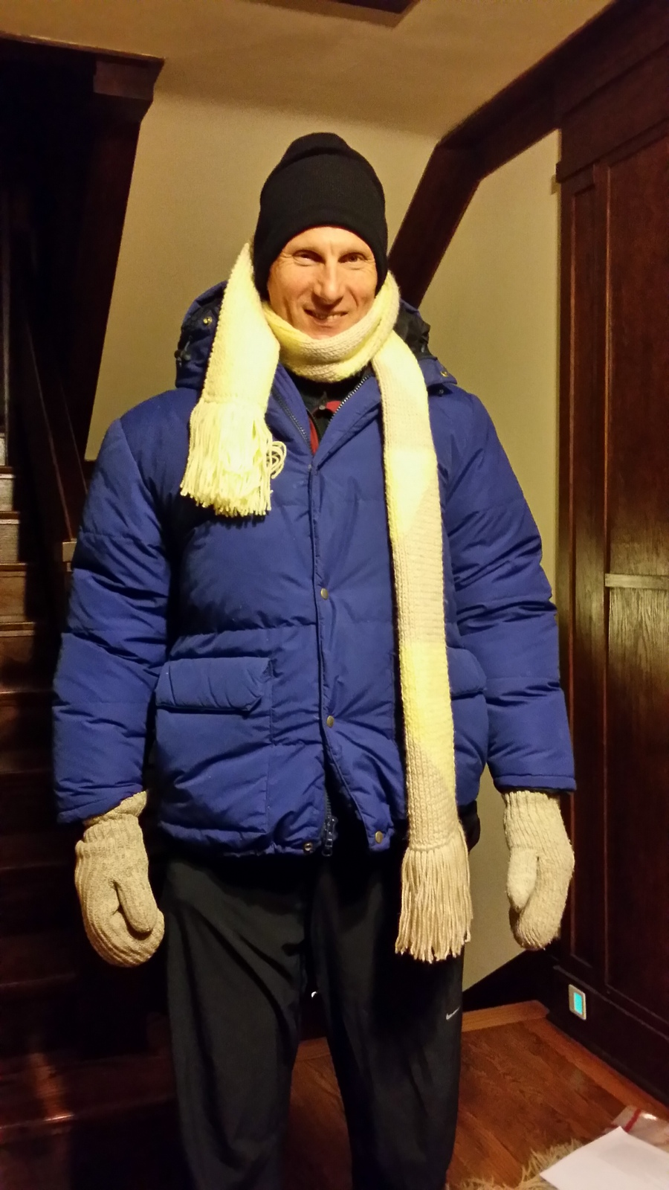
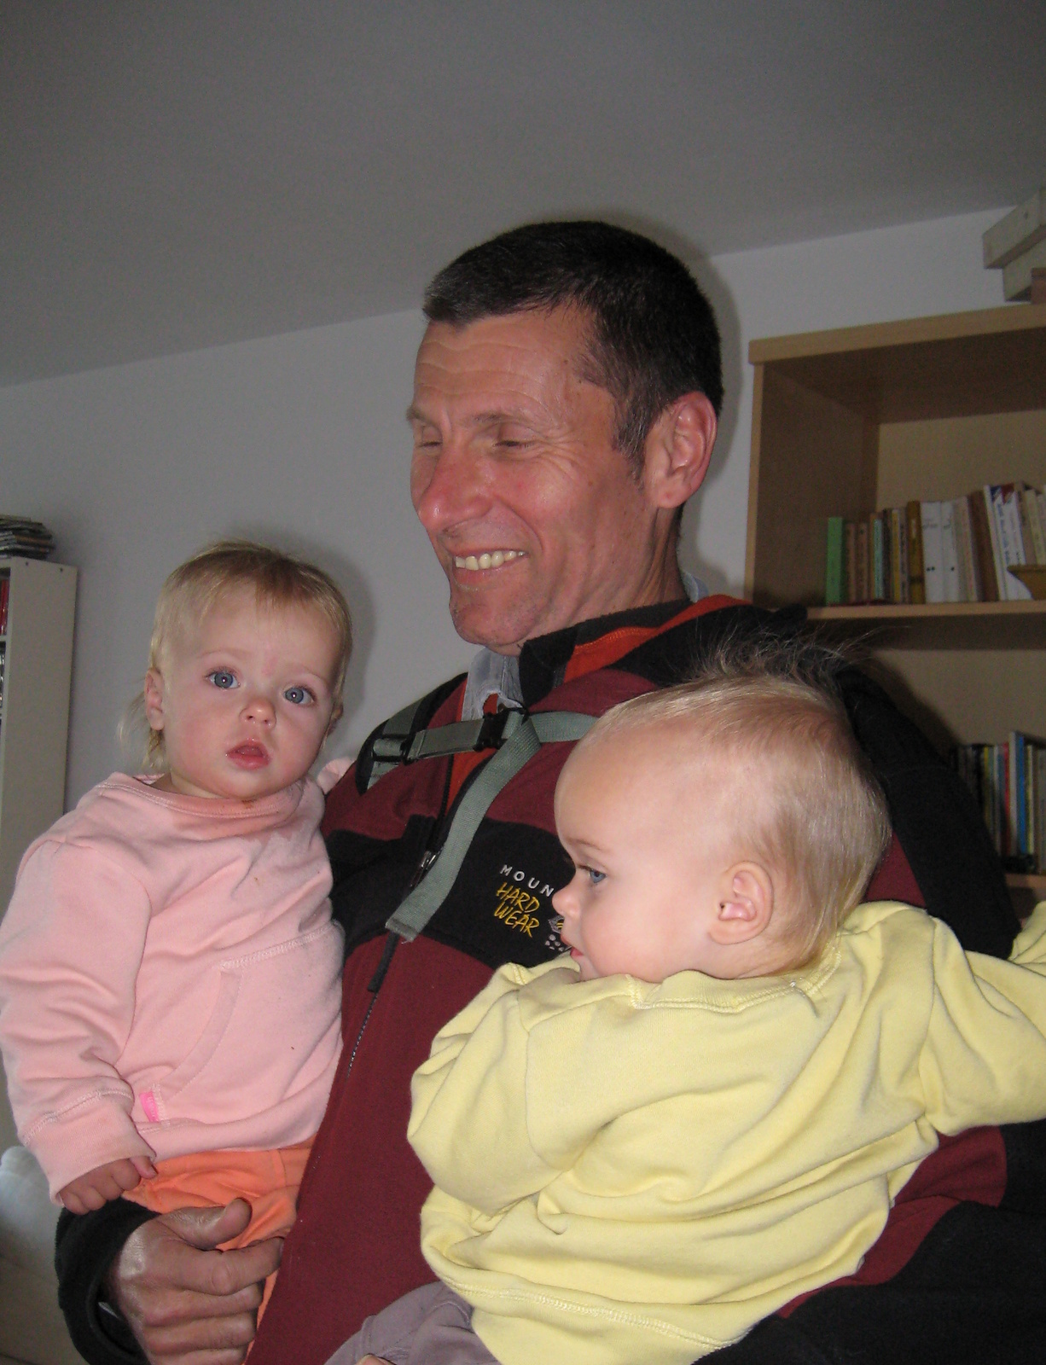
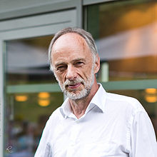
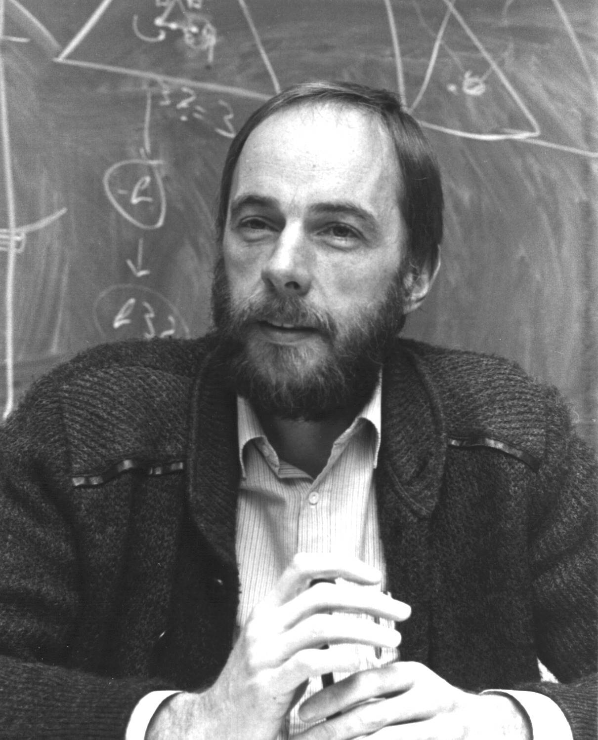
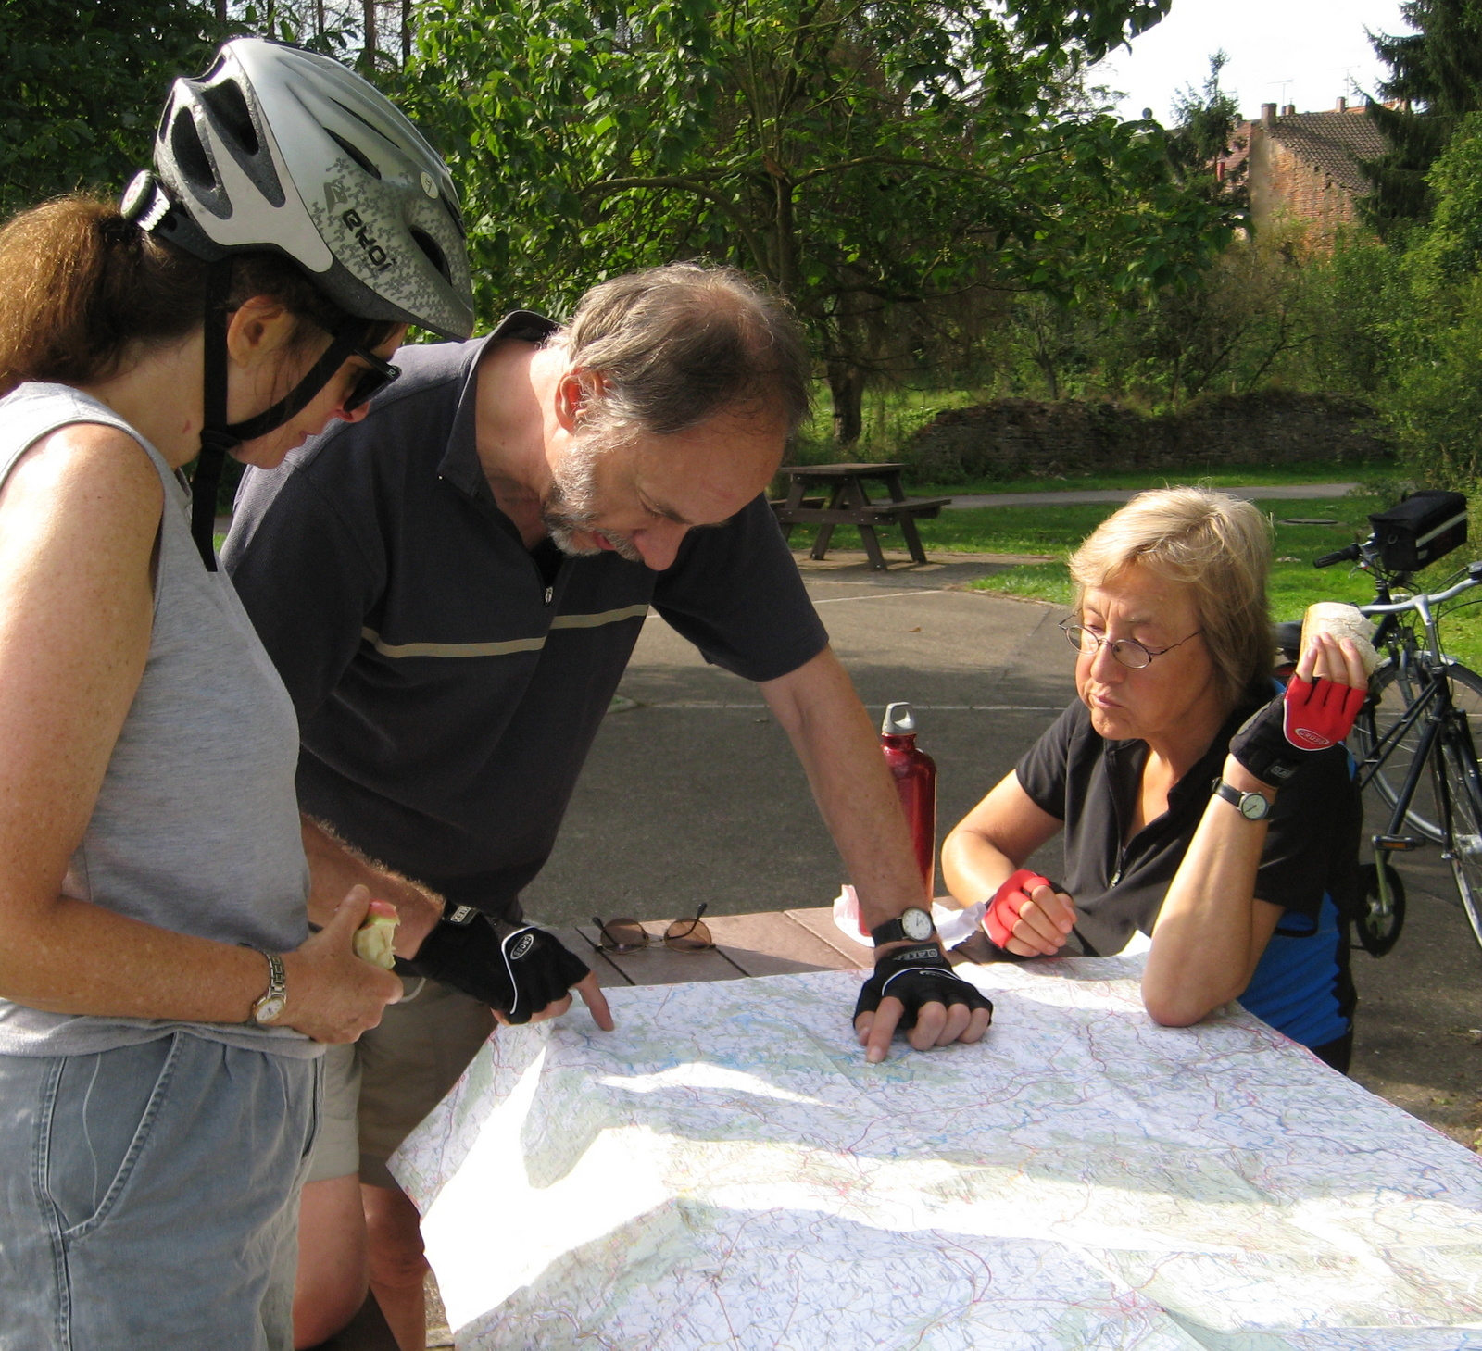
Mooly Sagiv and Reinhard Wilhelm
How is the submission coming along?
We concluded that we’re thinking too much and not writing enough . . .
. . . so we decided to stop thinking and start writing fool-speed ahead
Notes:
Another key intellectual adventure was the work on shape analysis with Mooly and Reinhard. The ideas that I learned during that period have shaped how I’ve thought about all of the research that I’ve worked on ever since. And again, deep friendships developed. When I think of my closest friends, I think of Ithaca, Tel-Aviv, and Saarbruecken.
I’d like to tell one anecdote about our work. One time when Mooly came to Madison to work on a paper, Reinhard was unable to come. As the submission deadline was approaching, we got a message from Reinhard: <CLICK> “How is the submission coming along?” . . . <CLICK> . . . <CLICK>

Slide 23
Wisconsin PL Colleagues
Charles
Fischer
Marvin
Solomon
Susan
Horwitz
Jim
Larus
Ras
Bodik
Somesh
Jha
Ben
Liblit
Aws
Albarghouthi
Loris
D’Antoni
Charles
Fischer
Susan
Horwitz
Jim
Larus
Ras
Bodik
Somesh
Jha
Ben
Liblit
Notes:
I have also benefitted greatly from my interactions with my PL colleagues at Wisconsin <NAME THEM>.
Just for grins, I also gathered some more recent pictures so that you can see what working at Wisconsin – or leaving Wisconsin – does to you <CLICK>. My conclusion was that if you want to keep your hair, don’t leave the Wisconsin PL group. And I’m another piece of confirming evidence <CLICK>.

Slide 24
Susan Horwitz http://pages.cs.wisc.edu/~horwitz/
1981
1992
1985
1989
1997
2014
2000
2007
Notes:
Susan and I were together more than 34 years. We enjoyed life in Ithaca, Madison, Paris, Copenhagen, and Pisa. She had a great attitude toward life – a healthy balance between work and play. She was a gifted teacher, and did some notable research, which she wrote up in clear prose and illustrated by well-chosen examples. Recently, my colleague Aws Albarghouthi read one of her pointer-analysis papers, and remarked, “People don’t write papers like this today – everything was so clear.” I invite you to visit her Wisconsin web page, where you’ll find a link to the presentation I gave at her commemoration, which covers her life – including the life I shared with her.

Slide 25
Fran Wong
Notes:
Finally, I’d like to thank Fran Wong, who with her energy and enthusiasm has helped me to build a new life with some new interests and new activities. She’s the one with the toothy grin in the rightmost picture.

Slide 26
You have to wonder at times what you're doing out there.
Over the years, I've given myself a thousand reasons to
keep running, but it always comes back to where it started.
It comes down to self-satisfaction and a sense of achievement.
Steve Prefontaine
Notes:
There are many more people to thank: my students, my collaborators, Patrick and Radhia Cousot for inventing our sub-field, today’s speakers, and Microsoft Research and my five friends who organized today’s celebration.
I’ll leave you with two final thoughts:<CLICK> and <CLICK>

Slide 27
And the plan for the future?
Fool-speed ahead!
Notes:
And for the future? <CLICK>

Slide 29
[Hamming 1986]: How to Address All of Next Year’s Problems?
“. . . [the ability] to generalize often means that the solution is simple. Often by stopping and [observing], `This is the problem he wants but this is characteristic of so and so’ . . . I can attack the whole class with a far superior method than the particular one because I was earlier embedded in needless detail.
The business of abstraction frequently makes things simple. . . . Altering the problem . . . can make a great deal of difference . . . because you can either do it in such a fashion that people can indeed build on what you've done, or you can do it in such a fashion that the next person has to essentially duplicate again what you've done. . . . It's just as easy to do a broad, general job as one very special case.”

Slide 30
Alexey
Loginov
Tal
Lev-Ami
Alexey
Loginov
Thomas
Reps
Neil
Immerman
David
Binkley
Akash
Lal
Louis Rall
Tim
Teitelbaum
Alan
Demers
Akash
Lal
Junghee
Lim
Mooly
Sagiv
Greta
Yorsh
Aditya
Thakur
Susan
Horwitz
Ramalingam
Reinhard
Wilhelm
Gogul
Balakrishnan
Somesh Jha
Stefan
Schwoon
Evan
Driscoll

