Slide 1

An Improved Algorithm for Slicing Machine Code
Venkatesh Srinivasan
Thomas Reps
{venk, reps}@cs.wisc.edu

Slide 2
Slicing
[Background]
Computes the set of program points that might affect/be affected
by slicing criterion
Backward slicing
‘
Forward slicing
void sum_prod(
int n
) {
int sum = 0;
int prod = 1;
while (n--) {
prod *= n;
sum += n;
}
printf(“%d\n”, sum);
printf(“%d\n”, prod);
}
void sum_prod(
int n
) {
int sum = 0;
int prod = 1;
while (n--) {
prod *= n;
sum += n;
}
printf(“%d\n”, sum);
printf(“%d\n”, prod);
}
Slicing criterion
Slicing criterion

Slide 3
Slicing – Applications
[Background]
Debugging
Component Extraction
Program Integration
Slicing
Program Understanding
Testing
Program Specialization
Notes:
Slicing has so many applications in program analysis and software engineering, ranging from automated debugging techniques to component extraction.

Slide 4
McSlice in a nutshell
McSlice: tool to slice machine code more accurately
State-of-the-art tools: Granularity issue
  Instruction level is too coarse grained
  Imprecise slices
McSlice slices at microcode level
Program reconstitution: machine-code synthesis
Tested on binaries of 8 FreeBSD utilities
Reduction in slice sizes
  33% for backward slices
  70% for forward slices

Slide 5
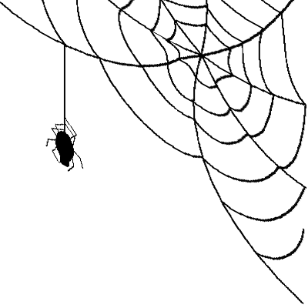

Software is Pervasive
Binaries are
[Motivation]
Software is everywhere
  Everyday systems: phones, laptops, watches, cars, etc.
  Critical systems: aircrafts, space shuttles, medical devices, etc.
Binaries are
No documentation
No source code
01000101011111101010101001000101011111101010
Binary
00101010101110101010101001000101011111101010
Can this binary crash?
What does this binary do?
Does this binary satisfy a given property?
Does this binary have a security vulnerability?
Notes:
This is the defecto first slide of the job talk of any PL researcher.
Software is pervasive.
I’m sure you’ve seen plenty of these so far.
Let me change it a little bit and say that binaries are pervasive.
Binaries are running in all devices.
Sometimes, some of these binaries lack source code and documentation.
And we, as computer scientists, are often asked to develop tools to that analyze these binaries, and answer questions about their properties.

Slide 6


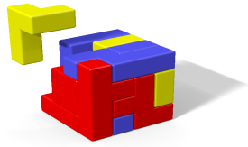
Machine-Code Slicer
[Motivation]
0100010Binary’
1011101
Partial Evaluation
(binding-time analysis – BTA)
01000101011111101010101001000101011111101010
Binary
00101010101110101010101001000101011111101010
Machine-code slicer
1101010Binary’
0010111
Taint tracking
(e.g., prune away parts of binary irrelevant to taint sources)
0111101Binary’
0010111
Component Extraction
(e.g., line count from wc binary)
Notes:
In this world of binary analysis, a machine-code slicer is an important tool to have.
A precise machine-code slicer is an essential primitive for several client analyses.
For example, in machine-code partial evaluation, slicing is used in binding-time analysis.
In taint tracking, a slicer can be used to exclude from consideration portions of the binary that are irrelevant to taint sources.
A slicer can also be used to extract an executable component from a binary, for example, word count from the wc binary.

Slide 7



State-of-the-art
Machine-Code Slicers
[Motivation]
There are state-of-the-art tools that can slice machine code
(e.g., CodeSurfer/x86)
We need a machine-code slicer that exhibits a high level of precision
But, slices are extremely imprecise
Slices often include entire binary
Notes:
There are state of the art tools that can slice machine code.
However, as we will shortly see, the slices computed by these tools are extremely imprecise
Often including essentially the entire binary.
So we need a mahine code slicer that exhibits a high degree of precision.

Slide 8
Outline
Motivation
Background
Problem with state-of-the-art tools: Granularity issue
McSlice
Experiments
Conclusion
Notes:
We just covered the motivation for this work: we need a machine-code slicer that has high precision
Let us now cover some background material.

Slide 9
Program-Dependence Graph
(PDG)
[Background]
System-dependence graph (SDG)
for multi-procedure programs
void sum_prod(int n) {
int sum = 0;
int prod = 1;
while (n--) {
prod *= n;
sum += n;
}
printf(“%d\n”, sum);
printf(“%d\n”, prod);
}
Data dependence
Control dependence
sum_prod
n_formal_in
sum = 0
prod = 1
while(n--)
sum += n
prod *= n
printf(“%d\n”, sum)
printf(“%d\n”, prod)
Notes:
- The program dependence graph is an intermediate representation used for slicing.
Recall this program I showed you earlier. The PDG for this program looks like this.
Nodes in the PDG denote program points like statements, predicates etc.
Edges denote data and control dependences between nodes.
For a multi-procedure program, the collection of PDGs and the the interprocedural edges between them is called a system dependence graph or SDG.

Slide 10
Slicing
[More background]
Intraprocedural slicing ⇔
reachability in PDG
Context-sensitive interprocedural slicing ⇔
context-free reachability in SDG
Data dependence
Control dependence
sum_prod
n_formal_in
sum = 0
prod = 1
while(n--)
sum += n
prod *= n
printf(“%d\n”, sum)
printf(“%d\n”, prod)
Notes:
Intraprocedural slicing is just reachability over the PDG starting from the slicing criterion.
Backwards slicing is backwards reachability; forward slicing is forwards reachability.
Context sensitive interprocedural slicing is just context-free reachability over the SDG starting from the slicing criterion.

Slide 11
IA-32 Primer
[Even more background]
Registers
1000
20
20
996
1000
20
40
ESP
EAX
EBX
Stack
lea esp, [esp+4]
push eax
mov ebx, eax
mov [esp], 40
Notes:
For those of you who are unfamiliar with IA-32, here is a brief primer.
ESP is the stack pointer register
Push instruction pushes an operand on the stack and updates the stack pointer. Note that the stack grows upwards.
For instructions with two operands, the operand on the left is the destination. This mov instruction moves the contents of the EAX register to the EBX register.
Square brackets indicate memory operands. This instruction moves the value 40 in the location pointed to by ESP.
Except in the case of the lea instruction, in which square brackets indicate the effective address of the operand.
That’s all the IA-32 you need to know.

Slide 12
QFBV Formulas
[I swear, this is the final
slide on background … ]
Explicit representation of semantics of an instruction (microcode)
ESP’ = ESP – 4 ∧
Mem’ = Mem[ESP – 4 ↦ EAX] ∧
EBP’ = EBP ∧
EAX’ = EAX ∧
EBX’ = EBX ∧
.
.
.
CF’ = CF ∧
OF’ = OF
ESP’ = ESP – 4 ∧
Mem’ = Mem[ESP – 4 ↦ EAX]
push eax
Semantics of instructions in ISA
Instruction
Symbolic Execution
QFBV Formula
Notes:
The concrete operational semantics or the microcode of IA-32 instructions can be formally represented by QFBV formulas.
Converting an instruction into a QFBV formula is super straightforward: you just perform symbolic execution. There are sevarl tools that can perform this conversion for you.

Slide 13
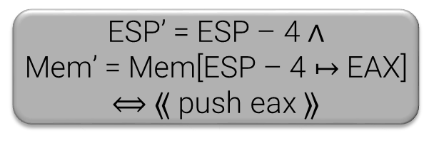
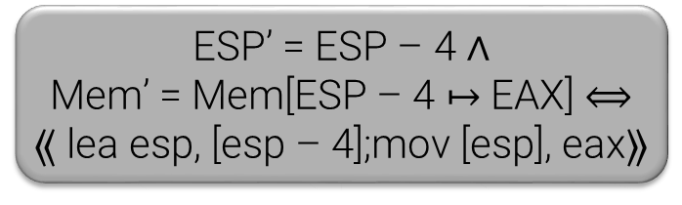
Machine-Code Synthesis
[I lied ☺]
Synthesize machine-code instructions from a semantic specification
  QFBV formula
ESP’ = ESP – 4 ∧
Mem’ = Mem[ESP – 4 ↦ EAX]
McSynth*
lea esp, [esp – 4]
mov [esp], eax
push eax
ESP’ = ESP – 4 ∧
Mem’ = Mem[ESP – 4 ↦ EAX] $⟺$
⟪ lea esp, [esp – 4];mov [esp], eax⟫
ESP’ = ESP – 4 ∧
Mem’ = Mem[ESP – 4 ↦ EAX] $⟺$ ⟪ push eax ⟫
* V. Srinivasan and T. Reps. Synthesis of machine code from semantics. In PLDI, 2015
Notes:
Going from an instruction to a QFBV formula is straightforward.
But going from a formula to an instruction sequence is not so straightforward. It involves search or synthesis.
A machine code synthesizer synthesizes an instruction sequence that implements a QFBV formula.
McSynth is the name of a state-of-the-art machine-code synthesizer.
Here is an instruction sequence that implements the input formula.
This is another instruction sequence that implements the formula.

Slide 14
Outline
Motivation
Background
Problem with state-of-the-art tools: Granularity issue
McSlice
Experiments
Conclusion

Slide 15
Machine-Code Slicing
State-of-the-art Tools
[Granularity issue]
Why is the entire body of ‘add’ in the slice?
int add(int a, int b) {
int sum = a + b;
return sum;
}
int square(int a) {
int product = a * a;
return product;
}
int main() {
int a = 10;
int b = 20;
int c = add(a, b);
int d = square(c);
return a - b;
}
Note that body of ‘add’ is not in the slice
main:
push ebp
mov ebp,esp
sub esp,0x20
mov [ebp – 0x14],0xA
mov [ebp – 0x10],0x14
push [ebp – 0x10]
push [ebp – 0x14]
call add
add esp,8
mov [ebp – 0xC],eax
push [ebp – 0xC]
call square
add esp,4
mov [ebp – 0x8],eax
mov eax, [ebp – 0x10]
mov edx, [ebp – 0x14]
sub eax,edx
leave
ret
add:
push ebp
mov ebp, esp
sub esp, 10
mov eax, [ebp + 0xC]
mov edx, [ebp + 0x8]
lea eax, [eax + edx]
mov [ebp – 0x4], eax
mov eax, [ebp – 0x4]
leave
ret
square:
push ebp
mov ebp, esp
sub esp, 10
mov eax, [ebp + 0x8]
imul eax, [ebp + 0x8]
mov [ebp – 0x4], eax
mov eax, [ebp – 0x4]
leave
ret
Notes:
There are tools such as CodeSufer/x86 which can perform slicing at the machine code level. But the computed slices are extremely imprecise. Let me illustrate that with an example.
Suppose we have this program that contains two functions: add and square.
The main function calls these two functions, but doesn’t use the return values.
It simply returns a – b;
Suppose we want to find the statements that affect the return value of main.
We compute a backward slice, and the slice looks like this.
Note that the body of the add function is not in the slice.
Now let us compute the same slice at the machine-code level.
The assembly listing for this function looks like this, and the analogous slicing criterion is this instruction.
And the backward slice looks like this.
This is weird. Why is the entire body of add, which is completely irrelevant to the slicing criterion, added to the slice?

Slide 16
Granularity Issue
[Granularity issue]
main:
push ebp
mov ebp,esp
sub esp,0x20
mov [ebp – 0x14],0xA
mov [ebp – 0x10],0x14
push [ebp – 0x10]
push [ebp – 0x14]
call add
add esp,8
mov [ebp – 0xC],eax
push [ebp – 0xC]
call square
add esp,4
mov [ebp – 0x8],eax
mov eax, [ebp – 0x10]
mov edx, [ebp – 0x14]
sub eax,edx
leave
ret
add:
push ebp
mov ebp, esp
sub esp, 10
mov eax, [ebp + 0xC]
mov edx, [ebp + 0x8]
lea eax, [eax + edx]
mov [ebp – 0x4], eax
mov eax, [ebp – 0x4]
leave
ret
square:
push ebp
mov ebp, esp
sub esp, 10
mov eax, [ebp + 0x8]
imul eax, [ebp + 0x8]
mov [ebp – 0x4], eax
mov eax, [ebp – 0x4]
leave
ret
Granularity Issue
ESP’ = ESP – 4 ∧
Mem’ = Mem[ESP – 4 ↦ Mem(EBP – 12)]
Notes:
Let us zoom into the problem.
Say the slice is at this point, and it has included all the relavant instructions.
Now it needs to ascend into main.
The imprecision arises at this push instruction, and the imprecision arises because of a granularity issue.
The qfbv formula of the push instruction looks like this. The push instruction updates the stack pointer and also a memory location.
The slice needs to include the update to the stack pointer alone.
But the slice cannot include a part of an instruction---it can either include the entire instruction, or nothing at all.
So the slice includes the entire instruction, and, this predecessor instruction which uses the return value of add, gets added to the slice.
Consequently, the entire body of add, which has nothing to do with the slicing criterion, gets included in the slice.
Let us visualize the problem.
The slice only needs one update of an instruction.
Because of the granularity issue, the slice is forced to include the entire instruction.
And consequently, irrelevant predecessors get included in the slice.
This effect can cascade, irrelevant predecessors can cause even more irrelevant instructions to be included in the slice.
And usually, the final slice includes the entire binary.

Slide 17
Granularity Issue
[Granularity issue]
Machine code
111101010101001000101011111101010
Binary
001010101011101010101010010001010
Instruction-level PDG
Imprecise
slice
CodeSurfer/x86
Slicing Algorithm
Slicing criterion
Instruction-level is too coarse-grained for machine-code slicing!
Notes:
Let me summarize the problem with the way state-of-the-art tools perform slicing.
CodeSurfer/x86 recover an instruction level PDG from the binary.
And then, they it uses existing slicing algorithms to slice over the PDG to compute the slice.
And the key issue that an instruction-level PDG is too coarse grained for machine-code slicing, and results in imprecise slices.

Slide 18
Outline
Motivation
Background
Problem with state-of-the-art tools: Granularity issue
McSlice
Experiments
Conclusion

Slide 19
Improved Slicing with McSlice
[Algorithm]
Machine code
111101010101001000101011111101010
Binary
001010101011101010101010010001010
Instruction-level PDG
CodeSurfer/x86
Microcode
Precise
microcode
slice
µ-PDG
Instruction-level PDG to µ-PDG
Slicing Algorithm
Slicing criterion
Notes:
We created a tool called McSlice that performs machine-code slicing more accurately.
McSlice addresses the granularity issue by slicing at the microcode level instead of the instruction level.
By microcode, I just mean an explicit representation of the semantics of an instruction. We use QFBV formulas for microcode.
Here is how McSlice works.
McSlice starts with the instruction-level PDG created by CodeSurfer/x86 and converts it into a microcode-level PDG or a mu-PDG.
A mu-PDG is just a PDG where nodes are microcode updates instead of whole instructions
We’ll see an example mu-PDG shortly.
Then it performs the slicing at the microcode level using existing slicing algorithms, and obtains a more precise microcode slice.

Slide 20
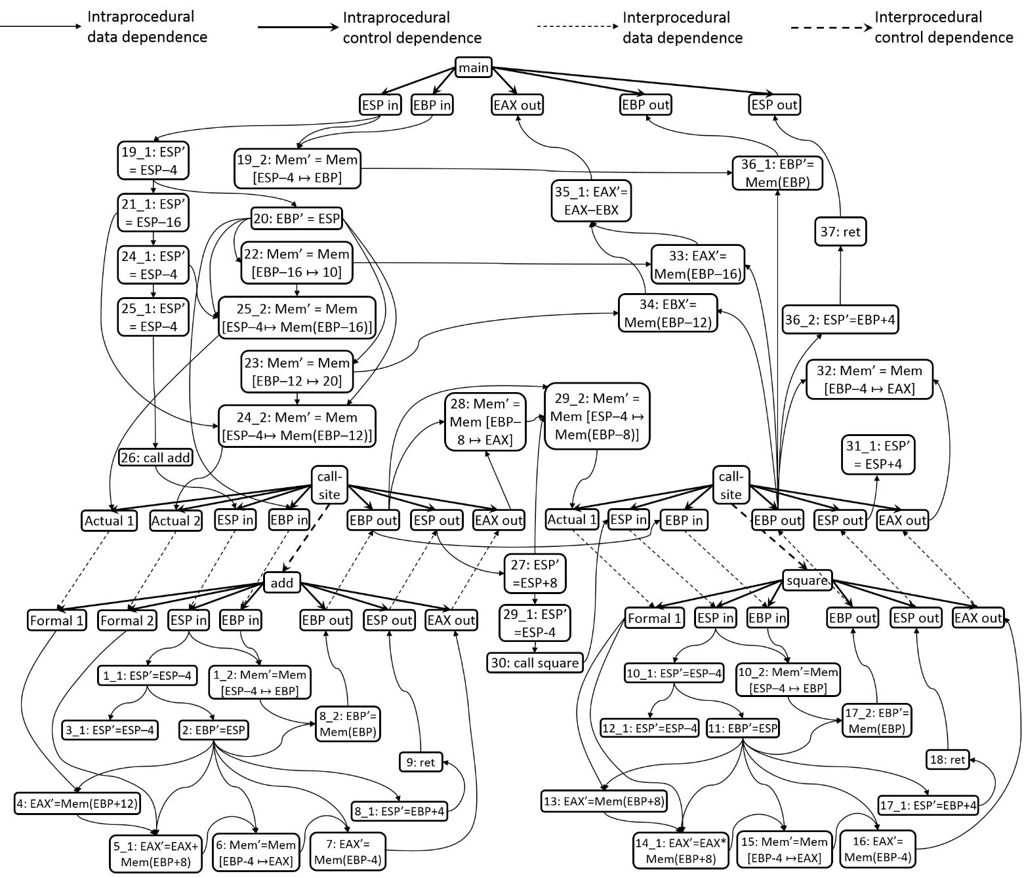
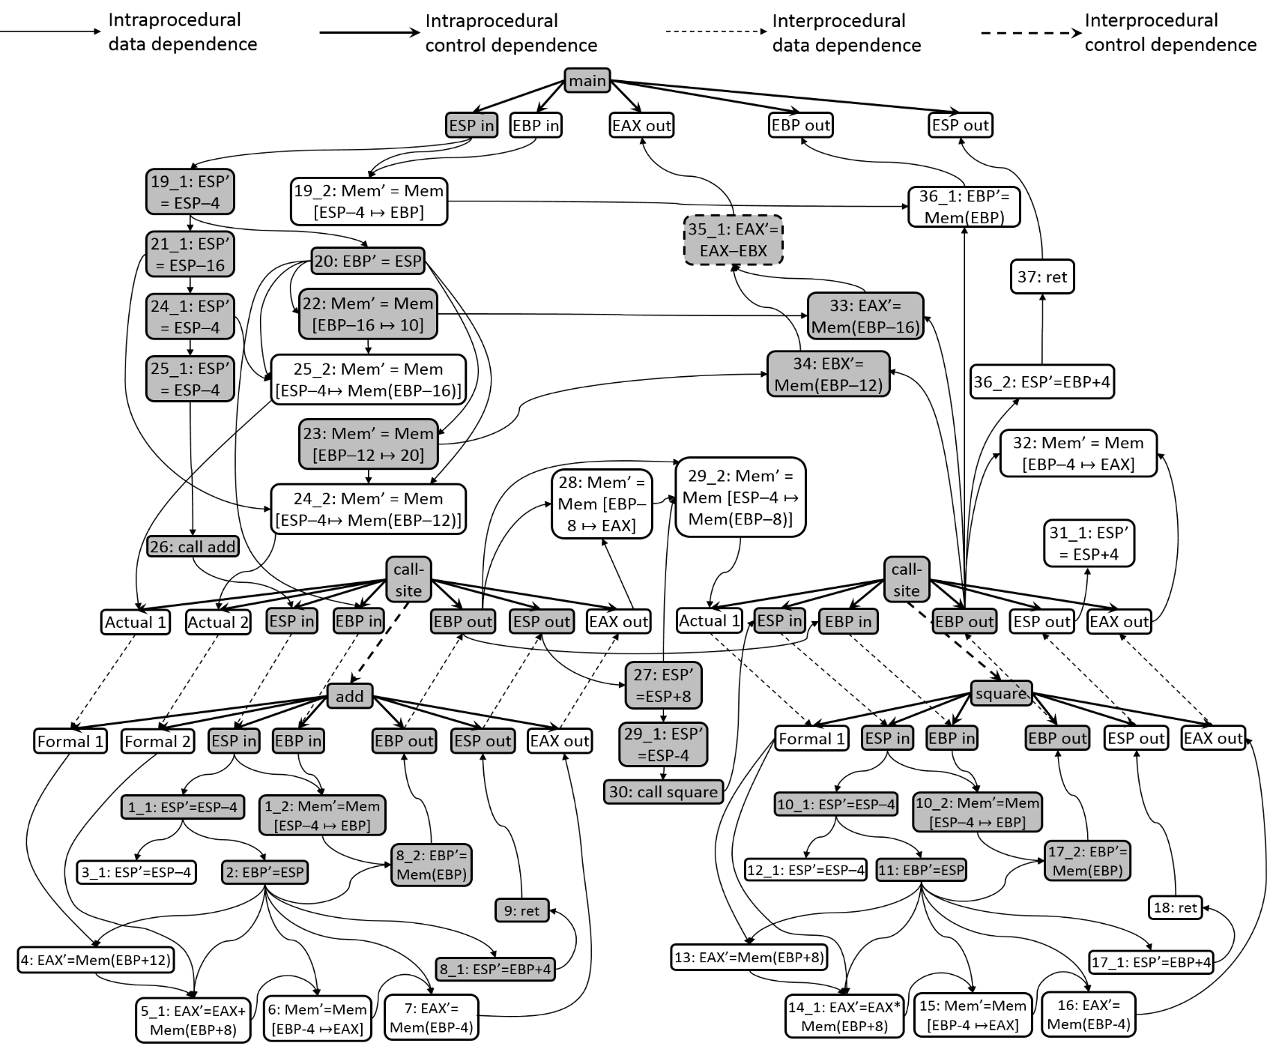
µ-PDG
[Algorithm]
add:
1: push ebp
2: mov ebp, esp
3: sub esp, 4
4: mov eax, [ebp + 0xC]
5: add eax, [ebp + 0x8]
6: mov [ebp – 0x4], eax
7: mov eax, [ebp – 0x4]
8: leave
9: ret
square:
10: push ebp
11: mov ebp, esp
12: sub esp, 4
13: mov eax, [ebp + 0x8]
14: imul eax, [ebp + 0x8]
15: mov [ebp – 0x4], eax
16: mov eax, [ebp – 0x4]
17: leave
18: ret
main:
19: push ebp
20: mov ebp,esp
21: sub esp,0x20
22: mov [ebp – 0x14],0xA
23: mov [ebp – 0x10],0x14
24: push [ebp – 0x10]
25: push [ebp – 0x14]
26: call add
27: add esp,8
28: mov [ebp – 0xC],eax
29: push [ebp – 0xC]
30: call square
31: add esp,4
32: mov [ebp – 0x8],eax
33: mov eax, [ebp – 0x10]
34: mov edx, [ebp – 0x14]
35: sub eax,edx
36: leave
37: ret
Notes:
Let me show you an example.
Remember the program that I used earlier.
The mu-PDG for that program looks like this.
Don’t be scared. I’ll explain the key parts of the mu-PDG.
As you can see it has several nodes connected by data dependence and control dependence edges.
Each node contains a single microcode update.
To reduce clutter, I’ve not shown the microcode updates corresponding to flag updates.
For example, the microcode nodes corresponding to the first push instruction in main are here.
Remember push has two microcode updates, one to the stack pointer, and another to a memory location.
These are the nodes corresponding to those two updates.
The mu-pdg also has more precise dependence edges connecting the microcode nodes.

Slide 21
CodeSurfer/x86 Vs. McSlice
[Algorithm]
add:
push ebp
mov ebp, esp
sub esp, 4
mov eax, [ebp + 0xC]
add eax, [ebp + 0x8]
mov [ebp – 0x4], eax
mov eax, [ebp – 0x4]
leave
ret
square:
push ebp
mov ebp, esp
sub esp, 4
mov eax, [ebp + 0x8]
imul eax, [ebp + 0x8]
mov [ebp – 0x4], eax
mov eax, [ebp – 0x4]
leave
ret
main
push ebp
mov ebp,esp
sub esp,0x20
mov [ebp – 0x14],0xA
mov [ebp – 0x10],0x14
push [ebp – 0x10]
push [ebp – 0x14]
call add
add esp,8
mov [ebp – 0xC],eax
push [ebp – 0xC]
call square
add esp,4
mov [ebp – 0x8],eax
mov eax, [ebp – 0x10]
mov edx, [ebp – 0x14]
sub eax,edx
leave
ret
add:
push ebp
mov ebp, esp
sub esp, 4
mov eax, [ebp + 0xC]
add eax, [ebp + 0x8]
mov [ebp – 0x4], eax
mov eax, [ebp – 0x4]
leave
ret
square:
push ebp
mov ebp, esp
sub esp, 4
mov eax, [ebp + 0x8]
imul eax, [ebp + 0x8]
mov [ebp – 0x4], eax
mov eax, [ebp – 0x4]
leave*
ret
main
push ebp*
mov ebp,esp
sub esp,0x20*
mov [ebp – 0x14],0xA
mov [ebp – 0x10],0x14
push [ebp – 0x10]*
push [ebp – 0x14]*
call add
add esp,8
mov [ebp – 0xC],eax
push [ebp – 0xC]*
call square
add esp,4
mov [ebp – 0x8],eax
mov eax, [ebp – 0x10]
mov edx, [ebp – 0x14]
sub eax,edx*
leave
ret

Slide 22
Program Reconstitution
[Algorithm]
Machine code
111101010101001000101011111101010
Binary
001010101011101010101010010001010
Instruction-level PDG
Precise
Machine-code
program
CodeSurfer/x86
Fix parameter mismatches at call-sites
Include microcode for ARs
Microcode
Precise
microcode
slice
µ-PDG
Instruction-level PDG to µ-PDG
Slicing Algorithm
McSynth
Slicing criterion
Notes:
We have obtained a precise microcode slice.
but what if the client of the slicer wants the results as an executable machine code program?
Somehow, we should now go from microcode, which is at a lower level, to machine code, which is at a higher level.
For this purpose, McSlice uses machine-code synthesis.
First, McSlice ensures that it has included all the relevant microcode to get an executable program.
For example, it includes all microcode relevant to allocating and de-allocating activation records.
The it uses McSynth to synthesize instruction sequences for each microcode update included in the program.
This renders the precise microcode slice as an executable machine-code program.

Slide 23
Outline
Motivation
Background
Problem with state-of-the-art tools: Granularity issue
McSlice
Experiments
Conclusion

Slide 24
Test Suite
[Experiments]
Binaries of 8 FreeBSD utilities
295 – 2207 LOC
Backward-slicing criterion – actuals to print procedures
Forward-slicing criterion – variables initialized at program start
CodeSurfer/x86 Vs. McSlice
  CodeSurfer/x86: No. of instructions in slice
  McSlice: No. of instructions whose microcode is included in slice
Notes:
We tested McSlice on the binaries of 8 FreeBSD utilities whose sizes varied from 295 to 2207 lines of C code.
For each application, we selected one slicing criterion for backward and forward slicing.
For backward slicing, it was one of the actuals to a call to an output procedure at the end of the program.
For forward slicing, it was one of the variables initialized at the beginning of the program.
We compared the sizes of slices computed by CodeSurfer/x86 against those computed my McSlice.
But CodeSurfer computes instruction-level slices, and McSlice computed microcode slices.
To facilitate meaningful comparison between slice sizes we compared the no. of instructions in slices computed by CodeSurfer/x86 and against the no. of instructions whose microcode updates were in the microcode slices computed by McSlice.

Slide 25
Slice Sizes
[Experiments]
Backward Slice: 33%
Forward slice: 70%
Notes:
This slide shows our results.
The y axes are in logarithmic scale.
The first half shows results for backward slicing and second half shows results for forward slicing.
The average reduction in the size of backward slices is 33%, and for forward slices it is 70%.
For two applications, the reduction in size is over two orders of magnitude.

Slide 26
Partial Instructions
[Experiments]
Backward Slice: 40%
Forward slice: 16%
Notes:
We also measured the percentage of instructions for which only a subset of their microcode updates were included in the slice.
We call such instructions partial instructions included in the slice.
For backward slices, an average of 40% of instructions were partial instructions.
For forwad slices, that number was 16%.
We also found the top opcode variants whose instructions were only partially included in the slice.
For backward slices, many opcode variants were included only partially.
But for forward slices, only 3 opcode variants caused all the imprecision in CodeSurfer/x86 slices.

Slide 27
Component Extraction
[Experiments]
Backward microcode slice
Include extra microcode for executable program
McSynth: microcode to machine code
Executable machine-code program
Application | Extracted component | No. of instructions in binary | No of instructions in extracted component
wc-lite | Line count | 295 | 64
wc | Word count | 790 | 242
cksum | Length of input | 815 | 338

Slide 28
Conclusion
Algorithm to slice machine code more accurately
McSlice – slicer for IA-32
Granularity issue: McSlice slices at microcode level
Program-reconstitution issue: machine-code synthesis
McSlice reduces slice sizes by 33% for backward slices, and 70% for forward slices
Extract executable components from binaries

Slide 29
Questions?
Machine code
111101010101001000101011111101010
Binary
001010101011101010101010010001010
Instruction-level PDG
Precise
Machine-code
program
CodeSurfer/x86
Microcode
Precise
microcode
slice
µ-PDG
Instruction-level PDG to µ-PDG
Slicing Algorithm
McSynth
Slicing criterion
Microcode
Notes:
We have obtained a precise microcode slice.
but what if the client of the slicer wants the results as an executable machine code program?
Somehow, we should now go from microcode, which is at a lower level, to machine code, which is at a higher level.
For this purpose, McSlice uses machine-code synthesis.
First, McSlice ensures that it has included all the relevant microcode to get an executable program.
For example, it includes all microcode relevant to allocating and de-allocating activation records.
The it uses McSynth to synthesize instruction sequences for each microcode update included in the program.
This renders the precise microcode slice as an executable machine-code program.

