Slide 1
Analysis of Concurrent Programs Under a Context Bound

Slide 2
Early influences
Model checking
  the only plausible approach for concurrent systems
  simple
  … too simple to scale
Depth-bounded search
  originated in early AI literature
  universally applicable
  enthusiastically adopted by model checking to achieve scalability
  … at the cost of coverage

Slide 3
The question
How do we achieve scalable search
over behavior of concurrent systems
while retaining high coverage?

Slide 4
A general recipe
Create a system model with a parameter N
  set of behaviors increases monotonically with N
  coverage of interesting behaviors possible with low N
Devise methods that exploit the bound N to get complexity reduction and scale
Shift in perspective
  the bounding parameter is specific to system characteristics

Slide 5
Multiple streams of new results
Dramatic reduction in worst-case complexity for many models of concurrent computation
Sequentialization or efficient encoding of concurrent executions into lower complexity models
  akin to dimensionality reduction
Paradigm shift from exploration of states to exploration of complete executions

Slide 6

Context-bounded analysis
[BEP11]
Message-Passing
[LRQ09]
[ABP11]
CHESS
[CGS11]
Asynchronous Programs
[LMP09]
[EQR11]
KISS
[MP11]
Weak Memory Model
2004
2005
2007
2008
2009
2010
2011
2012
Unbounded threads
Liveness
[LR08]
[LMP10]
[GHR10]
[PLKR12]
[EL12]
Multi-core
[QR05]
Static threads
Shared memory
[R10]
[BE12]
[KJV10]
[ELQ12]
[LMP10]
[ABEL12]

Slide 7
Sit back & relax
How did the journey start?
Where are we now?
Are we there yet?
Throughout the talk
  reminiscences
  lessons learned
  several context switches

Slide 8
Context-Bounded Analysis
Phase I

Slide 9
Background
Static program analysis back then (around 2000) dominated by concepts from abstract interpretation or type systems, emphasizing soundness (over-approximation)
  Finds all bugs encompassed by abstract model, abstraction may lead to decidability or efficiency
  Precision problem (false positives)
Bounded model checking from HW-verification (finite executions)
  Clarke et al. 2001
Software model checking had shown great potential
  SLAM, Ball-Rajamani 2002
What about concurrent software?
  MSR: ZING, KISS

Slide 10
Q-Wu PLDI 2004
Introduced the idea of context-bounding for model checking concurrent programs
  Under-approximating behavior of target system but with practically interesting levels of coverage
Based on translation (by instrumentation) to sequential program
PROs:
  Finds concurrency bugs in real code (e.g. race conditions in device drivers)
  Never reports false errors but may miss some errors
  Technique can leverage existing sequential checkers (SLAM, PREfix, …)
  Analysis complexity does not grow exponentially
CONs:
  Coverage inherently limited (2 context switches for 2 threads)
  Does not consider the question of CBMC in general (independent of technique used)

Slide 11
Q-Wu PLDI 2004

Slide 12
Q-R TACAS 2005
context
context
context
switch
switch
General CBA decision problem inspired by KISS:
  “Given a multithreaded boolean program P and a positive integer k, does P go wrong by failing an assertion via an execution with at most k contexts?“
Formal version: Is k-bounded reachability for concurrent PDAs decidable?
  Reachability undecidable w/o bound (Ramalingam, 2000)
  Problem: unbounded stacks, hence unbounded state space within each context
  So, context switches can be situated in any of infinitely many states
  Hence, decidability needs an argument

Slide 13
Q-R TACAS 2005
Additional questions that were pragmatically important to us:
  Does k>2 really matter? Can we demonstrate it?
  Does it matter that we can handle unbounded stacks (recursion)?
  Can we handle dynamic thread creation?

Slide 14
Decidability via regularity of pushdown store language
  J. R. Büchi: Regular canonical systems. Archiv für Mathematische Logik und Grundlagenforschung 6 (1964), 91-111.
  S. A. Greibach: A note on pushdown store automata and regular systems. Proc. Amer. Math. Soc. 18 (1967), 263-268.
    ``In this paper we shall use a theorem of Bar-Hillel, Perles and Shamir to show that the set of tapes left on the pushdown store by a regular set is regular, and derive Büchi‘s theorem from that result‘‘
Bouajjani & Maler, Reachability analysis of pushdown automata. INFINITY Workshop, 1996
Bouajjani, Esparza, & Maler, Reachability analysis of pushdown automata: Application to model-checking. CONCUR 1997
Finkel, Willems, & Wolper, A direct symbolic approach to model checking pushdown systems. INFINITY 1997

Slide 15


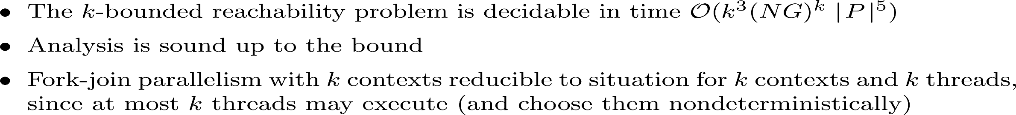
.
.
.
.
.
.
.
.
.

Slide 16

Does it matter?
Great luck that we had ZING:
  Andrews-Q-Rajamani-R-Xie, CONCUR 2004:
  Exploiting program structure for model checking concurrent software
… and Mayur Naik!
… then a summer intern, now a professor …
  We analyzed a transaction management system
  by translating 10 KLOC of C#-code into input language of ZING
  Found 3 bugs each requiring 3 or 4 context switches to manifest in any execution

Slide 17
Does it matter?

Slide 18
Lal-Reps FMSD 2009
A new and very different approach from Q-R 2005
  Surprising (at least to some of us)!
Key idea: Reduction of interleaving executions to sequential executions in which the (finite!) effect on global store is assumed and later checked
For example, analysis of thread interleaving T1; T2; T1 (2 context switches) is reduced to analyzing the sequential executions of T1; T1; T2 in which the possible effects of T2 on the global store are assumed for the second execution of T1. It is later (executing T2) checked that this effect was in fact obtainable.

Slide 19
Lal-Reps FMSD 2009
Obviates the need to compute the entire reachability sets (as in Q-R 2005)
Obviates the need to consider cross product of local states of threads
Scales linearly in local state space
Enables sequential analysis (hence, in some sense, fulfilling the programme of Q-Wu 2004!)

Slide 20
Atig-Bouajjani-Q LMCS 2011
Generalization to dynamic thread creation
  Q-R 2005: Context-bound automatically bounds the number of threads
Basic idea: Bound the number of context switches for each thread instead of bounding the number of switches for all threads
Uses that a newly created thread can perform at most a-1 switches, where a is the number of switches performed by its ancestor
Deep study of complexity of several variants of reachability problem
  EXPSPACE-completeness of SR problem (equivalence to VASS coverability)
  2EXPSPACE-completeness of more general model (upper bound here)

Slide 21
“Sequentialization”
[L-R FMSD 2009]: Given a concurrent program P, and context bound K, we can construct a (simple) sequential program P_{K} that preserves reachability under K
Path from point A to point B is seldom a straight line

Slide 22




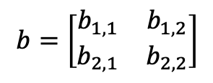







Weighted reachability
$$a_{1}$$
$$a_{2}$$
$$a_{3}$$
$$b_{1}$$
$$b_{2}$$
$$b_{3}$$
$$a_{4}$$
$$a_{5}$$
$$a_{6}$$
context
context
context
switch
switch
$$a=\left[\begin{matrix}a_{1,1} & a_{1,2} \\ a_{2,1} & a_{2,2}\end{matrix}\right]$$
$$b=\left[\begin{matrix}b_{1,1} & b_{1,2} \\ b_{2,1} & b_{2,2}\end{matrix}\right]$$
$$a⋅b$$

Slide 23









Reordering operations (threads)
$$a_{1}$$
$$a_{2}$$
$$a_{3}$$
$$b_{1}$$
$$b_{2}$$
$$b_{3}$$
$$a_{4}$$
$$a_{5}$$
$$a_{6}$$
context
context
context
switch
switch
$$a_{1}$$
$$a_{2}$$
$$a_{3}$$
$$a_{4}$$
$$a_{5}$$
$$a_{6}$$
$$b_{1}$$
$$b_{2}$$
$$b_{3}$$
context
context
context
termination

Slide 24
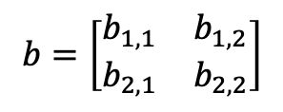


Composition of Actions == matrix multiplication
$$a=\left[\begin{matrix}a_{1,1} & a_{1,2} \\ a_{2,1} & a_{2,2}\end{matrix}\right]$$
$$b=\left[\begin{matrix}b_{1,1} & b_{1,2} \\ b_{2,1} & b_{2,2}\end{matrix}\right]$$
$$a⋅b$$
State mutation is a binary relation R: set of (state-before, state-after) pairs
Represent R as a Boolean matrix
Relation composition is then matrix multiplication

Slide 25
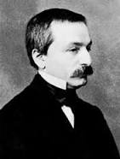
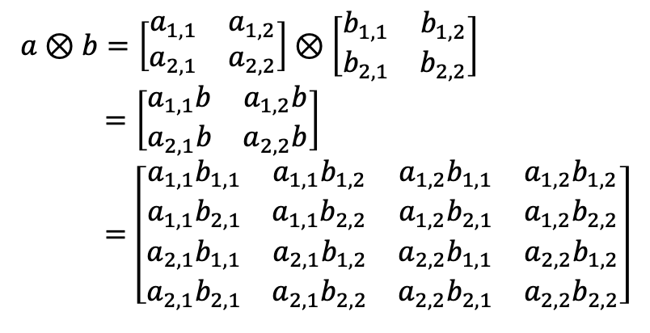
Tensor Product of matrices
$a⊗b=\left[\begin{matrix}a_{1,1} & a_{1,2} \\ a_{2,1} & a_{2,2}\end{matrix}\right]⊗\left[\begin{matrix}b_{1,1} & b_{1,2} \\ b_{2,1} & b_{2,2}\end{matrix}\right]$
$=\left[\begin{matrix}a_{1,1}b & a_{1,2}b \\ a_{2,1}b & a_{2,2}b\end{matrix}\right]$
$=\left[\begin{matrix}\begin{matrix}a_{1,1}b_{1,1} & a_{1,1}b_{1,2} \\ a_{1,1}b_{2,1} & a_{1,1}b_{2,2}\end{matrix} & \begin{matrix}a_{1,2}b_{1,1} & a_{1,2}b_{1,2} \\ {a_{1,2}b}_{2,1} & a_{1,2}b_{2,2}\end{matrix} \\ \begin{matrix}a_{2,1}b_{1,1} & a_{2,1}b_{1,2} \\ a_{2,1}b_{2,1} & a_{2,1}b_{2,2}\end{matrix} & \begin{matrix}a_{2,2}b_{1,1} & a_{2,2}b_{1,2} \\ a_{2,2}b_{2,1} & a_{2,2}b_{2,2}\end{matrix}\end{matrix}\right]$
Leopold
Kronecker
Notes:
There is another way to take a product of two matrices, namely, via tensor product (sometimes called the Kronecker product, or more rarely, the Zehfuss product).

Slide 26
Tensor Product and Multiplication
$$\left(a_{1}⊗a_{2}\right)⋅\left(b_{1}⊗b_{2}\right)=\left(a_{1}⋅b_{1}\right)⊗\left(a_{2}⋅b_{2}\right)$$
Notes:
There is another important property of tensor product – the “mixed-product property.” You can think of tensor product as a “smart-pairing” operation so that products work component-wise.
When you apply the de-tensor operation to a mixed-product value, there is an interesting effect. Here we see that the result is a shuffling of a1, b2, a2, and b2, which is exactly what is needed to model three context switches among sub-actions a1, a2 (from process a) and b1, b2 (from process b)!

Slide 27

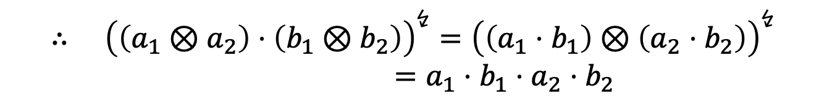
Supporting operations
$$a⋅b={\left(a⊗b\right)}^{↯}$$
$$∴ {\left(\left(a_{1}⊗a_{2}\right)⋅\left(b_{1}⊗b_{2}\right)\right)}^{↯}={\left(\left(a_{1}⋅b_{1}\right)⊗\left(a_{2}⋅b_{2}\right)\right)}^{↯}$$
$=a_{1}⋅b_{1}⋅a_{2}⋅b_{2}$
Notes:
It turns out that the matrix product can always be retrieved from the tensor product. In essence, the tensor product computes all the “ai bj” products needed for the matrix product, plus additional ones.
In some sense, the tensor and de-tensor operations break the abstract data-type of matrices down into some constituent operations. We are breaking an abstraction here!

Slide 28
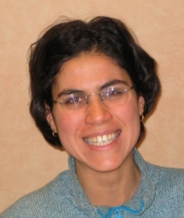
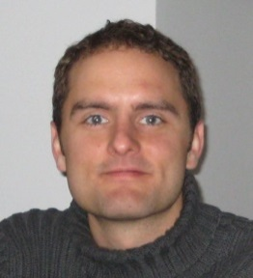



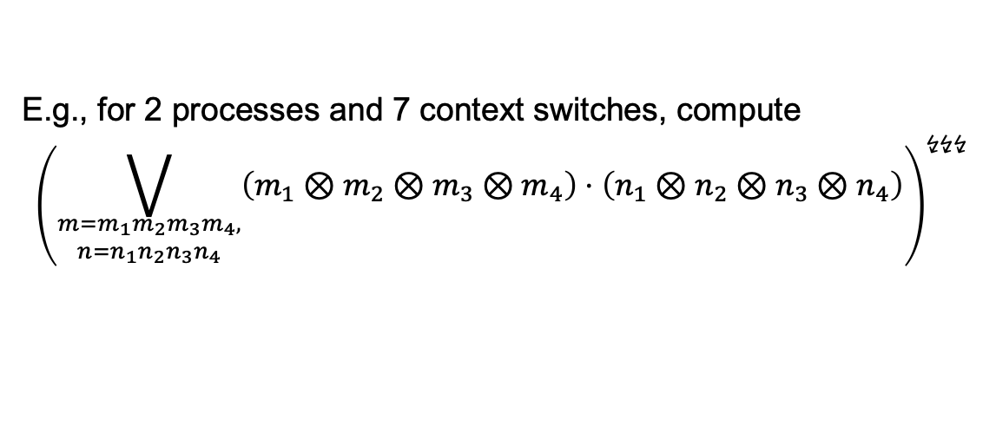





Tensor Product: A Way to Reorder Contexts
$$m_{1}$$
$$m_{2}$$
$$m_{3}$$
$$m_{4}$$
$$n_{1}$$
$$n_{2}$$
$$n_{3}$$
$$n_{4}$$
$${\left(\left(m_{1}⊗m_{2}⊗m_{3}⊗m_{4}\right)⋅\left(n_{1}⊗n_{2}⊗n_{3}⊗n_{4}\right)\right)}^{↯↯↯}={\left(\left(m_{1}⋅n_{1}\right)⊗\left(m_{2}⋅n_{2}\right)⊗\left(m_{3}⋅n_{3}\right)⊗\left(m_{4}⋅n_{4}\right)\right)}^{↯↯↯}$$
$=m_{1}⋅n_{1}⋅m_{2}⋅n_{2}⋅m_{3}⋅n_{3}⋅m_{4}⋅n_{4}$
E.g., for 2 processes and 7 context switches, compute
$${\left(\bigvee_{\begin{matrix}m=m_{1}m_{2}m_{3}m_{4}, \\ n=n_{1}n_{2}n_{3}n_{4}\end{matrix}}{\left(m_{1}⊗m_{2}⊗m_{3}⊗m_{4}\right)⋅\left(n_{1}⊗n_{2}⊗n_{3}⊗n_{4}\right)}\right)}^{↯↯↯}$$
Tayssir
Touili
Nick
Kidd
L., Touili, Kidd, & R., Interprocedural analysis of concurrent programs under a context bound. TACAS 2008
Notes:
This effect generalizes to an arbitrary, finite number of sub-actions. Here we show how 7 context switches are modeled. Each process contributes 4 sub-actions, and the shuffling of the sub-actions involves two per-process tensor-product expressions, one multiplication, and three detensor operations.
Thus, to compute the result of all possible traces with 7 context switches, we need to compute all the ways of decomposing processes a and b into a1, a2, a3, a4 and b1, b2, b3, b4, respectively. For each decomposition, we then compute the product of the per-process tensored values. Then apply de-tensor the appropriate number of times (in this case, three times).

Slide 29
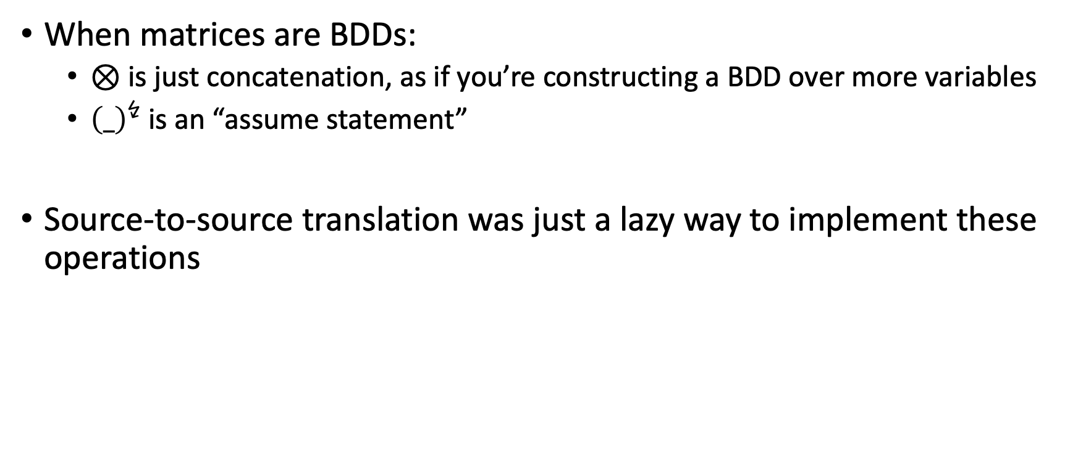
Tensors via Source Code Transformation
When matrices are BDDs:
  $⊗$ is just concatenation, as if you’re constructing a BDD over more variables
  ${\left(_\right)}^{↯}$is an “assume statement”
Source-to-source translation was just a lazy way to implement these operations

Slide 30
From Static Analysis to Systematic Testing

Slide 31







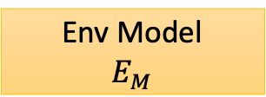
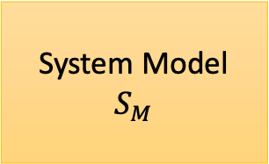
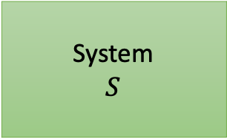
System and Environment Modeling
Spec
System
$$S$$
System Model
$$S_{M}$$
Environment
E
Env Model
$$E_{M}$$
Proof
Bug

Slide 32
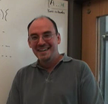

Model Checking as Systematic Testing [Verisoft, CAV ‘97]
Soundness of bugs
A bug report is guaranteed to be
  a bug in the system,
  a bug in the environment model,
  a bug in the spec, or
  a bug in the model checker
Spec
System
$$S$$
System
$$S$$
System Model
$$S_{M}$$
Patrice Godefroid
Environment
E
Env Model
$$E_{M}$$
Coverage w.r.t. a test harness/input
Coverage
Bug
Proof

Slide 33
Two Approaches
Stateless model checking [Verisoft ‘97]
  Enumerate paths in state space graph
  Associated (exponential) redundancy
  Limited depth exploration
Explicit-state model checking [JPF ‘00, CMC ‘02]
  Complex state management
  Associated engineering difficulty/speed
  Relatively deeper exploration
Spec
System
$$S$$
System Model
$$S_{M}$$
Env Model
$$E_{M}$$
Coverage
Bug
Depth-bounded exploration is not effective at finding deep bugs in large systems

Slide 34
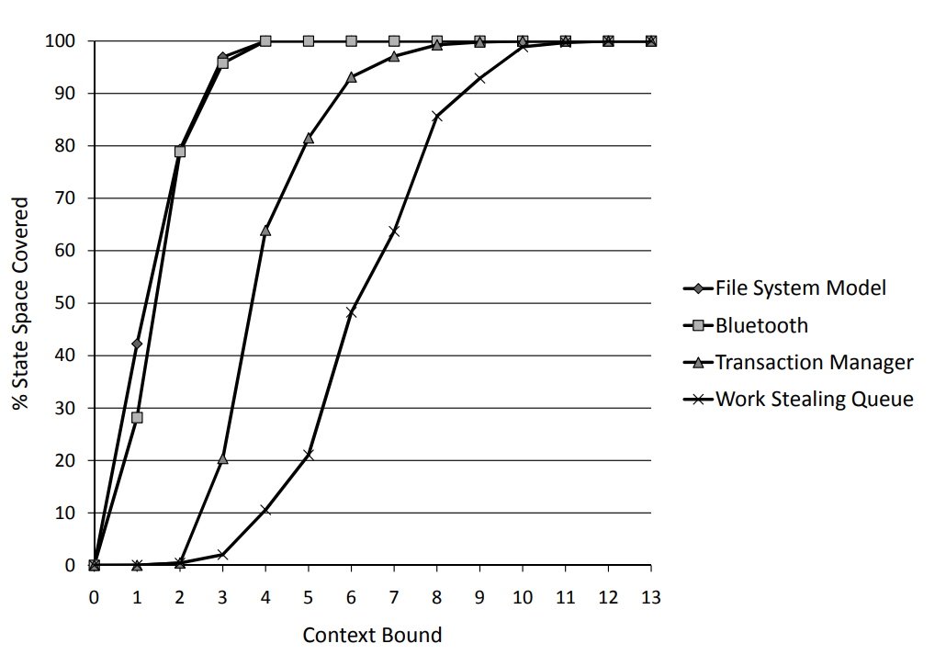
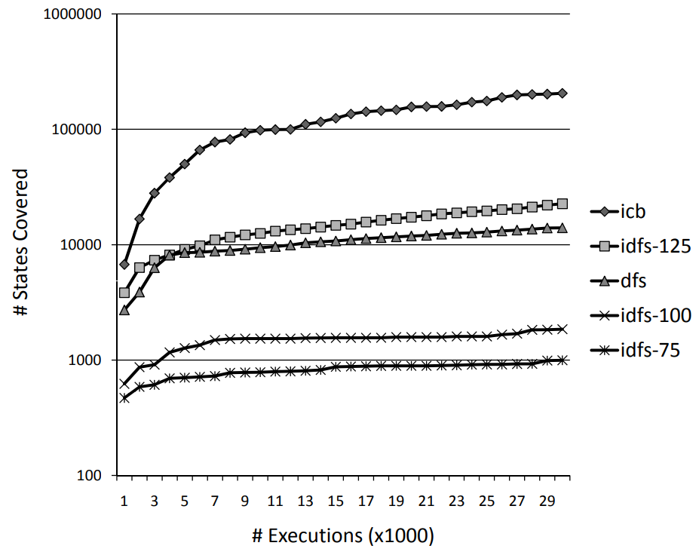
Context-bounding provides effective state coverage [PLDI ‘07]
Context-bounding alleviates state-redundancy of state-less path enumeration

Slide 35
From context-bounding to preemption-bounding
Shaz
Jakob
Akash
Madan
Preemption is a forced context-switch
Coverage w.r.t preemption bounds are more meaning
Search can go deeper
Can run programs to completion

Slide 36
CHESS – Concurrency Unit Testing
TestStartup();
while(*){
RunTest();
}
TestShutdown();
Program
Schedule Controller
+
Environment Mocks
Runtime
Concurrency bugs can be found in the small

Slide 37

Industrial Scale-Up
Confidence! .. that we shake even the largest of systems
P: safe asynchronous event-driven programming. PLDI 2013
[Desai-Gupta-Jackson-Q-Rajamani-Zufferey]
Windows USB 3.0
Running on 100M+ devices
Insignificant concurrency issues
Better design: faster performance
(Open-sourced, now actively used in AWS for modeling + testing distributed systems)

Slide 38

Further scale-up with Coyote
A .NET library and tool for concurrency unit testing of C#
  APIs for writing unit tests, specifications and capturing sources of nondeterminism
  https://github.com/microsoft/coyote
Key enablers
  Tighter integration with C#
  Rising complexity and importance of cloud infrastructure
  Advancing research, from context bounding to portfolio of bounded and randomized search
Pantazis Deligiannis,
Microsoft Research
Sebastian Burckhardt, Pravesh Kothari, Madanlal Musuvathi, Santosh Nagarakatte: A randomized scheduler with probabilistic guarantees of finding bugs. ASPLOS 2010

Slide 39
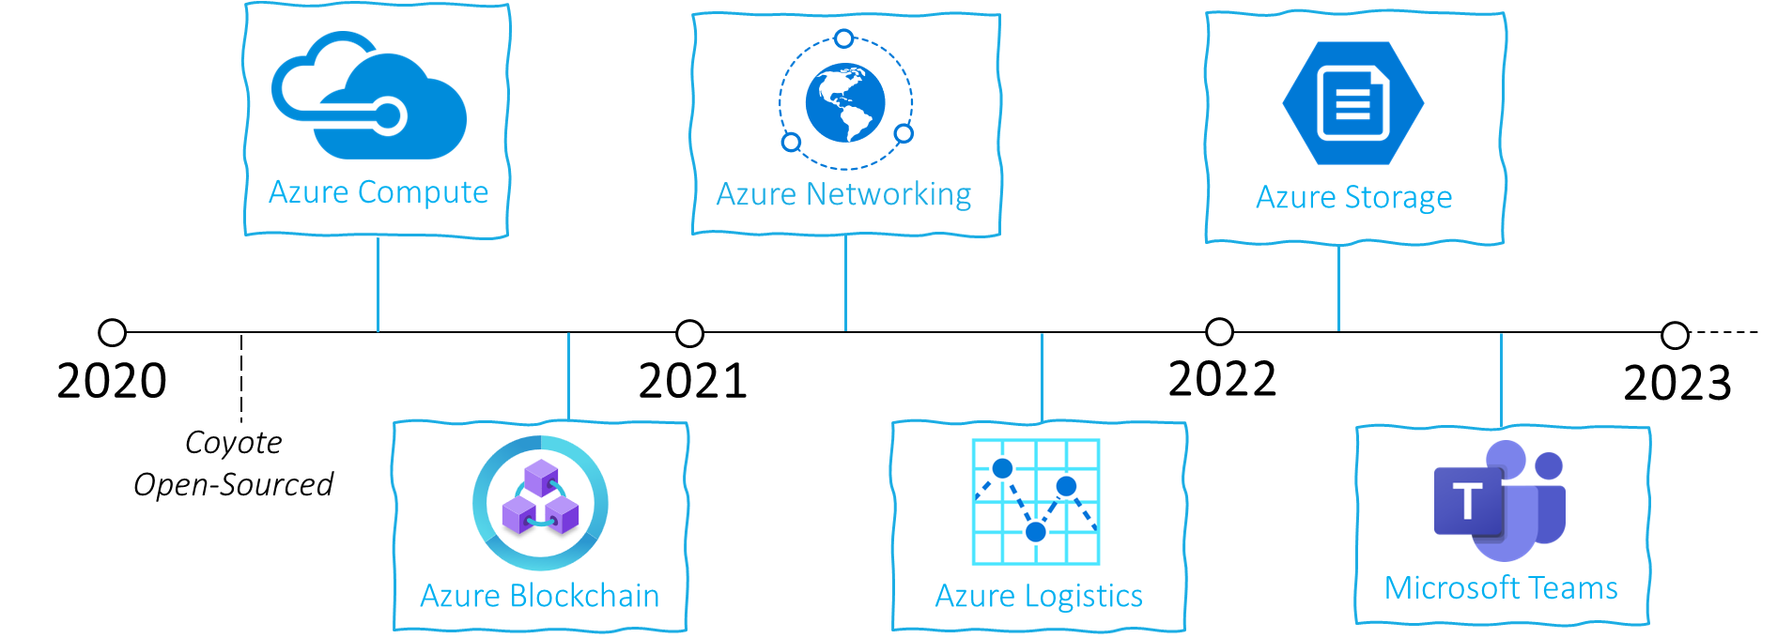
Coyote Adoption in Azure
Used in services covering a large fraction of Microsoft Azure infrastructure

Slide 40
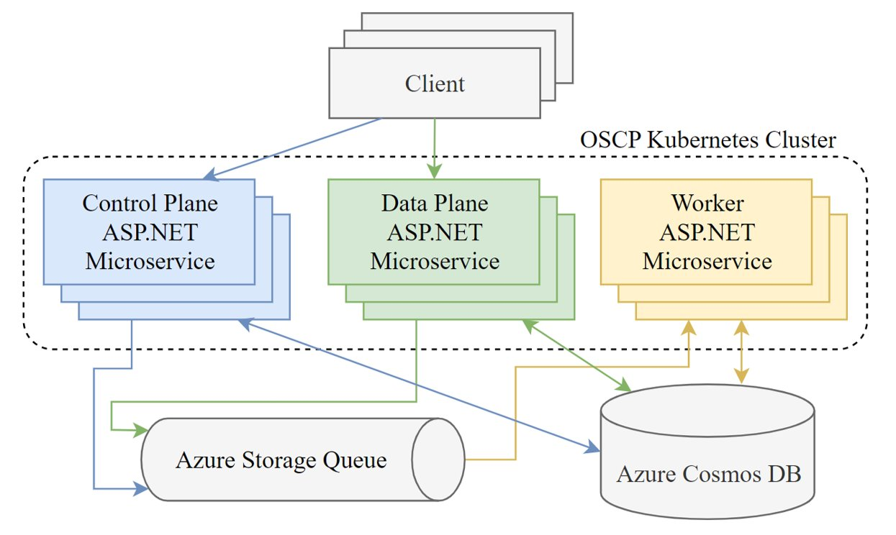
Distributed Systems

Slide 41
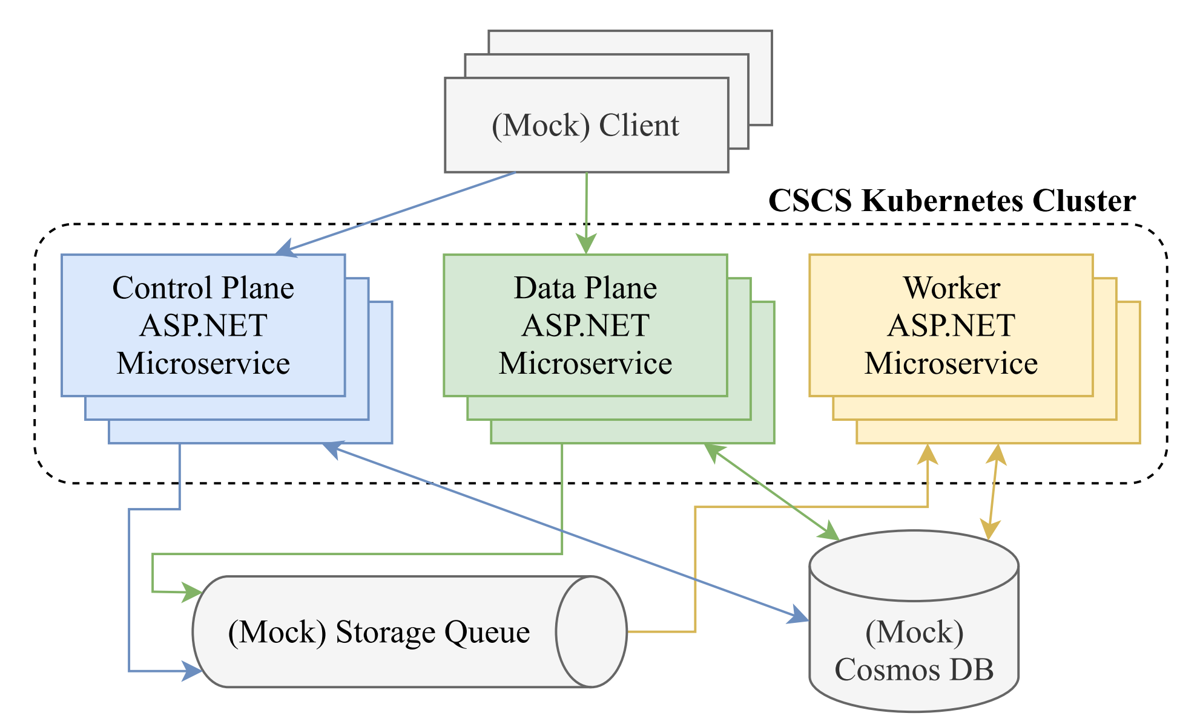
Distributed Systems are just concurrent systems

Slide 42
Concurrency unit testing in C#
[TestMethod]
public async Task TestService()
{
// Setting up the unit test (with mocks).
var mockCosmosDB = new MockCosmosDB();
var mockStorageQueue = new MockStorageQueue();
var controlService = new ControlService(mockCosmosDB, mockStorageQueue);
var dataService = new DataService(mockCosmosDB, mockStorageQueue);
// Spawn concurrent requests and exercise the logic.
var controlServiceTask = Task.Run(() = controlService.Execute());
var dataServiceTask = Task.Run(() = dataService.Execute());
await Task.WhenAll(controlServiceTask, dataServiceTask);
// Assert that state of the mock Cosmos DB is consistent.
Assert.IsTrue(mockCosmosDB.IsConsistent);
}
C# Concurrent Unit Test
Usage ranges from unit testing to end-to-end scenarios
  Covers failover, interleavings, timing, etc.
13

Slide 43





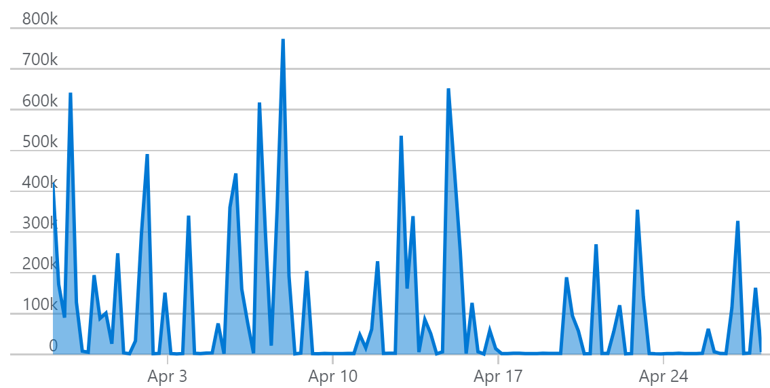
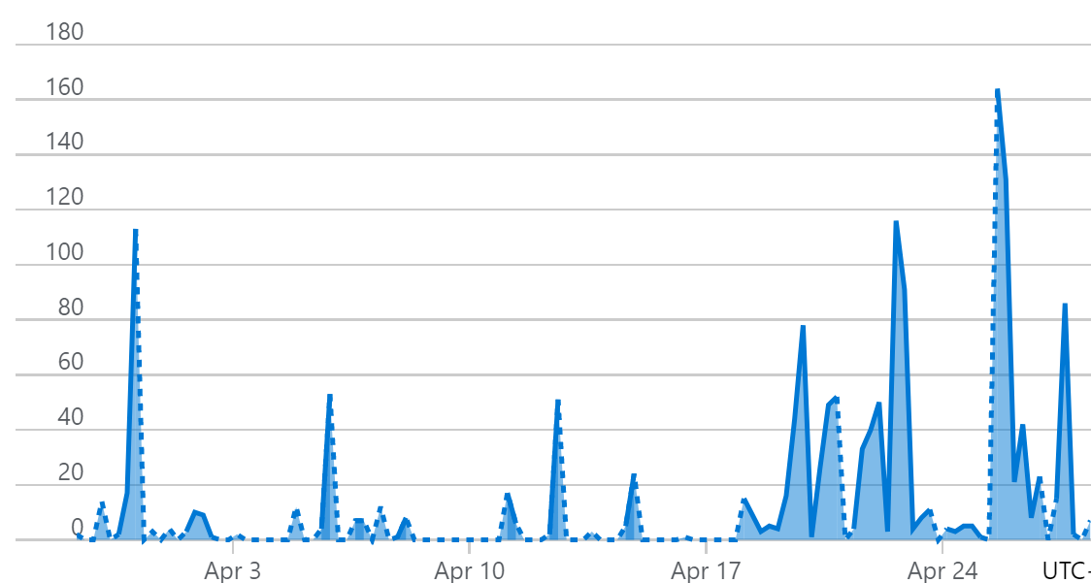
Coyote Usage
Downloads 1.1M

Slide 44
Developer Feedback
“Code coverage data in the range of 85% to 90%, unheard-of for large components”
“Found several potential issues early that would have been very expensive to fix later”
“The ability to precisely control and explore the non-determinism and emit reproducible traces is beyond amazing”
“Coyote improved our development cycle massively. […] want to develop all new features in Coyote. Compared to another team in our skip’s org, we are so much more productive because of Coyote”

Slide 45
Much remains to be done
Concurrent systems are more important than ever before
Emphasis on correctness continues to increase
  outages cause extreme distress
  regulations regarding data privacy and data loss
  emphasis on open and therefore interacting systems
Abstractions and tools are unable to keep pace with the complexity
  continue to be geared towards established sequential paradigms

Slide 46
Big challenges
How do we make modeling and specifying as natural as programming?
How do we enable co-development of models, specifications, and programs?

Slide 47
A few concrete directions
Revisit timed systems with the lens of context-bounded analysis
  bounds on clock skew relevant for both embedded and distributed systems
Revisit verification of system-level hardware (aka distributed-system-on-a-chip)
Construction of verified concurrent and distributed systems
  leverage sequentialization for proof debugging
Modeling and analysis of GPU kernels

Slide 48
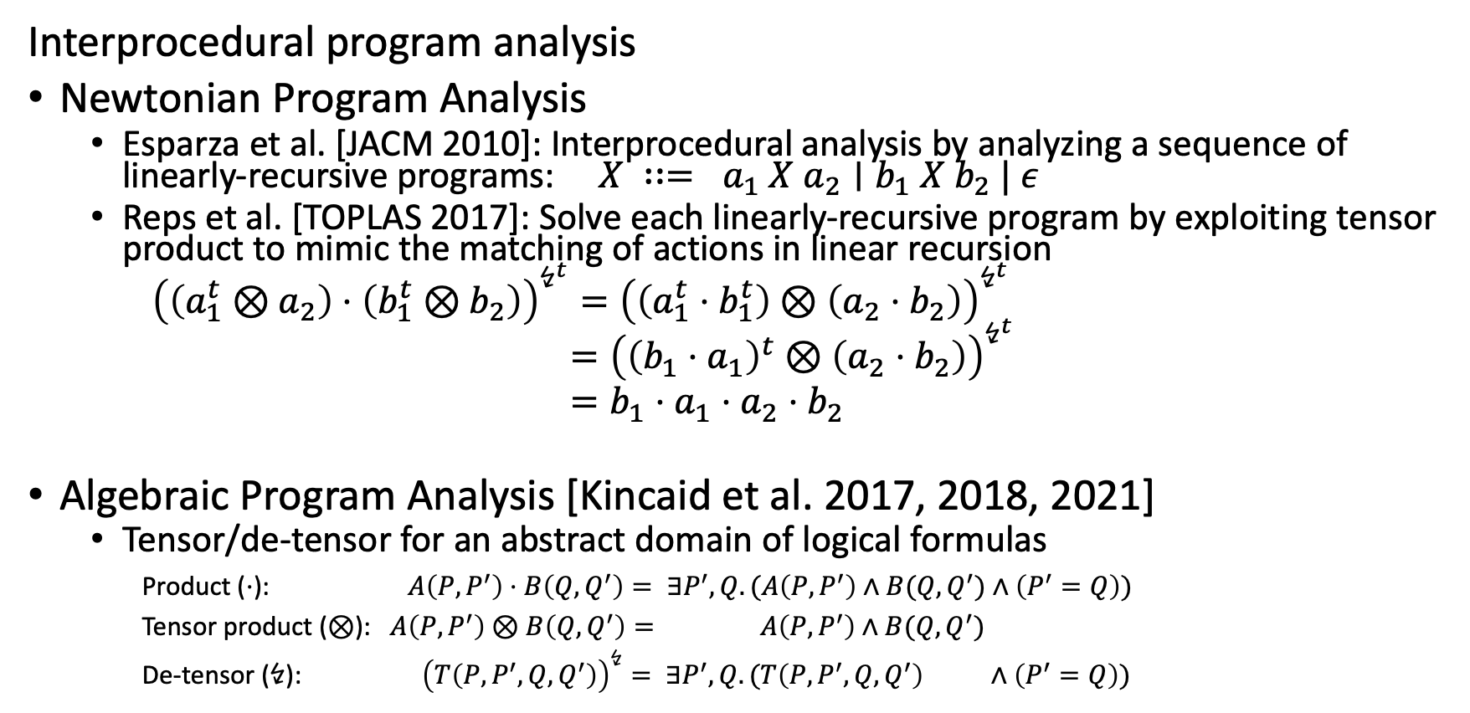
Subsequent Uses of Tensor Product
Interprocedural program analysis
Newtonian Program Analysis
  Esparza et al. [JACM 2010]: Interprocedural analysis by analyzing a sequence of linearly-recursive programs: $X ∷= a_{1} X a_{2}∣b_{1} X b_{2} | ε$
  Reps et al. [TOPLAS 2017]: Solve each linearly-recursive program by exploiting tensor product to mimic the matching of actions in linear recursion
  ${\left(\left(a_{1}^{t}⊗a_{2}\right)⋅\left(b_{1}^{t}⊗b_{2}\right)\right)}^{↯^{t}}={\left(\left(a_{1}^{t}⋅b_{1}^{t}\right)⊗\left(a_{2}⋅b_{2}\right)\right)}^{↯^{t}}$
  $={\left({\left(b_{1}⋅a_{1}\right)}^{t}⊗\left(a_{2}⋅b_{2}\right)\right)}^{↯^{t}}$
  $=b_{1}⋅a_{1}⋅a_{2}⋅b_{2}$
Algebraic Program Analysis [Kincaid et al. 2017, 2018, 2021]
  Tensor/de-tensor for an abstract domain of logical formulas
Product ($⋅$): $A\left(P,P^{′}\right)⋅B\left(Q,Q^{′}\right)= ∃P^{′},Q. (A\left(P,P^{′}\right)∧B(Q,Q^{′})∧\left(P^{′}=Q\right))$
Tensor product ($⊗$): $A\left(P,P^{′}\right)⊗B\left(Q,Q^{′}\right)= A\left(P,P^{′}\right)∧B(Q,Q^{′})$
De-tensor ($↯$): ${\left(T\left(P,P^{′},Q,Q^{′}\right)\right)}^{↯}= ∃P^{′},Q. (T\left(P,P^{′},Q,Q^{′}\right) ∧\left(P^{′}=Q\right))$
Notes:
<For later in the talk in some part about follow-on uses of the ideas>

