Slide 1

A New Abstraction Framework for Affine Transformers
Tushar Sharma and Thomas Reps
SAS’17

Slide 2
Motivations
Prove Program Assertions
Function and loop summaries
Sound with respect to bitvectors

Slide 3
Affine Transformers Abstraction (ATA)
  Affine Transformer Abstraction Framework: ATA[B]
  Family of abstract domains
  Parametrized over a base domain ‘B’ for bitvectors
ATA[B]
B
Repurposing
Abstraction over points
Abstraction over affine transformers
Notes:
Pictorially display this.

Slide 4
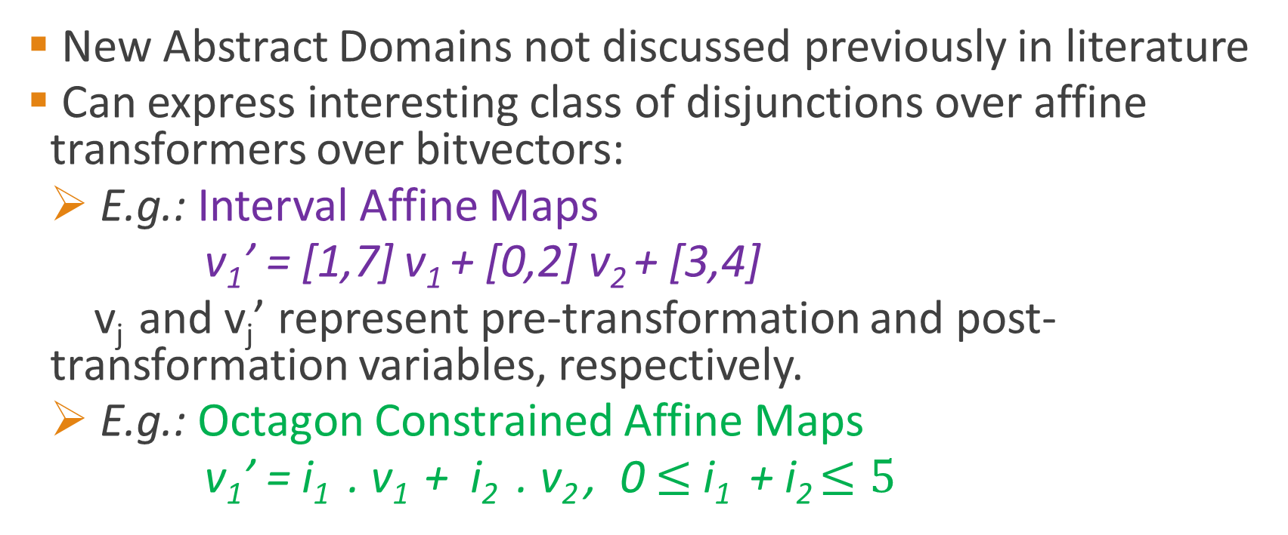
Affine Transformers Abstraction (ATA)
  New Abstract Domains not discussed previously in literature
  Can express interesting class of disjunctions over affine transformers over bitvectors:
    E.g.: Interval Affine Maps
    v₁’ = [1,7] v₁ + [0,2] v₂ + [3,4]
    v_{j} and v_{j}’ represent pre-transformation and post-transformation variables, respectively.
    E.g.: Octagon Constrained Affine Maps
    v₁’ = i₁ . v₁ + i₂ . v₂ , 0 $≤$i₁ + i₂ $≤5$

Slide 5
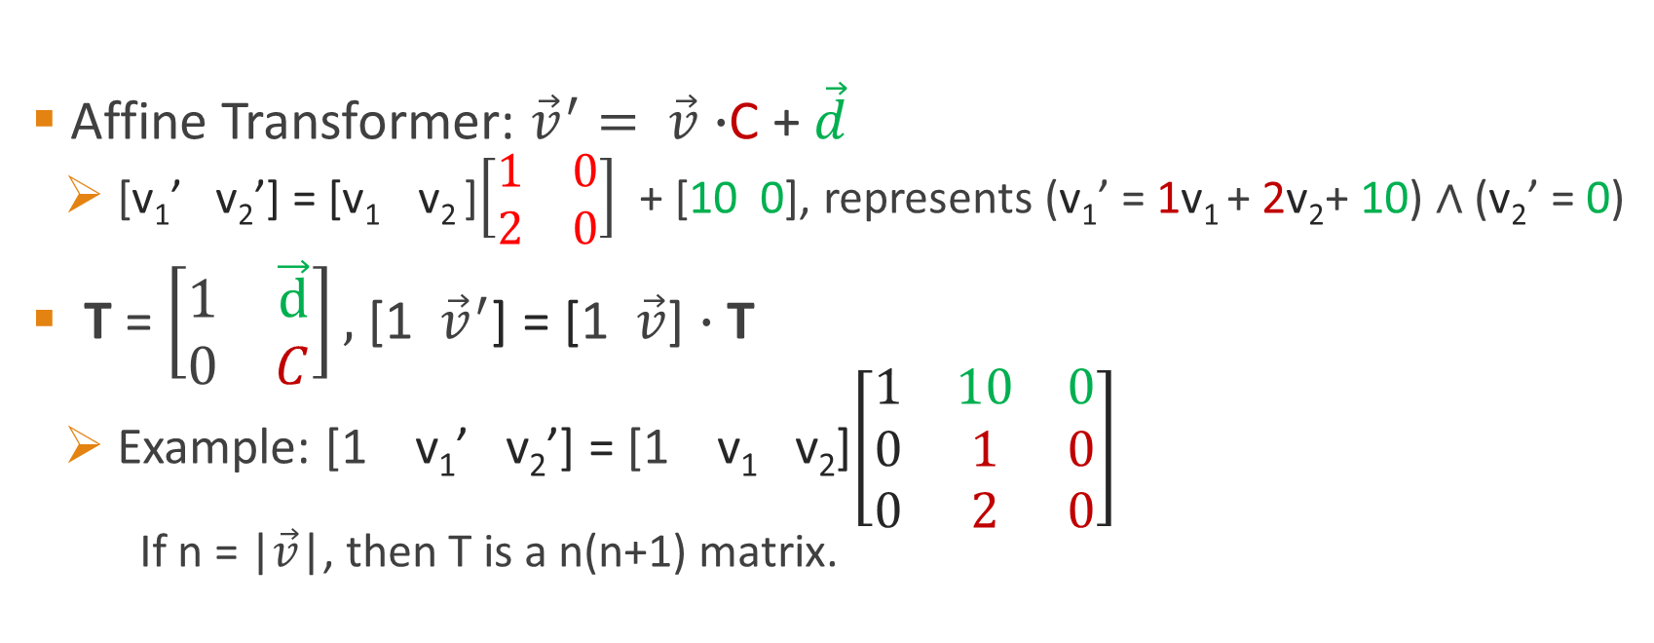
Affine Transformer
Affine Transformer: ${\vec{v}}^{′}= \vec{v}∙$C + $\vec{d}$
  [v₁’ v₂’] = [v₁ v₂ ]$\left[\begin{matrix}1 & 0 \\ 2 & 0\end{matrix}\right]$ + [10 0], represents (v₁’ = 1v₁ + 2v₂+ 10) $∧$ (v₂’ = 0)
T = $\left[\begin{matrix}1 & \vec{d} \\ 0 & C\end{matrix}\right],$[1 ${\vec{v}}^{′}$] = [1 $\vec{v}$] $∙$ T
  Example: [1 v₁’ v₂’] = [1 v₁ v₂]$\left[\begin{matrix}1 & 10 & 0 \\ 0 & 1 & 0 \\ 0 & 2 & 0\end{matrix}\right]$
  If n = |$\vec{v}$|, then T is a n(n+1) matrix.
All variables and coefficients are equal-width bitvectors (8,16,32,64)

Slide 6
Background: Abstract Interpretation
Program
Abstract Domain + Abstract Semantics
Abstraction
Fixpoint Analysis
Program Invariants

Slide 7

Background: Abstract Interpretation
Simple example program with Parity Domain.
L0
{v: even}
Abstraction at
each node.
L0: v=v+1
L1: while(*) {
L2: v=v+2
}
L3: if(v%2==0) {
L4: v=v+1
}
L5: print(1/v) // assert(v!=0)
L1
{v: odd}
L2
{v: odd}
L3
{v: odd}
L4
{v: $⊥$}
L5
{v: odd}

Slide 8
Background: Abstract Interpretation
Program
Abstraction at
each node.
Abstraction at
each edge.
Abstract Domain + Abstract Semantics
Abstraction
(Abstract Transformers)
Fixpoint Analysis
Program Invariants

Slide 9
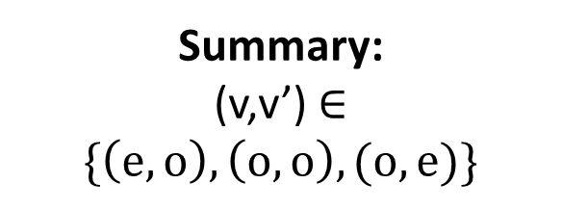

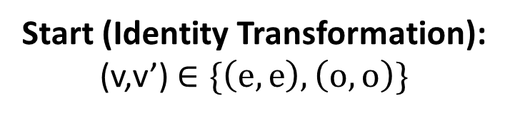

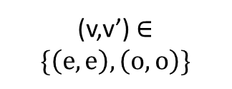




Abstraction at each edge
L0
Start (Identity Transformation): (v,v’)$∈\{\left(e,e\right),\left(o,o\right)\}$
L0: v=v+1
L1: while(*) {
L2: v=v+2
}
L3: if(v%2==0) {
L4: v=v+1
}
L5: print(1/v)
(v,v’) $∈\{\left(e,o\right),\left(o,e\right)\}$
L1
(v,v’)$∈\{\left(e,e\right),\left(o,o\right)\}$
(v,v’) $∈\{\left(e,e\right),\left(o,o\right)\}$
L2
(v,v’)$∈\{\left(e,e\right),\left(o,o\right)\}$
L3
Summary:
(v,v’)$∈\{\left(e,o\right),\left(o,o\right),(o,e)\}$
(v,v’)$∈\{\left(e,e\right)\}$
(v,v’) $∈\{\left(o,o\right)\}$
L4
(v,v’) $∈\{\left(e,o\right),\left(e,o\right)\}$
L5

Slide 10
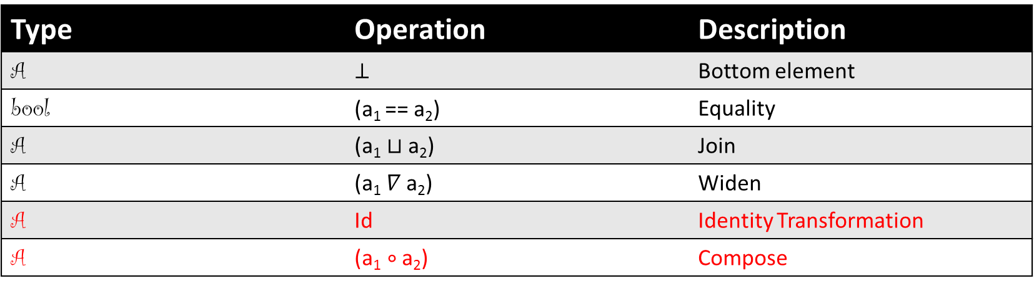
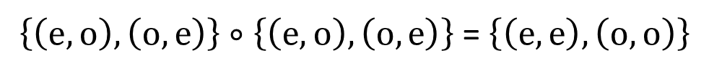
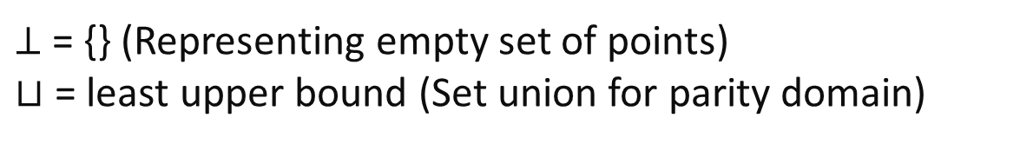
Background: Abstract Transformers
Type | Operation | Description
A | $$⊥$$ | Bottom element
bool | $$\text{(}\text{a}\text{1 }\text{== }\text{a}\text{2}\text{)}$$ | Equality
A | (a₁ $⊔$a₂) | Join
A | (a₁ $∇$a₂) | Widen
A | Id | Identity Transformation
A | (a₁$∘$a₂) | Compose
$⊥$ = {} (Representing empty set of points)
$⊔$ = least upper bound (Set union for parity domain)
Start (Identity Transformation): (v,v’)$∈\{\left(e,e\right),\left(o,o\right)\}$
$\left\{\left(e,o\right),\left(o,e\right)\right\}∘\left\{\left(e,o\right),\left(o,e\right)\right\}$ = $\left\{\left(e,e\right),\left(o,o\right)\right\}$

Slide 11
Background: Past Bit-Precise Equality Domains
KS
MOS
Both KS and MOS elements can be used as abstract transformers

Slide 12
KS Definition
A. King and H. Søndergaard, CAV 2008
A matrix, where each row encodes a constraint
Example:
where, v and v’ are 32-bit values.
In other words, (v-v’) is even.
=
2³¹ -2³¹ 0
v
v’
1
0

Slide 13
MOS Definition
M. Muller-Ohm and H. Seidl: Set of affine transformers
A set of matrices, every affine combination those matrices may transform the initial state
Example:
means,
v’= v+2p for some bitvector p.
In other words, (v-v’) is even.
M₁
M₂
,
1 0
0 1
1 2
0 1
M
Ǝi:
=
1 2p
0 1
1 v’
1 v

Slide 14
Bit-Vector Equality Domains
KS:
  Conjunction of affine constraints
  Affine-closed set
MOS:
  Affine-closed set of affine transformers

Slide 15
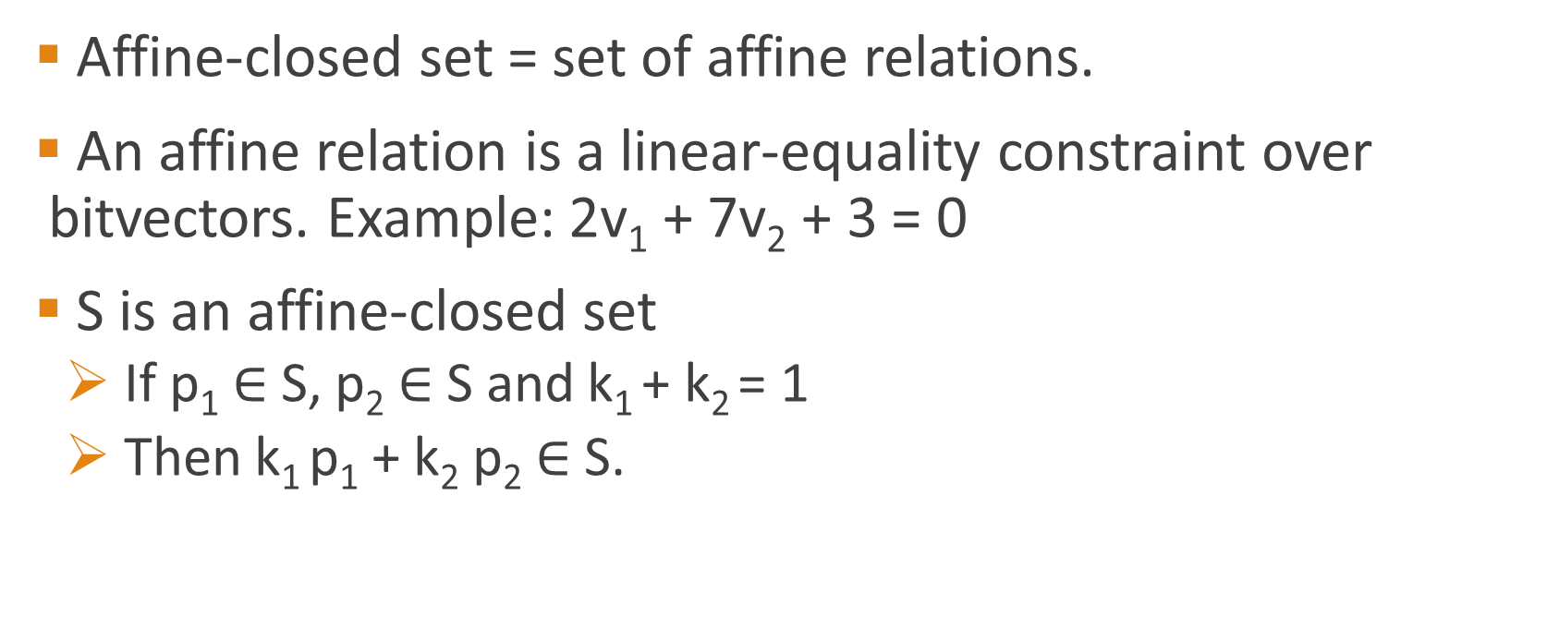
Affine-Closed Set
Affine-closed set = set of affine relations.
An affine relation is a linear-equality constraint over bitvectors. Example: 2v₁ + 7v₂ + 3 = 0
S is an affine-closed set
  If p₁$∈$ S, p₂$∈$ S and k₁ + k₂ = 1
  Then k₁ p₁ + k₂ p₂$∈$ S.

Slide 16
KS versus MOS
Incomparable
KS can represent pre-condition guard, but MOS cannot:
  v = 2
  MOS cannot express v=2: no affine transformer exists
=
1 0 -2
v
v’
1
0

Slide 17
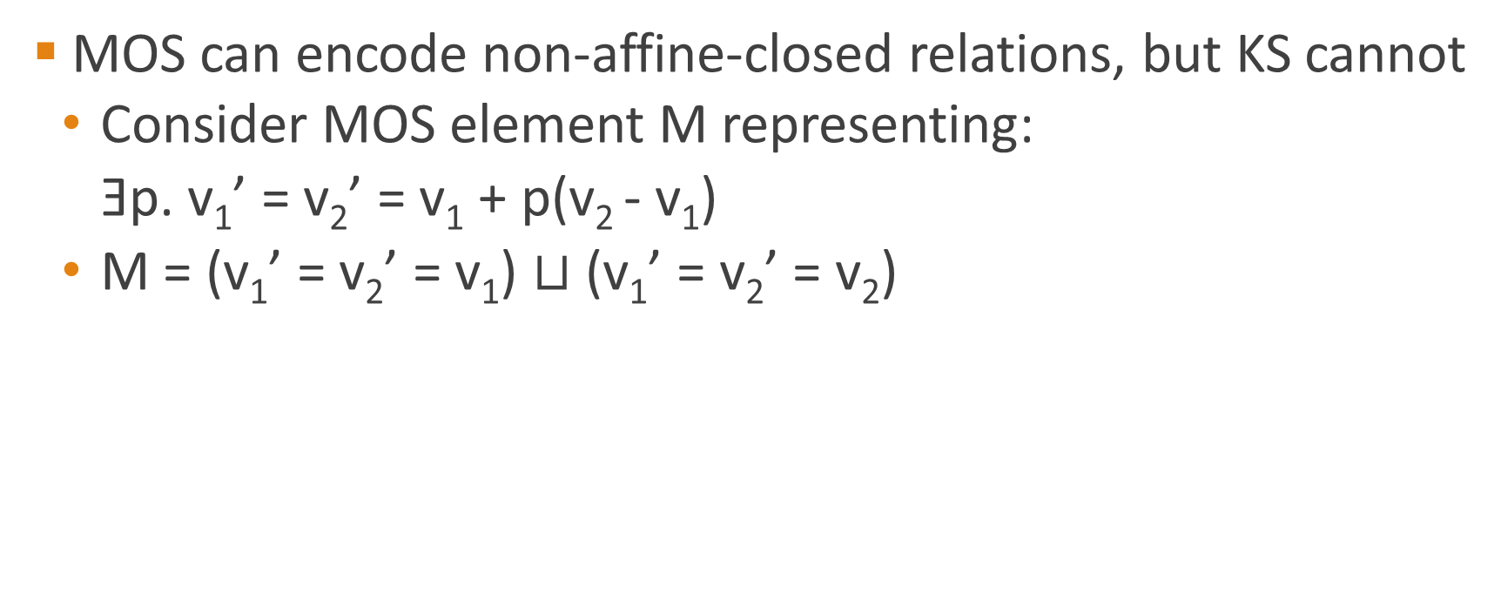
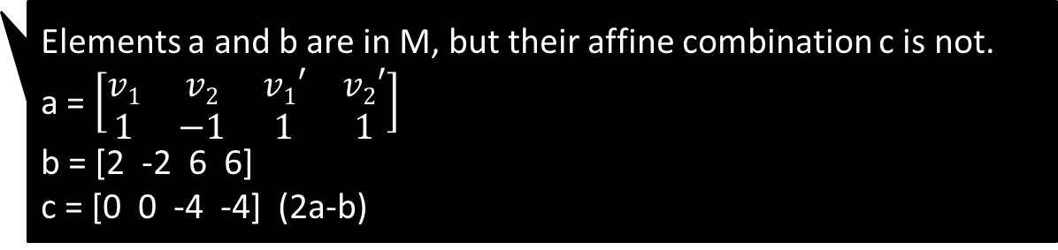
KS versus MOS
MOS can encode non-affine-closed relations, but KS cannot
  Consider MOS element M representing:
  Ǝp. v₁’ = v₂’ = v₁ + p(v₂ - v₁)
  M = (v₁’ = v₂’ = v₁) $⊔$(v₁’ = v₂’ = v₂)
Elements a and b are in M, but their affine combination c is not.
a = $\left[\begin{matrix}v1 & v2 & v1′ & v2′ \\ 1 & −1 & 1 & 1\end{matrix}\right]$
b = [2 -2 6 6]
c = [0 0 -4 -4] (2a-b)

Slide 18

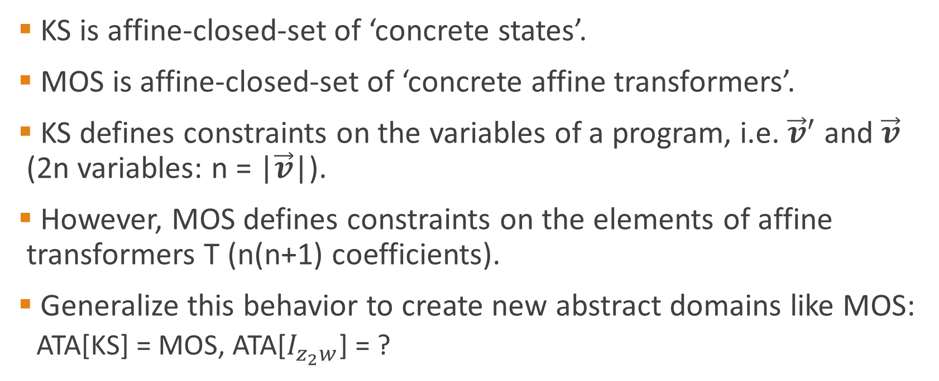
Why are KS and MOS incomparable?
KS is affine-closed-set of ‘concrete states’.
MOS is affine-closed-set of ‘concrete affine transformers’.
KS defines constraints on the variables of a program, i.e. ${\vec{v}}^{′}$ and $\vec{v}$ (2n variables: n = |$\vec{v}$|).
However, MOS defines constraints on the elements of affine transformers T (n(n+1) coefficients).
Generalize this behavior to create new abstract domains like MOS:
  ATA[KS] = MOS, ATA[$I_{z_{2}w}$] = ?

Slide 19
ATA Contributions
  Affine Transformer Abstraction Framework (ATA[B])
  Parameter B allows control over precision/performance tradeoff
  Provide abstract-domain operations for ATA, such as ‘Join’ and ‘Abstract Composition’
Notes:
Pictorially display this.

Slide 20
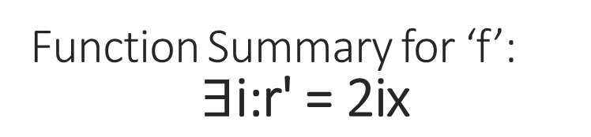
Program Analysis using ATA[KS]
ENT: int f(int x) {
L0: int i = 0, r = 0;
L1: while(i <= 10) {
L2: if(*)
L3: r = r + 2*x;
L4: i = i + 1;
}
L5: return r;
}
Function Summary for ‘f’:
$$∃\text{i}\text{:}\text{r}\text{′ = 2}\text{ix}$$
Abstract Transformers for ATA[KS]

Slide 21
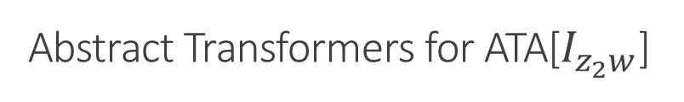
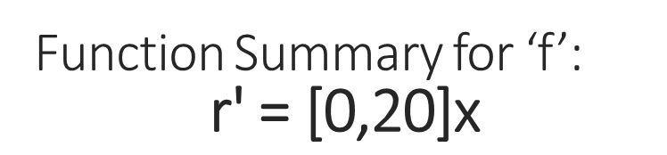

Program Analysis using ATA[$I_{z_{2}w}$]
ENT: int f(int x) {
L0: int i = 0, r = 0;
L1: while(i <= 10) {
L2: if(*)
L3: r = r + 2*x;
L4: i = i + 1;
}
L5: return r;
}
Function Summary for ‘f’:
$$\text{r}\text{′ = [0,20]}\text{x}$$
Abstract Transformers for ATA[$I_{z_{2}w}$]

Slide 22

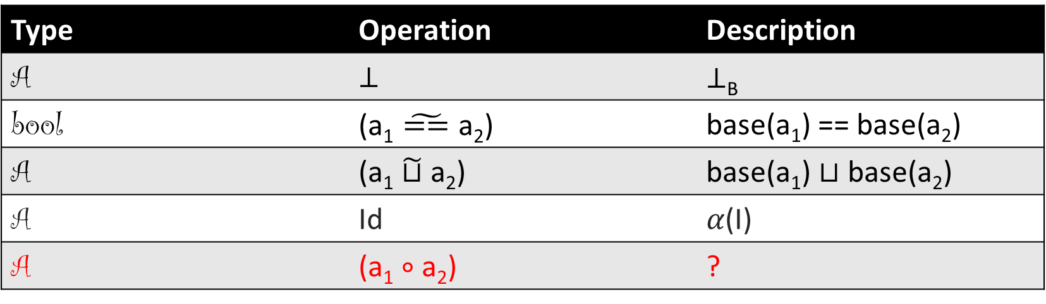
A (ATA[B]) Abstract-Domain Operations
Each element a $∈$ A contains an element base(a) $∈$ B.
Type | Operation | Description
A | $$⊥$$ | $⊥$_{B}
bool | $$\text{(}\text{a}\text{1}\tilde{==}\text{a}\text{2}\text{)}$$ | base($\text{a}\text{1}$) == base($\text{a}\text{2}$)
A | (a₁ $\tilde{⊔}$a₂) | base(a₁) $⊔$base(a₂)
A | Id | 𝛼(I)
A | (a₁$∘$a₂) | ?
[1, 1] [0, 10] [0, 0]
[0, 0] [1, 1] [0, 0]
[0, 0] [0, 0] [1, 1]
[1, 1] [5, 15] [0, 1]
[0, 0] [2, 2] [0, 0]
[0, 0] [1, 3] [1, 2]
$$\tilde{⊔}$$
[1, 1] [0, 15] [0, 1]
[0, 0] [1, 2] [0, 0]
[0, 0] [0, 3] [1, 2]
=

Slide 23

Abstract Composition
a₃ = a₂ $∘$ a₁
If affine transformer t₁ $∈$ γ(a₁) and affine transformer t₂$∈$ γ(a₂), then (t₁ $×$ t₂) $∈$ γ(a₃).
t₁ and t₂ are (n+1)$×$(n+1) matrices.

Slide 24
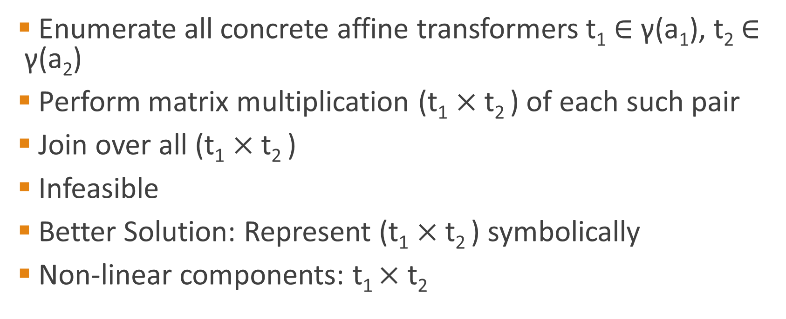
Best (but Naïve) Solution
Enumerate all concrete affine transformers t₁ $∈$ γ(a₁), t₂$∈$ γ(a₂)
Perform matrix multiplication (t₁ $×$t₂ ) of each such pair
Join over all (t₁ $×$t₂ )
Infeasible
Better Solution: Represent (t₁ $×$t₂ ) symbolically
Non-linear components: t₁ $×$ t₂

Slide 25
Abstract Composition
General Solution (Symbolic Abstraction)
Naïve Solution
Generality
Specific Solutions:
Non-Relational
Weakly-Convex Relational
Affine-Closed Relational
Performance

Slide 26
General Case
Use Symbolic Abstraction
  Employ SMT solvers to cleverly search the space of the resulting abstract composition
  Offshore solving non-linear bitvector equations to the solver

Slide 27



Abstract Composition via Symbolic Abstraction
Symbolic Representation of matrix multiplication
Uses blackbox learning over a lattice using SMT solvers.
$$φ$$
$$\hat{α}$$
$$a$$
Abstract Transformer

Slide 28



Special Case: Non-relational Base Domain
Use abstract addition and multiplication operations to perform abstract composition.
[1, 1] [0, 10] [0, 0]
[0, 0] [1, 1] [2, 3]
[0, 0] [0, 0] [1, 1]
[1, 1] [0, 0] [0, 0]
[0, 0] [2, 4] [0, 0]
[0, 0] [1, 3] [1, 2]
$∘$
$=$
[1, 1] [0, 10] .# [2,4] [0, 0]
[0, 0] ([1, 1] .# [2, 4]) +# ([2,3] .# [1, 3]) [2,3] .# [1, 2] [0, 0] [1,1] .# [1, 3] [1, 1] .# [1, 2]
[1, 1] [0, 40] [0, 0]
[0, 0] [4, 13] [2, 6]
[0, 0] [1, 3] [1, 2]
$=$
Notes:
Add a callout to explain one entry.

Slide 29

Examples of Non-relational base domains
Small sets (SS_{n}): All sets with maximum cardinality n
Intervals ($I_{z_{2}w}$): [a,b] = {a, a+1, a+2, …, b}
Strided Intervals (S$I_{z_{2}w}$): s[a,b] = {a, a+s, a+2s, …, b}

Slide 30
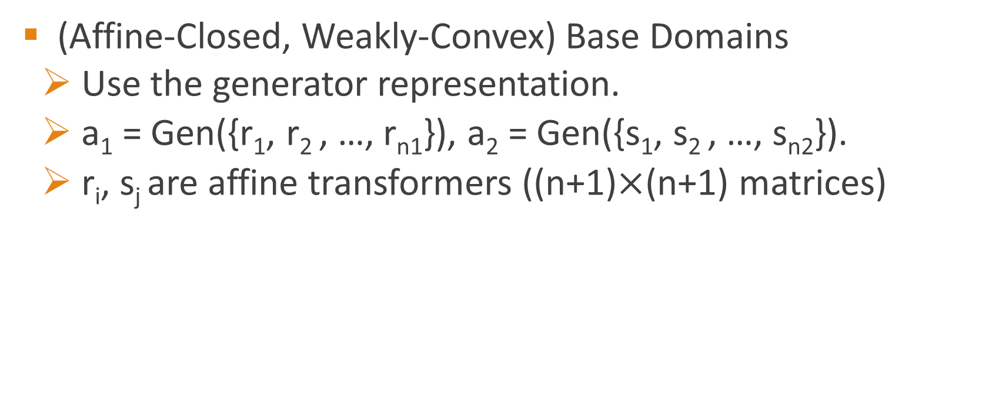
Special Cases of Relational base domains
(Affine-Closed, Weakly-Convex) Base Domains
  Use the generator representation.
  a₁ = Gen({r₁, r₂ , …, r_{n1}}), a₂ = Gen({s₁, s₂ , …, s_{n2}}).
  r_{i}, s_{j} are affine transformers ((n+1)$×$(n+1) matrices)
r₂
r₃
s₂
a₁
r₁
a₂
r₄
s₁
s₃
r₆
r₅

Slide 31






Special Cases of Relational base domains
Matrix multiplication over generators is sufficient (no SMT calls).
  a₃ = Gen({r₁ $×$ s₁ , …, r₁ $×$ s_{n2}, r₂ $×$ s₁ , …, r_{n1} $×$ s_{n2} })
…
…
r₁ $×$ s₂
a₃ = a₂ $∘$ a₁
r₃ $×$ s₂
r₁ $×$ s₁
…
…
r₆ $×$ s₃

Slide 32
Examples of base relational domains
  KS Domain: Affine Relations
  Bit-Vector Sound versions of
    Polyhedra
    Octagons

Slide 33
Discussion: No Greatest Lower bound in ATA[B]
The “best” affine transformer abstracting any single point does not exist.
v’
v’ = v
(0,0)
v
v’ = -v

Slide 34
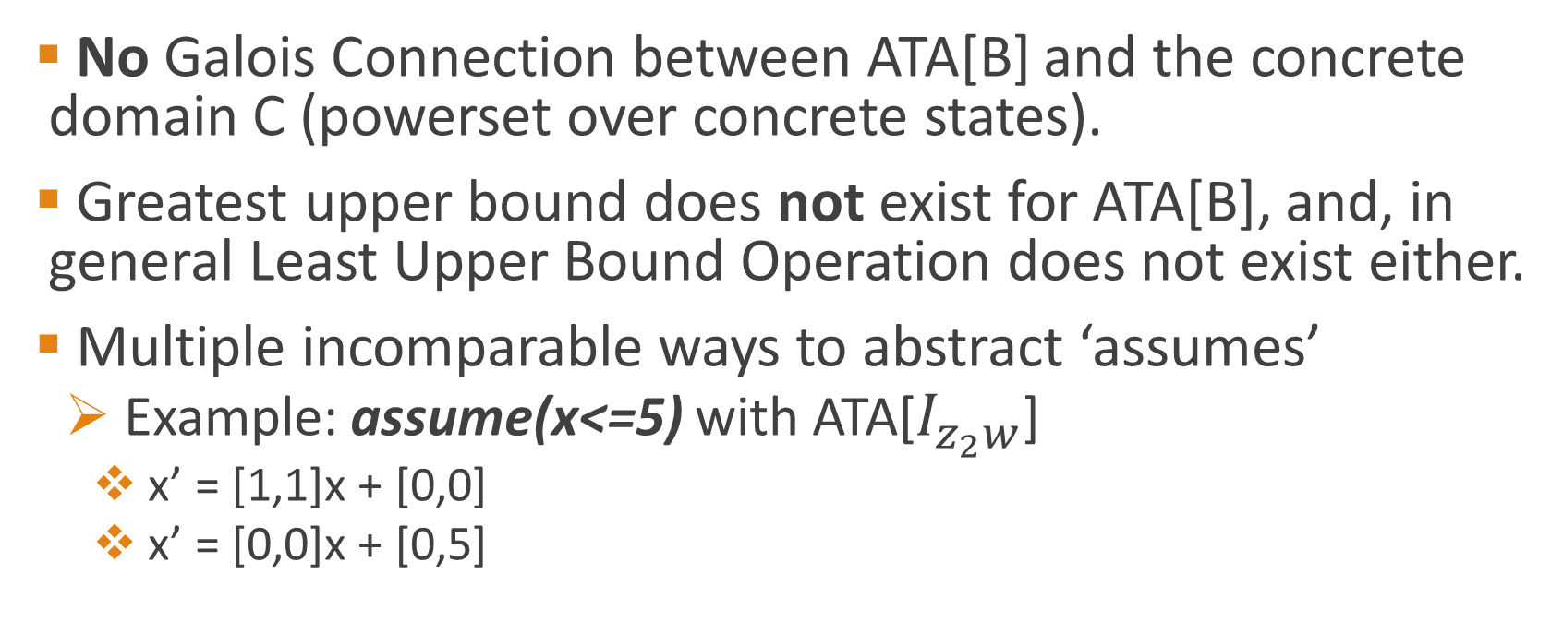
Discussion
No Galois Connection between ATA[B] and the concrete domain C (powerset over concrete states).
Greatest upper bound does not exist for ATA[B], and, in general Least Upper Bound Operation does not exist either.
Multiple incomparable ways to abstract ‘assumes’
  Example: assume(x<=5) with ATA[$I_{z_{2}w}$]
    x’ = [1,1]x + [0,0]
    x’ = [0,0]x + [0,5]

Slide 35
Recap
Introduced a generic framework of abstract domains: ATA[B].
Parameter B allows control over precision/performance tradeoff.
B and ATA[B] are, in general, incomparable.
Fast abstract composition for some classes of B:
  Non-relational Domains
  Affine-closed or Weakly Convex Relational Domains
ATA framework can be extended to integers and rationals as well.

Slide 36
Questions?
  Affine Transformer Abstraction Framework: ATA[B]
  Family of abstract domains
  Parametrized over a base domain ‘B’ for bitvectors
ATA[B]
B
Repurposing
Abstraction over points
Abstraction over affine transformers
Notes:
Pictorially display this.

