Slide 1
Scalable Quantitative Reasoning about Quantum Circuits
Nengkun Yu (SBU), Jens Palsberg (UCLA), Thomas Reps (UW)

Slide 2
Quantum Computational Advantage
Faster algorithms
Shor’s factoring algorithm
Grover search algorithm
quantum simulation algorithm
Secure computation and communication
Quantum key distribution
Quantum multipartite computation

Slide 3
Quantum Computation Models
Quantum Circuit Model—most widely studied
Quantum Turing Machine
One-way quantum computation
…

Slide 4
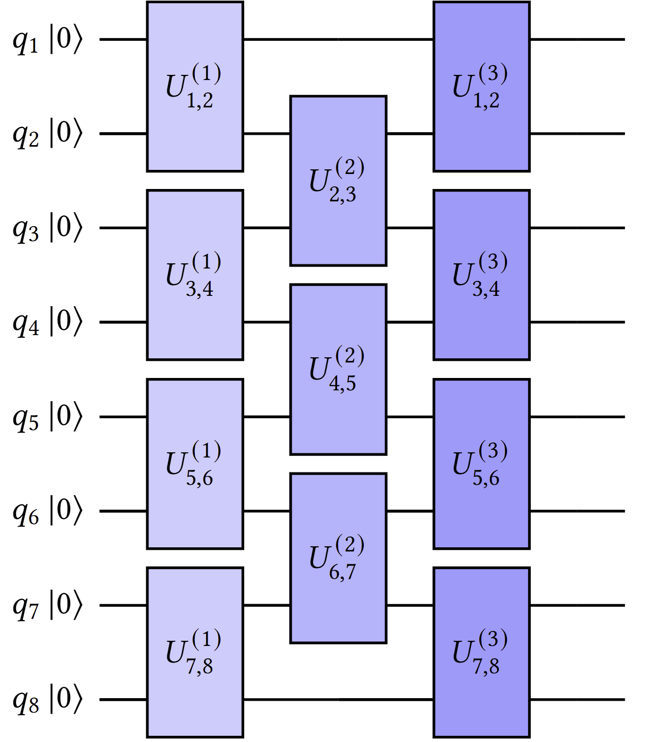
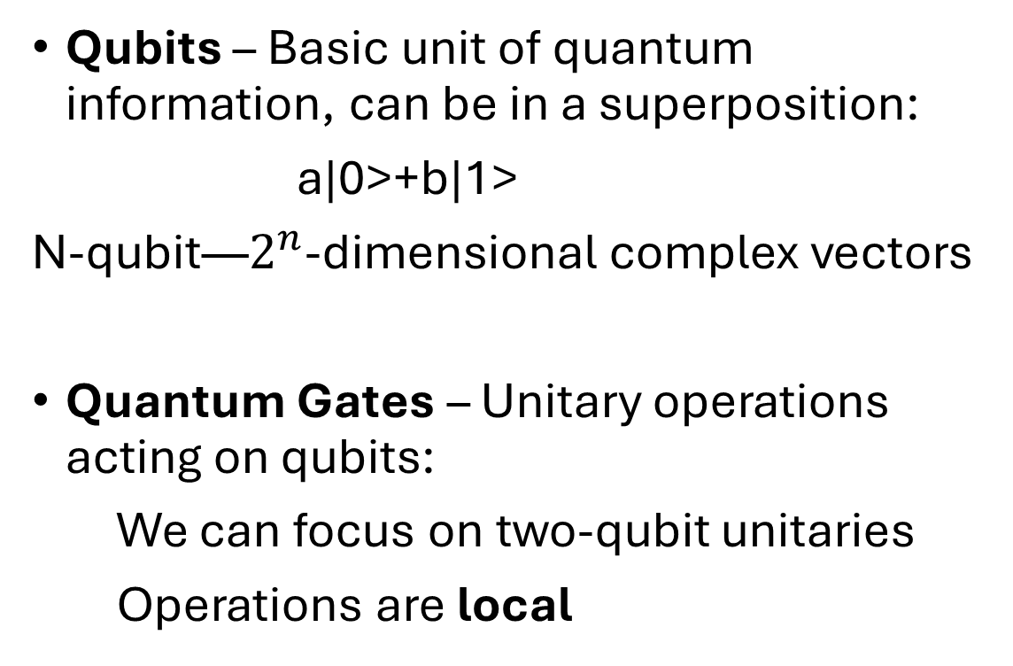
We Focus on the Circuit Model
Qubits – Basic unit of quantum information, can be in a superposition:
a|0>+b|1>
N-qubit—$2^{n}$-dimensional complex vectors
Quantum Gates – Unitary operations acting on qubits:
We can focus on two-qubit unitaries
Operations are local

Slide 5
Verification: Understand Quantum Algorithms
Hard to simulate on a classical computer
- quantum computing has an advantage: If simulatable, then no advantage
Verification using classical computer is nontrivial
Necessity of Verification:
for quantum software correctness and new algorithm design

Slide 6
What do we miss here?
What do we mean by “verification”?
to say something about the output state, denoted by ϱ
What are the objects we need to verify?

Slide 7
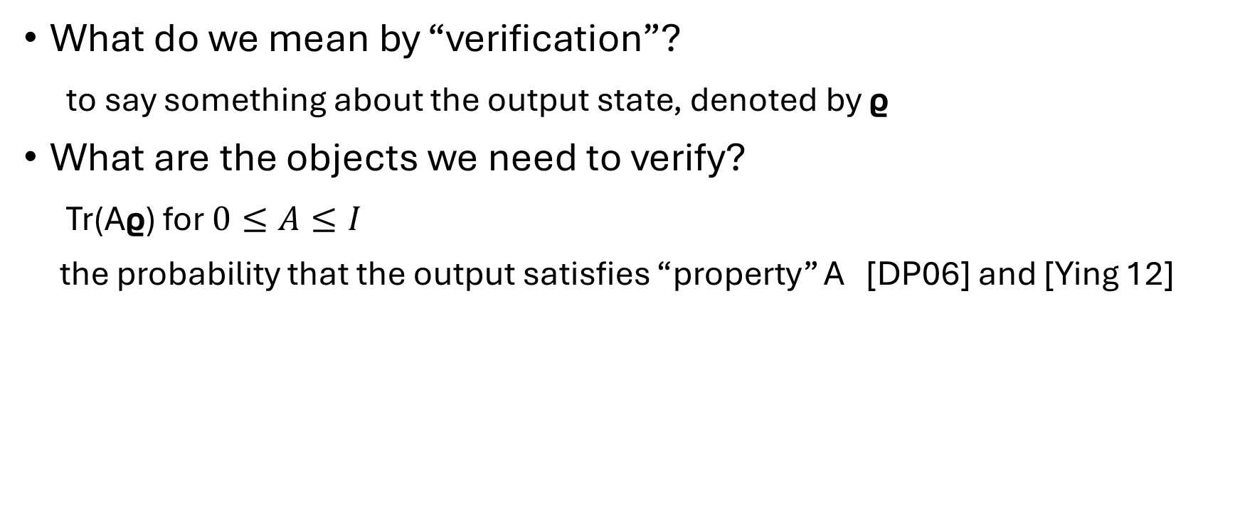
What do we miss here?
What do we mean by “verification”?
to say something about the output state, denoted by ϱ
What are the objects we need to verify?
Tr(Aϱ) for $0≤A≤I$
the probability that the output satisfies “property” A [DP06] and [Ying 12]

Slide 8

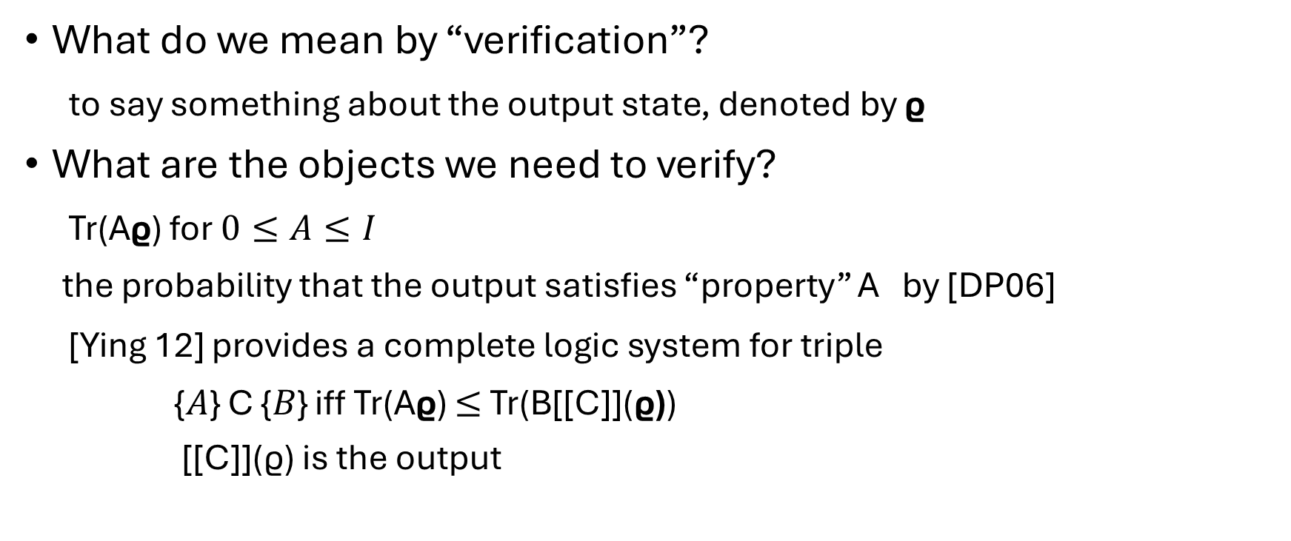
What do we miss here?
What do we mean by “verification”?
to say something about the output state, denoted by ϱ
What are the objects we need to verify?
Tr(Aϱ) for $0≤A≤I$
the probability that the output satisfies “property” A by [DP06]
[Ying 12] provides a complete logic system for triple
{𝐴} C {𝐵} iff Tr(Aϱ) $≤$ Tr(B[[C]](ϱ))
[[C]](ϱ) is the output

Slide 9
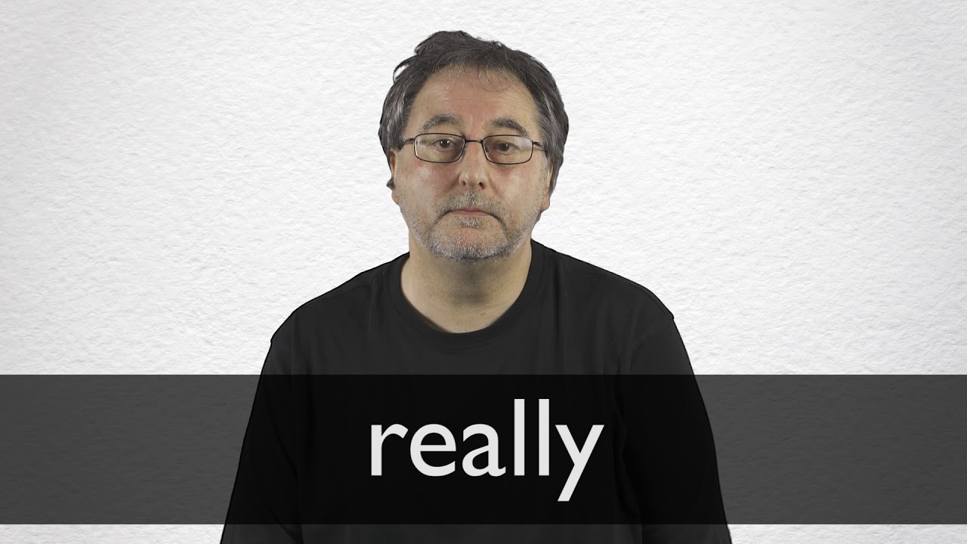
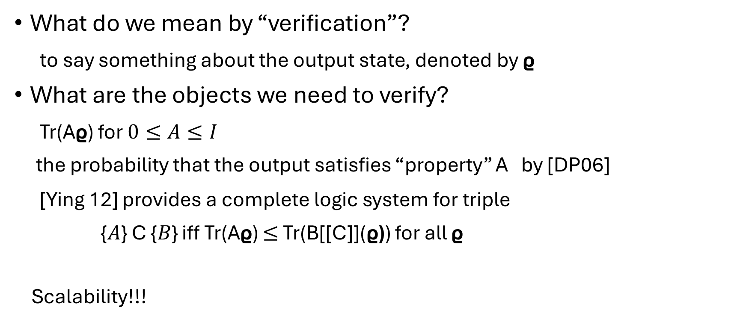
What do we miss here?
What do we mean by “verification”?
to say something about the output state, denoted by ϱ
What are the objects we need to verify?
Tr(Aϱ) for $0≤A≤I$
the probability that the output satisfies “property” A by [DP06]
[Ying 12] provides a complete logic system for triple
{𝐴} C {𝐵} iff Tr(Aϱ) $≤$ Tr(B[[C]](ϱ)) for all ϱ
Scalability!!!

Slide 10
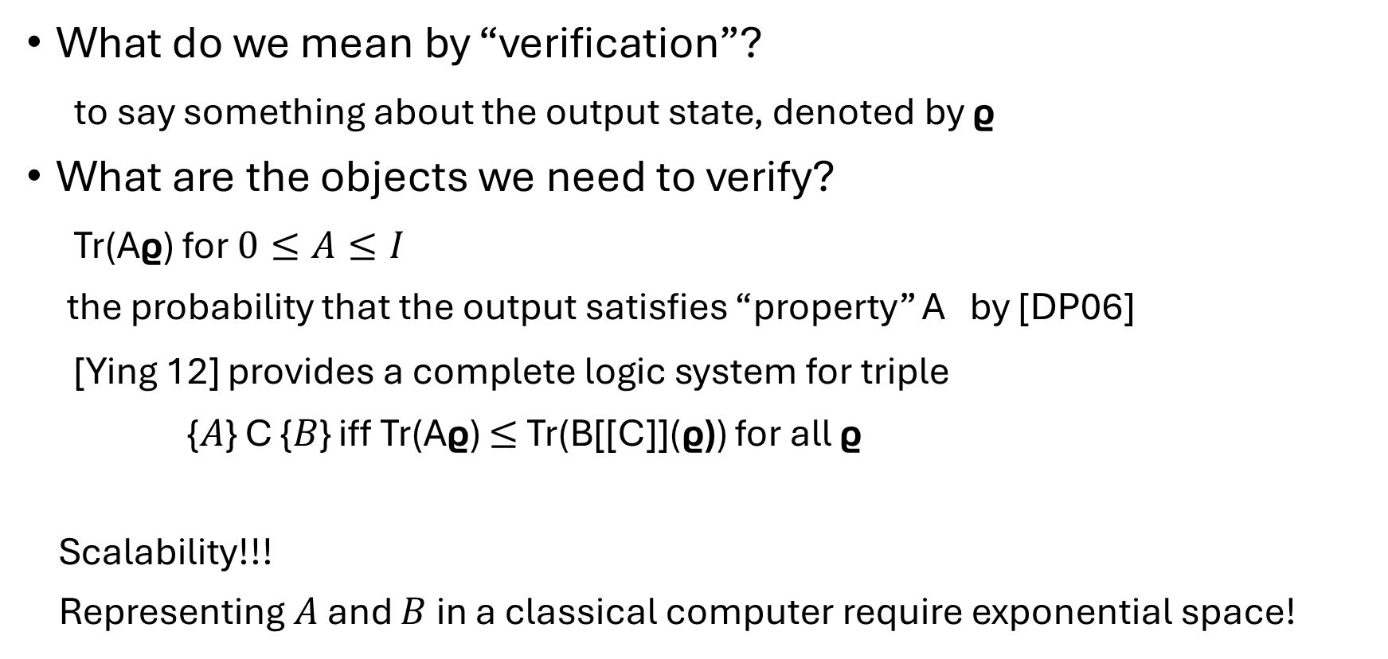
What do we miss here?
What do we mean by “verification”?
to say something about the output state, denoted by ϱ
What are the objects we need to verify?
Tr(Aϱ) for $0≤A≤I$
the probability that the output satisfies “property” A by [DP06]
[Ying 12] provides a complete logic system for triple
{𝐴} C {𝐵} iff Tr(Aϱ) $≤$ Tr(B[[C]](ϱ)) for all ϱ
Scalability!!!
Representing $A$ and $B$ in a classical computer require exponential space!

Slide 11
We miss something here!
What do we mean by “verification”?
What are the objects we need to verify?
We lack a logical foundation that supports scalable reasoning about quantum programs
Scalable: describe/prove system properties using polynomial space

Slide 12
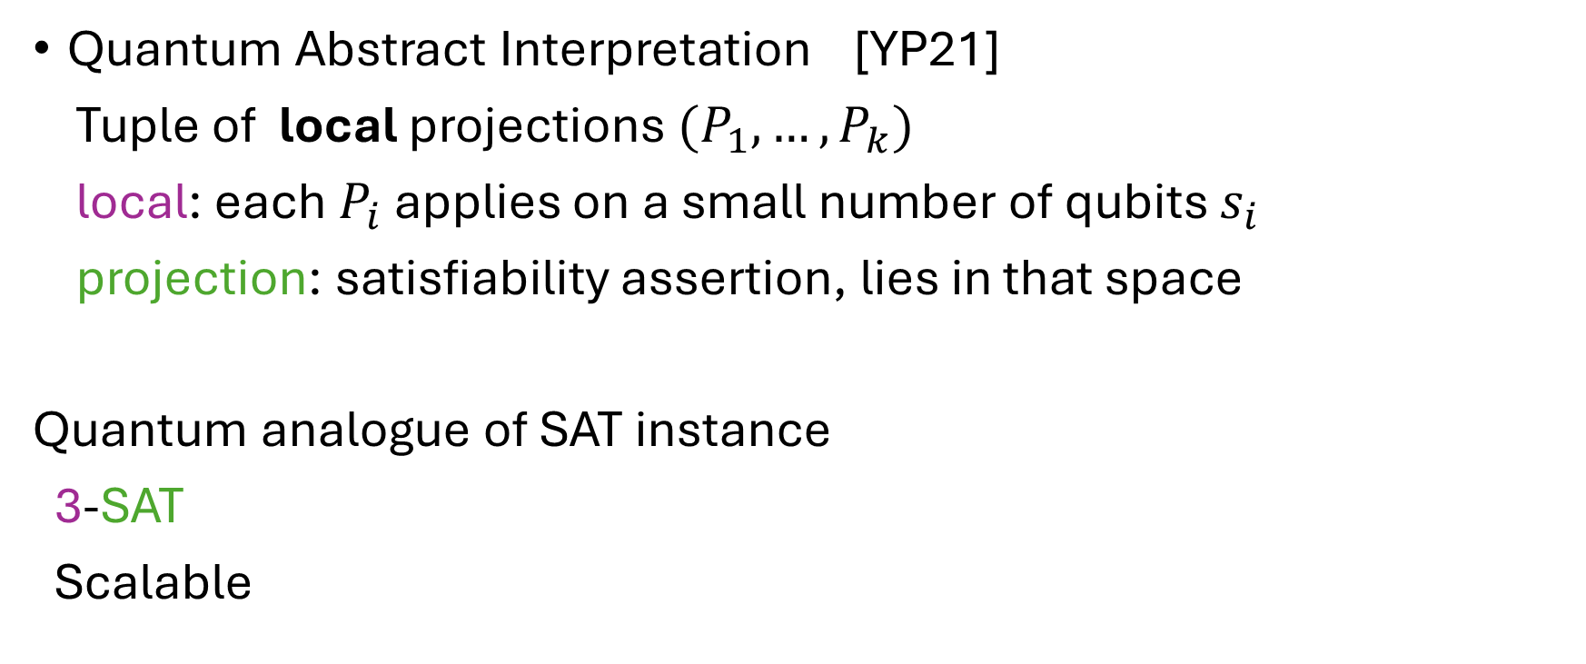
Anything scalable available already?
Quantum Abstract Interpretation [YP21]
Tuple of local projections $(P_{1},…,P_{k})$
local: each $P_{i}$ applies on a small number of qubits $s_{i}$
projection: satisfiability assertion, lies in that space
Quantum analogue of SAT instance
3-SAT
Scalable

Slide 13
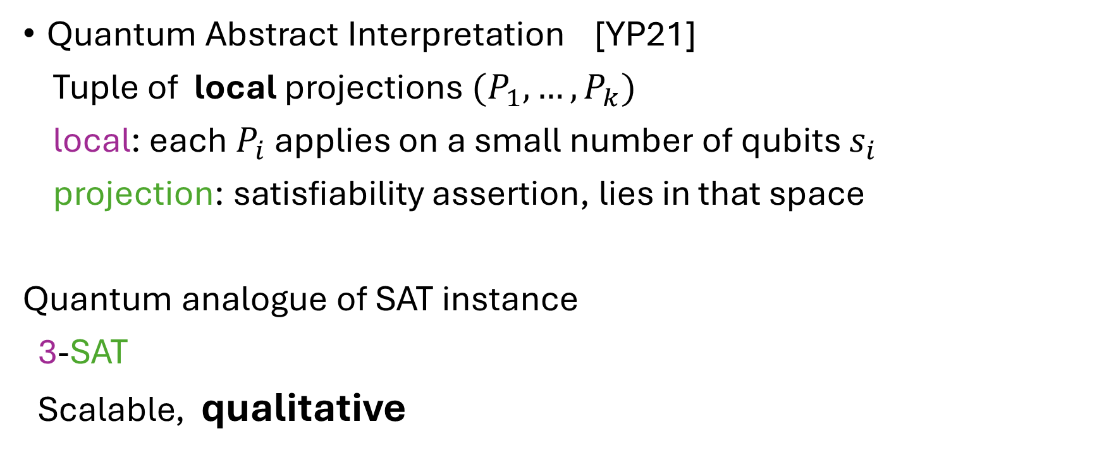
Anything scalable available already?
Quantum Abstract Interpretation [YP21]
Tuple of local projections $(P_{1},…,P_{k})$
local: each $P_{i}$ applies on a small number of qubits $s_{i}$
projection: satisfiability assertion, lies in that space
Quantum analogue of SAT instance
3-SAT
Scalable, qualitative

Slide 14
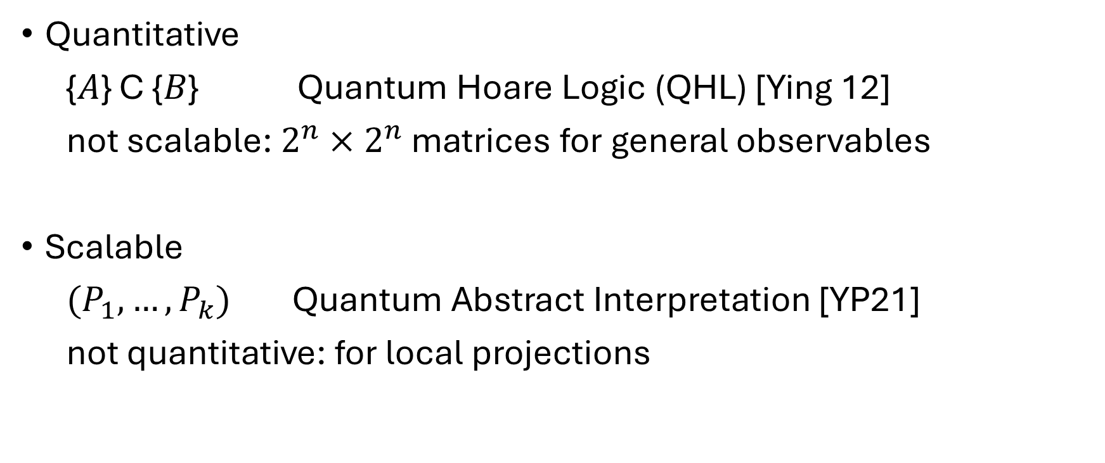
Quantitative or Scalable
Quantitative
{𝐴} C {𝐵} Quantum Hoare Logic (QHL) [Ying 12]
not scalable: $2^{n}×2^{n}$ matrices for general observables
Scalable
$(P_{1},…,P_{k})$ Quantum Abstract Interpretation [YP21]
not quantitative: for local projections

Slide 15
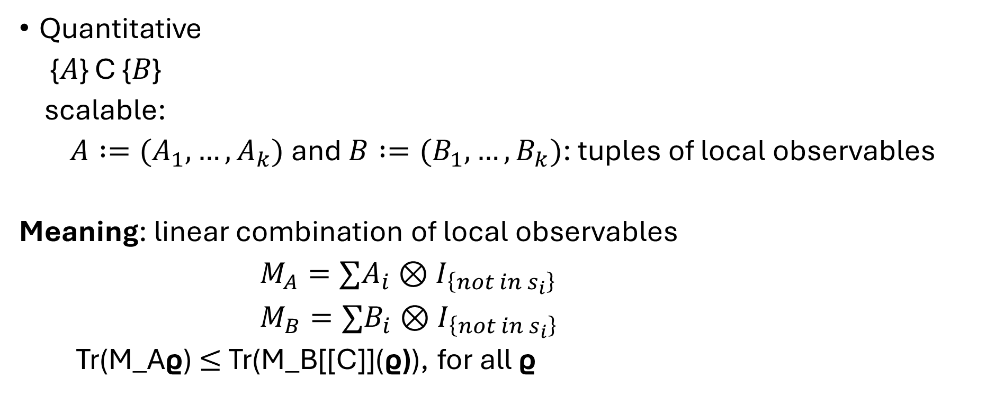
Quantitative and Scalable
Quantitative
{𝐴} C {𝐵}
scalable:
$A :=(A_{1},…,A_{k})$and $B :=(B_{1},…,B_{k})$: tuples of local observables
Meaning: linear combination of local observables
$M_{A}=∑A_{i}⊗I_{\left\{not in s_{i}\right\}}$
$M_{B}=∑B_{i}⊗I_{\left\{not in s_{i}\right\}}$
Tr(M_Aϱ) $≤$ Tr(M_B[[C]](ϱ)), for all ϱ

Slide 16
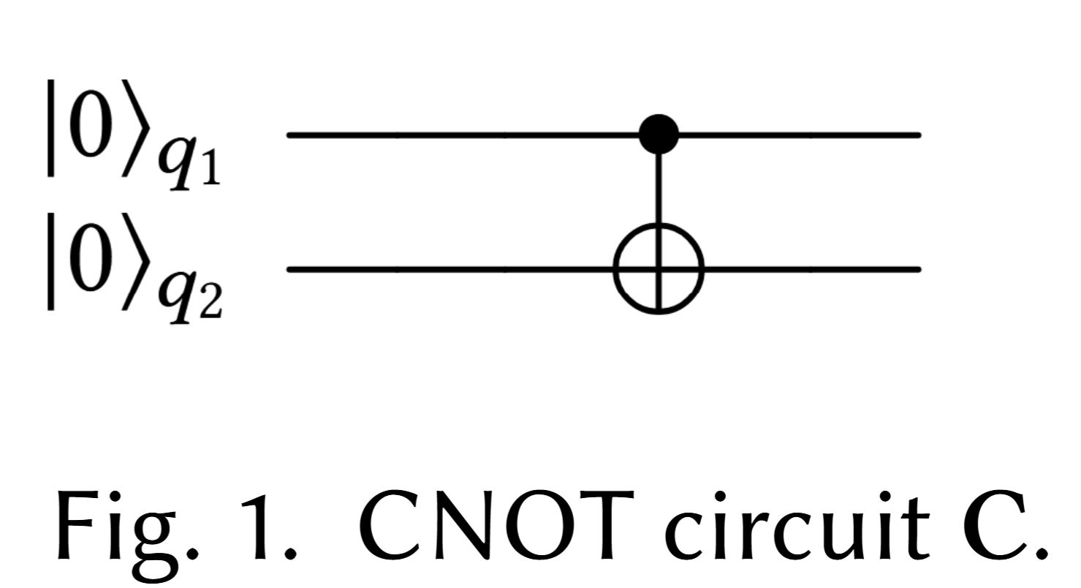
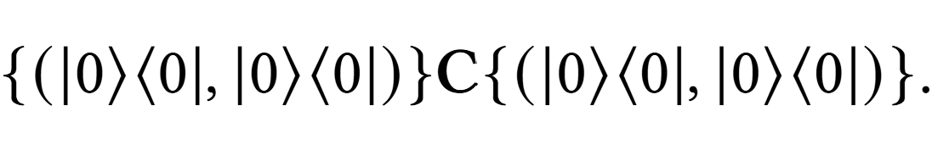
Quantitative and Scalable: Good enough?
No!!!
For the circuit, the output is |00>
The previous logic formula can not even prove

Slide 17
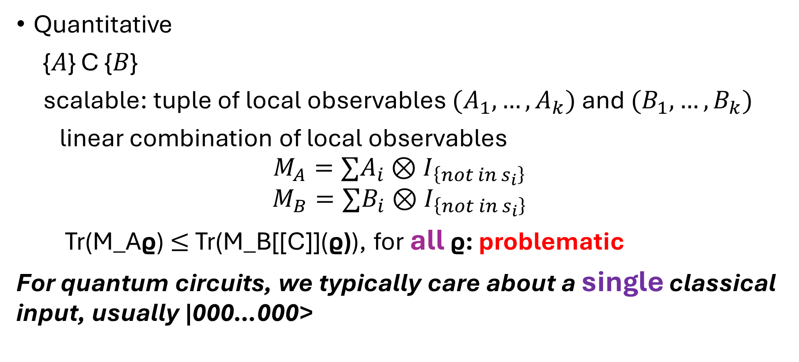
Why Not Good Enough?
Quantitative
{𝐴} C {𝐵}
scalable: tuple of local observables $(A_{1},…, A_{k})$ and $(B_{1},…,B_{k})$
linear combination of local observables
$$M_{A}=∑A_{i}⊗I_{\left\{not in s_{i}\right\}}$$
$$M_{B}=∑B_{i}⊗I_{\left\{not in s_{i}\right\}}$$
Tr(M_Aϱ) $≤$ Tr(M_B[[C]](ϱ)), for all ϱ: problematic
For quantum circuits, we typically care about a single classical input, usually |000…000>

Slide 18
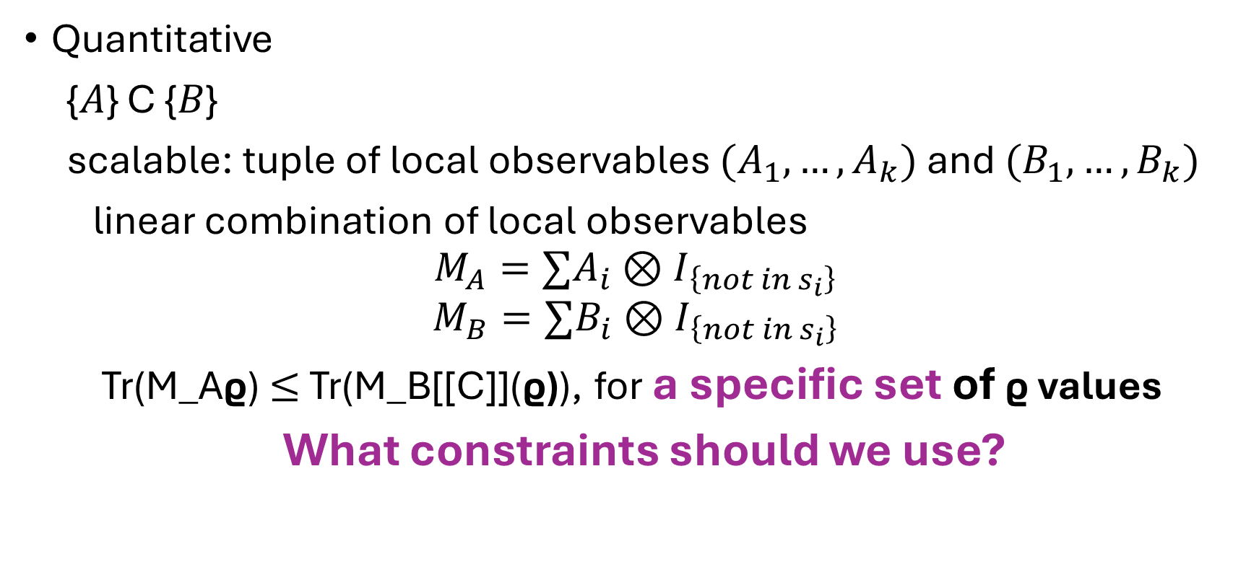
Quantitative and Scalable
Quantitative
{𝐴} C {𝐵}
scalable: tuple of local observables $(A_{1},…, A_{k})$ and $(B_{1},…,B_{k})$
linear combination of local observables
$$M_{A}=∑A_{i}⊗I_{\left\{not in s_{i}\right\}}$$
$$M_{B}=∑B_{i}⊗I_{\left\{not in s_{i}\right\}}$$
Tr(M_Aϱ) $≤$ Tr(M_B[[C]](ϱ)), for a specific set of ϱ values
What constraints should we use?

Slide 19
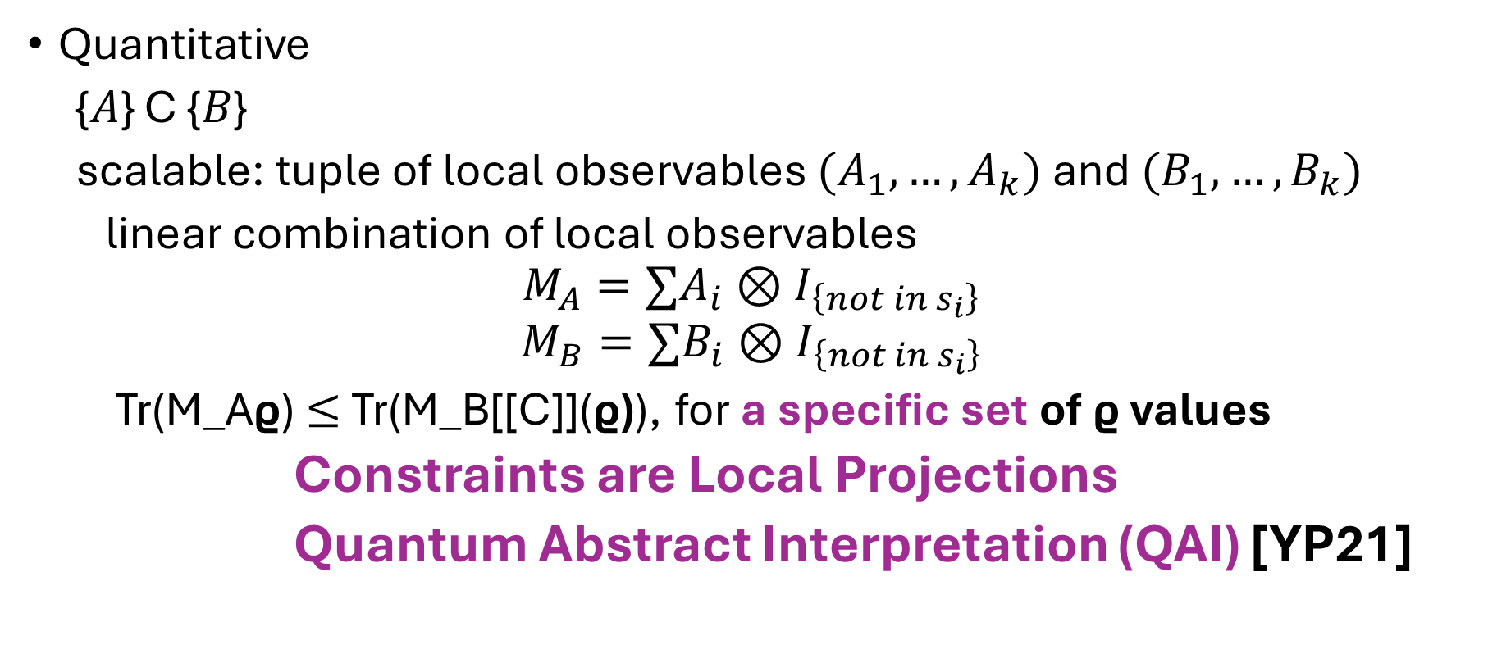
Quantitative and Scalable
Quantitative
{𝐴} C {𝐵}
scalable: tuple of local observables $(A_{1},…, A_{k})$ and $(B_{1},…,B_{k})$
linear combination of local observables
$$M_{A}=∑A_{i}⊗I_{\left\{not in s_{i}\right\}}$$
$$M_{B}=∑B_{i}⊗I_{\left\{not in s_{i}\right\}}$$
Tr(M_Aϱ) $≤$ Tr(M_B[[C]](ϱ)), for a specific set of ϱ values
Constraints are Local Projections
Quantum Abstract Interpretation (QAI) [YP21]

Slide 20
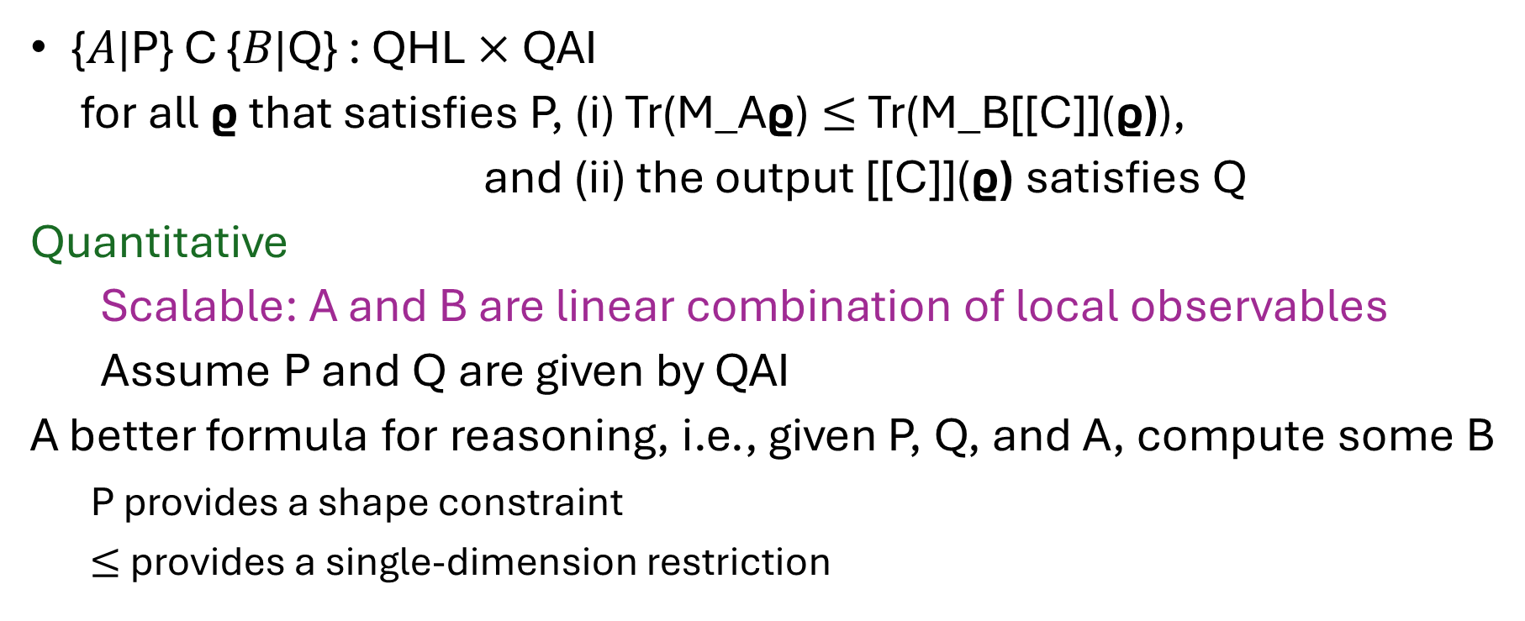
The Formulas in our Logic
{𝐴|P} C {𝐵|Q} : QHL $×$ QAI
for all ϱ that satisfies P, (i) Tr(M_Aϱ) $≤$ Tr(M_B[[C]](ϱ)),
and (ii) the output [[C]](ϱ) satisfies Q
Quantitative
Scalable: A and B are linear combination of local observables
Assume P and Q are given by QAI
A better formula for reasoning, i.e., given P, Q, and A, compute some B
P provides a shape constraint
$≤$ provides a single-dimension restriction

Slide 21
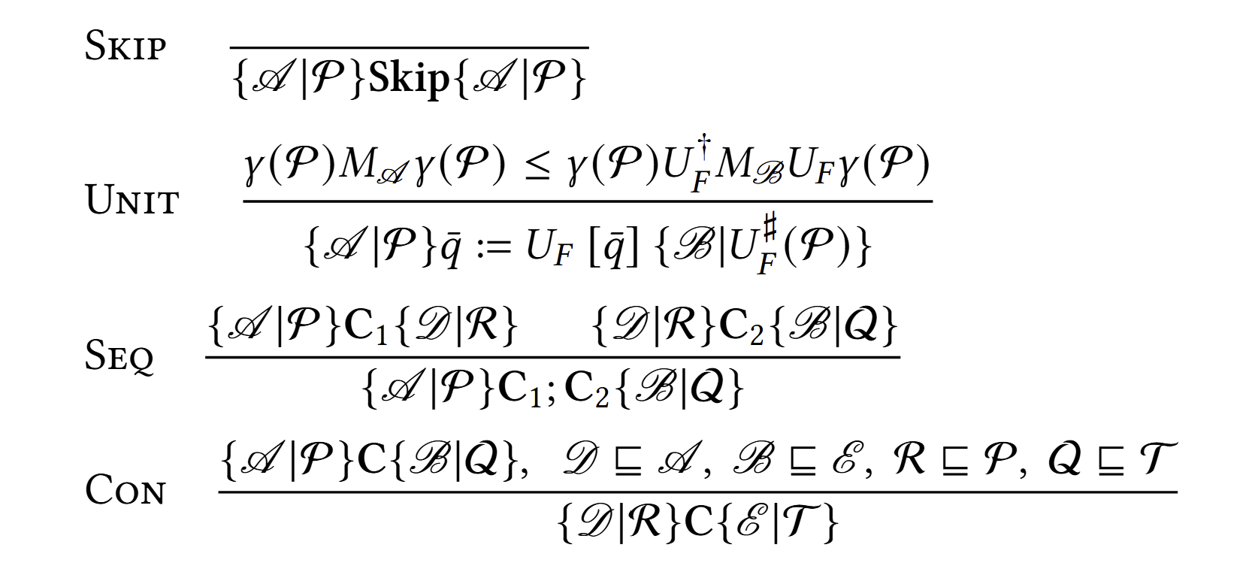
Inference Rules for Circuits

Slide 22
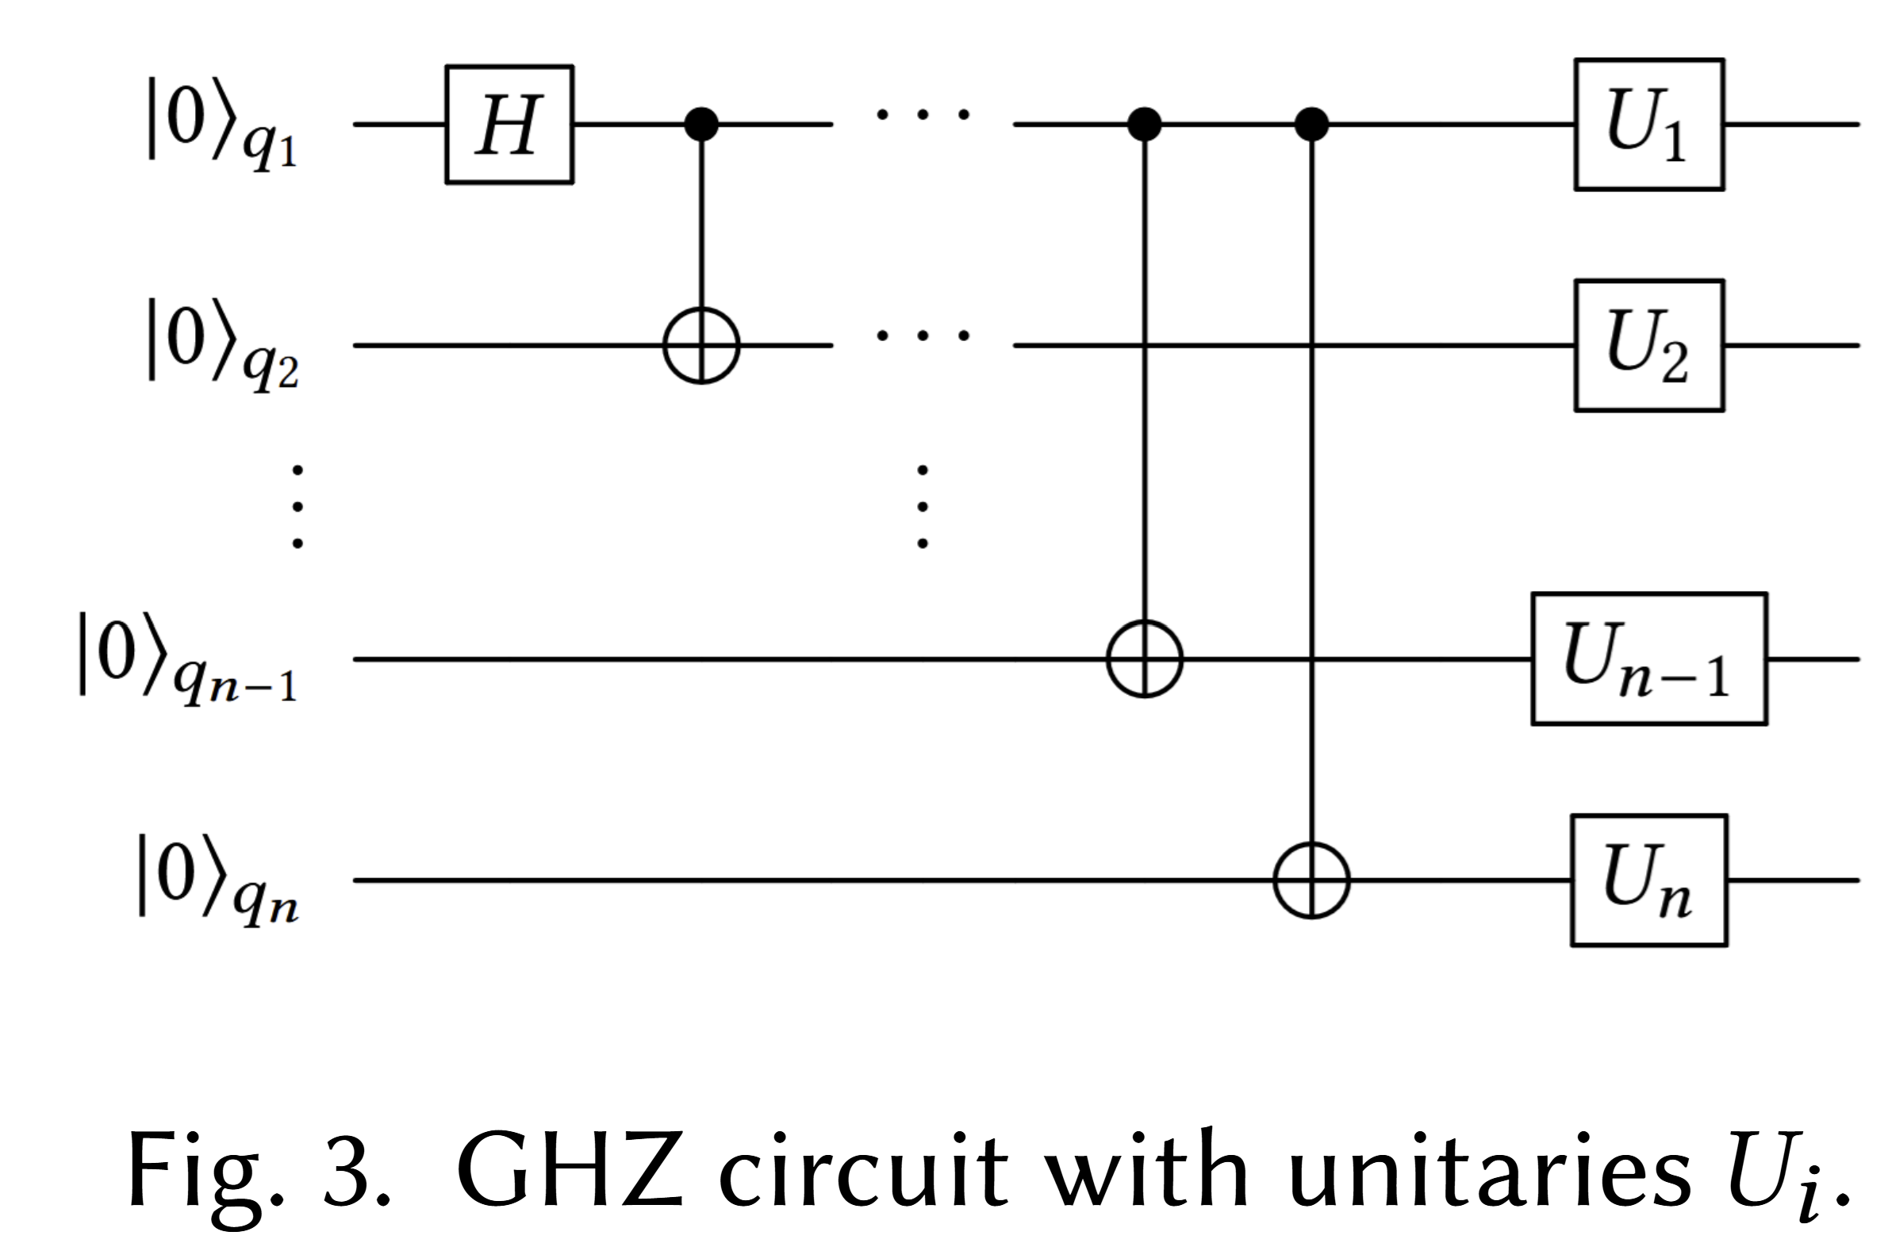

Example: GHZ Circuits with Unitaries
Beyond standard reasoning
arbitrary $U_{1},…, U_{n}$

Slide 23


Example: GHZ Circuits with Unitaries
Beyond standard reasoning
arbitrary $U_{1},…, U_{n}$
Simulating standard Clifford
circuits to obtain the full
output state
requires exponential time

Slide 24
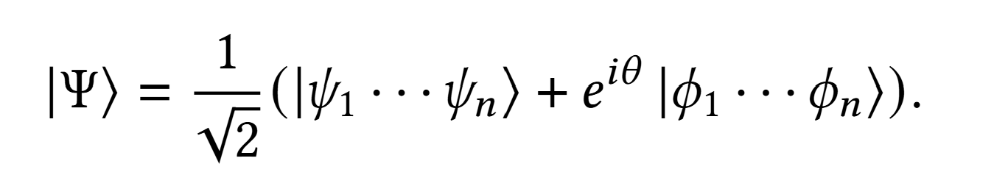


Example: GHZ Circuits with Unitaries
Beyond standard reasoning
arbitrary $U_{1},…, U_{n}$
Our logical system leads to
the following formula for
the output:
where the proof is small
This circuit is a generalized
GHZ circuit; these are orthogonal:

Slide 25
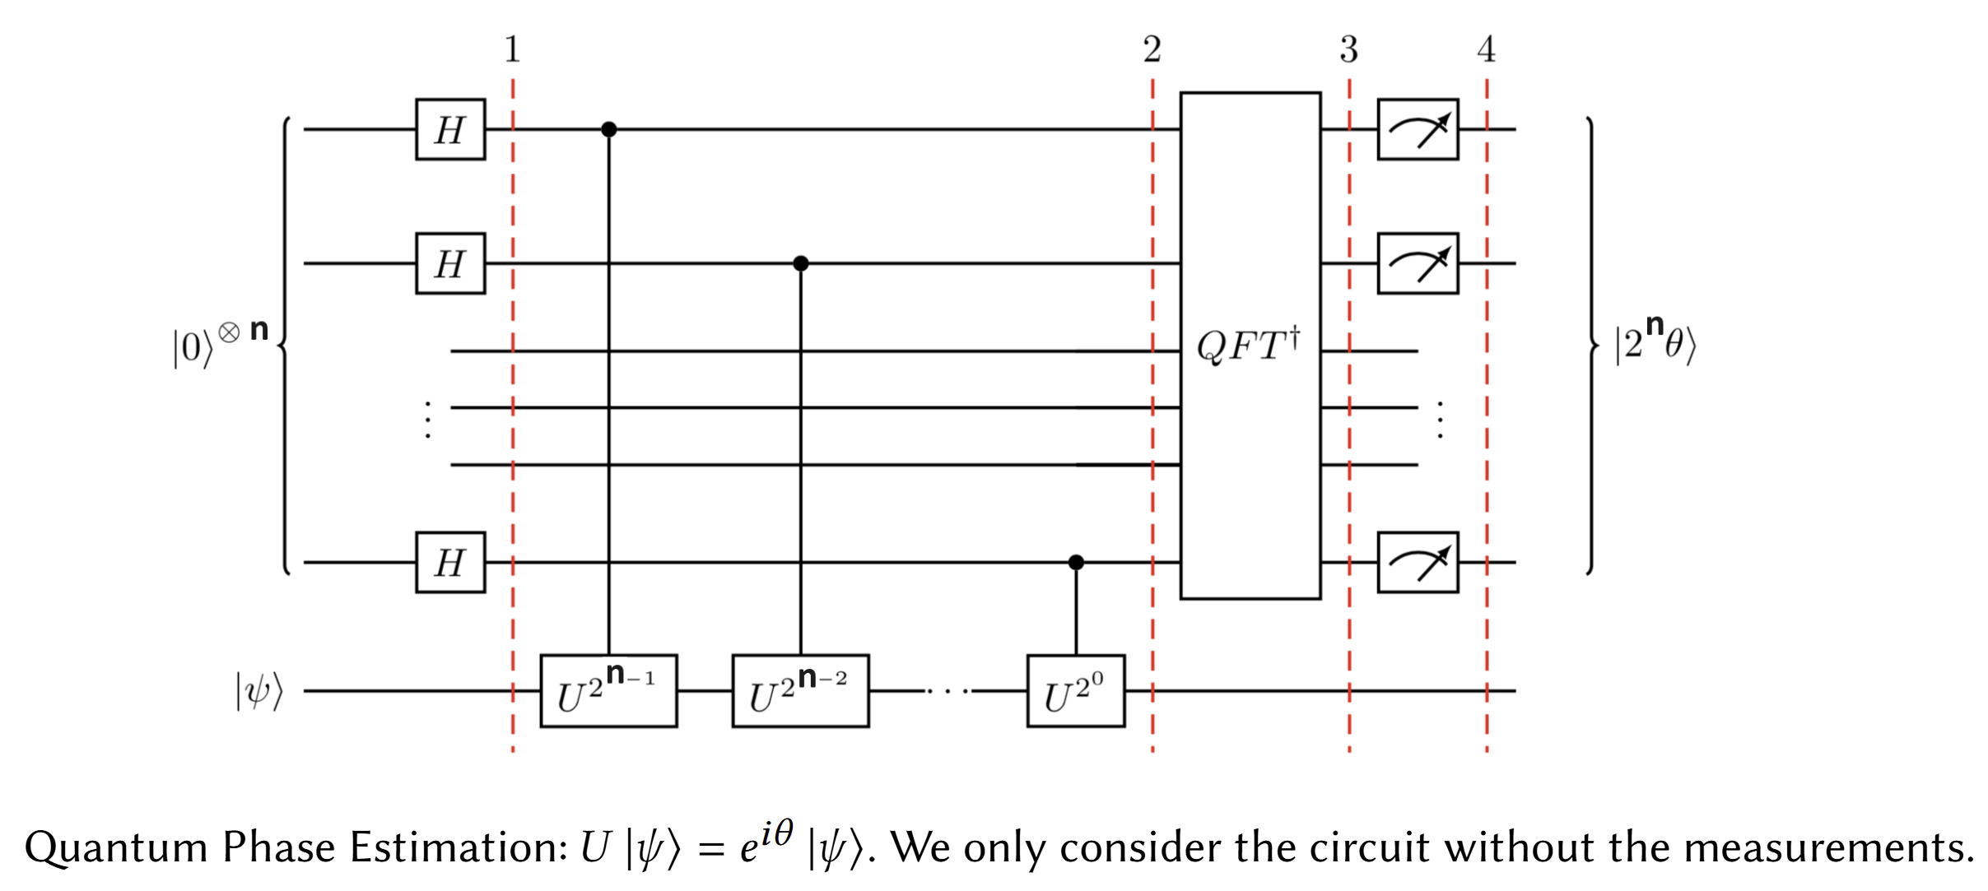

Example 2: Quantum Phase Estimation
The circuit consists of the control unitaries, and the inverse of quantum Fourier transform, computes an estimation of $θ$, i.e, output an $n$-bit to approximate $2^{n} θ$.
In an ideal world, the algorithm outputs the best $n$-bit approximation of $2^{n} θ$with probability at least $4/π^{2}$.

Slide 26

Example 2: Quantum Phase Estimation
In an ideal world, the algorithm outputs the best $n$-bit approximation of $2^{n} θ$with probability at least $4/π^{2}$.
We prove that the algorithm outputs the optimal low $k$-bit approximation with probability at least $4/π^{2}$, using a short proof.

Slide 27
Example 2: Quantum Phase Estimation
Our proof divides the circuits into three parts C1: the control unitaries
S: SWAPs in QFT inverse
C2: QFT-inverse except S

Slide 28
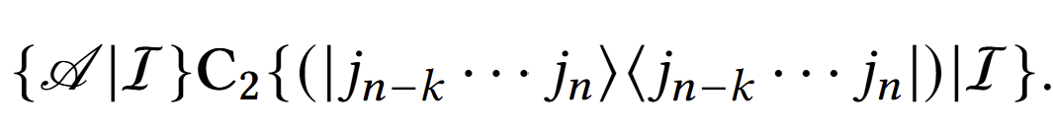
Example 2: Quantum Phase Estimation
C2: QFT-inverse except S

Slide 29
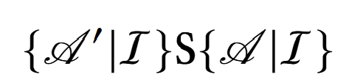

Example 2: Quantum Phase Estimation
S: SWAPs—change domain-qubits

Slide 30
Example 2: Quantum Phase Estimation
C1 before QFT: the control unitaries—next page

Slide 31
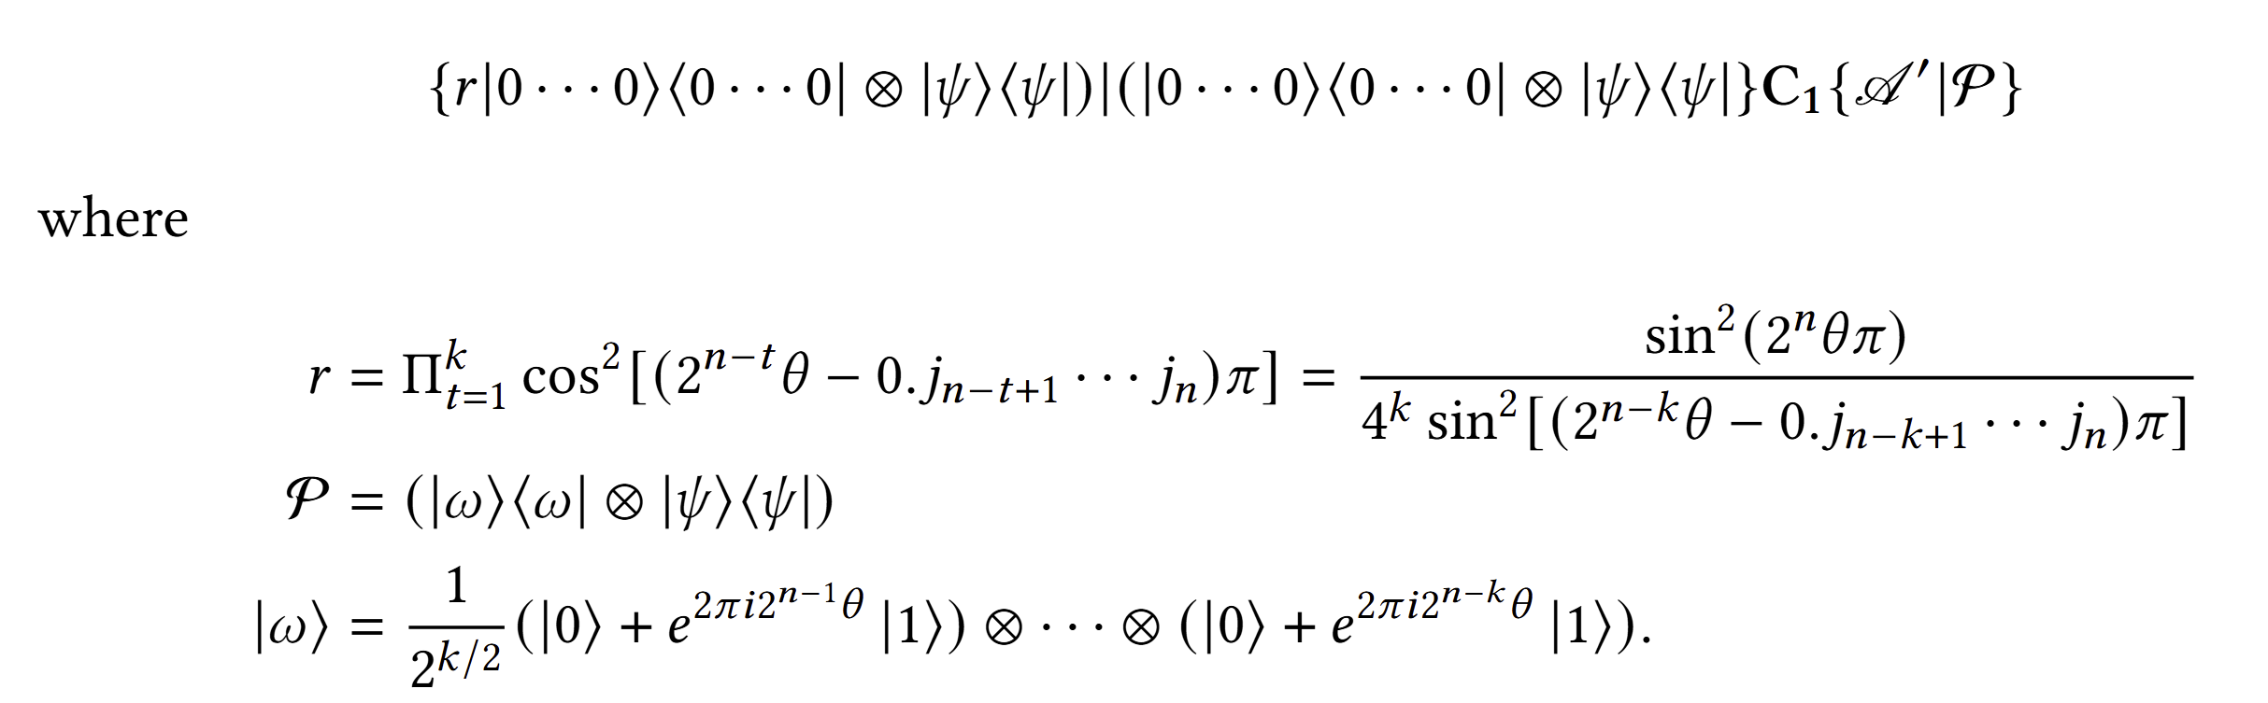
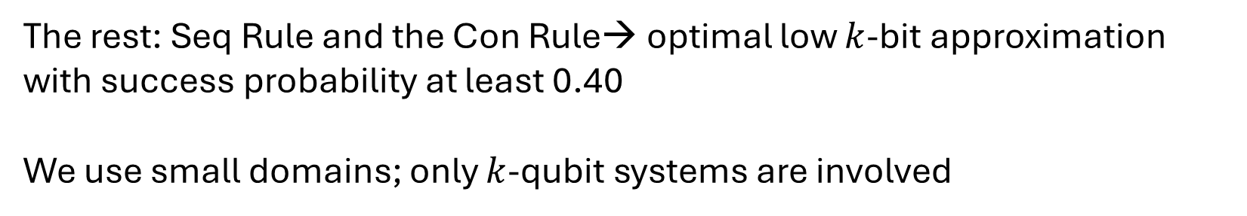
Reasoning about each Subcircuit
The rest: Seq Rule and the Con Rule→ optimal low $k$-bit approximation with success probability at least 0.40
We use small domains; only $k$-qubit systems are involved

Slide 32
Thank You!

