Slide 1

Polynomial Bounds of CFLOBDDs against BDDs
Xusheng Zhi, Thomas Reps

Slide 2
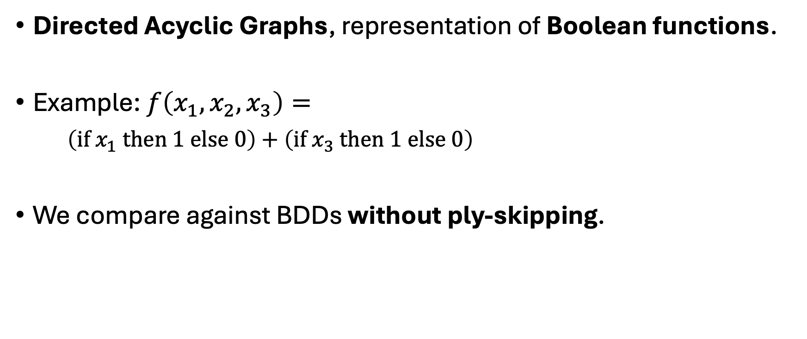
Backgrounds: Binary Decision Diagrams (BDDs)
Directed Acyclic Graphs, representation of Boolean functions.
Example: $f\left(x_{1}, x_{2}, x_{3}\right)=$
$\left(if x_{1} then 1 else 0\right)+\left(if x_{3} then 1 else 0\right)$
We compare against BDDs without ply-skipping.
0
1
2
2

Slide 3


Backgrounds: Context-Free Language Ordered Binary Decision Diagrams (CFLOBDDs) [Sistla et al, 2024]
Alternative to BDDs, with “procedure calls”.
Hierarchal Structure: groupings at different levels
Level $l$-CFLOBDD => Boolean function for $2^{l}$ variables
Level 0:
Level $l>0$:
Fork-Grouping
Vertices
A-Connection
Vertices
B-Connection(s)
Don’t-Care Grouping
Vertices
3

Slide 4
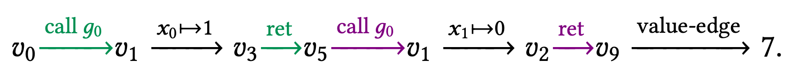














Backgrounds: Context-Free Language Ordered Binary Decision Diagrams (CFLOBDDs) [Sistla et al, 2024]
$$g_{1}$$
Example: $f\left(x_{0},x_{1}\right)=\text{if} \left(x_{0}∧¬x_{1}\right) \text{then} 7 \text{else} 5$
$f\left(1, 0\right)=7$
$$v_{0}$$
$$v_{1}$$
$$g_{0}$$
$$v_{2}$$
$$v_{3}$$
$$v_{4}$$
$$v_{5}$$
$$v_{6}$$
$$g_{2}$$
$$v_{7}$$
$$v_{8}$$
$$v_{9}$$
5
7
4

Slide 5
Comparing the Sizes: BDD vs. CFLOBDDs
Best Case: For some Boolean functions, CFLOBDDs are exponentially smaller than any BDD. [Sistla et al, 2024]
  When sharing is “maximized” in CFLOBDDs.
Worst Case: ? ?
Let’s consider: same function, same variable ordering.
5

Slide 6


The Issue “3/4-depth duplication”
BDD $B$
CFLOBDD $C$
“Duplication” (repetition of CFLOBDD vertices when comparing with BDD nodes)
…
…
3/4 of total depth
…
6

Slide 7
The Issue “3/4-depth duplication”
BDD $B$
CFLOBDD $C$
Can this “duplication” cascade?
…
…
3/4 of total depth
…
6

Slide 8
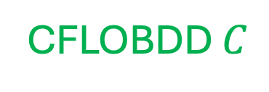


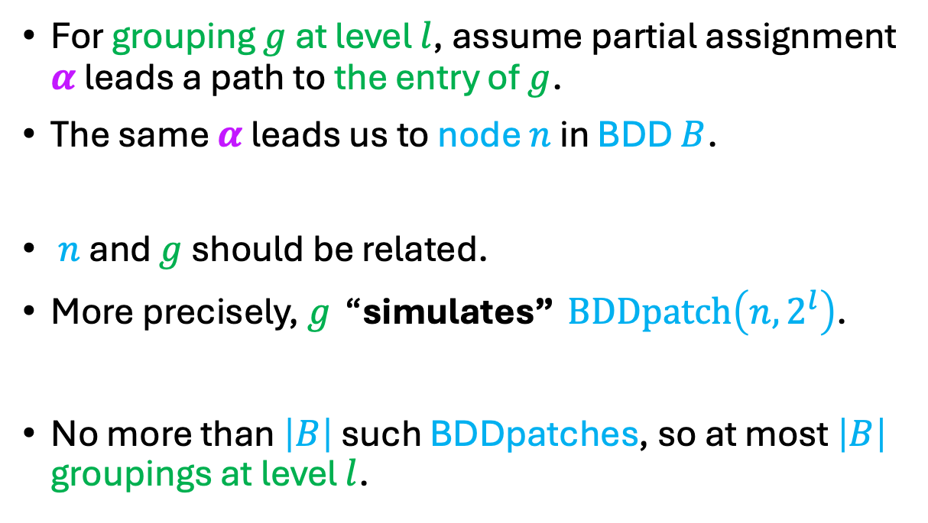


A Viewpoint with “Level-Locality”
BDD $B$
CFLOBDD $C$
For grouping $g$ at level $l$, assume partial assignment $α$ leads a path to the entry of $g$.
The same $α$ leads us to node $n$ in BDD $B$.
$n$ and $g$ should be related.
More precisely, $g$ “simulates” $BDDpatch\left(n, 2^{l}\right)$.
No more than $\left|B\right|$ such BDDpatches, so at most $\left|B\right|$ groupings at level $l$.
$$g$$
$$n$$
$$2^{l}$$
Simulate
7

Slide 9

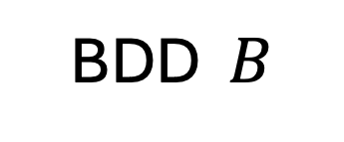
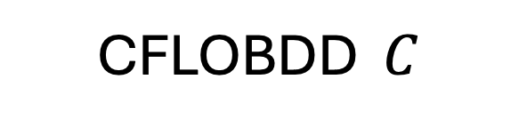
Reflection on “3/4 depth duplication”
BDD $B$
CFLOBDD $C$
…
…
…
8
Must share (because they “simulate” the same BDDpatch)
Sharing prevents the propagation!

Slide 10
Reflection on “3/4 depth duplication”
BDD $B$
CFLOBDD $C$
Sharing prevents the propagation!
…
…
Must share
…
8

Slide 11
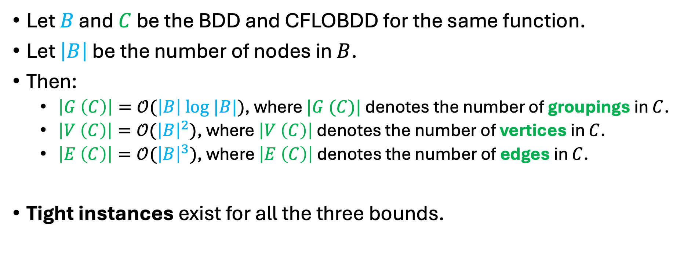
The Counting Results
Let $B$ and $C$ be the BDD and CFLOBDD for the same function.
Let $\left|B\right|$ be the number of nodes in $B$.
Then:
  $\left|G \left(C\right)\right|=𝒪(\left|B\right| log |B|)$, where $|G (C)|$ denotes the number of groupings in $C$.
  $\left|V \left(C\right)\right|=𝒪({\left|B\right|}^{2})$, where $\left|V \left(C\right)\right|$ denotes the number of vertices in $C$.
  $\left|E \left(C\right)\right|=𝒪({\left|B\right|}^{3})$, where $\left|E \left(C\right)\right|$ denotes the number of edges in $C$.
Tight instances exist for all the three bounds.
9

Slide 12
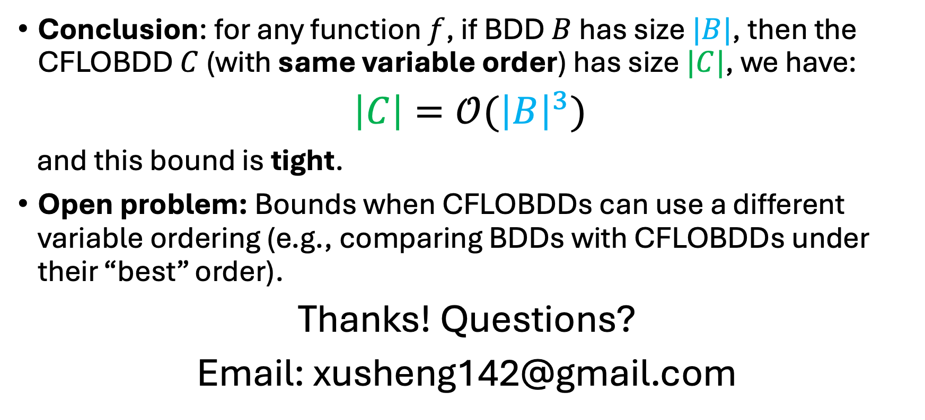
Conclusion & Outlook
Conclusion: for any function $f$, if BDD $B$ has size $|B|$, then the CFLOBDD $C$ (with same variable order) has size $|C|$, we have:
$\left|C\right|=𝒪({\left|B\right|}^{3})$
and this bound is tight.
Open problem: Bounds when CFLOBDDs can use a different variable ordering (e.g., comparing BDDs with CFLOBDDs under their “best” order).
Thanks! Questions?
Email: xusheng142@gmail.com
10

