Slide 1


Roses Are Blue, Violets Are Red; With Future AI, Is Research Dead?
Thomas Reps
University of Wisconsin
Notes:
We are in a sea change, and things could be so different in the future that I almost bailed on this talk.
Loris D’Antoni: “your experience is still useful”. We’ll have to see – there is a saying that …

Slide 2
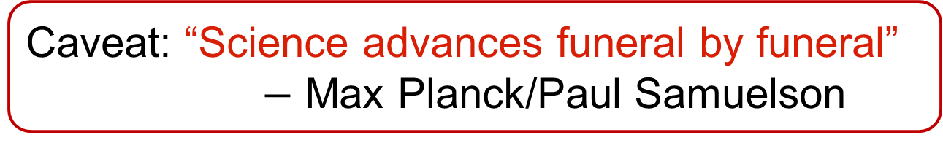
Roses Are Blue, Violets Are Red; With Future AI, Is Research Dead?
Caveat: “Science advances funeral by funeral”
$−$ Max Planck/Paul Samuelson
Claude’s suggestion:
Roses Are Blue, Violets Are Red;
Notes from a Researcher Not Yet Dead
Thomas Reps
University of Wisconsin

Slide 3
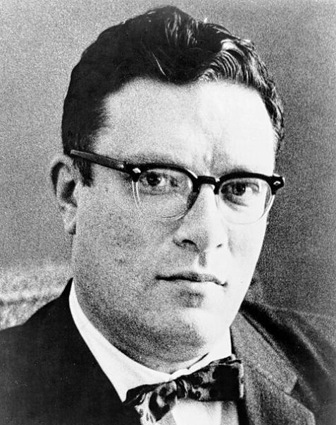
Reflections on Reflections
Isaac
Asimov
Wanted to close with something inspiring:
  "The most exciting phrase to hear in science, the one that heralds new discoveries, is not 'Eureka!' but 'That's funny ...'" — Isaac Asimov
But ... Google pointed me to https://quoteinvestigator.com/2015/03/02/eureka-funny/
Notes:
This talk is about reflecting on some of the exploration modes of my career, and I wanted to end with an overall reflection – something inspiring.

Slide 4
… not 'Eureka!' but 'That's funny ...'
Attributed to Asimov in the Unix “fortune” program (6/3/87)
More likely, Gordon Rattray Taylor, Science Journal (1965)
  Asimov (1987):
  For a moment, Konev and Morrison stared at each other hostilely and then Dezhnev said in a voice that seemed drained of some of its life, “My poor old father used to say: “The most frightening phrase in the Russian language is ‘That’s odd.’”
  Konev turned angrily and said, “Shut up, Arkady.”
  Dezhnev replied, “I mentioned that only because it is now time for me to say it: That’s odd.”

Slide 5
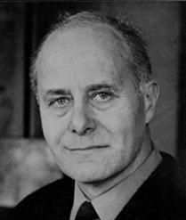
… not 'Eureka!' but 'That's funny ...'
Attributed to Asimov in the Unix “fortune” program (6/3/87)
More likely, Gordon Rattray Taylor, Science Journal (1965)
  G.R. Taylor (1965):
  The popular picture of the scientist is of a man who is visited by a flash of insight and cries, in effect, “Eureka!” Or, more modestly, as a man who notices something others have ignored and mutters “That’s odd.”
  To be realistic, however, the successful scientist often seizes on a new tool or a new technique and applies it sooner than anyone else.
G.R.
Taylor
Notes:
What Taylor said is much closer to the Unix “fortune” program’s quote, but not as memorably stated. <Click> Moreover, he had an additional sentence that completely deflates it from standpoint of being inspirational. However, in the context of the present day, it is relevant because – at least in the medium term – LLMs are the “new tool” that Taylor find at the root of success.

Slide 6
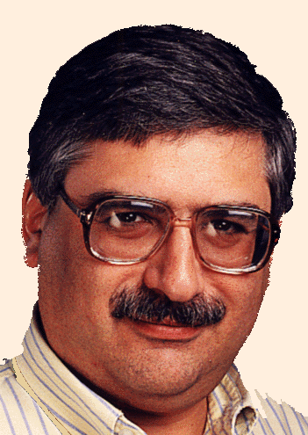
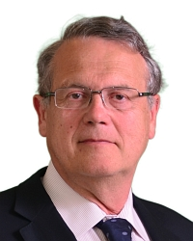
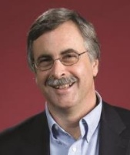
A Powerful New Tool
Claude Code = Programmer’s Apprentice (1976)
  Natural-language programming assistant (notional)
  Clichés (anticipated programming patterns)
    Graph fragments representing computational idioms
    Plan calculus: Cliché composition/decomposition, parsing/unparsing
Howie
Shrobe
Dick
Waters
Charles
Rich
Notes:
… of course, the way that Claude achieves its magic has nothing to do with the methods the Programmer’s Apprentice group explored back in the days of GOFAI, e.g., cliches for Claude are just natural-language phrases used in prompts.

Slide 7
A Powerful New Tool
My first experience with Claude Code
  Pet project w/ the algorithms specified in a PDF
  Running project in about 1 hour
  Over the following few weeks
    Sped up the code by a factor of 5-15x on my application
    And about 2x on previous applications of the codebase
Changes the relationship between grad student and advisor
  A former faculty member
    “My personal productivity with Claude Code is roughly equal to half my former group (12 grad students and post-docs)”

Slide 8
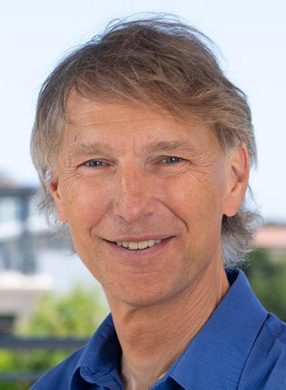
First Publishable Project
Alex
Aiken
Dinner conversation with Alex Aiken
  “The first publishable project often sets the tone for the rest of a student’s graduate career”
    The expected pace of a project
    What is a publishable chunk of work
  But … we could all point to exceptions
    A lengthy first project, culminating in notable success (e.g., award paper) jump‑started a broad range of subsequent results
How does this situation change with AI?

Slide 9
What This Talk is About
A few slides about picking problems
Three modes of thinking
  Hamming mode
  Amoeba mode
  Frog mode

Slide 10
Picking Problems
Edsger Dijkstra (1 of 10 points of advice)
  “Never tackle a problem of which you can be pretty sure that (now or in the near future) it will be tackled by others who are, in relation to that problem, at least as competent and well-equipped as you are.”
In other words, look in a direction other than where the (well-qualified) herd is looking
Notes:
Dijkstra’s advice about academic research contains the following (one of 10 points of advice), https://www.cs.utexas.edu/~EWD/transcriptions/EWD10xx/EWD1055A.html. I find his phrasing awkward, because read literally you might interpret it as filtering out all problems to work on – there is almost always going to be someone as competent or well-equipped as you are. But boiled down to its essence, it means “look in a direction other than where the herd is looking.”

Slide 11
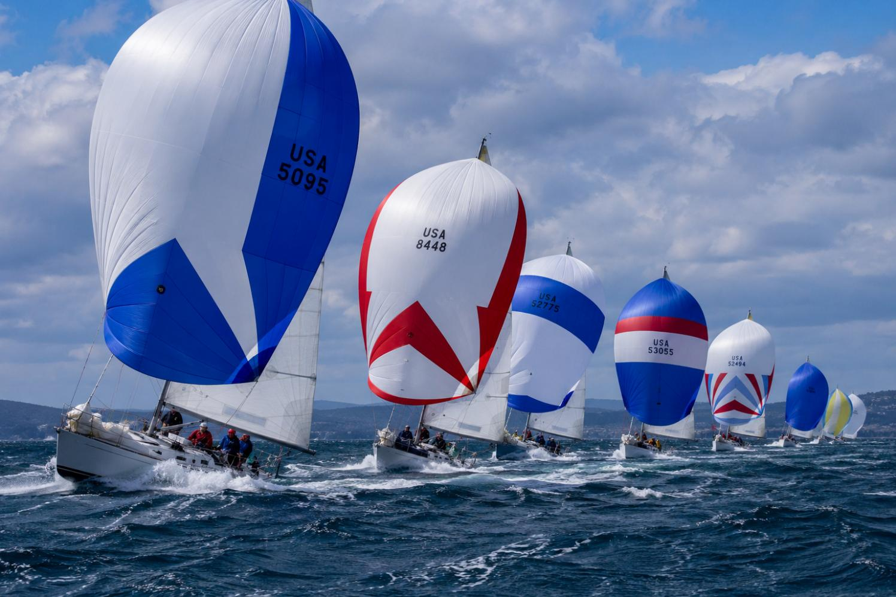
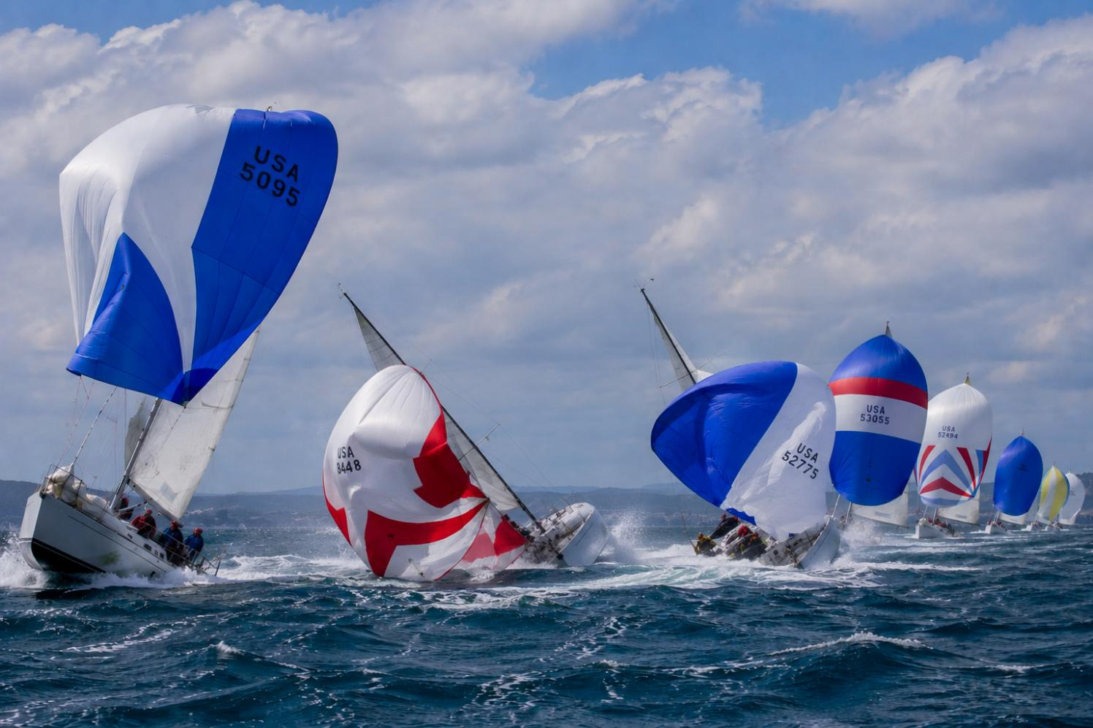
Picking Problems
Oh my god, look at those guys!!
Notes:
I used to explain the issue to my grad students by means of something I learned racing sailboats with crews of 6, 7, 8 people. When sailing downwind with spinnakers up on a windy day, a big gust would sometimes come through the fleet causing some of the boats to wipe out. Someone on my boat would point, and say “Oh my god, look at those guys!!” Everybody’s head would swivel to look at the carnage, and that was usually when the gust would hit your own boat and you would wipe out. I trained myself that when I heard “look at those guys” I would look in the other direction, where the wind was coming from so that I could warn our skipper before the gust hit.

Slide 12
Two Styles of “Picking a Problem”
Problem-driven, technique-agnostic
  Pragmatic orientation
  Solves “real” problems
  You may be able to learn/internalize many techniques
  But does the problem yield to a mundane solution?
Technique-driven, problem-agnostic
  Develops the technology base
  “If you have a hammer, everything looks like a nail"
Notes:
For me, mostly technique-driven, problem-agnostic.
But one problem-driven case: DARPA “scout” for techniques to ameliorate the Y2K problem

Slide 13
Three Modes of Thinking
Hamming mode
Amoeba mode
Frog mode
All should be amplifiable via LLMs
Notes:
We can come back to discussing LLMs in the question period. I’m going to spend most of the time talking about three modes of thinking that have been successful during my career.
… but first, a bit of backstory that will set up Hamming mode and Amoeba mode

Slide 14
A Bit of Backstory
Paragraph four of my Ph.D. thesis (1982):
  "Winograd has argued that the programming tools of the future will be knowledge-based systems incorporating artificial intelligence techniques. Without being overly pessimistic, it is safe to say that such systems are a decade away, if not two decades away. In the meantime, program development systems with more modest goals can be developed.“
Over-optimistic by 24 years!

Slide 15
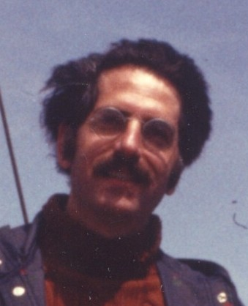
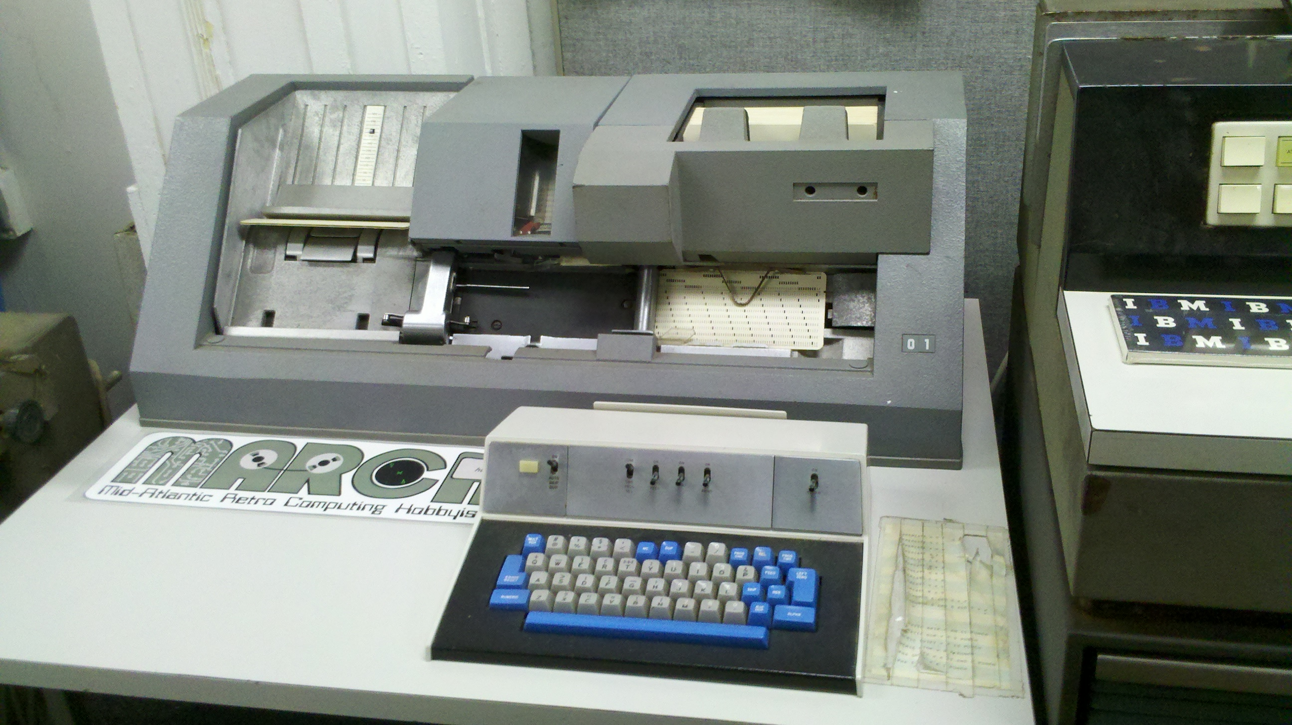
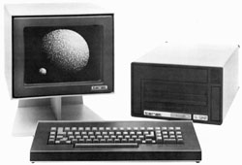
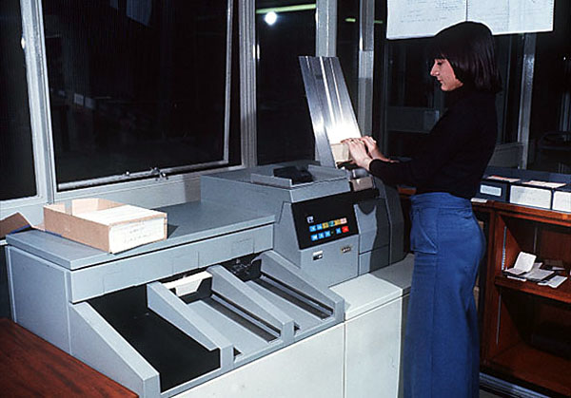
Cornell Program Synthesizer
[1978-81]
Tim
Teitelbaum
https://wincsc.files.wordpress.com/2012/05/2012-05-06_15-22-53_464.jpg
Terak 8510/a
Graphics Computer System
https://c1.staticflickr.com/3/2647/3904970406_a779176c13.jpg
https://www.staff.ncl.ac.uk/roger.broughton/museum/iomedia/images/rdr.jpg
Notes:
Earlier in 1978, the fabled Cornell Computer Science Department, apparently after endless discussions, had decided that they were willing to sully themselves by actually purchasing their own computer. They bought a PDP-11/60, and earlier in the year one of the graduate students had written a very nice screen-oriented text editor. At that time, Tim Teitelbaum had not done very much research, had no students working with him, but had started teaching the introductory CS class, CS 100. Tim was very effective and very popular with the 500+ students who were taking the class each semester. All of the programming exercises were done using punch cards. Tim had a dream one night in which the idea came to him for an integrated system in which one could create, edit, run, and debug programs. At the time, there were a few such systems – InterLisp for Lisp, and the SmallTalk system – but apparently people thought that that kind of interactive capability wasn’t possible for imperative, statically typed programming languages. (Communication of scientific results was a lot harder in those days, and he had not heard of the Mentor system of Kahn, Huet, Lang, and Donzeau-Gouge.)
During my very first week in the PL/C group (a group of about 7), led by Dick Conway, Tim gave a presentation in which he described the vision, and said that he was looking for help. Conway said, “Tom just joined us; he’s not doing anything yet; he can go work with you.”
What was important for me was that I had fallen into an incredibly interesting research project – the Cornell Program Synthesizer – right as it got off the ground, and because Tim was jazzed about it and had no students, I had 100% of the mindshare of a private tutor!
Within about 18 months, all of CS100 had been converted to use the Cornell Program Synthesizer, running on 27 Terak microcomputers. In essence, the Cornell students jumped in 1979 or 1980 from a stone-age computing method to the rough equivalent of Eclipse or VisualStudio.

Slide 16
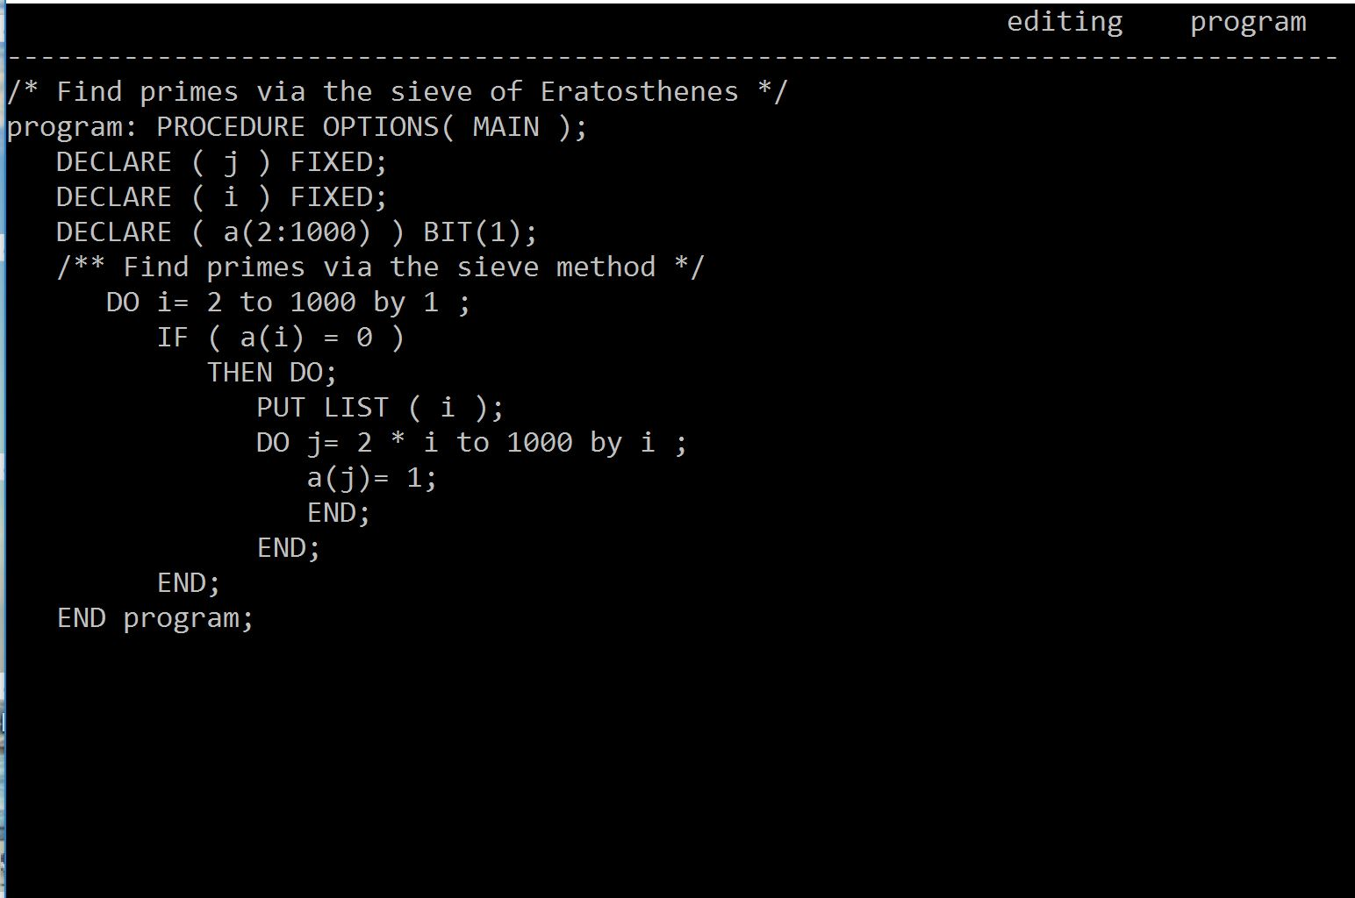
Cornell Program Synthesizer
[1978-81]
Notes:
A screen-shot of a program written using the Cornell Program Synthesizer.

Slide 17
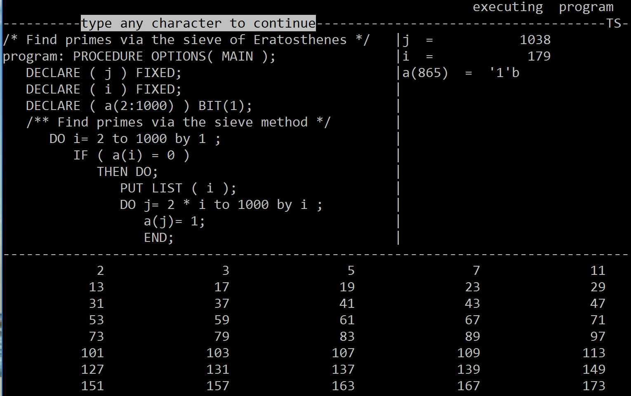
Cornell Program Synthesizer
[1978-81]
Notes:
The slides illustrates execution with all debugging aids turned on. The cursor shows the location of the program counter; variable values are shown in the right-hand pane; and the output is shown in the bottom pane.

Slide 18
Cornell Program Synthesizer
[1978-81]
Notes:
On-the-fly, the Cornell Program Synthesizer also performed what used to be called static-semantic analysis. For instance, here the cursor is at the identifier “j” in the first declaration statement. When the identifier is deleted <CLICK> . . .

Slide 19
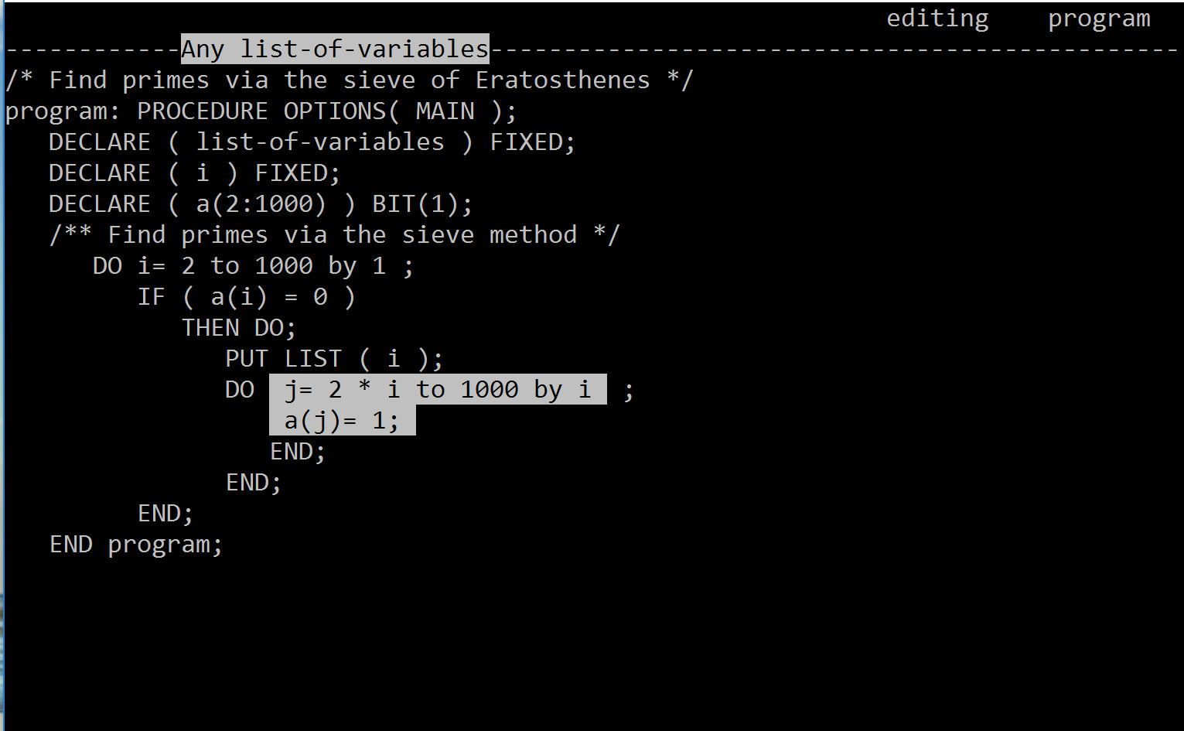
Cornell Program Synthesizer
[1978-81]
Notes:
. . . the places where “j” is used light up to show that they are uses of a variable that has not been declared. When “j” is declared, <CLICK> . . .

Slide 20
Cornell Program Synthesizer
[1978-81]
Abstract. Programs are not text; they are hierarchical compositions of computational structures and should be edited, executed, and debugged in an environment that consistently acknowledges and reinforces this viewpoint. . . .
Oops, in 2026 we now know that programs are text . . .
Notes:
. . . the highlighting goes away. The paper about the Cornell Program Synthesizer appeared in the September 1981 issue of CACM <CLICK>, where it started with the ringing slogan that Tim composed: “Programs are not text,” and went on to elaborate, “they are hierarchical compositions of computational structures and should be edited, executed, and debugged in an environment that consistently acknowledges and reinforces this viewpoint.”
. . . Oops, in 2026 we now know that programs are text . . .

Slide 21


Optimal-Time Incremental Attribute Updating
[POPL 1982]
$||$AFFECTED$||$
T
AFFECTED
T
+
+
U
U’
U
U’
Optimal running time: O($||$AFFECTED$||$)
Notes:
The plan was that for my master’s degree, I would implement a system to generate systems like the Cornell Program Synthesizer from some kind of formal specification. Obviously one would use a context-free grammar for the basic language part, but it wasn’t at all clear what kind of specification to use for static-semantic checks. Eventually, I learned what an attribute grammar was, and we decided to adopt them as the mechanism for the new system, the Synthesizer Generator.
A key moment was the realization that there was an optimal method to update the attributes in an attributed tree after some subtree U is replaced by some other subtree U’. By optimal, we meant that after the new tree has been updated, there is some set (which we called the AFFECTED set) that actually needed new values – as opposed to the attributes that an algorithm might choose to give new values – possibly only temporarily, until it can establish what the final correct value is. The algorithm actually has to go one step beyond the AFFECTED set to be able to determine that updating has quiesced.
This algorithm was so unexpected that Tim said, “Forget about writing a master’s thesis; write it up for a Ph.D.,” which I did, and ended up finishing my Ph.D. three years after enrolling in the Cornell CS graduate program. I was still very green: I’d only taken two CS courses as an undergrad, and I only took about seven courses as a Cornell grad student. Fortunately, I had met Susan, who was still in the process of searching for a Ph.D. topic when I finished, and Tim had gotten tenure, was ready for a sabbatical, and offered to take us to INRIA, outside of Paris, for a year. After that, I came back to Cornell for two years as a post-doc, still working with Tim, until Susan finished her Ph.D. and we both took faculty positions at Wisconsin.

Slide 22
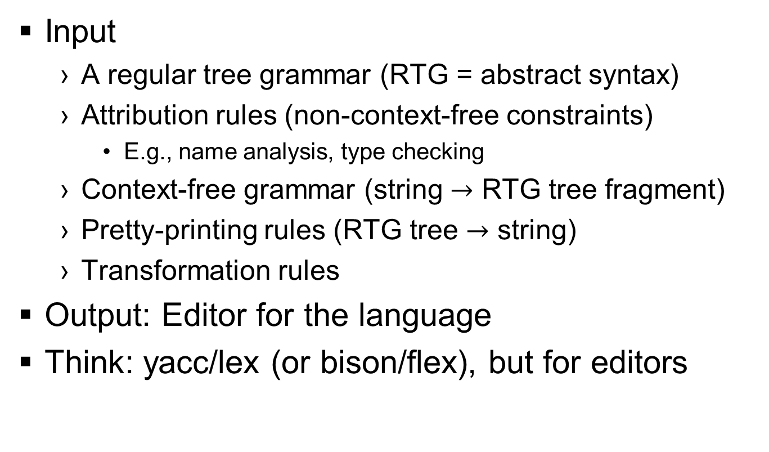
The Synthesizer Generator
Input
  A regular tree grammar (RTG = abstract syntax)
  Attribution rules (non-context-free constraints)
    E.g., name analysis, type checking
  Context-free grammar (string $→$ RTG tree fragment)
  Pretty-printing rules (RTG tree $→$ string)
  Transformation rules
Output: Editor for the language
Think: yacc/lex (or bison/flex), but for editors

Slide 23

Three Modes of Thinking
Hamming mode
Amoeba mode
Frog mode
$\left\{{\text{Exemplified} \text{by} \atop \text{I}\text{llustrated} \text{via}}\right\}$ the Synthesizer Generator
Notes:
This discussion of the Synthesizer Generator brings me to what I’m calling “Hamming mode,” and the Synthesizer Generator will also show us what amoeba mode is all about.

Slide 24
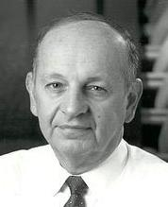
Heilmeier's Catechism
George
Heilmeier
What are you trying to do? Articulate your objectives using absolutely no jargon.
How is it done today, and what are the limits of current practice?
What is new in your approach and why do you think it will be successful?
Who cares? If you are successful, what difference will it make?
What are the risks?
How much will it cost?
How long will it take?
What are the mid-term and final "exams" to check for success?

Slide 25
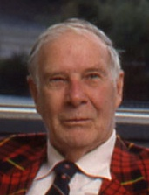
A Question Heilmeier Should Have Asked:
How does this approach address all of next year’s problems?
Richard
Hamming
“. . . in the early days, I was solving one problem after another after another; . . . I was depressed. I could see life being a long sequence of one problem after another after another. After quite a while of thinking I decided, `No, I should be in the [business of] mass production of a variable product. I should be concerned with all of next year's problems, not just the one in front of my face.‘
You should do your job in such a fashion that others can build on top of it . . .
Instead of attacking isolated problems, I made the resolution that I would never again solve an isolated problem except as characteristic of a class.
https://www.cs.virginia.edu/~robins/YouAndYourResearch.html

Slide 26
A Question Heilmeier Should Have Asked:
How does this approach address all of next year’s problems?
Richard
Hamming
. . . [the ability] to generalize often means that the solution is simple. Often by stopping and [observing], `This is the problem he wants but this is characteristic of so and so’ . . . I can attack the whole class with a far superior method than the particular one because I was earlier embedded in needless detail.
The business of abstraction frequently makes things simple. . . . Altering the problem . . . can make a great deal of difference . . . because you can either do it in such a fashion that people can indeed build on what you've done or you can do it in such a fashion that the next person has to essentially duplicate again what you've done. . . . It's just as easy to do a broad, general job as one very special case.”
The 9th Heilmeier Question™
https://www.cs.virginia.edu/~robins/YouAndYourResearch.html

Slide 27
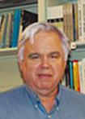
Hamming Mode for PL:
Generators (and Frameworks)
Steve
Johnson
Canonical example of a generator: yacc
A problem instance, Parse(L, s), has two parameters
  L: a context-free language
  s: a string to be parsed. String s changes more frequently than language L
Context-free grammars are a formalism for specifying context-free languages
Create a tool that implements the following specification:
  Input: a context-free grammar that describes language L
  Output: a parser, yyparse(), such that invoking yyparse() on s computes Parse(L, s)
Behind the scenes, there is an “engine”
  A table-driven LALR(1) parser

Slide 28
Hamming Mode for PL:
Generators (and Frameworks)
The Synthesizer Generator:
A problem instance, Edit(L, s, cursor, …), has several parameters
Attribute grammars are a formalism for specifying formal languages with non-context-free restrictions
Create a tool that implements the following specification:
  Input: an attribute grammar (+ more) that describes L
  Output: an editor for L
Behind the scenes, there is an “engine”
  An algorithm for optimal-time incremental attribute updating

Slide 29

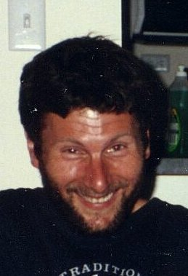
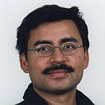
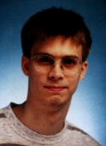
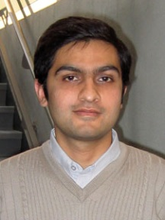
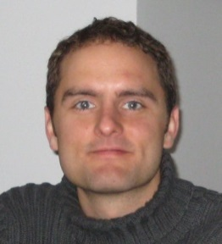
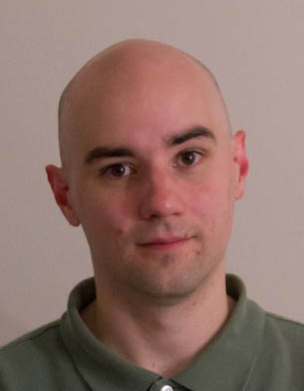
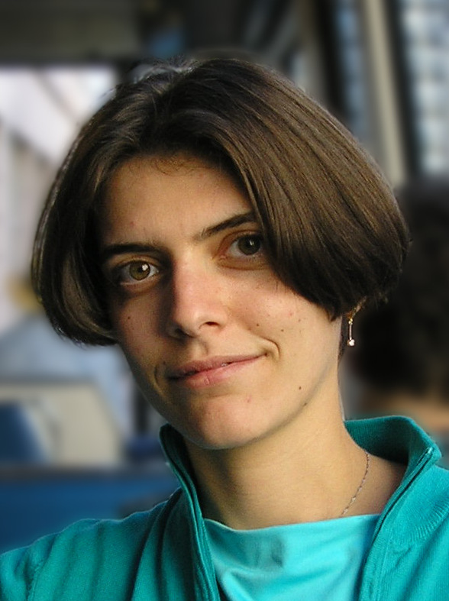
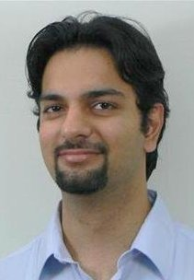
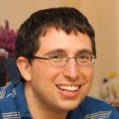
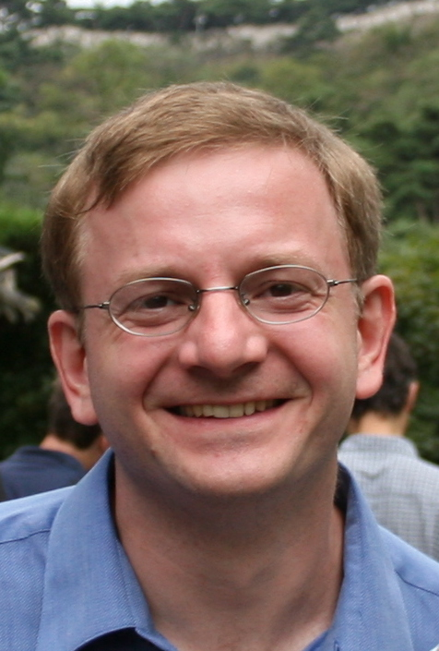
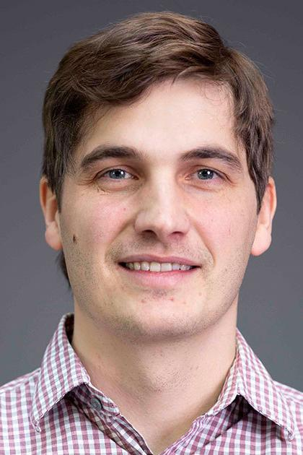

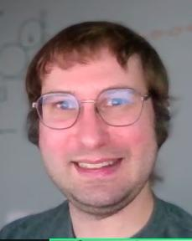
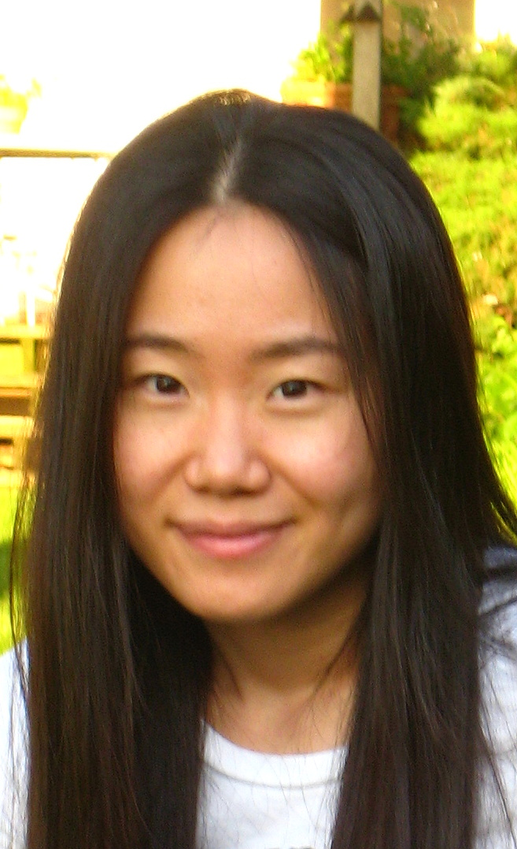
Generators and Frameworks
Reinhard
Wilhelm
Mooly
Sagiv
Somesh Jha
Stefan
Schwoon
Tim
Teitelbaum
Akash
Lal
Nick
Kidd
Evan
Driscoll
Mooly
Sagiv
Greta
Yorsh
Aditya
Thakur
Tal
Lev-Ami
Alexey
Loginov
The
Synthesizer
Generator
(1982-89)
WPDS++, WALi,
OpenNWA
(2003-13)
Symbolic
Abstraction
(2003-2016 )
TVLA
(1999-2007)
Loris
D’Antoni
Jinwoo
Kim
Keith
Johnson
Junghee
Lim
SemGuS
(2020-2026)
TSL
(2006-2012)
Notes:
A different slice of the problems on which I’ve worked shows another theme that goes back to the work with Tim on the Synthesizer Generator, namely, an emphasis on creating frameworks and generators that apply to whole classes of problems. I think of these as “let’s create a Yacc for X” – an idea that was applied to program-development environments, shape analyzers, equation solvers, a general attempt at abstract interpretation in general, machine-code analyzers, and program synthesizers.

Slide 30
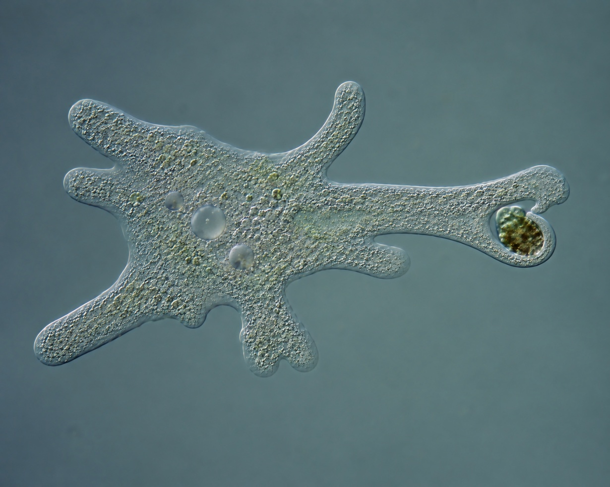
Three Modes of Thinking
Hamming mode
Amoeba mode
Frog mode
$\left\{{\text{Exemplified} \text{by} \atop \text{I}\text{llustrated} \text{via}}\right\}$ the Synthesizer Generator

Slide 31
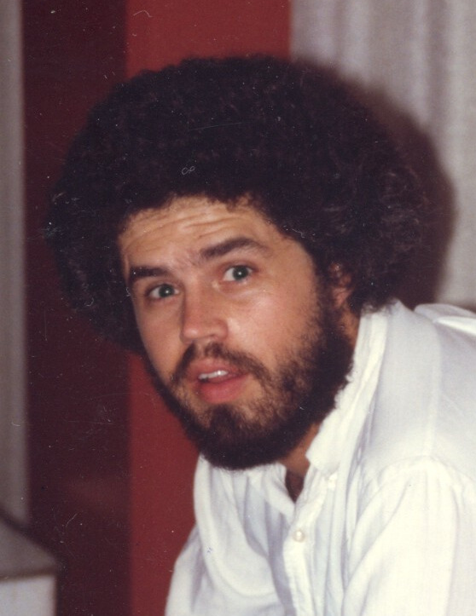
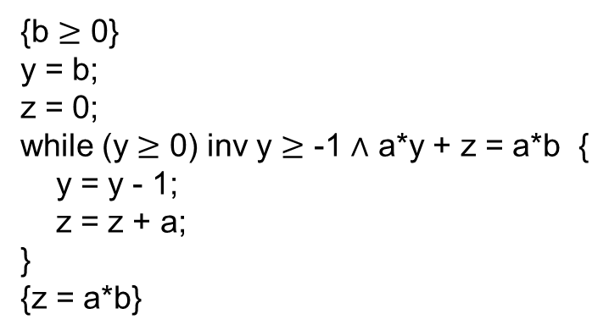
Amoeba-Mode Example:
A Proof-Checking Editor Built Using the Synthesizer Generator
Bowen
Alpern
{b $≥$ 0}
y = b;
z = 0;
while (y $≥$ 0) inv y $≥$ -1 $∧$ a*y + z = a*b {
y = y - 1;
z = z + a;
}
{z = a*b}

Slide 32
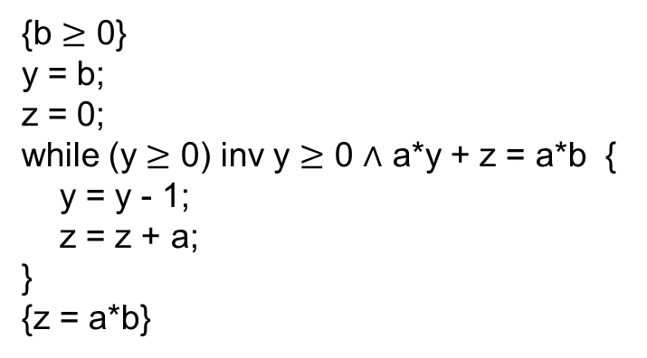
Amoeba-Mode Example:
A Proof-Checking Editor Built Using the Synthesizer Generator
Bowen
Alpern
{b $≥$ 0}
y = b;
z = 0;
while (y $≥$ 0) inv y $≥$ 0 $∧$ a*y + z = a*b {
y = y - 1;
z = z + a;
}
{z = a*b}

Slide 33
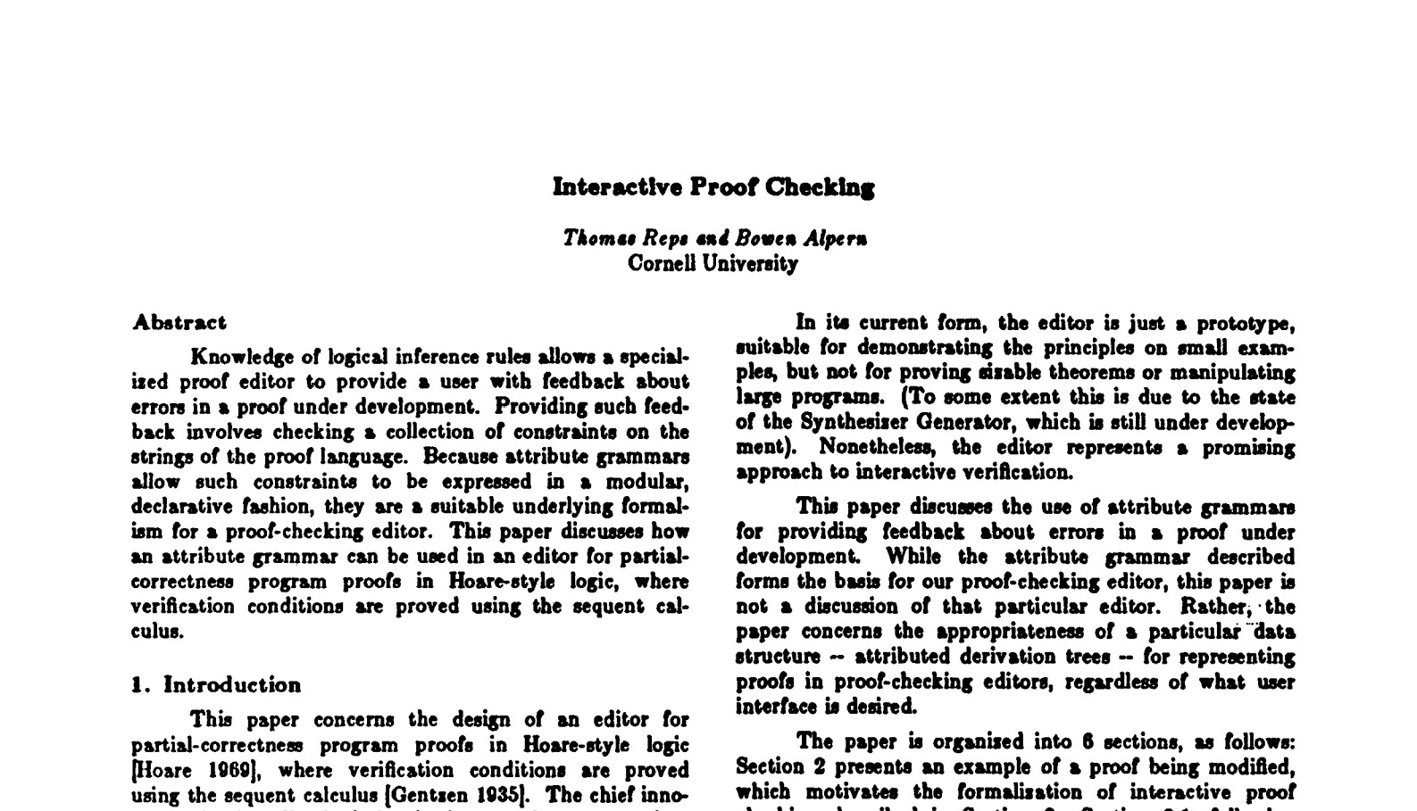
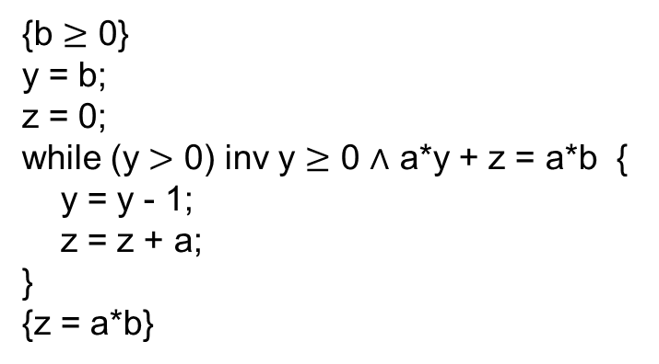
Amoeba-Mode Example:
A Proof-Checking Editor Built Using the Synthesizer Generator
Bowen
Alpern
{b $≥$ 0}
y = b;
z = 0;
while (y $>$ 0) inv y $≥$ 0 $∧$ a*y + z = a*b {
y = y - 1;
z = z + a;
}
{z = a*b}
POPL 1984

Slide 34
Amoeba-Mode Examples, 1981-2003
Synthesizer Generator applications (1981-84)
  Interactive proof-checker (Hoare logic, sequent calculus)
  SKI combinators
  Register allocation & code generation
  Hindley-Milner type inference
  Text-formatting algorithms
Attribute-grammar I/O graphs to interprocedural slicing of PDGs & dataflow analysis
  System-dependence-graph summary edges (1988)
  IFDS dataflow-analysis framework (1994)
  Program analysis via CFL-reachability (1997)
  IDE dataflow-analysis framework (1996)
  Datalog for dataflow analysis (1994)
Incremental algorithms
  Optimal-time incremental updating of attributed trees (1982)
  Incremental graph algorithms (1993)
  Divided-difference arithmetic/automatic differentiation (2000)
  Finite differencing of formulas (2003)
Program merging (via merging of SDGs) (1988)
  Is program merging associative? (category theory?, Browerian algebra!, logic + algebra) (1990)

Slide 35
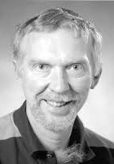
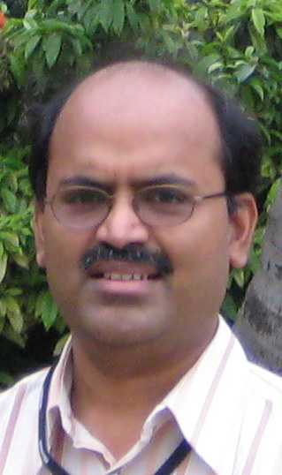
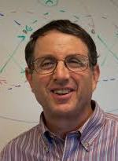
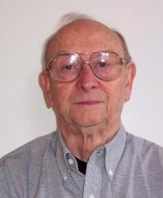
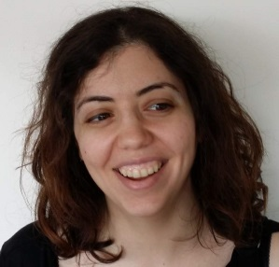
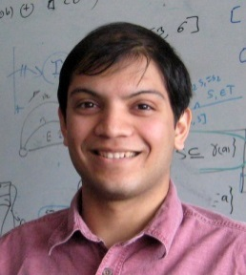
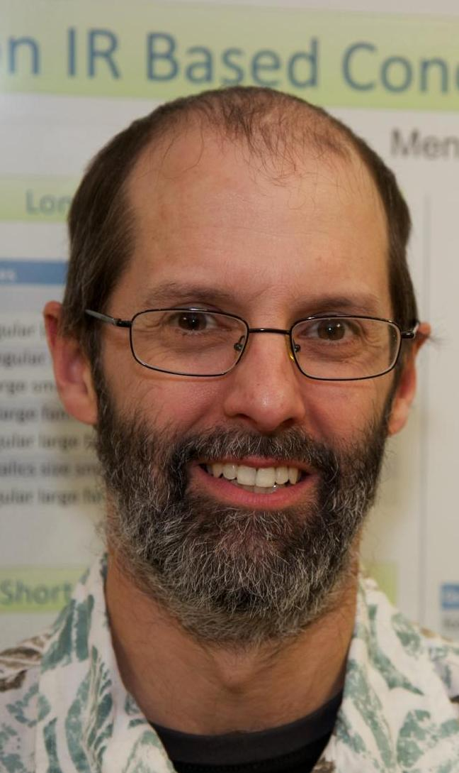
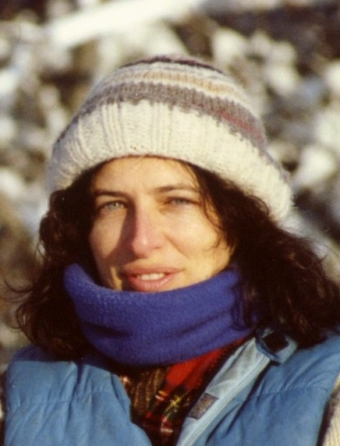
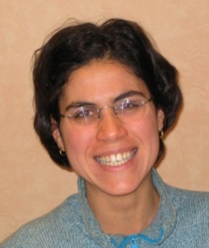
Tim
Teitelbaum
Alan
Demers
Mooly
Sagiv
Alexey
Loginov
Neil
Immerman
Incremental
attribute
updating
[POPL81,82]
Ramalingam
Louis Rall
Incremental graph
algorithms [JAlg96]
Divided-difference
arithmetic [HOSC03]
Finite differencing
of formulas [ESOP03]
Emma
Turetsky
Prathmesh
Prabhu
NPA-TP
[POPL16]
Interprocedural
slicing [PLDI88]
Shape analysis
[POPL96,99]
Reinhard
Wilhelm
Mooly
Sagiv
Context-
bounded
analysis
[TACAS08]
Interprocedural
dataflow analysis
using Datalog
[CC94]
IFDS framework
(CFL-reachability)
[POPL95]
IDE
framework
[FASE95]
Error
propagation
[SAS07]
David
Binkley
Susan
Horwitz
WPDSs
[SAS03]
Mooly
Sagiv
Susan
Horwitz
Somesh Jha
Stefan
Schwoon
Tayssir
Touili
Akash
Lal
Nick
Kidd
Notes:
The experience with Tim at Cornell had a huge impact on my life. The interests I developed there had a lot to do with a number of the things I’ve worked on ever since. For instance, incremental attribute updating is an example of an incremental-computing problem, and Incremental computing is something I’ve come back to at several different periods. Also, the background on attribute grammars led directly to the work on interprocedural slicing, which then got me interested in using Datalog for interprocedural dataflow analysis. One thing led to another, also with some interplay between the two threads.

Slide 36
Three Modes of Thinking
Hamming mode
Amoeba mode
Frog mode

Slide 37

Frog Mode

Slide 38
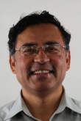
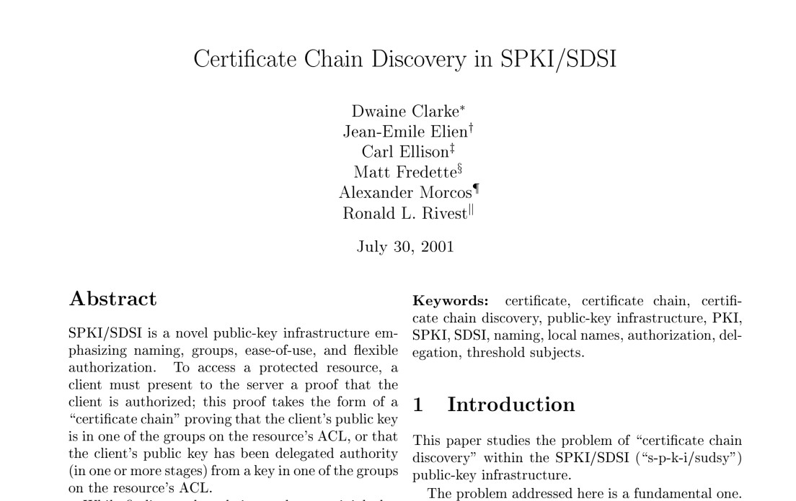

Frog-Mode Example: SPKI/SDSI & PDSs
Somesh Jha: “Can this trust-management formalism (SPKI/SDSI) be expressed using CFL-reachability?”
  Like access-control lists + delegation
  SPKI/SDSI has an $O(n^{3})$ algorithm for authorization checking:
    Given resource R and principal K, is K authorized to access R?
TWR: “It probably could be, but it looks closer to Pushdown Systems (PDSs)”
Somesh
Jha

Slide 39
Frog-Mode Example: SPKI/SDSI & PDSs
Somesh and I knew that an algorithm for LTL model checking of PDSs had been developed in the CAV community [BEM97, FWW97]
Wrote a paper
    “Our work stems from a simple observation: A set of SPKI/SDSI name and authorization certificates defines a PDS.”
  The Introduction listed 12 SPKI/SDSI-analysis problems that could be stated in LTL
    What are the properties of this security policy?
    What would happen if the policy were changed?

Slide 40





Frog-Mode Example: SPKI/SDSI & PDSs
Actually, SPKI/SDSI $≠$ PDS
  What about issues such as recency, trust level, and expiration?
From PDSs to weighted PDSs [SJRS03, RSJM05]
  A more expressive framework for program analysis
Stefan
Schwoon
Somesh
Jha
Thomas
Reps
Dave Melski
Ahmed
Bouajjani
Javier
Esparza
Tayssir
Touili

Slide 41

Frog-Mode Example: SPKI/SDSI & PDSs
The moral of the story
Aha!
  My problem $P$ can be cast in formalism $F$, and I can use a known algorithm $AF$
Bonus ☺
  Can sometimes do more, now that you know that $P$ is an $F$ problem
Bummer ☹
  I want to do “something” that $F$ doesn’t support
Ah! ☺
  Extend $F$ to do “something”
  Write new paper, which is interesting because of the connection to $P$
  Discover that the extension has an analogue and/or applications in the original context (i.e., $F$ problems)

Slide 42



Frog-Mode Example:
Ball-Larus Path Profiling & CFLOBDDs
Tom Ball
Jim Larus
For paths in a dag, you can have a “smart odometer”
  Initialization: “pathNum = 0”
  “pathNum += $c_{e}$” on each edge $e$
  At the end
    the value of “pathNum” indicates what path you took
    a dense numbering: pathNum $∈$ [0 .. #paths-1] (i.e., no gaps)
For purposes of numbering
  “Remove” CFG backedges (add surrogate edges)
enter_{power}
power = 1.0;
while(exp > 0)
0
8
power *= base;
0
4
exp--;
0
2
return power;
0
1
exit_{power}
11

Slide 43


Melski-Reps Interprocedural Path Profiling
Dave Melski
Path fragments can cross procedure boundaries
For purposes of numbering
  “Remove” backedges (add surrogate edges)
  “Remove” calls that introduce recursion (add more surrogate edges)
  Yields a loop-free, non-recursive, interprocedural control-flow graph
TR: “How is the implementation coming along, Dave?”
DM: “I can instrument a 20,000-line program.”
TR: “Fantastic! That’s great news!”
DM: “Well, there is a problem. There are $2^{400,000}$ paths,
so I have to use 400,000-bit numbers.”
TR: WHAT?? How can there be that many paths?
We moved to my office and realized that a loop-free, non-recursive ICFG of size $n$ can have $2^{2^{n}}$ paths

Slide 44
What Causes a Profusion of Paths?

Slide 45
What Causes a Profusion of Paths?

Slide 46
What Causes a Profusion of Paths?
256 paths
16 paths
4 paths
2 paths

Slide 47









What Causes a Profusion of Paths?
Level $k$
Level $k−1$
$$…$$
Level $0$
$$2^{2^{k}}$$
paths
$$2^{2^{k−1}}$$
paths
$2$paths
$$…$$
$P\left(k\right)={\left(P\left(k−1\right)\right)}^{2}$
$P\left(0\right)=2$
$P\left(k\right)=2^{2^{k}}$

Slide 48








Repeated Squaring
Recurrences
  $P\left(n\right)=2⋅P\left(n−1\right); P\left(0\right)=1$ $P\left(n\right)=2^{n}$
  $P\left(n\right)={\left(P\left(n−1\right)\right)}^{2}; P\left(0\right)=2$ $P\left(n\right)=2^{2^{n}}$
“Repeated squaring”
  Transition relation
  Length: $L\left(n\right)=2⋅L\left(n−1\right)$ $L\left(n\right)=O\left(2^{n}\right)$
  Paths: $P\left(n\right)={\left(P\left(n−1\right)\right)}^{2}$ $P\left(n\right)=$ $2^{O\left(2^{n}\right)}$
$P\left(4\right)$ paths
$2^{4}=16$ paths
$$τ$$
$${τ∘τ=τ}^{2}$$
$${τ^{2}∘τ^{2}=τ}^{4}$$
3
9
81
$$. . .$$
$$3^{2^{n}}$$

Slide 49



Frog Mode
Idea: Hijack the bad for the good!
  Make a data structure akin to Binary Decision Diagrams in which
  “bad program graphs” (for interprocedural path profiling)
  $⇒$ “good data structures” (for representing set and relations)
Challenge: Create a plug-compatible replacement for BDDs
1999 NSF Proposal: “A frog has been turned into a prince”

Slide 50
OBDDs, aka
Read-Once, Ordered, Branching Programs
Key Benefit
BDDs: Compression from sharing sub-DAGs
CFLOBDDs: Compression from sharing elements in the “middle of a DAG”
Read-once, ordered, branching program
memory-
access
limitation
acyclic
program
CFLOBDD: acyclic program with
non-recursive procedure calls
with a restricted structure

Slide 51
Sharing via Procedure Calls?
F
T
Quasi-BDD

Slide 52
Sharing via Procedure Calls?
F
T
F
T
Quasi-BDD

Slide 53





Frog Mode: What Was Achieved?
A data structure, CFLOBDDs—Context-Free Language
Ordered Binary Decision Diagrams—that . . .
Can represent (some) enormous sets, vectors, and matrices very compactly
Large vectors and matrices? Quantum simulation!
  Quantum circuit: sequence of matrix operations (and sampling)
  With a 15-minute timeout
In the best case, a data structure of size $O\left(n\right)$ represents
a subset of a set with $2^{2^{n}}$ elements
a vector of size $2^{2^{n}}$
a matrix of size $2^{2^{n−1}}×2^{2^{n−1}}$
Double-exponential compression
Circuit | #Qubits
 | CFLOBDDs | BDDs | CFLOBDD/BDD
Greenberger–Horne–Zeilinger (GHZ) | 65,536 | 512 | 128$×$
Bernstein-Vazirani (BV) | 524,288 | 512 | 1024$×$
Deutsch–Jozsa (DJ) | 4,194,304 | 512 | 8192$×$
Grover’s Algorithm | 4,096 | 32 | 1$\text{28}×$
Simon’s Algorithm | 32 | 32 | 1$×$
Quantum Fourier Transform (QFT) | 16 | 16 | 1$×$
Shor’s Algorithm | 7 | 7 | 1$×$
Meghana Sistla
(UT-Austin)
Swarat Chaudhuri
(UT-Austin)
Xusheng
Zhi
(UW-Madison)

Slide 54


Frog Mode: What Was Achieved?
Hijack the bad for the good!
  “bad program graphs” (for interprocedural path profiling)
  $⇒$ “good data structures” (for representing relations)

Slide 55
Observations about Frameworks (I)
What I learned about generalization
Understand a suite of solutions: It might be the case that only one of them generalizes
  Ramalingam: Generalizing from batch algorithms to an incremental algorithm for computing shortest distances in a graph
  [Third hand]
    To create parallel numerical-analysis algorithms, needed to resurrect algorithms from the 50s & 60s
    Later algorithms had sequentialization baked in
Ramalingam

Slide 56

Observations about Frameworks (II)
Usually creating a framework involves finding the right abstraction or right underlying abstract data type
  But sometimes you need to break an abstraction
  Matrix multiplication $⇒$ Kronecker product
    Context-bounded analysis of parallel programs: permits rearrangements of program transitions
    NPA-TP: can handle weighted Linear CFLs as weighted regular languages
Akash
Lal
Tayssir
Touili
Nick
Kidd

Slide 57




Some Intuition About Kronecker Product
$A^{t}⊗B=\left[\begin{matrix}a_{1,1} & a_{2,1} \\ a_{1,2} & a_{2,2}\end{matrix}\right]⊗\left[\begin{matrix}b_{1,1} & b_{1,2} \\ b_{2,1} & b_{2,2}\end{matrix}\right]$
$=\left[\begin{matrix}a_{1,1}B & a_{2,1}B \\ a_{1,2}B & a_{2,2}B\end{matrix}\right]$
$=\left[\begin{matrix}\begin{matrix}a_{1,1}b_{1,1} & a_{1,1}b_{1,2} \\ a_{1,1}b_{2,1} & a_{1,1}b_{2,2}\end{matrix} & \begin{matrix}a_{2,1}b_{1,1} & a_{2,1}b_{1,2} \\ {a_{2,1}b}_{2,1} & a_{2,1}b_{2,2}\end{matrix} \\ \begin{matrix}a_{1,2}b_{1,1} & a_{1,2}b_{1,2} \\ a_{1,2}b_{2,1} & a_{1,2}b_{2,2}\end{matrix} & \begin{matrix}a_{2,2}b_{1,1} & a_{2,2}b_{1,2} \\ a_{2,2}b_{2,1} & a_{2,2}b_{2,2}\end{matrix}\end{matrix}\right]$
$readout\left(\left[\begin{matrix}\begin{matrix}a_{1,1}b_{1,1} & a_{1,1}b_{1,2} \\ a_{1,1}b_{2,1} & a_{1,1}b_{2,2}\end{matrix} & \begin{matrix}a_{2,1}b_{1,1} & a_{2,1}b_{1,2} \\ {a_{2,1}b}_{2,1} & a_{2,1}b_{2,2}\end{matrix} \\ \begin{matrix}a_{1,2}b_{1,1} & a_{1,2}b_{1,2} \\ a_{1,2}b_{2,1} & a_{1,2}b_{2,2}\end{matrix} & \begin{matrix}a_{2,2}b_{1,1} & a_{2,2}b_{1,2} \\ a_{2,2}b_{2,1} & a_{2,2}b_{2,2}\end{matrix}\end{matrix}\right]\right)$
$=\left[\begin{matrix}a_{1,1}b_{1,1}∨a_{1,2}b_{2,1} & a_{1,1}b_{1,2}∨a_{1,2}b_{2,2} \\ a_{2,1}b_{1,1}∨a_{2,2}b_{2,1} & a_{2,1}b_{1,2}∨a_{2,2}b_{2,2} \end{matrix}\right]$
$=\left[\begin{matrix}a_{1,1} & a_{1,2} \\ a_{2,1} & a_{2,2}\end{matrix}\right]×\left[\begin{matrix}b_{1,1} & b_{1,2} \\ b_{2,1} & b_{2,2}\end{matrix}\right]$
$=A×B$
readout is $∃P^{′},Q. (T\left(P^{′},Q,P,Q^{′}\right)∧\left(P^{′}=Q\right))$
$$a_{P,P′}b_{Q,Q′}$$
Leopold
Kronecker

Slide 58



Kronecker Product from a Logical Perspective
$${A\left(P,P^{′}\right)}^{t}⊗B\left(Q,Q^{′}\right)=A^{R}\left(P′,P\right)∧B(Q,Q^{′})=A\left(P,P^{′}\right)∧B(Q,Q^{′})$$
$A^{t}⊗B=\left[\begin{matrix}a_{1,1} & a_{2,1} \\ a_{1,2} & a_{2,2}\end{matrix}\right]⊗\left[\begin{matrix}b_{1,1} & b_{1,2} \\ b_{2,1} & b_{2,2}\end{matrix}\right]$
$=\left[\begin{matrix}a_{1,1}B & a_{2,1}B \\ a_{1,2}B & a_{2,2}B\end{matrix}\right]$
$=\left[\begin{matrix}\begin{matrix}a_{1,1}b_{1,1} & a_{1,1}b_{1,2} \\ a_{1,1}b_{2,1} & a_{1,1}b_{2,2}\end{matrix} & \begin{matrix}a_{2,1}b_{1,1} & a_{2,1}b_{1,2} \\ {a_{2,1}b}_{2,1} & a_{2,1}b_{2,2}\end{matrix} \\ \begin{matrix}a_{1,2}b_{1,1} & a_{1,2}b_{1,2} \\ a_{1,2}b_{2,1} & a_{1,2}b_{2,2}\end{matrix} & \begin{matrix}a_{2,2}b_{1,1} & a_{2,2}b_{1,2} \\ a_{2,2}b_{2,1} & a_{2,2}b_{2,2}\end{matrix}\end{matrix}\right]$
$readout\left(\left[\begin{matrix}\begin{matrix}a_{1,1}b_{1,1} & a_{1,1}b_{1,2} \\ a_{1,1}b_{2,1} & a_{1,1}b_{2,2}\end{matrix} & \begin{matrix}a_{2,1}b_{1,1} & a_{2,1}b_{1,2} \\ {a_{2,1}b}_{2,1} & a_{2,1}b_{2,2}\end{matrix} \\ \begin{matrix}a_{1,2}b_{1,1} & a_{1,2}b_{1,2} \\ a_{1,2}b_{2,1} & a_{1,2}b_{2,2}\end{matrix} & \begin{matrix}a_{2,2}b_{1,1} & a_{2,2}b_{1,2} \\ a_{2,2}b_{2,1} & a_{2,2}b_{2,2}\end{matrix}\end{matrix}\right]\right)$
$=\left[\begin{matrix}a_{1,1}b_{1,1}∨a_{1,2}b_{2,1} & a_{1,1}b_{1,2}∨a_{1,2}b_{2,2} \\ a_{2,1}b_{1,1}∨a_{2,2}b_{2,1} & a_{2,1}b_{1,2}∨a_{2,2}b_{2,2} \end{matrix}\right]$
$=\left[\begin{matrix}a_{1,1} & a_{1,2} \\ a_{2,1} & a_{2,2}\end{matrix}\right]×\left[\begin{matrix}b_{1,1} & b_{1,2} \\ b_{2,1} & b_{2,2}\end{matrix}\right]$
$=A×B$
readout is $∃P^{′},Q. (T\left(P^{′},Q,P,Q^{′}\right)∧\left(P^{′}=Q\right))$
$$a_{P,P′}b_{Q,Q′}$$
$⊗$ breaks the abstraction of $×$: performs $∧$; delays $∃P^{′},Q. … ∧\left(P^{′}=Q\right))$
Leopold
Kronecker
$$A\left(P,P^{′}\right)×B\left(Q,Q^{′}\right)= ∃P^{′},Q. (A\left(P,P^{′}\right)∧B(Q,Q^{′})∧\left(P^{′}=Q\right))$$

Slide 59


Academia vs. Industry
Gogul
Balakrishnan
Analysis of machine code
ONR MURI grant with Somesh Jha and Bart Miller
Goal: connect IdaPro disassembler to CodeSurfer system for program slicing
ONR Proposal: export IdaPro CFG; perform points-to analysis; supply to CodeSurfer
Doesn’t work: address (numeric) calculations and operations on variables are inextricably intermingled
16 months of trying different analysis techniques until Gogul Balakrishnan said, “we need the values at every point” $⇒$ VSA, and then ASI, ARA, recency abstraction, …
No company would have let us beat our head against the wall for 16 months

Slide 60
Three Modes of Thinking $→$ Three Lines of Inquiry
How can I generalize this solution?
How can I apply this framework?
Hamming mode
Amoeba mode
Frog mode
All should be amplifiable via LLMs
What is a nearby question?
In what other areas does this kind of problem arise?
Notes:
All three modes should be amplifiable via LLMs; you just have to ask the right questions to go down those roads.

Slide 61
Picking Problems
Relevance
  Who cares if you solve it?
Time frame
  Academic research: 5-10 years out
  Industry research: 1-3 years out
Tractability
Intellectual challenge
  What would the “surprise value” of a solution be?
Personal Fit
  Does it fit your skills?
  Is it a platform for your intellectual development?
  Does it make you think, "I can't believe they pay me to do this"?

Slide 62


Advice to/from Yannis Ioannidis
Yannis
Ioannidis
Eugene
Wong
From Eugene Wong:
  “Set your own standard”
  “In grad school and until you have tenure, reach for the stars, but focus on ‘reachable stars’”
Maybe now 10% on ‘faraway stars’ even in early career?
Brings us back to Hamming (“You and Your Research”):
  “Friday afternoons for years - great thoughts only - means that I committed 10% of my time trying to understand the bigger problems in the field, i.e., what was and what was not important. I found in the early days I had believed ‘this’ and yet had spent all week marching in ‘that’ direction. It was kind of foolish. If I really believe the action is over there, why do I march in this direction? I either had to change my goal or change what I did. So, I changed something I did, and I marched in the direction I thought was important. It's that easy.”

Slide 63
Roses Are Blue, Violets Are Red;
With Future AI, Is Research Dead?
Albert Einstein (1918) – tribute to Max Planck on Planck’s 60th birthday
“Many kinds of [people] devote themselves to science … [Some] come into her temple because it offers them … a kind of sport in the practice of which they exult, just as an athlete exults in the exercise of his muscular prowess. … [Others] come into the temple … in the hope of securing a profitable return. These [people] are scientists only by the chance of some circumstance … if the attending circumstance had been different, they might have become politicians or captains of business.
Should an angel of God descend and drive from the temple of science all those who belong to the categories I have mentioned, I fear the temple would be nearly emptied. But a few worshippers would still remain—some from former times and some from ours. To these latter belongs our Planck. And that is why we love him. … The state of mind which furnishes the driving power here resembles that of the devotee or the lover. The long-sustained effort is not inspired by any set plan or purpose. Its inspiration arises from a hunger of the soul.”
No matter what your level of contribution, be the kind of researcher who would not be driven from the temple by Einstein’s angel
Notes:
I wanted to close with something inspiring, and I found it in Einstein’s tribute to Max Planck.
You probably won’t achieve anything at the level that Max Planck did, but no matter what your level of contribution, be the kind of researcher who would not be driven from the temple by Einstein’s angel.

Slide 64
Roses Are Blue, Violets Are Red; With Future AI, Is Research Dead?
Thomas Reps
University of Wisconsin

Slide 66
Photo Attributions
Alex Aiken: https://theory.stanford.edu/~aiken/
Isaac Asimov: https://en.wikipedia.org/wiki/Isaac_Asimov
Bowen Alpern: T. Reps, personal collection
Loris D’Antoni: https://ls.wisc.edu/faculty-staff/ls-tenure/loris-dantoni-l-s-tenured-faculty
Richard Hamming: https://nps.edu/web/cs/hamming-resources
George Heilmeier: https://www.optica.org/History/Biographies/bios/George_H_Heilmeier
Yannis Ioannidis: https://www.madgik.di.uoa.gr/people/faculty/yioannidis
Steve Johnson: https://www.red-gate.com/simple-talk/opinion/geek-of-the-week/stephen-curtis-johnson-geek-of-the-week/
Charles Rich: https://www.wpi.edu/news/memoriam-charles-rich-computer-science-professor-and-artificial-intelligence-pioneer
Gordon Rattray Taylor: https://en.wikipedia.org/wiki/Gordon_Rattray_Taylor
Tim Teitelbaum: T. Reps, personal collection
Dick Waters: https://www.merl.com/people/dick
Eugene Wong: https://www2.eecs.berkeley.edu/Faculty/Homepages/wong.html
Amoeba: AI-generated (ChatGPT)
Boats broaching: AI-generated (ChatGPT)
Boats with spinnakers: AI-generated (ChatGPT)
Frog tongue: AI-generated (Copilot)

Slide 67
EWD 1055A https://www.cs.utexas.edu/~EWD/transcriptions/EWD10xx/EWD1055A.html
Raise your standards as high as you can live with, avoid wasting your time on routine problems, and always try to work as closely as possible at the boundary of your abilities. Do this because it is the only way of discovering how that boundary should be moved forward.
We all like our work to be socially relevant and scientifically sound. If we can find a topic satisfying both desires, we are lucky; if the two targets are in conflict with each other, let the requirement of scientific soundness prevail.
Never tackle a problem of which you can be pretty sure that (now or in the near future) it will be tackled by others who are, in relation to that problem, at least as competent and well-equipped as you are.
Write as if your work is going to be studied by a thousand people.
Don't get enamored with the complexities you have learned to live with (be they of your own making or imported). The lurking suspicion that something could be simplified is the world's richest source of rewarding challenges.
Before embarking on an ambitious project, try to kill it.
Remember that research with a big R is rarely mission-oriented and plan in terms of decades, not years. Resist all pressure —be it financial or cultural— to do work that is of ephemeral significance at best.
Don't strive for recognition (in whatever form): recognition should not be your goal, but a symptom that your work has been worthwhile.
Avoid involvement in projects so vague that their failure could remain invisible: such involvement tends to corrupt one's scientific integrity.
Striving for perfection is ultimately the only justification for the academic enterprise; if you don't feel comfortable with this goal —e.g. because you think it too presumptuous—, stay out!

