Slide 1




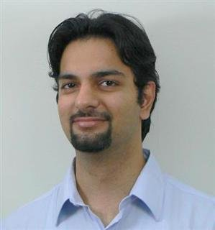

Recovering Components from Executables
[Cooperative Agreement HR0011-12-2-0012]
Thomas Reps
University of Wisconsin
Thomas Reps
Venkatesh
Karthik Srinivasan
Tushar
Sharma
Divy Vasal
Aditya
Thakur
Evan
Driscoll

Slide 2
Project Goals
Develop a “redeveloper’s workbench”
  Tools to identify and extract components, and establish their behavioral properties
  identify components
  make adjustments to components identified
  issue queries about a component’s properties
    type information; function prototypes
    side-effect “footprint” and other invariants
    error-triggering properties

Slide 3
Project Activities
Component identification
  Recovering class hierarchies using dynamic analysis
    group functions into classes
    identify inheritance and delegation relationships among the inferred classes
Component extraction
  Specialization slicing
    create multiple specialized versions of a procedure, each equipped with a different subset of the original procedure's parameters
    novel algorithm creates optimal specialization slice
  Partial evaluation of machine code
    general method to address extraction, specialization, and optimization of machine code
Verifying component properties
  Symbolic abstraction (BET + ONR STTR)
    methods to obtain most-precise results in abstract interpretation
    for a given abstract domain, attains the limit of what is achievable by any analysis algorithm
  Domain-combination technique: combine results from multiple analysis methods
  Abstract domain of bit-vector inequalities
    allows a tool to identify inequality invariants for machine arithmetic (arithmetic mod 2³² or 2⁶⁴)
    fills a long-standing need in both source-code and machine-code analysis
  Format-compatibility checking (ONR)
Notes:
Recovering class hierarchies
Goals:
(i) group functions into classes, and (ii) identify inheritance and delegation relationships among the inferred classes
Method:
Gather runtime traces of the actions performed on allocated objects. (Objects are identified by the value
of the “this’” parameter. Consequently, the tool tracks new/delete to identify when storage is reused for
different objects.) The sequence of destructor calls for an object provides the main evidence of the class
hierarchy.
Specialization-slicing algorithm
Goal:
The slice of a program with respect to a set of program elements S is a projection of the program that
includes only program elements that might affect (either directly or transitively) the values of the variables
used at members of S. Slicing allows one to find semantically meaningful decompositions of programs,
where the decompositions consist of elements that are not textually contiguous. In specialization slicing
we want to create multiple specialized versions of a procedure, each equipped with an appropriate subset
of the original procedure's parameters.
Method:
Partitioning problem on an infinite graph. Symbolic techniques are used to represent the infinite graph
in a finite way (and to find the desired partition). Our algorithm creates a specialization slice that is
optimal: it includes specialized procedures for (i) all parameter combinations that can arise, and
(ii) only parameter combinations that can arise.
Partial evaluation of machine code (started 2/2013)
Goal:
Create a machine-code partial evaluator: Given a machine-code procedure P(x,y) and a value “a” for x,
create a specialized procedure P_{a}(y) such that if the value “b” is supplied for y, P_{a}(b) computes P(a,b).
Use the partial evaluator to address method extraction, specialization, and optimization for machine-code
programs.
Method:
Adapt known methods for partial evaluation of source-code programs to the machine-code level.
Symbolic abstraction
Goal:
Bridge the gap between (i) the use of logic for specifying program semantics and performing program analysis,
and (ii) abstract interpretation. Formally, most program-analysis steps can be cast as the problem of
symbolic abstraction: “Given a formula ϕ in logic L, find the most-precise value in abstract domain A that
over-approximates the meaning of ϕ”.
The goal is to create methods that, for a given abstract domain, can attain the provable limit
of precision achievable. In addition, if too much time or space is being used, we want “anytime”
algorithms – i.e., algorithms that can be stopped at any time, and provide a safe (over-approximating) answer.
Method:
Several methods have been developed:
o One is a bilateral successive-approximation algorithm. It maintains both an over-approximation
and an under-approximation of the desired answer.
o Another resurrects (and generalizes) an old method for satisfiability checking, called Staalmarck’s method,
and harnesses if for symbolic abstraction.
Note:
These ideas turned out to be “dual-use”: not only do they lead to better program-analysis methods,
they have the potential to lead to better satisfiability procedures in automated logic.
Domain-combination technique
Goal:
Create ways of combining abstract domains so that results from multiple analysis methods can be combined
Method:
Information from both domains is maintained, and partial information that can be shared is communicated
between them.
Abstract domain of bit-vector inequalities
Goal:
Create an analysis datatype (“abstract domain ”) that can identify inequality invariants for
machine arithmetic (i.e., arithmetic mod 2³² or 2⁶⁴). Such a domain has been a long-standing
need in both source-code and machine-code analysis
Method:
Use two domains (affine equalities + intervals), and make use of a method that allows information
to be communicated between them (see “Domain-combination technique” below). The bounds
on intervals provide information about inequalities. E.g., (x -> [5, 10]) provides the inequalities
5 <= x and x <= 10.

Slide 4
Project Activities
Theme of all BET projects: Recover abstractions of program
Deliberately lossy: Model some aspect(s) of a program’s behavior
Range from
  syntactic (CFG, PDG) to
  semantic (invariants, procedure summaries, symbolic states)
Different algorithms/transformations need different properties
UW Theme: Fundamental techniques for recovering abstractions
Can attain provably best abstractions (under some conditions)
Easier to build tools: Correct-by-construction analyzers
Component identification
  Recovering class hierarchies using dynamic analysis
    group functions into classes
    identify inheritance and delegation relationships among the inferred classes
Component extraction
  Specialization slicing
    create multiple specialized versions of a procedure, each equipped with a different subset of the original procedure's parameters
    novel algorithm creates optimal specialization slice
  Partial evaluation of machine code
    general method to address extraction, specialization, and optimization of machine code
Verifying component properties
  Symbolic abstraction (BET + ONR STTR)
    methods to obtain most-precise results in abstract interpretation
    for a given abstract domain, attains the limit of what is achievable by any analysis algorithm
  Domain-combination technique: combine results from multiple analysis methods
  Abstract domain of bit-vector inequalities
    allows a tool to identify inequality invariants for machine arithmetic (arithmetic mod 2³² or 2⁶⁴)
    fills a long-standing need in both source-code and machine-code analysis
  Format-compatibility checking (ONR)
Notes:
Recovering class hierarchies
Goals:
(i) group functions into classes, and (ii) identify inheritance and delegation relationships among the inferred classes
Method:
Gather runtime traces of the actions performed on allocated objects. (Objects are identified by the value
of the “this’” parameter. Consequently, the tool tracks new/delete to identify when storage is reused for
different objects.) The sequence of destructor calls for an object provides the main evidence of the class
hierarchy.
Specialization-slicing algorithm
Goal:
The slice of a program with respect to a set of program elements S is a projection of the program that
includes only program elements that might affect (either directly or transitively) the values of the variables
used at members of S. Slicing allows one to find semantically meaningful decompositions of programs,
where the decompositions consist of elements that are not textually contiguous. In specialization slicing
we want to create multiple specialized versions of a procedure, each equipped with an appropriate subset
of the original procedure's parameters.
Method:
Partitioning problem on an infinite graph. Symbolic techniques are used to represent the infinite graph
in a finite way (and to find the desired partition). Our algorithm creates a specialization slice that is
optimal: it includes specialized procedures for (i) all parameter combinations that can arise, and
(ii) only parameter combinations that can arise.
Partial evaluation of machine code (started 2/2013)
Goal:
Create a machine-code partial evaluator: Given a machine-code procedure P(x,y) and a value “a” for x,
create a specialized procedure P_{a}(y) such that if the value “b” is supplied for y, P_{a}(b) computes P(a,b).
Use the partial evaluator to address method extraction, specialization, and optimization for machine-code
programs.
Method:
Adapt known methods for partial evaluation of source-code programs to the machine-code level.
Symbolic abstraction
Goal:
Bridge the gap between (i) the use of logic for specifying program semantics and performing program analysis,
and (ii) abstract interpretation. Formally, most program-analysis steps can be cast as the problem of
symbolic abstraction: “Given a formula ϕ in logic L, find the most-precise value in abstract domain A that
over-approximates the meaning of ϕ”.
The goal is to create methods that, for a given abstract domain, can attain the provable limit
of precision achievable. In addition, if too much time or space is being used, we want “anytime”
algorithms – i.e., algorithms that can be stopped at any time, and provide a safe (over-approximating) answer.
Method:
Several methods have been developed:
o One is a bilateral successive-approximation algorithm. It maintains both an over-approximation
and an under-approximation of the desired answer.
o Another resurrects (and generalizes) an old method for satisfiability checking, called Staalmarck’s method,
and harnesses if for symbolic abstraction.
Note:
These ideas turned out to be “dual-use”: not only do they lead to better program-analysis methods,
they have the potential to lead to better satisfiability procedures in automated logic.
Domain-combination technique
Goal:
Create ways of combining abstract domains so that results from multiple analysis methods can be combined
Method:
Information from both domains is maintained, and partial information that can be shared is communicated
between them.
Abstract domain of bit-vector inequalities
Goal:
Create an analysis datatype (“abstract domain ”) that can identify inequality invariants for
machine arithmetic (i.e., arithmetic mod 2³² or 2⁶⁴). Such a domain has been a long-standing
need in both source-code and machine-code analysis
Method:
Use two domains (affine equalities + intervals), and make use of a method that allows information
to be communicated between them (see “Domain-combination technique” below). The bounds
on intervals provide information about inequalities. E.g., (x -> [5, 10]) provides the inequalities
5 <= x and x <= 10.

Slide 5
Outline of Talk
Review of goals
Progress (Oct. 2012 - May 2013)
  Component identification
    Recovering class hierarchies using dynamic analysis
  Component extraction
    Specialization slicing
    Partial evaluation of machine code
  Verifying component properties
    Symbolic abstraction (BET + ONR STTR)
    Domain-combination technique: combine results from multiple analysis methods
    Abstract domain of bit-vector inequalities
    Format-compatibility checking (ONR)
Recap of publications/submissions
Recap of plans for 2013

Slide 6
Outline of Talk
Review of goals
Progress (Oct. 2012 - May 2013)
  Component identification
    Recovering class hierarchies using dynamic analysis
  Verifying component properties
    Symbolic abstraction (BET + ONR STTR)
    Domain-combination technique: combine results from multiple analysis methods
    Abstract domain of bit-vector inequalities
    Format-compatibility checking (ONR)
  Component extraction
    Specialization slicing
    Partial evaluation of machine code
Recap of publications/submissions
Recap of plans for 2013

Slide 7
Recovering Class Hierarchies
_Disassembly of section .text:
00000000004003e0 <.text>:
4003e0: xor %ebp,%ebp
4003e2: mov %rdx,%r9
4003e5: pop %rsi
4003e6: mov %rsp,%rdx
4003e9: push %rax
4003ea: push %rsp
.
.
.
Given:
  Stripped binary
Goals:
  Group functions in the binary into classes
  Identify inheritance and composition relationships between inferred classes
?
Inheritance relationship
Composition relationship
Methods:
0x400460
0x4004c4
…
Methods:
0x4004f0
0x400530
…
Class A
Class B
Methods:
0x4005bf
0x400607
…
Methods:
0x40054a
0x400576
…
Class C
Class D

Slide 8
Recovering Class Hierarchies
Why?
  Reengineering legacy software
  Understanding architecture of software that lack documentation and source code
Lego
  Dynamic analysis tool
  Recovers software architecture
  Modulo code coverage

Slide 9
Key Ideas
“this” pointer idiom
  Common idiom in object-oriented programming
  “this” pointer = 1st argument of methods of a class
  Used to classify sets of functions
Unique finalizer idiom
  Unique method in each class (Destructor in C++)
  Cleans up object
  Parent-class finalizer called at end of child-class finalizer
  Used to recover inheritance and composition relationships
void SetID(int nID)
void SetID(Simple* const this, int nID)

Slide 10
Lego – 2 Phases
Phase 1
  Input: stripped binary and test input
  Executes given binary under test input
  Performs dynamic analysis by dynamic binary instrumentation
  Records methods invoked on allocated objects
  Output: object-traces (summary of lifetime of every object)
Phase 2
  Input: object-traces
  Uses order of finalizer calls as evidence from object-traces to infer class hierarchies
  Output: Inferred class hierarchy and composition relationships between inferred classes

Slide 11
Phase 1: Object-Traces
A sequence of method calls and returns that have the same receiver object
class Vehicle {
public:
Vehicle();
~Vehicle();
};
class Car :
public Vehicle {
public:
Car(int n);
~Car();
void print_car();
private:
void helper();
};
class Bus :
public Vehicle {
public:
Bus();
~Bus();
void print_bus();
};
int main() {
Car c(10);
Bus b;
c.print_car();
b.print_bus();
return 0;
}
0xAAAA
(Address of c):
Car(int) C
Vehicle() C
Vehicle() R
Car(int) R
print_car() C
print_car() R
~Car() C
helper() C
helper() R
~Vehicle() C
~Vehicle() R
~Car() R
0xBBBB
(Address of b):
Bus() C
Vehicle() C
Vehicle() R
Bus() R
print_bus() C
print_bus() R
~Bus() C
~Vehicle() C
~Vehicle() R
~Bus() R

Slide 12
Object Traces – How to get them?
Instrument binary using PIN to trace:
  Values of 1st-arguments of methods
  Method calls and returns
Emit a trace of <“this” pointer, method Call/Return> pairs
Group methods based on “this”-pointer values
From the trace, compute object-traces, pairs <A, S> where
  A is an object address
  S is the sequence of method calls/returns that were passed A as the value of the “this” pointer (1st argument)

Slide 13
Object-Traces
m()
{
. . .
}
n()
{
. . .
}
a1
a1
a2
. . .
a3
. . . <a1, m, C> . . <a1, n, C> . . . <a1, n, R> . . <a1, m, R> . . .
<a2, m, C> . . <a2, m , R> . . <a3, m, C> . . <a3, m , R>
Emitted Trace
Object Traces
[a1: <m, C>, <n, C>, <n, R>, <m, R>], [a2: <m, C>, <m, R>], [a3: <m, C>, <m, R> ]

Slide 14
Challenges – Blacklisting Methods
Stand-alone methods and static methods don’t receive a “this” pointer
Lego maintains estimates of allocated address space
  Stack pointer values during calls and returns
  Allocated heap objects – instrument new and delete
If 1st argument’s value of a method is not within allocated address space, method is blacklisted
  Removed from existing object-traces
  Never added to future object-traces
void foo(); static void Car::setInventionYear(int a);

Slide 15
Challenges – Object-address Reuse
class A {
public:
. . .
printA();
};
class B {
public:
. . .
printB();
};
void foo() {
A a;
a.printA();
}
void bar() {
B b;
b.printB();
}
int main {
foo();
bar();
return 0;
}
Methods of two (or more) unrelated classes appear in same object-trace
Reuse of stack space for objects on different Activation Records (ARs)
Reuse of same heap space by heap manager
Lego versions addresses – increment version of address A when A is deallocated

Slide 16
Challenges – Spurious Traces
Spurious traces
  Methods of two (or more) unrelated classes appear in the same object-trace
  Reuse of same stack space by compiler for different objects in different scopes within same AR
  Locate initializer and finalizer methods to split spurious traces
void f() {
{
Foo a;
…
}
{
Bar b;
…
}
}
Stack space reused for a and b
AR of f()

Slide 17
Phase 2: Object-Trace Fingerprints
Common semantics of OO languages – derived class’s finalizer calls base finalizer just before returning
Fingerprint – ‘return-only’ suffix of object-trace
‘return-only’ – Methods that were called just before caller returned
Has methods involved in cleanup of object and inherited parts
class A {
~A();
};
class B :
public A {
~B();
};
class C :
public B {
~C();
helper();
};
class D:
public C {
~D();
};
~D() C
~C() C
helper() C
helper() R
~B() C
~A() C
~A() R
~B() R
~C() R
~D() R
Length indicates possible number of levels in class hierarchy
Methods in fingerprint – potential finalizers in the class and ancestor classes

Slide 18
Finding Class Hierarchies
Create a trie from fingerprints
Associate each object-trace with trie node that accepts object-trace’s fingerprint
Add methods in each object-trace to associated trie node
If parent and child nodes have common methods, remove common methods from child
...
p(), ~A()
~A()
. . p() ~A()
...
q() ~B()
~B()
~C()
B
. . q() ~A() ~B()
~A()
D
…
s()
~C()
...
r() ~D()
~D()
~A() ~B()
. . r() ~A() ~B() ~D()
~A()
. . s() ~A() ~C()

Slide 19
Composition Relationships
Class A has a member instance of B
A is responsible for cleaning up B – A’s finalizer calls B’s finalizer
Record the methods directly called by each method in object-trace
Conditions for a composition relationship to exist between inferred classes A and B
  A’s finalizer calls B’s finalizer
  A is not B’s ancestor or descendant in the inferred hierarchy

Slide 20
Scoring – Ground Truth
ios_base
Vehicle
GPS
ios
Road
Bus
Car
ostream
Inter
state
Restricted GT
Arterials
Compact
SUV
ofstream
Partially Restricted GT
Local
Unrestricted GT
Notes:
Explain why we only use only PRGT and RGT
Also explain what is the significance of using PRGT – gives us the scoring for the realistic case

Slide 21
Scoring
Precision and Recall
Can’t treat classes as flat sets of methods – inheritance relationships between classes
For every path in the GT inheritance hierarchy, find the path in the inferred hierarchy that gives maximum precision and recall
Vehicle
p = X%
r = Y%
Vehicle’
p = X%
r = Y%
Bus
Car
p = X%
r = Y%
Bus’
Car’
p = X%
r = Y%
Compact
p = X%
r = Y%
Compact’
SUV’
SUV’’
SUV

Slide 22
Results

Slide 23
Results – Destructor copies not provided

Slide 24
Results – Composition Relationships

Slide 25
Outline of Talk
Review of goals
Progress (Oct. 2012 - May 2013)
  Component identification
    Recovering class hierarchies using dynamic analysis
  Verifying component properties
    Symbolic abstraction (BET + ONR STTR)
    Domain-combination technique: combine results from multiple analysis methods
    Abstract domain of bit-vector inequalities
    Format-compatibility checking (ONR)
  Component extraction
    Specialization slicing
    Partial evaluation of machine code
Recap of publications/submissions
Recap of plans for 2013

Slide 26





Verifying component properties
Property holds for all possible inputs
No null-pointer deferences
No accesses outside array bounds
No stack smashing
No division by zero
while(1) {
x = input();
If (x > 0) {
y = 2*x;
z = w/y;
}
}
while(1) {
x = input();
If (x > 0) {
y = 2*x;
z = w/y;
}
}
Sign Abstraction: only track whether
variable is positive, negative, or zero
y$→2$
y$→8$
y$→42$
y$>0$
y$→1$78
…
Program statement
Program
Possible concrete
values of y
Invariant
Notes:
Indicate div by zero is the goal

Slide 27








Inductive Invariants
Program points
Inductive Invariants
$$P_{1}$$
$$I_{1}$$
$$τ_{12}$$
$$P_{2}$$
$$I_{2}$$
$$τ_{23}$$
$$P_{3}$$
$$I_{3}$$

Slide 28
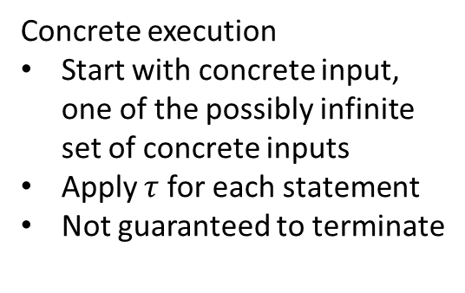
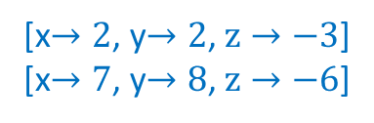
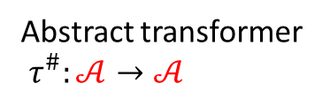

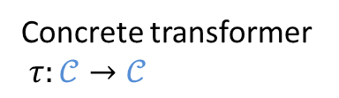


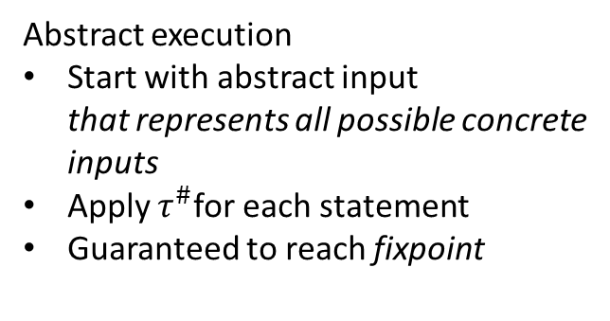
Abstract Interpretation
Concrete
Abstract
Concrete state $𝒞$
Abstract state $𝒜$
[x$→2$, y$→2$, $z→−3$]
[x$→7$, y$→8$, $z→−6$]
[x$>0$, y$>0$, $z<0$]
Has to be
sound, precise over-approximation
Concrete transformer
$τ:𝒞→𝒞$
Abstract transformer
$τ^{\#}:𝒜→𝒜$
Concrete execution
Start with concrete input,
one of the possibly infinite
set of concrete inputs
Apply $τ$ for each statement
Not guaranteed to terminate
Abstract execution
Start with abstract input
that represents all possible concrete
inputs
Apply $τ^{\#}$for each statement
Guaranteed to reach fixpoint

Slide 29
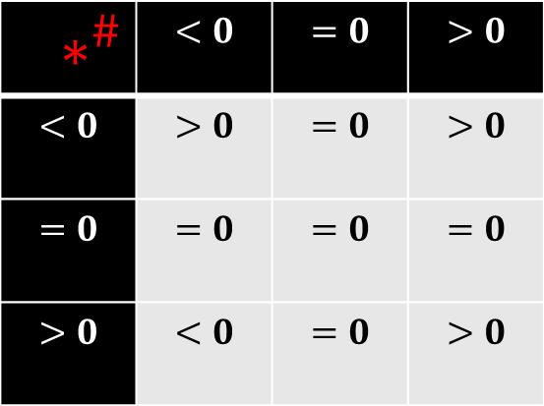
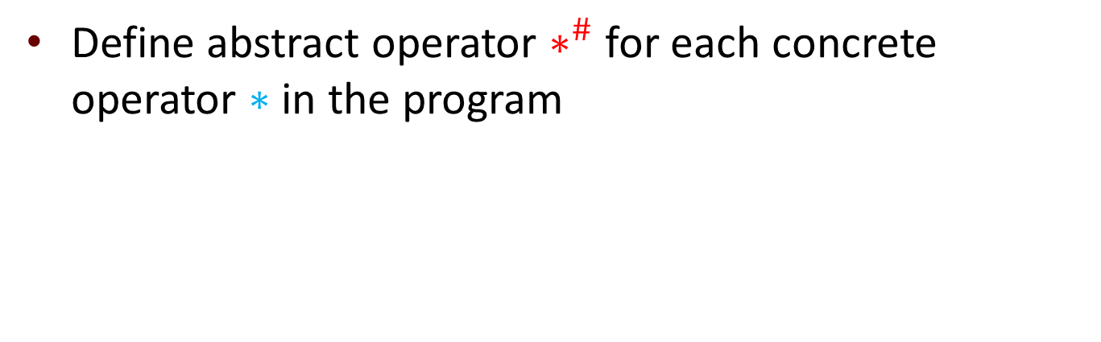
Transformers via reinterpretation
Define abstract operator $∗^{\#}$ for each concrete operator $∗$ in the program
$∗^{\#}$ | $$<0$$ | $$=0$$ | $$>0$$
$$<0$$ | $$>0$$ | $$=0$$ | $$>0$$
$$=0$$ | $$=0$$ | $$=0$$ | $$=0$$
$$>0$$ | $$<0$$ | $$=0$$ | $$>0$$

Slide 30

Transformers via reinterpretation
Define abstract operator $∗^{\#}$ for each concrete operator $∗$ in the program
$∗^{\#}$ | $$<0$$ | $$=0$$ | $$>0$$
$$<0$$ | $$>0$$ | $$=0$$ | $$<0$$
$$=0$$ | $$=0$$ | $$=0$$ | $$=0$$
$$>0$$ | $$<0$$ | $$=0$$ | $$>0$$

Slide 31
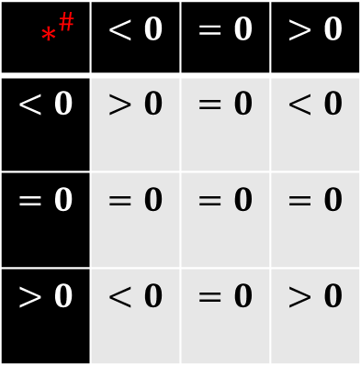






Transformers via reinterpretation
Compositionally define abstract transformers for statements using abstract operators
[x$>0$, y$>0$, $z<0$]
a $=^{\#}$ (x $∗^{\#}$y) $∗^{\#}$z;
a $=$ (x $∗$ y) $∗$ z;
a $=^{\#}$ $<0$
a $=^{\#}$ ( $>0$ ) $∗^{\#}$z;
$∗^{\#}$ | $$<0$$ | $$=0$$ | $$>0$$
$$<0$$ | $$>0$$ | $$=0$$ | $$<0$$
$$=0$$ | $$=0$$ | $$=0$$ | $$=0$$
$$>0$$ | $$<0$$ | $$=0$$ | $$>0$$
[$a<0,\text{x}>0\text{, }\text{y}>0\text{, }z<0$]

Slide 32
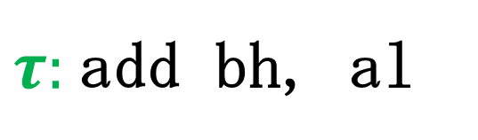

Transformers via reinterpretation
$τ:$add bh, al
Adds al, the low-order byte of 32-bit register eax,to
bh, the second-to-lowest byte of 32-bit register ebx
eax
$$+$$
ebx
Notes:
Don’t use a circled plus

Slide 33
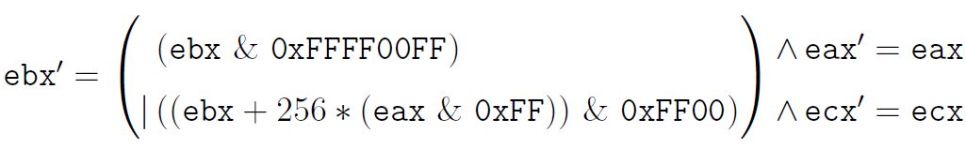


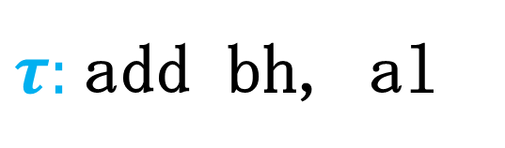





Transformers via reinterpretation
$τ:$add bh, al
$𝒜$: Conjunctions of bit-vector affine equalities between registers
ebx $−$ ecx $=0$ $∈𝒜$
$$^{\#}$$
$$^{\#}$$
$$^{\#}$$
$$^{\#}$$
$$^{\#}$$
$$^{\#}$$
$$^{\#}$$
$$^{\#}$$
$$^{\#}$$
Semantics expressed as a formula
$2^{24}$ebx’ $−$ $2^{24}$ecx’ $=0$ $∈𝒜$
Not the most-precise value
$∧2^{16}$ebx’ $=$ $2^{16}$ecx’ $+2^{24}$eax’
Primed variables represent values
in post-state.

Slide 34




Automation of best transformer
$$τ$$
$$a∈𝒜$$
Ensures correctness
Ensures precision
Reduces time to implement primitives
$$a′$$
Application of
best transformer

Slide 35









Symbolic Abstract Interpretation
$$𝒞$$
$$ℒ$$
$$𝒜$$
Easy
$$\hat{γ}$$
$$φ$$
$$a$$
$$γ$$
Symbolic Concretization

Slide 36



Symbolic Abstract Interpretation
$$𝒞$$
$$ℒ$$
$$Intervals$$
$$\hat{γ}$$
$$x≥2∧x≤10$$
$$\{x↦\left[2,10\right]\}$$
$$γ$$
Symbolic Concretization

Slide 37



Symbolic Abstract Interpretation
$$𝒞$$
$$ℒ$$
$$𝒜$$
Challenging
$$\hat{α}$$
$$φ$$
$$a$$
$$γ$$
Symbolic Abstraction

Slide 38








Symbolic abstraction $⇒$ best transformer
$$𝒞$$
$$ℒ$$
$$𝒜$$
$$\hat{γ}$$
$$a$$
$$φ_{τ}∧\hat{γ}(a)$$
$$τ^{\#}$$
$$τ$$
$$\hat{α}$$
$$a′$$

Slide 39
Automation of best transformer
$$τ$$
$$a∈𝒜$$
$$a′$$
Application of
best transformer

Slide 40


Automation of best transformer
$$φ_{τ}$$
$$a∈𝒜$$
$$\hat{α}$$
$$a′$$
Application of
best transformer

Slide 41




Algorithm for $\hat{α}\left(φ\right)$
$$𝒞$$
$$φ$$
SMT Solver
$$S⊨φ$$
SMT:= Satisfiability Modulo Theory

Slide 42




RSY algorithm for $\hat{α}\left(φ\right)$ [VMCAI’04]
$$𝒞$$
$$𝒜$$
Smart sampling
$$\hat{α}(φ)$$
$$⟦φ⟧$$
Converge “from below”
$$⊥$$

Slide 43






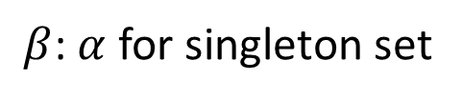
RSY algorithm for $\hat{α}\left(φ\right)$ [VMCAI’04]
$$𝒞$$
$$ℒ$$
$$𝒜$$
$$S⊨φ$$
$$φ$$
$$S$$
$$\hat{γ}(ans)$$
$$\hat{γ}$$
$$β(S)$$
$$⟦φ⟧$$
$$β$$
$$⊥$$
ans
$β$: $α$ for singleton set
Notes:
Make [\varphi] dotted.
Put dot in front of S

Slide 44




RSY algorithm for $\hat{α}\left(φ\right)$ [VMCAI’04]
$$𝒞$$
$$ℒ$$
$$𝒜$$
$$β$$
$$S_{1}$$
$$φ_{1}$$
ans
$$S_{1}⊨φ_{1}$$
$$⟦φ⟧$$
$$⊥$$
$$φ_{1}=φ∧¬\hat{γ}(ans)$$

Slide 45



RSY algorithm for $\hat{α}\left(φ\right)$ [VMCAI’04]
$$𝒞$$
$$ℒ$$
$$𝒜$$
$$\hat{γ}(ans)$$
$$\hat{γ}$$
ans
$$S_{1}$$
$$⟦φ⟧$$
$$⊥$$
$$φ_{1}=φ∧¬\hat{γ}(ans)$$

Slide 46




RSY algorithm for $\hat{α}\left(φ\right)$ [VMCAI’04]
$$𝒞$$
$$ℒ$$
$$𝒜$$
$$\hat{γ}(ans)$$
$$\hat{γ}$$
$$\hat{α}(φ)$$
ans
$$⟦φ⟧$$
$$⊥$$
$φ_{k}=φ∧¬\hat{γ}(ans)$ UNSAT

Slide 47



Bilateral algorithm for $\hat{α}\left(φ\right)$ [SAS’12]
$$⊤$$
Converge “from below”
and “from above”
$$\hat{α}(φ)$$
$$⊥$$

Slide 48


Bilateral algorithm for $\hat{α}\left(φ\right)$ [SAS’12]
$$⊤$$
Stop at any time→ sound answer
$$\tilde{α}(φ)$$
$$\hat{α}(φ)$$
$$⊥$$

Slide 49

Bilateral algorithm for $\hat{α}\left(φ\right)$ [SAS’12]
$$⊤$$
Tunable
More time → more precision
$$\tilde{α}(φ)$$
$$\hat{α}(φ)$$
$$⊥$$

Slide 50



Bilateral algorithm for $\hat{α}\left(φ\right)$ [SAS’12]
$$𝒞$$
$$ℒ$$
$$𝒜$$
$$⊤$$
upper
$$S⊨φ$$
$$φ$$
$$S$$
$$\hat{γ}(lower)$$
$$\hat{γ}$$
$$β(S)$$
$$⟦φ⟧$$
$$β$$
$$⊥$$
lower
$β$: $α$ for singleton set

Slide 51



Bilateral algorithm for $\hat{α}\left(φ\right)$ [SAS’12]
$$𝒞$$
$$ℒ$$
$$𝒜$$
$$⊤$$
upper
$$\hat{γ}(p)$$
$$\hat{γ}$$
p
lower
$$⟦φ⟧$$
$$⊥$$
$$φ_{1}=φ∧¬\hat{γ}(p)$$
UNSAT!

Slide 52

Bilateral algorithm for $\hat{α}\left(φ\right)$ [SAS’12]
$$𝒞$$
$$ℒ$$
$$𝒜$$
$$⊤$$
upper
$$\hat{γ}(p)$$
$$\hat{γ}$$
p
$$S_{1}$$
$$β$$
lower
$$⟦φ⟧$$
$$⊥$$
$$φ_{1}=φ∧¬\hat{γ}(p)$$
SAT!

Slide 53

Symbolic abstraction $⇒$ Best inductive invariants
Theoretical limit of attainable precision
Achieved via repeated application of best transformer
  That’s it! [TAPAS 2013]

Slide 54
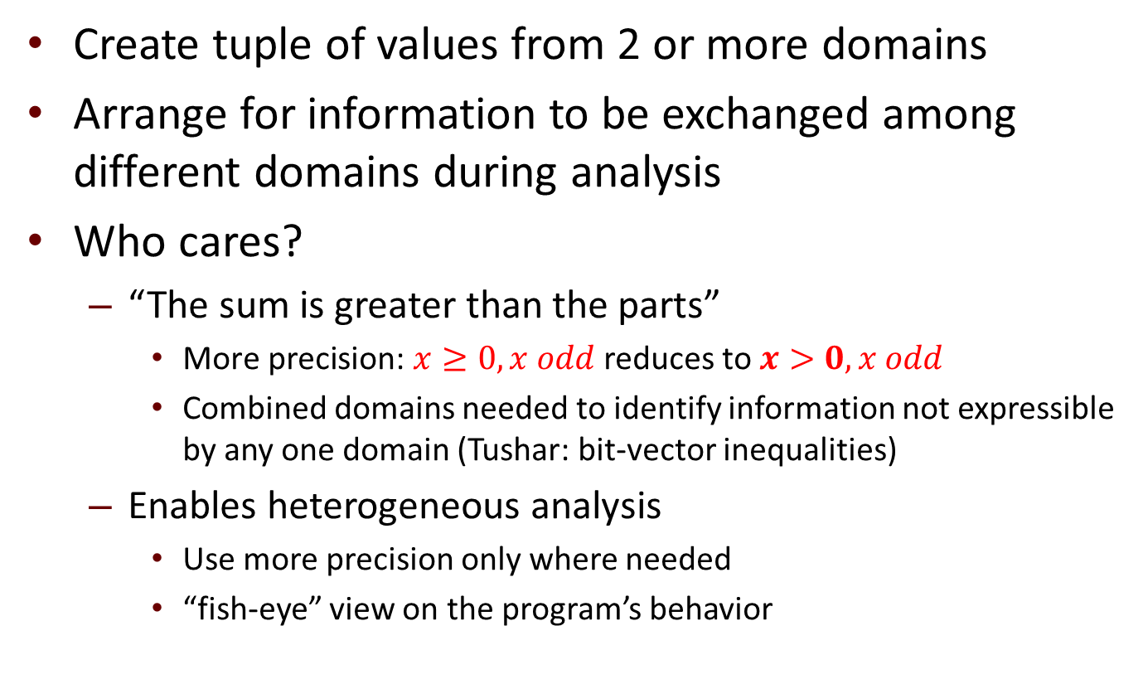
Combining domains
Create tuple of values from 2 or more domains
Arrange for information to be exchanged among different domains during analysis
Who cares?
  “The sum is greater than the parts”
    $\text{More} \text{precision}$: $x≥0, x odd$ reduces to $x>0, x odd$
    Combined domains needed to identify information not expressible by any one domain (Tushar: bit-vector inequalities)
  Enables heterogeneous analysis
    Use more precision only where needed
    “fish-eye” view on the program’s behavior
Notes:
. . . fish-eye view: give analogy with finite-element analysis:
modeling an airplane wing
use more and smaller triangles (= better model) in places of greater stress, such as
where the wing meets the fuselage

Slide 55
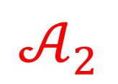

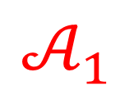










Symbolic abstraction $⇒$ information exchange
$$𝒜_{1}$$
$$𝒜_{2}$$
$$ℒ$$
$${\hat{γ}}_{1}$$
$$a_{1}$$
$${\hat{γ}}_{2}$$
$$a_{2}$$
$${\hat{γ}}_{1}\left(a_{1}\right)∧{\hat{γ}}_{2} (a_{2})$$
$$a_{1}^{′}$$
$${\hat{α}}_{1}$$
$${\hat{α}}_{2}$$
$$a_{2}^{′}$$

Slide 56


Symbolic abstraction $⇒$ information transfer
$$𝒜_{1}$$
$$𝒜_{2}$$
$$ℒ$$
$${\hat{γ}}_{1}$$
$$a_{1}$$
$${\hat{γ}}_{1}\left(a_{1}\right)$$
$${\hat{α}}_{2}$$
$$a_{2}^{′}$$
Notes:
Using similar ideas, can also switch to a completely new domain.
Use symbolic abstraction (in A2) to convert from value a1 to the best
Value a2’ in A2.

Slide 57
Summary
Symbolic abstraction increases level of automation, and ensures correctness when
applying abstract transformers,
computing best inductive invariants, and
exchanging information among domains
Algorithms for symbolic abstraction require
off-the-shelf SMT solvers, and
implementation of very few abstract-domain operations

Slide 58
Outline of Talk
Review of goals
Progress (Oct. 2012 - May 2013)
  Component identification
    Recovering class hierarchies using dynamic analysis
  Verifying component properties
    Symbolic abstraction (BET + ONR STTR)
    Domain-combination technique: combine results from multiple analysis methods
    Abstract domain of bit-vector inequalities
    Format-compatibility checking (ONR)
  Component extraction
    Specialization slicing
    Partial evaluation of machine code
Recap of publications/submissions
Recap of plans for 2013

Slide 59
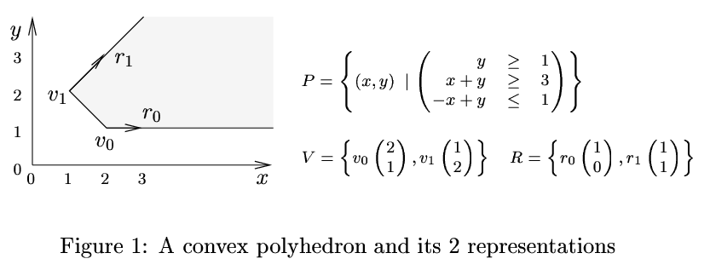
Convex Polyhedra
[Figures from Halbwachs et al. FMSD97]
Conjunctions of linear inequalities over rationals
  a₁ x₁ + a₂ x₂ + . . . + a_{k} x_{k} ≤ c

Slide 60
Limitations of convex polyhedra
Consider the following code fragment:
assume (0 <= low <= high ) ;
mid = ( low + high ) / 2 ;
assert (0 <= low <= mid <= high ) ;
Polyhedral analysis unsoundly says that the assert holds
  e.g., 5-bit signed ints
Notes:
Bug in binary search program that Bentley proved correct and subsequently tested in Chapter 5.

Slide 61
Limitations of convex polyhedra
y
P[x+1/x]
P
x
Effect of the linear transformation might overflow
Polyhedra express constraints over rationals, not bit-vector integers

Slide 62
Problems with Polyhedra
Unsound for machine arithmetic
  machine integers wrap
  mathematical integers and rationals do not
Solution: Bit-Vector Inequality Domain

Slide 63
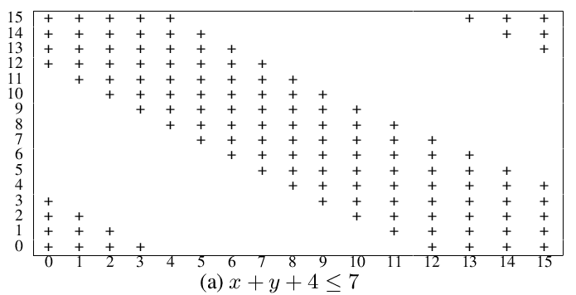
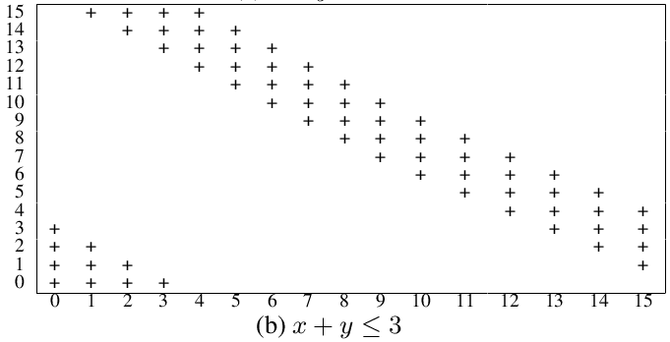
Bit-vector inequalities (Not so well-behaved . . .)

Slide 64

Key Idea!
Split inequality into an equality and an interval by using a view variable
For example, is changed to
x + y = s, s ∈ [0, 3]
x + y = s, s ∈ [-4, 3]
Notes:
Mention that x+y <= 3 is a subset of the space x+y+4 <= 7

Slide 65
Bit-Vector Inequality Domain (BVI)
Use a bit-vector equality domain (Ԑ)
(King-Sondergaard 2010; Elder et al. 2011)
    Ԑ is a conjunction of equalities over P ∪ S
Bit-vector interval domain (I) on view variables
    I is a conjunction of intervals over S
P and S are the set of program and view variables, respectively

Slide 66
Bit-Vector Inequality Domain (BVI)
S, the set of view variables, is shared between Ԑ and I
S allows information to be exchanged between the two domains
  Example:
    Ԑ specifies the constraints and
    I specifies the constraints

Slide 67
View Variables
View variables are defined by integrity constraints
For example, in
is an integrity constraint

Slide 68
Symbolic Abstraction
BVI is a combination of Ԑ and I
Symbolic abstraction for Ԑ and I is available
Information exchange is provided through common vocabulary S
Symbolic abstraction for BVI is automatically available through $\hat{α}\left(φ\right)$

Slide 69
Preliminary Results
Setup: View constraints are of the form s = r, where r represents the 32-bit register of the instruction-set architecture (e.g., x86)
BVI domain was 3.5 times slower than bit-vector equality domain
BVI more precise than equality domain at 63% of the control points
BVI’s procedure summaries more precise than that of equality domain at 29% of the procedures

Slide 70
Heuristics
Heuristics to choose view variables
View constraints are of the form s = r are not sufficient
a=0; b=0;
for (i = 0; i < 100; i++) {
a++;
if (i%2 == 0)
b++;
}
Cannot obtain the constraint that

Slide 71
Heuristics for view selection
  Use linear expressions obtained from branch predicates and assert statements
    analyze branch condition
      e.g., eax + ebx < 0
    heuristic: create s = eax + ebx
  “Candidate invariants” produced by running an unsound analysis
    e.g., polyhedra over rationals

Slide 72
Handling Memory
BVI only tracks information about registers
Memory is treated as flat array in machine code
Introduce memory views:
u = mm[e], where
u is a memory-view variable,
mm is the memory map,
e is an address.
Memory domain element:
  conjunction of memory-view constraints

Slide 73
BVMI domain
BVMI domain is capable of expressing bit-vector inequalities over memory variables
BVMI components
  Ԑ is an equality-domain element over P ∪ U ∪ S
      I is an interval-domain element over S
      M is a memory-domain element over U
Information exchange
  between Ԑ and I via the common variables S
  between Ԑ and M via the common variables U.

Slide 74
Current Status
First implementation of BVI is finished
  incorporates a “one-off” combination of domains Ԑ and I
Implementing a general-purpose template for combining domains: combine<D₁,D₂>
Revising the BVI implementation to use combine
BVI = combine<Ԑ, I>

Slide 75
Future Work
Implementing heuristics for selecting view definitions for BVI and BVMI
Integrating memory domain in the new domain-combination framework

Slide 76
Recap
Classical convex polyhedra unsound for machine ints
Bit-vector inequality domain (BVI) handles bit-vector inequalities by splitting them into bit-vector equalities and bit-vector intervals
Memory variables can be incorporated in a similar fashion
  split into bit-vector equalities and memory constraints
  Information exchange between combined domains happen through view variables

Slide 77
Outline of Talk
Review of goals
Progress (Oct. 2012 - May 2013)
  Component identification
    Recovering class hierarchies using dynamic analysis
  Verifying component properties
    Symbolic abstraction (BET + ONR STTR)
    Domain-combination technique: combine results from multiple analysis methods
    Abstract domain of bit-vector inequalities
    Format-compatibility checking (ONR)
  Component extraction
    Specialization slicing
    Partial evaluation of machine code
Recap of publications/submissions
Recap of plans for 2013

Slide 78
Partial evaluation of machine code
Slicing has limitations
  limited semantic information – i.e., just dependence edges
  no evaluation/simplification
Partial evaluation: a framework for specializing and optimizing programs
Binding-time analysis
  what patterns are foo and bar called with?
    e.g, { foo(S,S,D,D), foo(S,D,S,D), bar(S,D), bar(D,S) }
  polyvariant binding-time analysis? specialization slicing!
Venkatesh
Srinivasan

Slide 79
Partial evaluation of machine code
Given:
  Machine-code procedure P(x, y)
  Value “a” for x
Goals:
  Create a specialized procedure P_{a}(y)
  If the value “b” is supplied for y, P_{a}(y) computes P(a,b)
. . .
mov dword [ebp - C],eax
. . .
mov dword [ebp - 8],eax
mov eax,dword [ebp - 8]
mov edx,dword [ebp - C]
add eax, edx
mov dword [ebp - 4],eax
mov eax,0
leave
ret
. . .
mov dword [ebp - C],eax
mov eax,dword [ebp - C]
add eax, 2
mov dword [ebp - 4],eax
mov eax,0
leave
ret
a
b
P(x,y)
P(x,y)
P(a, b)
P_{a}(y)
Partial
Evaluator
b
a

Slide 80
Partial Evaluation – Why?
Extraction of functional components
  gzip incorporates compress and decompress
  Partial evaluation of ‘gzip -d’ would produce an executable that only decompresses
Optimization
  P.E. produces faster and smaller binaries optimized for a specific task
  “Re-optimizer” capable of performing
    constant propagation and constant folding
    loop unrolling
    elimination of unreachable/infeasible basic blocks
    . . .

Slide 81
Sketch of Method
Input
  Stripped binary
  Division on the inputs to binary
    Static: inputs to the binary whose values are known at specialization time
    Dynamic: other inputs
Output: Specialized binary
Steps
  Binding-time analysis (BTA)
  Specialization

Slide 82
Binding-Time Analysis
Input
  Division on the inputs (S/D)
Output
  Division on the instructions (S/D)
  Static instructions
    Depend only on static inputs
  Dynamic instructions
    May depend on dynamic inputs
Method
  Interprocedural forward slice from dynamic inputs
. . .
mov dword [ebp - C],eax
. . .
mov dword [ebp - 8],eax
mov eax,dword [ebp - 8]
mov edx,dword [ebp - C]
add eax, edx
mov dword [ebp - 4],eax
mov eax,0
leave
ret
. . .
mov dword [ebp - C],eax
. . .
mov dword [ebp - 8],eax
mov eax,dword [ebp - 8]
mov edx,dword [ebp - C]
add eax, edx
mov dword [ebp - 4],eax
mov eax,0
leave
ret

Slide 83
Specialization
Input:
  Division on the instructions
Output:
  Specialized binary
Method:
  Evaluate static instructions using partial static state
  Simplify dynamic instructions using partial static state
  Emit simplified dynamic instructions (“residual code”)
  Evaluate static jumps to eliminate entire basic blocks
. . .
mov dword [ebp - C],eax
. . .
mov dword [ebp - 8],eax
mov eax,dword [ebp - 8]
mov edx,dword [ebp - C]
add eax, edx
mov dword [ebp - 4],eax
mov eax,0
leave
ret
. . .
mov dword [ebp - C],eax
mov eax,dword [ebp - C]
add eax, 2
mov dword [ebp - 4],eax
mov eax,0
leave
ret

Slide 84
Challenges
No variables in machine code
  BTA in partial evaluation for source code classifies variables as static/dynamic
Stack pointer
  Instructions that manipulate stack: storage-allocation instructions
  Stack growth of specialized binary must correspond to that of input binary
Specialization of instructions
  Syntactic issues (properties of ISA)
    For each instruction I, is every possible specialization of I a single instruction I’? If not, how do you generate the appropriate I₁’; I₂’; …; I_{k}’
  Semantic issues
    Hidden operands (registers, flags, memory operands)

Slide 85
Implementation Plans
Binding-time analysis implemented via slicing
Simplification of dynamic instructions using partial static state is being implemented
Future work:
  More semantics-based way to simplify instructions
  “Given the semantics of ISA L in TSL, automatically generate a partial evaluator for L”

Slide 86
Outline of Talk
Review of goals
Progress (Oct. 2012 - May 2013)
  Component identification
    Recovering class hierarchies using dynamic analysis
  Verifying component properties
    Symbolic abstraction (BET + ONR STTR)
    Domain-combination technique: combine results from multiple analysis methods
    Abstract domain of bit-vector inequalities
    Format-compatibility checking (ONR)
  Component extraction
    Specialization slicing
    Partial evaluation of machine code
Recap of publications/submissions
Recap of plans for 2013

Slide 87
Recap of publications/submissions
Lim, J. and Reps. T., TSL: A system for generating abstract interpreters and its application to machine-code analysis. To appear in ACM Trans. on Program. Lang. and Syst. (TOPLAS), April 2013. http://www.cs.wisc.edu/wpis/papers/toplas13-tsl-final.pdf
Srinivasan, V.K. and Reps, T., Software-architecture recovery from machine code. TR-1781, Computer Sciences Department, University of Wisconsin, Madison, WI, March 2013. Submitted for conference publication. http://www.cs.wisc.edu/wpis/papers/tr1781.pdf
Aung, M., Horwitz, S., Joiner, R., and Reps, T., Specialization slicing. TR-1776, Computer Sciences Department, University of Wisconsin, Madison, WI, October 2012. Submitted for journal publication. http://www.cs.wisc.edu/wpis/papers/SpecSlicing-submission.pdf
Thakur, A., Lal, A., Lim, J., and Reps, T., PostHat and all that: Automating abstract interpretation. To appear in Electr. Notes in Theor. Comput. Sci., 2013. http://www.cs.wisc.edu/wpis/papers/tapas13.pdf
Sharma, T., Thakur, A., and Reps, T., An abstract domain for bit-vector inequalities. TR-1789, Computer Sciences Department, University of Wisconsin, Madison, WI, April 2013. http://www.cs.wisc.edu/wpis/papers/tr1789.pdf
Elder, M., Lim, J., Sharma, T., Andersen, T., and Reps, T., Abstract domains of affine relations. TR-1792, Computer Sciences Department, University of Wisconsin, Madison, WI, May 2013. Submitted for journal publication. http://www.cs.wisc.edu/wpis/papers/tr1792.pdf

Slide 88
Plans for next six months
Component extraction
  Partial evaluator for machine code
Verifying component properties
  Perfecting domain-combination template
    BVMI
    Heuristics for view selection
  Apply symbolic abstraction to list-manipulating programs
  Better than best inductive invariants!

Slide 89


Stålmarck’s method
E.g., best inductive invariant
$$⊤$$
An invariant
Not inductive
More precise (= better) than best inductive invariant
$$⊥$$
Notes:
Set v_root to false first

Slide 90
Plans for next six months
Component extraction
  Partial evaluator for machine code
Verifying component properties
  Perfecting domain-combination template
    BVMI
    Heuristics for view selection
  Apply symbolic abstraction to list-manipulating programs
  Better than best inductive invariants!
    Incorporate “Stålmarck pump” into McVeto (Machine code Verification tool)
  Technology transfer to GrammaTech’s DARPA VET project
    Tim Fraser, DARPA VET PM
    Alexey Loginov, GrammaTech PI

Slide 92
Future Work: Dependences across the OS
Aim: Identify pairs of functions that have producer consumer relationships mediated by the OS
Not identified by existing program-analysis tools
  treat system calls conservatively (system call exhibits every possible behavior)
  treat system calls unsoundly (system call does “nothing”)

Slide 93
Basic scenario

Slide 94
Dependences across the OS
Why do we need them?
  reuse of a component requires extraction and reuse of all component dependences
  must identify all dependences of a component so that they can be extracted as well
Component B writes to a pipe
Component A reads from the same pipe
If A is extracted and executed, it will block forever
Since A is dependent on B, B should also be extracted and executed
Component A
Component B
Operating System

Slide 95
Bit-vector Inequality Domain
Split inequality into equality using view variables
For example, is changed to
Use a bit-vector equality domain for equalities
(King-Sondergaard 2010; Elder et al. 2011)

Slide 96
Bit-vector Inequality Domain
A (reduced) product of equality domain and interval domain with extra view vocabulary
An element is of the form <E,I>
E is an equality-element over P ∪ S
I is an interval domain element over S
P and S are the set of program and view variables, respectively

Slide 97
Reduce Operation
Reduce: Improve interval values of view variable using affine relations in equality domain
For example,
is reduced to

Slide 98
Proposed Analysis
Summaries for each basic block are created
Symbolic abstraction is performed using Bilateral alphaHat algorithm
Homogeneous analysis: Same views for every basic block
Heterogeneous analysis: Different views for different basic blocks

Slide 99
Abstract-Domain Operations
Homogeneous analysis
  Meet: Point wise Meet of equality and interval components
  Join: Pointwise Join
  Compose: Keep the same views for the new composed vocabulary, project out the rest
Heterogeneous analysis
  Meet: Point wise Meet of Equality and Interval components
  Join, Compose:
    heuristic to decide which views to keep in the result: look at the Howell form of the equality component
Homogeneous version working with x86 registers as the variables

Slide 100
Heterogeneous Analysis
Abstract Operations like Join, Meet and Compose have been implemented for Heterogeneous Analysis
The big challenge is to come up with heuristics for appropriate views for each basic block

Slide 101
Proposed Heuristics
Linear expressions in branch predicates and assert statements
Convex hull of the models obtained in the process of performing symbolic abstraction

Slide 102
Incorporating abstract locations
Keeping track of inequality relations between memory variables and registers
VSA gives us a-locs
Clustering important a-locs for a particular basic block

Slide 103
Widening
Inequality domain has finite height but is too large to be practical
Use of widening weights

Slide 104
Outline of Talk
Review of goals
Progress (Oct. 2012 - May 2013)
  Component identification
    Recovering class hierarchies using dynamic analysis
  Verifying component properties
    Symbolic abstraction (BET + ONR STTR)
    Domain-combination technique: combine results from multiple analysis methods
    Abstract domain of bit-vector inequalities
    Format-compatibility checking (ONR)
  Component extraction
    Specialization slicing
    Partial evaluation of machine code
Recap of publications/submissions
Recap of plans for 2013

Slide 105

Specialization Slicing
Problem statement
  Ordinary “closure slices” can have mismatches between call sites and called procedures
    different call sites have different subsets of the parameters
  Idea: specialize the called procedures
  Challenge: find a minimal solution (minimal duplication)
Min
Aung

Slide 106
Specialization Slicing
(1)
(2)
(3)
(4)
(5)
(6)
(7)
(8)
(9)
(10)
(11)
(12)
(13)
(14)
(15)
(16)
(17)
(18)
int g1, g2, g3;
void p(int a, int b) {
g1 = a;
g2 = b;
g3 = g2;
}
int main() {
g2 = 100;
p(g2, 2);
p(g2, 3);
p(4, g1+g2);
printf("%d", g2);
}
int g1, g2;
void p(int a, int b) {
g1 = a;
g2 = b;
}
int main() {
p( 2);
p(g2, 3);
p( g1+g2);
printf("%d", g2);
}
int g1, g2;
void p1(int b) {
g2 = b;
}
void p2(int a, int b) {
g1 = a;
g2 = b;
}
int main() {
p1(2);
p2(g2, 3);
p1(g1+g2);
printf("%d", g2);
}
Closure slice
Specialized slice

Slide 107
System Dependence Graph (SDG)
m1: main
C2
m21: call printf
m2: g2=100
m9: call p
C1
m14: g1
C3
m22: “%d”
m23: g2
m3: call p
m10: g2
m13: g2
m15: call p
m8: g1
m11: 3
m12: g3
m20: g1
m4: g2
m7: g2
m16: 4
m19: g2
m5: 2
m6: g3
m17: g1+g2
m18: g3
p1: p
p2: a
p3: b
p7: g3
p8: g2
p9: g1
p6: g3=g2
p5: g2=b
p4: g1=a
Notes:
example1SDG
107

Slide 108
Unrolled SDG
(m1, ε)
(m21, ε)
(m2, ε)
C2
C3
(m22, ε)
(m23, ε)
C1
(m9, ε)
(m15, ε)
(m3, ε)
(m10, ε)
(m11, ε)
(m12, ε)
(m13, ε)
(m14, ε)
(m16, ε)
(m17, ε)
(m18, ε)
(m19, ε)
(m20, ε)
(m4, ε)
(m5, ε)
(m6, ε)
(m7, ε)
(m8, ε)
(p1, C2)
(p1, C3)
(p1, C1)
(p2, C2)
(p3, C2)
(p7, C2)
(p8, C2)
(p9, C2)
(p2, C3)
(p3, C3)
(p7, C3)
(p8, C3)
(p9, C3)
(p2, C1)
(p3, C1)
(p7, C1)
(p8, C1)
(p9, C1)
(p6, C2)
(p6, C3)
(p6, C1)
(p5, C2)
(p5, C3)
(p5, C1)
(p4, C2)
(p4, C3)
(p4, C1)
Notes:
example1unrolledSDG
108

Slide 109
Specialized SDG
m1
m21
C2
C3
m22
m23
C1
m9
m15
m3,
m10
m11
m13
m14
m17
m19
m5
m7
p1
p1)
p2
p3
p8
p9
p3
p8
p5
p5
p4
Notes:
example1unrolledSDG
109

Slide 110
Specialization slice of a recursive program
(1) int g1, g2;
(2)
(3) void s(int a,
(4) int b){
(5)
(6) g1 = b;
(7) g2 = a;
(8) }
(9)
(10)
(11)
(12) int r(int k) {
(13)
(14) if (k > 0) {
(15) s(g1, g2);
(16) r(k-1);
(17) s(g1, g2);
(18) }
(19)
(20) }
(21)
(22)
(23)
(24) int main() {
(25) g1 = 1;
(26) g2 = 2;
(27) r(3);
(28) printf("%d\n", g1);
(29) }
int g1, g2;
void s_1(int b) {
g1 = b;
}
void s_2(int a) {
g2 = a;
}
void r_1(int k) {
if (k > 0) {
s_2(g1);
r_2(k-1);
s_1(g2);
}
}
void r_2(int k) {
if (k > 0) {
s_1(g2);
r_1(k-1);
s_2(g1);
}
}
int main() {
g1 = 1;
r_1(3);
printf("%d\n", g1);
}
Calling pattern: (27) ((16)(16))*
Calling pattern: (27)(16)((16)(16))*

Slide 111
Specialization Slicing
Problem statement
  Ordinary “closure slices” can have mismatches between call sites and called procedures
    different call sites have different subsets of the parameters
  Idea: specialize the called procedures
  Challenge: find a minimal solution (minimal duplication)
In the worst case, specialization causes an exponential increase in size
In practice, observed a 9.4% increase

Slide 112
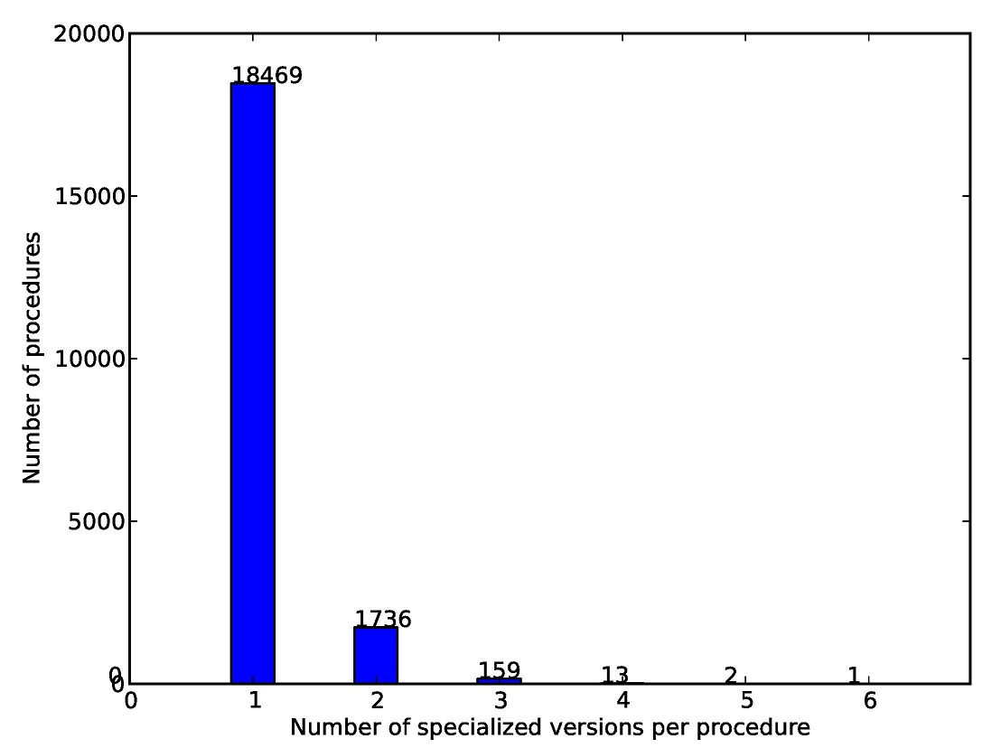
Relatively Few Specialized Procedures

Slide 113
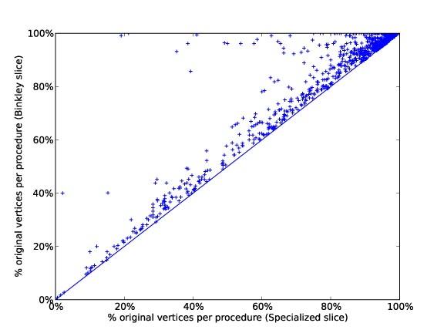
Specialization vs. Monovariant
Many procedures have nearly 100% of the PDG nodes with both techniques
Some procedures are significantly smaller with specialization slices
Specialization-slice procedure
----------------------------------- ≈ 93%
Monovariant-slice procedure
(geometric mean)

Slide 114
Specialization Slicing
Problem statement
  Ordinary “closure slices” can have mismatches between call sites and called procedures
    different call sites have different subsets of the parameters
  Idea: specialize the called procedures
  Challenge: find a minimal solution (minimal duplication)
Key insight
  minimal solution involves solving a partitioning problem on a certain infinite graph
  problem solvable using PDSs: all node-sets in infinite graph can be represented via FSMs
  algorithm: a few automata-theoretic operations

Slide 115
Algorithm
Partition obtained by determinizing and minimizing:
Each state = set of calling contexts for one specialized procedure
Input: SDG S and slicing criterion C
Output: An SDG R for the specialized slice of S with respect to C
// Create A₆, a minimal reverse-deterministic automaton for the
// stack-configuration slice of S with respect to C
1 P_{S} = the PDS for S
2 A₀ = a P_{S}-automaton that accepts C
3 A₁ = Prestar[P_{S}](A₀)
4 A₂ = reverse(A₁)
5 A₃ = determinize(A₂)
6 A₄ = minimize(A₃)
7 A₅ = reverse(A₄)
8 A₆ = removeEpsilonTransitions(A₅)
// Read out SDG R from A₆
...
Automata used to hold onto sets of points in possibly infinite graph

Slide 116
Unrolled SDG
(m1, ε)
(m21, ε)
(m2, ε)
C2
C3
(m22, ε)
(m23, ε)
C1
(m9, ε)
(m15, ε)
(m3, ε)
(m10, ε)
(m11, ε)
(m12, ε)
(m13, ε)
(m14, ε)
(m16, ε)
(m17, ε)
(m18, ε)
(m19, ε)
(m20, ε)
(m4, ε)
(m5, ε)
(m6, ε)
(m7, ε)
(m8, ε)
(p1, C2)
(p1, C3)
(p1, C1)
(p2, C2)
(p3, C2)
(p7, C2)
(p8, C2)
(p9, C2)
(p2, C3)
(p3, C3)
(p7, C3)
(p8, C3)
(p9, C3)
(p2, C1)
(p3, C1)
(p7, C1)
(p8, C1)
(p9, C1)
(p6, C2)
(p6, C3)
(p6, C1)
(p5, C2)
(p5, C3)
(p5, C1)
(p4, C2)
(p4, C3)
(p4, C1)
Each yellow name has the same set of stack configurations {C1,C3}
Such sets are infinite for recursive programs => FSMs
Notes:
example1unrolledSDG
116

Slide 117
Specialized SDG
m1
m21
C2
C3
m22
m23
C1
m9
m15
m3,
m10
m11
m13
m14
m17
m19
m5
m7
p1
p1
p2
p3
p8
p9
p3
p8
p5
p5
p4
Each yellow name has the same set of stack configurations {C1,C3}
Such sets are infinite for recursive programs => FSMs
Notes:
example1unrolledSDG
117

Slide 118
Feature Removal
int add(int a,int b) {
q: return a+b;
}
int mult(int a,int b) {
int i = 0;
int ans = 0;
while(i < a) {
c5: ans = add(ans,b);
c6: i = add(i,1);
}
return ans;
}
void tally
(int& sum,int& prod,int N) {
int i = 1;
while(i <= N) {
c2: sum = add(sum,i);
c3: prod = mult(prod,i);
c4: i = add(i,1);
}
}
int main() {
int sum = 0;
int prod = 1;
c1: tally(sum,prod,10);
printf("%d ",sum);
printf("%d ",prod);
}
int add(int a,int b) {
q: return a+b;
}
int mult( int b) {
int i = 0;
int ans = 0;
return;
}
void tally
(int& sum, int N) {
int i = 1;
while(i <= N) {
c2: sum = add(sum,i);
c3: mult( i);
c4: i = add(i,1);
}
}
int main() {
int sum = 0;
c1: tally(sum, 10);
printf("%d ",sum);
}

Slide 119
Feature Removal
(1)
(2)
(3)
(4)
(5)
(6)
(7)
(8)
(9)
(10)
(11)
(12)
(13)
(14)
(15)
(16)
(17)
(18)
int g1, g2, g3;
void p(int a, int b) {
g1 = a;
g2 = b;
g3 = g2;
}
int main() {
g2 = 100;
p(g2, 2);
p(g2, 3);
p(4, g1+g2);
printf("%d", g2);
}
int g1, g2, g3;
void p(int a, int b) {
g1 = a;
g2 = b;
g3 = g2;
}
int main() {
g2 = 100;
p(g2, 2);
p(g2, 3);
p(4, g1+g2);
printf("%d", g2);
}
int g1, g2;
void p1(int a) {
g1 = a;
}
void p2(int b) {
g2 = b;
g3 = g2;
}
int main() {
g2 = 100;
p1(g2);
p2(3);
p1(4);
}
Forward
closure slice
Specialized slice

Slide 120
Unrolled SDG
(m1, ε)
(m21, ε)
(m2, ε)
C2
C3
(m23, ε)
C1
(m9, ε)
(m15, ε)
(m22, ε)
(m3, ε)
(m10, ε)
(m11, ε)
(m12, ε)
(m13, ε)
(m14, ε)
(m16, ε)
(m17, ε)
(m18, ε)
(m19, ε)
(m20, ε)
(m4, ε)
(m5, ε)
(m6, ε)
(m7, ε)
(m8, ε)
(p1, C2)
(p1, C3)
(p1, C1)
(p2, C2)
(p3, C2)
(p7, C2)
(p8, C2)
(p9, C2)
(p2, C3)
(p3, C3)
(p7, C3)
(p8, C3)
(p9, C3)
(p2, C1)
(p3, C1)
(p7, C1)
(p8, C1)
(p9, C1)
(p6, C2)
(p6, C3)
(p6, C1)
(p5, C2)
(p5, C3)
(p5, C1)
(p4, C2)
(p4, C3)
(p4, C1)
Notes:
example1unrolledSDG
120

Slide 121
Complemented Unrolled SDG
(m1, ε)
(m21, ε)
(m2, ε)
C2
C3
(m23, ε)
C1
(m9, ε)
(m15, ε)
(m22, ε)
(m3, ε)
(m10, ε)
(m11, ε)
(m12, ε)
(m13, ε)
(m14, ε)
(m16, ε)
(m17, ε)
(m18, ε)
(m19, ε)
(m20, ε)
(m4, ε)
(m5, ε)
(m6, ε)
(m7, ε)
(m8, ε)
(p1, C2)
(p1, C3)
(p1, C1)
(p2, C2)
(p3, C2)
(p7, C2)
(p8, C2)
(p9, C2)
(p2, C3)
(p3, C3)
(p7, C3)
(p8, C3)
(p9, C3)
(p2, C1)
(p3, C1)
(p7, C1)
(p8, C1)
(p9, C1)
(p6, C2)
(p6, C3)
(p6, C1)
(p5, C2)
(p5, C3)
(p5, C1)
(p4, C2)
(p4, C3)
(p4, C1)
Notes:
example1unrolledSDG
121

Slide 122
Complemented Unrolled SDG
(m1, ε)
(m21, ε)
(m2, ε)
C2
C3
(m23, ε)
C1
(m9, ε)
(m15, ε)
(m22, ε)
(m3, ε)
(m10, ε)
(m11, ε)
(m12, ε)
(m13, ε)
(m14, ε)
(m16, ε)
(m17, ε)
(m18, ε)
(m19, ε)
(m20, ε)
(m4, ε)
(m5, ε)
(m6, ε)
(m7, ε)
(m8, ε)
(p1, C2)
(p1, C3)
(p1, C1)
(p2, C2)
(p3, C2)
(p7, C2)
(p8, C2)
(p9, C2)
(p2, C3)
(p3, C3)
(p7, C3)
(p8, C3)
(p9, C3)
(p2, C1)
(p3, C1)
(p7, C1)
(p8, C1)
(p9, C1)
(p6, C2)
(p6, C3)
(p6, C1)
(p5, C2)
(p5, C3)
(p5, C1)
(p4, C2)
(p4, C3)
(p4, C1)
Notes:
example1unrolledSDG
122

Slide 123
Complemented Unrolled SDG
(m1, ε)
(m21, ε)
(m2, ε)
C2
C3
(m23, ε)
C1
(m9, ε)
(m15, ε)
(m22, ε)
(m3, ε)
(m10, ε)
(m11, ε)
(m12, ε)
(m13, ε)
(m14, ε)
(m16, ε)
(m17, ε)
(m18, ε)
(m19, ε)
(m20, ε)
(m4, ε)
(m5, ε)
(m6, ε)
(m7, ε)
(m8, ε)
(p1, C2)
(p1, C3)
(p1, C1)
(p2, C2)
(p3, C2)
(p7, C2)
(p8, C2)
(p9, C2)
(p2, C3)
(p3, C3)
(p7, C3)
(p8, C3)
(p9, C3)
(p2, C1)
(p3, C1)
(p7, C1)
(p8, C1)
(p9, C1)
(p6, C2)
(p6, C3)
(p6, C1)
(p5, C2)
(p5, C3)
(p5, C1)
(p4, C2)
(p4, C3)
(p4, C1)
Notes:
example1unrolledSDG
123

Slide 124
Complemented Unrolled SDG
(m1, ε)
(m2, ε)
C2
C3
C1
(m9, ε)
(m15, ε)
(m3, ε)
(m11, ε)
(m12, ε)
(m13, ε)
(m16, ε)
(m20, ε)
(m4, ε)
(m8, ε)
(p1, C2)
(p1, C3)
(p1, C1)
(p3, C2)
(p7, C2)
(p8, C2)
(p2, C3)
(p9, C3)
(p2, C1)
(p9, C1)
(p6, C2)
(p5, C2)
(p4, C3)
(p4, C1)
Notes:
example1unrolledSDG
124

Slide 125
Complemented Unrolled SDG
m1
m2
C2
C3
C1
m9
m15
m3
m11
m12
m13)
m16
m20
m4
m8
p1
p1
p3,
p7
p8
p2
p9
p6
p5
p4
Notes:
example1unrolledSDG
125

Slide 126
Goal: check format compatibility
Producer component
Consumer component
Infer output format
Infer accepted format
Check compatibility
Evan
Driscoll

Slide 127
Formats are strings over “types”
Header of gzip format:
ID
CM
FG
M TIME
FG
OS
…
short byte byte word byte byte

Slide 128
Current work: enhance format spec
nrows ncols pix11 pix12 pix13 pix14 pix21 pix22 pix23 …
Notes:
“Suppose we have a program that works on a simple image format…”

Slide 129
Current work: enhance format spec
nrows ncols pix11 pix12 pix13 pix14 pix21 pix22 pix23 …
nrows

Slide 130
Current work: enhance format spec
nrows ncols pix11 pix12 pix13 pix14 pix21 pix22 pix23 …
ncols
ncols
nrows
nrows
ncols

Slide 131
Current work: enhance format spec
nrows ncols pix11 pix12 pix13 pix14 pix21 pix22 pix23 …
ncols
ncols
nrows
Infer an automaton equivalent to:
nrows:int ncols:int ((byte byte byte byte)^{ncols})^{nrows}
Notes:
Note verbally that we are inferring this from a PROGRAM that could output or read the example, not from the example.

Slide 132
Roadmap: Inference
Program
Traces
I/O equalities
Inputs
ICFG
Inferred XFA

Slide 133
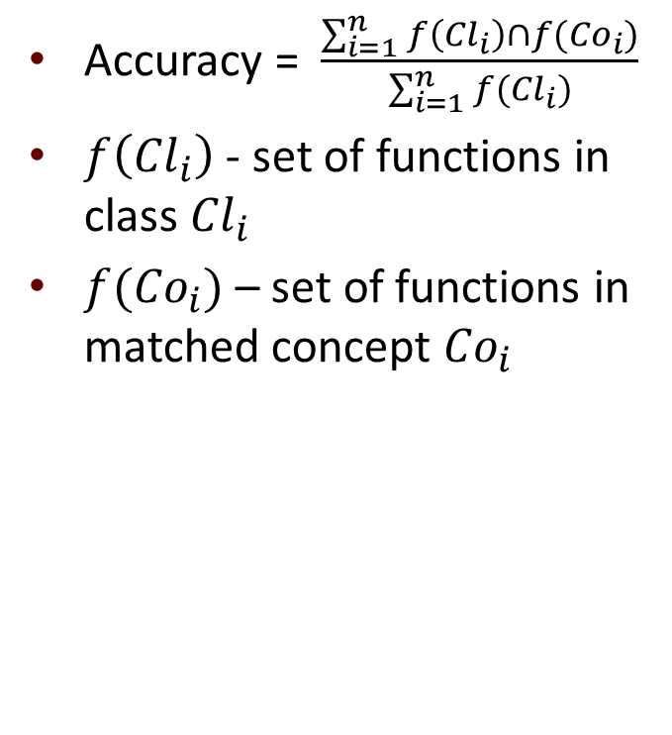
Roadmap: Compatibility
Producer component
Consumer component
$⊆$ ?
Inferred XFA
Inferred XFA

Slide 134
Status
Prototype essentially done, but not well-tested. Working on performance and on finding tests.

Slide 135
How we do it
nrows:int ncols:int ((byte byte byte)*)*
Exponents start as standard Kleene *,
and correspond to program loops

Slide 136
How we do it
nrows:int ncols:int ((byte byte byte)*)*
We instrument loops with trip counts
We instrument I/O calls to remember values

Slide 137
How we do it
nrows:int ncols:int ((byte byte byte)*)*
remembered I/O value
trip count
We instrument loops with trip counts
We instrument I/O calls to remember values
When two of these are found to always equal,
replace the * with an exponent

Slide 138
How we do it
nrows:int ncols:int ((byte byte byte)*)^{nrows}
remembered I/O value
trip count
We instrument loops with trip counts
We instrument I/O calls to remember values
When two of these are found to always equal,
replace the * with an exponent

Slide 139
How we do it
nrows:int ncols:int ((byte byte byte)*)^{nrows}
We instrument loops with trip counts
We instrument I/O calls to remember values
When two of these are found to always equal,
replace the * with an exponent

Slide 140
How we do it
nrows:int ncols:int ((byte byte byte)^{ncols})^{nrows}
We instrument loops with trip counts
We instrument I/O calls to remember values
When two of these are found to always equal,
replace the * with an exponent

Slide 141
We use Daikon
Daikon identifies dynamic invariants
Hold over all test runs; might not actually be invariants
Could use statically inferred instead
We wrote our own Daikon front end for machine code
Assumes debugging information
  can we remove this restriction?
Front ends supplied with Daikon not sufficient
  checks only entry-to-exit invariants, whereas we need
    loop trip-count instrumentation
    I/O-to-loop-exit invariants
Instruments program using Dyninst

Slide 142
Instrumentation remembers I/O vals
If value is returned:
x = read_int(); x = __io1 = read_int();
If value is “returned” via out parameter:
err = read_int(&x); err = read_int(&x);
__io2 = *(&x);
If value is passed by parameter:
write_int(x); __io3 = x;
write_int(x);

Slide 143
Instrumentation finds trip counts

Slide 144
Instrumentation finds trip counts
On loop entry:
Set trip count to 0
__trip1 = 0;

Slide 145
Instrumentation finds trip counts
On loop entry:
Set trip count to 0
__trip1 = 0;
Entering loop body:
Increment trip count
__trip1++;

Slide 146
Instrumentation finds trip counts
On loop exit:
Output current value of variables
Interested in invariants here
print(__io1, __io2, …, __trip1);
On loop entry:
Set trip count to 0
__trip1 = 0;
Entering loop body:
Increment trip count
__trip1++;

Slide 147
We use Daikon to find I/O equalities
Instrumented
program
Dakion dynamic
invariant detector
Value trace
I/O equalities
LOOP_EXIT_A
__io2 = 2
__io4 = 5
__trip_count_A = 5
LOOP_EXIT_B
__io2 = 6
__io4 = 5
__trip_count_B = 6
__trip_count_A = __io4 = 5
__trip_count_B = __io2 = 6

Slide 148
We model programs as XFAs
XFAs: extended finite automata
Add separate bounded “data state” to standard FAs
Transformers on transitions describe data-state changes

Slide 149
Instrumentation remembers I/O vals
Possible “easy” extensions to support printf, scanf:
printf(“%d + %d = %f”, x, y, (double)x+y);
printf(“%d + %d = %f”,
__io4 = x,
__io5 = y,
__io6 = ((double)x+y));
Notes:
We only need integer values because of our goal

Slide 150
Instrumentation remembers I/O vals
“Easy” extensions to support printf, scanf:
printf(“User %s has uid %d”, user_name, uid);
                __io4 = uid;
                printf(…);
string
string
string
int
Notes:
We only need integer values because of our goal

Slide 151
Modeling program control flow
Transform each program’s interprocedural control-flow
graph into states and transitions of the XFA, using
Ɛ transitions
Except: calls to I/O functions
read_int
int
Notes:
(Actually, I/O is more complicated)

Slide 152
XFA tracks I/O variables
Similar to the front end’s instrumentation…
…except that was to find, and this is to enforce

Slide 153
XFA tracks I/O variables
A lie
int

Slide 154
XFA tracks I/O variables
start_int
Ɛ
int1
int0

Slide 155
XFA tracks I/O variables
start_int
Ɛ
int1
int0
Read the input bit-by-bit

Slide 156
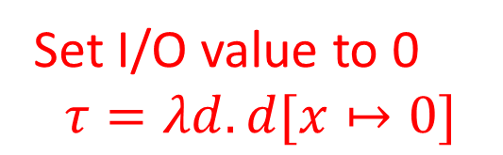
XFA tracks I/O variables
Set I/O value to 0
$$τ=λd.d[x↦0]$$
start_int
Ɛ
int1
int0

Slide 157
XFA tracks I/O variables
Set I/O value to 0
$$τ=λd.d[x↦0]$$
start_int
Ɛ
int1
int0
Add 0 to I/O value
(no change in data value)

Slide 158
XFA tracks I/O variables
Set I/O value to 0
$$τ=λd.d[x↦0]$$
start_int
Ɛ
int1
int0
Add 1 to I/O value
$$τ=λd.d[x↦d\left[x\right]+1]$$
Add 0 to I/O value
(no change in data value)

Slide 159
XFA tracks I/O variables
Set I/O value to 0
$$τ=λd.d[x↦0]$$
start_int
Multiply value by 2
$$τ=λd.d[x↦d\left[x\right]+d[x]]$$
Ɛ
int1
int0
Add 1 to I/O value
$$τ=λd.d[x↦d\left[x\right]+1]$$
Add 0 to I/O value
(no change in data value)

Slide 160
XFA tracks trip counts
Again, similar to instrumentation – but for enforcement

Slide 161

XFA tracks trip counts
Set trip count to 0
$$τ=λd.d[k↦0]$$
$$ε$$
$$ε$$
$$ε$$
Increment trip count
$$τ=λd.d[k↦d\left[k\right]+1]$$

Slide 162
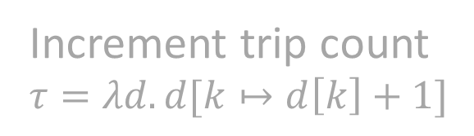
XFA tracks trip counts
Set trip count to 0
$$τ=λd.d[k↦0]$$
$$ε$$
$$ε$$
Enforce: if $k≠x$, set reject,
otherwise no change
$$τ=λd.d[reject↦reject∨d\left[k\right]≠d[x]]$$
$$ε$$
Increment trip count
$$τ=λd.d[k↦d\left[k\right]+1]$$

Slide 163
Symbolic abstraction: Who cares?
Win, win, win
Easier/faster implementation of analysis tools
  just state concrete (actual!) semantics in logic
  supply an abstract domain
    e.g., as a class that meets a specific interface
  obtain analyzer/decision-procedure
More precise results in abstract interpretation
  can identify loop and procedure summaries that are more precise than ones obtained via conventional techniques
Applies to interesting, non-standard logics (we think!)
  separation logic: memory safety properties
interfere?

Slide 164
Symbolic abstraction: Who cares?
Win, win, win
Easier/faster implementation of analysis tools
  just state concrete (actual!) semantics in logic
  supply an abstract domain
    e.g., as a class that meets a specific interface
  obtain analyzer/decision-procedure
More precise results in abstract interpretation
  can identify loop and procedure summaries that are more precise than ones obtained via conventional techniques
Applies to interesting, non-standard logics (we think!)
  separation logic: memory safety properties
  Improve level of automation for creating analyzers
    implement analysis tools in a much smaller time-span and with drastically reduced programmer effort
interfere?

Slide 165


In 1977, Cousot & Cousot gave us a beautiful theory of overapproximation
{(2,1), (2,2), (2,3),
(3,1), (3,2), (3,3),
(4,1), (4,2), (4,3),
(5,1), (5,2), (5,3)}
{(x→2, y→1),
(x→5, y→3)}
x → [2,5]
y → [1,3]
γ
α
α
Universe of States

Slide 166
In 1979, Cousot & Cousot gave us:
α
τ
τ#
γ
Universe of States

Slide 167


Slide 168
In 1979, Cousot & Cousot gave us:
α
τ
τ#
γ
Universe of States

Slide 169


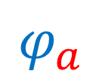
In 2004, Reps, Sagiv, and Yorsh gave us:
Universe of States
Symbolic Abstract Interpretation
Symbolic Concretization

Slide 170
In 2004, Reps, Sagiv, and Yorsh gave us:
Universe of States
Symbolic Abstraction

Slide 171
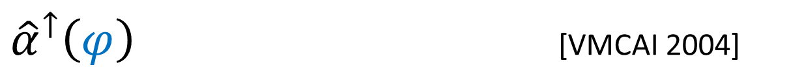
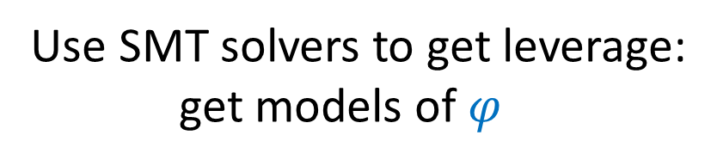
Universe of States

Slide 172



S  ϕ
← →
ans
Universe of States

Slide 173

ans
Universe of States

Slide 174


Slide 175
From “Below” vs. From “Above”
Reps, Sagiv, and Yorsh 2004: approximation from “below”
Desirable: approximation from “above”
  always have safe over-approximation in hand
  can stop algorithm at any time (e.g., if taking too long)
  Thakur, A. and Reps, T., A method for symbolic computation of abstract operations. In Proc. Computer-Aided Verification (CAV), 2012
Aditya
Thakur

Slide 176
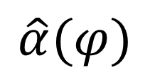
[CAV 2012]

Slide 177
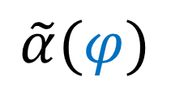
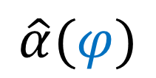
[CAV 2012]
Stop at any time
→ sound answer
Tunable
More time → more precision

Slide 178




Stålmarck’s method (1989)
Dilemma Rule
$$R$$
Split
$$R∪\{v=\text{True}\text{\}}$$
$$R∪\{v=\text{False}\text{\}}$$
Propagate
$$R_{1}^{′}∩R_{2}^{′}$$
Merge
$$R_{2}^{′}$$
$$R_{1}^{′}$$

Slide 179
Stålmarck’s method (1989)
1-saturation

Slide 180
Stålmarck’s method (1989)
2-saturation

Slide 181













Stålmarck’s method for ${\tilde{α}}^{↓}$
$$⊤$$
Dilemma Rule
$$A$$
$$γ\left(a_{1}\right)∪γ\left(a_{2}\right)⊇ γ\left(A\right)$$
$$R$$
Split
$$R∪\{v=\text{False}\text{\}}$$
$$A⊓a_{1}$$
$$A⊓a_{2}$$
$$R∪\{v=\text{True}\text{\}}$$
Propagate
$$F_{1}^{′}∩F_{2}^{′}$$
$$A_{1}^{′}⊔A_{2}^{′}$$
Merge
$$F_{2}^{′}$$
$$A_{2}^{′}$$
$$A_{1}^{′}$$
$$F_{1}^{′}$$
$$⊥$$
Notes:
Change intersection to union in split.

Slide 182
Stålmarck’s method
$$⊤$$
$$\tilde{α}$$
$$⊥$$
Notes:
Set v_root to false first

Slide 183

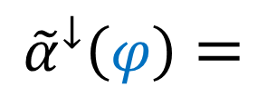
[CAV 2012]
Reasoning: Using ${\tilde{α}}^{↓}\left(φ\right)$ in an SMT solver
Dual use:
$\tilde{α}$ for abstract interpretation
Unsat/validity checking for
pure logical reasoning
⇒ abstract interpretation in
service to logic!
$$⊤$$
Property verification
via model checking:
OK if Unsat(Program ∧ Bad)
$${\tilde{α}}^{↓}\left(φ\right)=$$
$$⊥$$
$φ$ is unsatisfiable
Notes:
Set v_root to false first

Slide 184
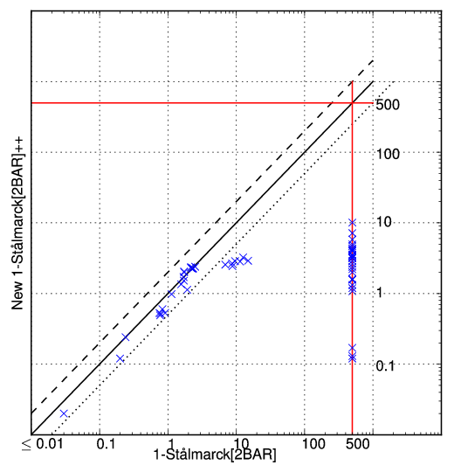
The importance of data structures
Classic union-find
  plus layers
  plus least-upper bound
Given UF₁ and UF₂, find the coarsest partition that is finer than UF₁ and UF₂
Roughly, “confluent, partially-persistent union-find”

Slide 185

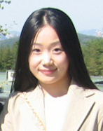
Extend WALi to use α
∧
Weighted Automaton Library (WALi):
  supports context-sensitive interprocedural analysis
  weights = dataflow transformers
  weighted version of PDSs (a la material on specialized slicing)
More precise results in abstract interpretation
Easier implementation of analysis tools
Junghee
Lim
Aditya
Thakur

Slide 186
AlphaHat
AlphaHat technique in three ways
  WALi + AlphaHat (Aditya Thakur and Junghee Lim)
    ~October 2012
  Boogie + AlphaHat for source code (Akash Lal at Microsoft India)
    ~November 2012
  Boogie + AlphaHat for machine code (Aditya Thakur and Junghee Lim)
    ~November 2012

Slide 187
Possible-overflow example
char* concat(char* a, char* b)
{
unsigned size = strlen(a)+strlen(b)+1;
char* out = (char*)malloc(size*sizeof(char)); // Possible overflow
for(unsigned i = 0; i < strlen(a); i++) {
out[i] = a[i]; // Potential memory corruption
}
for(unsigned i = 0; i < strlen(b); i++) {
out[i+strlen(a)] = b[i]; // Potential memory corruption
}
out[i+strlen(a)] = '\0';
return out;
}

Slide 188
Basic scenario

