Slide 1
Finding Limits of Parallelism using Dynamic Dependency Graphs – How much parallelism is out there?
Jonathan Mak & Alan Mycroft
University of Cambridge
WODA 2009, Chicago

Slide 2
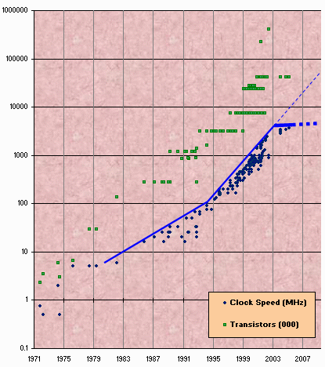
Motivation
Moore’s Law, Multi-core and end of the “Free Lunch”
We need programs to be parallel
Source: Herb Sutter. A fundamental turn toward concurrency in software. Dr. Dobb’s Journal, 30(3):16–20, March 2005.

Slide 3
Two approaches
Explicit Parallelism
Implicit Parallelism
Specified by programmer
E.g. OpenMP, Java, MPI, Cilk, TBB, Join calculus
Too hard for the average programmer?
Extracted by compiler
E.g. Polaris [Blume+ 94], Dependence analysis [Kennedy 02], DSWP [Ottoni 05], GREMIO [Ottoni 07]

Slide 4
Implicit Parallelism – What’s the limit?
Existing implementations evaluated on small number of cores/processors (<10)
Speed-up rises with #procs
But how far can we go?
Limits of Instruction-level parallelism first explored by [Wall 93]
Assume:
No threading overheads
Inter-thread communication is free
Perfect alias analysis
Perfect oracle for dependence analysis

Slide 5
Types of Dependencies
Name dependencies
True dependencies (RAW)
add $4, $5, $6
sub $2, $3, $4
False dependencies (WAR)
add $4, $5, $6
sub $6, $2, $3
Control dependencies
beq $2, $3, L
L:...
Output dependencies (WAW)
add $4, $5, $6
sub $4, $2, $3

Slide 6
Dynamic Dependency Graph

Slide 7
Implementation
Benchmarks (mostly miBench)
gcc + μClibc
MIPS executables
QEMU
Instruction Traces
DDG builder
Dynamic Dependency Graphs

Slide 8
Effects of Control dependencies

Slide 9
Effects of Control dependencies
Restricts parallelism to within (dynamic) basic block
Parallelism <10 in most cases
Already exploited in multiple-issue processors
Good news #1: Good branch prediction is not difficult
But only applies locally, examining at most 10s of instructions in advance
Good news #2: Control flow merge points not considered here
E.g. if R1 then { R2 } else { R3 } R4
Static analysis would help us remove such dependencies

Slide 10
True dependencies only
Can speculate away control dependencies
Some name dependencies are compiler artifacts
Caused by memory being reused by unrelated calculations
True dependencies represent essence of algorithm

Slide 11
True dependencies only

Slide 12
Spaghetti stack – removing more compiler artifacts
Some dependencies on execution stack are compiler-induced
Inter-frame name dependencies
True dependencies on stack pointer
1 jal foo # main: call foo()
2 addiu $sp,$sp,-32 # foo: decrement stack pointer (new frame)
3 addu $fp,$0,$sp # copy stack pointer to frame pointer
... <code for foo()>...
4 addu $sp,$0,$fp # copy frame pointer to stack pointer
5 addiu $sp,$sp,32 # increment stack pointer (discard frame)
6 jr $ra # return to main()
7 jal bar # main: call bar()
8 addiu $sp,$sp,-32 # bar: decrement stack pointer (new frame)
9 addu $fp,$0,$sp # copy stack pointer to frame pointer
... <code for bar()>...
10 addu $sp,$0,$fp # copy frame pointer to stack pointer
11 addiu $sp,$sp,32 # increment stack pointer (discard frame)
12 jr $ra # return to main()
void main() {
foo();
bar();
}

Slide 13
Spaghetti stack – removing more compiler artifacts
Linear stack
Spaghetti stack

Slide 14
Spaghetti stack – removing more compiler artifacts
SP−−
alloc frame
SP++
free frame
SP−−
alloc frame
SP++
free frame

Slide 15
Spaghetti Stack

Slide 16
What about other compiler artifacts?
Stack pointer is just one example
Calls to malloc() is another
Extreme case – remove all address calculation nodes from the graph

Slide 17
Ignoring all Address calculations

Slide 18
Conclusions
Control dependencies are the biggest obstacle to getting parallelism above 10
→ Control speculation
Most programs exhibit parallelism >100 when only true dependencies (essence of algorithm) are considered
Spaghetti stack removes certain compiler-induced true dependencies, further doubling the parallelism in some cases
Good figures, but realising such parallelism remains a challenge

Slide 19
Future work
Scale up analysis framework
Bigger, more complex benchmarks (e.g. web/DB server, etc.)
How does parallelism change when data input size grows?
How much parallelism is instruction-level (ILP), and how much is task-level (TLP)?
Map dependencies back to source code
Paper addressing some of these questions has just been submitted

Slide 20
Related work
Wall, “Limits of instruction-level parallelism” (1991)
Lam and Wilson, “Limits of control flow on parallelism” (1992)
Austin and Sohi, “Dynamic dependency analysis of ordinary programs” (1992)
Postiff, Greene, Tyson and Mudge, “The limits of instruction level parallelism in SPEC95 applications” (1999)
Stefanović and Martonosi, “Limits and graph structure of available instruction-level parallelism” (2001)

