Slide 1
What’s new in HTCondor?
What’s coming?
HTCondor Week 2017
Madison, WI -- May 3, 2017
Todd Tannenbaum
Center for High Throughput Computing
Department of Computer Sciences
University of Wisconsin-Madison

Slide 2
Challenge Areas
“...we have identified six key challenge areas that we believe will drive HTC technologies innovation in the next five years.”
Evolving resource acquisition models
Hardware complexity
Widely disparate use cases
Data intensive computing
Black-box applications
Scalability

Slide 3
Release Timeline
Stable Series
  HTCondor v8.6.x - introduced Jan 2017
  Currently at v8.6.2
  (Last year at v8.4.6)
Development Series (should be 'new features' series)
  HTCondor v8.7.x
  Currently at v8.7.1
  (Last year at v8.5.4)

Slide 4
Enhancements in HTCondor v8.4 discussed last year
Scalability and stability
  Goal: 200k slots in one pool, 10 schedds managing 400k jobs
Introduced Docker Job Universe
IPv6 support
Tool improvements, esp condor_submit
Encrypted Job Execute Directory
Periodic application-layer checkpoint support in Vanilla Universe
Submit requirements
New RPM / DEB packaging
Systemd / SELinux compatibility

Slide 5
Some enhancements in
HTCondor v8.6

Slide 6

Page 790

Slide 7
Enabled by default and/or easier to configure
Enabled by default: shared port, cgroups, IPv6
  Have both IPv4 and v6? Prefer IPv4 for now
Configured by default: Kernel tuning
Easier to configure: Enforce slot sizes
  use policy: preempt_if_cpus_exceeded
  use policy: hold_if_cpus_exceeded
  use policy: preempt_if_memory_exceeded
  use policy: hold_if_memory_exceeded

Slide 8
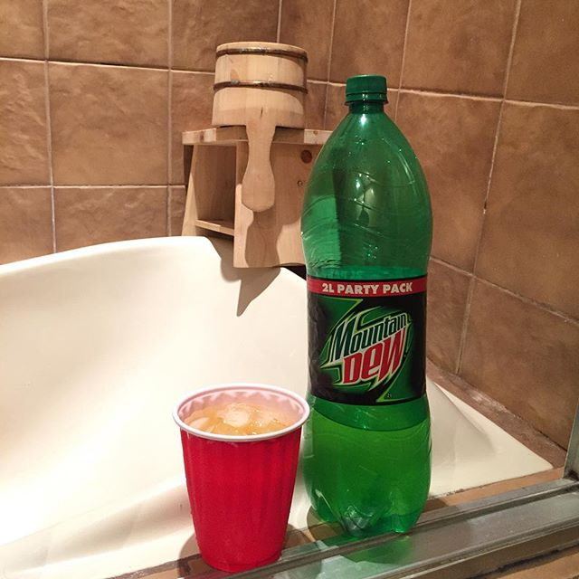
Easier to retry jobs if you shower
Dew drinker? Use old way
  executable = foo.exe
  on_exit_remove = \
  (ExitBySignal == False && \
  ExitCode == 0) || \
  NumJobStarts >= 3
  queue
Shower regularly? Use new way
  executable = foo.exe
  max_retries = 3
  queue

Slide 9
New condor_q default output
Only show jobs owned by the user
  disable with -allusers
Batched output (-batch, -nobatch)
New default output of condor_q will show summary of current user's jobs.
---- Schedd: submit-3.batlab.org : <128.104.100.22:50004?... @ 05/02/17 11:19:41
OWNER BATCH_NAME SUBMITTED DONE RUN IDLE HOLD TOTAL JOB_IDS
tannenba CMD: /bin/python 4/27 11:58 463 87 19450 5 20000 9.463-467
tannenba mydag.dag+10 4/27 19:13 9824 1 _ _ 9825 10.0
29900 jobs; 10287 completed, 0 removed, 19450 idle, 88 running, 5 held, 0 suspended

Slide 10
Schedd Job Transforms
Transformation of job ad upon submit
Allow admin to have the schedd securely add/edit/validate job attributes upon job submission
  Can also set attributes as immutable by the user, e.g. cannot edit w/ condor_qedit or chirp
Get rid of condor_submit wrapper scripts!
One use case: insert accounting group attributes based upon the submitter
use feature: ​AssignAccountingGroup( filename )

Slide 11
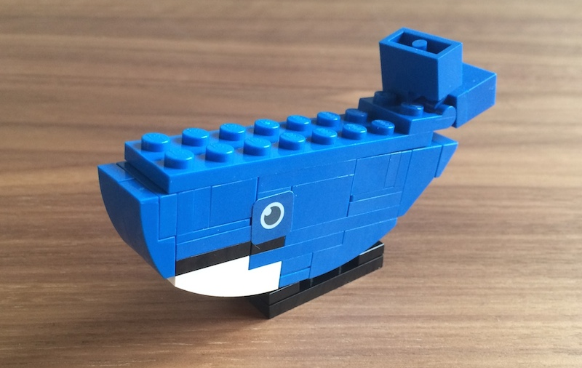
Docker Universe Enhancements
Docker jobs get usage updates (i.e. network usage) reported in job classad
Admin can add additional volumes
  That all docker universe jobs get
  Why?
    Large shared data
Condor Chirp support
Also new knob:
DOCKER_DROP_ALL_CAPABILITIES

Slide 12

HTCondor Singularity Integration
What is Singularity?
http://singularity.lbl.gov/
Like Docker but…
  No root owned daemon process, just a setuid
  No setuid required (post RHEL7)
  Easy access to host resources incl GPU, network, file systems
Sounds perfect for glideins/pilots!
  Maybe no need for UID switching

Slide 13
And lots more…
JSON output from condor_status, condor_q, condor_history via "-json" flag
condor_history -since <jobid or expression>
Config file syntax enhancements (includes, conditionals, …)
…

Slide 14

Some enhancements in
HTCondor v8.7 and beyond

Slide 15
Smarter and Faster Schedd
User accounting information moved into ads in the Collector
  Enable schedd to move claims across users
Non-blocking authentication, smarter updates to the collector, faster ClassAd processing
Late materialization of jobs in the schedd to enable submission of very large sets of jobs
  More jobs materialized once number of idle jobs drops below a threshold (like DAGMan throttling)

Slide 16








Grid Universe
Reliable, durable submission of a job to a remote scheduler
Popular way to send pilot jobs, key component of HTCondor-CE
Supports many “back end” types:
  HTCondor
  PBS
  LSF
  Grid Engine
  Google Compute Engine
  Amazon EC2
  OpenStack
  Cream
  NorduGrid ARC
  BOINC
  Globus: GT2, GT5
  UNICORE
Notes:
16

Slide 17

Add Grid Universe support for SLURM, Azure, OpenStack, Cobalt
Speak native SLURM protocol
  No need to install PBS compatibility package
Speak to Microsoft Azure
Speak OpenStack’s NOVA protocol
  No need for EC2 compatibility layer
Speak to Cobalt Scheduler
  Argonne Leadership Computing Facilities
Jaime:
Grid
Jedi

Slide 18
Elastically grow your pool into the Cloud: condor_annex
Start virtual machines as HTCondor execute nodes in public clouds that join your pool
Leverage efficient AWS APIs such as Auto Scaling Groups and Spot Fleets
Secure mechanism for cloud instances to join the HTCondor pool at home institution

Slide 19
Without condor_annex
+ Decide which type(s) of instances to use.
+ Pick a machine image, install HTCondor.
+ Configure HTCondor:
  to securely join the pool. (Coordinate with pool admin.)
  to shut down instance when not running a job (because of the long tail or a problem somewhere)
+ Decide on a bid for each instance type, according to its location (or pay more).
+ Configure the network and firewall at Amazon.
+ Implement a fail-safe in the form of a lease to make sure the pool does eventually shut itself off.
+ Automate response to being out-bid.

Slide 20
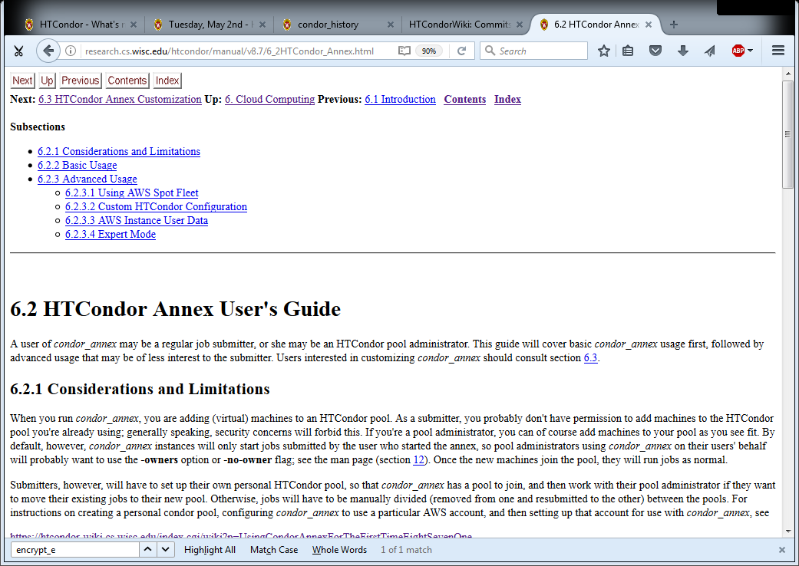
With condor_annex
Goal: Simplified to a single command:
condor_annex -annex-name 'ProfNeedsMoore_Lab' \
-count \
--instances 1000

Slide 21
…Live demo of late job materialization and
HTCondor Annex to EC2...

Slide 22
HTCondor and Kerberos
HTCondor currently allows you to authenticate users and daemons using Kerberos
However, it does NOT currently provide any mechanism to provide a Kerberos credential for the actual job to use on the execute slot

Slide 23
HTCondor and Kerberos/AFS
So we are adding support to launch jobs with Kerberos tickets / AFS tokens
Details
  HTCondor 8.5.X to allows an opaque security credential to be obtained by condor_submit and stored securely alongside the queued job ( in the condor_credd daemon )
  This credential is then moved with the job to the execute machine
  Before the job begins executing, the condor_starter invokes a call-out to do optional transformations on the credential

Slide 24
DAGMan Improvements
ALL_NODES
  RETRY ALL_NODES 3
Flexible DAG file command order
Splice Pin connections
  Allows more flexible parent/child relationships between nodes within splices

Slide 25
New condor_status default output
Only show one line of output per machine
Can try now in v8.5.4+ with "-compact" option
The "-compact" option will become the new default once we are happy with it
Machine Platform Slots Cpus Gpus TotalGb FreCpu FreeGb CpuLoad ST
gpu-1 x64/SL6 8 8 2 15.57 0 0.44 1.90 Cb gpu-2 x64/SL6 8 8 2 15.57 0 0.57 1.87 Cb gpu-3 x64/SL6 8 8 4 47.13 0 16.13 0.85 Cb matlab-build x64/SL6 1 12 23.45 11 23.33 0.00 ** mem1 x64/SL6 32 80 1009.67 0 160.17 1.00 Cb

Slide 26
More backends for condor_gangaliad
In addition to (or instead of) sending to Ganglia, aggregate and make available in JSON format over HTTP
  condor_gangliad rename to condor_metricd
View some basic historical usage out-of-the-box by pointing web browser at central manager (modern CondorView)…
Or upload to influxdb, graphite for Grafana

Slide 27
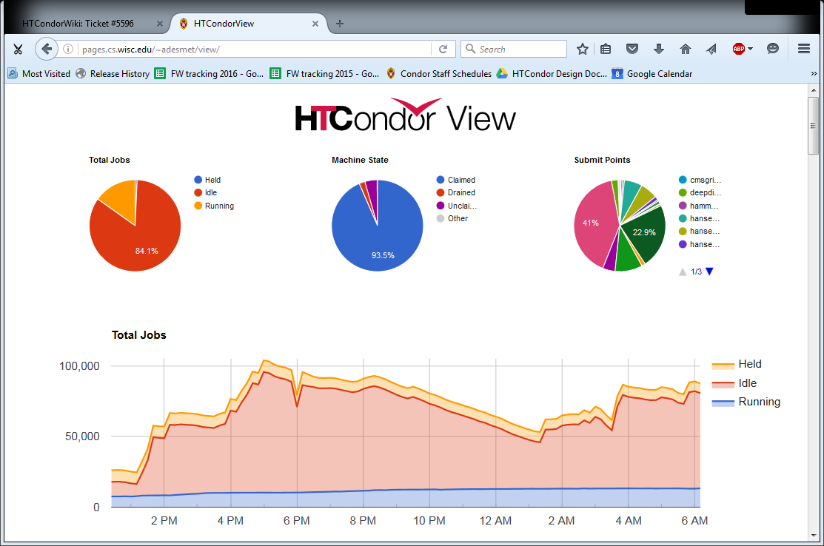

Slide 28
Potential Future Docker Universe Features?
Advertise images already cached on machine ?
Support for condor_ssh_to_job ?
Package and release HTCondor into Docker Hub ?
Network support beyond NAT?
Run containers as root??!?!?
Automatic checkpoint and restart of containers! (via CRIU)

Slide 29
The future
Working with the cloud : elasticity into the cloud.
Scalability.
More manageable, monitoring.
Containers.
Data, incl storage management options
More Python interfaces

Slide 30

Thank You!
P.S. Interested in working
on HTCondor full time?
Talk to me! We are hiring!
htcondor-jobs@cs.wisc.edu

