Slide 1
Monitoring Primer HTCondor Week 2017 Todd Tannenbaum Center for High Throughput Computing University of Wisconsin-Madison

Slide 2
Ad types in the condor_collector
startd ads
An ad for each slot on each machine
State = Unclaimed | Claimed | Drained …
Activity = Busy | Idle | Retiring | Vacating …
CPUs, Memory, Disk, GPUs, …
submitter ads
An ad for each unique user
RunningJobs, IdleJobs, HeldJobs, …
schedd, master, negotiator, collector ads
One ad from each daemon instance

Slide 3
Q: How many slots are running a job? A: Count slots where State == Claimed (and Activity != Idle) How?

Slide 4
Obvious solutions aren’t the best
% condor_status
slot7@ale-22.cs.wi LINUX X86_64 Claimed Busy 0.990 3002 0+00:28:24
slot8@ale-22.cs.wi LINUX X86_64 Claimed Busy 1.000 3002 0+00:14:13
slot1@ale-23.cs.wi LINUX X86_64 Unclaimed Idle 0.920 3002 0+00:00:04
…
condor_status | grep Claimed | grep –v Idle | wc –l
Output subject to change, wrong answers, slow
condor_status –l | grep Claimed | wc –l
Wrong answers, really slow

Slide 5
Use constraints and projections
From
condor_status [-startd | -schedd | -master…]
–constraint <classad-expr>
–autoformat <attr1, attr2, …>
Where
Select
condor_status -startd \
-cons 'State=="Claimed" && Activity!="Idle"' \
-af name | wc -l

Slide 6
Q: Which slots are running on machines where NFS is broken?
Ask startd to run a script/program to test health of NFS
STARTD_CRON_JOB_LIST = tag STARTD_CRON_tag_EXECUTABLE = detect.sh
Script returns a ClassAd with attribute NFS_Broken = True | False
condor_status -cons 'NFS_Broken==True'
Could specify customized output (i.e. a report) for condor_status to display broken machines
https://htcondor-wiki.cs.wisc.edu/index.cgi/wiki?p=ExperimentalCustomPrintFormats

Slide 7
Q: How many CPU cores are being utilized?
Sum the Cpus attribute for each slot that is Claimed and Busy:
% condor_status -startd \
-cons 'State=="Claimed" && Activity!="Idle"' \
-af Cpus | less
1
1
4
4
…
% condor_status -startd \
-cons 'State=="Claimed" && Activity!="Idle"' \
-af Cpus | st
N min max sum mean stddev
9053 1 40 10410 1.1499 1.39239
Simple Statistics from command line
https://github.com/nferraz/st

Slide 8
Graph of CPU utilization over time
Could have a cron job run every minute…
#!/bin/sh
echo `date`, ; condor_status \
-cons 'State=="Claimed" && Activity!="Idle"' \
-af Cpus | st --sum
What if you have hundreds or thousands of metrics?
COLLECTOR_QUERY_WORKERS = 5000?
How about query the collector just once per minute for all attributes needed to compute all metrics?

Slide 9
Ganglia and condor_gangliad
condor_gangliad queries the condor_collector once per minute
DAEMON_LIST = MASTER, GANGLIAD,…
condor_gangliad has config file to filter and aggregate attributes from the ads in the condor_collector in order to form metrics
Forwards these metrics to Ganglia, which stores these values in a database and provides graphs over the web

Slide 10
Example metric definitions in condor_gangliad
[
Name = "CpusInUse";
Aggregate = "SUM";
Value = Cpus;
Requirements = State=="Claimed" && Activity!="Idle";
TargetType = "Machine";
]
[
Name = "CpusNotInUse";
Aggregate = "SUM";
Value = Cpus;
Requirements = State!="Claimed" || Activity=="Idle";
TargetType = "Machine";
]

Slide 11
Add a graph to a view dashboard: /var/lib/ganglia/view_Miron.json
{ "aggregate_graph":"true",
"host_regex":[
{"regex":"cm.chtc.wisc.edu"}
],
"metric_regex":[
{"regex":"(Cpus(InUse|NotInUse)"}
],
"graph_type":"stack",
"vertical_label":"cores",
"title":"CPU Core Utilization"
}

Slide 12
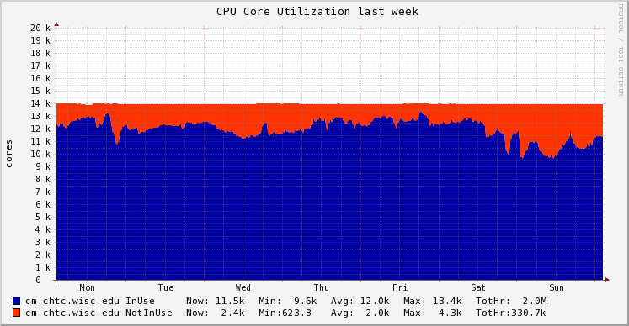
Voila!

Slide 13
Why are cores not in use?
[
Name = "CpusNotInUse_LowMemory";
Aggregate = "SUM";
Value = Cpus;
Requirements = State=="Unclaimed" && Memory < 1024;
TargetType = "Machine";
]
[
Name = "CpusNotInUse_Draining";
Aggregate = "SUM";
Value = Cpus;
Requirements = State=="Drained";
TargetType = "Machine";
]

Slide 14
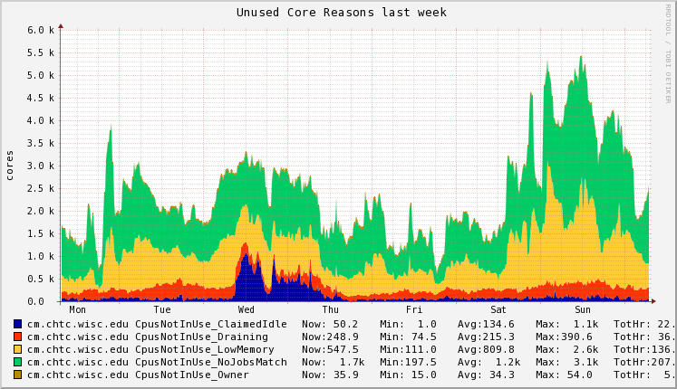
Unused Core Reasons

Slide 15
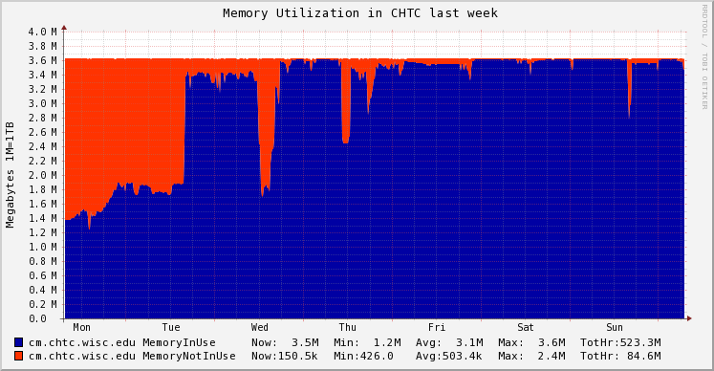
Memory Provisioned
[
Name = "MemoryInUse";
Aggregate = "SUM";
Value = Memory;
Requirements = State=="Claimed" && Activity!="Idle";
TargetType = "Machine";
]
[
Name = "MemoryNotInUse";
Aggregate = "SUM";
Value = Memory;
Requirements = State!="Claimed" || Activity=="Idle";
TargetType = "Machine";
]

Slide 16
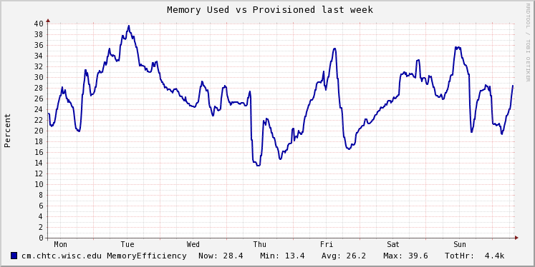
Memory Used vs Provisioned
In condor_config.local :
STARTD_JOB_EXPRS =
$(START_JOB_EXPRS) MemoryUsage
Then define MemoryEfficiency metric as:
[
Name = "MemoryEfficiency";
Aggregate = "AVG";
Value = real(MemoryUsage)/Memory*100;
Requirements = MemoryUsage > 0.0;
TargetType = "Machine";
]

Slide 17
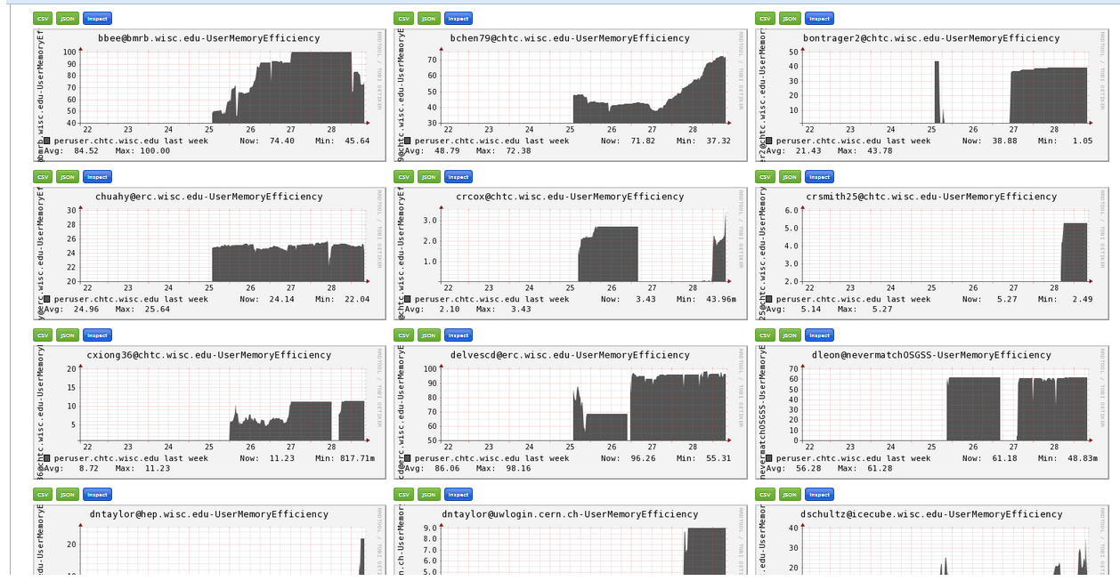
Example: Metrics Per User
[
Name = strcat(RemoteUser,"-UserMemoryEfficiency");
Title = strcat(RemoteUser," Memory Efficiency");
Aggregate = "AVG";
Value = real(MemoryUsage)/Memory*100;
Requirements = MemoryUsage > 0.0;
TargetType = "Machine";
]

Slide 18
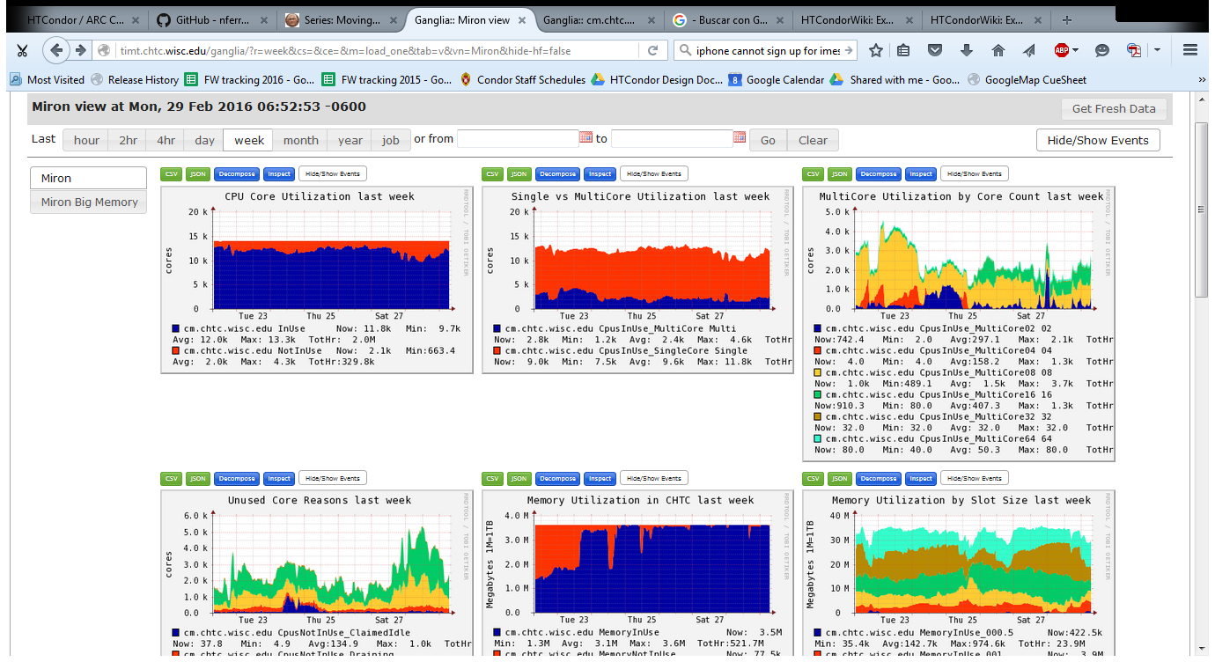
Dashboard(s) of useful charts

Slide 19
New Hotness: Grafana
Grafana
Open Source
Makes pretty and interactive dashboards from popular backends including Graphite's Carbon, Influxdb, and very recently ElasticSearch
Easy for individual users to create their own custom persistent graphs and dashboards
condor_gangliad -> ganglia -> graphite
# gmetad.conf - Forward metrics to Carbon via UDP
carbon_server "mongodbtest.chtc.wisc.edu"
carbon_port 2003
carbon_protocol udp
graphite_prefix "ganglia"

Slide 20
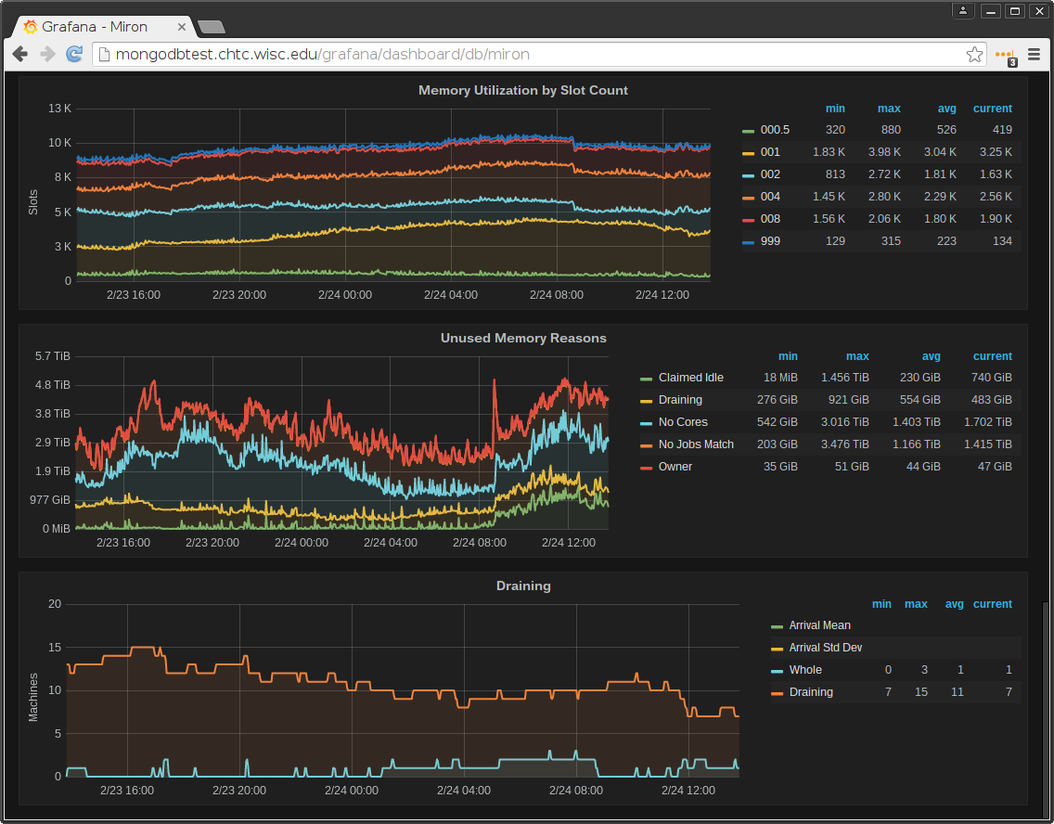

Slide 21
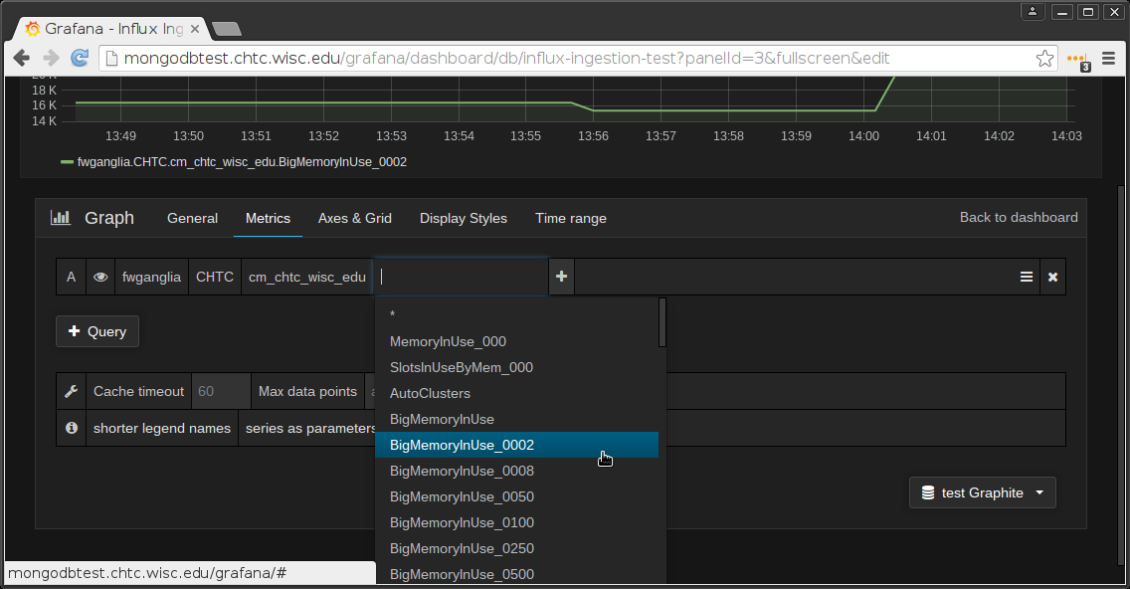
Adding Grafana graph (Graphite)

Slide 22
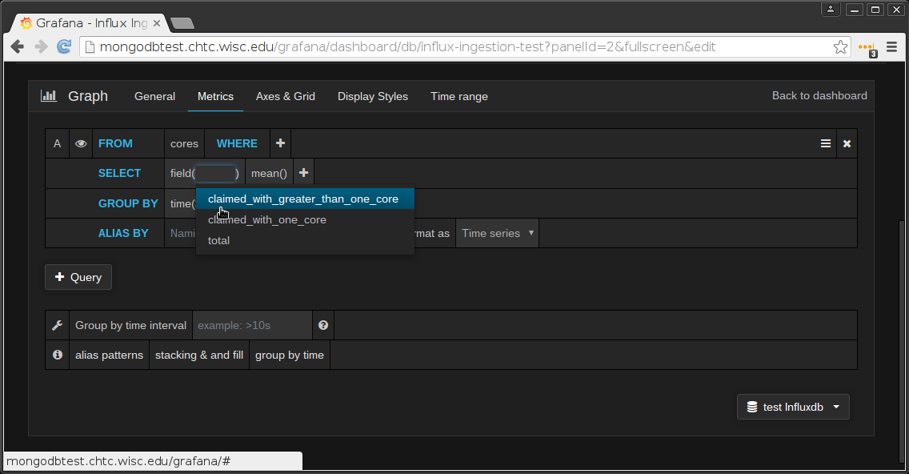
Adding Grafana graph (Influxdb)

Slide 23
What sort of attributes are avail?
Lots of good attributes in the collector by default; browse via
condor_status -schedd -l,
condor_status -submitter -l
condor_status -startd -l
Lots more available via HTCondor "Statistics"
Especially in the schedd, collector
condor_status –direct –schedd –statistics all:2 <name>
Send to the collector via knobs STATISTICS_TO_PUBLISH and STATISTICS_TO_PUBLISH_LIST
All kinds of output, mostly aggregated
See TJ or Manual for details

Slide 24
Condor Statistics, cont. Disaggregated stats
SCHEDD_COLLECT_STATS_FOR_Gthain = (Owner==“gthain")
Schedd will maintain distinct sets of status per owner, with name as prefix:
Gthain_JobsCompleted = 7
Gthain_JobsStarted = 100

Slide 25
Even better
SCHEDD_COLLECT_STATS_BY_Owner = Owner
For all owners, collect & publish stats:
Owner_gthain_JobsStarted = 7
Owner_tannenba_JobsStarted = 100

Slide 26
RecentDaemonCoreDutyCycle
Todd's favorite statistic for watching the health of submit points (schedds) and central manager (collector)
Measures time not idle
If goes 98%, your schedd or collector is saturated

Slide 27
Individual job monitoring
Job event log (log = foo.log in submit file)
001 (50288539.000.000) 07/30 16:39:50 Job executing on host: <128.105.245.27:40435>
...
006 (50288539.000.000) 07/30 16:39:58 Image size of job updated: 1
3 - MemoryUsage of job (MB)
2248 - ResidentSetSize of job (KB)
...
004 (50288539.000.000) 07/30 16:40:02 Job was evicted.
(0) Job was not checkpointed.
Usr 0 00:00:00, Sys 0 00:00:00 - Run Remote Usage
Usr 0 00:00:00, Sys 0 00:00:00 - Run Local Usage
41344 - Run Bytes Sent By Job
110 - Run Bytes Received By Job
Partitionable Resources : Usage Request Allocated
Cpus : 1 1
Disk (KB) : 53 1 7845368
Memory (MB) : 3 1024 1024

Slide 28
Individual Job Monitoring
Schedd Event Log (rotates)
Union of all job event logs for all jobs on a schedd
Config Knob: EVENT_LOG = /some/file
Audit Log (rotates)
Provenance of modifications to any job
Config Knob: SCHEDD_AUDIT_LOG = /file
History File (rotates)
Schedd history : all job ads that left the queue
HISTORY = /file
Startd history : all job ads that used a slot
STARTD_HISTORY = /file
View with condor_history (local or remote)

Slide 29
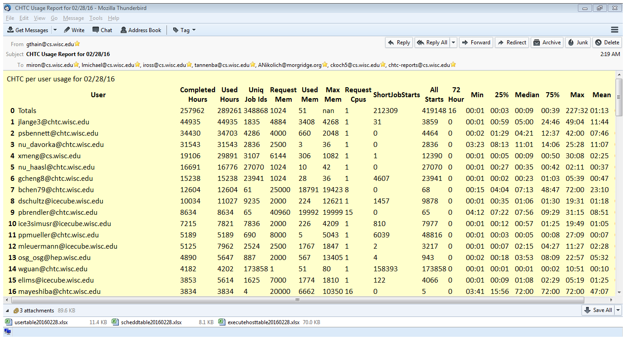
condor_pool_job_report

Slide 30
History Ads Pushed to ElasticSearch
CMS pushes 1M history ads per day
4GB disk/day, Server: 64GB Ram, 4 cores

Slide 31
Upcoming
condor_gangliad → condor_metricd
Send aggregated metrics to Ganglia
Write out aggregated metrics to rotating JSON files
Send aggregated metrics to Graphite / Influx
A new "HTCondor View" tool
Some basic utilization graphs out-of-the-box

Slide 32
Check out Fifemon!
"Comprehensive grid monitoring with Fifemon has improved resource utilization, job throughput, and computing visibility at Fermilab"
Probes, dashboards, and docs at:
https://github.com/fifemon
Fifemon Overview talk from HTCondor Week 2016:
https://research.cs.wisc.edu/htcondor/HTCondorWeek2016/presentations/ThuRetzke_Fifemon.pdf

Slide 33
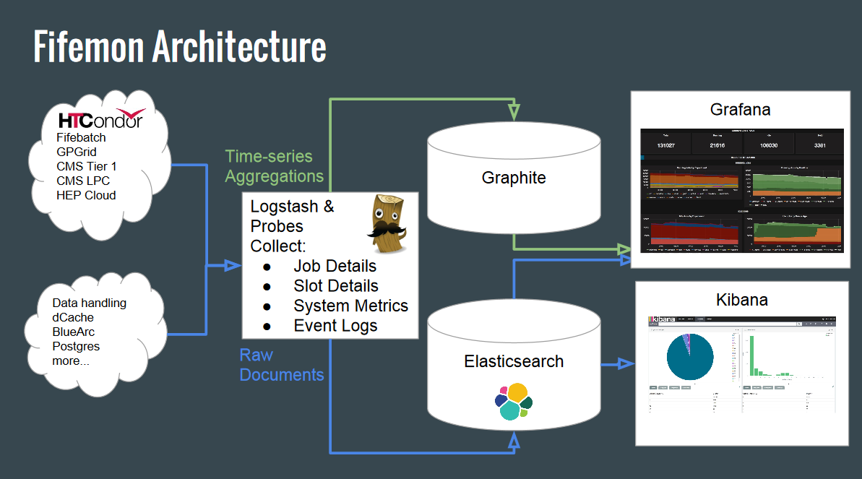
Fifemon, cont.

Slide 34
Thank you!

