Slide 1
Detecting & Managing Job Events & Progress with an HTCondor Update Job Info Hook
UNCLASSIFIED
Integrated Defense Systems
Michael V. Pelletier
May 2017
This document does not contain technology or Technical Data controlled under either the U.S. International Traffic in Arms Regulations or the U.S. Export Administration Regulations. eTPCR IDS-10494
UNCLASSIFIED

Slide 2
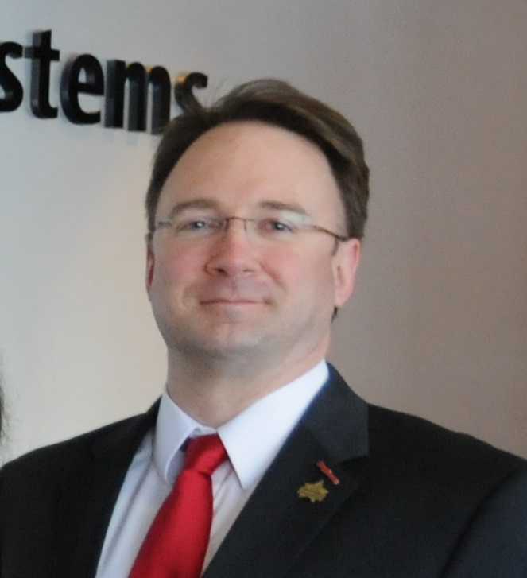
About Michael V. Pelletier
Joined Raytheon IT on March 2, 2009
2009-2015: Sysadmin at Raytheon Missile Defense Center
2015-present: Program Support & Delivery – Architecture
Highlights
2009 Excellence in Information Solutions Award
2010 Authors & Inventors Award
2011-2013 Technical Honors Peer Recognition
2013 Excellence in Engineering & Technology Award
In recognition of HTCondor implementation
2016 Excellence in Information Technology Award
Prior Roles
Nortel: 2000-2008
Taos: 1998-2000
TechTeam Global: 1992-1998
University of Michigan Engineering: 1988-1992
Photo: Raytheon Advanced Media, March 2017

Slide 3
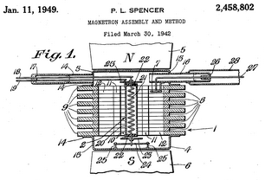
About Raytheon
Raytheon Company
Founded in 1922
$24.1 billion in 2016 sales
63,000 employees worldwide
Integrated Defense Systems
Headquartered in Tewksbury, Mass.
Broad portfolio of weapons, sensors, and integration systems across multiple mission areas including air and missile defense radars; early warning radars; naval ship operating systems; command, control, communications; air traffic systems
Information Technology
“Today's extensive High Performance Computing needs require us to continuously push the envelope to create leading-edge technical processing solutions for complex systems and program challenges.”
Photo: Michael Pelletier mvpel@flickr
Nearing a century of technology and innovation
Notes:
Raytheon’s Percy L. Spencer pioneered additive manufacturing in 1940, using stamped copper sheets to build magnetrons for British air defense radars. http://www.google.co.ug/patents/US2458802 - “Magnetron Assembly & Method”

Slide 4
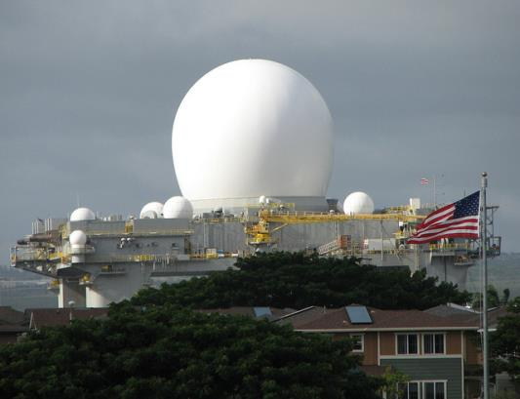
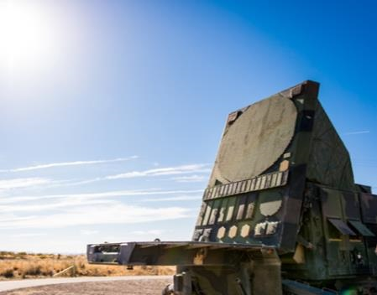
Raytheon’s Vision
Clockwise from top left: SM-3 launch: US Navy Pub Dom; SBX-1: © 2011 Michael Pelletier (Author); Patriot radar set, AN/TPY-2 AEU: © Raytheon (by Dan Plumpton – Raytheon Advanced Media)
Notes:
“You can’t build a global team without trust. Innovation requires teamwork – bringing different spheres of knowledge together to devise a new solution to a complex problem. Our innovative solutions help make the world a safer place.”
From top left, clockwise:
SM-3 interceptor launch on the Aegis destroyer USS Arleigh Burke, radar to be replaced by the Raytheon AMDR Air & Missile Defense Radar.
SBX-1 – Sea-Based X-Band radar, self-propelled midcourse sensing and discrimination radar.
PATRIOT radar unit supporting air and missile defense.
AN/TPY-2 transportable radar, used in THAAD terminal-phase interceptor system and as forward-based detection, tracking and discrimination radar.
Image credits:
Patriot Radar, AN/TPY-2: Raytheon Advanced Media, Copyright Raytheon Corporation
SM-3 Launch: United States Navy, public domain
SBX-1 at Ford Island: Copyright 2011 Michael V. Pelletier (author)

Slide 5
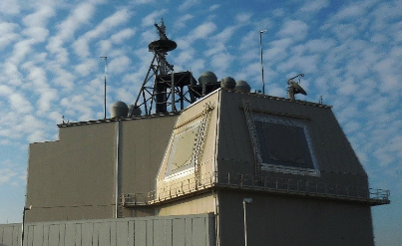
What’s At Stake
US Naval Institute News
Paula Hancocks & Joshua Berlinger, March 7, 2017
US MDA Photo – Public Domain

Slide 6
Modeling and Simulation
Raytheon has been deeply involved with all phases of modeling and simulation, from the design and development of models and simulation systems to their use in real-world, mission-critical applications.
…simulations play a central role in optimizing the value of what are typically expensive field tests, and in some cases simulations actually reduce the amount of field testing needed.
This was published in January 2013…
It’s still relevant today, but even more so.
Mark Russell Vice President of Engineering, Technology & Mission Assurance
Notes:
“Expensive field test” – MDA annual research, development, testing, & evaluation (RDT&E) budget is $6.2 billion, with a B.
A complex, threat-representative flight test can cost over a quarter billion dollars start to finish.
“Matter of life and death” – may seem like an exaggeration. But during the Gulf War, the Patriot system proved this to be absolutely true, and many lives were saved when Iraqi Scud missile attacks on Israel and Saudi Arabia were thwarted.

Slide 7
Software Peril: Hangs
Hang cause is not always obvious
MIL-STD-498, EIA/IEEE J-STD-016
Calls for entity-based software design, with defined communication interfaces between entities
static bool retry = true; while( retry = true ) { … }
?
CC-BY-NC 2.5 – https://xkcd.com/253/

Slide 8
Hangs in HTCondor Slots
True Story!
condor1$ condor_q
-- Schedd: condor1 : <10.1.1.10:25399?...
ID OWNER SUBMITTED RUN_TIME ST PRI SIZE CMD
611.38 joeuser 4/2 20:50 5+13:27:15 R 0 23544 (Scenario 39)
1 jobs; 0 completed, 0 removed, 0 idle, 1 running, 0 held, 0 suspended
condor1$
The job was only supposed to take three or four hours, and it hung in the first 10 minutes
Wasted slot time == badput
Mrs Vivian Bennett – Little Rock – MemeSuper.com
Notes:
Infinite loop hammering a CPU.
Asymptotic solution failing to converge
Uninitialized variable references
Typo in termination conditional > vs <
Photo: https://memesuper.com/download/e382a6f029e66639c9980fe1b60c0a33f3d2c268.html

Slide 9
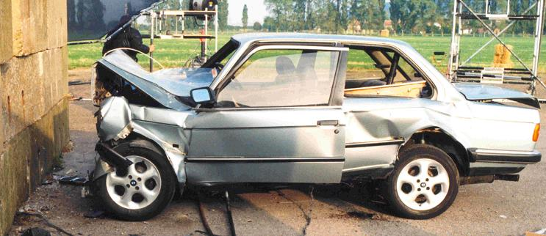
The Usual Workarounds
Runtime Cap / Deadline
periodic_hold = ( CurrentTime – JobCurrentStartDate > 5 * $(HOUR))
What if an important off-nominal run really needs six hours instead of five?
It will be killed 5 hours into a good run
Cap has to be configured for each type of job, and use the longest expected runtime
What if the job hangs after five minutes?
It will occupy the slot until the full cap elapses four hours and 55 minutes later
Automatic restart of intermittently-hanging jobs is impractical with long deadlines
Mrs Annette Wallace of Murietta, Georgia – ClipartFest.com

Slide 10
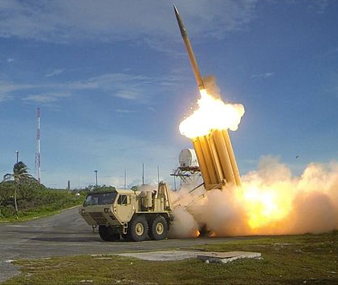
The Usual Workarounds
Software-internal abort timeout
THAAD Flight Test FTO-01, September 2013
Software Unit
Some of our software will run on hardware destined for destruction, so “reconnect or die trying” is the rule
“Test like you fly” – words to live by
Could pose security risks if used
US Army Photo – CC-BY 2.0
Notes:
THAAD launch Photo: https://www.flickr.com/photos/soldiersmediacenter/10175108175/
Stopwatch: Microsoft Office clipart
Axe – free image from ClipArtLord.com: http://www.clipartlord.com/category/miscellaneous-clip-art/weapons-clip-art/axe-clip-art/

Slide 11
Solution: the “Update Job Info” Hook
<Keyword>_HOOK_UPDATE_JOB_INFO
HTCondor V8.6.1 Manual Section 4.4, p.559
4.4 Hooks
A hook is an external program or script invoked by HTCondor.
…
The Daemon ClassAd hooks permit the condor_startd and condor_schedd daemons to execute hooks once or on a periodic basis.
HTCondor V8.6.1 Manual Section 3.5.33, p.352
For the fetch work hooks, the full path to the program invoked by the condor_starter periodically as the job runs, allowing the condor_starter to present an updated and augmented job ClassAd to the program.

Slide 12
Update Job Info Hook Operation
Invoked eight seconds after job starts and then once every five minutes
The current job ClassAd is provided on standard input
Runs in job’s workspace as job owner
Output and exit status are ignored
Updates to the job’s ClassAd require Chirp
Write it to run quickly and efficiently
Hook
Job
US Agricultural Research Service – Public Domain
Notes:
Timing of the invocations can be adjusted.
Photo:
https://commons.wikimedia.org/wiki/File:Manusingmicroscope.jpg

Slide 13
The “Checkfile” Hook for Hang Detection
Probe the job
Last modification time of output file
If it stops updating, job is likely hung
Pattern matching in the output file
If the software generates known output that indicates a hang or other failure
Update the job attributes
CheckfileLastModifiedTime = 1491190343
CheckfileRegexpFound = False
Use job attributes to take action (not the hook itself)
periodic_hold = ( CurrentTime – CheckfileLastModifiedTime > 600 )
CC BY-NC-SA – wikiHow.com
Notes:
Photo:
http://www.wikihow.com/Calculate-Pulse-Pressure
This use is non-commercial; to be presented at HTCondor Week 2017 conference sponsored by the Center for High-Throughput Computing at the University of Wisconsin – Madison.

Slide 14
Setup and Use
Install the hook script
Configure the pool to offer a hook keyword for it
CHECKFILE_HOOK_UPDATE_JOB_INFO = $(LIBEXEC)/hook_checkfile
The STARTER_INITIAL_UPDATE_INTERVAL and UPDATE_INTERVAL configuration parameters control the time of the first run after job start, and the interval for subsequent runs, but there’s no need to change these for typical use
Call the hook in a submit description
+HookKeyword = “Checkfile”
+WantIOProxy = True
+CheckfileName = “job.out”
Notes:
Relinquishment of Raytheon IP requires division president or delegate approval; currently exploring the options to make it possible to contribute my hook_checkfile code to the HTCondor community.

Slide 15
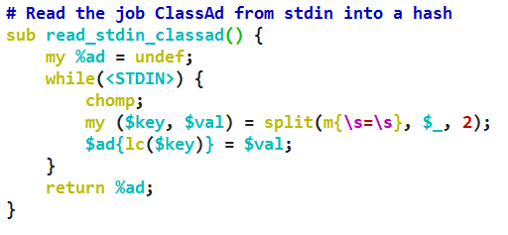
Checkfile: Step 1
Reading the job ClassAd into a Perl hash
Script receives simple key-value pairs, just like condor_q –long output
All hash keys are standardized to lower case
No parsing is done, so ClassAd strings retain their quotes

Slide 16
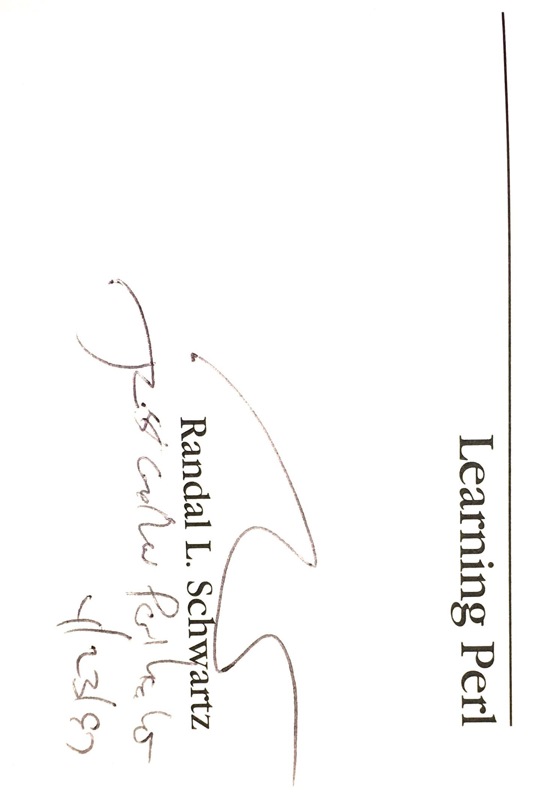
You May Be Wondering, “Why Perl?”
As a novice USENET sysadmin at the University of Michigan, I noticed Larry Wall’s posts in comp.sources in 1988, and…
But if you prefer
mandatory whitespace,
feel free to use
something else.
Images CC-BY 2.0 Michael V. Pelletier (Author)
Notes:
Images: Michael Pelletier (Author). Released into the public domain.

Slide 17
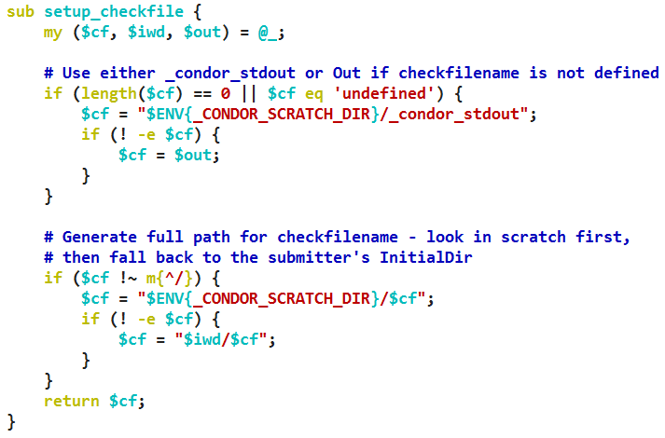
Checkfile: Step 2
Canonicalize the CheckfileName attribute
If undefined, use the job’s “output” submit description file, or _condor_stdout
Insure the checkfile is a full pathname, using either the scratch directory or the job’s “Iwd” attribute, the “initialdir”
MATCH_EXP_CheckfileName is set to the identified full path

Slide 18
Checkfile: Step 3
Run a stat() on the CheckfileName
The get_info() function caches the result of the stat() call in a BEGIN block, to avoid making multiple stat() calls on the same file
The +CheckfileName which was set in the submit description is the stat() target
Items of interest are the last modification time, last access time, and file size

Slide 19
Checkfile: Step 4
Use condor_chirp to update the job ClassAd via set_job_attr
Be sure to avoid updating previously-set values you failed to find in this run
Non-delayed, so it requires the WantIOProxy attribute to be set to True
Since a non-delayed “set_job_attr” call is more labor-intensive, we don’t send an update unless the value has changed by comparing to STDIN job ClassAd
Delayed updates could take up to 15 minutes to be recognized

Slide 20
Implementing a Trailing Stop Order
Set the file-activity timeout policy in the submit description
TIMEOUT = 10 * $(MINUTE)
LOG_AGE = ifThenElse( \ ( ! isUndefined(CheckfileLastModifiedTime ), \ ( CurrentTime – CheckfileLastModifiedTime ), 0) periodic_hold = JobStatus == 2 \ && ( $(LOG_AGE) > $(TIMEOUT) )
periodic_hold_reason = “Log not updated for 10 minutes”
periodic_hold_subcode = 54321
No hard deadlines, no risky app-induced abort timeout
A four-hour job hung after 10 minutes stops in 15 minutes instead of five hours
The six hour job can run to completion as long as it keeps generating output

Slide 21
Adjustments Needed for Automatic Restart
The ClassAd and Checkfile will have old data upon restart
Need to adjust periodic_hold to avoid immediately holding restarted jobs
Insure the job has been running at least as long as the timeout before holding
TIMEOUT = 600 SUSP = ifThenElse(isUndefined(CumulativeSuspensionTime), \
0, CumulativeSuspensionTime )
MOD = ifThenElse(isUndefined(CheckfileLastModifiedTime), \
0, CurrentTime – CheckfileLastModifiedTime )
periodic_hold = JobStatus == 2 \
&& ( CurrentTime - $(SUSP) - $(MOD) >= $(TIMEOUT ) \
&& ( CurrentTime – JobCurrentStartDate >= $(TIMEOUT) )
periodic_hold_subcode = 54321

Slide 22
Automatic Restart with Periodic Release
Release the job if it was held due to a hang
The software might only hang under certain circumstances, and might run to completion if restarted.
MAX_TRIES = 3
periodic_release = ( HoldReasonCode == 3 \
&& HoldReasonSubcode == 54321 \
&& NumJobStarts < $(MAX_TRIES) )
By matching against the subcode set for the periodic_hold, this expression will not auto-release a job that was put on hold by the user or as a result of an error
The job will not be restarted once it reaches three attempts

Slide 23
So Far, So Good
So what can we check besides the file’s size and timestamps?
Anything we can code!
geralt @ Pixabay – Public Domain
Notes:
Image: https://pixabay.com/p-396266/?no_redirect – Public Domain

Slide 24
Flagging an Error in the File
Set Boolean job attribute CheckfileRegexpFound
Submit description invocation:
+CheckfileName = “interceptor_entity.out”
+CheckfileRegexp = “^error:”
+CheckfileRegexpModifier = “i”
+CheckfileRegexpChunkSize = 1024
Translation: if the file contains a case-insensitive match to the string “error:” at the beginning of a line in the last 1024 bytes of the file, CheckfileRegexpFound is set to True.
Take action using periodic_hold:
periodic_hold = ( CheckfileRegexpFound =?= True )
periodic_hold_reason = “Error detected in interceptor log”

Slide 25
Capture File Contents as Job Attributes
Extract data values from the Checkfile using regexp matches
+CheckfileDataRegexp = “^Percent Complete: (\d+)”
+CheckfileName = “rcs_analysis.out”
+CheckfileDataAttributeName = “JobPercentComplete”
Translation: look for the last line in the default chunk size beginning with “Percent Complete” and pull out the numeric value following the colon, and set the JobPercentComplete attribute accordingly.
description = Progress: $$(JobPercentComplete)%
PREEMPTION_REQUIREMENTS = ( isUndefined(JobPercentComplete) \
|| JobPercentComplete < 50 )
Notes:
Using the JobPercentComplete in the pool’s preemption requirements, you can avoid preempting jobs which are more than 50% complete, to help minimize badput ratios.

Slide 26
Future Development
Use string lists to allow multiple checks to be performed
+CheckfileName = { “interceptor.log”, “c2bmc.log” } +CheckfileRegExp = { “^error:”, “^exception:” } CheckfileRegExpFound = False || True
Translation: an exception line was found in the c2bmc.log file
Limited only by your mad coding skillz
*Command & Control, Battle Management, & Communications https://www.mda.mil/system/c2bmc.html
Notes:
Ask for ideas from the audience if time permits.
Photo: http://www.icanhascheezburger.com/

Slide 27
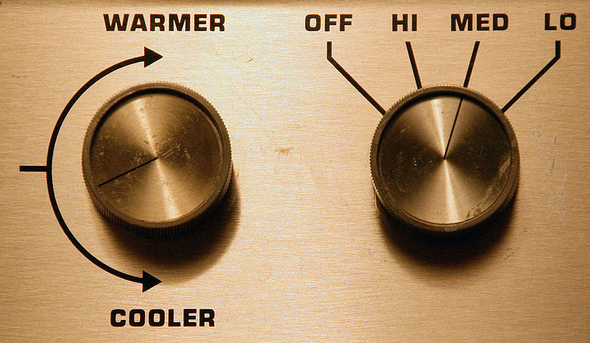
Feature Request
Non-hook periodic program invocation in submit description
Read the job ClassAd updates from hook standard output
Allow a user-specified interval with a reasonable minimum limit
“THERE OUGHTA BE A KNOB FOR THAT!”
Tysto @ Wikimedia – Public Domain
Notes:
Hooks come as kits, so if you need to use another prepare_job hook, you need a separate configuration to include checkfile and the prepare_job hook.
Image: https://commons.wikimedia.org/wiki/File:Knobs-for-climate-control.jpg

Slide 28
Questions and Comments

