Slide 1
HTCondor Workflow Development for Statistical Modeling of Satellite Image Time Series with Ancillary Data
Matthew Garcia
Ph.D. Candidate, Forest Science
University of Wisconsin–Madison
Advised by Prof. Philip Townsend
HTCondor Week 2017
Madison, Wisconsin
5 May 2017

Slide 2
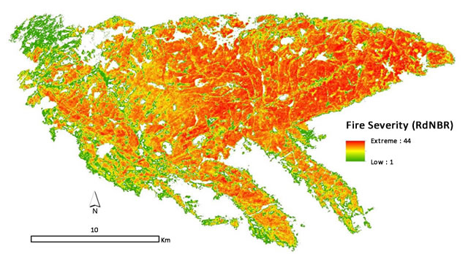
Pagami Creek Fire, NE Minnesota, September 2011
Data provided by US Geological Survey
Burn Severity analysis by USDA Forest Service, Northern Research Station
https://www.fs.fed.us/nrs/highlights/#highlight160
HTCondor Week 2017
5 May 2017
matt.e.garcia@gmail.com

Slide 3
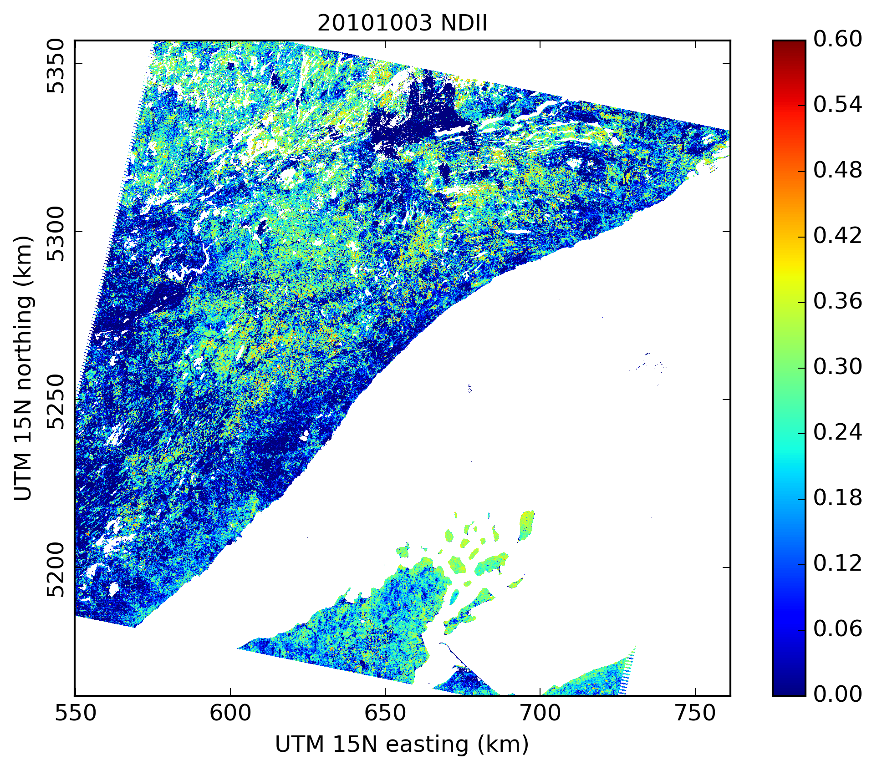
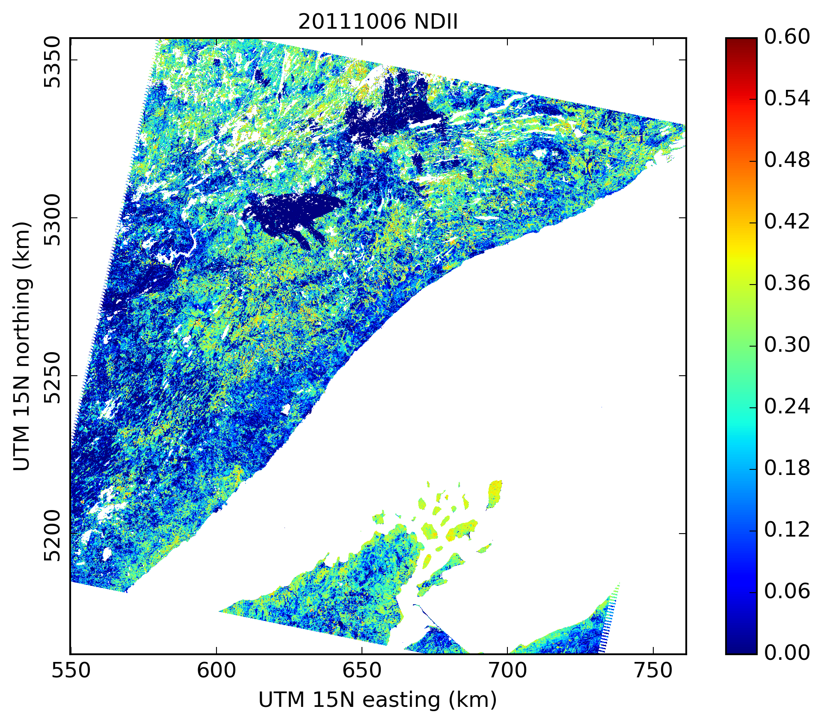
Landsat-based Vegetation Index Temporal Difference, NE Minnesota (P26R27)
Data from US Geological Survey, my own processing and analysis in Python
Part of an HTCondor tutorial at https://github.com/megarcia/HTCondor_examples
HTCondor Week 2017
5 May 2017
matt.e.garcia@gmail.com

Slide 4
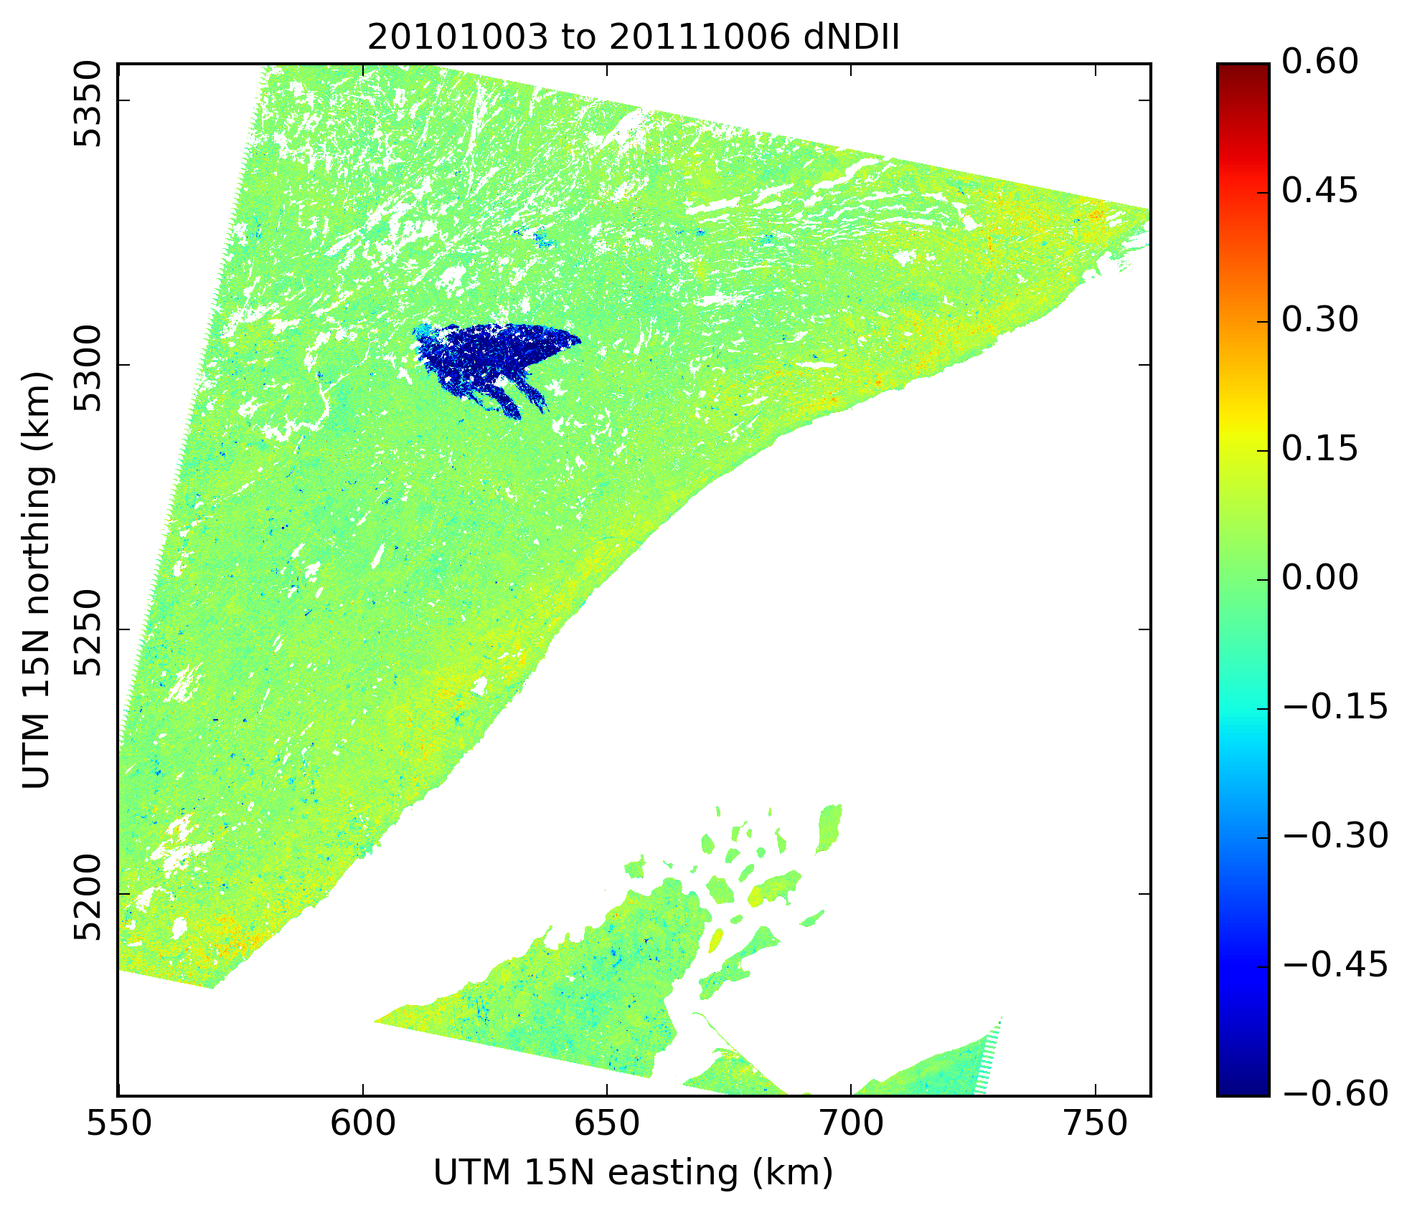
Landsat-based Vegetation Index Temporal Difference, NE Minnesota (P26R27)
Data from US Geological Survey, my own processing and analysis in Python
Part of an HTCondor tutorial at https://github.com/megarcia/HTCondor_examples
HTCondor Week 2017
5 May 2017
matt.e.garcia@gmail.com

Slide 5
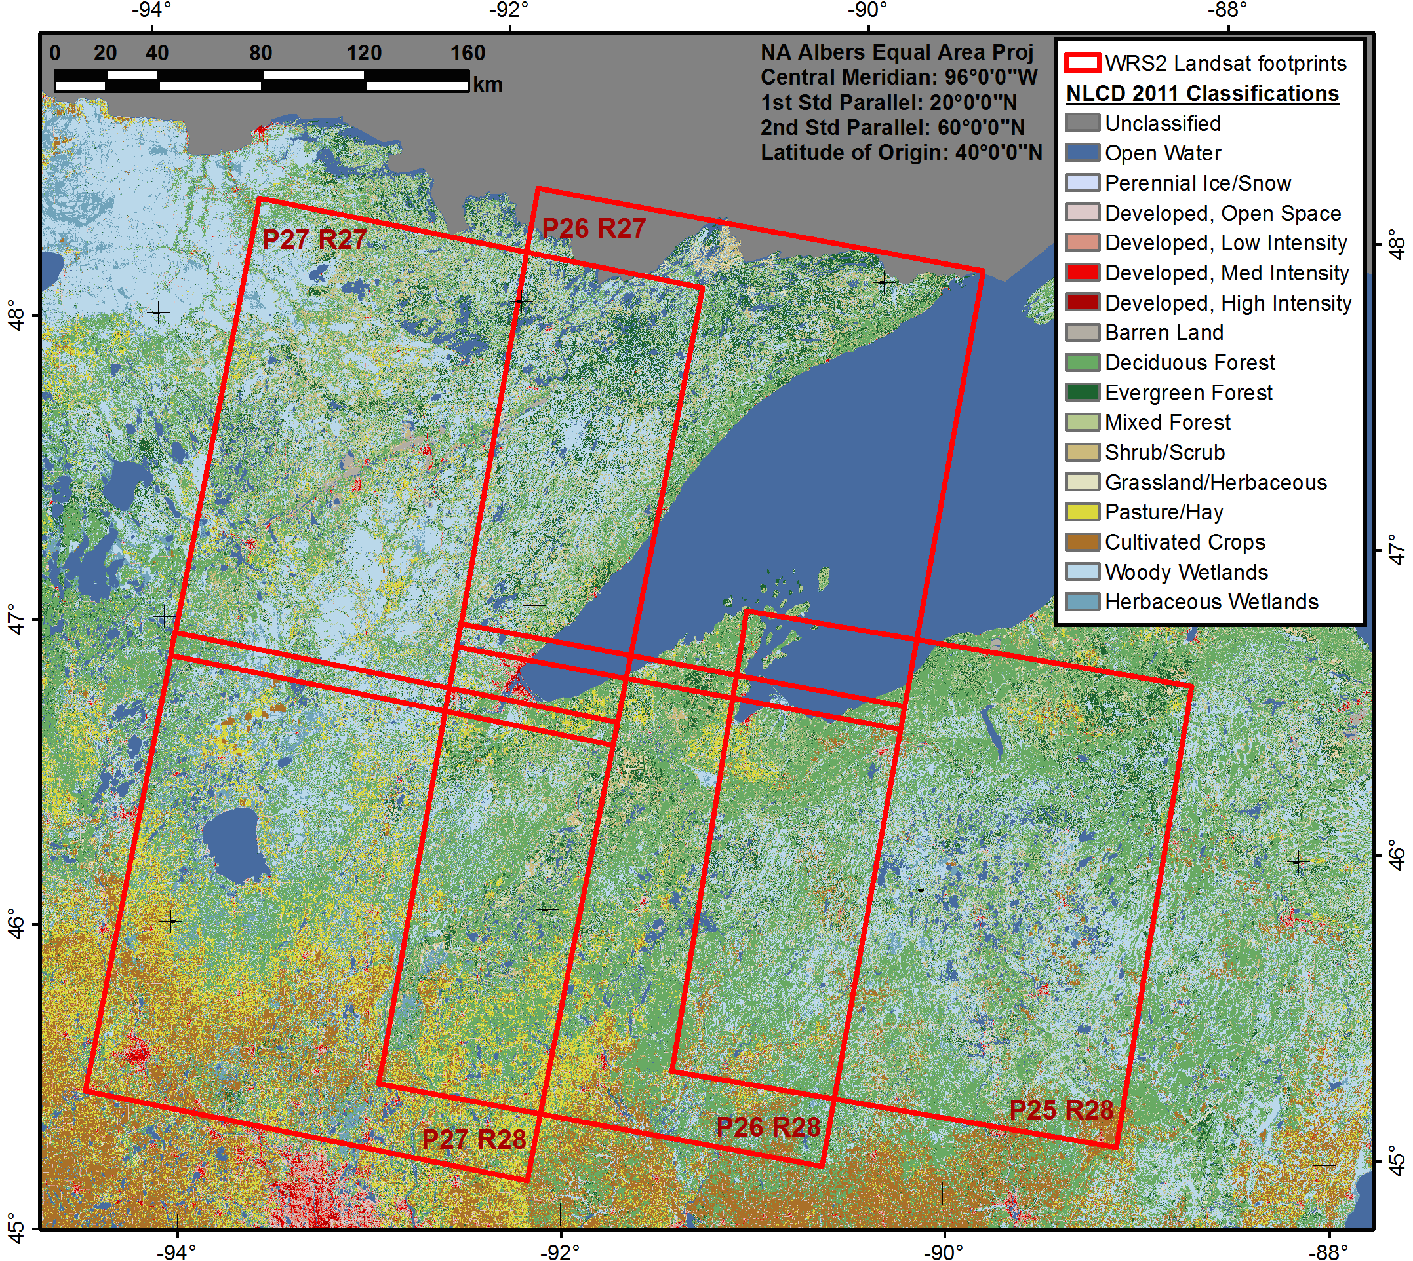
Dissertation Study Area and Data
~202,000 sq. km (U.S. only)
1984 – 2013 (30 years)
Landsat scenes from US Geological Survey
200 – 250 scenes per footprint
GHCN-D weather data from NOAA/NCEI
Project Considerations
Python (pandas, numpy, scipy, matplotlib)
HDF5 storage with internal compression
Exploit scalability of HTCondor and OSG
Repeatable, reproducible, transferable
Publications with open-source repos
HTCondor Week 2017
5 May 2017
matt.e.garcia@gmail.com

Slide 6
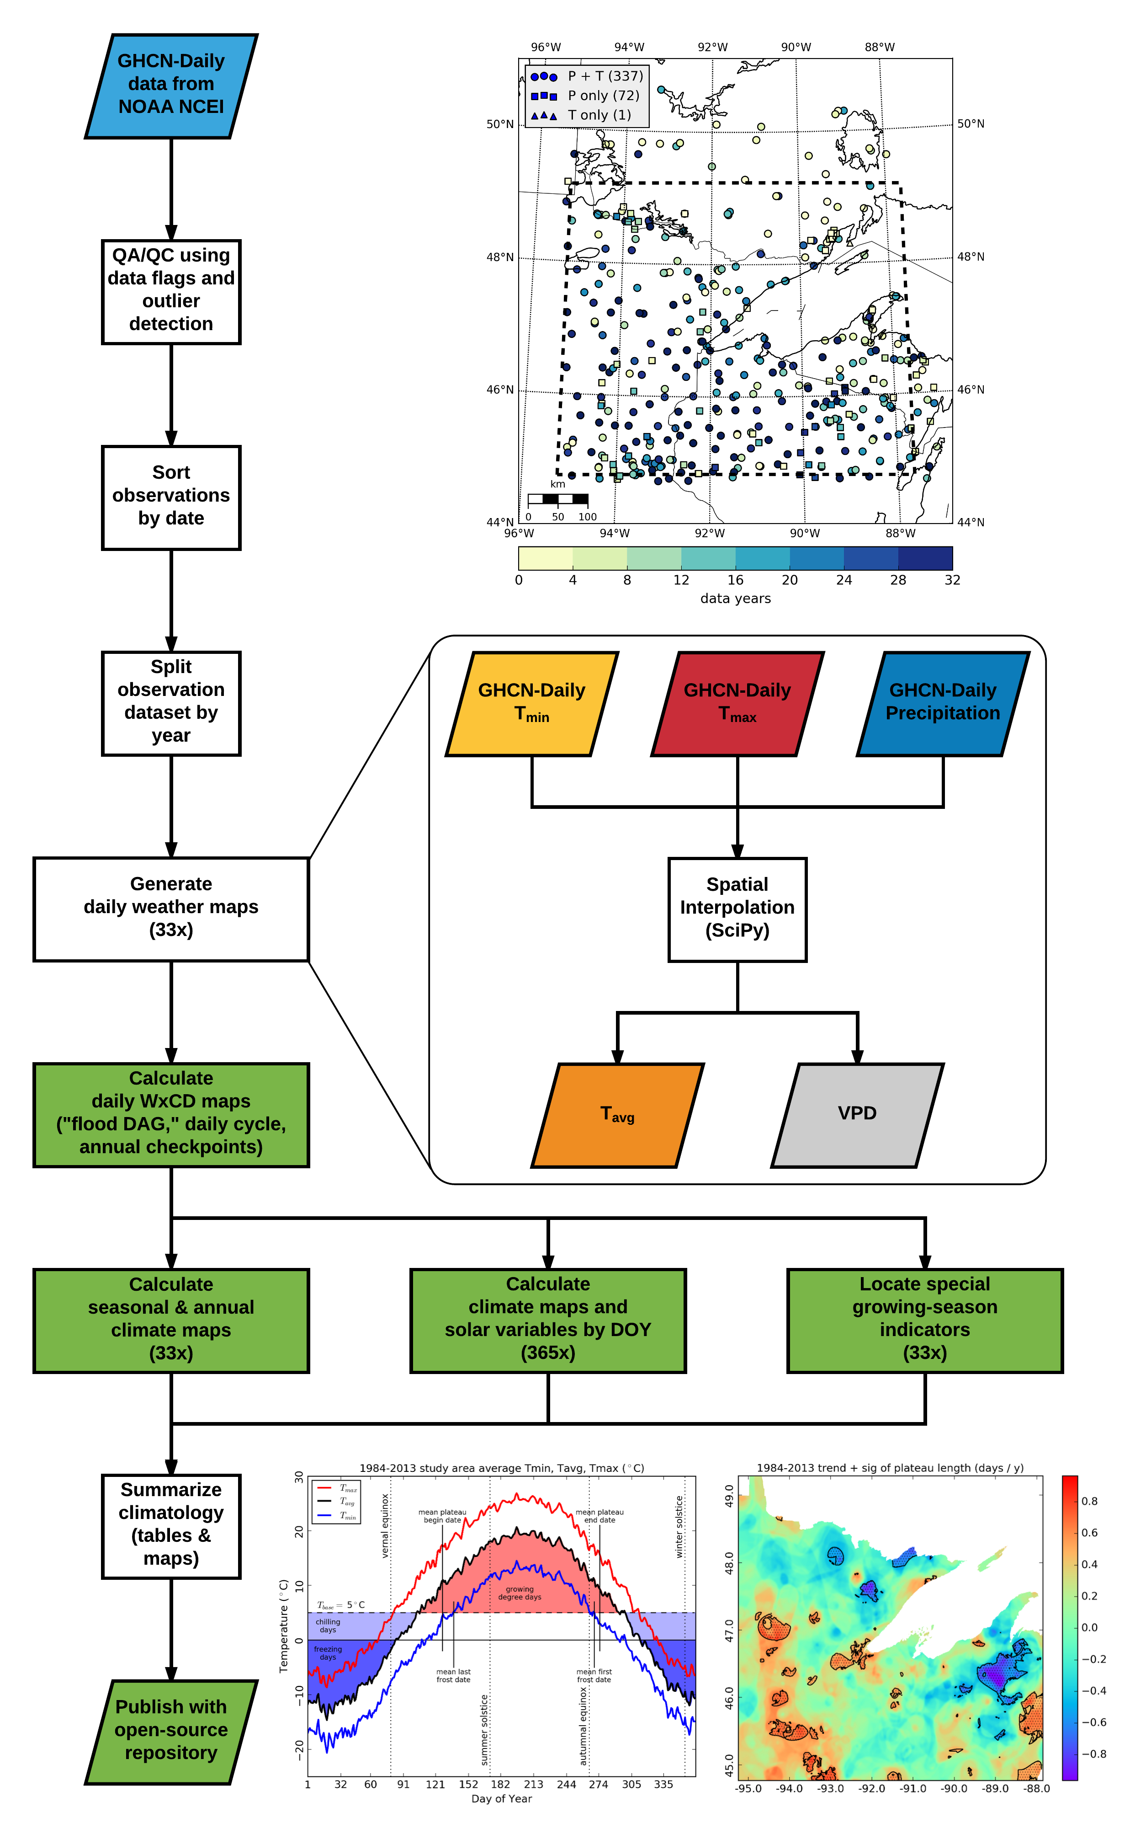
HTCondor Week 2017
5 May 2017
matt.e.garcia@gmail.com

Slide 7
HTCondor Week 2017
5 May 2017
matt.e.garcia@gmail.com
Notes:
LiveSlide Site
http://proxy.chtc.wisc.edu/SQUID/megarcia/HTCondorWeek2017/wxcd_anim.html

Slide 8
HTCondor Week 2017
5 May 2017
matt.e.garcia@gmail.com

Slide 9
https://megarcia.github.io/WxCD/
HTCondor Week 2017
5 May 2017
matt.e.garcia@gmail.com

Slide 10
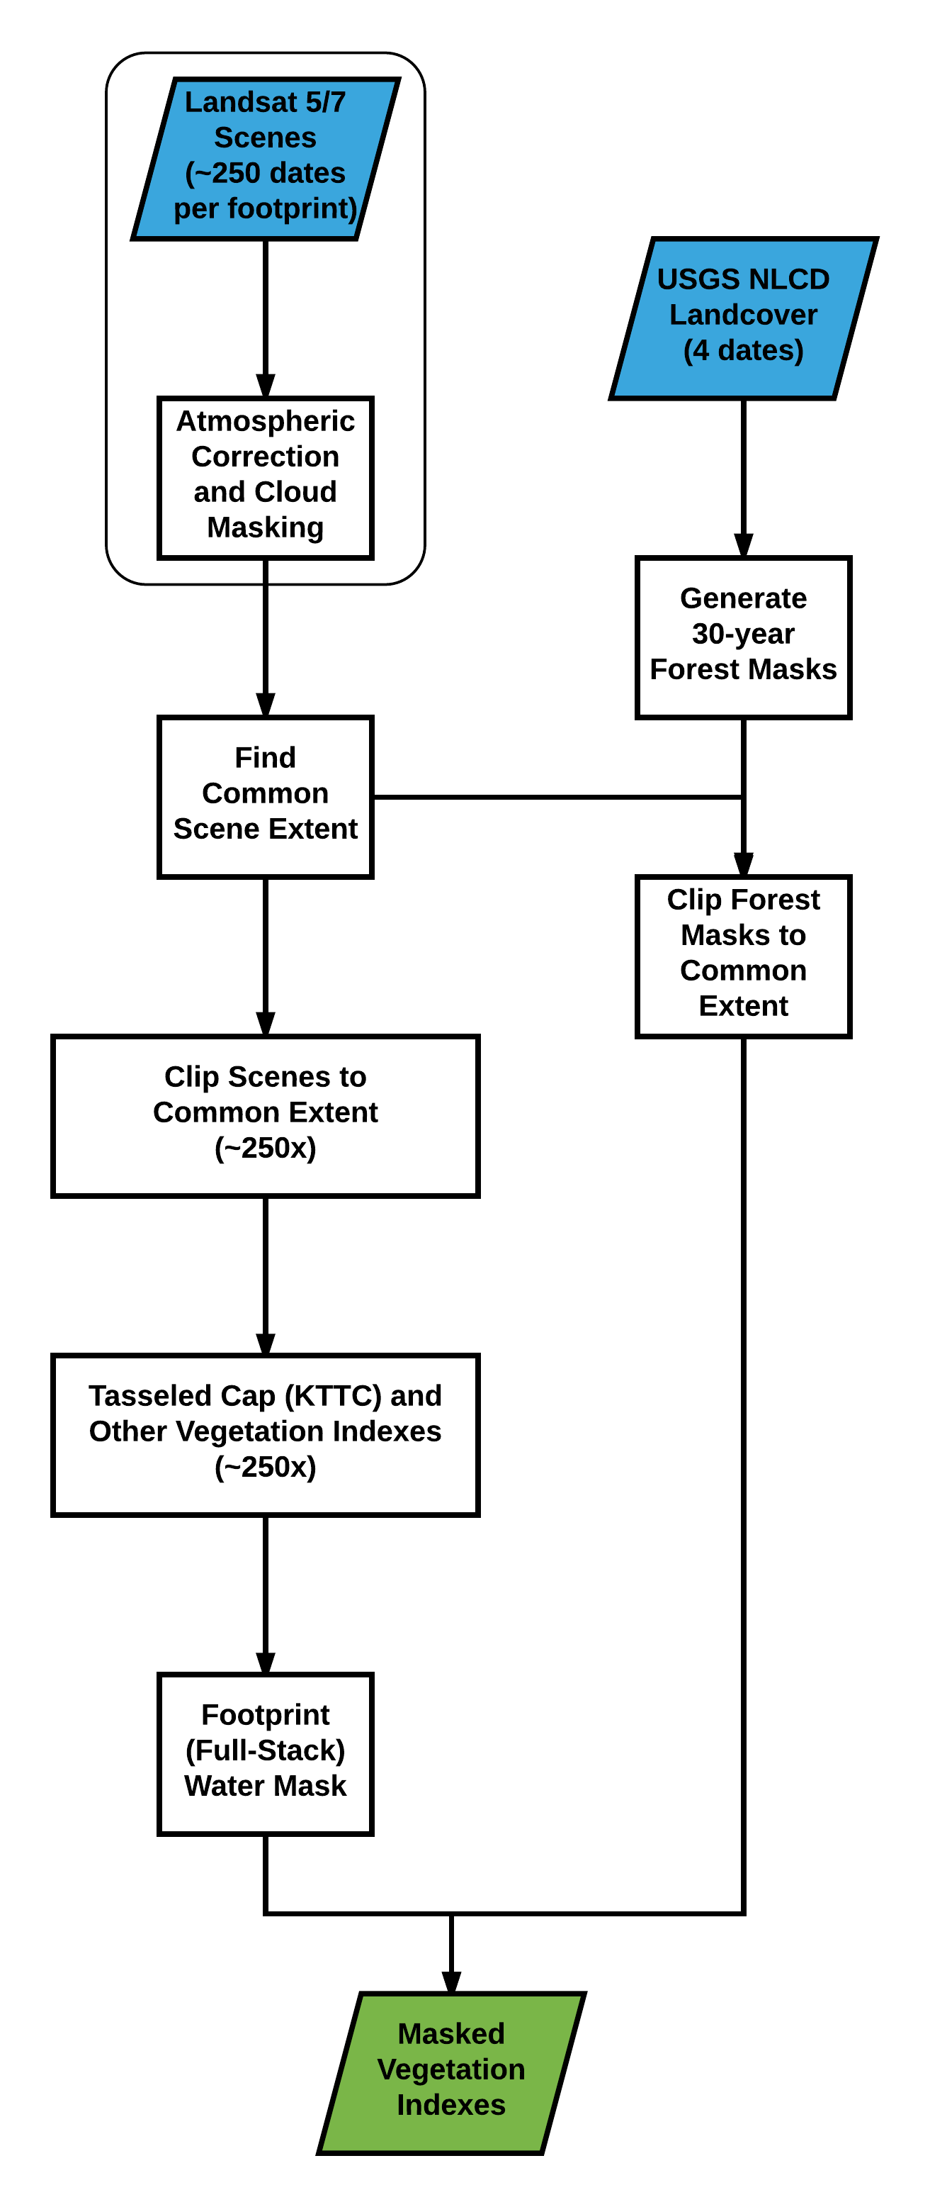
HTCondor Week 2017
5 May 2017
matt.e.garcia@gmail.com

Slide 11
HTCondor Week 2017
5 May 2017
matt.e.garcia@gmail.com
Notes:
LiveSlide Site
http://proxy.chtc.wisc.edu/SQUID/megarcia/HTCondorWeek2017/merge_anim.html

Slide 12
HTCondor Week 2017
5 May 2017
matt.e.garcia@gmail.com
Notes:
LiveSlide Site
http://proxy.chtc.wisc.edu/SQUID/megarcia/HTCondorWeek2017/shuffle_anim.html

Slide 13
HTCondor Week 2017
5 May 2017
matt.e.garcia@gmail.com

Slide 14
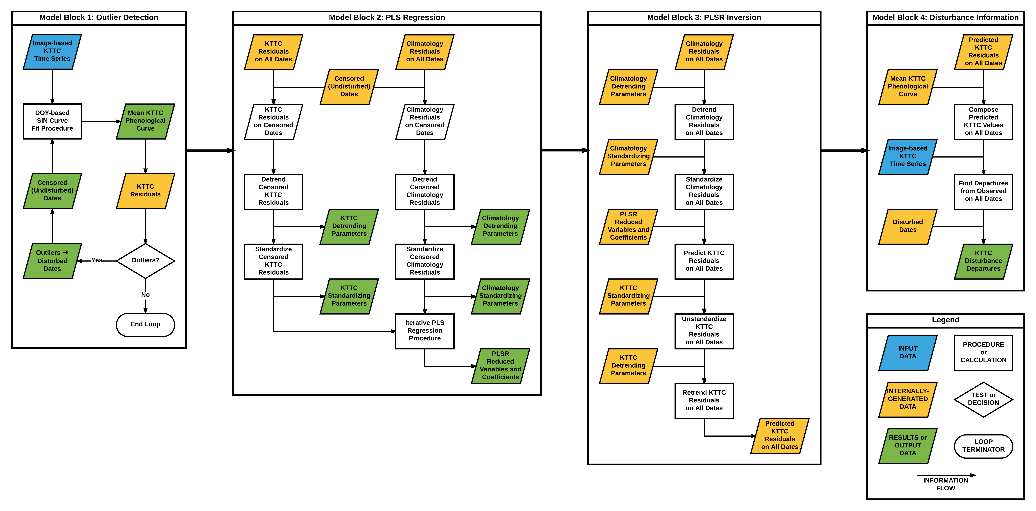
HTCondor Week 2017
5 May 2017
matt.e.garcia@gmail.com

Slide 15
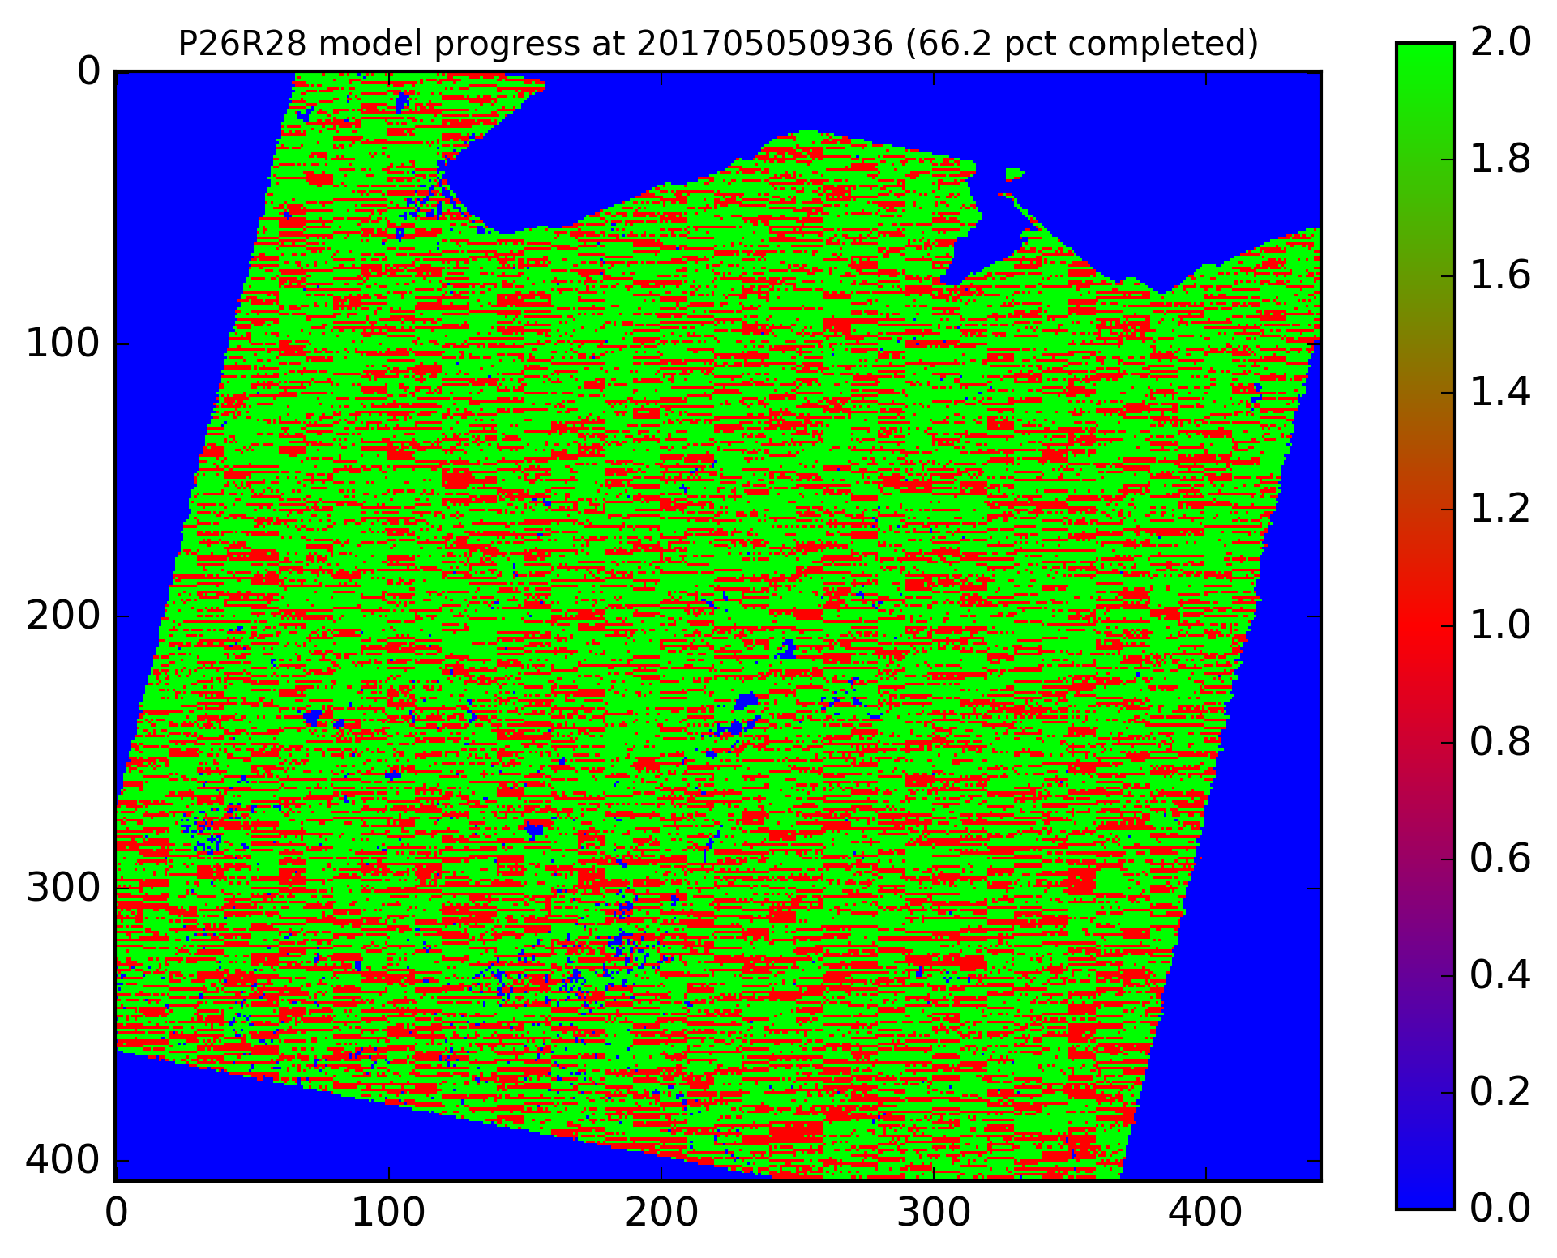
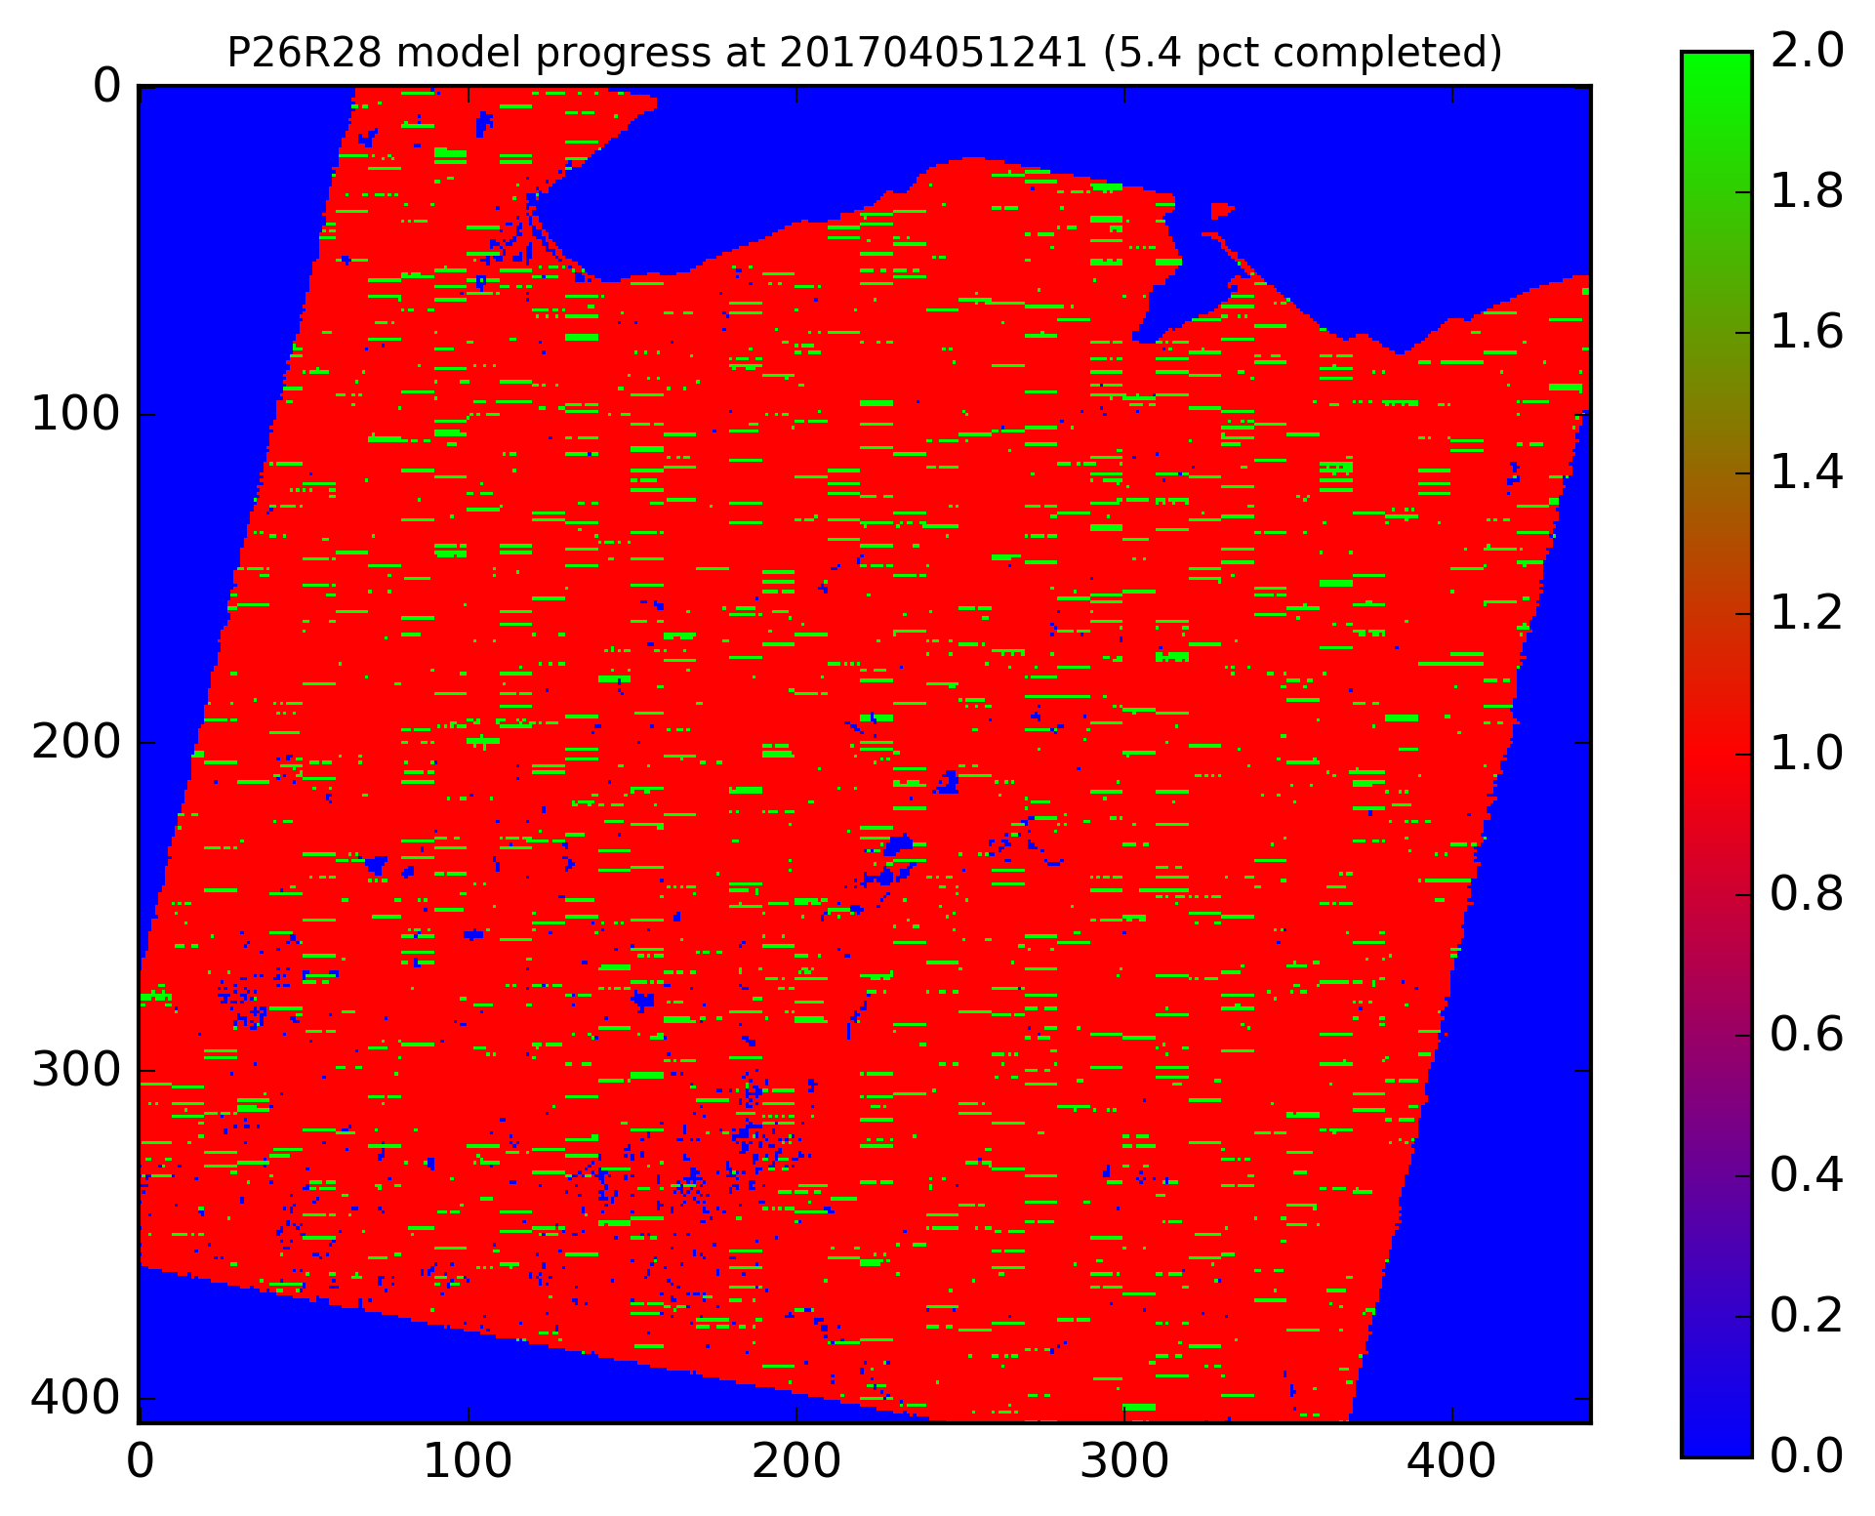
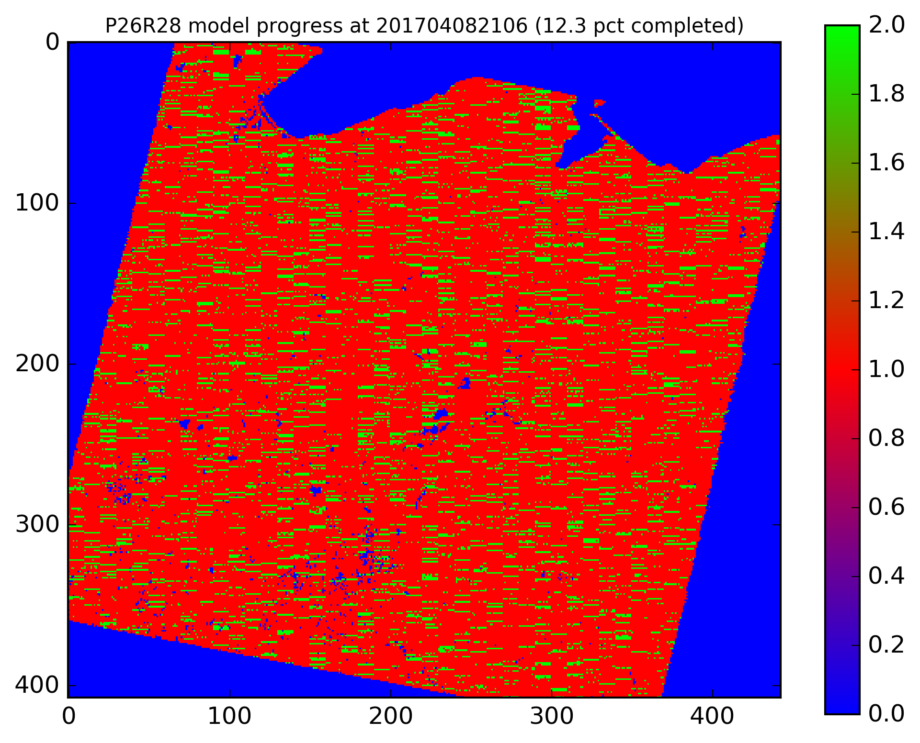
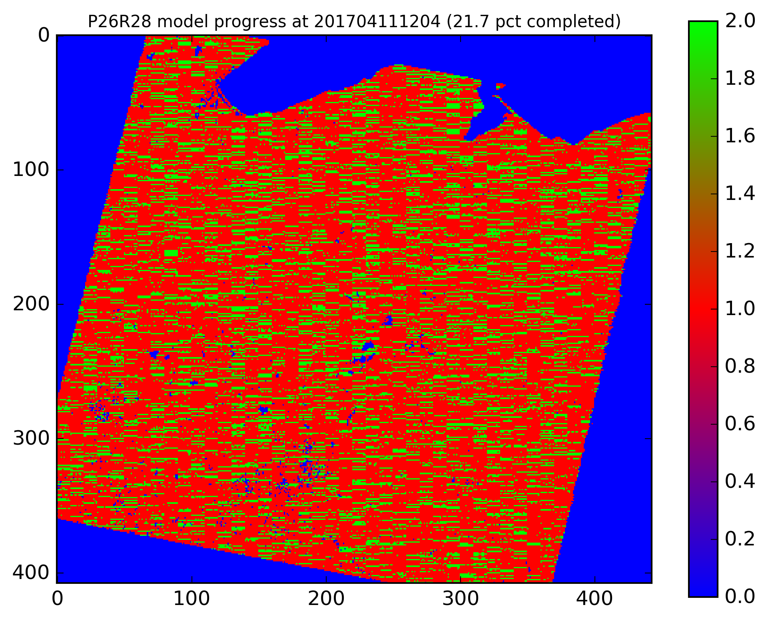
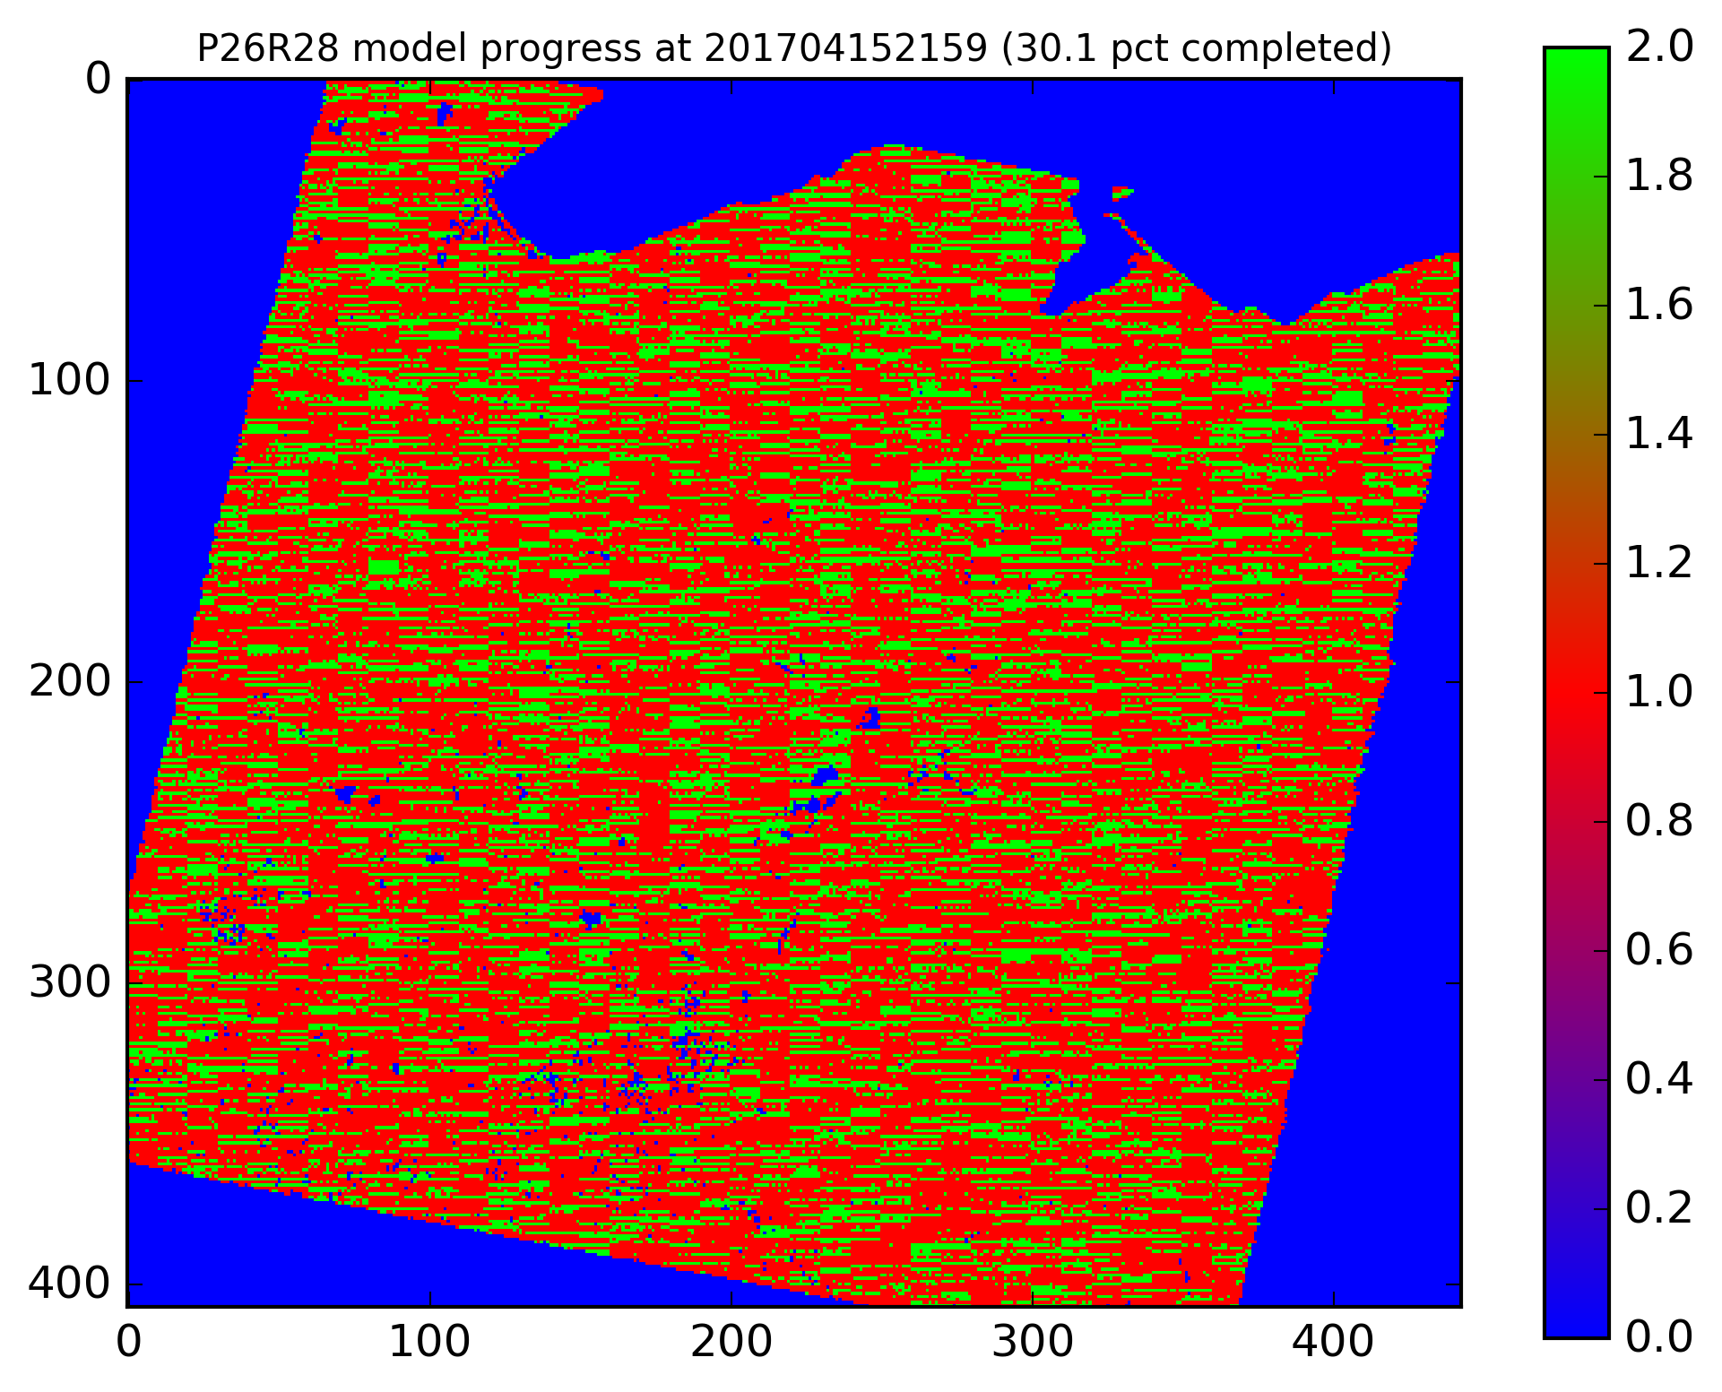
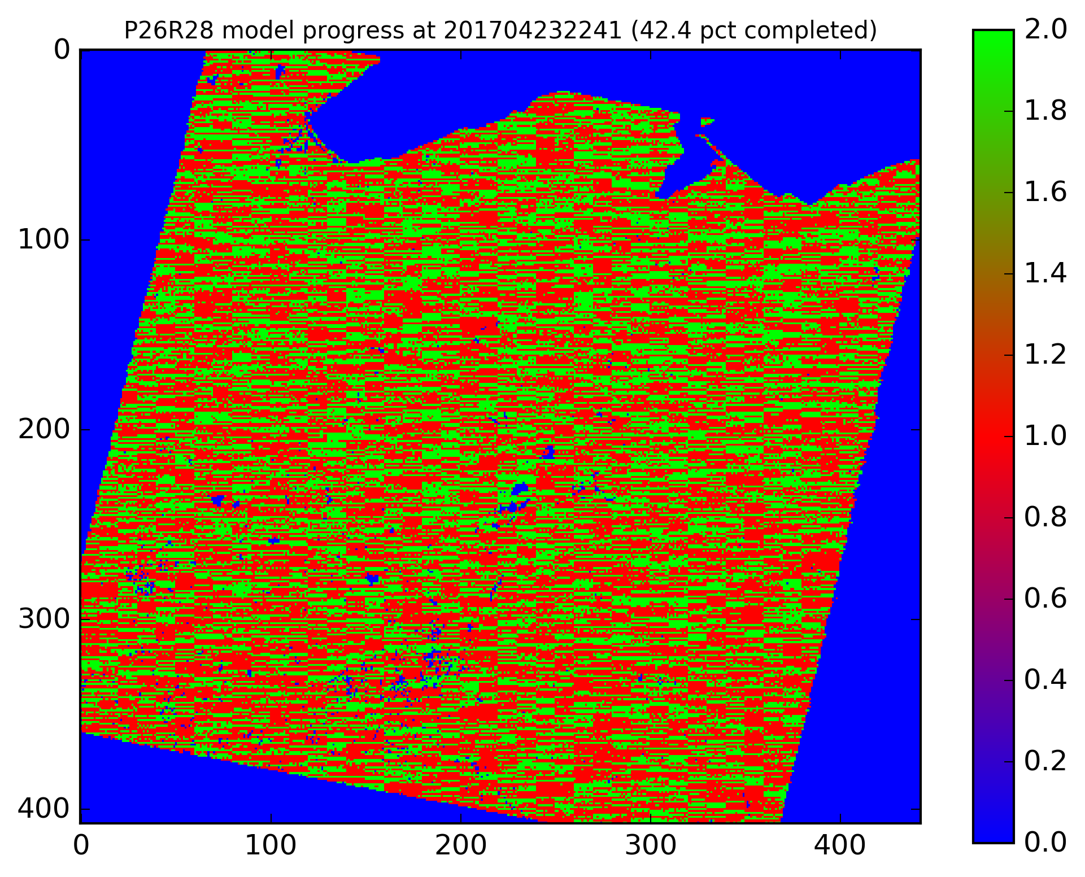
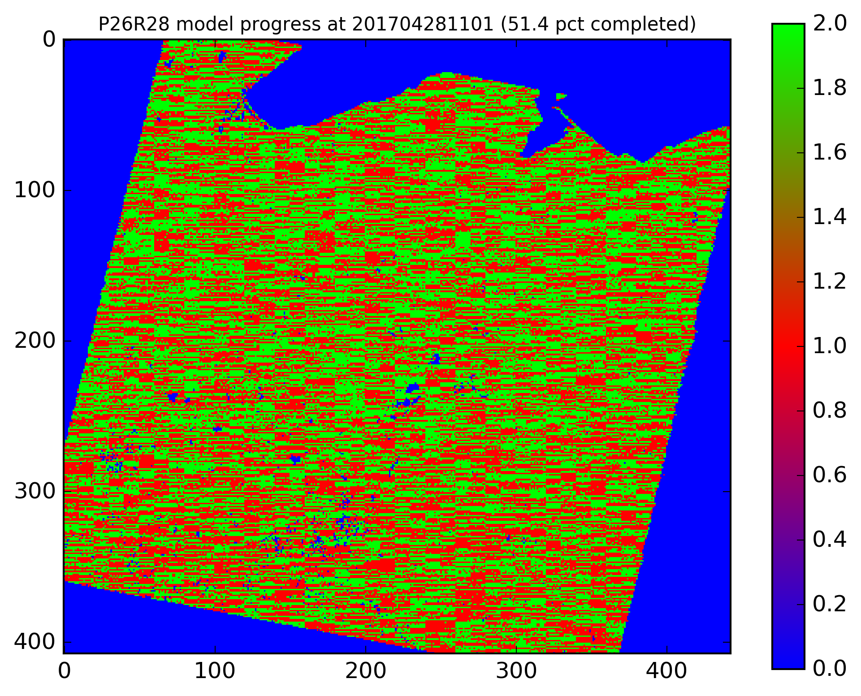
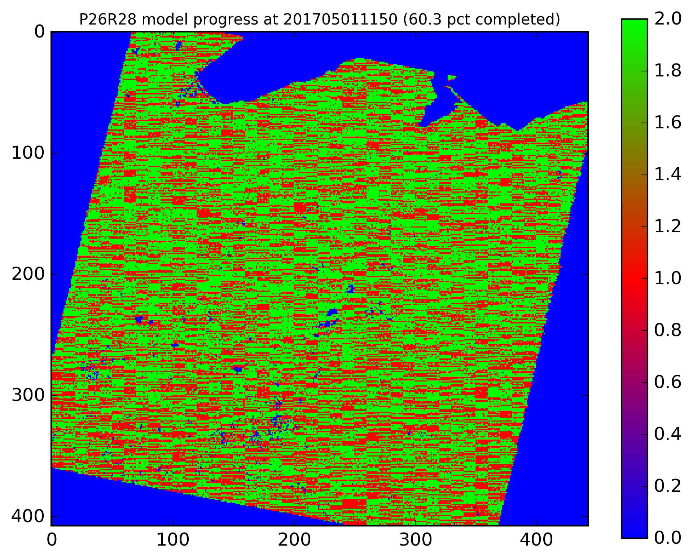
HTCondor Week 2017
5 May 2017
matt.e.garcia@gmail.com

Slide 16
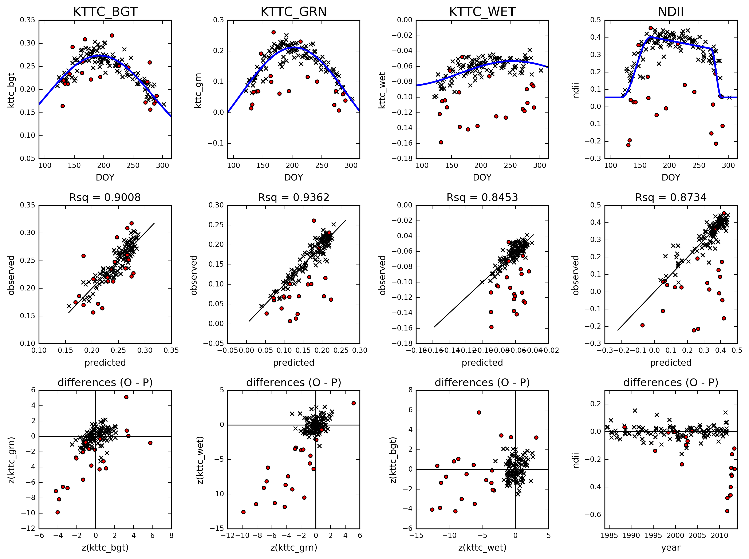
HTCondor Week 2017
5 May 2017
matt.e.garcia@gmail.com

Slide 17
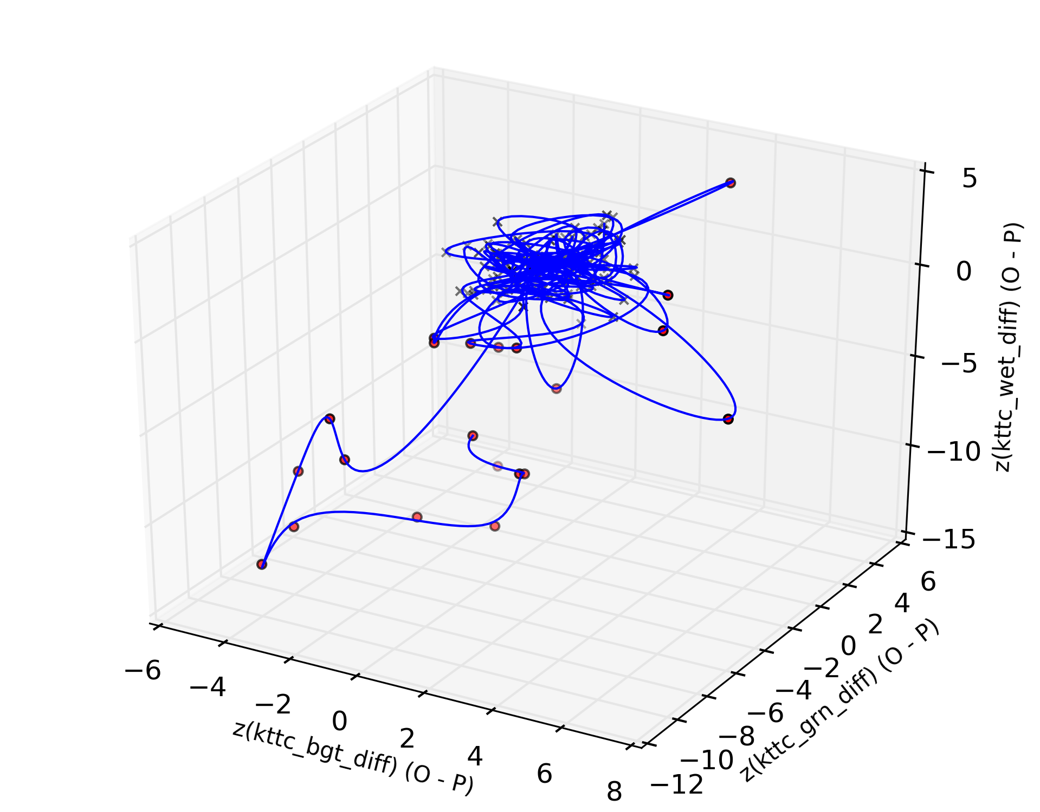
HTCondor Week 2017
5 May 2017
matt.e.garcia@gmail.com

Slide 18
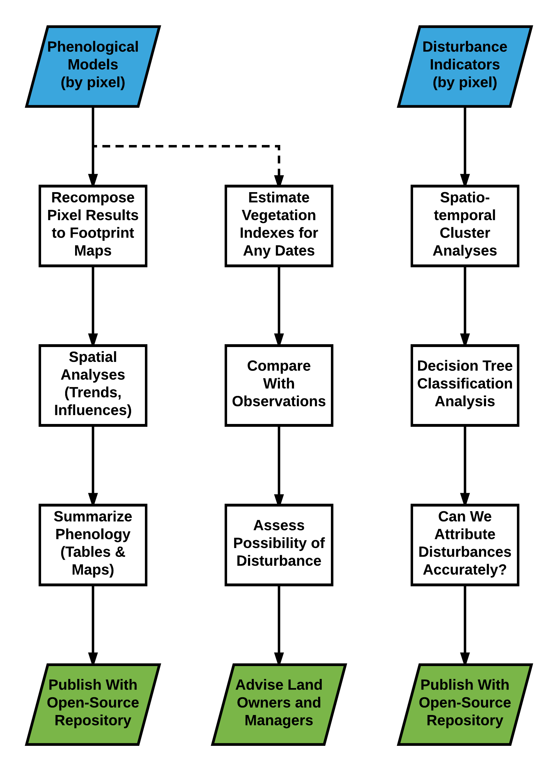
Thank You!
Special thanks to:
CHTC (esp. Lauren and Christina)
HTCondor Team, OSG
Data:
USGS, NOAA/NCEI
Funding:
CALS, FWE, USDA, USFS, NASA, WSGC
HTCondor Week 2017
5 May 2017
matt.e.garcia@gmail.com

Slide 19
HTCondor Week 2017
5 May 2017
matt.e.garcia@gmail.com

