Slide 1
New Directions and HTCondor @ BNL
USATLAS Tier-3 & New Computing Directives
William Strecker-Kellogg
RHIC/ATLAS Computing Facility (RACF)
Brookhaven National Lab
May 2016

Slide 2
RACF Overview
RHIC—Collider at BNL
STAR+PHENIX detectors
~15000 slots each
~6Pb central Disk (GPFS/NFS)
~16Pb Distributed Disk (dCache/xrootd)
~60Pb HPSS Tape
USATLAS T1
~15kCores
~11Pb Replicated dCache Disk
~20Pb HPSS Tape
3 Large HTCondor clusters
Share resources via flocking
Several Smaller clusters
Recent 8.2→8.4 update

Slide 3
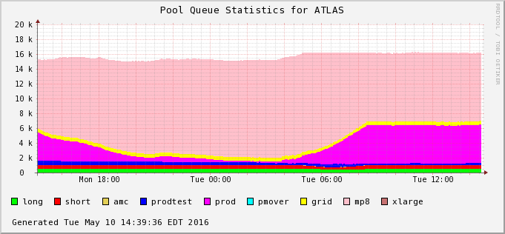
ATLAS Load Balancing
Working steadily since last year's talk, and HEPIX Fall 2015 talk
Allows occupancy to remain at 95% or above despite dynamically changing workload with no human intervention
Prevents starvation due to competition with larger jobs
Only inefficiency is due to (de)fragmentation

Slide 4
V8.4 Bug Fixing
Minor issue with classad not appearing in the negotation context
RemoteGroupResourcesInUse
In context of group-based preemption
Fixed quicky by Greg
Ticket #5593
Major issue with Schedd halting for up to an hour
No disk/network IO of any kind
No syscalls
GDB shows a mess (STL)
Ticket #5648

Slide 5
V8.4 Schedd Bug
Schedd spending up to an hour recomputing internal array using autocluster→jobid and the reverse mapping
Jobs would die after their shadows couldn't talk to their schedd that went dark
After day of debugging, code fix was implemented
Built & tested at BNL, max time reduced from 1h to 2s
Thank you to Todd & TJ
Still suspect something off in our environment (500k ac/day)
Not a problem anymore!

Slide 6
USATLAS Tier-3 @ BNL
Consolidates previously scattered Tier-3 facilities
Shared resource ~1000 cores
Many user-groups represented
Local submission
Hierarchical Group Quotas
Group-Membership authorization problem
Surplus sharing
Group-based fair-share preemption
After slow start, increased usage in past few months

Slide 7
Group Membership
Extended group-quota editing web UI
Added user-institute-group mappings
Cron generates a config fragment that asserts Owner → Group in START expression
Require group at submission
Currently 74 users and 26 groups use the T3
Surplus sharing & group-respecting preemption
RemoteGroupResourcesInUse

Slide 8
Preemptable Partitionable Slots
Users are frequently asking to run high-memory jobs…
…which motivates: User-prio preemption with partitionable slots
Absolutely need to support group-constrained fair-share with preemption
Currently Pslot Preemption operates on entire slot
Entire group's quota can fit on one 40-core machine
A function of the small scale of having 30+ groups sharing 1000 cores
No way to respect group quotas as schedd splits slots
Not Currently Possible!

Slide 9
New Directions
what we talk about when we talk about
H[TP]C

Slide 10
New Science & Evolving Needs
Traditional Model
New Model
RACF as a microcosm of HEP/NP computing
Many other facilities of a similar (within an order of magnitude) scale and capability
Embarrassingly parallel workloads
Data storage as large or larger a problem than computing
Batch is simple—provisioning/matchmaking vs. scheduling
Large, persistent, well-staffed experiments
New Users with traditionally HPC-based workloads
National Synchrotron Lightsource II
Center for Functional Nanomaterials
Revolving userbase
No institutional “repository” of computing knowledge
Not used to large-scale computing
Software support not well-defined
Large pool of poorly supported open source or free/abandon-ware
Commercial or GUI-Interactive

Slide 11
Institutional Cluster
New cluster of 108 nodes, each with 2xGPUs
Plans to increase next year by a factor of 2, then perhaps more
Infiniband interconnect in fat-tree topology
SLURM is being evaluated
Seems to be the growing choice for new HPC clusters
Active Development
DOE experience
Open Source
Large userbase (6 of top 10 of TOP500)
Test sample workloads in proposed queue configurations
Set up Shifter for docker intergration
Will be run as a “traditional” HPC cluster
MPI support an important consideration

Slide 12
New Science & Evolving Needs
Lab-management support for consolidation of computing
Computational Science Initiative (CSI) at BNL “leverages” experience at RACF in support of other non-HEP/NP science domains
CSI is also organizing software support to fill a gap in current BNL computational services
…
The $10,000 question:
Can we leverage existing infrastructure?

Slide 13
Running at HTC Facility
Zero-Order Requirements
Embarrassingly Parallel
(small) Input → (one) Process → (small) Output
No communication of intermediate results
X86_64
Other hardware not standard in the community
Data accessible
May seem obvious, but need adequate bandwidth to get data to the compute and back
Something to think about of moving from single desktop

Slide 14
Running at HTC Facility
First-Order Requirements
Linux (RedHat)
Virtualization is an extra complexity, Windows expensive
Containers / Docker allows simple cross-linux compatibility
Free Software
Instance-limited licenses are hard to control across many pools
Cost of licenses becomes prohibitive with exponential computing growth
“Friendly” resource profile
Code runs not just within the machine, but within the general limits its neighboring jobs use

Slide 15
HTC/HPC Divide
Not a false dichotomy, but surely an increasingly blurry line
Several users in our experience fit in middle-ground (albeit with considerable help from the RACF to fit workload into an exclusive HTC environment)
Biology Group: 800 cores for 5 months simple dedicated scheduler
Wisconsin group at CFN: successfully ran opportunistically on RHIC resources
Key factors
How much state transfer and with what IO patterns?
Size
10 years to now: 2 racks collapse into 1 machine
How many problems fit inside one machine today?

Slide 16
Scheduling
HTCondor recently can submit to SLURM via grid universe
Different sharing models
Condor-as-SLURM-job (glidein-style)
Coexist, mutually exclude via policy
Flocking/Routing (needs work for our users)
Ideal: transparent for users who know the requirements of their workload

Slide 17
The End
Thank you for your time!
Questions? Comments?

