Slide 1
Welcome to HTCondor Week #17 (year 32 of our project)

Slide 2
In 1996 I introduced the distinction between High Performance Computing (HPC) and High Throughput Computing (HTC) in a seminar at the NASA Goddard Flight Center in and a month later at the European Laboratory for Particle Physics (CERN). In June of 1997 HPCWire published an interview on High Throughput Computing.

Slide 3
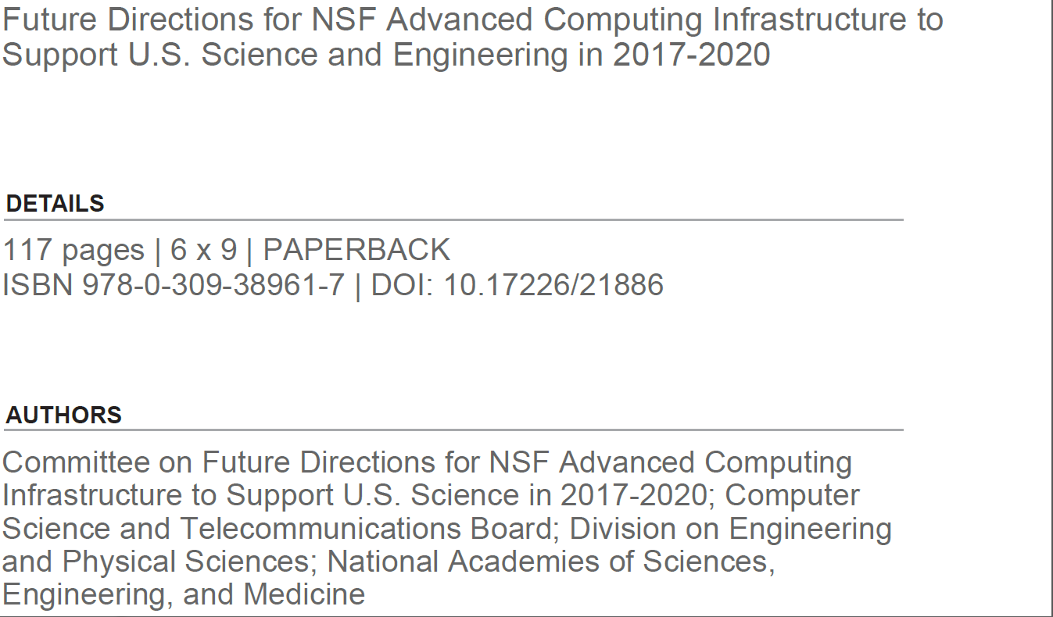

Slide 4
“Increased advanced computing capability has historically enabled new science, and many fields today rely on high-throughput computing for discovery.”
“Many fields increasingly rely on high-throughput computing”
“Recommendation 2.2. NSF should (a) provide one or more systems for applications that require a single, large, tightly coupled parallel computer and (b) broaden the accessibility and utility of these large-scale platforms by allocating high-throughput as well as high-performance workflows to them.”

Slide 5
Thank you for building such
a wonderful HTC community

