Slide 1
Building the International Data Placement Lab Greg Thain Center for High Throughput Computing

Slide 2
Overview
What is the IDPL?
How we built it
Examples of use

Slide 3
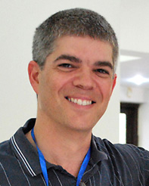
Who is the IDPL?
Phil Papadapolus -- UCSD
Miron Livny -- Wisconsin
Collaborators in China:Beihang // CNIC

Slide 4
Beihang
Wisc
CNIC
UCSD (2x)

Slide 5
A network engineer worldview:
200 ms ping
BUAA /
CNIC
Wisconsin
50 ms ping
UCSD

Slide 6
A Topologist’s World View
Beihang
UCSD1
CNIC
Run full set hourly
UCSD2
Wisconsin

Slide 7
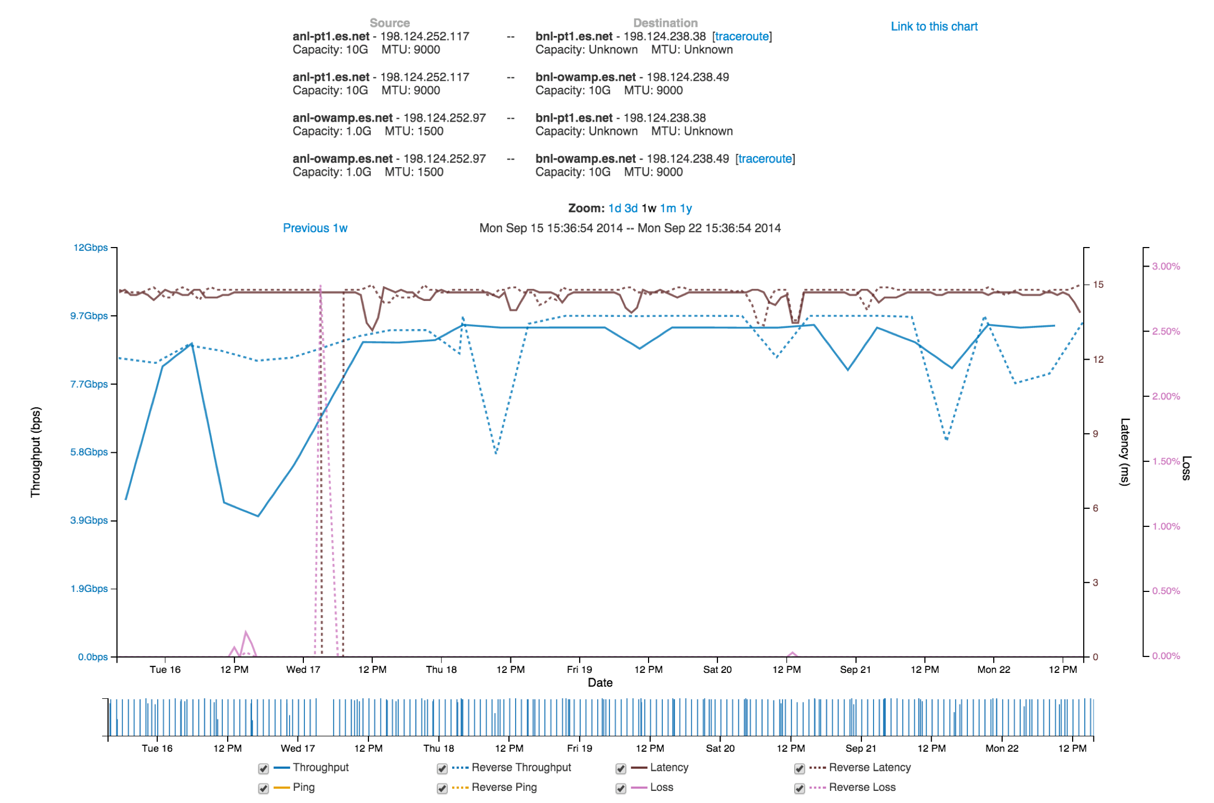
Wait? What about PerfSonar?
www.perfsonar.net

Slide 9
Wait? What about PerfSonar?
www.perfsonar.net
Necessary, not sufficient
Network only

Slide 10
Requirements for data placement
Co-scheduling of jobs
Start client and server simultaneously
Timed start of jobs
To prevent overlap and race conditions
Returning and managing of results

Slide 11
Co-Scheduling with Parallel Universe
Using static slots
One slot per host
Submit two-host job
Proc 0 is client
Proc 1 is server
(just a convention)

Slide 12
Example Submit file
Universe = parallel
Executable = startup_script.sh
+ParallelShutdownPolicy = “WAIT_FOR_ALL”
<usual file transfer stuff>
Requirements = (machine == “client-machine-name”)
Queue
Requirements = (machine == “server-machine-name”)
Queue

Slide 13
Startup Script (mark 1)
#!/bin/sh
if [ $_CONDOR_PROCNO = 0 ]
then
do_client_stuff
else
do_server_stuff
fi

Slide 14
But this doesn’t work…
Synchronization problem
Not actually co-scheduled
Servers need to tell clients their port numbers

Slide 15
Unix Process :: Condor Job
Unix Process | Condor Job
fork/exec | condor_submit
kill -9 | condor_rm
Environment variables | Job Attributes
Standard error file | Condor job log

Slide 16
condor_chirp to the rescue!
condor_chirp set_job_attr
Uses job ad as a blackboard whiteboard
Always read/writes to Proc 0
(in parallel universe)

Slide 17
Simplified Workflow
Server Side
Start Server
Listen on ephemeral port
condor_chirp set_job_attr Port #
Client Side
condor_chirp get_job_attr Port #
repeat as needed
run test

Slide 18
That works – once
Need to do this periodically
Condor cron – two features
on_exit_remove = false
cron_minute = 23
cron_hour = 0-23/2
cron_month = *
cron_day_of_week = *

Slide 19
Problems with condor cron
on_exit_remove = false
Means one job for all runs
stale set_job_attr’s
held jobs a headache
Really want one condor job per run

Slide 20
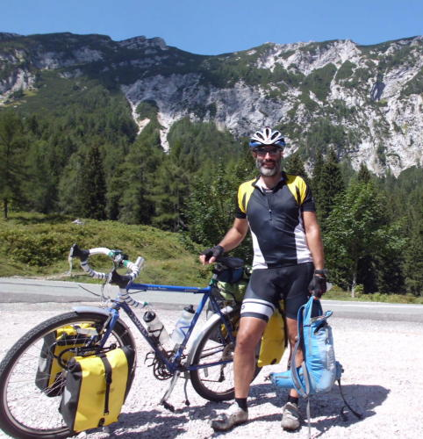
Enter… “CronMan”

Slide 21
The Idea
Have dagman itself be the restarter
Creates a new job every time
With a one-node dag
Whose one node has a delayed start time
Gives the placement job the job-nature

Slide 22
The dag file
JOB A placement4-submit
SCRIPT POST A /bin/false
RETRY 1000000

Slide 23
Modified Submit file
Universe = parallel
Executable = startup_script.sh
+ParallelShutdownPolicy = “WAIT_FOR_ALL”
cron_minute = 30
cron_window = 400
Requirements = (machine == “client-machine-name”)
Queue
Requirements = (machine == “server-machine-name”)
Queue

Slide 24
condor_q output
$ condor_q
ID OWNER SUBMITTED RUN_TIME ST PRI SIZE CMD
26795.0 gthain 1/20 23:50 11+12:26:06 R 0 0.3 condor_dagman
27720.0 gthain 5/11 10:22 0+00:00:00 I 0 0.0 wrapper_script
27720.1 gthain 5/11 10:22 0+00:00:00 I 0 0.0 wrapper_script

Slide 25
Two of three problems solved
What about reporting results?
condor_chirp ulog “server start”
condor_chirp ulog “client results x y z”

Slide 26
Job log output
000 (27720.000.000) 05/11 10:22:48 Job submitted from host: DAG Node: A
014 (27720.000.000) 05/11 11:17:00 Node 0 executing on host: client
008 (27720.000.000) 05/11 11:17:00 ‘client:start'
014 (27720.000.001) 05/11 11:17:04 Node 1 executing on host:
001 (27720.000.000) 05/11 11:17:04 Job executing on host: MPI_job
008 (27720.000.000) 05/11 11:17:06 'server:start'
033 (27720.000.000) 05/11 11:17:08 Setting job attribute iperfServer to '20650'
008 (27720.000.000) 05/11 11:17:31 ‘results,1462979830.739976,1462979851.114580,1,20.100000,5736960'
008 (27720.000.000) 05/11 11:17:31 'komatsu.chtc.wisc.edu(iperf) client:end'
008 (27720.000.000) 05/11 11:17:31 'komatsu.chtc.wisc.edu(irods) client:start'
008 (27720.000.000) 05/11 11:17:31 'davos.cyverse.org(iperf) server:end'

Slide 27
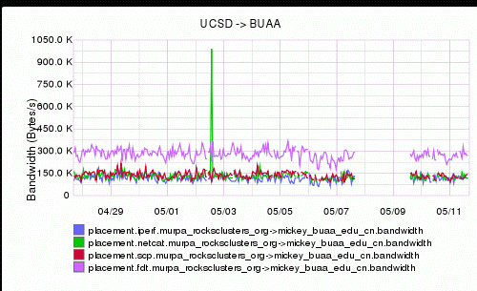
Then forward to Graphite

Slide 28
Application of IDPL: The Phytomorph problem
PI in the Spalding lab researching corn seedlings
Runs analysis jobs at Wisconsin HTCondor pool
Pulling data from Cyverse (nee iPlant) in Arizona
Claims data xfer rates slow

Slide 29
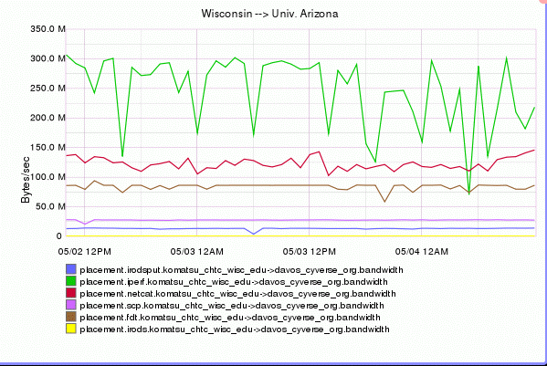

Slide 30
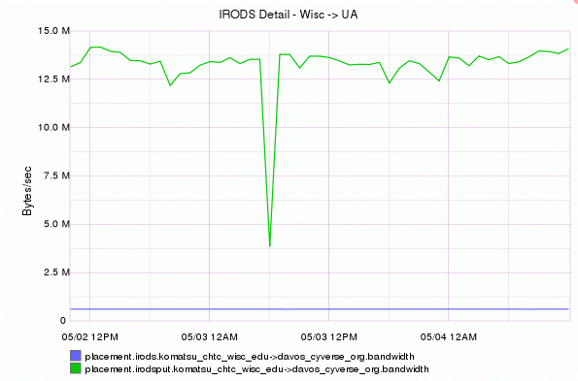

Slide 31
After talking with iRODS devs
All performance testing had been LAN
Our Networking folks ID’d problems
Made one big fix
Don’t set TCP_SNDBUF explicitly!
Gave us new clients & servers

Slide 32
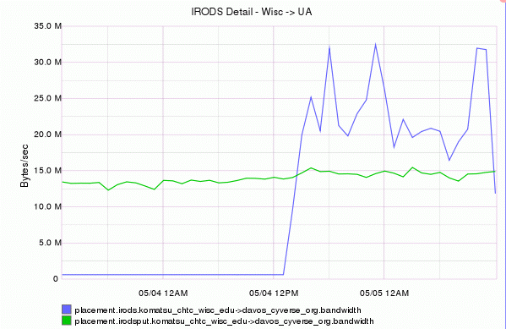

Slide 33
Future Work
Add more protocols
More sites
Work with clouds

Slide 34
Thank you!
Try CronMan pattern yourself!
Even with vanilla universe jobs
Think about Unix process patterns
Example on slides simplified!
Real code on git hub at
https://github.com/iDPL/placement

