Slide 1
Docker and HTCondor
Greg Thain
HTCondor Week 2015

Slide 2
Start with the Basics…
HTCondor is designed to:
Allow a machine “owner” to loan it out
The machine must be protected from job

Slide 3
Ancient History: Chroot
HTCondor used to chroot every job:
No job could touch the file system
Private files in host machine stayed private

Slide 4
Chroot: more trouble than value
Increasingly difficult to work:
Shared libraries
/dev
/sys
/etc
/var/run pipes for syslog, etc.
How to create root filesystem?
Easier now with yum, apt get, etc., but still hard:

Slide 5
Repos make images Easier*
$ dnf -y --releasever=21 –nogpg installroot=/srv/mycontainer --disablerepo='*' --enablerepo=fedora install systemd passwd dnf fedora-release vim-minimal
$ debootstrap --arch=amd64 unstable ~/debian-tree/
$ pacstrap -c -d ~/arch-tree/ base

Slide 6
We gave up!
HTCondor no longer chroots all jobs
But you can optionally do so.
Very few site sites do…
NAMED_CHROOT = /foo

Slide 7
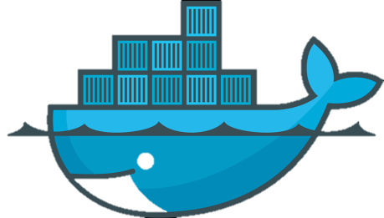
Enter Docker!

Slide 8
This is Docker
Docker manages Linux containers.
Containers give Linux processes a private:
Root file system
Process space
NATed network
UID space

Slide 9
Examples
This is an “ubuntu” container
Processes in other containers on this machine can NOT see what’s going on in this “ubuntu” container
This is my host OS, running Fedora

Slide 10
At the Command Line
$ hostname
whale $ cat /etc/redhat-release
Fedora release 20 (Heisenbug)
$ docker run ubuntu cat /etc/debian_version
jessie/sid
$ time docker run ubuntu sleep 0
real 0m1.825s
user 0m0.017s
sys 0m0.024s

Slide 11
More CLI detail
$ docker run ubuntu cat /etc/debian_version
“cat” is the Unix process, from the image
we will run (followed by the arguments)
“ubuntu” is the base filesystem for the container
an “image”
“run” command runs a process in a container
All docker commands are bound into the “docker” executable
Notes:
“How do images get made”? More on that later.

Slide 12
Images
Images provide the user level filesystem
Doesn’t contain the linux kernel
Or device drivers
Or swap space
Very small: ubuntu: 200Mb.
Images are READ ONLY

Slide 13
Docker run two step
Every image that docker run must be local
How to get
$ docker search image-name
$ docker pull image-name
Docker run implies pull first!
run can fail if image doesn’t exist
or is unreachable

Slide 14
Where images come from
Docker, inc provides a public-access hub
Contains 10,000+ publically usable images behind a CDN
What’s local?
$ docker images
$ docker images
REPOSITORY TAG IMAGE ID CREATED VIRTUAL SIZE
new_ubu latest b67902967df7 8 weeks ago 192.7 MB
<none> <none> dd58b0ec6b9a 8 weeks ago 192.7 MB
<none> <none> 1d19dc9e2e4f 8 weeks ago 192.7 MB
rocker/rstudio latest 14fad19147b6 8 weeks ago 787 MB
ubuntu latest d0955f21bf24 8 weeks ago 192.7 MB
busybox latest 4986bf8c1536 4 months ago 2.433 MB
How to get
$ docker search image-name
$ docker pull image-name

Slide 15
Image name
hub.demo.org:8080/user/image:ver
Image name and version: (default: “latest”)
Name of the user (default: system user)
Name of the hub (default docker-io)

Slide 16
Wait! I don’t want my images public!
Easy to make your own images (from tar files)
The docker hub is open source
Straightforward to start your own
How is it distributed?

Slide 17
Docker hub is an image!
$ docker run docker/docker-registry
(and a bunch of setup – google for details)
Any production site will want to run own hub
Or put a caching proxy in front of the public one

Slide 18
Under the hood of images
Images are composed of layers
Images can share base layers:
ubuntu : 200 Mb
ubuntu + R : 250 Mb
ubuntu + matlab : 250 Mb
All three: 300 Mb.

Slide 19
Container vs. Image
Image is like Unix program on disk
read only, static
Container is like Unix process
Docker run starts a container from an image
Container states: like a condor job:
Running
Stopped

Slide 20
Containers
$ docker ps
CONTAINER ID IMAGE COMMAND NAMES
b71fff77e7b9 ubuntu:latest /bin/sleep owly_tannenba
shows running containers
$ docker ps –a
CONTAINER ID IMAGE COMMAND NAMES
b71fff77e7b9 ubuntu:latest /bin/sleep owly_tannenba
7eff0a4dd0b4 debian:jessie /bin/sleep owly_tannenba

Slide 21
Operations on Containers
$ docker ps –a
$ docker run …
$ docker stop containerId
$ docker restart containerId
$ docker rm containerId

Slide 22
Where is my output?
$ docker diff containerId
$ sudo docker diff 7bbb
C /dev
A /dev/kmsg
C /etc
D /foo
$ docker cp containerId:/path /host
Works on running or stopped containers

Slide 23
Or, use “volumes”
$ docker run –v /host:/container …
Volume is a directory that isn’t mapped
Output to volume goes directly to host
Fast: just a local mount

Slide 24
Why should you care?
Reproducibilty
How many .so’s in /usr/lib64 do you use?
Will a RHEL 6 app run on RHEL 9 in five years?
Packaging
Image is a great to package large software stacks
Ease of inspection and management
Imagine an OSG with container support!

Slide 25
I Know What You Are Thinking!

Slide 26
Isn’t this a Virtual Machine?
Containers share Linux kernel with host
Host can “ps” into container
One-way mirror, not black box
Docker provides namespace for images
Docker containers do not run system daemons
CUPS, email, cron, init, fsck, (think about security!)
Docker images much smaller than VM ones
Just a set of files, not a disk image
Much more likely to be universally available

Slide 27
Semantics: VM vs. Container
VMs provide ONE operation:
Boot the black box
Run until poweroff
Containers provide process interface:
Start this process within the contain
Run until that process exits
Much more Condor-like

Slide 28
Docker and HTCondor
Package HTCondor as docker image
Add new “docker universe”
(not actually new universe id)

Slide 29
Installation of docker universe
Need condor 8.3.6+
Need docker (maybe from EPEL)
$ yum install docker-io
Docker is moving fast: docker 1.6+, ideally
odd bugs with older dockers!
Condor needs to be in the docker group!
$ useradd –G docker condor
$ service docker start

Slide 30
What? No Knobs?
Default install should require no condor knobs!
But we have them anyway:
DOCKER = /usr/bin/docker

Slide 31
Condor startd detects docker
$ condor_status –l | grep –i docker
HasDocker = true
DockerVersion = "Docker version 1.5.0, build a8a31ef/1.5.0“
$ condor_status –const HasDocker
Check StarterLog for error messages

Slide 32
Docker Universe
universe = docker
executable = /bin/my_executable
arguments = arg1
docker_image = deb7_and_HEP_stack
transfer_input_files = some_input
output = out
error = err
log = log
queue

Slide 33
Docker Universe Job Is still a job
Docker containers have the job-nature
condor_submit
condor_rm
condor_hold
Write entries to the user log event log
condor_dagman works with them
Policy expressions work.
Matchmaking works
User prio / job prio / group quotas all work
Stdin, stdout, stderr work
Etc. etc. etc.*

Slide 34
Docker Universe
universe = docker
executable = /bin/my_executable
Executable comes either from submit machine or image
NEVER FROM execute machine!

Slide 35
Docker Universe
universe = docker
# executable = /bin/my_executable
Executable can even be omitted!
trivia: true for what other universe?
(Images can name a default command)

Slide 36
Docker Universe
universe = docker
executable = ./my_executable
input_files = my_executable
If executable is transferred,
Executable copied from submit machine
(useful for scripts)

Slide 37
Docker Universe
universe = docker
executable = /bin/my_executable
docker_image =deb7_and_HEP_stack
Image is the name of the docker image stored on execute machine. Condor will fetch it if needed.

Slide 38
Docker Universe
universe = docker
transfer_input_files= some_input
HTCondor can transfer input files from submit machine into container
(same with output in reverse)

Slide 39
Condor’s use of Docker
Condor volume mounts the scratch dir
Condor sets the cwd of job to the scratch dir
Can’t see NFS mounted filesystems!
Condor runs the job with the usual uid rules.
Sets container name to
HTCJob_$(CLUSTER) _$(PROC)_slotName

Slide 40
Scratch dir == Volume
Means normal file xfer rules apply
transfer in, transfer out
subdirectory rule holds
condor_tail works
RequestDisk applies to scratch dir, not container
Any changes to the container are not xfered
Container is removed on job exit

Slide 41
Docker Resource limiting
RequestCpus = 4
RequestMemory = 1024M
RequestDisk = Somewhat ignored…
RequestCpus translated into cgroup shares
RequestMemory enforced
If exceeded, job gets OOM killed
job goes on hold
RequestDisk applies to the scratch dir only
10 Gb limit rest of container

Slide 42
Why is my job on hold?
Docker couldn’t find image name:
$ condor_q -hold
-- Submitter: localhost : <127.0.0.1:49411?addrs=127.0.0.1:49411> : localhost
ID OWNER HELD_SINCE HOLD_REASON
286.0 gthain 5/10 10:13 Error from slot1@localhost: Cannot start container: invalid image name: debain
Exceeded memory limit?
Just like vanilla job with cgroups
297.0 gthain 5/19 11:15 Error from slot1@localhost: Docker job exhaused 128 Mb memory

Slide 43
Surprises with Docker Universe
Condor_ssh_to_job doesn’t work
Condor_chirp doesn’t work
Suspend doesn’t work
Can’t access NFS/shared filesystems
Job not a child of the condor_starter:
Request_disk doesn’t work
resource usage is funky
Networking is only NAT

Slide 44
Coming soon…
Advertise images we already have
Garbage collection of used images
Report resource usage

Slide 45
Potential Features?
Network support? Better than NAT? LARKy?
Support for shared filesystems?
Mapping other directories to containers?
Get entire container diff back?
Run containers as root?
Mount fake /proc/cpuinfo and friends
condor_ssh_to_job
Automatic checkpoint and restart of containers!

Slide 46
Surprises with Docker
Moving fast – bugs added/removed quickly
10 Gb limit on container growth
Security concerns
Adding new hub requires ssl cert on client
Containers don’t nest by default
Docker needs root – problem for glidein ☹
No support for Windows/Mac/BSD or other
Everyone shares a linux kernel
The “init” problem

Slide 47
The “init” problem
Or, “How come my docker job isn’t exiting”
Docker process runs as pid 1 in pid namespace
Linux blocks all unhandled catchable signals
Soft kills usually don’t work
shell wrapper fixes
condor_pid_ns_init

Slide 48
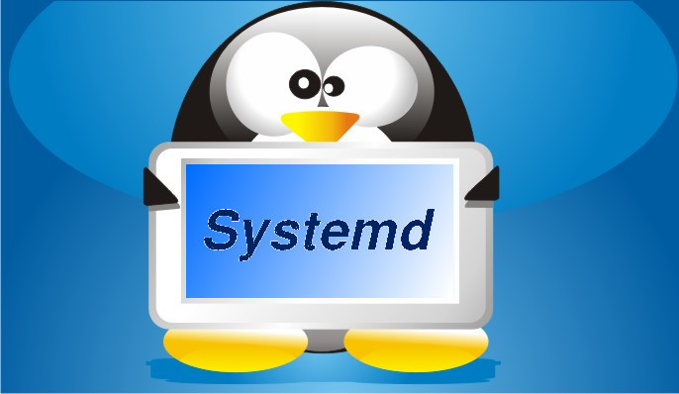
Alternatives to docker
RedHat: Rocket
Systemd: nspawn

Slide 49
Summary
Docker universe coming to Condor
Could be game-changing
Very interested in user feedback
THANK YOU!

