Slide 1
HTCondor at Cycle Computing: Better Answers. Faster.
Ben Cotton
Senior Support Engineer

Slide 2
We believe utility access to technical computing power accelerates discovery & invention

Slide 3
The Innovation Bottleneck:
Scientists/Engineers
forced to size their work to the
infrastructure their organization bought

Slide 4
Our slogan
Better Answers. Faster.
We want our customers to get the resources they need when they need them

Slide 5
Better Answers…

Slide 6
Measure woody biomass on the southern Sahara at 40-50 CM scale
NASA project in partnership with
Intel
Amazon Web Services
Cycle Computing

Slide 7
Project goals
Estimate carbon stored in trees and bushes in arid and semi-arid south Sahara
Establish a baseline for future CO₂ studies of the region

Slide 8
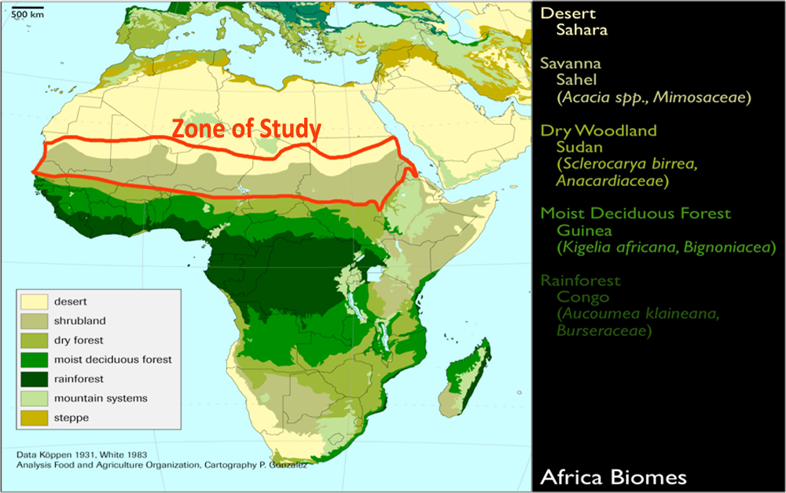

Slide 9
The input data
Images collected from satellites
~ 20 terabytes total

Slide 10
The workflow
Pleasantly parallel
Each task takes 20-30 minutes
0.5 million CPU hours total

Slide 11
The workflow
Tasks have two parts
Orthorectification and cloud detection
Feature detection
Uses 2-20 GB of RAM

Slide 12
AWS setup
Spot instances
C3 and M3 instance families
Data staged into S3

Slide 13
Job Submission
DataMan uploads data from local Lustre filer to S3
When transfers complete, DataMan creates a record in CycleCloud
CycleCloud batches records and builds HTCondor submit files

Slide 14
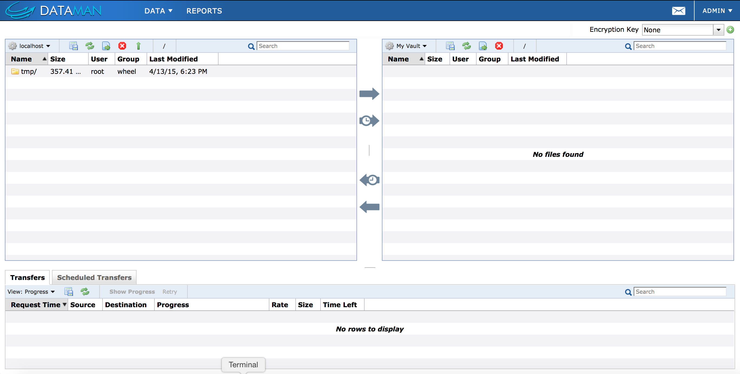
Job Submission
Easy for the scientist

Slide 15
What’s next?
Proof-of-concept is wrapping up
Operational project expected to take approximately 1 month

Slide 16
Faster….

Slide 17
Improve hard drive design
HGST runs an in-house drive head simulation suite
In-house grid engine cluster runs the simulations in 30 days
~620K compute hours

Slide 18
We can make this faster!
On Wednesday: “Hey, guys! Can we have this done by this weekend?”

Slide 19
We can make this faster!
Un-batch the sweeps: 1.1M jobs
5-10 minute per-job runtime

Slide 20
Enter the cloud
Used 10 AWS availability zones, spanning 3 regions
Spot instances from the m3, c3, and r3 families

Slide 21
Pool setup
One pool per availability zone
Two schedulers per pool

Slide 22
How we did it
CycleCloud autoscaled multiple instance types and multiple availability zones
CycleServer spread jobs across multiple schedulers/pools based on load
Used Amazon S3 instead of a shared filer

Slide 23
HTCondor configuration
Very little!
NEGOTIATOR_CYCLE_DELAY and NEGOTIATOR_INTERVAL set to 1
CLAIM_WORKLIFE set to 1 hour
*_QUERY_WORKERS set to 10

Slide 24
HTCondor configuration
SHADOW_WORKLIFE set to 1 hour
JOB_START_COUNT set to 100
Disabled authentication

Slide 25
We did it!
Went from 0 to 50k cores in 23 minutes
Peaked at ~ 70K cores from 5689 instances
Simulation completed in 8 hours
Infrastructure cost: $5,594

Slide 26
Where do we go from here?

Slide 27
Better-er answers. Faster-er.

Slide 28
If you build it, they will come
Large financial institution actuarial modeling
Originally just wanted to do Federal Reserve stress tests
Then month-end actuarial runs
Now regularly use 8000 cores in AWS

Slide 29
Coming concerns
Data movement
Multi-provider cloud usage
Seamless burst to cloud

Slide 30
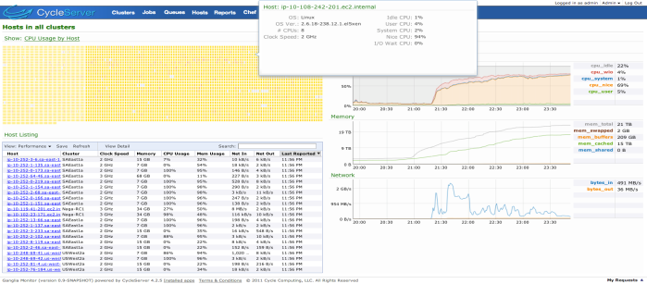
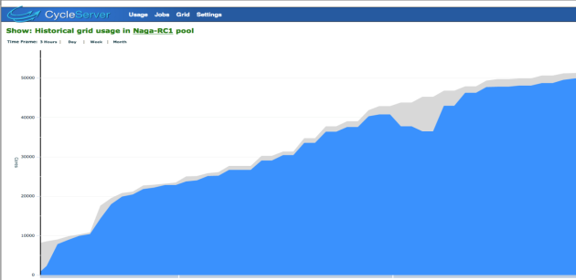
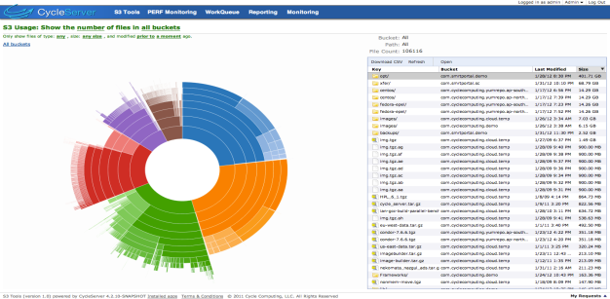
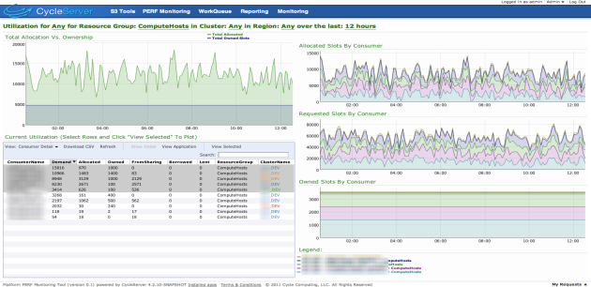
We write software to do this…
Cycle Computing easily orchestrates workloads and data access to local and Cloud technical computing
Scales from 100 - 100,000’s of cores
Handles errors, reliability
Schedules data movement
Secures, encrypts and audits
Provides reporting and chargeback
Automates spot bidding
Supports Enterprise operations

Slide 31
Does this resonate with you?
We’re hiring support engineers, solutions architects, sales, etc.
jobs@ cyclecomputing.com

