Slide 1
HTCondor at the RACF
Seamlessly Integrating Multicore Jobs
and other developments
William Strecker-Kellogg
RHIC/ATLAS Computing Facility
Brookhaven National Laboratory
April 2014

Slide 2
RACF Overview
Main HTCondor pools
PHENIX—12.2kCPU
STAR—12.0kCPU
ATLAS—13.1kCPU
STAR/PHENIX are RHIC detectors
Loose federation of individual users
ATLAS—tightly controlled, subordinate to PANDA workflow management, strict structure
Smaller Experiments
LBNE
Dayabay
LSST

Slide 3
Supporting Multicore
Priorities and Requirements
Keep management workload at a minimum
No manual re-partitioning
Needs to be dynamic and/or partitionable
Support automatic demand-spillover
Need to retain group-quota system with accept-surplus feature
Maximize throughput—minimize latency
Same goals as above
Attempt to support future developments in same framework
More than just multicore
High-Memory already used in this context (with caveat)
Principle of proportional pain
Okay to make multicore wait longer—but no starvation is allowed

Slide 4
Supporting Multicore
Step 1: Partitionable Slots Everywhere
Step 2: Policy Changes
Required change to monitoring
Job-count no longer correct metric for measuring occupancy
Minor script change with SlotID
Slot<n> → Slot<m>_<n>
Works with no side effects
Preemption is no longer possible
OK for now since not needed
Slot-Weight can only be CPUs
Needs to change in the future
Defragmentation is necessary
Detail next slide
Dedicated queues for now

Slide 5
Defragmentation Policy
Defragmentation Daemon
Key change: Negotiator Policy
Start Defragmentation
(PartitionableSlot && !Offline && TotalCpus > 12)
End Defragmentation
(Cpus >= 10)
Rate: max 4/hr
Default policy is breadth-first filling of equivalent machines
(Kflops – SlotId)
Depth-first filling preserves continuous blocks longer
(-Cpus)

Slide 6
Multicore in Dedicated Queues
Works well now, issues were resolved
Allocation is handled by group quota and surplus-share
Dedicated queue per species of job
Currently two—high-memory (6Gb) and 8-core
Changing requirements require manual action

Slide 7
Multicore in common Queue
Works well, no starvation
Lack of control over strict allocation of m. vs. n core jobs within queue
Not currently done in ATLAS
Issue of allocation control is just part of reason why
Structural and not likely to change soon

Slide 8
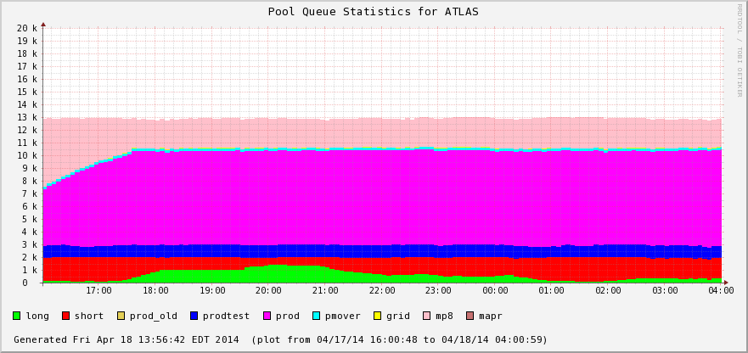
Fixing bugs in HTCondor
Last summer a period of intensive development/testing in collaboration with HTCondor team
Built a VM testbed, rapid build & test of patches from HTCondor team
Built new monitoring interface
After many iterations had working config with Partitionable slots and Hierarchical Group Quotas with accept_surplus
Should Stay Here
Now it does!

Slide 9
Bugfix Testbed Details
Rapid build, test, deploy cycle from git patches
Email patch
Rebuild condor
Run test-feeder
Job Feeder
Defines groups in config-file with different random length-ranges and requirements
Variable workload—keep N jobs idle in each queue

Slide 10
Current Multicore Status
Fully utilize PSlots
All traditional nodes (x86_64) can have same config
Fix works perfectly when accept_surplus is on for any combination of groups
Major Limitation: SlotWeight=Cpus
High-memory jobs can be accommodated by asking for more CPUs.
Need ability to partition better and interact with global resource limits
SlotWeight should be a configurable function of all consumable resources
Other Limitation: No Preemption
Required to support opportunistic usage
SLOT_TYPE_1 = 100%
NUM_SLOTS = 1
NUM_SLOTS_TYPE_1 = 1
SLOT_TYPE_1_PARTITIONABLE = True
SlotWeight=Cpus

Slide 11
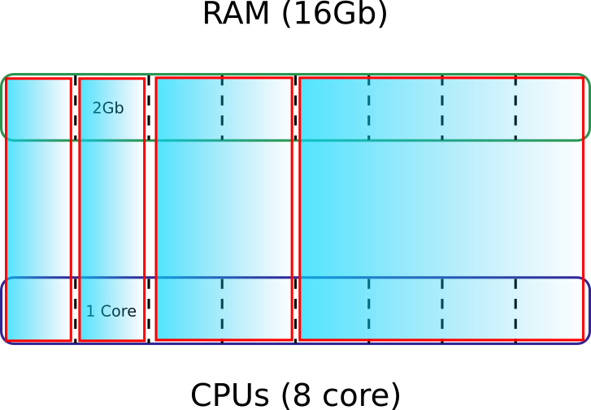
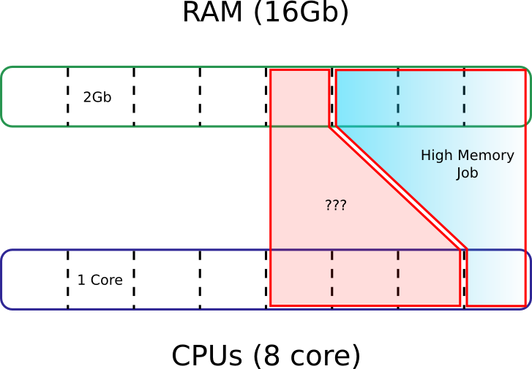
Issue With High Memory Jobs
1
2
3
1…ok, 2…ok, 3…not ok!
General problem:
Inefficiencies in heterogeneous jobs scheduling to granular resources
Worse as you add dimensions: imagine GPSs, Disks, CoProcessors, etc…

Slide 12
Goals
Need all the same behavior as we have now regarding groups and accept_surplus
Want to be able to slice by any resource
Sane and configurable defaults/quantization of requests
Defragmentation inefficiencies should be kept to a minimum—we are mostly there already!
Overall we are something like ¾ of the way to our ideal configuration.

Slide 13
Problem of Weights and Costs
What does SlotWeight mean with heterogeneous resources?
Job of administrator to determine how much to “charge” for each requested resources
E.g. (cpus + 1.5(ram exceeding cpus * ram/core))
Are these weights normalized to what CPU counting would give?
If not then what does the sum of SlotWeights represent?
Quotas related to sum of SlotWeights, needs to be constant pool-wide and independent of current job allocation—if specifying static number!
Cost functions need to be linear?
Only dynamic quota instead (e.g. 80%X + 20%Y)…

Slide 14
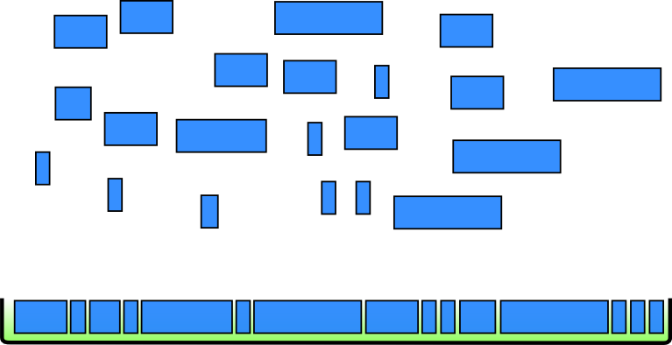
Implications
A picture is worth 1000 words…
The more barriers between nodes that can be broken down the better
MPI-like batch software with NUMA-aware scheduling making other machines like further away NUMA nodes?

Slide 15
ATLAS Load Balancing
PANDA contains knowledge of upcoming work
Wouldn’t it be nice to adapt the group allocation accordingly
A few knobs can be tuned—surplus and quota
Dynamic adjustment based on current pending-work
Gather heuristics on past behavior to help
Timeframe: Fall 2014—project will be picked up by a summer student this year

Slide 16
PHENIX Job Placement
Data stored on PHENIX nodes (dCache)
New this year is RAW data is placed hot off the DAQ
Reprocessing no longer requires second read from tape
Less tape wear, faster—no stage latency
Analysis continues to read input from dCache
No intelligent placement of jobs
HDFS-like job placement would be great—but without sacrificing throughput
Approach:
Need to know where files are first!
Need to suggest placement without waiting for the perfect slot
Started as proof-of-concept for efficacy of non-flat network
Testing Infiniband fabrics with tree-based topology

Slide 17
PHENIX Job Placement
File placement harvested from nodes and placed in database
Database contains map of file->machine
Also contains machines->rack and rack->rack-group mapping
Machines run a STARTD_CRON to query & advertise their location
Job-RANK statement used to steer jobs towards machines where their files are
E.g: (3*(Machine==“a” || Machine==“c”)) + 2*(Rack==“21-6”) + (RackGroup == “10”)
Slight increase in negotiation time, upgraded hardware to compensate
Several thousand matches/hr with possibly unique RANK statements
Working on modified dCache client to directly read file if on local node

Slide 18
PHENIX Job Placement Results
We achieved expected results with machine-local jobs
>80% on an empty farm
~10% on a full farm
All localization in rack-group
>90% empty farm
~15% full farm
Argues that great benefit could be gained from utilizing multi-tier networking
Without it, only machine-local jobs benefit

Slide 19
PHENIX Job Placement Results
Machine-Local
Rack-Local (exclusive of Machine-Local)
All Localized (Sum 1. + 2.)
All Jobs

Slide 20
PHENIX Job Placement Results
Machine-Local
Rack-Local (exclusive of Machine-Local)
All Localized (Sum 1. + 2.)

Slide 21
PHENIX Job Placement Results
Simulated No Localization
Results from Localization
Machine-Local
Rack-Local (exclusive of Machine-Local)
Non-Local
Histogram of portion of jobs in each state taken in 1 hour intervals
*Plots generated by Alexandr Zaytsev

Slide 22
THANK YOU
Questions? Comments? Stock Photo?

Slide 23
Configuration Changes
Taking advantage of config-dir
Old Way
Main Config:
LOCAL_CONFIG_FILES = /dir/a, /dir/b
Order:
/etc/condor/condor_config (or $CONDOR_CONFIG)
/dir/a
/dir/b
Since 7.8 Condor supports a config.d/ directory to read configuration from
More easily allows programmatic/automated management of configuration
Refactored configuration files at RACF to take advantage
New Way
Main Config:
LOCAL_CONFIG_DIR = /etc/condor/config.d
LOCAL_CONFIG_FILES = /dir/a, /dir/b
Order:
/etc/condor/condor_config (or $CONDOR_CONFIG)
/etc/condor/config.d/* (in alphanumeric order)
/dir/a
/dir/b

