Slide 1
Communicating with Users about HTCondor and High Throughput Computing
Lauren Michael, Research Computing Facilitator
HTCondor Week 2014

Slide 2
CHTC Services
Center for High Throughput Computing, est. 2006
Large-scale, campus-shared computing systems
campus high-throughput (HTC) grid and high-performance (HPC) cluster resources
all standard services provided free-of-charge
hardware buy-in options for priority access
automatic access to the Open Science Grid (OSG)
chtc.cs.wisc.edu

Slide 3
Campus HTC Resources
Notes:
We also have an HPC cluster, managed with SLURM, but ‘backfilled’ with HTCondor jobs as part of the CHTC Pool.

Slide 4
CHTC Services (cont.)
Support for using our systems
consultation services, training, and proposal assistance
solutions for numerous software (including Python, Matlab, R)
Systems design/administration consulting
Notes:
Research Systems Administrators Group (RSAG) on campus for researcher admins

Slide 5
CHTC Services (cont.)
Support for using our systems
consultation services, training, and proposal assistance
solutions for numerous software (including Python, Matlab, R)
Systems design/administration consulting
HTCondor: CHTC’s R&D Arm
Services provided to the campus community
R&D for HTC Software
HTCondor, DAGMan (workflows), Bosco (“MyHTC”)
Software Engineering Expertise & Consulting
Software Testing & Security Consulting
Notes:
CHTC also includes several members of the OSG software team

Slide 6
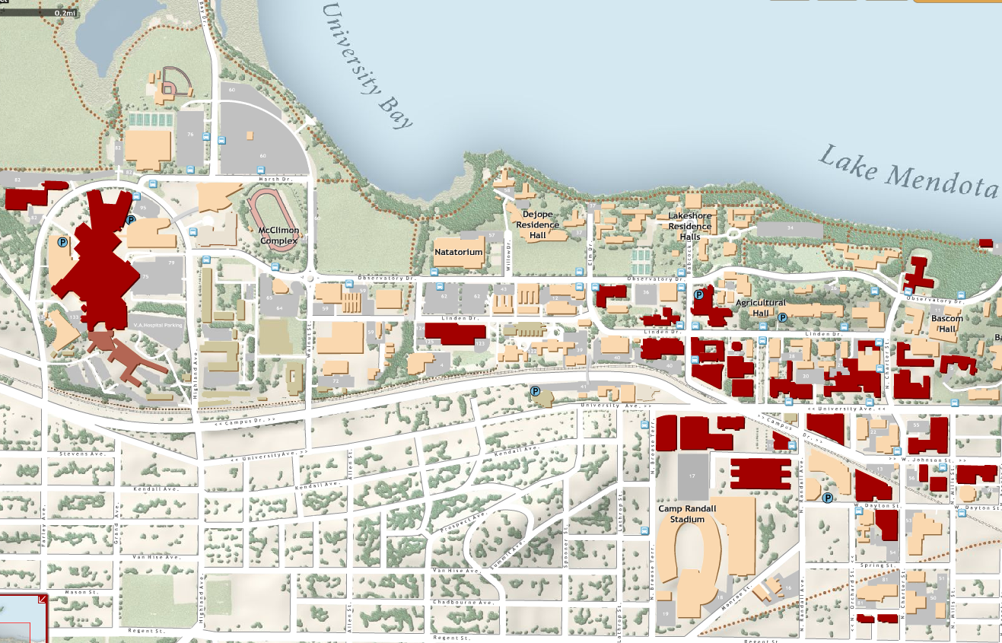
http://chtc.cs.wisc.edu
Jul’10- Jun’11 | Jul’11- Jun’12 | Jul’12-Jun’13 | Quick Facts
45 | 70 | 97 | Million Hours Served
54 | 106 | 126 | Research Projects
35 | 52 | 52 | Departments
10 | 13 | 15 | Off-Campus
Researchers who use the CHTC are located all over campus (red buildings)

Slide 7
Problem:
Large-scale computing is complex, and
not all users speak “computer geek”
Communicating well is hard.

Slide 8
Users are people.
Notes:
Users are not usernames; they’re not an email ticket issue that needs to be resolved; they are not data, or compute needs, or a new technical solution
Users are people, people who, in most cases, have a fraction of the knowledge that you do in making decisions between available technologies …
And HTC is just one method or technology available to them
We prefer the term “Researchers”, as it’s more descriptive and conveys the fact that:
-being a user of compute technologies is just PART of what a researcher does
-most researchers spend much more time on other research activities than on computing
-researchers spend much LESS time than you on computing

Slide 9
Know Your People

Slide 10
Know Your People
1. What is the person’s understanding of relevant terms?
RAM, CPU, node, high-throughput computing (HTC)
2. What relevant experience does the person posses?
unix command line? programming? schedulers?
3. Is the person following what you say?

Slide 11
Provide Clear Explanations
Cater your communication to the person.
(more difficult - but more IMPORTANT - in email)
Keep things simple.
-Avoid unnecessary details, but allude to them.
-Start with the “big picture”
Introduce new vocabulary when necessary.
Define terms. Be consistent.
-Avoid “terms of confusion”

Slide 12
Terms of Confusion:
“high level”

Slide 13
Terms of Confusion:
“high level”
Computer Geek: Many Users:
… of abstraction … of complexity
“bird’s eye view” … of detail
“big picture” “advanced”

Slide 14
Terms of Confusion:
“high level” alternatives
“big picture”
“Basically, …”
“If we step back …”
or, just define what you mean

Slide 15
Terms of Confusion:
“parallel”, “parallelize”
high-throughput high-performance

Slide 16
Terms of Confusion:
“parallel” alternatives
“independent tasks”
“separate jobs”
-versus-
“parallelize within the program”
“multi-thread”, “MP”, “MPI”

Slide 17
Terms of Confusion:
“cluster” – define terms
HTCondor $(cluster)
-or-
an organized set of hardware?

Slide 18
Terms of Confusion:
“job”
Can be used to describe:
-a program and what it does
-an item in the queue
-all items from a single submit file
-all items of the same HTCondor “cluster”
-an entire workflow (DAG)

Slide 19
Terms of Confusion:
“job” – define terms first
“Referring to each submit file as a ‘batch’, and each queued process as a ‘job’ …”
“So, your first DAG node submits 10 jobs …

Slide 20
Terms of Confusion:
acronyms, abbrev’ns, and jargon
wget
FTP
SL6
LDAP
TCP
DNS
schedd
startd

Slide 21
Terms of Confusion:
acronyms, abbrev’ns, and jargon – Use general terms

Slide 22
Terms of Confusion:
other
log
process
node
workflow

Slide 23
Answer the REAL Question
Identify questions that indicate confusion.
Is the user asking the wrong question?
Anticipate the next or ultimate question.
Is the user on the way to bigger ideas?
Focus on solutions and expectations.

Slide 24
In Summary …
Know your audience! (Users are people)
Provide clear explanations, catered to the individual.
Be aware of “terms of confusion”.
Lead the user to their own expanded, accurate understanding.

Slide 25
And Finally …
Communicate about Communication!
Lauren Michael
lmichael@wisc.edu
Notes:
Cluster
Log
-dagman, user log

