Slide 1
What’s new in HTCondor? What’s coming? HTCondor Week 2013
Todd Tannenbaum
Center for High Throughput Computing
Department of Computer Sciences
University of Wisconsin-Madison

Slide 2
Release Situation
Development Series
HTCondor v7.9.6 frozen, in beta test (release candidate for v8.0.0)
Series v7.9.x now dead, v8.1.x in ~four weeks.
Stable Series
End of May: Condor v8.0.0
v7.8.8 will likely be the last v7.8.x released
Last Year: Condor v7.8.0 (May 10th 2012)
16 releases since Condor Week 2012

Slide 3
Six key HTC challenge areas

Slide 4
Challenge 1 Evolving Resource Acquisition Models
Cloud services – fast and easy acquisition of compute infrastructure for short or long time periods.
Research effective management of large homogenous workloads on homogenous resources
Policy-driven capabilities to temporarily augment local resources
React to how cloud providers offer resources

Slide 5
Challenge 2 Hardware Complexity
As the size and complexity of an individual compute server increases, so does the complexity of its management.
Modern servers have many disparate resources leading to disparate job mixes
Increased need for effective isolation and monitoring

Slide 6
Challenge 3 Widely Disparate Use Cases
As a result of increased demand for higher throughput, HTC technologies are being called upon to serve in a continuously growing spectrum of scenarios.
Increasing need from non-admins
Must continue to be expressive enough for IT professionals, but also tuned for intended role, aware of target environment, and approachable by domain scientists
Notes:
from running on multi-purpose clusters professionally configured and managed by IT experts, to running on or creating ephemeral overlay clusters atop
other batch systems via glide-ins, to running on short-lived, purpose-built virtual clusters of resources
acquired from a cloud provider, to allowing a researcher’s desktop to easily extend into an existing
batch system. “increasing need from users who cannot afford to train themselves in the particulars”

Slide 7
Challenge 4 Data Intensive Computing
Due to the proliferation of data collection devices, scientific discovery across many disciplines will continue to be more data-driven.
Increasingly difficult to statically partition and unable fit on a single server.
Integration of scalable storage into HTC environments.
Notes:
New approaches are needed to address
the throughput needs of data-intensive applications in the context of new science domains, modern
network capabilities, advanced workflow engines, emerging data caching frameworks, dynamic compute
and data resources, and evolving storage management technologies.

Slide 8
Challenge 5 Black-box Applications
Contemporary HTC users, many of whom have no experience with large scale computing, are much less knowledgeable about the codes they run than their predecessors.
Goal: “You do not need to be a computing expert in order to benefit from HTC.”
Unknown software dependencies, requirements
Often environment must change, not application

Slide 9
Challenge 6 Scalability
Sustain an order of magnitude greater throughput without increasing the amount of human effort to manage the machines, the jobs, and the software tools.
Grouping and meta-jobs.
Submission points that are physically distributed (for capacity), but logically unified (for management)

Slide 10
Official Ports for v8.0.0
Compatible w/ v7.8.x
Binary packages available for
Windows XP SP3+ (runs on 32bit or 64bit)
Debian 5 (x86_64)
Debian 6 (x86, x86_64)
RHEL 5 (x86, x86_64)
RHEL 6 (x86_64)
MacOS 10.7 (x86_64)
Adding RHEL 7, Windows 8, Debian 7
Of course source code as well
Continue to push into distro repositories

Slide 11
New goodies with v7.8
Scheduling:
Partitionable Slot improvements
Drain management
Statistics
Improved slot isolation and monitoring
IPv6
Diet! (Shared Libs)
Better machine descriptions
Absent Ads
…
Last Year's News

Slide 12
New goodies with v8.0
HTCondor-CE
Bosco
DAGMan additions
EC2 Spot, OpenStack
Several new tools
ClassAd Compression
Generic Slot Resources
Python Interfaces
Job Sandboxing
Interactive jobs
Open development process progress
Security policy maturation
Many more…

Slide 13
Generic Slot Resources
Memory, CPU, Disk no longer hard coded – can define new machine (startd) resources.
In condor_config:
MACHINE_RESOURCE_BoosterRockets = 25
In condor_submit:
request_cpu = 1
request_BoosterRockets = 4

Slide 14
Python Interface
Some HTCondor client API choices:
Command line
DRMAA Version 1.x (C bindings)
Web Service (SOAP) : built-in or Aviary contrib
REST: condor-agent contrib
And now… Python!
Built on top of HTCondor’s shared libraries
Linux only
Interact with ClassAds, Collector, Schedd

Slide 15
Job Sandboxing
Real-time protection on Linux of : CPU cores, /tmp, run-away processes, memory, processes running as the same user as the job
ASSIGN_CPU_AFFINITY = true
MOUNT_UNDER_SCRATCH = /tmp,/var/tmp
BASE_CGROUP = htcondor
CGROUP_MEMORY_LIMIT_POLICY = hard
USE_PID_NAMESPACES = true
Also have chroot support!

Slide 16
Let’s add some spice…

Slide 18
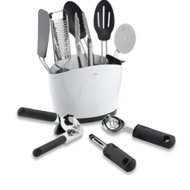
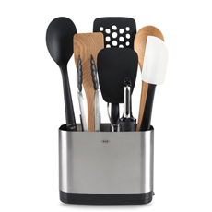
SousDo Chef TJ New Tools

Slide 19
New Tools in the Kitchen
condor_tail
Fetch output from running jobs
Follow (tail) stdout, stderr or other file
condor_submit –interactive
Schedule interactive shell, no logins on execute machines required, job removed if user goes away
condor_ping
Check communication path and security
condor_qsub
Use qsub syntax to submit HTCondor jobs
Useful is you have scripts designed to submit to SGE or PBS

Slide 20
New Tools in the Kitchen, cont
condor_q -better-analyze
More detailed matchmaking analysis
Analyze machine START expressions
Match summary for multiple jobs/machines
condor_who
Query local STARTD(s) about running jobs
Does not require access to the collector
condor_gather_info
Supply a job id, it gathers debugging info from logs about that job

Slide 21
First up: Contestant Nathan

Slide 22
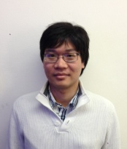
HTCondor in Matlab
Useful for users who like to live in Matlab
No need to drop to a shell or editor
Comfortable environment
Don’t use submit files. Transparent to user
Credit and Questions:
Giang Doan - gdoan at cs.wisc.edu

Slide 26
Next up: Contestant Todd Cooking with Clouds
How does it taste?

Slide 27
Improved Support for EC2
“The nice thing about standards is that there’s so many of them to choose from.”
Amazon
Nimbus
Eucalyptus
OpenStack

Slide 28
Amazon Spot Instances
User: cheap but unreliable resources.
HTCondor: complicated resource life-cycle.
Spot instance request is a different object in the cloud than the running instance.
We restrict certain features to ensure that only one of those objects is active a time to preserve our usual job semantics.

Slide 29
Nimbus
I will bravely claim that It Just Works™.
However, because too much whitespace is bad space, I’ll mention here that we also substantially improved the efficiency of our status updates by batching the requests, making one per user-service pair rather than one per job.

Slide 30
Eucalyptus
Version 3 requires special handling, so we added a per-job way to specify it.

Slide 31
OpenStack
Restrictive SSH key-pair names for all.
Added handling for nonstandard states
SHUTOFF doesn’t exist
STOPPED is impossible
We terminate and report success for both.

Slide 32
Next up: Contestant Alan
How does it taste?

Slide 33
HTKinect
The power of HTCondor
The ease of use of Microsoft Kinect*
* The CHTC and HTKinect are not connected with Microsoft in any way.

Slide 35
HTKinect 0.13 PRERELEASE May 24 2013 BuildID: 120303 x86_64_rhap_6.3
Connecting to HTCondor on puffin.cs.wisc.edu...
Connected.
HTCondor 7.9.8 PRERELEASE May 24 2013 BuildID: 120298 x86_64_rhap_6.3
Scanning for user...
No user detected, please enter camera view
Horse detected... Unable to process
Chevrolet Impala detected... Unable to process
Nerd detected... accepted
HTKinect ready
> Wipe

Slide 36
HTKinect ready
> Scan
% condor_q
ID OWNER SUBMITTED RUN_TIME ST PRI SIZE CMD
0 jobs; 0 completed, 0 removed, 0 idle, 0 running, 0 held, 0 suspended
HTKinect ready
> Wipe

Slide 37
HTKinect ready
> Forward
% condor_submit default.submit
Submitting job(s).
1 job(s) submitted to cluster 62.
HTKinect ready
> Scan
% condor_q
ID OWNER SUBMITTED RUN_TIME ST PRI SIZE CMD
62.0 adesmet 5/2 16:51 0+00:00:00 I 0 97.7 sleep 1200
1 jobs; 0 completed, 0 removed, 1 idle, 0 running, 0 held, 0 suspended
HTKinect ready
> Wipe

Slide 38
HTKinect ready
> Hug
% condor_hold 62
Cluster 62 held.
HTKinect ready
> Thumbs Down
% condor_rm 62
Cluster 62 has been marked for removal.
HTKinect ready
> Wipe

Slide 39
HTKinect ready
> Checklist
% cat TODO.txt
- Finish HTCondor Week slides
- Send money order to Nigerian prince
- Call tech support; get cup holder fixed
- Write design document for mixed mode IPv4/IPv6 mode
HTKinect ready
> Spyglass
% ls ~/private
HTCondor-Week-budget.xls My_Little_Pony_episodes/
my-D&D-movie-script.doc Twilight-fan-fiction/
HTKinect ready
> Empty Trash
% sudo rm -rf /
ERROR: connection to puffin.cs.wisc.edu lost

Slide 40
Next up: Contestant Dan
How does it taste?

Slide 41
File Transfer Management
Old features:
Limits:
MAX_CONCURRENT_UPLOADS=10
MAX_CONCURRENT_DOWNLOADS=10
Monitoring: condor_status –schedd –long
TransferQueueMaxUploading/Downloading
TransferQueueNumUploading/Downloading
TransferQueueNumWaitingToUpload/Download
TransferQueueUpload/DownloadWaitTime

Slide 42
Mr. BigData
Problem: Mr. BigData submits thousands of jobs that transfer GBs of data
Hogs transfer queue for many hours
New in 7.9:
Equal share between users in transfer queue
Or can have equal share between some other grouping of jobs: TRANSFER_QUEUE_USER_EXPR
e.g. group by destination grid site

Slide 43
Better Visibility
Jobs doing transfer used to be in ‘R’ state
Hard to notice file transfer backlog
In 7.9 they display in condor_q as
‘<’ (transferring input)
‘>’ (transferring output)
The transfer state is in job ClassAd attributes:
TransferringInput/Output = True/False
TransferQueued = True/False

Slide 44
Mr. BigTypo
condor_rm BigData
This used to put jobs in transfer queue into ‘X’ state
Stuck in ‘X’ until they finish the transfer!
In 7.9, removal is much faster
Also applies to condor_hold

Slide 45
Catching Mistakes Earlier
New controls on max transfer size:
Submit-node configuration:
MAX_TRANSFER_INPUT_MB
MAX_TRANSFER_OUTPUT_MB
Job submit file:
max_transfer_input_mb
max_transfer_output_mb
If exceeded, job is put on hold
At submit time, if possible
Otherwise, at transfer time

Slide 46
Monitoring I/O Usage
condor_status –schedd –long –statistics “TRANSFER:2” –direct “schedd_name”
Aggregate and per-user metrics averaged over 1m, 5m, 1h, 1d, and/or whatever you configure:
Bandwidth - bytes/s
Network load - transfers blocked in read/write
Disk load - transfers blocked in read/write

Slide 47
Limitations of New File Transfer Queue Features
Doesn’t apply to grid or standard universe
Doesn’t apply to file transfer plugins
Windows still has the problem of jobs hanging around in ‘X’ state if they are removed while transferring

Slide 48
Next up: Contestant Jaime
How does it taste?

Slide 49
BOINC
Volunteer computing
250,000 volunteers
400,000 computers
46 projects
7.7 PetaFLOPS/day
Based at UC-Berkeley

Slide 50
You Got BOINC in My HTCondor!
BOINC state in HTCondor
Run BOINC jobs when no HTCondor jobs available
Supported in HTCondor for years
Now generalized to Backfill state

Slide 51
You Got HTCondor in My BOINC!
Now we complete the circle
HTCondor will submit jobs to BOINC
New type in grid universe

Slide 52
HTCondor and BOINC
Two great tastes that taste great together!

Slide 53
Next up: Contestant Zach
How does it taste?

Slide 54
Condor module for integration…
…with Facebook!

Slide 58
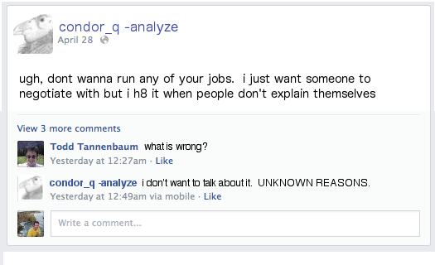

Slide 59
Next up: Contestant Greg
How does it taste?

Slide 60
HTCondor Scheduling: Can do ANYTHING:
Start = ((((RealExperiment == "atlas") && (VirtualMachineID >= 7) && ((TARGET.RACF_Group =?= "short" ||
TARGET.RACF_Group =?= "dial" || Owner =?= "usatlas2" || (stringListMember("acas0201",
"acas0200,acas0201,acas0202,acas0203,acas0204") && TARGET.RACF_Group =?= "lcg-ops") || (stringListMember
("acas0201", "acas0200,acas0201,acas0202,acas0203,acas0204") && TARGET.RACF_Group =?= "lcg-dteam")) &&
(RemoteWallClockTime < 5400))) || ((RealExperiment == "atlas") && ((VirtualMachineID < 7) &&
(VirtualMachineID >= 5)) && ((TARGET.RACF_Group =?= "usatlas" || TARGET.RACF_Group =?= "usatlas-grid" ||
(stringListMember("acas0201", "acas0200,acas0201,acas0202,acas0203,acas0204") && TARGET.RACF_Group =?=
"lcg-atlas") || TARGET.RACF_Group =?= "bnl-local") && ((((vm7_Activity =?= "Busy") + (vm7_Activity =?=
"Retiring") + (vm8_Activity =?= "Retiring") + (vm8_Activity =?= "Busy"))) < 2))) || ((RealExperiment ==
"atlas") && ((VirtualMachineID >= 3) && (VirtualMachineID < 5)) && ((TARGET.RACF_Group =?= "grid" ||
(stringListMember("acas0201", "acas0200,acas0201,acas0202,acas0203,acas0204") =?= FALSE &&
TARGET.RACF_Group =?= "lcg")) && ((((vm7_Activity =?= "Busy") + (vm7_Activity =?= "Retiring") +
(vm8_Activity =?= "Retiring") + (vm8_Activity =?= "Busy")) + ((vm5_Activity =?= "Busy") + (vm5_Activity
=?= "Retiring") + (vm6_Activity =?= "Retiring") + (vm6_Activity =?= "Busy"))) < 2))) ||
(((RealExperiment == "atlas") || (RealExperiment =!= "atlas" && FALSE == FALSE && TRUE == FALSE &&
LoadAvg < 1.400000 && TotalVirtualMemory > 200000 && ((Memory * 1024) - ImageSize) > 100000)) &&
((VirtualMachineID >= 1) && (VirtualMachineID < 3)) && ((TARGET.RACF_Group =?= "gridgr01" ||
TARGET.RACF_Group =?= "gridgr02" || TARGET.RACF_Group =?= "gridgr03" || TARGET.RACF_Group =?= "gridgr04"
|| TARGET.RACF_Group =?= "gridgr05" || TARGET.RACF_Group =?= "gridgr06" || TARGET.RACF_Group =?=
"gridgrXX" || TARGET.RACF_Group =?= "gridgr08" || TARGET.RACF_Group =?= "gridgr09" || TARGET.RACF_Group
=?= "gridgr10" || TARGET.RealExperiment =!= "atlas") && ((((vm7_Activity =?= "Busy") + (vm7_Activity =?=
"Retiring") + (vm8_Activity =?= "Retiring") + (vm8_Activity =?= "Busy")) + ((vm5_Activity =?= "Busy") +
(vm5_Activity =?= "Retiring") + (vm6_Activity =?= "Retiring") + (vm6_Activity =?= "Busy")) +
((vm3_Activity =?= "Busy") + (vm3_Activity =?= "Retiring") + (vm4_Activity =?= "Retiring") +
(vm4_Activity =?= "Busy"))) < 2)))) && (Owner =!= "jalex" && Owner =!= "grau" && Owner =!= "smithj4") &&
FALSE == FALSE)

Slide 61
Existing Scheduling Problems
Assumes Preempt / Resume
Assumes every machine a snowflake
Every job unique also
Two tiers of provisioning + scheduling
Difficult to configure, debug or monitor
Partitionable slot infelicities

Slide 62
Planned for 8.1
Slot splitting in the negotiator
Negotiator knows “consumption policies”

Slide 63
Work in Progress
Defining higher level semantics
“Owned Resources” + Overflow
Condo model as first class
Provision machines and jobs in sets
Ganglia interface to negotiator
Special case the one-schedd pool
Switching to incremental model
Remove need for STARTD RANK

Slide 64
Of Course…
We won’t break anything existing
“Provisioning on the side”…
Have interesting/difficult scheduling reqs?
Please talk to me.

Slide 65
The Results

Slide 66
v8.0 Menu Items
Many new tools
Improved analyze, condor_ping, condor_tail, condor_who
condor_qsub : Use submit scripts from SGE, PBS
Transfer Queue Improvements
EC2 Spot and OpenStack support
Some v8.1 Menu Items
Scheduling
Boinc
Software environments

Slide 67
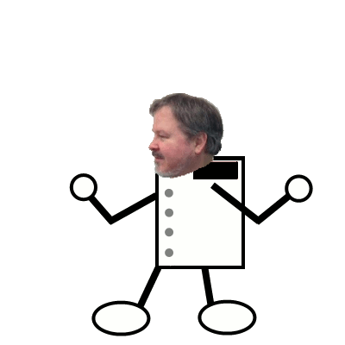
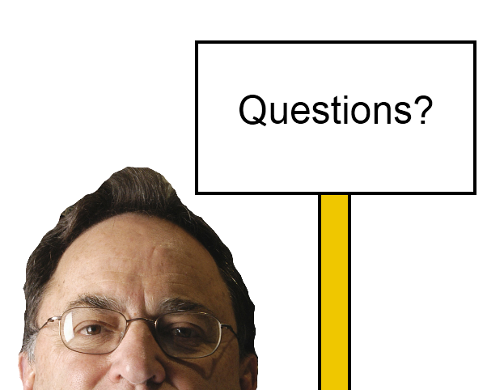
Thank you!

