Slide 1
CONI
The SDN Evolution
Phil Casini, Senior Product Manager, Cisco Systems

Slide 2
So How Far Have We Come with SDN?
Up to 2011
2012
1H2013
Developing SDN
Building Blocks
Shaping SDN
Use Cases
SDN Based Solutions
Emerging
Open
Network
Foundation
Project
Daylight
University
Experimentation
And Exploration
University and
Enterprise Exploration
Production
Qualification
Commercial Controllers
Integrated Network Slicing
Commercial Applications
DC Traffic Monitoring
WAN Transit Selection
Network Controllers
Flowvisor
Universities Have Led Innovation Throughout the Journey!

Slide 3
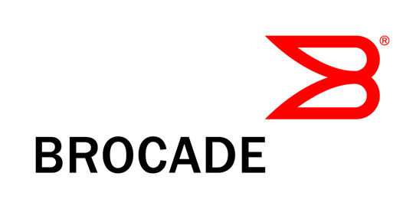
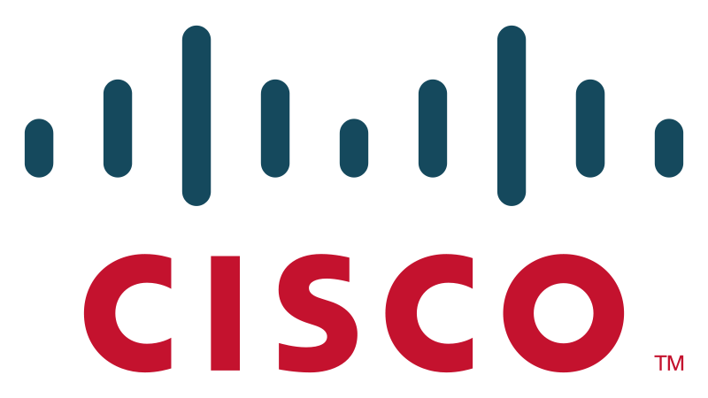
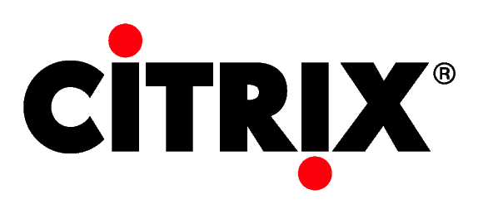
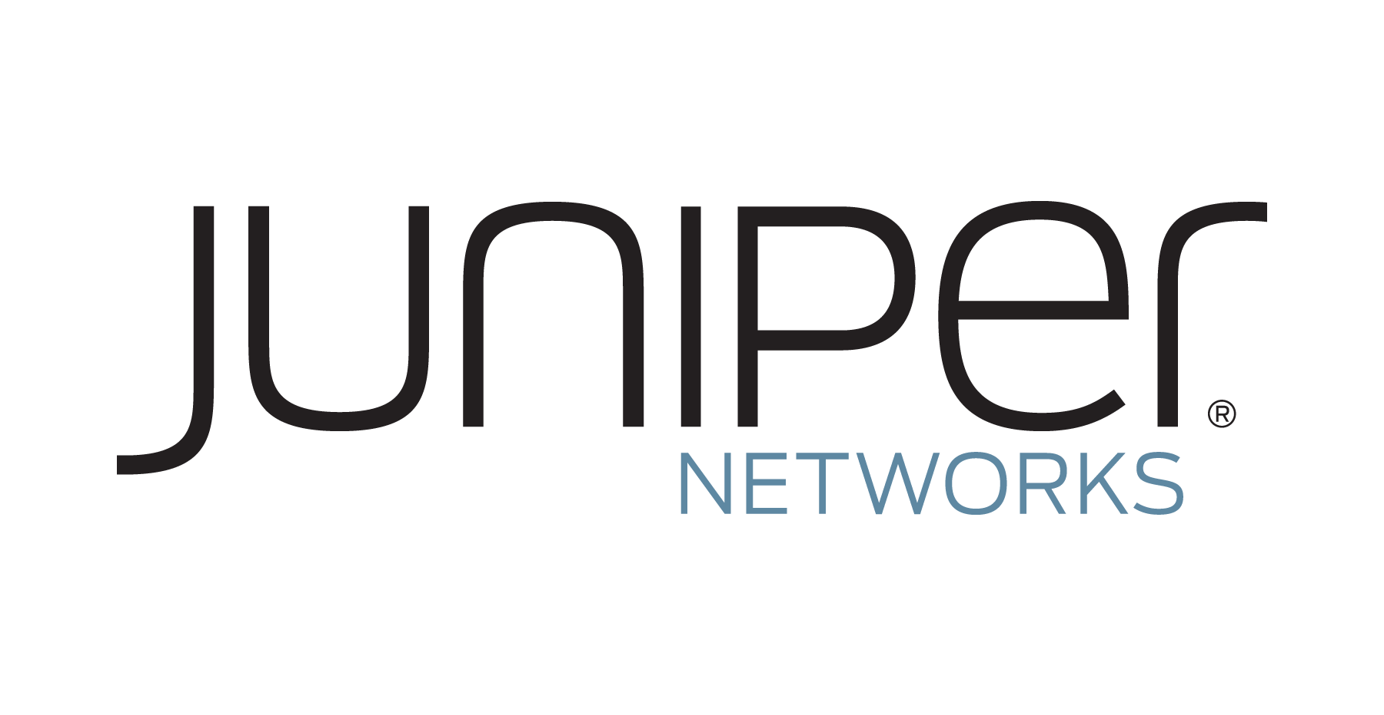
What is Project Daylight?
Daylight is an open source project formed by industry leaders and others under the Linux Foundation with the mutual goal of furthering the adoption and innovation of Software Defined Networking (SDN) through the creation of a common vendor supported framework.
Platinum
Gold
Silver

Slide 4
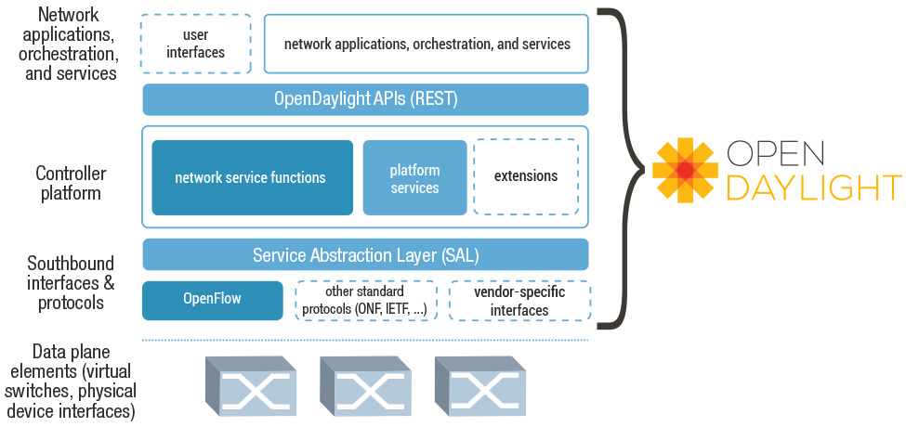
Project Framework
A New “Sandbox” For Experimentation and Innovation

Slide 5
Northbound API Standardization: The Next Big Exploration Area for SDN
Shifting the management
of network operations
“state” to the boundary between the northbound
controller interface and
the SDN application requires innovation

Slide 6
Is HTCondor An Answer?
Submission of SDN application ”requests” (aka job requests) to the SDN Controller in a uniform manner may provide a useful structure for efficiently arbitrating the Controller’s utilization
Mapping resource requests with available resources across a distributed topology may provide an efficient “scheduling” element for networking flow management policies
Providing network policies to an SDN Controller from HT Condor CAN provide useful guidance to improve network behavior

