Slide 1
Active Harmony’s Plug-in Interface
A World of Possibilities
Ray S. Chen <rchen@cs.umd.edu>
Jeffrey K. Hollingsworth <hollings@cs.umd.edu>
Paradyn/Dyninst Week 2013
April 30, 2013

Slide 2
Overview and Motivation
Auto-tuning has a broad range of applications
Optimization of run-time, throughput, energy, etc.
Supporting new features increasingly difficult due to monolithic internals
10+ years of non-structured development
Core search logic implemented in Tcl
Reorganization produced a generalized auto-tuning framework
Á la componentization of Dyninst API
Eases integration with other projects
Notes:
Added a web server, suffered through internals.
Added a global configuration system, suffered through internals.
“Those guys were just looking for something else to componentize!”

Slide 3
Auto-tuning Basics
Empirically test configurations for performance
Searches a set of valid configurations for optimal
Valid configurations defined by tuning variables
Variables can be integer, real, or enumerated strings
Each variable bound by minimum, maximum, and step
Set of tuning variables define a parameter space
N variables create an N-dimensional space
Cartesian coordinates represent unique configurations

Slide 4
Parameter Space Example
Variable 1
Name: Tile
Min: 2
Max: 16
Step: 2
Variable 2
Name: Unroll
Min: 0
Max: 10
Step: 1

Slide 5
Auto-Tuning Feedback Loop
Evaluated Performance
Auto
Tuner
Client
Application
5.1
Search
Strategy
Candidate Points

Slide 6
Search Strategies
Drives the feedback loop
Pluggable module with two major interfaces
Fetch: Generates a new point for client
Report: Accepts a point/performance pair from client
Four strategies included in Active Harmony
Brute Force
Random
Nelder-Mead
Parallel Rank Order (PRO)

Slide 7
Generalized Auto-Tuning
Evaluated Performance
Active
Harmony
Client
Application
REPORT
3
2
1
Search
Strategy
3
2
1
FETCH
Candidate Points
Notes:
The remaining piece that completes our vision for a generalized auto-tuning framework is the ability to trigger functionality as configurations leave and enter the auto-tuner. We implement this via plug-in’s that are stackable.

Slide 8
Onion Model Workflow
Allows for paired functionality, but either hook is optional.
Fetch hooks executed in ascending order.
Report hooks executed in descending order.
Point values cannot be modified (directly).
REPORT
Search
Strategy
3
2
1
FETCH
Notes:
Any number of plug-ins can loaded into a tuning session. There are three plug-ins illustrated here, organized as layers of an onion. Like search strategies, plug-in’s have two major interfaces.

Slide 9
Plug-in Workflow: ACCEPT
Indicates successful processing at this level.
Plug-in relinquishes control of the point to entity below.
Search
Strategy
3
2
1

Slide 10
Plug-in Workflow: RETURN
Allows a short-circuit in the feedback loop.
Plug-in must provide the performance value.
Processing resumes at the same level from the report workflow.
Search
Strategy
3
2
1

Slide 11
Plug-in Workflow: REJECT
Allows modification of the search indirectly.
Plug-in must provide an alternate valid point.
Search strategy is not obligated to use it.
Processing jumps directly back to search strategy.
Search
Strategy
3
2
1

Slide 12
Plug-in Example: Point Logger
logger_init()
{
outfd = open(“performance.log”);
}
logger_report(flow_t *flow, point_t *pt, double perf)
{
fprintf(outfd, “%s -> %lf\n”, string(pt), perf);
flow->type = ACCEPT;
}
logger_fini()
{
close(outfd);
}

Slide 13
Plug-in Workflow: WAIT
Allows asynchronous point processing
Plug-in sends point to external process
Other points processed in the mean time
Processing resumes at the same level upon return
Search
Strategy
3
2
1
External Process

Slide 14
Plug-in Example: Code Server
cs_init()
{
sockfd = tcp_connect(CODE_SERVER);
register_fetch_callback(sockfd, code_ready);
}
cs_fetch(flow_t *flow, hpoint_t *pt)
{
send_point(sockfd, pt);
flow->type = WAIT;
}
code_ready(flow_t *flow, hpoint_t *pt_list[])
{
recv_completed_id(sockfd, id);
flow->point = find_point_in_list(pt_list, id);
flow->type = ACCEPT;
}

Slide 15
Plug-in Example: Constraints
Support for non-rectangular parameter spaces.
Implemented as plug-in #2 using REJECT workflow.
$y≤x$
Search
Strategy
$$y$$
3
2
1
$$x$$

Slide 16
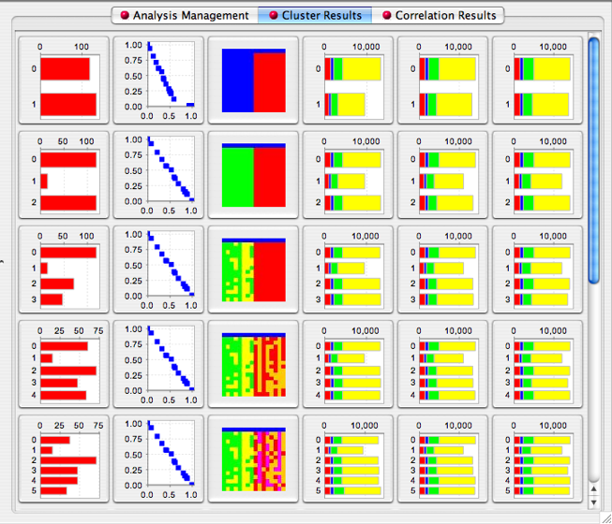
Plug-in Example: TAUdb
Integration with TAU via TAUdb.
Tuning and Analysis Utilities
Search data stored in persistent database
Adds parameter analysis to any tuning session.
Can potentially be used as result cache

Slide 17
Specifying Plug-ins
Pluggable modules read from configuration
Unstructured key/value pair system queried at launch
Directly from the command-line
Tuna to accept in-line configuration directives
Syntax to be determined
> cat harmony.cfg
SESSION_STRATEGY=pro.so
SESSION_PLUGIN_LIST=logger.so:taudb.so

Slide 18
Availability
Current release is Active Harmony 4.0
Includes Tuna and preliminary plug-in interface
Upcoming release to include
Improved plug-in interface
Library of basic strategies and plug-ins
No more Tcl code!

Slide 19
Summary and Next Steps
Generalized auto-tuning framework presented
Variety of systems possible with minimal coding
Functionality encapsulated to simplify development
Next steps
Develop library of search strategies and plug-ins
Hierarchical search?
We could use your help!
Investigation of further abstractions
Parameter spaces

