Slide 1
Modifying Binaries with Dyninst
Andrew Bernat

Slide 2
Instrumentation vs. modification
Instrumentation:
Inserts logically orthogonal code into a program
Does not alter the original CFG
Has no cumulative effect on the original program
Single-entry, single-exit
Modification:
Changes become part of the original CFG
May alter behavior of the original code
Should not cause unexpected side-effects!

Slide 3
Example
some_func
other_func

Slide 4
Obligatory “why binaries” slide:
No source code (or debugging info) required
Legacy code
Malicious code
Proprietary binaries or libraries
Stripped binaries
Include the effects of compiler, linker, and other tools
Allow modification during execution

Slide 5
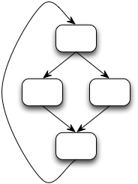
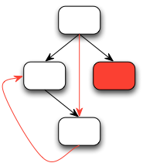
Binary modification interfaces
Function Modification
Instruction Modification
CFG Modification
main
5a0a80: push %ebp
5a0a81: mov %esp,%ebp
5a0a83: sub $0x18,%esp
5a0a86: mov 0x10(%ebp),%edx
5a0a89: cmp 0x14(%ebp),%edx
5a0a8c: ja 5a0abb
...
5a0abb: call 6b0930
...
sin
malloc
sort
strlen
redraw
abort
Dyninst, PIN
EEL, Etch, Vulcan, DynamoRIO,
Valgrind, FIT, SecondWrite
FIT (Lancet)
Preserves validity
Coarse granularity
Fine granularity
Requires user expertise
Users must ensure validity
Fine granularity
Users must ensure validity

Slide 6
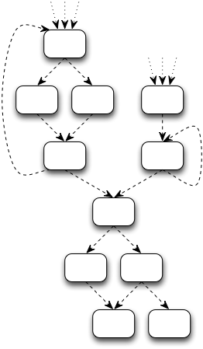
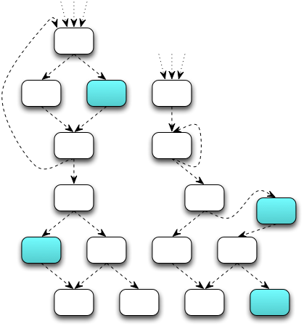
Binary modification via the CFG
Original Binary
Code
Modified Binary
Code

Slide 7
Structured Binary Editing
Enforce CFG validity constraint
Ensure modified CFG can be instantiated as new code
Maintain validity of the underlying binary
Define CFG transformation algebra
Closed under validity constraint
Operate on functions, loops, blocks, and edges
Handle indirect control flow
Validity cannot be determined without analysis

Slide 8
CFG Validity
A CFG is valid if each element is valid
All blocks are valid
All non-exit blocks have out-edge(s)
At least one entry block
Edge types represent realizable control flow
Valid Examples
(PPC, ARM only)
Valid Examples
Invalid Examples

Slide 9
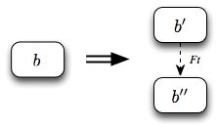
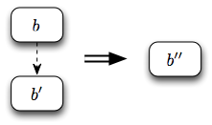
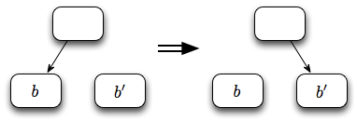
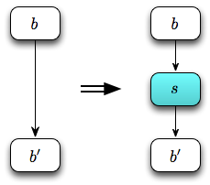
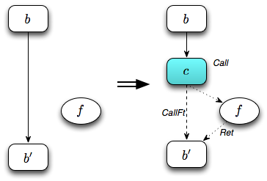
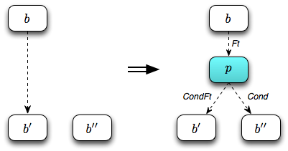
CFG transformation algebra
Block and Edge Modification
Block Splitting
Block Joining
Edge Redirection
Code Insertion
Edge Insertion
Call Insertion
Predicate Insertion

Slide 10
Indirect validity
Transforming the CFG may alter indirect control flow
Corrupting a function pointer
Skipping a jump table guard predicate
Detect alterations with slicing-based analysis
Allow
Conservative: disallow
Middle ground: monitor
Optimistic: allow
Disallow
Valid
Invalid
Unknown

Slide 11
Practice: PatchAPI Interface
Dyninst
Point/Snippet instrumentation interface
Interactive modification interface
Accessible from BPatch
Changes not reflected at BPatch layer
Callbacks for updating user data
Symtab
API
A Dyninst Component
DynC
A Dyninst
Value-Added Library
Instruction
API
A Dyninst Component
Parse
API
A Dyninst Component
Dataflow API
A Dyninst Component
Stack Walker API
A Dyninst Component
Proc
Control API
A Dyninst Component
Codegen
A Dyninst Component
Patch API
A Dyninst Component

Slide 12
PatchAPI Overview
CFG classes
PatchBlock, PatchEdge, PatchFunction
Binary file class
PatchObject
Instrumentation
Point, PatchMgr
Modification
PatchModifier, PatchCallback
, Snippet

Slide 13
class MySnippet : public PatchAPI::Snippet
bool generate(Point *point, Buffer &buffer)
Point provides context for code generation
Buffer is a code container
Snippet::Ptr PatchAPI::convert(BPatch_snippet *)
Convert BPatch_snippets to PatchAPI snippets

Slide 14
class PatchModifier
bool redirect(PatchEdge *, PatchBlock *);
PatchBlock *split(PatchBlock *, Address);
bool remove(vector<PatchBlock *>);
bool remove(PatchFunction *);
InsertedCode::Ptr insert(PatchObject *,
SnippetPtr, Point *);
class InsertedCode:
PatchBlock *entry()
vector<PatchEdge *> &exits()
set<PatchBlock *> &blocks()

Slide 15
class PatchCallback
Interface class for CFG modification updates
Register one (or more) child classes
Notify on CFG element:
Creation
Destruction
Block splitting
New in-edge or out-edge
Removed in-edge or out-edge
Notify on Point creation, destruction, or change

Slide 16
Example: Hot Patching Apache Vulnerability
Apache 2.2.21 has several vulnerabilities:
Using reverse proxy to access arbitrary server
Privilege escalation via .htaccess file
Denial of service with badly formatted cookie
(and others)
We used binary modification to patch these flaws
Act on unprepared, executing httpd daemon
Do not rely on specific compiler version(s)
Create “click to run” patching tool

Slide 17
CVE-2011-3368
Reverse proxy functionality broken in Apache
Introduced in 1.3.x
Fixed in 2.3.15 (released November 16, 2011)
Attacker sends illegal URI
GET @hiddenServer/hiddenFile
Proxy incorrectly forwards request
GET proxy@hiddenServer/hiddenFile
Attacker can access internal files

Slide 18
Hot Patching Overview
Create CFG “fingerprint” that identifies patch site(s)
Do not rely on addresses, functions, or particular instruction sequences
Create snippets from security patch file
Access and update local variables
Insert conditional error handling
Modify binary to incorporate new code
Matching patch file

Slide 19
Patch File
ap_parse_uri(r, uri);
+ if (r->method_number != M_CONNECT
+ && !r->parsed_uri.scheme
+ && uri[0] != ‘/’
+ && !(uri[0] == ‘*’ && uri[1] == ‘\0’)) {
+ r->args = NULL;
+ r->hostname = NULL;
+ r->status = HTTP_BAD_REQUEST;
+ }
if (ll[0]) {
r->assbackwards = 0;
pro = ll;
...
Error Condition
Detection
Error Handling

Slide 20
CFG Fingerprinting
ap_parse_uri(r, uri);
if (ll[0]) {
r->assbackwards = 0;
pro = ll;
len = strlen(ll);
}
else {
r->assbackwards = 1;
pro = “HTTP/0.9”;
len = 8;
}
ap_parse_uri
strlen

Slide 21
Snippet (error detection)
// r->method_number != M_CONNECT
boolExpr cond1(ne, r_method_number, constExpr(M_CONNECT));
// !r->parsed_uri.scheme
boolExpr cond2(eq, r_parsed_uri_scheme, constExpr(0));
// uri[0] != ‘/’
boolExpr cond3(ne, arithExpr(deref, uri), constExpr(‘/’));
// !(uri[0] == ‘*’ && uri[1] == ‘\0’)
boolExpr cond4(or,
boolExpr(ne, arithExpr(deref, uri), constExpr(‘*’)),
boolExpr(ne, arithExpr(deref, ...)));
boolExpr cond(and,
boolExpr(and, cond1, cond2),
boolExpr(and, cond3, cond4));

Slide 22
Snippet (error handling)
// r->args = NULL;
arithExpr body1(assign, r_args, constExpr(0));
// r->hostname = NULL;
arithExpr body2(assign, r_hostname, constExpr(0));
// r->status = HTTP_BAD_REQUEST
arithExpr body3(assign, r_status, constExpr(HTTP_BAD_REQUEST));
// r->uri = apr_pstrdup(r->pool, uri)
vector<snippet> call_args;
call_args.push_back(r_pool);
call_args.push_back(uri);
arithExpr body4(assign, r_uri,
funcCallExpr(findFunction(“apr_pstrdup”),
call_args));

Slide 23
Modification Code
bool patch(PatchBlock *b1,
PatchBlock *b2,
SnippetPtr snip,
Point *point) {
IC::Ptr code = PatchModifier::insert(b1->obj(),
snip, point);
// Redirect fallthrough of ap_parse_uri call to
// the entry of the inserted code region
PatchModifier::redirect(getEdge(b1, CALL_FT),
code->entry());
// Redirect exits of inserted code to b2
for (iterator iter = code->exits().begin();
iter != code->exits().end(); ++iter) {
PatchModifier::redirect(*iter, b2);
}
b1
ap_parse_uri
b2
strlen

Slide 24
Hot Patching
Error Detection
ap_parse_uri
Error Handling
ap_parse_uri
apr_pstrdup
strlen

Slide 25
Summary
Structured binary editing
Modify binaries by transforming their CFGs
Ensure validity of the resulting binary
PatchAPI implementation
Interactive CFG modification
Mix modification and instrumentation
Callback interface for updating user data
Bernat and Miller,
“Structured Binary Editing with a
CFG Transformation Algebra”

Slide 26
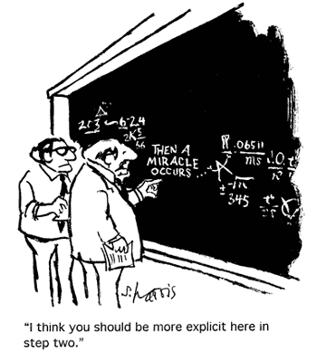
Questions?

