Slide 1
Intelligent Power Management over Large Clusters
Stephen McGough*, Clive Gerrard*, Paul Haldane*, Sindre Hamlander⁺, Paul Robinson⁺, Dave Sharples*, Dan Swan*, Stuart Wheater⁺
* Newcastle University
+ Arjuna Technologies Ltd
Condor Week 2011

Slide 2
Overview
What is the DI?
Background
Motivation
Power saving in Condor
Intelligent Power Management
Conclusion

Slide 3
What is the DI?
Society is increasingly dependent on digital technologies
energy, transport, healthcare, commerce, engineering….
How can Newcastle researchers develop and harness these technologies to shape the future for everyone's benefit?
Research is increasingly dependent on digital technologies
record, store, analyse, model, share, visualise..
How can Newcastle researchers harness these technologies to do new, innovative research?
Institute Goals
Facilitate Internationally-Leading Research
innovative, exciting, pioneering
impact on researchers & society
Thriving, Inter-Disciplinary Research Community

Slide 4
Background

Slide 5
Condor at Newcastle
Using open access cluster computers around campus
~ 1300 Computers Windows Based
~ 250 Computers Linux Based
Using Staff Desktops
~ 3000 Computers (not all Condor enabled – yet!)
Using dedicated resources
~ 200 Computers in research groups around Campus
All computers at least dual core, moving to quad
~ 6000 – 10000 core cluster
Condor originally installed 5 years ago as ‘unsupported’ service. Now we’re making it a supported service

Slide 6
Power Efficiency of Computers
Power Efficiency:
efficiency = flops/(PUE ∗ watts)
Flops/watts – pre-determined
Average value used
Power Usage Effectiveness (PUE) – depends on location of computer (and time)
Type | flops | Wattage
Ultraslim Desktop | 941M | 54
CAD Computer | 1265M | 87
Legacy | 600M | 100

Slide 7
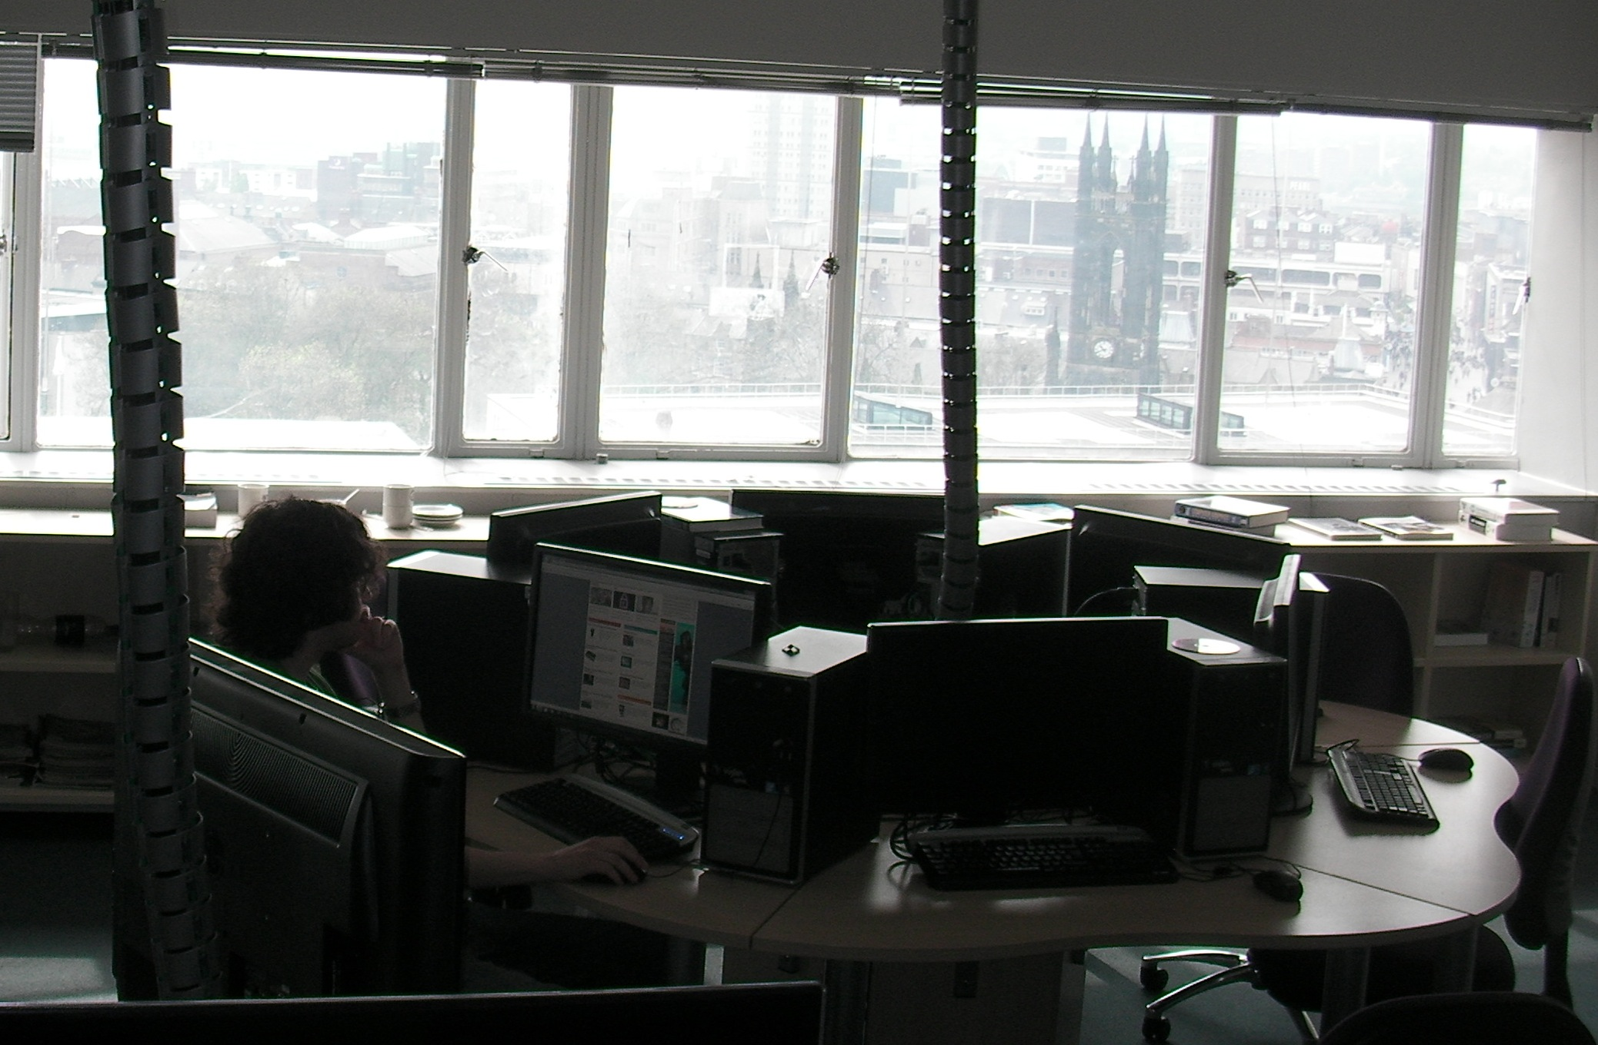
Cluster Locations
MSc Computing Cluster
South facing cluster room in High tower.
PUE > 1 (needs air-con all year)
Old Library
Basement Cluster room
Needs heating all year
PUE < 1 (offset heat from computers against room heating)

Slide 8
Motivation

Slide 9
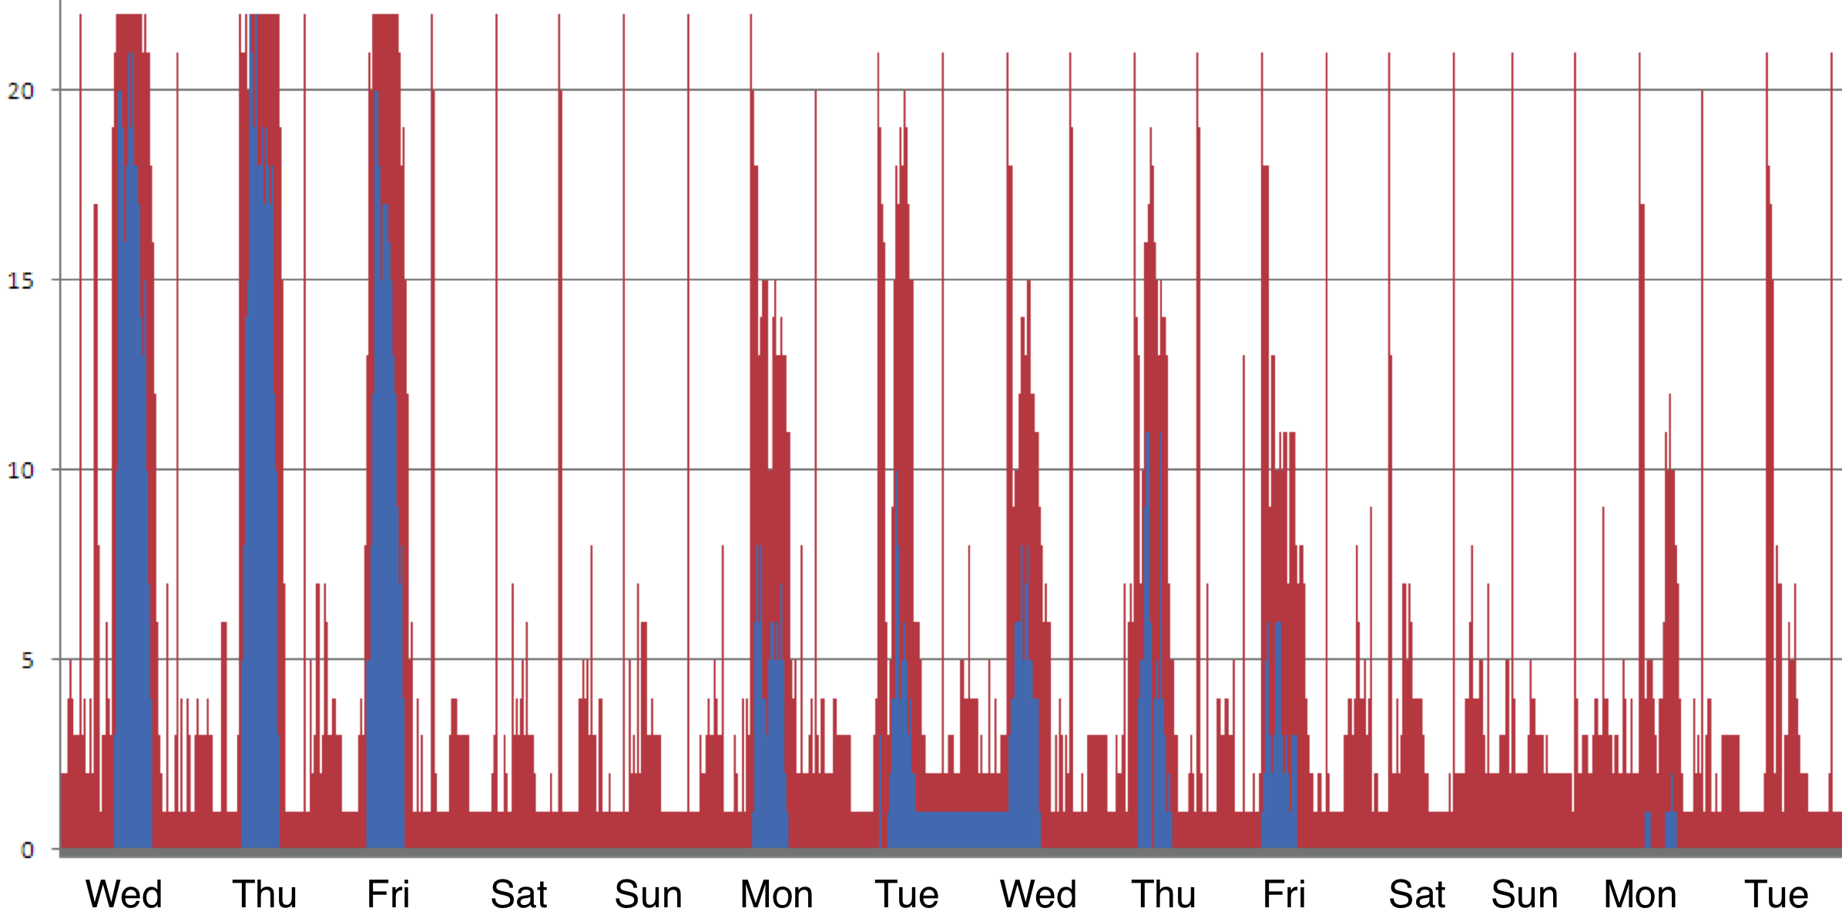
Motivation
University has strong desire to power down computers to save energy (money)
If a computer is not ‘working’ it should be powered down.
Windows XP Cluster
Windows 7 Cluster

Slide 10
Motivation
We have five years of condor logging to mine
Other computers were used
though this is the main log
Initial analysis looks promising…
Description | Number | %
Total number of jobs submitted to Condor | 642298 | 100%
- Which Completed | 469184 | 73%
- Without wasted time | 415807 | 65%
- With wasted time | 53377 | 8%
- Which were removed | 173114 | 27%
- Before execution | 164059 | 26%
- After some execution | 9055 | 1.4%

Slide 11
Motivation
Further analysis didn’t look as good…
(Data from main Condor Submit computer – others exist)
For every 1 second of useful time we require ~3 seconds through Condor
Total Time used by Condor | 51 years, 29 days, 20h, 2m, 52s | 100%
Total Wasted time | 33 years, 129 days, 4h, 6m, 13s | 65%
Total time wasted on jobs removed | 26 years, 33 days, 22h, 36m, 28s | 51%
Total time wasted on completed jobs | 7 years, 95 days, 5h, 29m, 45s | 14%
Total real job execution time | 17 years, 265 days, 15h, 56m, 39s | 35%

Slide 12
Average Wasted Time
(minutes)

Slide 13
Rank
Rank used to express preference
Vast majority of people don’t use Rank
Some who do get it wrong!
Rank Statement | % | Meaning
Null | 99.87% | No Preference
LoadAvg | 0.082% | Prefer computers with higher loads
((OpSys == "WINNT51")) + ((OpSys == "LINUX") * 2) | 0.047% | Prefer Linux to Windows
Memory | 0.0015% | Prefer computers with more memory
!!!
Notes:
((OpSys == "WINNT51")) + ((OpSys == "LINUX") * 2)
300 times
0.047% of jobs
0.00
641459
99.87% of jobs
LoadAvg
529 times
0.082% of jobs
Memory
10 times
0.0015% of jobs

Slide 14
Aims
Reduce Power Consumption
Produce no impact on interactive machine users
Produce no impact on Condor users
Provide auditing on computing time used
On a cycle-scavenging Condor system.
All These Things can be done using Condor
So What’s new?

Slide 15
Power Saving in Condor

Slide 16
What’s Wrong With Condor?
Nothing – Condor is “too good”, but…
With a good administrator all this can be done
With plenty of time this can be done
Put another way
Administrators are busy people
They have plenty of other tasks to do other than monitor and tweak Condor which gets along with things just fine
Most users don’t know enough Condor
Can’t specify preferences over resources
Only 3 users had done this at Newcastle – and one got it wrong

Slide 17
Power Saving in Condor
Power rating (watts) and a PUE added to each worker description
Rank equation needs to be added to each job submission
Rank = flops/(PUE ∗ watts)
Automatically added by our system
And merged with user rank - if present

Slide 18
Powering up and down
We use our own computer power-down script
When no-one is using the computer
When no Condor jobs are running
A persistent ClassAd is sent to Condor
Indicates computer is powered down
Rooster can power up the computer
If a job description requests this
This calls our wakeup script

Slide 19
Powering down Windows
We suspend computers
Windows can (wake up and) suspend for many reasons
Not all under our control
Anti-Virus updates, software updates
We can catch many of these
But ~20% we can’t
We monitor the cluster for these
Monitor condor_status for nodes which don’t update
If a node fails to update ping it
If it’s no longer there copy it’s last classad and post a fake replacement for a hibernating computer

Slide 20
Intelligent Power Management

Slide 21
Aims
Reduce Power Consumption
Produce no impact on interactive machine users
Produce no impact on Condor users
Provide auditing on computing time used
On a cycle-scavenging Condor system.
All These Things can be done using Condor
So What’s new?
Do this all in a more automatic ‘intelligent’ way

Slide 22
Arjuna's Agility is a federation tool
Often used with Cloud Computing Platforms
Support structuring of the Cloud into federated sub-clouds through Service
Agreements
User configured (or implemented) policies can be installed to manage the interaction via Service Agreements

Slide 23
Using Agility to provide intelligent management between parts of Condor
Adding in Rank
Deciding if a user has the right to power up computers
Monitoring activity and looking for anomalous behavior
Behavior is modified by the addition of new Agility policies
A Service Agreement change will be accepted only if no Policy rejects it and at least one Policy accepts it
Modification of Agility policies can lead to modification of the condor policies and/or modification of incoming jobs
Audit individuals' worker usage for potential billing

Slide 24
General Architecture

Slide 25
Job Submission Route

Slide 26
Defined Policy
Favor Energy efficient computers
Unless user states otherwise
Prioritize submissions
Professors over PhD’s
Mark and manage Rogue jobs
Jobs that have executed for too long
Jobs that have been restarted too many times
Jobs incorrectly submitted
Backlog reduction
Modify above policy to deal with backlogs
Auditing
Provide auditing for all jobs (per –user, -group, -school, -faculty, university)

Slide 27
Auditing
Agility stores all attempted job runs. We can use this to provide audits of computer use
A job which takes n attempts to run consumes power of:
Do we include evicted job time?
Can produce audit on user, group, school or university

Slide 28
Future Policy
Federating between Condor Pools
Federating with the Cloud – Cloud Bursting
Resource profiling
Working out when resources are idle and for how long
Job profiling
Try to estimate job lengths for users
Dedicated workers for evictees
Running jobs on computers with active users
Education of users

Slide 29
Conclusion
Condor is good
Most users aren’t as good
System administrators are busy
They need tooling to automatically monitor and tweak the setup
This along with preferring power efficient computers and turning off computers can save a lot of energy (and money)

Slide 30
Questions?
stephen.mcgough@ncl.ac.uk

