Slide 1
Cyberinfrastructure and Scientific Collaboration: Application of a Virtual Team Performance Framework to GLOW II Teams
Sara Kraemer
Chris Thorn
Value-Added Research Center
Wisconsin Center for Education Research
University of Wisconsin-Madison
Condor Week – April 14, 2010

Slide 2
Cyberinfrastructure and Collaboration
Cyberinfrastructure has enabled new forms of large-scale distributed scientific enterprises
Strong need for effective coordination and systemization of research across disciplines¹
Sites may adopt different formats/representations
Effective use could break down disciplinary boundaries
Need awareness of cross-site development activities to streamline time, talent
¹Report of the NSF Blue-Ribbon Panel on Cyberinfrastructure (2003)

Slide 3
Virtual Teams in HTC: Definition
Virtual teams in high throughput computing may vary across:
time and geography,
domains of science,
team size,
background or culture,
type of task,
type of research problems (e.g., applied, basic),
computational needs,
fluidity of membership in the HTC community,
and degree of interdisciplinarity within their scientific domain and/or across research projects

Slide 4
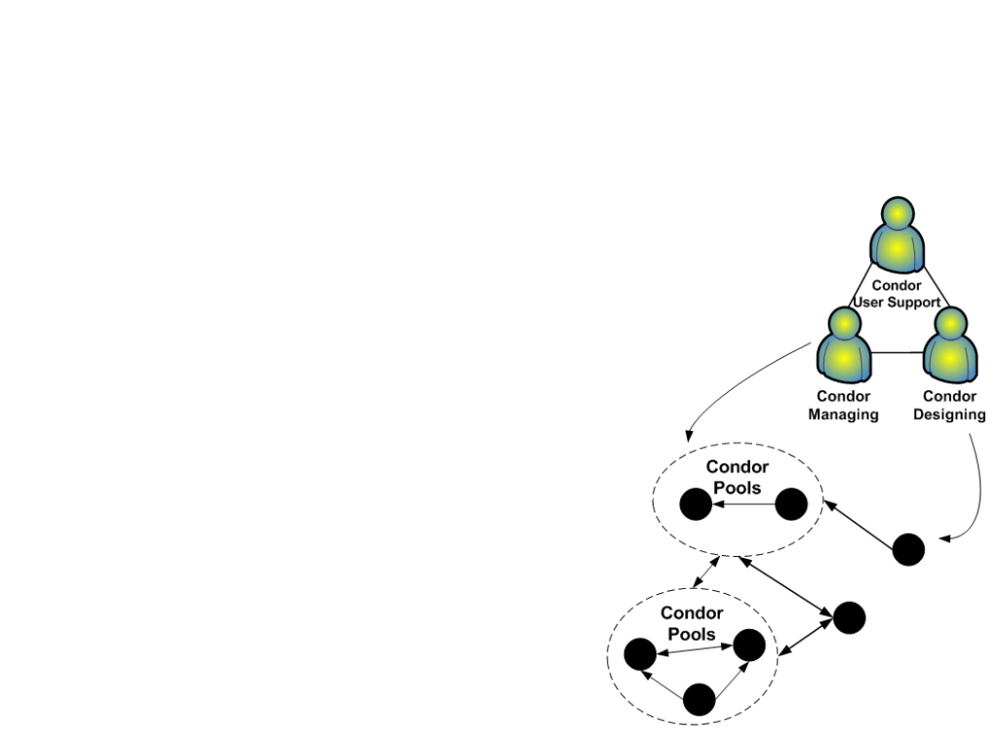
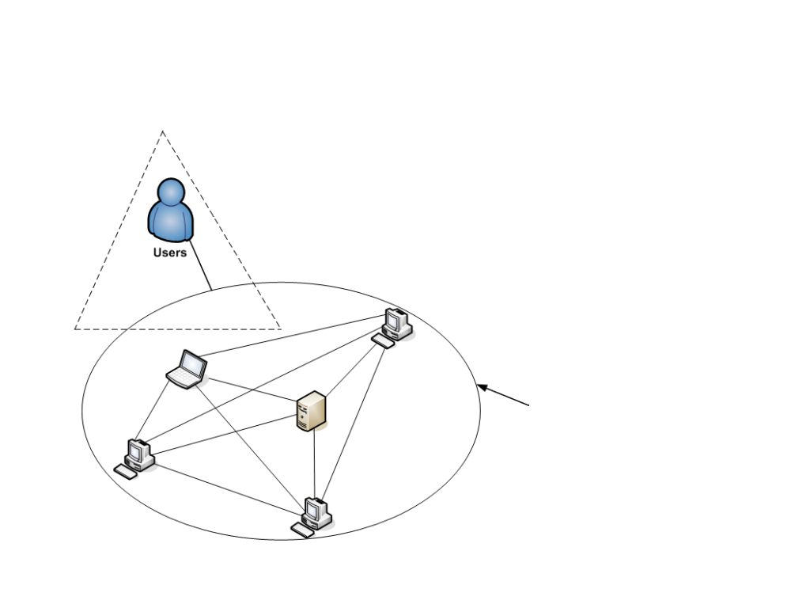
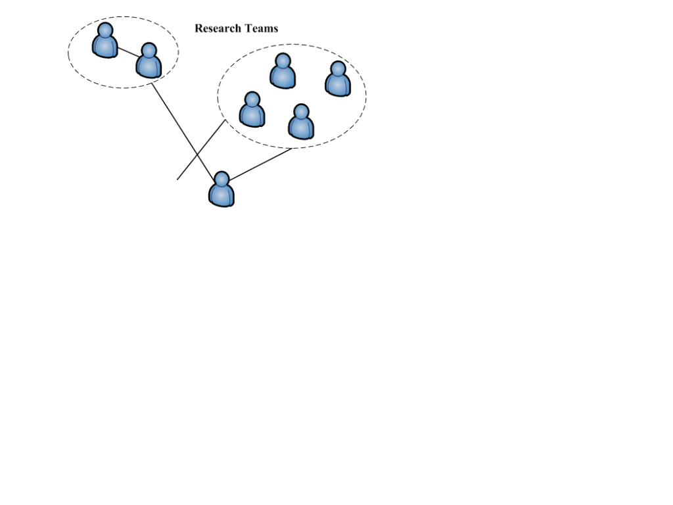
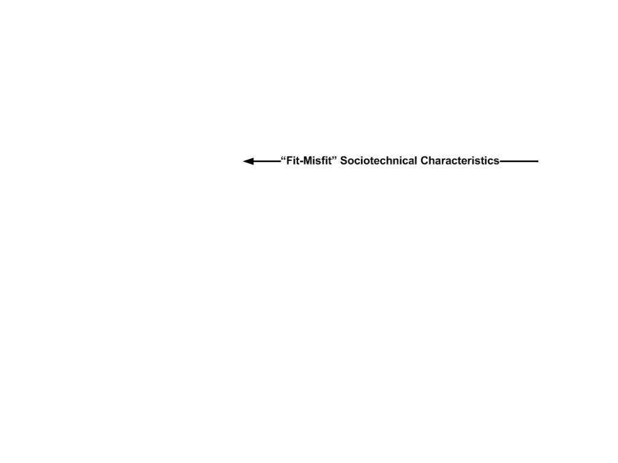
Human Factors Approach to Cyberinfrastructure

Slide 5
Condor Project + Scientific Collaboration
Condor’s Philosophy of Flexibility²
Let communities grow naturally
Leave the owner in control
Plan without being picky
Lend and borrow
Understand previous research
Links virtual team collaborations via Condor pools, facilitates coordination via networks of people and resources
²Thain et al. (2005). Distributed computing in practice: The condor experience.
Notes:
Briefly discuss how Condor’s philosophy of flexibility contributes to scientific collaboration.
High degrees of resource flexibility,
End user control
Open-ended planning
Distributed resource management

Slide 6
Research Questions
What are the sociotechnical characteristics of virtual teams using Condor and HTC technologies?
How do the characteristics of specific HTC technology (Condor) affect virtual team performance and collaboration?

Slide 7
Sociotechnical Model of Virtual Teams Using HTC³
³Adapted from Powell et al. (2004)

Slide 8
Exploratory Study with Grid Laboratory of Wisconsin (GLOW II Project Teams)
GLOW II
Interdisciplinary team of 10 research teams collaborating and using shared HTC resources
Collaborate in the development, implementation, testing, sharing, and deployment of HTC resoruces while conducting interdisciplinary science
How should teams/collaborations be designed and supported?

Slide 9
Study Design - 1
Focus groups with 2 interdisciplinary GLOW II teams:
IceCube
Search for dark matter with South Pole telescope
Over 250 people in 35 institutions
Condor/GLOW computational power for all scientific analyses and simulations
Laboratory for Molecular for Computational Geonomics (LMCG)
Investigates single molecule phenomena; creation of new systems in biological sciences
13 people at UW-Madison; 2-3 off-campus collaborators

Slide 10
Study Design - 2
Audio-recorded and notes
Systematic content analysis with qualitative research software support
Used Virtual Team Performance Framework as foundation of qualitative analysis

Slide 11
Input Factors for Team Performance Results – 1
Categories | IceCube | LMCG
Culture | 2 | 1
Technical expertise | 1 | 2
Training | 0 | 1
Culture (Icecube):
“And they [astronomers] are interested in more data and better data. And they've been very successful at this. And that's how they operate. Doing something new [telescope], that's left to physicists. That's the history…”
(LMCG):
They strive to hire team members that are diverse in: inquisitiveness, creativity, productiveness. “Differences bring people together”

Slide 12
Input Team Design Factors Results – 2
Categories | Sub-categories | IceCube | LMCG
Collaboration technologies | Condor and HTC | 6 | 1
 | Internet resources and phone | 5 | 0
Leadership |  | 4 | 0
Organization of sub-teams |  | 3 | 0
Organization of work |  | 10 | 1
Membership size |  | 1 | 1
Notes:
Both groups cited Condor as a ‘collaborative technology’; IceCube emphasized other collaborative (i.e., communication, coordination) technologies as critical (greater need for scaling coordination, not co-located).
Work is more formally organized in IceCube – sub-groups and topic related sub-teams – again, larger group, larger collaboration, greater need for formalized work/research organization
Leadership centralized in IceCube, then organized by topic (see above comment); LMCG describes their organization as “flat:

Slide 13
Socio-Emotional Process Factors Results - 3
Categories | IceCube | LMCG
Relationship building | 2 | 0
Trust | 2 | 0
Cohesion | 0 | 0
Trust (IceCube)
“We totally outraced that competition. […]
And it's partly because the group is small.”
Notes:
Why IceCube is not a ‘typical’ particle physics collaboration – small, out front on the tech/science, no competition.

Slide 14
Task Processes Results – 4
Categories | Sub-categories | IceCube | LMCG
Coordination | Conducting science | 3 | 0
 | Condor-specific | 2 | 3
 | Inter- and intra team coordination | 9 | 1
 | Roles | 4 | 0
Task-technology-structure fit |  | 4 | 0
Communication |  | 0 | 0
Notes:
For HTC-specific coordination, both teams relied on Condor’s expertise in distributed resource management to both deliver the necessary computational power needed to execute scientific algorithms, models, and simulations.
In addition, Condor helped both teams define and redefine their research problems and provided on going technical assistance as needed
The monthly GLOW coordination meeting was also cited as a key organizational design factor for inter-team collaboration/coordination across GLOW II. The computational resource manager for both teams was cited as a critical coordination role for the effective use of HTC in each of their centers

Slide 15
Output Factors Results – 5
Categories | Sub-categories | IceCube | LMCG
Performance | Technical output | 1 | 1
 | Publishing research – grant cycles | 1 | 0
Satisfaction |  | 1 | 1
Notes:
Quality of technical output was enchanced by Condor; both reported satisfaction with the technical aspects of Condor as well as the interactions with Condor support staff and scientists.

Slide 16
Potential Sociotechnial Design Areas
Codify team performance factors for inter-team collaboration
Coordination of resources; HTC support within teams
Importance of the HFT/Condor liaison embedded in each team
Coordination vs. Collaboration?
Brings together many disciplines and problem spaces
Are teams truly collaborating or just coordinating?
Notes:
This is an abbreviated list – shortened for time contraints

Slide 17
Further Study + Limitations
2 teams and 2 data collection points = Exploratory
Expand to include more teams
Examine GLOW II cross-team interactions
Include Condor staff perspective
Notes:
Purpose of study was to examine the viability of the Virtual Team Performance Framework in HTC and begin to identify key areas

Slide 18
Questions + Contact Info + Acknowledgements
Sara Kraemer
sbkraeme@wisc.edu
608-265-5624
Chris Thorn
cathorn@wisc.edu
(608) 263-2709
Acknowledgements
Miron Livny, Condor Project
Francis Halzen, IceCube
David Schwartz, Laboratory for Molecular and Computational Geonomics

