Slide 1
Condor on Campus: BoilerGrid, DiaGrid and Beyond
April 21, 2009
Preston Smith
Purdue University
Notes:
Highlights on activities, accomplishments and todos

Slide 2
No Cycle Left Behind
No Byte Left Unexplored

Slide 3
At BoilerGrid, we don’t make a lot of the products in our grid.
We make a lot of the products in our grid run bigger.
Notes:
You’ll see things in our talk that others are talking about as well..
We’re happy to be consumers and implementers of things created by the Condor community.. And take them and run at a large scale.

Slide 4
Outline
Pushing the Campus Grid to all corners of the campus
Evangelism
Virtualization
Requirements
Our implementation
Managing a large campus grid
Distributed Storage
DiaGrid
TeraGrid
Gratuitous Numbers

Slide 5
Some Uses
Research into Condor and distributed systems
JMS messaging service (Braun, Woo)
Debugging Distributed Systems via Data Mining (Thain, ND)
A System for Reliable Checkpoint Recovery in Shared Grid Environments (Islam, Bagchi, Eigenmann)
Domain sciences
Analysis of Rounding in the Beer Distribution Game (see talk tomorrow)
Usual suspects: Astronomy, Physics, Mathematics, Business, Hydrology, Materials Science, Bioinformatics

Slide 6
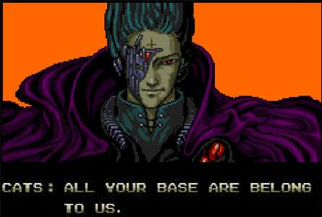
Centrally Operated Condor
To date, the bulk of BoilerGrid cycles are provided by ITaP, Purdue’s central IT
Rosen Center for Advanced Computing (RCAC) – Research Computing
Community Clusters – See http://www.isgtw.org/?pid=1001247
Teaching and Learning Technologies (TLT) – Student Labs
Centrally operated Linux clusters provide approximately 12k slots
Centrally operated student labs provide 6k Windows slots
That’s actually a lot of slots now, but there’s more around a large campus like Purdue
27, 317 machines, to be exact
Can the campus grid cover most of campus?

Slide 7
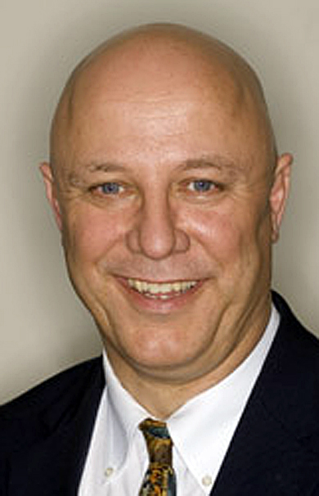
Target: All of Campus
Green Computing is big everywhere, Purdue is no exception
CIO’s challenge – power-save your idle computers, or run Condor and join BoilerGrid
A resource of this scale would cost $3M and use 2000 SF of data center space
Today, even the President of the University runs Condor on her PC
Centrally supported workstations have Condor available for install through SCCM.
Thou shalt turn off thy computer or run Condor

Slide 8
On-Campus Evangelism
What about non-centralized IT?
Less than half of Purdue’s IT staff is centralized (ITaP)
Of 27,317 machines, relatively few are operated by ITaP!
Outreach to distributed IT organizations – Many colleges and departments operate over 1000 machines each
Agriculture, Computer Science, Engineering, Management, Physical Facilities, Liberal Arts, Education
Educate IT leadership around campus about what Condor can do for their faculty
Provide preconfigured, managed packages to ease deployment burden for IT organizations (RPM, deb, .exe)
Campus evangelism is not a technology problem, but a people problem!

Slide 9
On-Campus Evangelism
Host periodic on-campus Condor “Boot camp” for users and sysadmins
One-on-one conversations with distributed IT leadership
Security questions
Configurability
Scoreboard: “My Dean wants to know how much work our machines have provided”
Machine owners need to be confident that they remain in control of how their machines are used.
Condor is perfect for this!
Working with Indiana Higher Education Telecommunication System (IHETS) to train Universities in Indiana to run a campus grid, and partner in DiaGrid.
Look for presentations on building a campus grid at campus IT conferences such as EDUCAUSE, LabMan conferences

Slide 10
On-Campus Evangelism
For example:
Engineering is Purdue’s largest non-central IT organization – 4000 machines
Already a BoilerGrid partner, providing nearly 1000 cores of Linux cluster nodes to BoilerGrid.
But what about desktops? What about Windows?
Engineering is interested... But…
Engineering leadership wants the ability to sandbox Condor away from systems holding research or business data.
Can we do this?

Slide 11
A note about Windows
We’ve heard this a couple times already today. Windows porting is definitely a hurdle to overcome.
Some users are making the effort – Visual Studio ports of code are in use by some users.
Now provide a centrally-operated Cygwin system configured to look like RCAC Linux server, can simplify porting that way
Hmmmm. An OS porting hurdle? Machine owners interested in sandboxing?
This sounds like an opportunity…

Slide 12
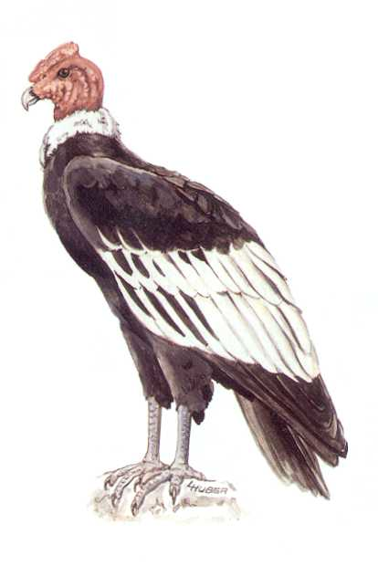
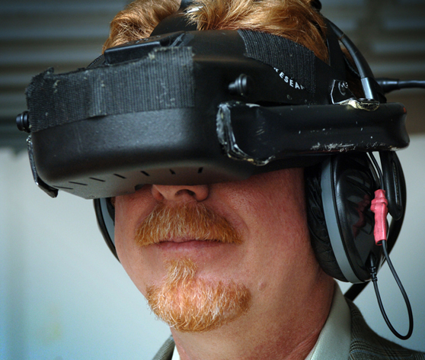
Virtual Condor
All of this has happened before, and all of this will happen again.
Some implementations exist
CoLinux (OU)
Grid Appliance (Florida)
Marquette’s VirtualBox solution
Some other ideas
Submit VM universe jobs as a “VM glide-in”
But Xen on Windows is a no go
… and VMWare has license problems in this mode
We’ve evaluated CoLinux
But, as Marquette noted, there’s some drawbacks

Slide 13
Virtual Condor
What we’ve implemented is a solution based on the Grid Appliance infrastructure from Florida’s ACIS lab
I won’t go into depth about this technology.. see Florida’s talk tomorrow
IPOP P2P network fabric
Solves NAT issues and IP space problems that come with bridged networking
No requirement for single VPN router to connect real network with the virtual overlay network.
We only need to run IPOP services (a userland application) on all central submit nodes to access nodes in the virtual pool

Slide 14
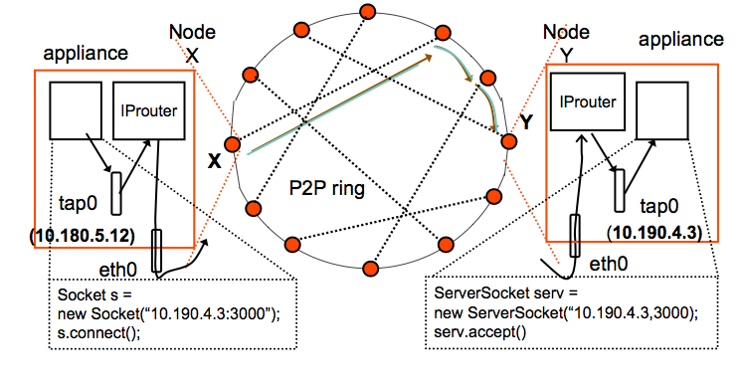
IPOP
http://www.acis.ufl.edu/~ipop/files/edu-docs/LocalGridAppliance2.pdf
http://www.acis.ufl.edu/~ipop/files/edu-docs/LocalGridAppliance2.pdf

Slide 15
Virtual Condor
For us and partners on campus, this is a win
Machine owners get their sandbox
Our support load to bring new machine owners online gets easier
Much of the support load with new “sites” is firewall and Condor permissions.
Virtual machines and the IPOP network makes that all go away.
Not only native installers for campus users, but now a VM image
With installer to run Vmware player as a service, an install systray app to connect keyboard and mouse to guest OS
Not Virtualization implementation dependent – we can prepare and distribute VM images with KVM, VirtualBox, Vmware, Xen, and so on.
Just VMWare currently
We’ll offer more in the future.

Slide 16
Manageability
So, given:
Thousands of virtual Linux systems out there not under central cluster management framework
Thousands upon thousands of Windows lab machines that research computing staff don’t administratively control..
How do we manage Condor on them?
We use Cycle Computing’s CycleServer
VM images are configured to report in to CycleServer for management
As are the native OS installers that we distribute
Notes:
Example for windows.. We wanted to turn on the setting to use TCP to update the collector on ALL windows nodes

Slide 17
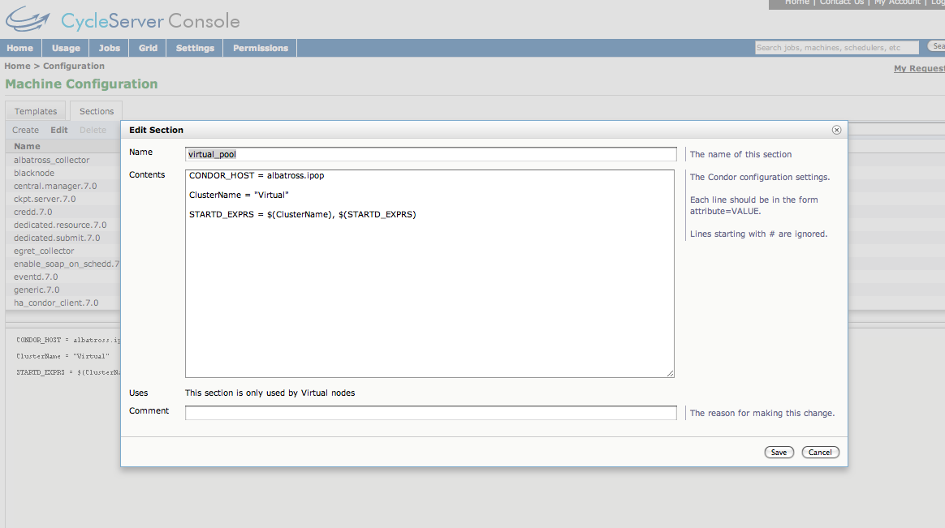
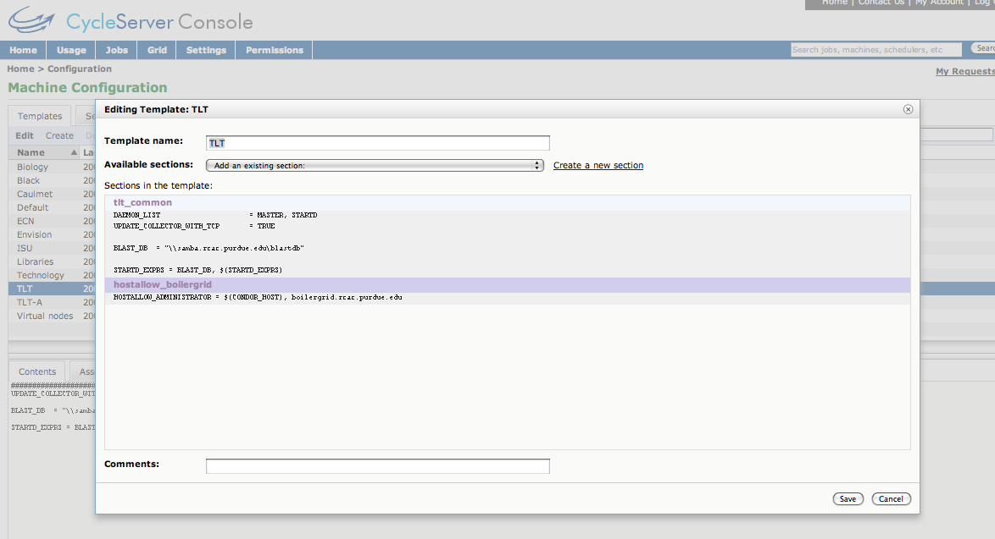
CycleServer

Slide 18
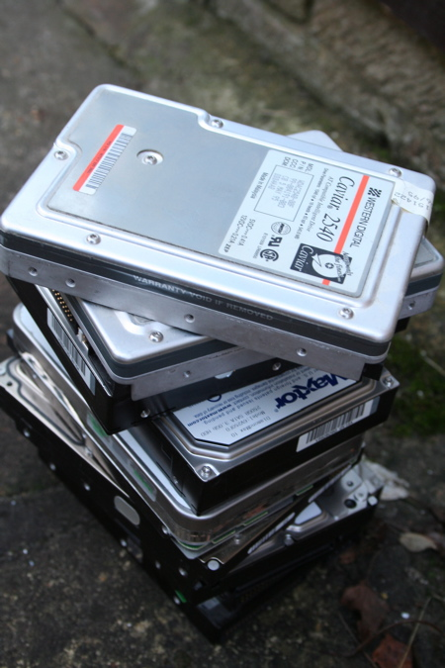
Bytes
Cycles are well understood, what about opportunistic bytes?
Our cluster nodes have 160+ GB boot disks.
Likewise with student labs
That’s over 300TB going unused
Newly deployed is an installation of Cycle’s CloudFS
Based on Hadoop
With FTP interface, FUSE filesystem interface, and S3-like REST interface
3TB testbed today
80TB deployment this summer
See Cycle Computing talk for further information

Slide 19
DiaGrid
New name for our effort to spread the campus grid gospel beyond Purdue’s borders
Perhaps institutions who wear red or green and may be rivals on the gridiron or hardwood wouldn’t like being in something named “Boiler”.
We’re regularly asked about implementing a Purdue-style campus grid at institutions without HPC on their campus.
Federate our campus grids into something far greater than what one institution can do alone
Can we use Condor to make a campus grid ^H^H^H^Hcloud across the entire Big 10?

Slide 20
DiaGrid Partners
Sure, it’d make a good basketball tournament…
Purdue - West Lafayette
Purdue Regionals
Calumet
North Central
IPFW
Indiana University
Notre Dame
Indiana State
Wisconsin (GLOW)
Via JobRouter
In progress: Louisville
Your Campus??

Slide 21
National scale: TeraGrid
The Purdue Condor Pool is a resource available for allocation to anybody in the nation today
NSF now recognizes high-thoughput computing resources as a critical part of the nation’s cyberinfrastructure portfolio going forward.
Not just Ranger-style megaclusters, XT5s, Blue Waters, etc, but loosely-coupled as well
NSF vision for HPC - Sharing among academic institutions to optimize the accessibility and use of HPC as supported at the campus level
This matches closely with our goal to spread the gospel of the campus grid via DiaGrid

Slide 22
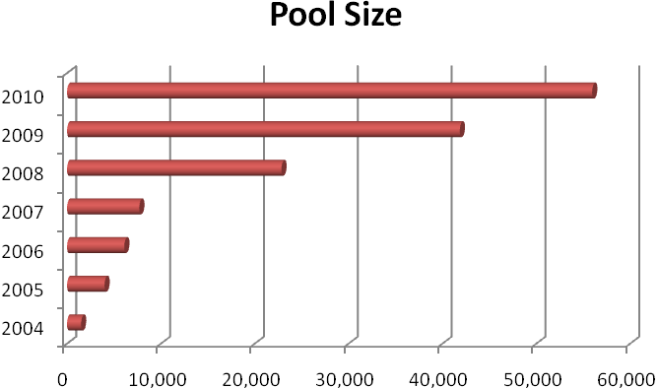
Gratuitous Numbers
12M hours delivered to users in 2008
12M jobs completed in 2008
23,000 slots today
This summer: 10k additional slots in new Community Cluster and student lab lifecycle upgrade
.5 Petaflops

Slide 23
The End
Questions?
http://www.rcac.purdue.edu/boilergrid

