Slide 1
BXGrid: A Data Repository and Computing Grid for Biometrics Research
Hoang Bui
University of Notre Dame

Slide 2
Overview
Biometrics Research
What is BXGrid?
BXGrid & Condor
Future Works
Questions
Notes:
What is biometrics?

Slide 3



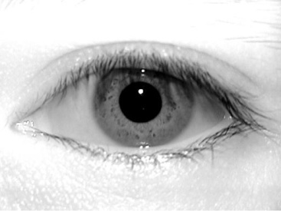
Biometric Research
Facial recognition
Iris recognition

Slide 4

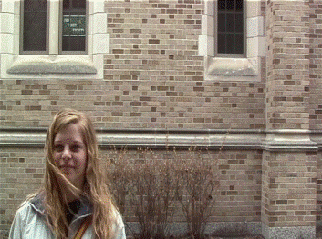

Acquisition process
Computer Vision Research Laboratory

Slide 6


Biometric Research
Now what?
  I have collected 100,000 irises.
  I have an algorithm to compare 2 irises
  I want evaluate my algorithm by comparing only brown irises
  First, I need to convert raw iris images to iris codes
  But I need to find all brown irises

Slide 7
BXGrid
Relational Database (2x)
Relational Database
How do I search for brown irises fast?
DBMS
Active Storage Cluster (16x)
Where do I store iris images?
Condor Pool (500x)
How do I evaluate my algorithm?
CPU
CPU
CPU
CPU
CPU
CPU
CPU
CPU

Slide 8
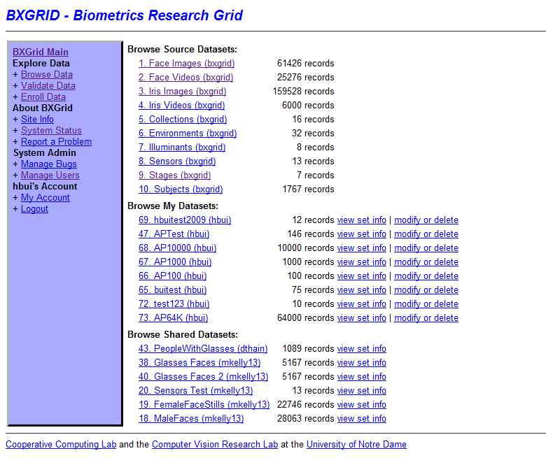

Slide 9
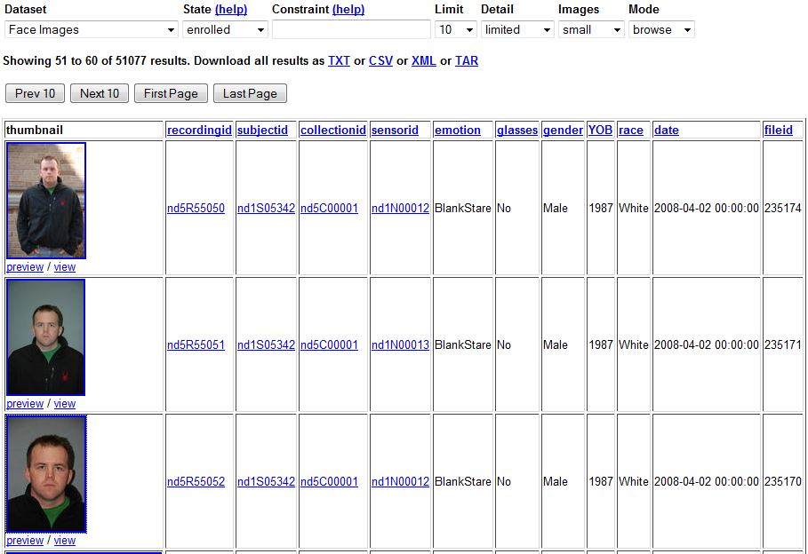

Slide 10
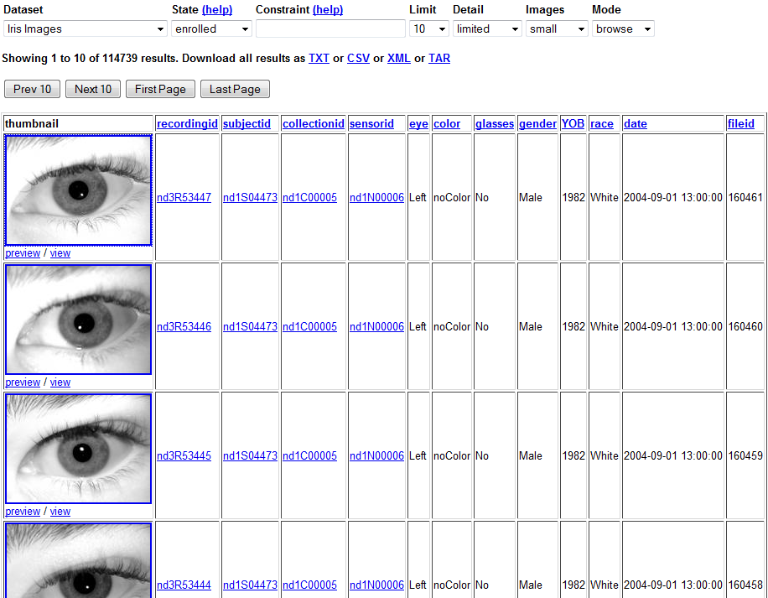
Notes:
1 recording page with metadata

Slide 11
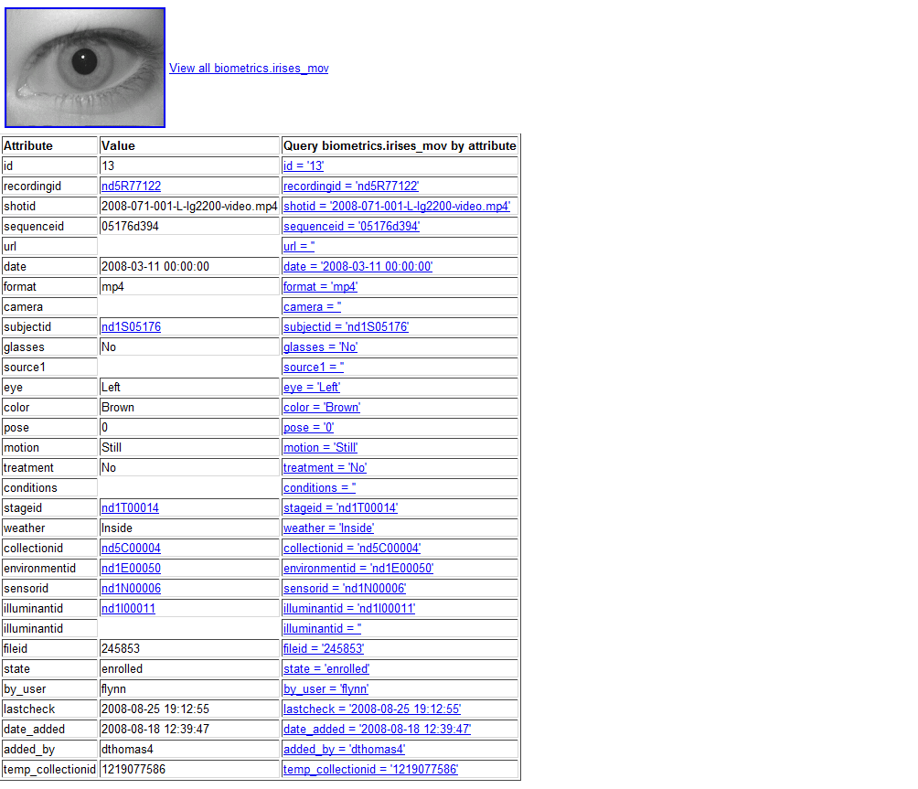

Slide 12
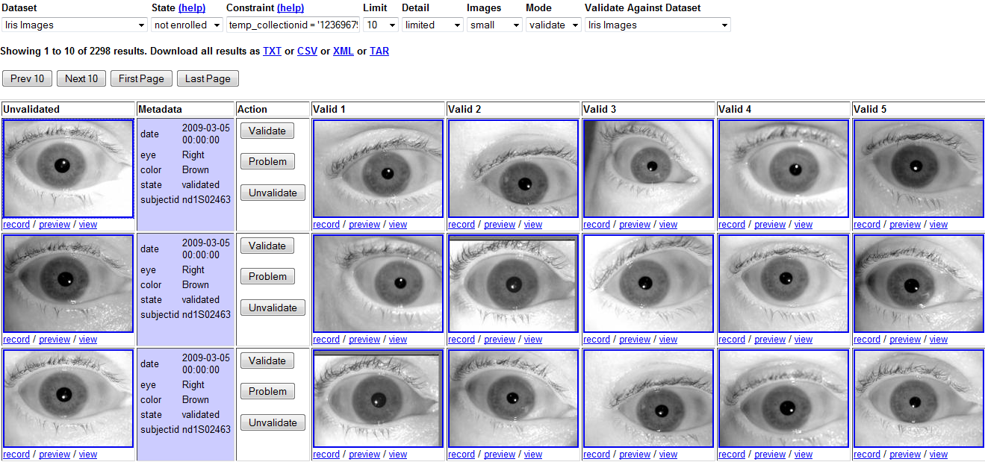

Slide 13
Workflow Abstractions
S = Select( color=“brown” )
B = Transform( S,F )
M = AllPairs( A, B, F )
eye
color
A1
A2
A3
L
brown
S1
F
B1
F
F
F
L
blue
ROC
Curve
S2
F
B2
F
F
F
R
brown
S3
F
B3
F
F
F
R
brown
Bui, Thomas, Kelly, Lyon, Flynn, Thain
BXGrid: A Repository and Experimental Abstraction… poster at IEEE eScience 2008

Slide 14
Transform Abstraction
  B = Transform( S,F )
    Transform set S into set B using function F
  Single PC and 100,000 iris images
  Core 2 Duo 1.8Ghz 1GB RAM PC
  6 seconds/transform→ 170 hours
  Storage: 30GB
Let’s use Condor
You want to:
  Do it faster
  Manage resource properly

Slide 15
Fileservers
Condor pool
J1
J2
J3
J
J
J1
JN
User Local Machine

Slide 16
Fileservers
Condor pool
J1
J2
J2
J3
J
J
J1
JN
JN+1
Wait()
User Local Machine

Slide 17
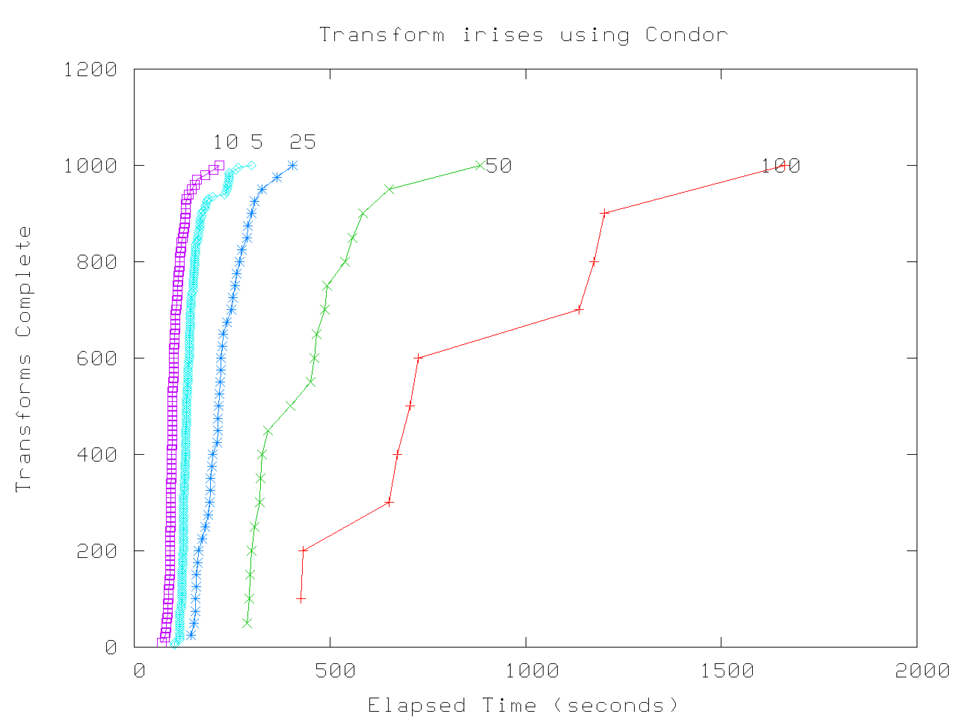
Result

Slide 18
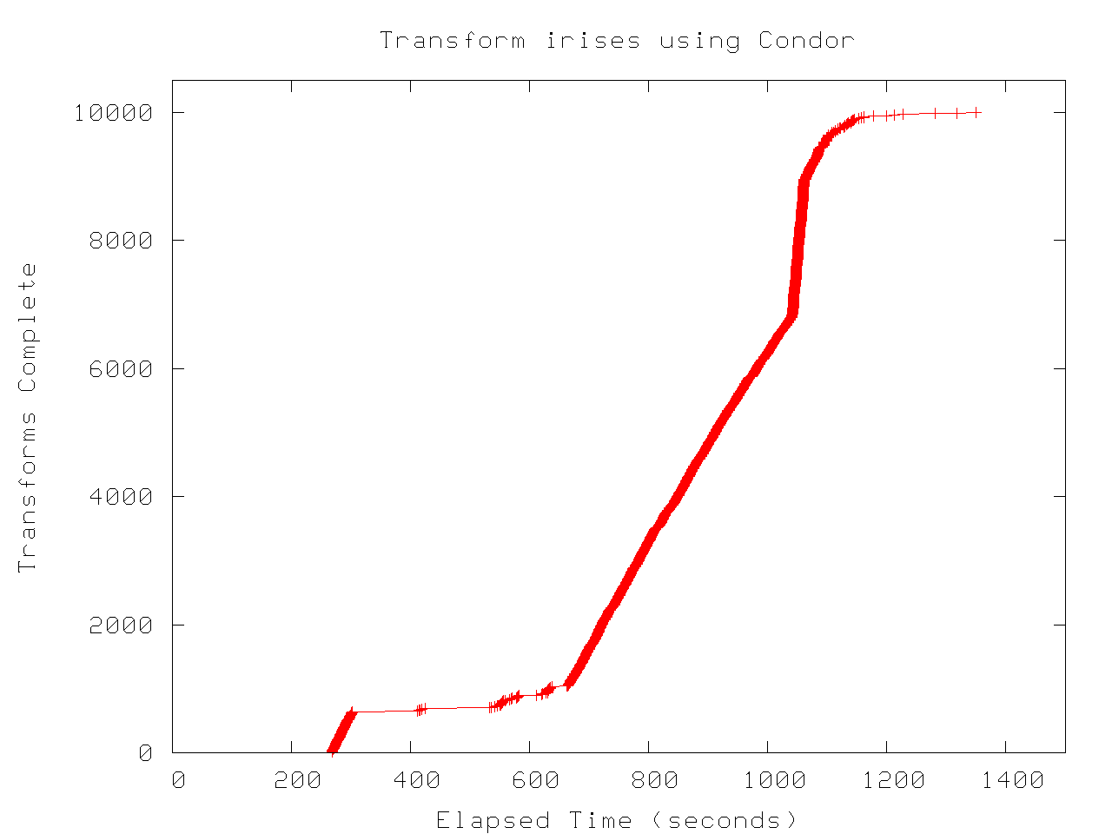

Slide 19
Transform Summary
Use up to 1GB local storage
Transform 10,000 irises
  Single PC: 60,000 seconds
  Condor: 1400 seconds
Speedup: ~43 times

Slide 20
AllPairs Abstraction
AllPairs( set A, set B, function F )
returns matrix M where
M[i][j] = F( A[i], B[j] ) for all i,j
A1
A1
A2
A3
A1
An
AllPairs(A,B,F)
B1
F
F
F
B1
B1
Bn
B2
F
F
F
F
B3
F
F
F

Slide 21
AllPairs Result
10,000 irises vs. 10,000 irises
Condor pool: 32 nodes
AllPairs took 150 minutes to complete 100,000,000 comparisons
Speedup: ~ 7 times

Slide 22
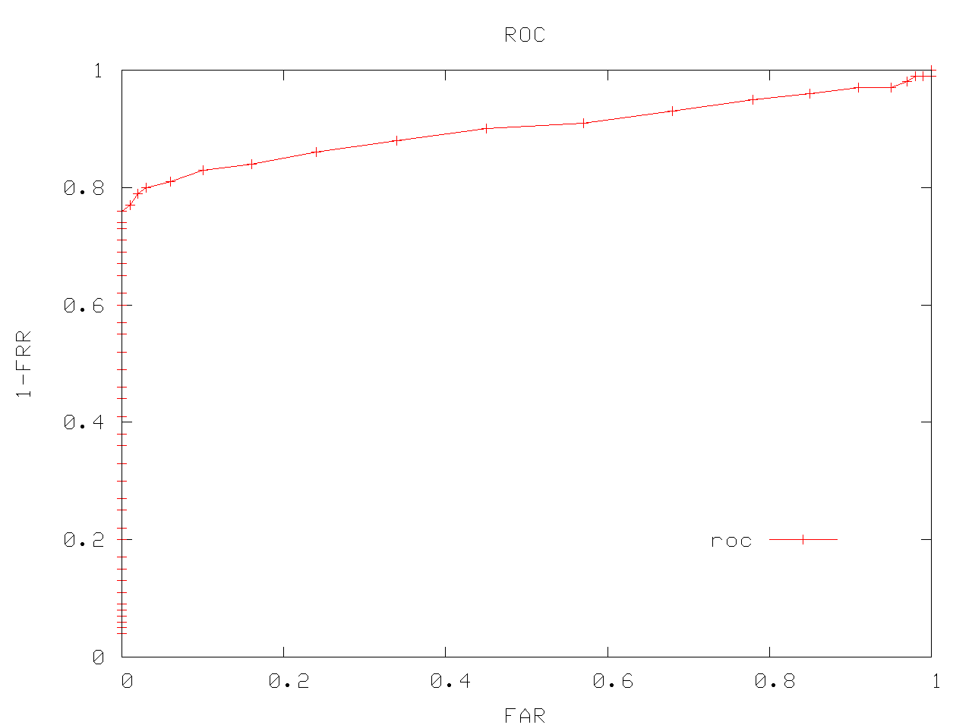
ROC Cruve

Slide 23
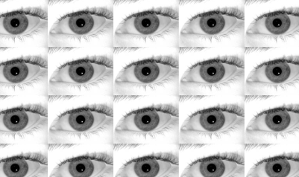
Workflow Summary
Result Matrix
Iris
Iris Code
A1
A2
A3
B1
F
F
F
Transform
AllPairs
Condor
Condor
B2
F
F
F
B3
F
F
F
Storage Cluster

Slide 24
Future Works
Run bigger Transform & All-Pairs experiments
Using Condor to perform Automated Validation
Extend the repository for other types of data

Slide 26
Acknowledgments
Cooperative Computing Lab
  http://www.cse.nd.edu/~ccl
BXGrid
  http://bxgrid.cse.nd.edu
Faculty:
  Douglas Thain
  Patrick Flynn
Grad Students
  Chris Moretti
  Li Yu
  Deborah Thomas
  Karen Hollingswort
  Tanya Peters
Undergrads & Staff
  Mike Kelly
  Rory Carmichael
  Mark Pasquier
  Christopher Lyon
  Diane Wright

Slide 27
Question

