Slide 1
Zettabyte Reliability with Flexible End-to-end Data Integrity
Yupu Zhang, Daniel Myers,
Andrea Arpaci-Dusseau, Remzi Arpaci-Dusseau
University of Wisconsin - Madison

Slide 2
Data Corruption
Imperfect hardware
Disk, memory, controllers [Bairavasundaram07, Schroeder09, Anderson03]
Buggy software
Kernel, file system, firmware [Engler01, Yang04, Weinberg04]
Techniques to maintain data integrity
Detection: Checksums [Stein01, Bartlett04]
Recovery: RAID [Patterson88, Corbett04]

Slide 3
In Reality
Corruption still occurs and goes undetected
Existing checks are usually isolated
High-level checks are limited (e.g, ZFS)
Comprehensive protection is needed
Memory ECC
Disk
ECC
Isolated Protection
Limited Protection

Slide 4
Previous State of the Art
End-to-end Data Integrity
Checksum for each data block is generated and verified by application
Same checksum protects data throughout entire stack
A strong checksum is usually preferred
Write Path
Read Path

Slide 5
Two Drawbacks
Performance
Repeatedly accessing data from in-memory cache
Strong checksum means high overhead
Timeliness
It is too late to recover from the corruption that occurs before a block is written to disk
Generate
Checksum
Verify
Checksum
FAIL
Write Path
unbounded
time
Read Path

Slide 6
Flexible End-to-end Data Integrity
Goal: balance performance and reliability
Change checksum across components or over time
Performance
Fast but weaker checksum for in-memory data
Slow but stronger checksum for on-disk data
Timeliness
Each component is aware of the checksum
Verification can catch corruption in time

Slide 7
Our contribution
Modeling
Framework to reason about reliability of storage systems
Reliability goal: Zettabyte Reliability
at most one undetected corruption per Zettabyte read
Design and implementation
Zettabyte-Reliable ZFS (Z²FS)
ZFS with flexible end-to-end data integrity

Slide 8
Results
Reliability
Z²FS is able to provide Zettabyte reliability
ZFS: $\sim$ Pettabyte at best
Z²FS detects and recovers from corruption in time
Performance
Comparable to ZFS (less than 10% overhead)
Overall faster than the straightforward end-to-end approach (up to 17% in some cases)

Slide 9
Outline
Introduction
Analytical Framework
Overview
Example
From ZFS to Z²FS
Implementation
Evaluation
Conclusion

Slide 10
Overview of the Framework
Goal
Analytically evaluate and compare reliability of storage systems
Silent Data Corruption
Corruption that is undetected by existing checks
Metric: $P_{undetected}$
Probability of undetected data corruption when reading a data block from system (per I/O)
Reliability Score = $−\log_{10}(P_{undetected})$

Slide 11
Models for the Framework
Hard disk
Undetected Bit Error Rate ($UBER$)
Stable, not related to time
Disk Reliability Index = $−\log_{10}(UBER)$
Memory
Failure in Time (FIT) / Mbit ($Failure Rate$)
Longer residency time, more likely corrupted
Memory Reliability Index = $−\log_{10} (Failure Rate)$
Checksum
Probability of undetected corruption on a device with a checksum

Slide 12
Calculating $P_{undetected}$
Focus on lifetime of block
From it being generated to it being read
Across multiple components
Find all silent corruption scenarios
$P_{undetected}$ is sum of probabilities of each silent corruption scenario during lifetime of block in storage system

Slide 13
Reliability Goal
Ideally, $P_{undetected}$ should be 0
It’s impossible
Goal: Zettabyte Reliability
At most one SDC when reading one Zettabyte data from a storage system
$P_{undetected}=P_{goal}=3.46 ×{10}^{−18}$
Assuming a data block is 4KB
Reliability Score is 17.5
100MB/s => 2.8 x 10⁻⁶ SDC/year
$\sim$17 nines

Slide 14
Outline
Introduction
Analytical Framework
Overview
Example
From ZFS to Z²FS
Implementation
Evaluation
Conclusion

Slide 15
Sample Systems
Disk Reliability Index = $10\sim 20$
Regular disk: 12
Memory Reliability Index = $13.4\sim 18.8$
non-ECC memory: 14.2
ECC memory: 18.8
Name | Reliability Index |  | Description
 | Memory | Disk
Worst | 13.4 | 10 | Worst memory & worst disk
Consumer | 14.2 | 12 | Non-ECC memory & regular disk
Server | 18.8 | 12 | ECC memory & regular disk
Best | 18.8 | 20 | ECC memory & best disk

Slide 16
Example
write()
read()
MEM
DISK
t₀
t₁
t₂
t₃
Assuming there is only one corruption in each scenario
Each time period is a scenario
$P_{undetected}$ = sum of probabilities of each time period
Assuming $t_{1}−t_{0}=30$ seconds (flushing interval)
Residency Time: $t_{resident}=t_{3}−t_{2}$

Slide 17
Example (cont.)
Reliability Score ($t_{resident}=1$)
Best
Goal: Zettabyte Reliability
score: 17.5
none achieves the goal
Server & Consumer
disk corruption dominates
need to protect disk data
Consumer
Server
Worst

Slide 18
Outline
Introduction
Analytical Framework
From ZFS to Z²FS
Original ZFS
End-to-end ZFS
Z²FS : ZFS with flexible end-to-end data integrity
Implementation
Evaluation
Conclusion

Slide 19
ZFS
Fletcher
write()
read()
MEM
DISK
t₀
t₁
t₂
t₃
Generate
Verify
Only on-disk blocks are protected

Slide 20
ZFS (cont.)
Reliability Score ($t_{resident}=1$)
Best
Goal: Zettabyte Reliability
score: 17.5
Best: only Petabyte
Now memory corruption dominates
need end-to-end protection
Consumer
Server
Worst

Slide 21
Outline
Introduction
Analytical Framework
From ZFS to Z²FS
Original ZFS
End-to-end ZFS
Z²FS : ZFS with flexible end-to-end data integrity
Implementation
Evaluation
Conclusion

Slide 22
End-to-end ZFS
Fletcher / xor
write()
read()
MEM
DISK
t₀
t₁
t₂
t₃
Generate
Verify
Checksum is generated and verified only by application
Only one type of checksum is used (Fletcher or xor)

Slide 23
End-to-end ZFS (cont.)
Reliability Score ($t_{resident}=1$)
Best
Best
Consumer
Consumer
Server
Server
Worst
Worst
Fletcher
xor
provide best reliability
just fall short of the goal

Slide 24
Performance Issue
End-to-end ZFS (Fletcher) is 15% slower than ZFS
End-to-end ZFS (xor) has only 3% overhead
xor is optimized by the checksum-on-copy technique [Chu96]
System | Throughput (MB/s) | Normalized
Original ZFS | 656.67 | 100%
End-to-end ZFS (Fletcher) | 558.22 | 85%
End-to-end ZFS (xor) | 639.89 | 97%
Read 1GB Data from Page Cache

Slide 25
Outline
Introduction
Analytical Framework
From ZFS to Z²FS
Original ZFS
End-to-end ZFS
Z²FS : ZFS with flexible end-to-end data integrity
Implementation
Evaluation
Conclusion

Slide 26
Z²FS Overview
Goal
Reduce performance overhead
Still achieve Zettabyte reliability
Implementation of flexible end-to-end
Static mode: change checksum across components
xor as memory checksum and Fletcher as disk checksum
Dynamic mode: change checksum overtime
For memory checksum, switch from xor to Fletcher after a certain period of time
Longer residency time => data more likely being corrupt

Slide 27
Static Mode
Fletcher
xor
write()
read()
MEM
DISK
t₀
t₁
t₂
t₃
Generate
Generate
Checksum
Chaining
Verify
Verify
Verify

Slide 28
Static Mode (cont.)
Reliability Score ($t_{resident}=1$)
Worst
use Fletcher all the way
Server & Best
xor is good enough as memory checksum
Consumer
may drop below the goal as $t_{resident}$ increases
Best
Consumer
Server
Worst

Slide 29
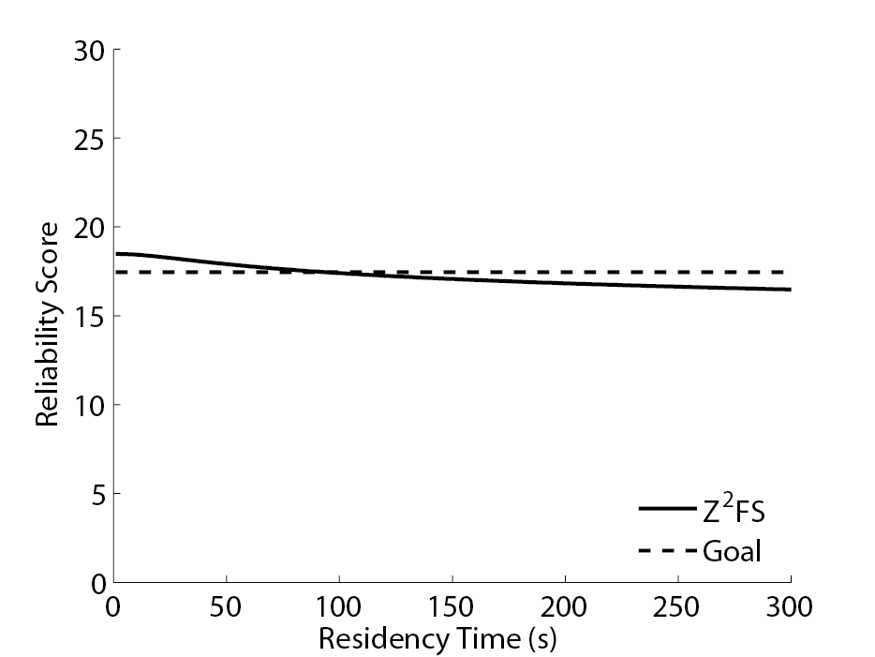
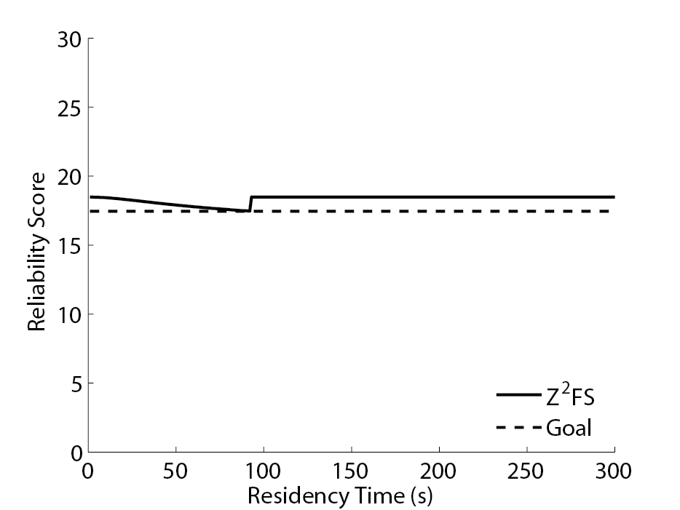
Evolving to Dynamic Mode
Reliability Score vs $t_{resident}$ for consumer
92 sec
92 sec
Static
Dynamic
switching the memory checksum from xor to Fletcher after 92 sec

Slide 30
Dynamic Mode
Fletcher
xor
write()
read()
t_{switch}
MEM
DISK
t₀
t₁
t₂
t₃
t₄
Generate
Generate
Verify
Verify
Verify
Verify
xor
Fletcher

Slide 31
Outline
Introduction
Analytical Framework
From ZFS to Z²FS
Implementation
Evaluation
Conclusion

Slide 32
Implementation
Attach checksum to all buffers
User buffer, data page and disk block
Checksum handling
Checksum chaining & checksum switching
Interfaces
Checksum-aware system calls (for better protection)
Checksum-oblivious APIs (for compatibility)
LOC : $\sim$6500

Slide 33
Outline
Introduction
Analytical Framework
From ZFS to Z²FS
Evaluation
Conclusion

Slide 34
Evaluation
Q1: How does Z²FS handle data corruption?
Fault injection experiment
Q2: What’s the overall performance of Z²FS?
Micro and macro benchmarks

Slide 35
Fault Injection: Z²FS
Fletcher
xor
write()
MEM
DISK
t₀
t₁
Generate
Generate
Verify
FAIL
Ask the application to rewrite

Slide 36
Overall Performance
read a 1 GB file
Warm Read-intensive
Dominately by
Random I/Os
Better protection usually means higher overhead
Z²FS helps to reduce the overhead, especially for warm reads

Slide 37
Outline
Introduction
Analytical Framework
From ZFS to Z²FS
Evaluation
Conclusion

Slide 38
Summary
Problem of straightforward end-to-end data integrity
Slow performance
Untimely detection and recovery
Solution: Flexible end-to-end data integrity
Change checksums across component or overtime
Analytical Framework
Provide insight about reliability of storage systems
Implementation of Z²FS
Reduce overhead while still achieve Zettabyte reliability
Offer early detection and recovery

Slide 39
Conclusion
End-to-end data integrity provides comprehensive data protection
One “checksum” may not always fit all
e.g. strong checksum => high overhead
Flexibility balances reliability and performance
Every device is different
Choose the best checksum based on device reliability

Slide 40
Thank you!
Questions?
Advanced Systems Lab (ADSL)
University of Wisconsin-Madison
http://www.cs.wisc.edu/adsl
Wisconsin Institute on Software-defined Datacenters in Madison
http://wisdom.cs.wisc.edu/

