Slide 1


An Analysis of Persistent Memory Use with WHISPER
Sanketh Nalli, Swapnil Haria Michael M. Swift, Mark D. Hill
Haris Volos*, Kimberly Keeton*
University of Wisconsin-Madison &
*Hewlett-Packard Labs (HPL)
Notes:
Good Morning, I am Sanketh & Today we’ll see how applications use persistent memory.
This is joint work with Swapnil, my advisors Mike and Mark and HP Enterprise.

Slide 2
WHISPER
Facilitate better system support for Persistent Memory
Wisconsin-HP Labs Suite for Persistence
Discovered behaviors:
4% accesses to PM, 96% accesses to DRAM
5-50 epochs/tx, contributed by memory allocation & logging
Re-referencing PM cachelines: Rare across threads, common within a thread
WHISPER: research.cs.wisc.edu/multifacet/whisper

Slide 3
Outline
WHISPER: Wisconsin-HP Labs Suite for Persistence
Analysis
Results

Slide 4
Persistent Memory is coming soon
Persistent Memory = NVM attached to CPU on memory bus
Offers low latency reads and persistent writes
Allows user-level, byte-addressable loads and stores
Notes:
Font size : 24
Color consistency
No space before colon

Slide 5
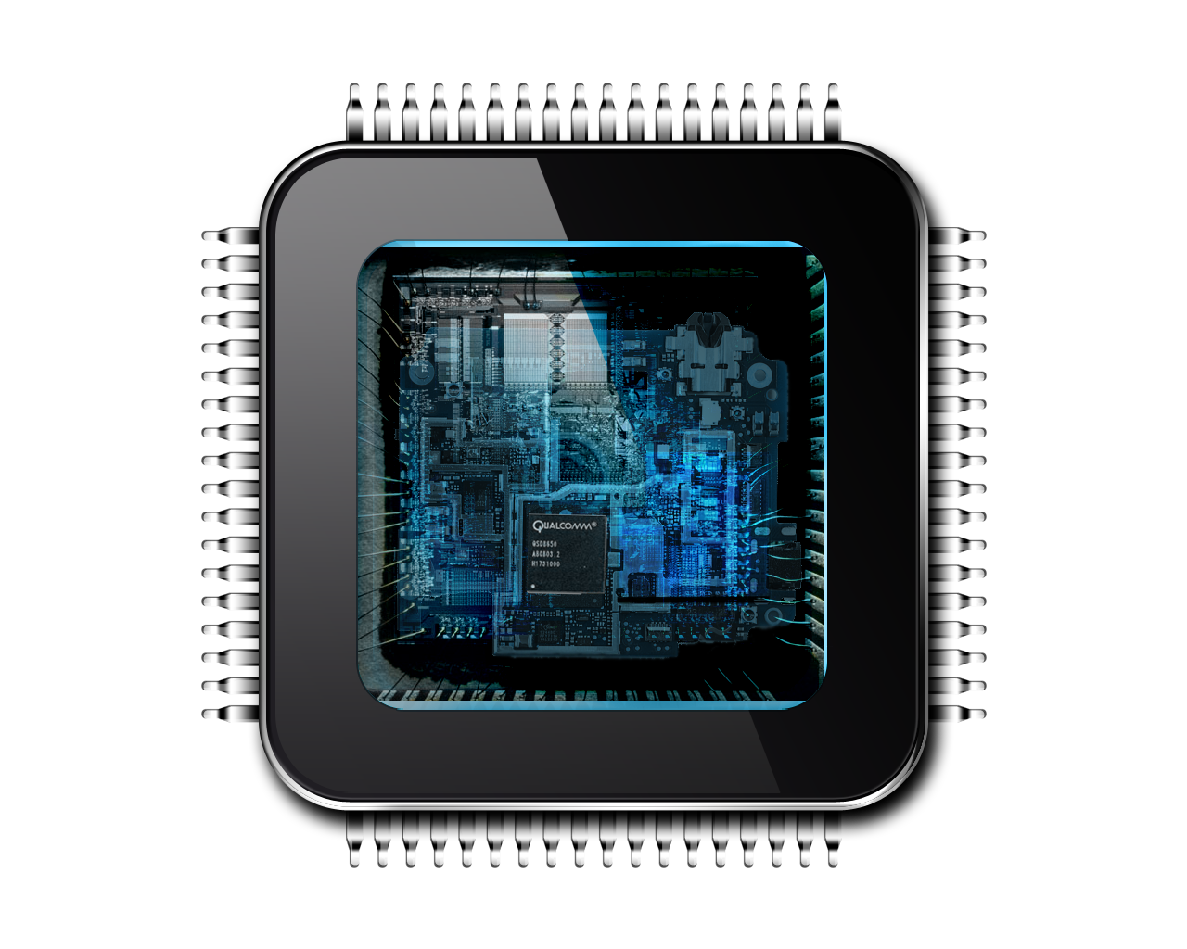
What guarantees do applications need ?
Durability = Content is available to user after failure
Consistency = Content is recoverable and usable after failure
Data
PM
CACHE
Data
Pointer
Pointer
Pointer
1 . Data update followed by pointer update in cache
2. Pointer is evicted from cache to PM
3. Data lost on failure, dangling pointer persists

Slide 6
Achieving consistency
Data
PM
Data
Data
Data
flush
Pointer
flush
Pointer
2 . Flush data update to PM
3 . Store pointer update in cache
4 . Flush pointer update to PM
1 . Store data update in cache
Ordering = Useful building block of consistency mechanisms
Epoch = Set of writes to PM guaranteed to be durable before ANY writes to PM in following epochs become durable
Ordering primitives: sfence, mfence of x86-64

Slide 7
PM systems for consistency
Native
Application-specific optimizations
Persistent Heaps
Atomic allocations, type safety
PM-aware Filesystems
POSIX interface
Application
load/ store
TX
TX
NVML
Mnemosyne
read/write
load/store
VFS
ext4-DAX
PMFS
Persistent Memory (PM)

Slide 8
What’s the problem ?
Lack of standard workloads slows research
Micro-benchmarks may not be representative
Partial understanding of how applications use PM

Slide 9
WHISPER
Benchmark | Type | Brief description (*Adapted to PM)
N-store* | Database | H-store like DB. Undo logs for consistency
Echo* | KV store | Scalable, multi-version key-value store
Memcached* | Mnemosyne | Distributed key-value store
Vacation* | Mnemosyne | Online travel reservation system
Redis | NVML | REmote Dictionary Service
C-tree | NVML | Microbenchmarks for simulations
Hashmap | NVML | Microbenchmarks for simulations
NFS | PMFS | Linux server/client for remote file access
Exim | PMFS | Mail server;stores mails in per-user file
MySQL | PMFS | Widely used RDBMS for OLTP

Slide 10
Outline
WHISPER: Wisconsin-HP Labs Suite for Persistence
Analysis
Results
✔

Slide 11
Identify writes to PM
PIN/mmiotrace
PM Application
PM Runtime
PM Writes
Identify
Instrument
Execute
Trace
Analyze
Stats
PIN for userspace, mmiotrace for the kernel
On average, 101 lines in applications that update PM
67 line in the kernel that update PM

Slide 12
Instrument writes to PM
PIN/mmiotrace
PM Application
PM Runtime
PM Writes
Identify
Instrument
Execute
Trace
Analyze
Stats
C macros capture all modes of updating PM and,
PM transaction start/end, cacheline flushes, fences
Example: Update and persist size of filesystem journal
log.size = size; flush_buffer(log.size); asm(“sfence”);
PM_SET(log.size, size); PM_FLUSH(log.size, 8); PM_FENCE();

Slide 13
Execute and Analyze
PIN/mmiotrace
PM Application
PM Runtime
PM Writes
Identify
Instrument
Execute
Trace
Analyze
Stats
Python analyzer and dependency-checker
Analyze trace for several statistics
Number of epochs/tx
Epoch dependencies
Epoch sizes

Slide 14
Outline
WHISPER: Wisconsin-HP Labs Suite for Persistence
Analysis
Results
✔
✔

Slide 15
How many accesses to PM ?
Suggestion: Do not impede volatile accesses

Slide 16
How many epochs/transaction ?
Durability after every epoch is impedes execution
Assumption: 3 epochs/TX = log + data + commit
Reality: 5 to 50 epochs/TX
Highest rate of epochs: Native & TM libraries
Suggestion: Enforce durability only at the end of a transaction

Slide 17
How large are epochs typically ?
# of 64B cachelines
Determines amount of state buffered per epoch
Small epochs are abundant
75% update single cacheline
Large epochs in PMFS
Suggestion: Consider optimizing for small epochs

Slide 18
What contributes to epochs ?
Log entries
Undo log: Alternating epochs of log and data
Redo log: 1 Log epoch + 1 data epoch
Persistent memory allocation
1 to 5 epochs
Suggestion: Use redo logs and reduce epochs
from memory allocator

Slide 19
What are epoch dependencies ?
1
Self-dependency: B → D
Cross-dependency: 2 → C
Why do they matter ?
Dependency can stall execution
Measured dependencies in 50 us window
A
B
2
C
3
D
Thread 1
Thread 2

Slide 20
How common are dependencies ?
Suggestion: Design multi-versioned caches OR avoid updating same cacheline across epochs

Slide 21
Summary
WHISPER: Wisconsin-HP Labs Suite for Persistence
4% accesses to PM, 96% accesses to DRAM
5-50 epochs/TX, primarily small in size
Memory allocation, logging introduce extra epochs
Cross-dependencies rare, self-dependencies common
More results in ASPLOS’17 paper and code at:
research.cs.wisc.edu/multifacet/whisper/

Slide 22
Extra

Slide 23
A Simple Transaction using Epochs
transaction_begin:
log[pobj.init] ← True log[pobj.data] ← 42
write_back(log)
wait_for_write_back()
pobj.init ← True
pobj.data ← 42
write_back(pobj)
wait_for_write_back()
transaction_end;
Epoch 1
Log entries stored & persisted.
TM_BEGIN();
pobj.data = 42;
pobj.init = True;
TM_END();
Epoch 2
Variables stored & persisted.

Slide 24
Runtimes cause write amplification
PMFS
Mnemosyne
Logs every PM write
PMFS
NVML
Clears log
Auxiliary structures
< 5% writes to PM
Non-temporal writes
Mnemosyne logs
PMFS user-data
Notes:
PM is vaporware, will come soon but not from intel
Don’t do whisper 2.0, look at something else as part of your grad school
Contribution. Benchmarks, allocators are not that exciting. Intel is doing
Rudimentary stuff. Language level persistence, compiler level persistence
Is an open problem. Compare diff tx libs and say why are they different
Or why are they same. Increasing server throuhput is more important than
User perceived latency. Msr uses battery backed dram. Companies don’t want
To scale out. They don’t want to buy more servers but pack them with more memory,
To save cost and fill as much memory in a tiny space.
Look at persistent memory manager. With big memory servers, mapping is a problem.
Windows has DAX. Micron has shown interest, not apple.
Facebook was more concerned about tail latency.
Os kernel team google

