Slide 1
Hands-Off Persistence System (HOPS)
Swapnil Haria¹, Sanketh Nalli¹, Haris Volos²,
Kim Keeton², Mark D. Hill¹, Mike M. Swift¹
¹ University of Wisconsin-Madison
² Hewlett Packard Labs
Notes:
Hey Everyone, today I will be describing our new hardware design for simplifying the programming of PM system.

Slide 2
WHISPER Analysis HOPS Design
4% accesses to PM, 96% to DRAM
Volatile memory hierarchy (almost) unchanged
5-50 epochs/transaction
Order epochs without flushing
Self-dependencies common
Allows multiple copies of same cacheline
Cross-dependencies rare
Correct, conservative method based on coherence
Notes:
Analysis preceeds good design. Our analysis of PM applications from the WHISPER suite, which I will recap now, guides our design of the HOPS.
We observed that a majority of accesses are to DRAM. Thus, any HW support for PM should not hurt the performance of volatile accesses. For example, this precludes adding state to the caches which would increase the access latency of all accesses. Thus, HOPS leaves the volatile memory structures untouched.
We noticed that transactions can comprise as many as 50 epochs, resulting in frequent flushing and low performance. But these greatly simply the programming of PM systems. So HOPS provides a mechanism for ordering epochs without flushing.
We found that self-dependencies are common for epochs updating logs and metadata. Thus to avoid flushing, HOPS allows multiple copies of the same cacheline to co-exist.
Finally we saw that cross-thread dependencies are quite rare. For correctness, HOPS uses a conservative method based on coherence to track these dependencies.

Slide 3
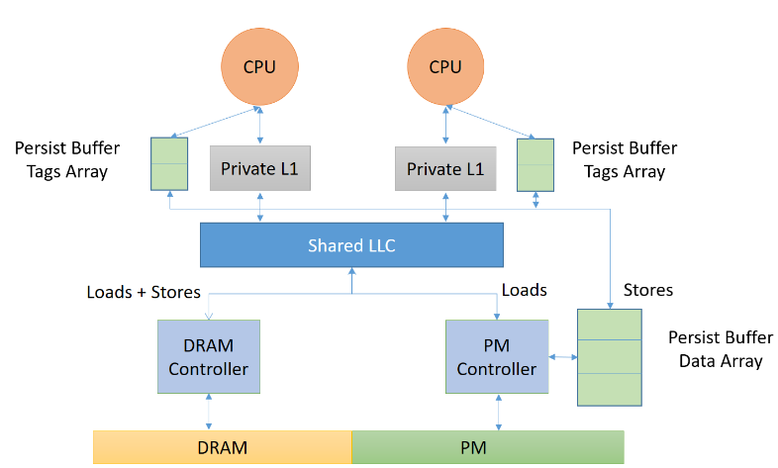
Outline
PM
HEAD
?
C
A
B
Motivation
HOPS Design
Evaluation

Slide 4
ACID Transactions (currently)
Acquire Lock
Prepare Log Entry
1
N
FLUSH EPOCH
1
Mutate Data Structure
N
FLUSH EPOCH
Commit Transaction
FLUSH EPOCH
Release Lock
Notes:
While PM promises the best of both worlds - Disk and DRAM, it is quite tricky to program these systems. For crash-consistent and recoverable applications, programmers are forced to worry about flushing cachelines in the right order, and fencing properly. Thankfully, Libraries like Mnemosyne and NVML help by supporting ACID transactions, which simplify programming tremendously.

Slide 5
Base System
CPU 0
CPU 1
Private L1
Private L1
Shared LLC
DRAM Controller
PM Controller
Volatile
Persistent
Notes:
To understand why flushes are expensive, let's consider our system first. The address space would be partitioned into volatile and persistent regions. Each of these regions will be managed by one or multiple memory controllers. The cores will interact with these via the coherent cache hierarchy.

Slide 6
Base System: Flush
1. Flush A
CPU 0
CPU 1
1. Flush A
2. Flush B
A=1
Writeback A
Flush ACK
DRAM Controller
PM Controller
Long Latency PM Write
Volatile
Persistent
Notes:
When a CPU issues a flush request, the dirty cacheline is written back from one level of the hierarchy to the next, all the way to the PM controller. There is a long-latency PM write, after which the ACK has to propagate back before the core can proceed. Flushes can be overlapped, but only within an epoch, so it doesn’t help much.

Slide 7
Outline
PM
HEAD
?
C
A
B
Motivation
HOPS Design
Evaluation

Slide 8
Hands-off Persistence System (HOPS)
Volatile memory hierarchy (almost) unchanged
Order epochs without flushing
Allows multiple copies of same cacheline
Correct, conservative method for handling cross-dependencies
Notes:
Let’s take a look at our proposal now.
To avoid touching volatile memory, we add a new path for persistent writes to propagate to PM.

Slide 9
Base System + Persist Buffers
Base System
CPU
CPU
Persist Buffer
Front End
Persist Buffer
Front End
Private L1
Private L1
Shared LLC
+
Loads + Stores
Loads
Stores
DRAM Controller
PM Controller
Persist Buffer
Back End
Volatile
Persistent
Notes:
Unlike non-temporal writes, this new path is redundant to the caches and enforces ordering. These Persist Buffers are responsible for propagating PM writes to the PM in order. PM stores also update the volatile caches, but this is only to serve data reuse. Caches do not write back to PM.

Slide 10
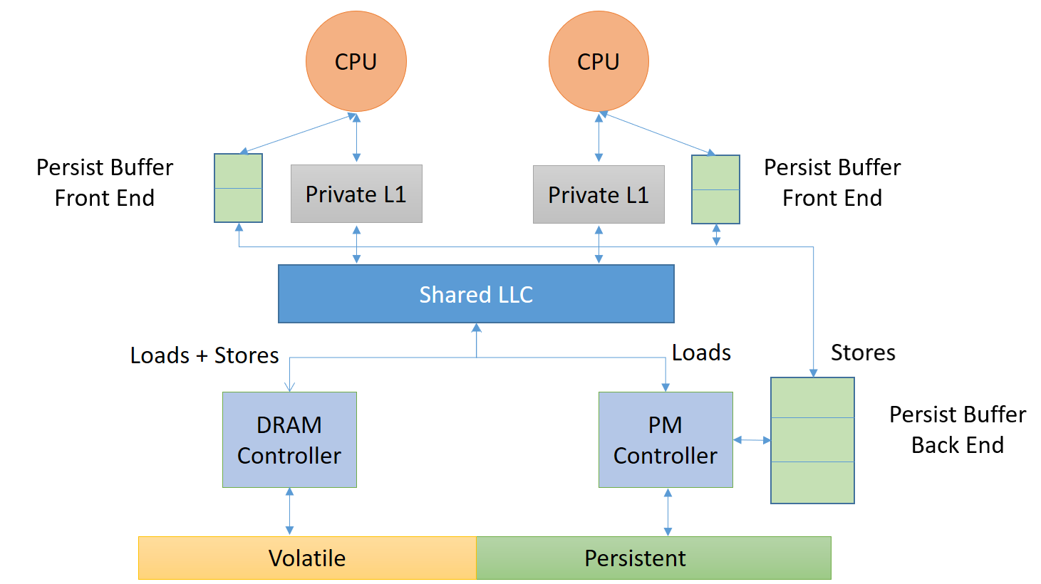
Persist Buffers
Volatile buffers
Front End (per-thread)
Address, Ordering Info
Back End (per-MC)
Cacheline data
Enqueue/Dequeue only
Not fully-associative
Notes:
Looking more closely at our PBs, they are volatile. They are split into the Front End, which is a small per-thread structure located at the L1 caches, which contain the address and some ordering infomation. The Back-End is much larger and is stored with the MCs, and stores the cacheline data for each entry. The Persist Buffers only needs to support enqueue and dequeue operations, and so they are not fully-associative structures.

Slide 11
Hands-off Persistence System (HOPS)
Volatile memory hierarchy (almost) unchanged
Order epochs without flushing
Allows multiple copies of same cacheline
Correct, conservative method for handling cross-dependencies
Notes:
For efficient transactions, we want to order epochs without flushing.

Slide 12
OFENCE: Ordering Fence
Orders stores preceding OFENCE before later stores
OFENCE
Thread 1
Thread 1
Volatile Memory Order
ST A=1
ST B=2
Time
Persistence Order
ST A=1
ST B=2
Happens Before
Notes:
We use a primitive also found in other recent proposals. The ordering FENCE orders stores without making them durable synchronously. We can implement this very efficiently.

Slide 13
Base System + Persist Buffers
CPU
CPU
Persist Buffer
Front End
Persist Buffer
Front End
Private L1
Private L1
Shared LLC
Loads + Stores
Stores
Loads
DRAM Controller
PM Controller
Persist Buffer
Back End
Volatile
Persistent
Notes:
To see how this works, let's zoom in on our persist buffers. We combine the persist buffers in our examples for simplicity.

Slide 14
Ordering Epochs without Flushing
ST A = 1
ST B = 1
LD R1 = A
OFENCE
ST A = 2
CPU 1
Local TS
25
26
A = 2
A = 1
B = 1
A = 2 26
B = 1 25
A = 1 25
L1 Cache
Persist Buffer
Notes:
A timestamp mechanism is utilized to order epochs. The local timestamp register contains the epoch timestamp of the currently inflight epoch, which is 25 in this example. CPU 1 is executing two epochs. Store A and B from the first epoch update the cache as well as the PB. The timestamp 25 is stored as part of each of their PB entries. The OFENCE simply marks the end of the epoch by incrementing the timestamp register to 26. The second epoch also has a store to A which clobbers the value in the caches, while creating a new PB entry.

Slide 15
ACID Transactions in HOPS
Acquire Lock
Volatile Writes
Prepare Log Entry
1
N
Persistent Writes
1
Mutate Data Structure
N
OFENCE
Commit Transaction
NOT DURABLE!
Release Lock
Notes:
So now we can have fast ACID transactions. SUPERB. WRONG. We forgot to guarantee durability. To solve this problem, we turn to sports. As fans of any sports team will tell you, good offence is nothing without a good defence. So, we introduce our second primitive to guarantee durability of outstanding PM writes.

Slide 16
ACID Transactions in HOPS
Acquire Lock
Volatile Writes
Prepare Log Entry
1
N
Persistent Writes
1
Mutate Data Structure
N
OFENCE
DFENCE
Commit Transaction
Release Lock

Slide 17
DFENCE: Durability Fence
Makes the stores preceding DFENCE durable
DFENCE
Thread 1
Thread 1
Volatile Memory Order
ST A=1
ST B=2
Happens Before
Time
Persistence Order
ST A=1
ST B=2
Notes:
If there are two stores from a thread with an DFENCE between them, ST B can only be committed after ST A is made persistent.

Slide 18
Durability is important too!
ST A = 1
ST B = 1
LD R1 = A
OFENCE
ST A = 2
N. DFENCE
CPU 1
Local TS
26
A = 2
A = 1
B = 1
A = 2 26
L1 Cache
Persist Buffer

Slide 19
Hands-off Persistence System (HOPS)
Volatile memory hierarchy (almost) unchanged
Order epochs without flushing
Allows multiple copies of same cacheline
Correct, conservative method for handling cross-dependencies
Notes:
We found that self-dependencies are quite common, and most PM proposals stall on encountering this.

Slide 20
Preserving multiple copies of cachelines
ST A = 1
ST B = 1
LD R1 = A
OFENCE
ST A = 2
CPU 1
Local TS
26
A = 2
A = 1
B = 1
A = 2 26
B = 1 25
A = 1 25
L1 Cache
Persist Buffer
Notes:
We have already seen HOPS deal with self-dependencies though. Looking back at our earlier example, you may not have realized that the two writes to address A are a self-dependency. The latest value of A is found in the caches to handle reuse. Both versions of A are present in the persist buffers.

Slide 21
Hands-off Persistence System (HOPS)
Volatile memory hierarchy (almost) unchanged
Orders epochs without flushing
Allows multiple copies of same cacheline
Correct, conservative method for handling cross-dependencies
Notes:
For handling cross-dependencies, we have a slow but correct method which piggybacks on coherence mechanisms. This is too complex for a talk in the last session, so we won’t go into detials. Feel free to ask me a question, or read our ASPLOS 17 paper for more details.

Slide 22
Outline
PM
HEAD
?
C
A
B
Motivation
HOPS Design
Evaluation

Slide 23
System Configuration
Evaluated using gem5 full-system mode with the Ruby memory model
Parameter | Setting
CPU Cores | 4 cores, OOO, 2Ghz
L1 Caches | private, 64 KB, Split I/D
L2 Caches | private, 2 MB
DRAM | 4GB, 40 cycles read/write latency
PM | 4GB, 160 cycles read/write latency
Persist Buffers | 64 entries

Slide 24
Performance Evaluation
HOPS
Ideal performance, unsafe on crash
HOPS + Persistent Write Queue
Baseline, uses clwb + sfence
Baseline + Persistent Write Queue
(Lower is Better)
Notes:
RGB values =
102,194,165
252,141,98
141,160,203
231,138,195
166,216,84

Slide 25
WHISPER Analysis HOPS Design
4% accesses to PM, 96% to DRAM
Volatile memory hierarchy (almost) unchanged
5-50 epochs/transaction
Order epochs without flushing
Self-dependencies common
Allows multiple copies of same cacheline
Cross-dependencies rare
Correct, conservative method based on coherence
Notes:
Volatile memory (almost) unchanged
Allows multiple copies of same cacheline

Slide 26
Questions?
Thanks!

Slide 27
BENCHWARMERS

Slide 28
Handling Cross Dependencies
CPU 0
CPU 1
ST A = 4
Local TS
24
Local TS
25
14
A = 1
0:25
A = 4
3
L1 Cache
L1 Cache
2
1
Directory
A = 4 14
0:25
Persist Buffer

Slide 29
Comparison with DPO (Micro 16)
Parameter | HOPS | DPO
Primitives | ✓✓ Ordering, Durability | ✓× Ordering
Conflicts | Buffered | ✓ Buffered
Effect on Volatile accesses | None | × Fully associative PBs snooped on every coherence request
Scalable to multiple cores | Lazy (cumulative) updates of PB drain | × Global Broadcast on every PB drain
Scalable to multiple MC | ✓ Works natively | × Designed for one MC

Slide 30
Comparison with Efficient PB (Micro 15)
Parameter | HOPS | Efficient PBs
Primitives | ✓✓ Ordering, Durability | ✓× Ordering
Intra-thread Conflict | Buffered | × Causes Synchronous Flush
Inter-thread Conflict | Buffered | ✓ Buffered (upto 5)
Cache modifications | ✓ 1 bit | × Proportional to number of cores, inflight epochs supported

Slide 31
Comparison with Non-Temporal Stores (x86)
Parameter | HOPS | NT Stores
Stores cached | ✓Yes | × Cache copy invalidated
Ordering Guarantees | Yes, with fast OFENCE | ✓ Yes, with slower FENCEs
Durability Guarantees | Yes, with DFENCE | × No

Slide 32
Linked List Insertion - Naive
CACHE
HEAD
Create Node
Update Node Pointer
Update Head Pointer
NODE C
NODE A
NODE B
CACHE WRITEBACK
PM
HEAD
NODE C
NODE A
NODE B
Notes:
This involves three separate updates- the node creation and the two pointers.
Head pointer is written back OOO. Inconsistent because Node C doesn’t point to Node A, and thus Nodes A and B are not reachable.

Slide 33
Linked List Insertion - Naive
CACHE
HEAD
Caches (volatile) wiped clean
Main Memory inconsistent!
NODE C
NODE A
NODE B
System Crash
PM
HEAD
NODE C
?
NODE A
NODE B

Slide 34
Linked List Insertion – Crash Consistent
CACHE
HEAD
Create Node
Update Node Pointer
FLUSH EPOCH 1
Update Head Pointer
FLUSH EPOCH 2
Epoch 1
NODE C
NODE A
NODE B
EXPLICIT WRITEBACK
CACHE WRITEBACK
Epoch 2
PM
HEAD
NODE C
NODE A
NODE B
Notes:
We can fix this by grouping updates into ordered epochs, and flushing each epoch to PM before starting next one. This is consistent because the head always points to a valid linked list at each point

Slide 35
Performance Evaluation
Baseline, uses clwb + sfence
Baseline + Persistent Write Q
HOPS
HOPS + Persistent Write Q
Ideal performance, incorrect on crash
(Lower is Better)
Notes:
RGB values =
102,194,165
252,141,98
141,160,203
231,138,195
166,216,84

Slide 36
Proposed Use-Cases
File Systems
Existing FS (ext4)
NVM-aware FS (PMFS, BPFS)
Persistent Data stores
Key-Value stores
Relational databases
Persistent Heap
Various forms of caching
Webserver/file/page caching
Low-power data storage for IoT devices
Notes:
Maybe do away with this slide?

Slide 37
Intel extensions for PM
CLWB - Cache line Write Back
Write back cached line (if present in cache hierarchy), may retain clean copy
Notes:
When should I introduce epochs?

Slide 38
Evaluating Intel extensions
Crash-Consistency
Sufficient to provide crash consistency, if used correctly
Programmability
Pushes burden of data movement onto programmer
Performance
Provides ordering and durability mixed in one
Notes:
SHOW ANIMATION ABOUT WHY THE EXTENSIONS MAKE CACHES FUNCTIONALLY VISIBLE?

Slide 39
Evaluating Intel extensions
Crash-Consistency
Sufficient to provide crash consistency, if used correctly
Programmability
Pushes burden of data movement onto programmer
Complex ordering guarantees, expressed in imprecise prose
Complex semantics, expressed in imprecise prose
Makes the programmer worry about caches
Notes:
SHOW ANIMATION ABOUT WHY THE EXTENSIONS MAKE CACHES FUNCTIONALLY VISIBLE?

Slide 40
CPU
Program
1. A = 1
2. B = 1
3. CLWB A
4. CLWB B
Coherent Cache Hierarchy
Caches -> Memory Controller Queues
A=1
B=1
Persistent Write Queue
(PM Controller)
A=0
B=0
A=0
B=0
Persistent Address Space
Notes:
Need to replace this with a simpler figure that makes more sense.

Slide 41
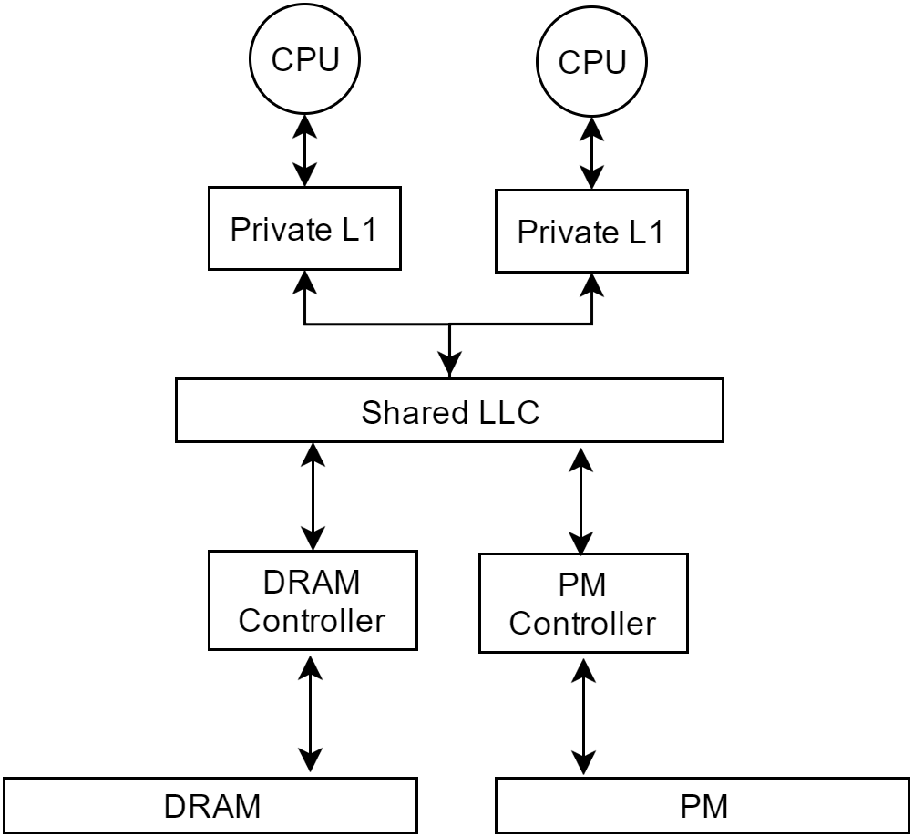

Slide 42
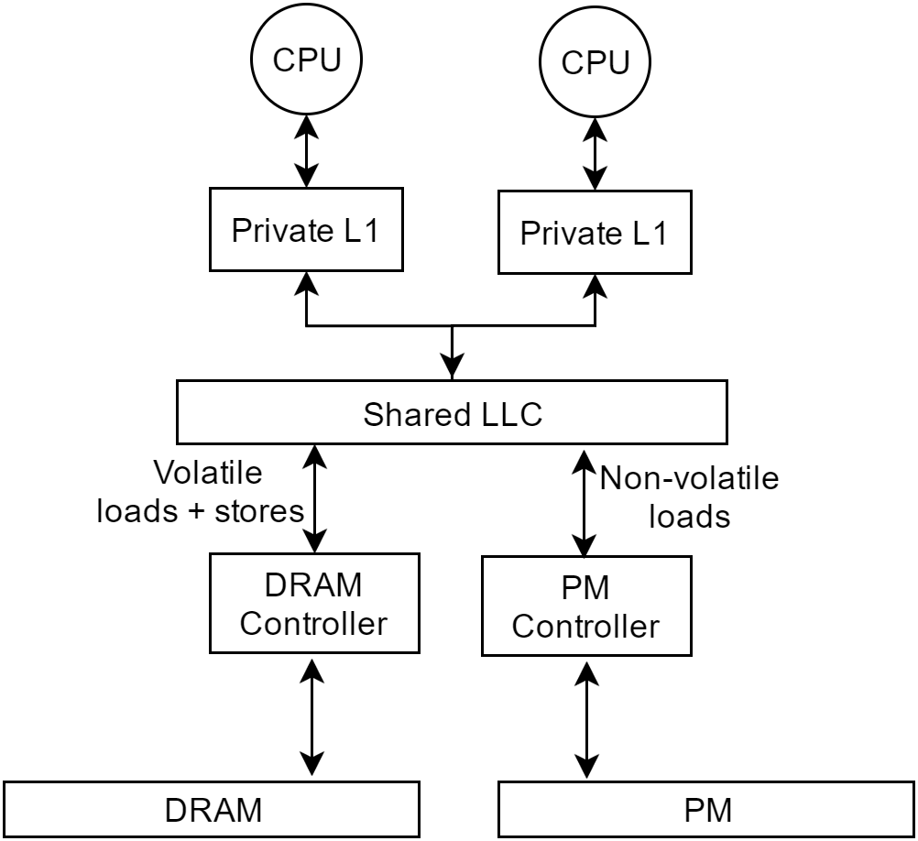

Slide 43
Intra-thread Dependency (Epoch) : Track
Local timestamp (TS) register maintained at L1 cache
Indicates epoch TS of current (incomplete) epoch
Local TS copied as part of PB entry for incoming PM stores
Local TS incremented on encountering persist barrier
CPU 1
Local TS
L1 Cache
Persist Buffer

Slide 44
Intra-thread Dependency (Epoch) : Track
Local timestamp (TS) register maintained at L1 cache
Indicates epoch TS of current (incomplete) epoch
Local TS copied as part of PB entry for incoming PM stores
Local TS incremented on encountering persist barrier
CPU 1
Local TS
25
L1 Cache
Persist Buffer

Slide 45
Intra-thread Dependency (Epoch) : Track
ST A = 1
Local timestamp (TS) register maintained at L1 cache
Indicates epoch TS of current (incomplete) epoch
Local TS copied as part of PB entry for incoming PM stores
Local TS incremented on encountering persist barrier
CPU 1
Local TS
25
A = 1
A = 1 25
L1 Cache
Persist Buffer

Slide 46
Intra-thread Dependency (Epoch) : Track
ST A = 1
Local timestamp (TS) register maintained at L1 cache
Indicates epoch TS of current (incomplete) epoch
Local TS copied as part of PB entry for incoming PM stores
Local TS incremented on encountering persist barrier
ST B = 1
CPU 1
Local TS
25
A = 1
B = 1
B = 1 25
A = 1 25
L1 Cache
Persist Buffer

Slide 47
Intra-thread Dependency (Epoch) : Track
ST A = 1
Local timestamp (TS) register maintained at L1 cache
Indicates epoch TS of current (incomplete) epoch
Local TS copied as part of PB entry for incoming PM stores
Local TS incremented on encountering persist barrier
ST B = 1
CPU 1
OFENCE
Local TS
26
A = 1
B = 1
B = 1 25
A = 1 25
L1 Cache
Persist Buffer

Slide 48
Intra-thread Dependency (Epoch) : Track
ST A = 1
Local timestamp (TS) register maintained at L1 cache
Indicates epoch TS of current (incomplete) epoch
Local TS copied as part of PB entry for incoming PM stores
Local TS incremented on encountering persist barrier
ST B = 1
CPU 1
OFENCE
Local TS
ST A = 2
26
A = 2
B = 1
A = 2 26
B = 1 25
A = 1 25
L1 Cache
Persist Buffer

Slide 49
Intra-thread Dependency (Epoch) : Enforce EXAMPLE TO BE DROPPED
Persist Buffer
Drain requests for all entries in epoch sent concurrently
Epoch entries drained after all drain ACKs received for previous epoch
A = 2 26
B = 1 25
A = 1 25
ST A = 1
ST B = 1
PM Controller
PM Controller
PM Region
PM Region

Slide 50
Intra-thread Dependency (Epoch) : Enforce
Persist Buffer
Drain requests for all entries in epoch sent concurrently
Epoch entries drained after all drain ACKs received for previous epoch
A = 2 26
B = 1 25
A = 1 25
ACK
ACK
PM Controller
PM Controller
A = 1
B = 1
PM Region
PM Region

Slide 51
Intra-thread Dependency (Epoch) : Enforce
Persist Buffer
Drain requests for all entries in epoch sent concurrently
Epoch entries drained after all drain ACKs received for previous epoch
A = 2 26
ST A = 2
PM Controller
PM Controller
A = 1
B = 1
PM Region
PM Region

Slide 52
Inter-thread Dependency : EXAMPLE TO BE DROPPED
Persist Buffer 0
Persist Buffer 1
Global TS register stored at LLC
Records <Thread ID:Flushed Epoch TS>
PBs check this before flushing epoch
PBs update this on DFENCEs
C = 2 24 -
A = 4 14 0:25
0:24 1:14
Global TS
PM Controller
PM Region
Notes:
Talk of local copy optimization

Slide 53
Inter-thread Dependency : Enforce
Persist Buffer 0
Persist Buffer 1
Global TS register stored at LLC
Records <Thread ID:Flushed Epoch TS>
PBs check this before flushing epoch
PBs update this on DFENCEs
C = 2 24 -
A = 4 14 0:25
Flush Stalled (24 < 25)
0:24 1:14
Global TS
PM Controller
PM Region
Notes:
Talk of local copy optimization

Slide 54
Inter-thread Dependency : Enforce
Persist Buffer 0
Persist Buffer 1
Global TS register stored at LLC
Records <Thread ID:Flushed Epoch TS>
PBs check this before flushing epoch
PBs update this on DFENCEs
DFENCE
C = 2 24 -
A = 4 14 0:25
C = 1
0:24 1:14
Global TS
PM Controller
PM Region
Notes:
Talk of local copy optimization

Slide 55
Inter-thread Dependency : Enforce
Persist Buffer 0
Persist Buffer 1
Global TS register stored at LLC
Records <Thread ID:Flushed Epoch TS>
PBs check this before flushing epoch
PBs update this on DFENCEs
DFENCE
C = 2 24 -
A = 4 14 0:25
ACK
0:24 1:14
Global TS
PM Controller
PM Region
Notes:
Talk of local copy optimization

Slide 56
Inter-thread Dependency : Enforce
Persist Buffer 0
Persist Buffer 1
Global TS register stored at LLC
Records <Thread ID:Flushed Epoch TS>
PBs check this before flushing epoch
PBs update this on DFENCEs
A = 4 14 0:25
0:25 1:14
Global TS
PM Controller
PM Region
Notes:
Talk of local copy optimization

Slide 57
Intra-thread Dependency (Epoch) : Track ANIMATION WIP
ST A = 1
ST A = 1
ST A = 1
Local timestamp (TS) register maintained at L1 cache
Indicates epoch TS of current (incomplete) epoch
Local TS copied as part of PB entry for incoming PM stores
Local TS incremented on encountering persist barrier
ST B = 1
CPU 1
OFENCE
Local TS
ST A = 2
26
A = 2 26
B = 1 25
A = 1 25
L1 Cache
Persist Buffer

Slide 58
Inter-thread Dependency : Enforce
Persist Buffer 0
Persist Buffer 1
Global TS register stored at LLC
Records <Thread ID:Flushed Epoch TS>
PBs check this before flushing epoch
PBs update this on DFENCEs
A = 4 14 0:25
Flush OK
0:25 1:14
Global TS
PM Controller
PM Region
Notes:
Talk of local copy optimization

Slide 59
Draining writes to multiple PM Controllers
Persist Buffer
A = 3
OFENCE
B = 2
A = 1
PM Controller
PM Controller
PM Controller
PM Region
PM Region

Slide 60
Loose Ends
PM addresses identified based on higher order address bits
PBs flushed on context switches using durable persist barriers
LLC misses to PM stalled if address present in PB
Tracked using counting bloom filters at the PM Controller
Rare as updates stay longer in the cache than in PBs

Slide 61
Reorder within an Epoch
OFENCE
Epoch 1
Epoch 1
Epoch 2
ST A=1
ST A=1
ST B=2
ST B=2
ST C=3
Global Visibility
ST C=3
Time
Persistence Order

Slide 62
Inter-thread Dependency : Track ANIMATION PENDING
CPU 0
CPU 1
ST A = 4
Identified using coherence activity
Loss of exclusive permissions signals inter-thread conflict
Local TS, Thread ID sent as part of coherence response (pessimistic)
Recorded in next epoch entry
Local TS
25
Local TS
14
A = 1
L1 Cache
L1 Cache
1
Directory
Persist Buffer
Notes:
Bloom filter to show all accesses since last durPB.

Slide 63
Inter-thread Dependency : Track
CPU 0
CPU 1
ST A = 4
Identified using coherence activity
Loss of exclusive permissions signals inter-thread conflict
Local TS, Thread ID sent as part of coherence response (pessimistic)
Recorded in next epoch entry
Local TS
25
Local TS
14
A = 1
L1 Cache
L1 Cache
2
1
Directory
Persist Buffer

Slide 64
Inter-thread Dependency : Track
CPU 0
CPU 1
ST A = 4
Identified using coherence activity
Loss of exclusive permissions signals inter-thread conflict
Local TS, Thread ID sent as part of coherence response (pessimistic)
Recorded in next epoch entry
Local TS
25
Local TS
14
0:25
A = 1
3
L1 Cache
L1 Cache
2
1
Directory
Persist Buffer

Slide 65
Inter-thread Dependency : Track
CPU 0
CPU 1
ST A = 4
Identified using coherence activity
Loss of exclusive permissions signals inter-thread conflict
Local TS, Thread ID sent as part of coherence response (pessimistic)
Recorded in next epoch entry
Local TS
25
Local TS
14
A = 4
L1 Cache
L1 Cache
Directory
A = 4 14 0:25
Persist Buffer

Slide 66
Cross Dependency : Enforce
Global TS register stored at LLC
Records <Thread ID:Flushed Epoch TS>
PBs check this before flushing epoch
PBs update this lazily
66
Notes:
Talk of local copy optimization

Slide 67
Key Idea 1
Support separate hardware primitives for ordering and durability

Slide 68
Epoch Persistency ^{[1]}
Stores to different PM addresses within an epoch can be reordered among themselves, but not across epoch boundaries in the same thread
Stores to same PM address from any thread must be persisted as observed in global memory order
[1] Steven Pelley, Peter M. Chen, and Thomas F. Wenisch. 2014. Memory persistency, ISCA '14.
Notes:
We implement the epoch persistency model

Slide 69
Self Dependency (Epoch) : Enforce
Drain requests for all entries in oldest epoch sent concurrently
Next epoch drained after all drain ACKs received for previous epoch

Slide 70
Self Dependency (Epoch) : Track
ST A = 1
ST B = 1
OFENCE
ST A = 2
Local timestamp (TS) register maintained at L1 cache
Indicates epoch TS of current (incomplete) epoch
Local TS copied as part of PB entry for incoming PM stores
Local TS incremented on encountering OFENCE/DFENCE
CPU 1
Local TS
25
26
A = 2
A = 1
B = 1
A = 2 26
B = 1 25
A = 1 25
L1 Cache
Persist Buffer

Slide 71
Write Ordering in HOPS
Two types of dependencies preserved
Cross dependencies between threads (address conflict)
Self dependencies within a thread (epoch)
Dependencies identified at the time of insertion
Dependencies enforced at the time of drain into PM

Slide 72
Draining writes to single PM Controller
Persist Buffer
A = 2 26
B = 1 25
A = 1 25
A = 3
A = 1
B = 1
ACK (A)
ACK (B)
PM Controller
PM Region

