Slide 1
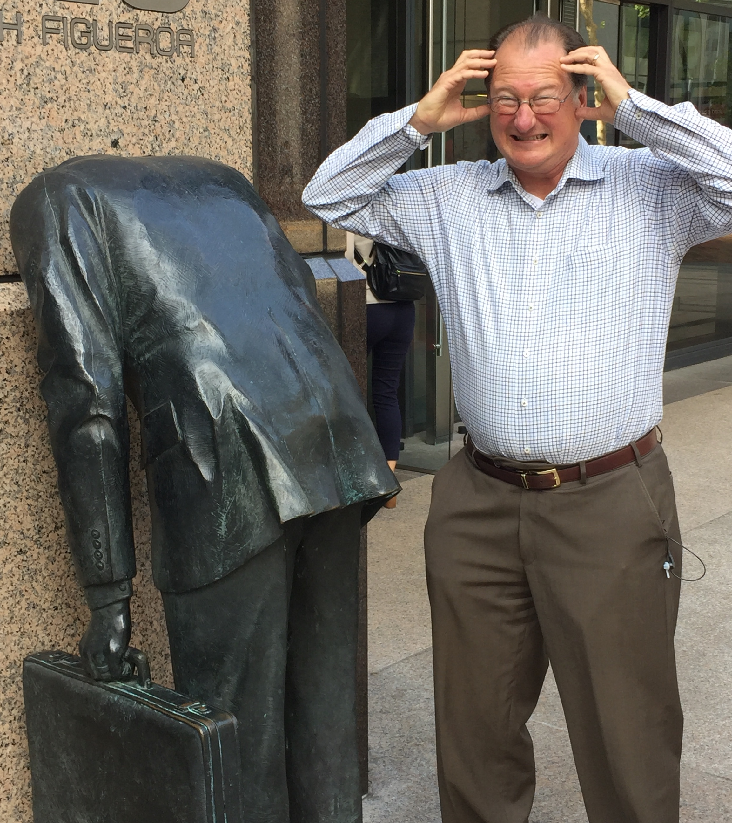
Micro-architectural & Architectural Implications of Meltdown & Spectre
@ UPMARC Day, Uppsala, SE, 11/2018
Mark D. Hill, U. Wisconsin-Madison, USA
Background, Meltdown, & Spectre
Repair Micro-Architecture
Change Architecture & Methods?
Addendum: Multicore Context
Computer Architect, Not Security Expert

Slide 2

In Iceland @ Eurasian vs. North American Tectonic Plates
Or US Democrats vs. Republicans
Or Swedish Social Democrats vs. The Alliance

Slide 3

Executive Summary
Architecture 1.0: the timing-independent functional behavior of a computer
Micro-architecture: the implementation techniques to improve performance
Question: What if a computer that is completely correct by Architecture 1.0
can be made to leak protected information via timing, a.k.a., Micro-Architecture?
Meltdown leaks kernel memory, but software & hardware fixes exist
Spectre leaks memory outside of bounds checks or sandboxes, and is scary
What TO-DO, since it can’t be “correct” to leak protected information?
We will repair Micro-Architecture: Manage, not fix, like crime
We should define Architecture 2.0 and/or change methods

Slide 4
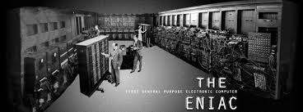
Computer Architecture 0.0 -- Pre-1964
Each Computer was New
Implemented machine (has mass) → hardware
Instructions for hardware (no mass) → software
Software Lagged Hardware
Each new machine design was different
Software needed to be rewritten in assembly/machine language
Unimaginable today
Going forward: Need to separate HW interface from implementation

Slide 5
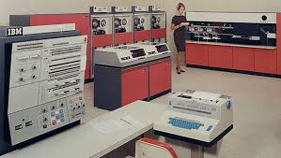
Computer Architecture 1.0 -- Born 1964
IBM System 360 defined an instruction set architecture
Stable interface across a family of implementations
Software did NOT have to be rewritten
branch (R1 >= bound) goto error
load R2 ← memory[train+R1]
and R3 ← R2 && 0xffff
load R4 ← memory[save+SIZE+R3]
Architecture 1.0: the timing-independent functional behavior of a computer
Micro-architecture: implementation techniques that change timing to go fast
Note: The code is not IBM 360 assembly, but is the example used later.

Slide 6
Micro-architecture Harvested Moore’s Law Bounty
For decades, every ~2 years: 2x transistors, 1.4x faster & 1x chip power possible;
2300 transistors for Intel 4004 → millions per core & billions for caches
(Micro-)architects took this ever doubling budget to make each processor core execute > 100x than what it would otherwise (including caches).
Key techniques w/ tutorial next:
Instruction Speculation
Hardware Caching
Hidden by Architecture 1.0: timing-independent functional behavior unchanged

Slide 7
Instruction Speculation Tutorial
Many steps (cycles) to execute one instruction; time flows left to right →
add
load
Go Faster: Pipelining, branch prediction, & instruction speculation
add
load
branch
Predict direction: target or fall thru
and
Speculate!
store
Speculate more!
Speculation correct: Commit architectural changes of and (register) & store (memory) go fast!
Mis-speculate: Abort architectural changes (registers, memory); go in other branch direction

Slide 8
Hardware Caching Tutorial
Main Memory (DRAM) 1000x too slow
Add Hardware Cache(s): small, transparent hardware memory
Like a software cache: speculate near-term reuse (locality) is common
Like a hash table: an item (block or line) can go in one or few slots
E.g., 4-entry cache w/ slot picked with address (key) modulo 4
0
--
12?
Miss
Insert 12
0
12
07?
Miss
Insert 07
0
12
12?
HIT!
No changes
0
12
16?
Miss
Victim 12
Insert 16
0
16
Note 12
victimized “early” due to “alias”
1
--
1
--
1
--
1
--
1
--
2
--
2
--
2
--
2
--
2
--
3
--
3
--
3
07
3
07
3
07

Slide 9
Whither Computer Architecture 1.0?
Architecture 1.0: timing-independent functional behavior
Question: What if a computer that is completely correct by Architecture 1.0
can be made to leak protected information via timing, a.k.a., micro-architecture?
Implication: The definition of Architecture 1.0 is inadequate to protect information
This is what Meltdown and Spectre do. Let's see why and explore implications.

Slide 10
Side-Channel Attack: SAVE Secret in Micro-Arch
Prime micro-architectural state
  Repeatedly access array train[]to train branch predictor to expect access < bound
  Access all of array save[]to put it completely in a cache of size SIZE
Coerce processor into speculatively executing instructions that will be nullified to (a) find a secret & (b) save it in micro-architecture
branch (R1 >= bound) goto error ; Speculate not taken even if R1 >= bound
load R2 ← memory[train+R1] ; Speculate to find SECRET outside of train[]
and R3 ← R2 && 0xffff ; Speculate to convert SECRET bits into index
load R4 ← memory[save+SIZE+R3] ; Speculate to save SECRET by victimizing memory[save+R3] since it aliases in cache with new access memory[save+SIZE+R3]
3. HW detects mis-speculation
Undoes architectural changes
Leaves cache (micro-architecture) changes (correct by Architecture 1.0)

Slide 11
To Over-Simply: SAVE Secret in Micro-Arch
branch (R1 >= bound) goto error
load R2 ← memory[train+R1] ; Get SECRET
and R3 ← R2 && 0xffff
load R4 ← memory[save+SIZE+R3] ; Put SECRET in address to perturb cache

Slide 12

Side-Channel Attack: RECALL Secret from Micro-Arch
4: Probe time to access each element of save[]--micro-architectural property;
If accessing save[foo] slow due to cache miss, then SECRET is foo. A leak!
5: Repeat many times to obtain secret information at some bandwidth. (More shifting/masking needed to get all SECRET bits victimizing 64B cache lines)
Well-known in 1983/85 DoD “Orange Book”
Covert timing channels include all vehicles that would allow one process to signal
information to another process by modulating its own use of system resources in
such a way that the change in response time observed by the second process would
provide information. --TRUSTED COMPUTER SYSTEM EVALUATION CRITERIA
But seemed fanciful
Spy vs. Spy, Mad Magazine, 1960

Slide 13
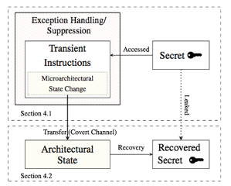
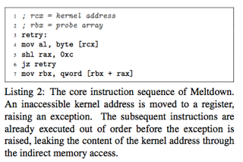
Meltdown (a.k.a. Google Variant 3)
Can leak the contents of kernel memory at up to 500KB/s
TRAP!! (not branch)
Under mis-speculation

Slide 14
Meltdown (a.k.a. Google Variant 3)
Instead of branch/load: user load of kernel memory that traps
Leaks kernel memory at up to 500KB/s on Intel x86-64 cores
Intel appears to start cache miss before trapping (allow micro-arch changes)
➔ Ok by Architecture 1.0 w/ High performance but Meltdown!
Others appear to trap without cache miss (e.g., at address translation)
➔ Ok by Architecture 1.0 ➔ No Meltdown
Solutions
SW: Don’t map kernel ➔ performance loss on syscalls
HW: Trap early (as done by many vendors & claimed for new Intel Cascade Lake)
“Easy” to stop speculation early: SW protection boundary known to HW

Slide 15
Spectre (Google Variants ≠ 3)
Classic side-channel attack w/ deep micro-arch info
Most—if not all—cores & vendors
Load does NOT trap (Meltdown traps)
Violation of managed language or sandbox
Hard as SW protection boundary unknown to HW
Variants
Use branch mis-prediction to let Javascript steal from Chrome browser
Uses indirect branches (returns) & return-oriented programming
Meltdown
Re write buffer bypass
... Coherence, functional units, TBD ☹
Page tables (L1TF 08/14/2018 ~ Meltdown)
Performance ➔ Speculation ➔ Spectre
What to do?

Slide 16
Ref 1/2: Spectre Variants, 10/2018, for IEEE Micro
Variant Name and Gist | Gist of Mitigation Strategies
V1 (Bounds Check Bypass). Mistrained conditional branch predictor used to violate program semantics by speculatively accessing data beyond an array limit. | Either enforce instruction stream serialization with respect to later loads (e.g. through an “lfence” on x86) or use speculative load clamping to constrain bounds of array. LLVM calls this “speculative load hardening”.
V1.1 (Bounds Check Bypass Store). Similar to variant 1 but applies to stores, allowing e.g. speculative buffer overflow/stack overflow with restoring of returns. | Careful auditing for potentially risky stores, aided by automated tools (smatch, etc.) or compiler lift (e.g. LLVM speculative load hardening, MSVC). Enforce instruction stream serialization or use clamping.
V1.2 (Read-only Protection Bypass). Hardware may implement lazy enforcement of page table protections allowing speculative writes to read-only data. | Extension of Bounds Check Bypass Store. Relying on read only memory protections against e.g function pointer overwrite is not sufficient. It is necessary to protect against potential overwrites into RO memory.
V2 (Branch Target Injection). Mistrained indirect branch predictor Branch Target Buffer (BTB) speculatively executes attacker-controlled “gadgets”. | Limit speculation based upon the Branch Target Buffer when crossing privilege boundaries, flush predictor state when transitioning from one task to another, limit speculation based upon BTB between SMT threads.
V3 (Rogue Data Cache Load, aka “Meltdown”). User load that speculatively accesses kernel space. See [Melt] | Exploitation requires both a valid address translation as well as (typically) data present in the L1 data cache. Either separate address space between privileged and unprivileged execution states, and/or ensure data is not present in the cache and cannot be loaded by attacker. On some architectures, implement Page Table Isolation (PTI) between user/kernel, on others use an L1D flush.
V3a (Rogue System Register Read). Speculative reads to normally inaccessible system registers may be used to infer information, such as page table base address used to point to all active page tables | In some cases, updated microcode (etc.) can be used to make such reads serializing and not execute speculatively. In other cases, it may not be possible to prevent certain information leakage - such as the location in memory of page table base address.
V4 (Speculative Store Bypass). Speculative reads may proceed prior to determining whether a conflicting store exists in the store buffer (memory disambiguation) | Disabling speculative store buffer bypassing (aka “memory disambiguation”) either globally, or on a per-application basis, is one mitigation path. Another is aggressive use of process-level isolation (separating contexts of execution), but this is difficult for some cases. Linux eBPF and Java runtimes are examples where a per-process control to disable speculative bypassing of the store buffer is typically employed.

Slide 17
Ref 2/2: Spectre Variants, 10/2018, for IEEE Micro
Variant Name and Gist | Gist of Mitigation Strategies
BranchScope. Conditional directional branch predictor attack used to infer direction of branches taken in vulnerable code (for example, cryptographic libraries) | Two broad strategies exist - careful removal of branch dependencies upon secret data, and “if-conversion” in which branches are converted to sequential code using conditional instructions. The latter can be implemented at the compiler level, while the former is purely manual.
LazyFPU save/restore. Processor implementation may be optimized to avoid saving Floating Point Unit (and vector) context when switching tasks until the new task performs an FPU operation. Vulnerable hardware still allows speculative reads of the disabled FPU state. | Disabling lazy save/restore of Floating Point Unit state. In many cases, this actually improves performance on contemporary processors, particularly those which have hardware assisted save/restore FPU instructions.
TLBleed. A temporal attack against Simultaneous Multithreading (SMT) implementations with tightly shared TLBs (Translation Lookaside Buffers) allowing precise measurement of TLB state on one thread to infer execution of process running on the peer thread. | The simplest solution is to carefully schedule sensitive (e.g.) cryptographic operations such that they do not occur on a sibling SMT thread (e.g. “Hyperthread”) at the same time as an untrusted workload is running on its peer. Other mitigations include refactoring libraries to use only constant time operations, which may not be feasible or possible (hardware may not support this).
SpectreRSB/ret2spec. Return Stack Buffer manipulated in order to divert speculative execution of a function return into an attacker-determine leak gadget. | RSB “stuffing” is employed to ensure the RSB is filled with a benign delay gadget. This RSB stuffing approach is also used as part of the mitigation for Spectre-v2 on certain process (e.g. Intel Skylake+) wherein an underfill in the RSB causes speculation from the BTB. Thus, it is preferable to reuse the existing mitigation.
NetSpectre. Similar to Spectre but performed over a network using a combination of a leak gadget (used to alter microarchitectural state) and transmission gadget (used to transmit this altered state across a network). | Mitigation is similar to Spectre-v1 however the impacted code is potentially very significant. As a result, other solutions at the network layer may be employed, or the impact of leakage may be reduced through careful application of rekeying during transactions. Very sensitive deployments may choose to recompile significant portions of applications using speculative load hardening techniques e.g. as found in LLVM.
L1TF (L1 Terminal Fault, “Foreshadow” - SGX). Speculative loads to virtual addresses translated by Page Table Entries (PTEs) with “present” bit not set may result in the processor forwarding the incorrect physical address to the L1 data cache (L1D), allowing reads of attacker-controlled addresses if in the cache. | L1TF requires that data be present in the L1 Data cache of impacted Intel processors, and that it be possible to construct a vulnerable page table entry. For the “bare metal” use case of an OS on hardware, it is possible to protect against malicious applications by ensuring that all “not present” OS PTEs are masked such that the address is outside of populated physical memory. For virtual machines, it is necessary to employ an L1D cache flush via microcode assist on VM entry.
Spectre variants after October 2018? | To be determined.

Slide 18
Outline
Background, Meltdown, & Spectre
Repair Micro-Architecture
Change Architecture & Methods?
Addendum: UPMARC Multicore Context

Slide 19
To Over Simplify: Just Eliminate Speculation? No
Modern Processors (Intel Skylake example numbers)
224-entry reorder buffer w/ 14-19-stage pipeline
3 cache levels: speculate hit for 0.25ns cycle vs. ~100ns DRAM
Interactions among 4-28 cores (speculate coherence good, no bank conflict, …)
Naïve elimination of speculation & caches would slow by >> 10X
Regardless on exact number
➔ Not viable for a general-purpose processor product
➔ Must more creatively mitigate timing channels

Slide 20

Repair Microarchitecture
W/o speculation/caches >> large performance loss
While (1)
Find timing channel with concerning bandwidth
Fix it with performance and/or complexity cost
Not easy
Does shared cache way-partitioning cut timing channels (e.g., Intel CAT)?
No, need changes to replacement algorithm & “shared” hits (see DAWG)
Treat timing channels like crime: Manage without solving
Goal: MIN(“security/police/etc. cost” + “crime cost”)

Slide 21
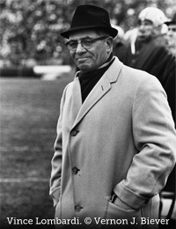
Micro-Architectural Ideas
Isolate branch predictor, BTB, TLBs, etc. & flush/restore on context switch
Partition caches among trusted processes (& flushed on context switch?)
Reduce aliasing information, e.g., fully-associative caches or fancy indexing
Randomize to lower BW; degrade/hide “timers”
HW Protection w/i user address space
e.g., trap if javascript accesses protected browser
Undo speculation (as much as possible)
Constant-time execution?
(at some granularity: instrn, function, program)
''He treats us all the same -- like dogs.’’
--Henry Jordan on Vince Lombardi

Slide 22



Whither High Performance & Timing-Channel “Free”?
perf
Performance →
safe
Safety →
Happy knee with good performance & good safety?
I fear not & arrives now as Moore’s Law bounty slows

Slide 23
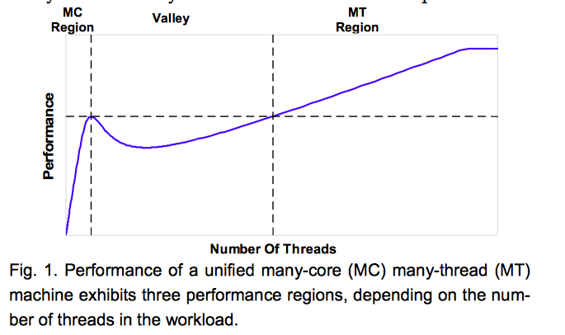
Bifurcate? As Done for CPU-GPU Performance
Multicore (MC) CPUs
use latency reduction (caches)
Multithreaded (MT) GPUs
use latency tolerance
Converge? No!
Beware the Valley where #threads
Enough to thrash caches
Not enough to hide latency
Guz et al., CAL, 1/2009

Slide 24

Bifurcate! How?
In Time: Modes for fast(er) & safe(r)
Disable some speculation & partition more
Dynamically flexible but limited
In Space: Fast Cores, Safe Cores, etc.
Extension of what is being done for security
Allows extremes; plays well w/ dark silicon
In Use:
Cloud provider charges more for exclusive VMs
Don’t execute downloaded code

Slide 25
Outline
Background, Meltdown, & Spectre
Repair Micro-Architecture
Change Architecture & Methods?
Addendum: UPMARC Multicore Context

Slide 26
Universe of Computer Behavior
X violates Spec: bug!
Desirable (no info leak)
X
B reveals FLAW
in Arch
Arch 2.0
refines Arch 1.0
& Desirable
B refines Arch
B
Implementation A refines Arch
A
Patch u-arch?
C
Arch Specification

Slide 27

Need Computer Architecture 2.0?
With Meltdown & Spectre, Architecture 1.0 is inadequate to protect information
Augment Architecture 1.0 with Architecture 2.0 specification of
(Abstraction of) time-visible micro-architecture?
Bandwidth of known (unknown?) timing channels?
Enforced limits on user software behavior? (c.f., KAISER)
Protect user-space regions & suppress speculation
None seem good enough to me (yet)

Slide 28
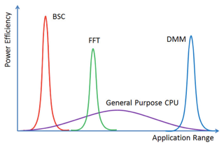
Computer Architecture 2.0: More Accelerators?
More generally, can we reduce our dependence on SPECULATION?
Accelerators!! GPU, DSP, IPU, TPU, ... [Hennessy & Patterson 2018 Taxonomy]
Dedicated Memories
More ALUs
Easy Parallelism
Lower precision data
Domain Specific Language
Yavits et al. MultiAmdahl, 2017
Speculation NOT a first-order feature!
But accelerators have timing channels
E.g., branch & memory divergence or bus & memory controller conflicts

Slide 29
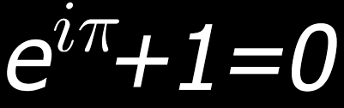
Formal Methods but Hard
Tools:
GLIFT [Tiwari ASPLOS’09] (follow-ons)
SecVerilog [Zhang, ASPLOS’15]
Can’t easily dynamically check for information exfiltration
See hyperproperties of set of executions [Clarkson & Schneider, ’10]
Presumes a spec to check against (Architecture 2.0)
Spatial bifurcation helps as methods may be easier to apply to safe cores

Slide 30


Open Architecture & Micro-Architectures?
Security Experts
Disdain “security by obscurity”
In favor of many “eyeballs”
Open-source SW can help security
More eyeballs but bad implementation is still bad
Whither open-source HW?
Interfaces: Instruction Set Architecture
Implementations: libraries for low- to medium-end
“Most future HW security ideas with be tried with RISC V first.” – D. Patterson

Slide 31

We Should Talk
“Computer Architect, Not Security Expert”
I am part of the problem
20th Century
Layers worked: Roman dīvide et imperā
Low BW among SW/HW/Security/Formal
21st Century needs
Cross-layer, end-to-end solutions
High BW inclusive discussions
in public and confidential

Slide 32
Executive Summary
Speculation leaks protected information but is essential for performance
Not bugs: Micro-Architecture correct to Architecture 1.0 spec
Flaws in the half-century-old timing-independent definition of Architecture 1.0
What TO-DO, since it can’t be “correct” to leak protected information?
We will repair Micro-Architecture: Manage, not fix, like crime
We should define Architecture 2.0 and/or change methods

Slide 33
Outline
Background, Meltdown, & Spectre
Repair Micro-Architecture
Change Architecture & Methods?
Addendum: UPMARC Multicore Context

Slide 34
20th Century ICT Set Up
Information & Communication Technology (ICT)
Has Changed Our World
  <long list omitted>
Required innovations in algorithms, applications, programming languages, …, & system software
Key (invisible) enablers (cost-)performance gains
  Semiconductor technology (“Moore’s Law”)
  Computer architecture (~80x per Danowitz et al.)

Slide 35
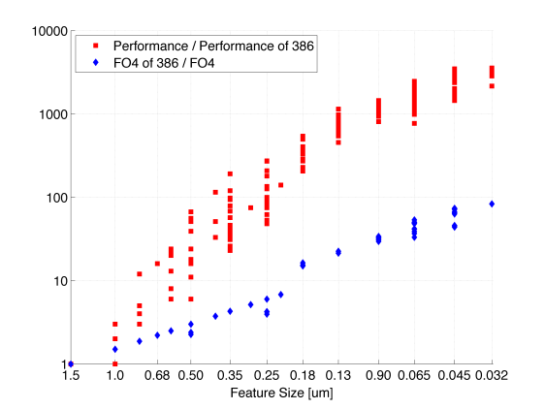
Enablers: Technology + Architecture
Architecture
Technology
  Danowitz et al., CACM 04/2012, Figure 1

Slide 36
A Computer Architecture History
P
$
bus
M
i/f
dev
1 CPU

Slide 37
A Computer Architecture History
P
$
bus
M
i/f
dev
1 CPU
Multiprocessor

Slide 38
A Computer Architecture History
P
$
bus
M
i/f
dev
1 CPU
Multicore

Slide 39
Decades of exponential performance growth stalled in 2004
Notes:
5 or 6 years ago, several decades of uninterrupted exponential growth in single-processor performance plateaued, thereby stalling the advance of computing power in traditional systems.

Slide 40
A Computer Architecture History
P
$
bus
dev-M
M
i/f
GPU
dev
1 CPU
Multicore
Discrete GPU

Slide 41
A Computer Architecture History
P
GPU
$
bus
M
i/f
dev
1 CPU
Multicore
Integrated GPU

Slide 42
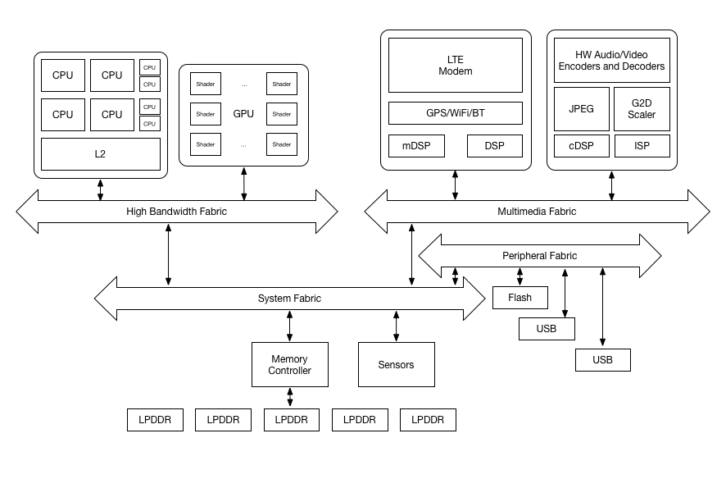
A Computer Architecture History
P
GPU
$
bus
M
i/f
dev
1 CPU
Multicore
Integrated GPU
System on a Chip (SoC)

Slide 43
Consumer SoC HW
Disclaimer: I’m influenced by my 2018 sabbatical visit to Google gChips

Slide 44
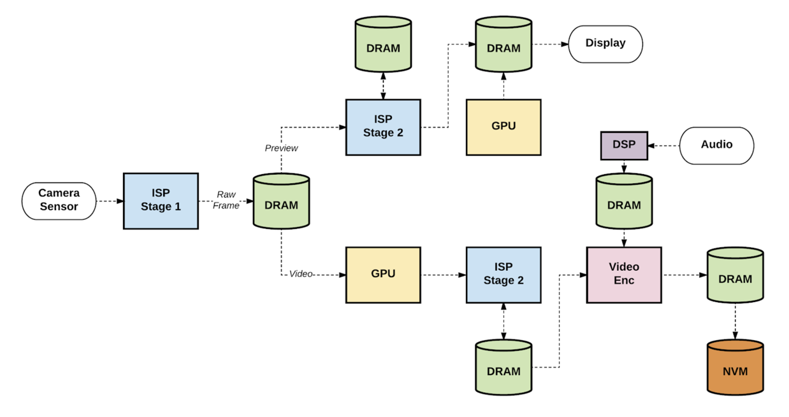
Example Usecase
(recording 4K video)
Janapa Reddi, et al.,
IEEE Micro, Jan/Feb 2019

Slide 45
Context Summary: Computer Architecture Long View
Instruction-Level Parallelism
Discrete (multiple chips) uniprocessor ➔ single-core microprocessor
Thread-Level Parallelism
Discrete multiprocessor ➔ MULTICORE CHIP
Heterogeneous Parallelism
Discrete general-purpose graphics processing unit ➔ integrated GP-GPU
Extreme Heterogeneity
Consumer System-on-a-Chip w/ many “accelerators” ➔ SoCs everywhere?
Must co-design with apps & system SW to enable HW success
Daunting Challenges ➔ Rich Research Opportunities!

