Slide 1


Crossing Guard: Mediating
Host-Accelerator Coherence Interactions
Lena E. Olson*, Mark D. Hill, David A. Wood
University of Wisconsin-Madison
* Now at Google
ASPLOS 2017
April 10th, 2017

Slide 2
Accelerators are here!
Complex, programmable accelerators increasingly prevalent
Many applications: graphics, scientific computing, video encoding, machine learning, etc…
Accelerators may benefit from cache coherent shared memory
May be designed by third parties

Slide 3
However…
Host coherence protocols may be proprietary and complex
Bugs in accelerator implementations might crash host system!
Crossing Guard: coherence interface to safely translate accelerator ↔ host protocol
Accel
CPU
Accel $
Host $
Hello!
你好!
XG

Slide 4

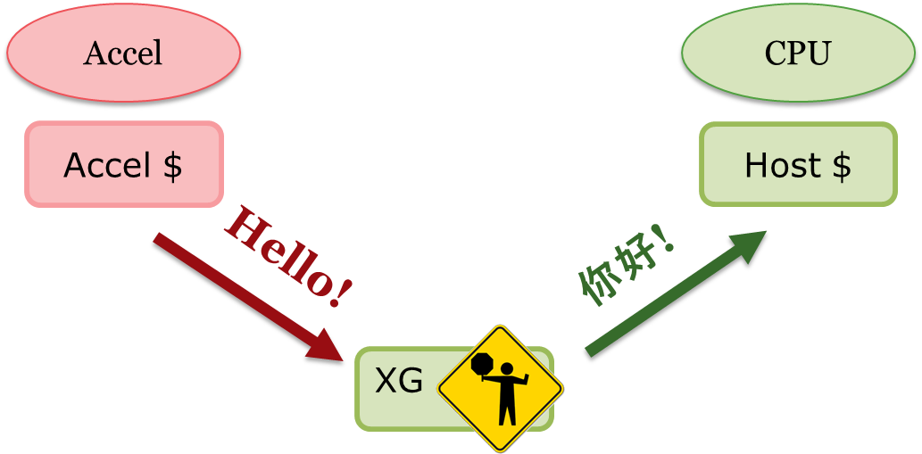


Outline
Goals
Design
Guarantees
Evaluation

Slide 5
Crossing Guard Goals
When adding accelerators to host coherence protocol:
Allow accelerators customized caches
Simple, standardized accelerator coherence interface
Guarantee safety for the host system

Slide 6
1. Why Customize Caches?
CPU caches have to work with most types of workloads
Accelerators may only run some workloads!
  Optimize caches for likely data access patterns
  Number of levels, writeback vs. writethrough, MSI vs VI, etc.
Accel
Accel
Accel
Accel
Accel
Accel
L1 $
L1 $
L1 $
L1 $
VI
L1 $
VI
L1 $
L2 $
L2 $

Slide 7
2. Why Simple, Standardized Interface?
Host systems speak different protocols…
Expensive to redesign for each one!
  Intel, AMD, ARM, IBM, Oracle…
  CCIX shows industry cares!
Accel
L1 $
Hello?
你好?
Bonjour?
Hej?
Host Directory

Slide 8
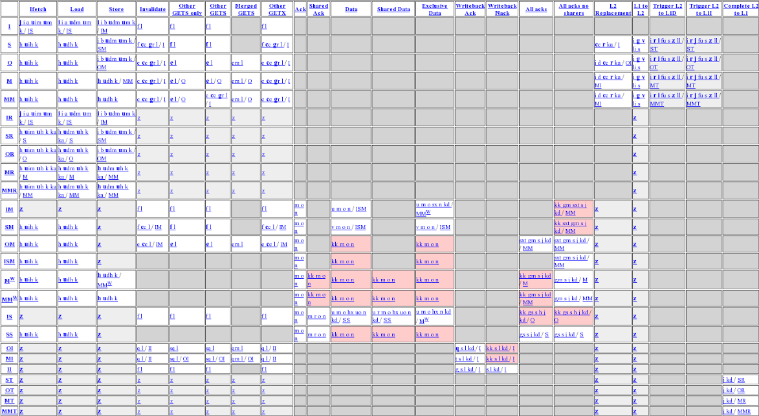
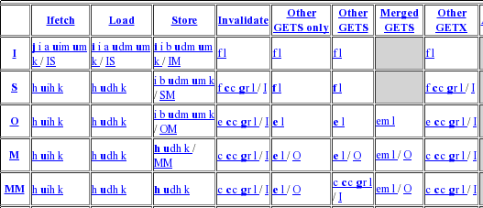
2. Why Simple, Standardized Interface?
L1 controller from gem5’s MOESI_hammer
Events
States
(Transition table in style of Sorin et al.)

Slide 9
3. Why Host Safety?
Accel
CPU
CPU
Accel Cache (#0)
Cache #1
Cache #2
Addr State
A I
Addr State
A S
Addr State
A I
Addr State Owner/Sharers Req
A SS 1, 2 -
Directory

Slide 10
3. Why Host Safety?
Accel Cache (#0)
Cache #1
Cache #2
Addr State
A I
Addr State
A S
Addr State
A I
Ack
? ? ?
? ? ?
Addr State Owner/Sharers Req
A SS 1, 2 -
Directory

Slide 11

3. Why Host Safety?
Accel Cache (#0)
Cache #1
Cache #2
Addr State
A M
Addr State
A I
Addr State
A I
Inv
Req: dir
Addr State Owner/Sharers Req
A MT 0 -
Addr State Owner/Sharers Req
A MT_I 0 -
Directory

Slide 12
Outline
Goals
Design
Guarantees
Evaluation

Slide 13
Crossing Guard
Hardware translating between host and accelerator protocols
Set of accelerator ↔ host coherence messages (like an API)
Accel
CPU
Accel $
Host $
Hello!
你好!
XG

Slide 14
Crossing Guard Interface
Accelerator → Host Requests
Host → Accelerator Responses
GetS, GetM
PutS, PutE, PutM
DataS, DataE, DataM
Writeback Ack
Host → Accelerator Requests
Accelerator → Host Responses
Invalidate
InvAck, Clean Writeback,
Dirty Writeback

Slide 15
Crossing Guard
Hides implementation details of host protocol
  No counting acks, sending unblocks, handling races, etc.
Moves protocol complexity into Crossing Guard hardware
  Only implemented once per host system
  By experts!

Slide 16
Experimental Implementation
Coherence controllers / protocols implemented in slicc
Simulations using gem5
Code and transition tables available online
http://research.cs.wisc.edu/multifacet/xguard/

Slide 17
Outline
Goals
Design
Guarantees
Evaluation

Slide 18

1. Customize Caches
Designed + implemented two sample systems
Private Per-Core L1 at Accelerator
Accel L1
Accel L1
Accel L1
CPU L1
CPU L1
XG
XG
XG
Host Directory / L2

Slide 19
1. Customize Caches
Designed + implemented two sample systems
Private L1s + Shared L2 at Accelerator
Accel L1
Accel L1
Accel L1
CPU L1
CPU L1
Accel L2
XG
Host Directory / L2

Slide 20
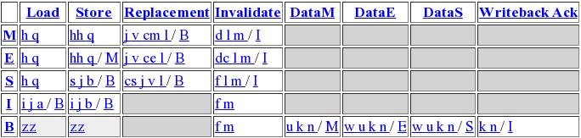
2. Simple, Standardized Interface
Single-level Accelerator Cache using Crossing Guard Interface
Controller | States | Transitions
AMD Hammer-like Private $$ | 24 | 148
Crossing Guard Single-Level Private L1 | 5 | 20

Slide 21
2. Simple, Standardized Interface
Implemented Crossing Guard controller for two host protocols
  AMD Hammer-like Exclusive MOESI
  Two-Level MESI Inclusive
Modularity: Host and Accelerator protocol choice is completely independent

Slide 22
2. Simple, Standardized Interface
Accel Cache
Cache #1
Cache #2
Addr State
A I
Addr State
A S
Addr State
A M
Addr State
A I
Addr State
A B
Addr State
A I
DataM
Ack
Ack
GetM
Inv
Req: 0
Addr State Acks Reqs Timer
A SM -2 - 0
Addr State Acks Reqs Timer
A I 0 - 0
Addr State Acks Reqs Timer
A M 0 - 0
Addr State Acks Reqs Timer
A SM -1 - 0
Addr State Acks Reqs Timer
A IM 0 - 0
Data
Acks:-2
Cache #0
GetM
UnblockM
Addr State Owner/Sharers Req
A SS 1, 2 -
Addr State Owner/Sharers Req
A M 0 -
Addr State Owner/Sharers Req
A SM_MB 1, 2 0
Directory

Slide 23
2. Simple, Standardized Interface
Accel Cache
Cache #1
Cache #2
Addr State
A M
Addr State
A S
Addr State
A I
Addr State
A I
Addr State
A IM
Addr State
A I
DataM
GetM
Ack
Ack
Addr State Acks Reqs Timer
A SM -2 - 0
Addr State Acks Reqs Timer
A I 0 - 0
Addr State Acks Reqs Timer
A M 0 - 0
Addr State Acks Reqs Timer
A SM -1 - 0
Addr State Acks Reqs Timer
A IM 0 - 0
Data
Acks:-2
Cache #0
GetM
UnblockM
Addr State Owner/Sharers Req
A SS 1, 2 -
Addr State Owner/Sharers Req
A M 0 -
Addr State Owner/Sharers Req
A SM_MB 1, 2 0
Directory

Slide 24

3. Host Safety
Accel Cache
Cache #1
Cache #2
Addr State
A I
Addr State
A S
Addr State
A I
Ack
Addr State Acks Reqs Timer
A I 0 - 0
Cache #0
Addr State Owner/Sharers Req
A SS 1, 2 -
Directory

Slide 25
3. Host Safety
Accel Cache
Cache #1
Cache #2
Addr State
A M
Addr State
A S
Addr State
A I
Inv
Addr State Acks Reqs Timer
A I 0 - 1210
Addr State Acks Reqs Timer
A M 0 - 0
Addr State Acks Reqs Timer
A MI 0 dir 1210
Inv
(Req: dir)
Cache #0
Data
Addr State Owner/Sharers Req
A MT_I 0 -
Addr State Owner/Sharers Req
A MT 0 -
Time:
500
Time:
1000
Time:
200
Time:
210
Addr State Owner/Sharers Req
A WB 0 -
Time:
1500
Directory

Slide 26
Outline
Goals
Design
Guarantees
Evaluation

Slide 27
Evaluation
Does it provide coherence to correct accelerator?
Does it provide safety to host?
Does it allow high performance?

Slide 28
I. Correctness Testing
Are coherence invariants are maintained when accelerator is acting correctly?
How? Random tester
  Store-Load pairs to random addresses
  Check integrity of data
Ran for 160 billion load/store pairs
Local coverage: 100% states, 100% events, > 99% transitions

Slide 29
II. Fuzz Testing
Is host safety maintained when accelerator misbehaves?
How? Replace accelerator cache with evil controller
  Generates random coherence messages to random addresses
  Desired outcome: No deadlocks / crashes
Ran for 7 billion load/store pairs
Local Coverage: 100% states, 100% events, > 99% transitions

Slide 30
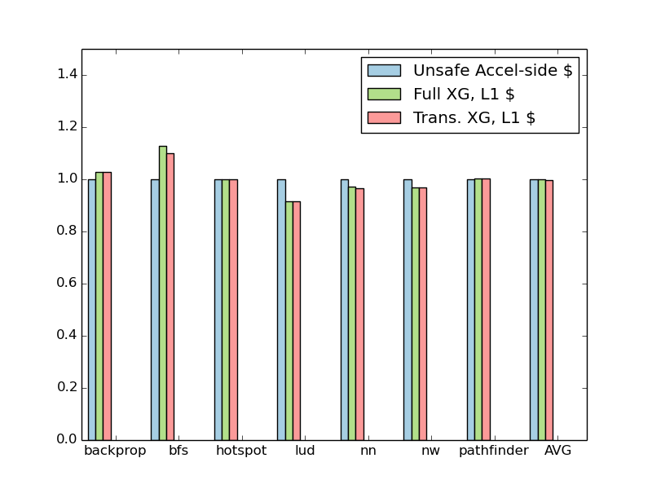
III. Performance Testing
gem5-gpu
Rodinia workloads
MESI Inclusive host protocol
Normalized Accelerator Execution Time
Benchmark

Slide 31
Crossing Guard Summary
Provides simple, standardized interface to ease accelerator development
Correctness when accelerator is correct
Host safety when accelerator is incorrect
Low performance overhead

Slide 32
Questions?
? ? ?
? ? ?

Slide 33
Backup Follows

Slide 34
Two-Level Accelerator Protocol (1)
Private L1s + Shared L2 at Accelerator
Accel L1
Accel L1
Accel L1
CPU L1
CPU L1
Accel L2
XG
Host Directory / L2

Slide 35
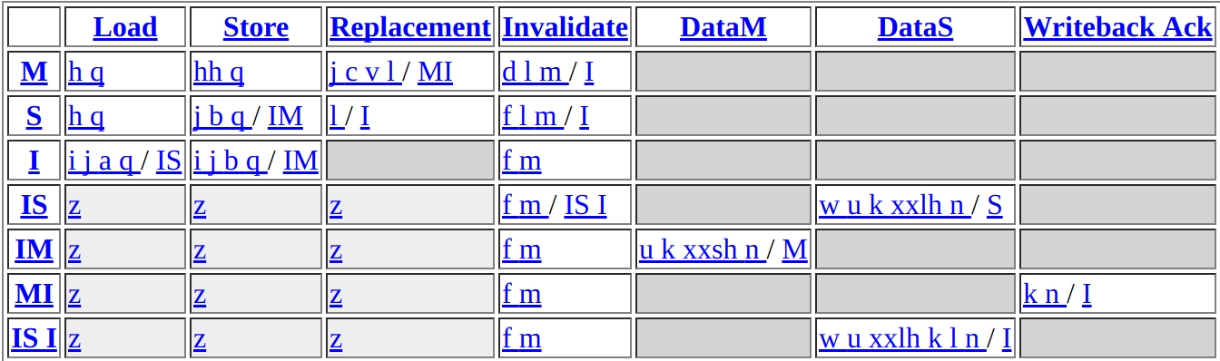
Two-Level Accelerator Protocol (2)
L1 Controller (M state contains dirty/clean bit)

Slide 36
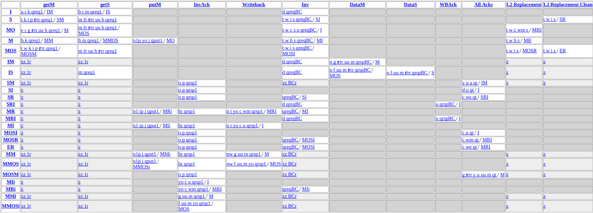
Two-Level Accelerator Protocol (3)
L2 Controller
(Coordinates Sharing among Accelerator L1s)

Slide 37
Crossing Guard Invariants
Crossing Guard Guarantees to Host:
Accelerator requests must be correct
  Consistent with block stable state at accelerator
  Consistent with block transient state at accelerator
Accelerator responses must be correct
  Consistent with block stable state at accelerator
  Consistent with block transient state at accelerator
  Received within a reasonable time
( + Border Control Protections!)

Slide 38
Crossing Guard Variants
Full State Crossing Guard
  Inclusive directory of accelerator state
  + Places few restrictions on host protocol
  + Can hide all errors
  - Requires tag + metadata storage for all blocks
Transactional Crossing Guard
  Stores only data for in-flight transactions
  + Small storage
  + Provides most safety properties
  - Requires some host tolerance

Slide 39
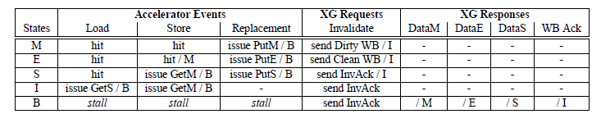
Single-Level Cache

Slide 40
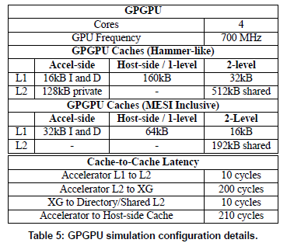
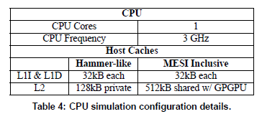
Simulation Parameters

Slide 41
Time Spent Simulating (Random)
Configuration | Time
XG Full + Hammer + 1 Level | 5.28 years
XG Full + Hamer + 2 Level | 2.51 years
XG Full + MESI Inc + 1 Level | 133 days
XG Full + MESI Inc + 2 Level | 223 days
XG Trans. + Hammer + 1 Level | 3.17 years
XG Trans. + Hammer + 2 Level | 1.38 years
XG Trans + Inc + 1 Level | 90 days
XG Trans + Inc + 2 Level | 103 days
TOTAL | 13.9 years

Slide 42
Full Coverage %s (Random)
Full State XG | Single-level | Two-level
Hammer-like | 99 | 99.8
MESI Inclusive | 100 | 99.4
Transactional XG | Single-level | Two-level
Hammer-like | 99.3 | 99.5
MESI Inclusive | 100 | 99.7

Slide 43
Time Spent Simulating (Fuzz)
Configuration | Time
XG Full + Hammer-like | 1.62 years
XG Full + MESI Inclusive | 287 days
XG Transactional + Hammer-like | 5.3 years
XG Transactional + MESI Inclusive | 41 days
Total | 7.82 years

Slide 44
Full Coverage %s (Fuzz)
Full State Crossing Guard | Fuzz Tester
Hammer-like | 99.3
MESI Inclusive | 99.7
Transactional Crossing Guard | Fuzz Tester
Hammer-like | 99.7
MESI Inclusive | 100

Slide 45
PutS Accelerator Messages
Why?
  Some host protocols use them
  Simplify management of Full State Crossing Guard
  Cannot implement Transactional Crossing Guard + host protocol with PutS without them
Bandwidth Impact
  Carry no data
  Only between accelerator cache → Crossing Guard, not host system
  ~1-4% of that bandwidth in experiments.
  Could be reduced by setting a flag at Crossing Guard.

Slide 46
Why not Model Checking?
Model checking is useful! Industrial implementation of Crossing Guard would use.
Academic tools have limitations ☹
  Benefit from symmetry, but Crossing Guard system asymmetric
  May only work with one block in system
  Substantial implementation overhead
This work was a proof of concept
  Random / Fuzz testing not perfect, but results suggestive.
  Even models can have mistakes!

Slide 47
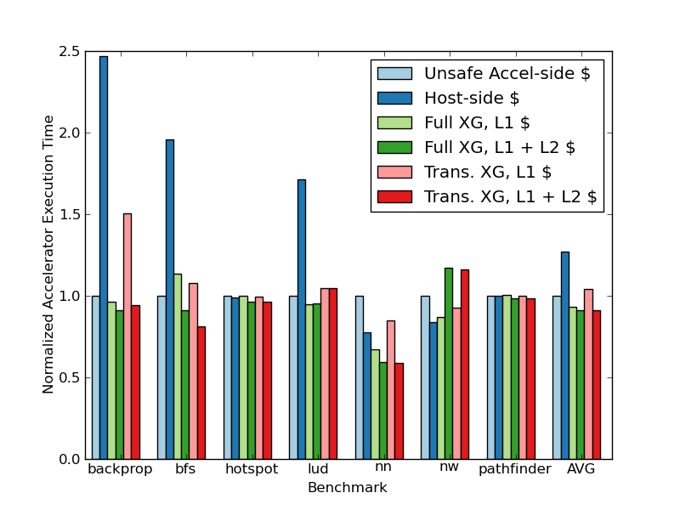
Performance: Hammer-like

Slide 48
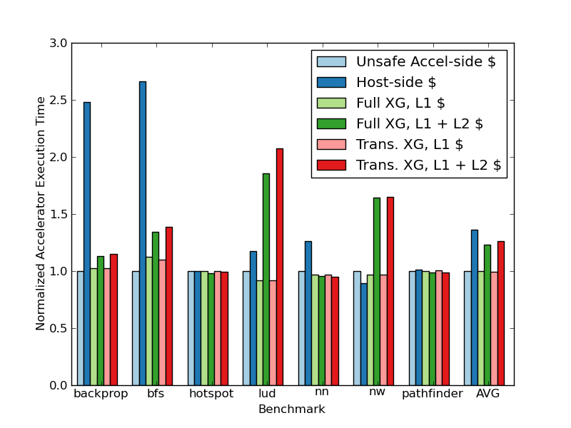
Performance: MESI Inclusive

Slide 49
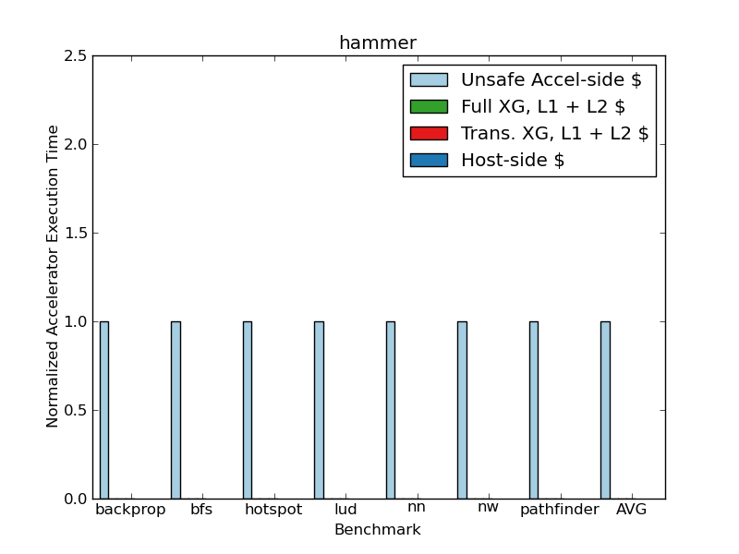
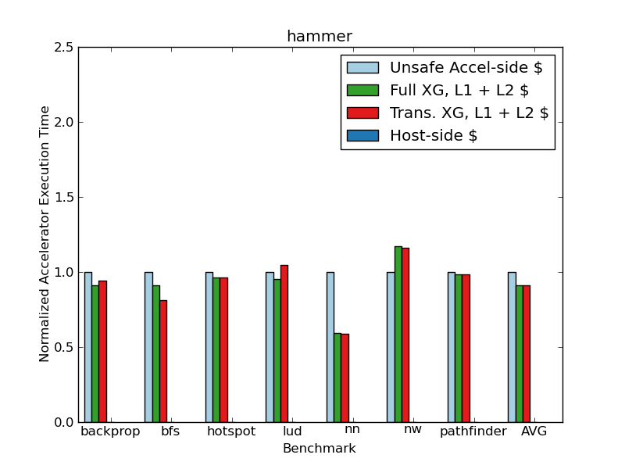
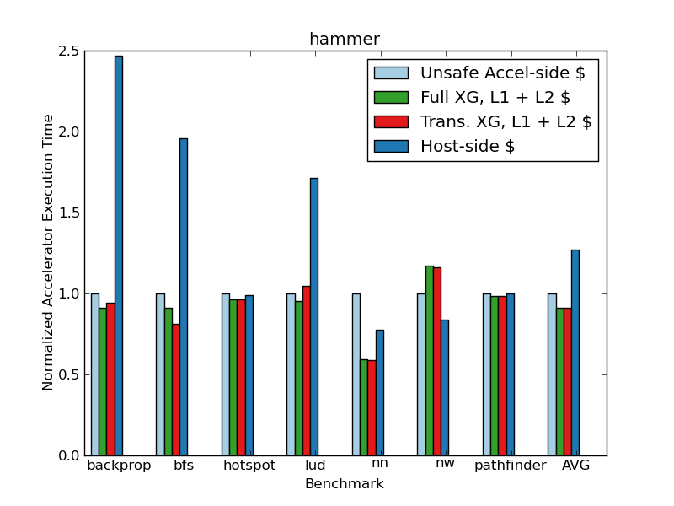
Performance (Hammer-like)

Slide 50
Template
Accel Cache
Cache #1
Cache #2
Addr State
A I
Addr State
A I
Addr State
A I
GetM
Ack
Addr State Acks Reqs Timer
A I 0 - 0
Cache #0
GetM
Addr State Owner/Sharers Req
A SS 1, 2 -
Directory

Slide 51
Old Slides

Slide 52

3. Why Host Safety?
Accelerator cache
Addr A: ?
Ack
Addr: A
Addr A: RW
? ? ?
? ? ?
Addr A: Not Present in caches
Directory

Slide 53

3. Why Host Safety?
Accelerator cache
Addr A: M
Addr A: RW
Addr A: M, owned by accelerator
Fwd-GetM
Addr: A
Directory

Slide 54
Crossing Guard Example
Accelerator cache
Addr A: M
Writeback
Addr: A
A: waiting for WB
Invalidate
Addr: A
Addr A: RW
Addr A: M, owned by accelerator
Fwd-GetM
Addr: A
Directory

Slide 55
Crossing Guard Example
Accelerator cache
Addr A: M
Invalidate
Addr: A
A: waiting for WB
Writeback
Addr: A
Addr A: RW
Addr A: M, owned by accelerator
Fwd-GetM
Addr: A
Directory

