Slide 2

Taming Local Users and Remote Clouds with HTCondor at CERN
Ben Jones -- ben.dylan.jones@cern.ch

Slide 3
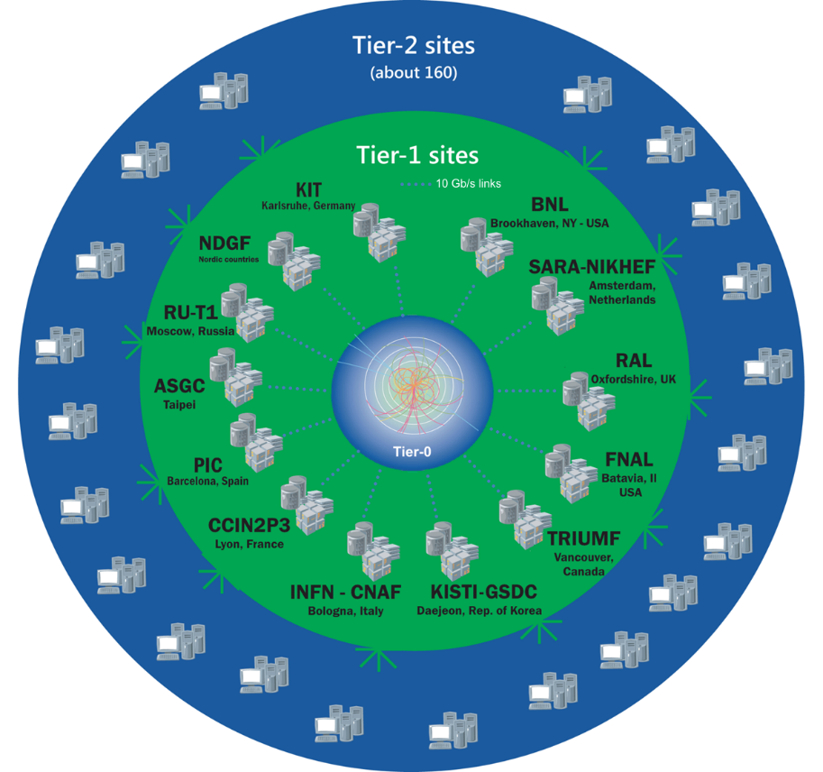
Worldwide LHC Computing Grid
TIER-0 (CERN):
data recording, reconstruction and distribution
nearly 170 sites,
40 countries
~350’000 cores
TIER-1:
permanent storage,
re-processing,
analysis
500 PB of storage
> 2 million jobs/day
TIER-2:
Simulation,
end-user analysis
10-100 Gb links
Notes:
I’m the Service Manager of the batch system in tier-0 of this diagram. The LCG is obviously an extremely important use case for the Batch system, often making up most, but not all, its use

Slide 4
Run 2 has only just started
Hint of an excess with diphoton mass of 750 GeV
  Seen by ATLAS and CMS – coincidence or a new signal?
Notes:
Two experiments are showing something “strange”
300 theory papers already being written
Interesting but can also be a statistical fluctuation

Slide 5
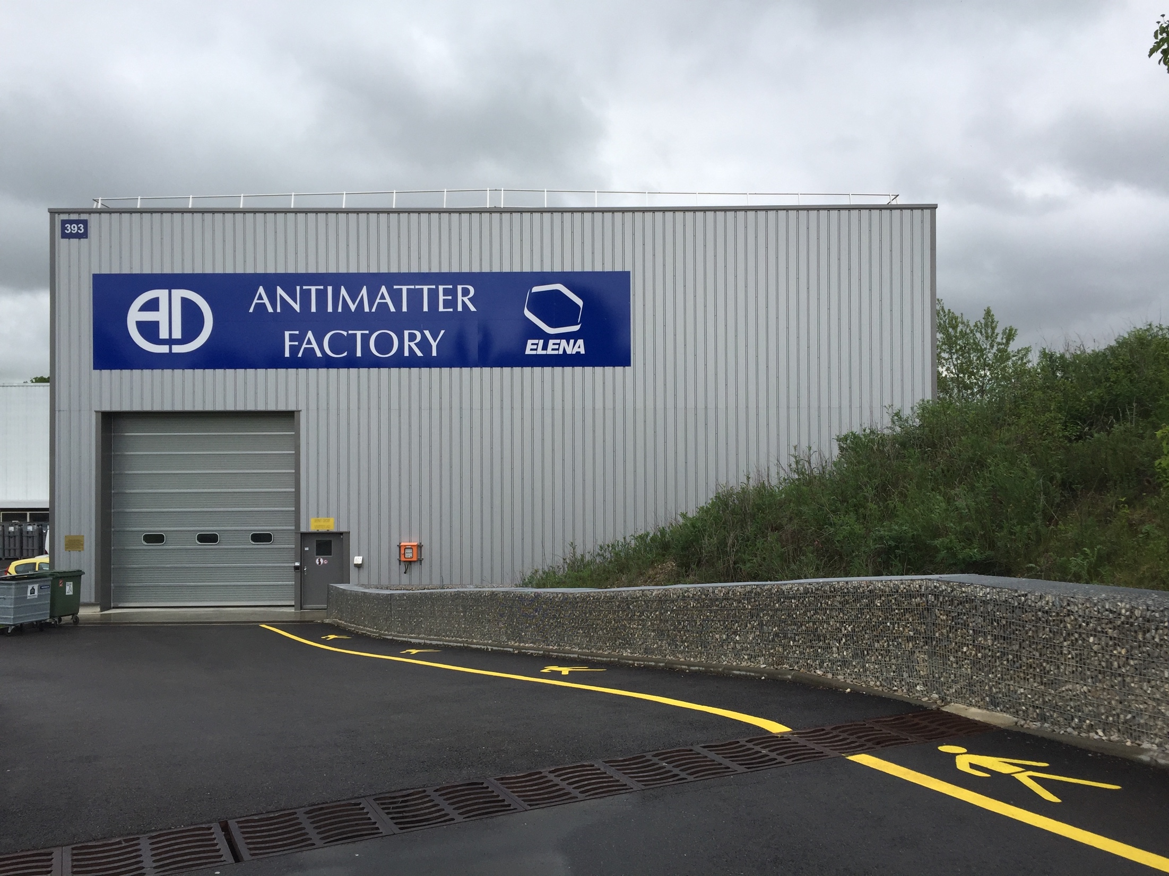
Notes:
There are though of course other experiments, such as this one which is behind my office in building 31. The AD has experiments such as ALPHA which tries to trap antihydrogen and see things like whether it falls up or down in gravity (down, they think)

Slide 6
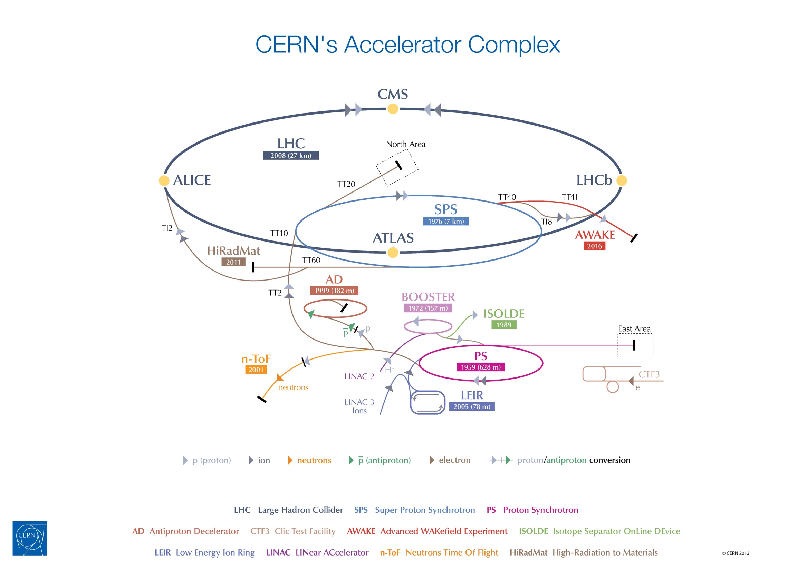
Notes:
For AD: beam of protons from the PS that gets fired into a block of metal. Energy from the collisions is enough to create a new proton-antiproton pair about once in every million collisions
Other experiments, and indeed batch system users that feed from the complex, such as COMPASS at the SPS
And then batch users that aren’t part of the accelerator complex, like AMS which is looking for anti-matter and evidence of dark matter with a module mounted on the ISS.

Slide 7
Batch Service at CERN
Service used for both grid and local submissions (roughly equal %)
Local public share open to all CERN users
400-600K job submissions / day
~60K Running jobs
Migration to HTCondor from LSF underway
  Some grid already moved, local imminent
  Vanilla, but planning on Docker

Slide 8
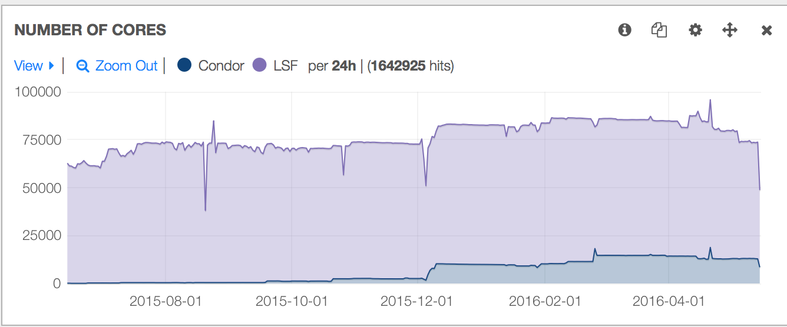
LSF v HTCondor

Slide 9
Requirements
Users need:
  Auth tokens for internal services (yes, including AFS $HOME)
  A schedd to use, and to query
  An accounting group to be charged to
  Some nice defaults for things like job timing
We need:
  Defined units of compute: 1 core means 2gb RAM, 20GB scratch

Slide 10
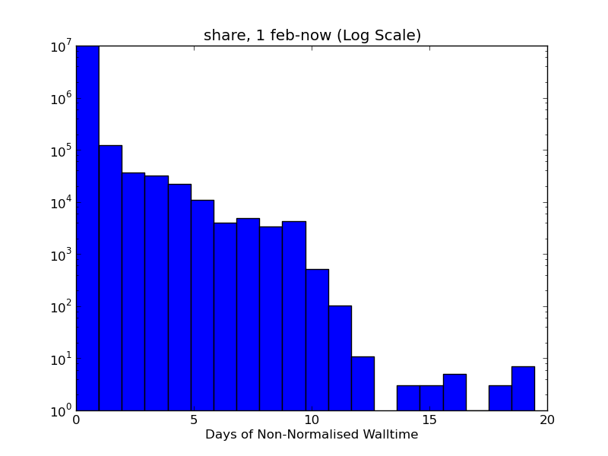
Token expiry
Standard expiry time is 1 day, renewable to 7 days
Our jobs can last for > 7 days
Mechanism required to keep authentication tokens refreshed (and in our case, beyond standard)

Slide 11
Integration with Kerberos
Controlled by config vars:
  SEC_CREDENTIAL_PRODUCER
  SEC_CREDENTIAL_MONITOR
  SEC_CREDENTIAL_DIRECTORY
Ability to add scripts to generate initial kerberos tickets, and to renew as necessary
Condor will monitor, copy to sandbox and refresh as necessary

Slide 12
Submit Side
condor_submit calls SEC_CREDENTIAL_PRODUCER which acquires a kerberos AS-REQ
The AP-REQ is handed to the schedd’s condor_credd by condor_submit, and is written to the schedd’s SEC_CREDENTIAL_DIRECTORY
The SEC_CREDENTIAL_MONITOR monitors the directory, and acquires/renews TGT

Slide 13
Execute Side
condor_starter copies credentials into the SEC_CREDENTIAL_DIRECTORY when a user has jobs scheduled to execute, and removes when there are no jobs left
The SEC_CREDENTIAL_MONITOR will acquire/renew TGTs with the stored AP-REQ
The TGT will be copied to the job sandbox when the job runs, with KRB5_CCNAME set

Slide 14
Schedds
Number of user jobs means we need multiple schedds
Want to make it easy & cheap to query, so needs to be static assignment
Currently using zookeeper as the k/v store
znode contains schedd
  /htcondor/users/$username/{current,old}
LOCAL_CONFIG_FILE piped script to contact zk on submit / query for schedd

Slide 15
Jobflavours
Current LSF service has defined queues for local
  Defined as “normalised” minutes/hours/weeks
  Slot limits for individual queues (ie limit long queues)
Use mixture of startd and schedd policy to enforce
Default to short time to ensure users think about it, restrict number of long slots

Slide 16
Accounting groups
Assigning users to accounting groups and delegating control to VO admin
  (hopefully using BNL’s solution)
Use SUBMIT_REQUIREMENTS and PROTECTED attribute to make Account group required and immutable
Also use SUBMIT_REQUIREMENTS to ensure users don’t request > 2gb / core

Slide 17
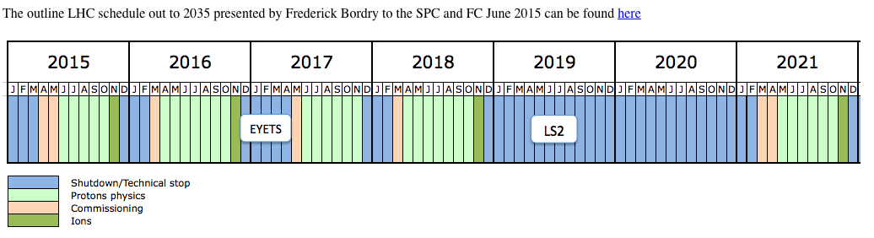
Compute Growth Outlook
Compute: Growth > x50
Moore’s law only x16
What we can afford
… and 400PB/year in Run 4
Notes:
EYETS – extended year technical stop

Slide 18
Cloudy with a chance of jobs…
“There is no cloud: it’s just someone elses computer”
Current public cloud investigations around adding flat capacity (cheaper), not elasticity
Treat additions to htcondor pool as just more computers, somewhere else
We maybe trust them slightly less

Slide 19
HTCondor cloud details
Most of plant mapped to worker-node, cloudy nodes mapped to xcloud-worker
  Differences in how we add in mapfile
We use a less trusted CA (no perms beyond joining pool)
For most VOs, common submission point using routes
  Jobs: +remote_queue=“externalcloud”
  Machines: XBatch =?= True

Slide 20
Questions

