Slide 1
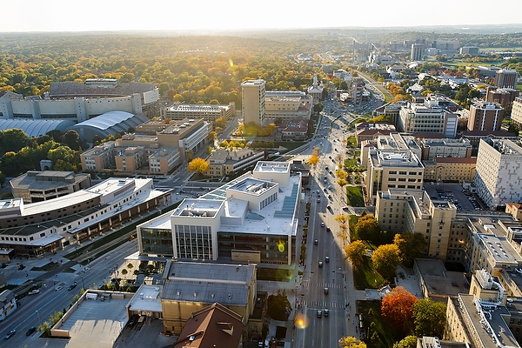
Facilitating Researchers with HTC Workloads
Lauren Michael, Research Computing Facilitator
Center for High Throughput Computing
22 Mar 2016

Slide 2
Overview
Research Computing at UW-Madison
The right people for support
The right model of support
Reaching researchers with HTC needs
Facilitating researchers with HTC needs

Slide 3
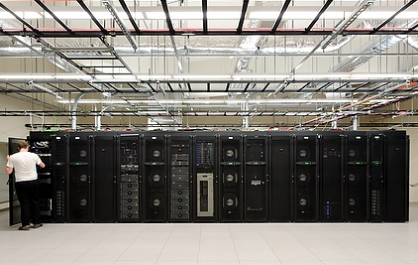
CHTC Services
Center for High Throughput Computing, est. 2006
Large-scale, campus-shared computing systems
  high-throughput computing (HTC) and
  high-performance computing (HPC) systems
  all standard services provided free-of-charge
  hardware buy-in options
  support and training for
  using our systems
  proposal assistance
  chtc.cs.wisc.edu

Slide 4

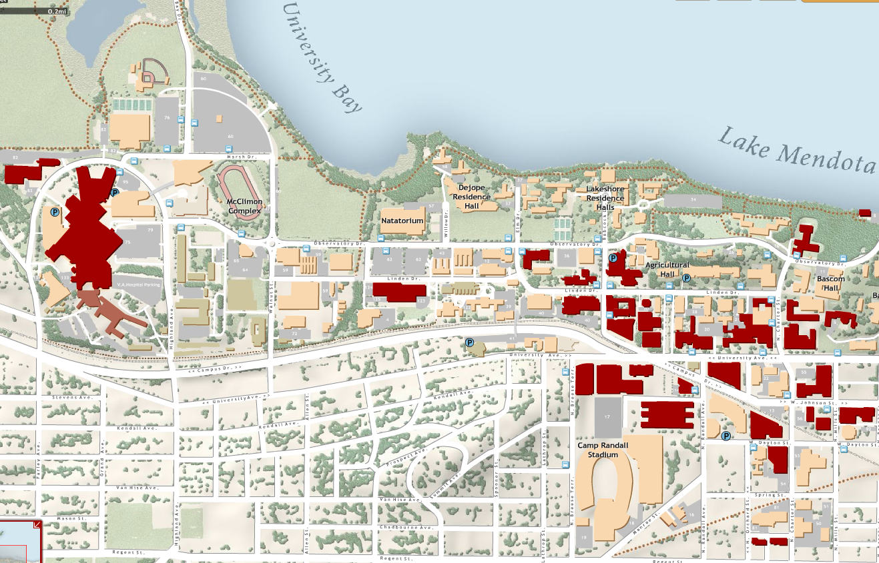
http://chtc.cs.wisc.edu
Jul’12- Jun’13 | Jul’13- Jun’14 | Jul’14- Jun’15 | Quick Facts
97 | 132 | 265 | Million Hours Served
120 | 148 | 188 | Research Projects
52 | 56 | 61 | Departments
Researchers who use the CHTC are located all over campus (red buildings)

Slide 5

Accessible HTC Computing:
CHTC
Notes:
We also have an HPC cluster, managed with SLURM, but ‘backfilled’ with HTCondor jobs as part of the CHTC Pool.

Slide 6
CHTC-Accessible Computing:
“UW Grid”
CHTC
Notes:
We also have an HPC cluster, managed with SLURM, but ‘backfilled’ with HTCondor jobs as part of the CHTC Pool.

Slide 7
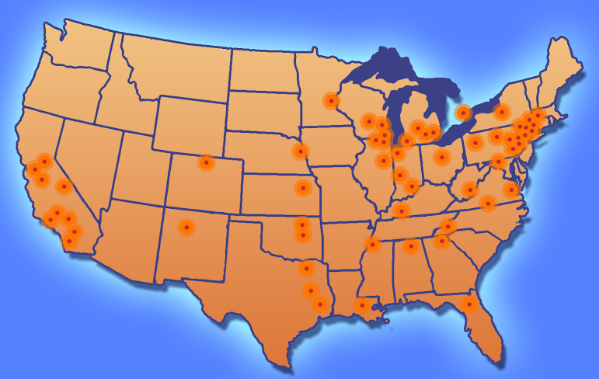
CHTC-Accessible Computing:
Open Science Grid
“UW Grid”
CHTC
Notes:
We also have an HPC cluster, managed with SLURM, but ‘backfilled’ with HTCondor jobs as part of the CHTC Pool.

Slide 8
http://chtc.cs.wisc.edu
Jul’12- Jun’13 | Jul’13- Jun’14 | Jul’14- Jun’15 | Quick Facts
97 | 132 | 265 | Million Hours Served
120 | 148 | 188 | Research Projects
52 | 56 | 61 | Departments
Individual researchers:
30 years of computing
per day
Researchers who use the CHTC are located all over campus (red buildings)

Slide 9
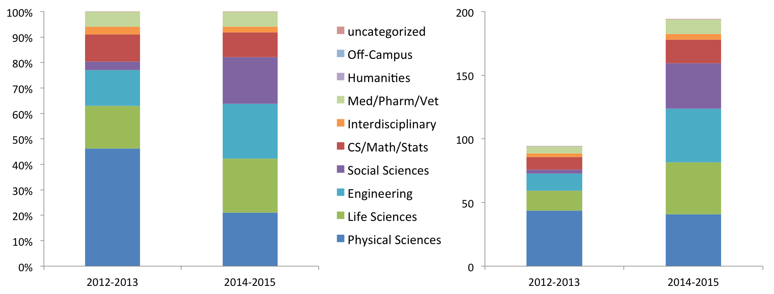
http://chtc.cs.wisc.edu
Jul’12- Jun’13 | Jul’13- Jun’14 | Jul’14- Jun’15 | Quick Facts
97 | 132 | 265 | Million Hours Served
120 | 148 | 188 | Research Projects
52 | 56 | 61 | Departments
% of Compute Hours Absolute Compute Hours
Researchers who use the CHTC are located all over campus (red buildings)

Slide 10
Users are people.
Researchers are people.

Slide 11
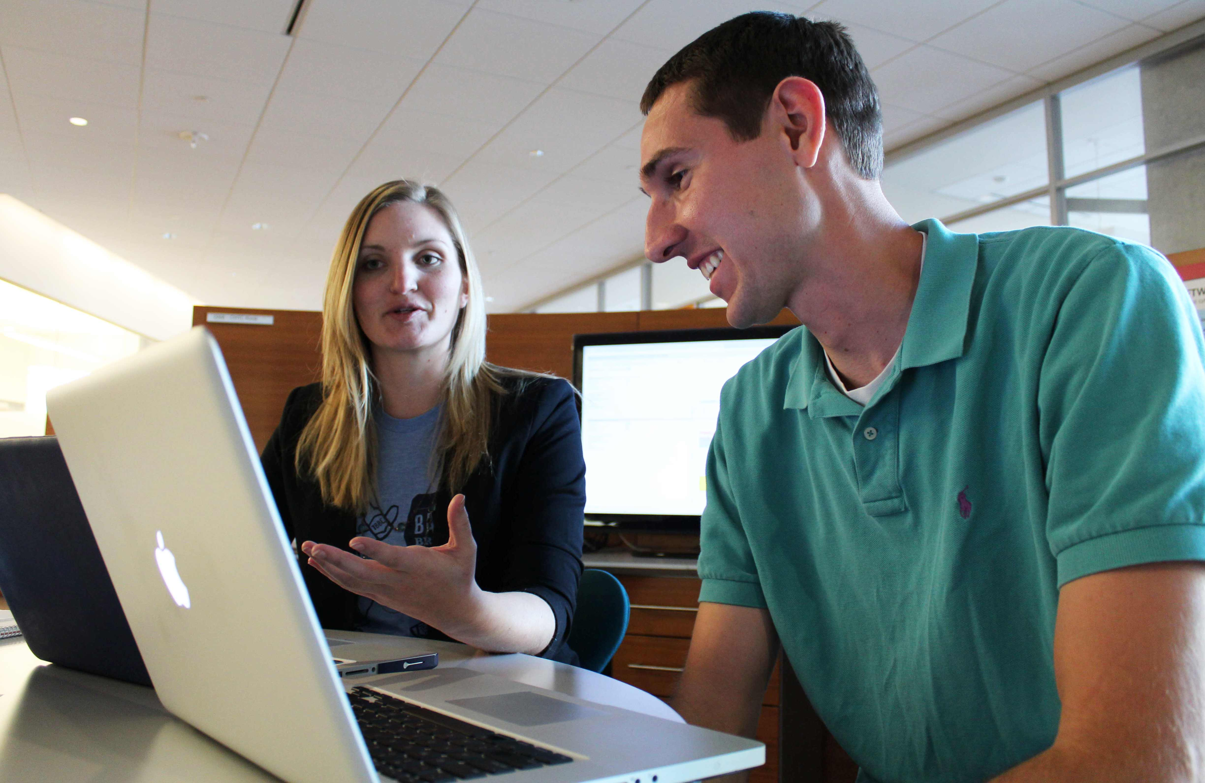
Make it easy for researchers
to find the right people.
“Facilitators”
-consultants/liaisons for research computing
-identify with the user perspective

Slide 12
Research Computing
Facilitation
proactive engagement
personalized guidance
teach-to-fish
relationship building
advocating for researchers
professional networking
http://aci-ref.github.io/facilitation_best_practices/
Michael, L. and Maas, B. Research Computing Facilitators: The Missing Human Link in Needs-Based Research Cyberinfrastructure. ECAR, May 16, 2016.

Slide 13
Research Computing
Facilitation
proactive engagement
personalized guidance
teach-to-fish
relationship building
advocating for researchers
professional networking
beyond-the-helpdesk
deliberate
designated
dedicated
http://aci-ref.github.io/facilitation_best_practices/
Michael, L. and Maas, B. Research Computing Facilitators: The Missing Human Link in Needs-Based Research Cyberinfrastructure. ECAR, May 16, 2016.

Slide 14
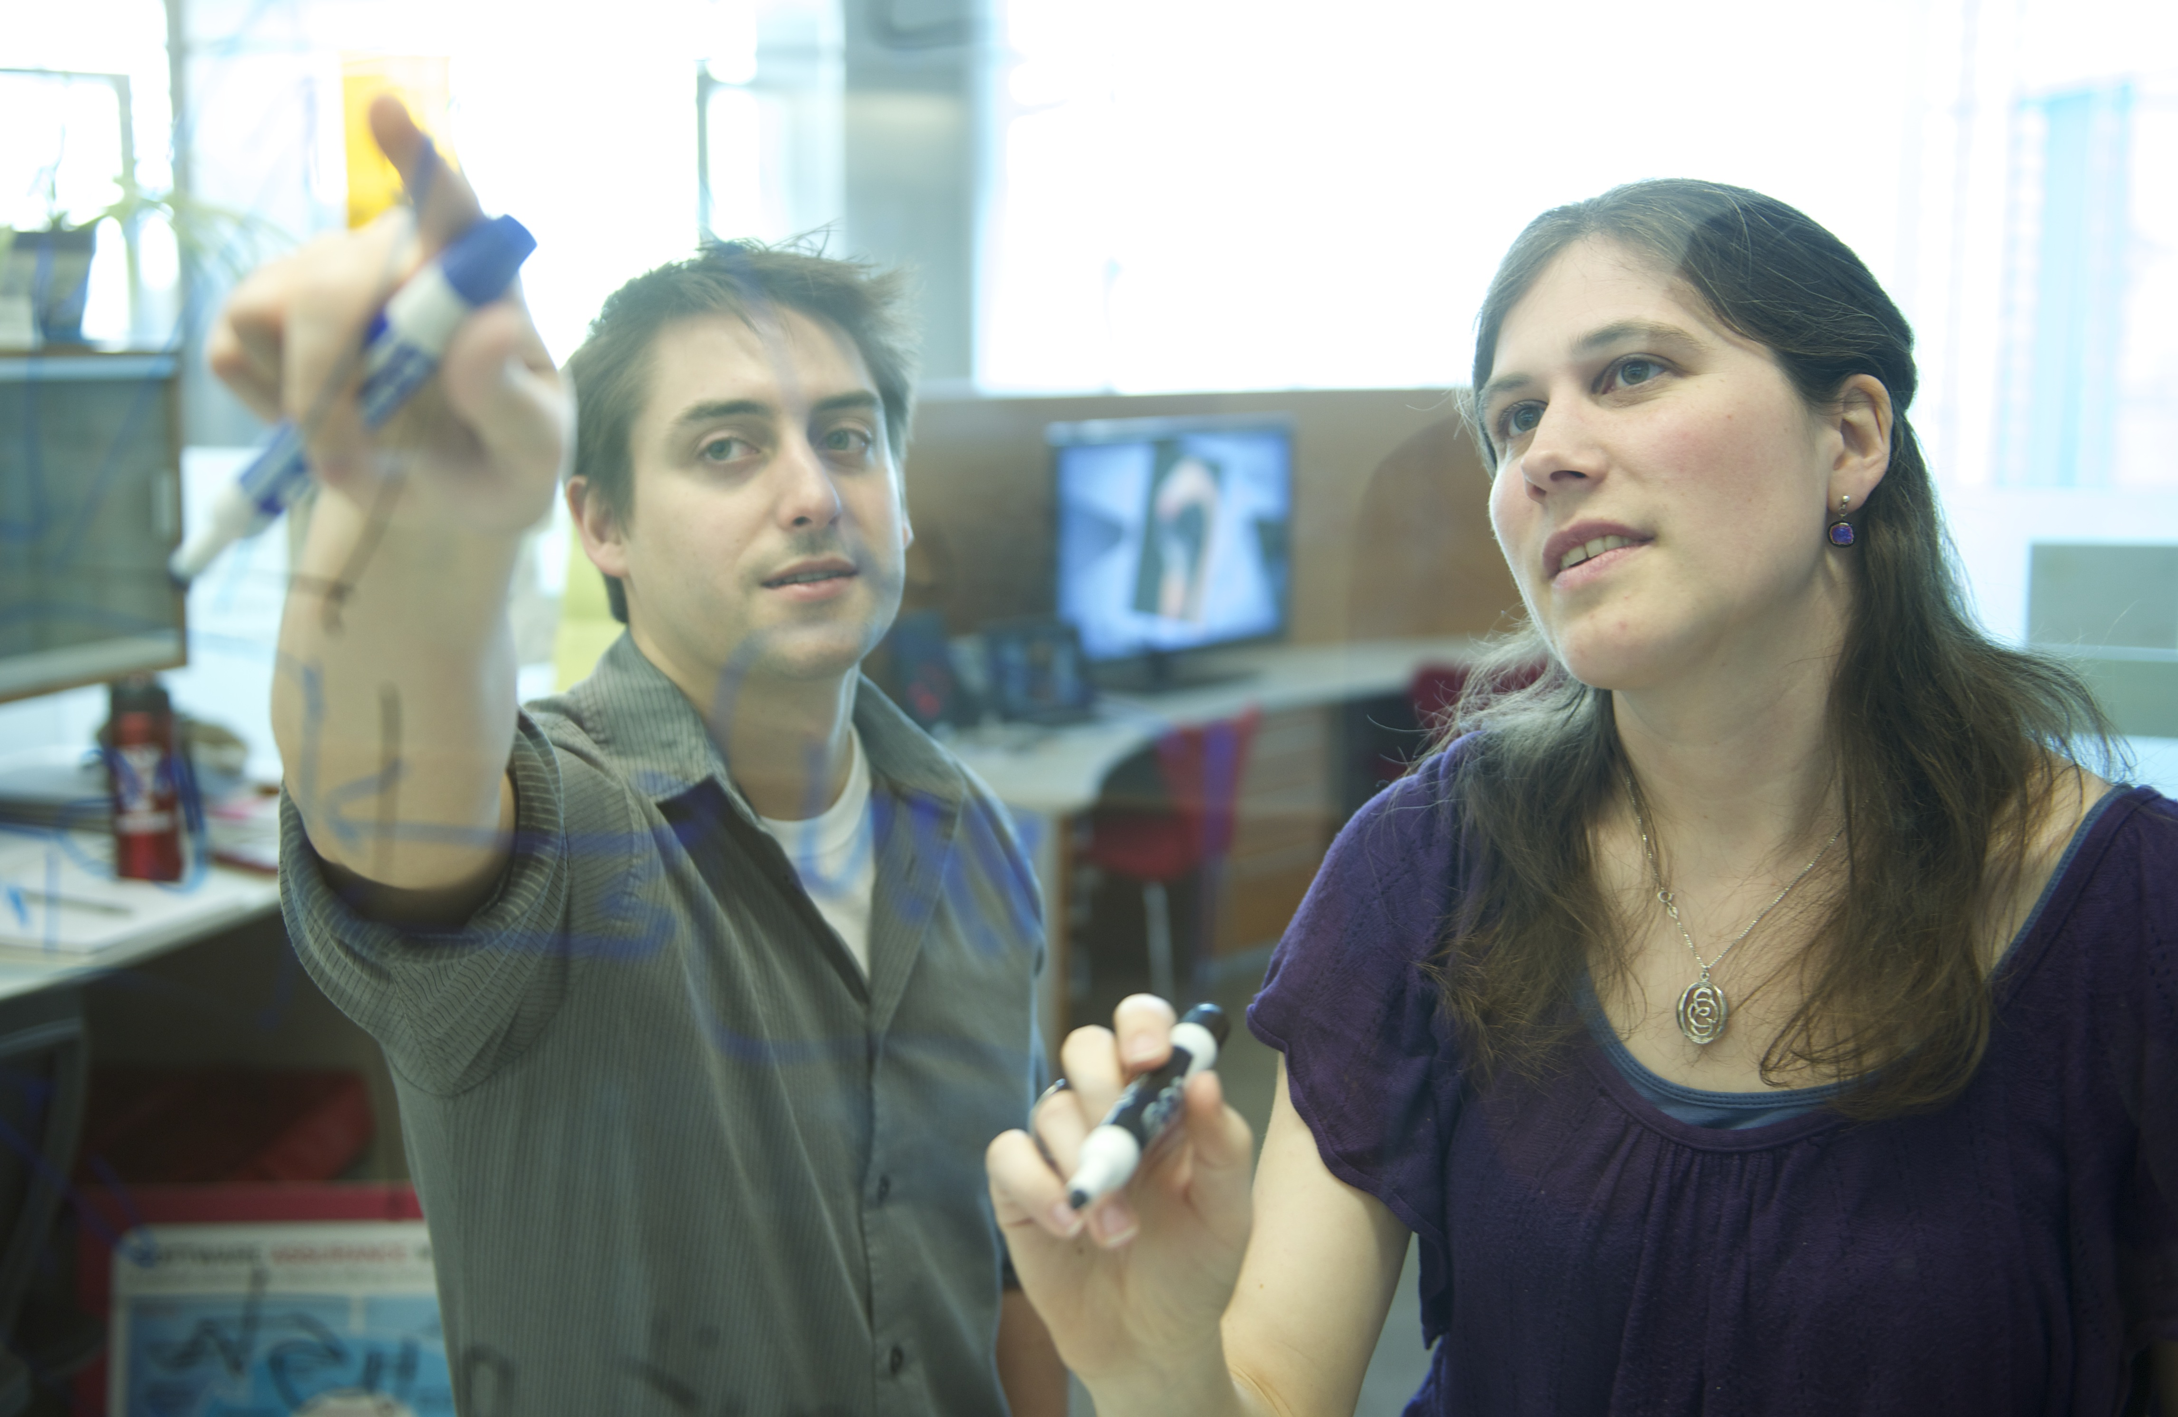

Research Computing
Facilitators
Communication, Teaching, Leadership
Scholarship Experience
Technical Skills

Slide 15
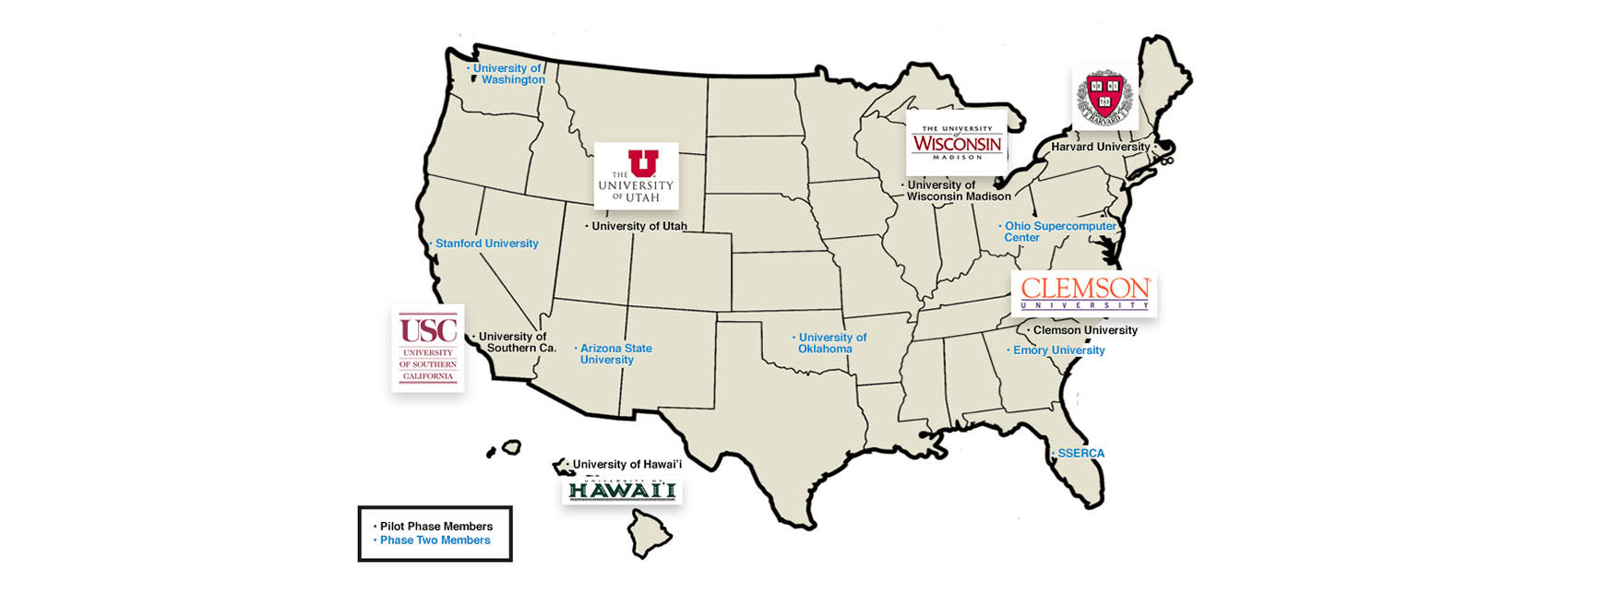
Share support practices
with others!
Advanced Computing Infrastructure
Research and Education Facilitators (ACI-REF)
https://aciref.org

Slide 16
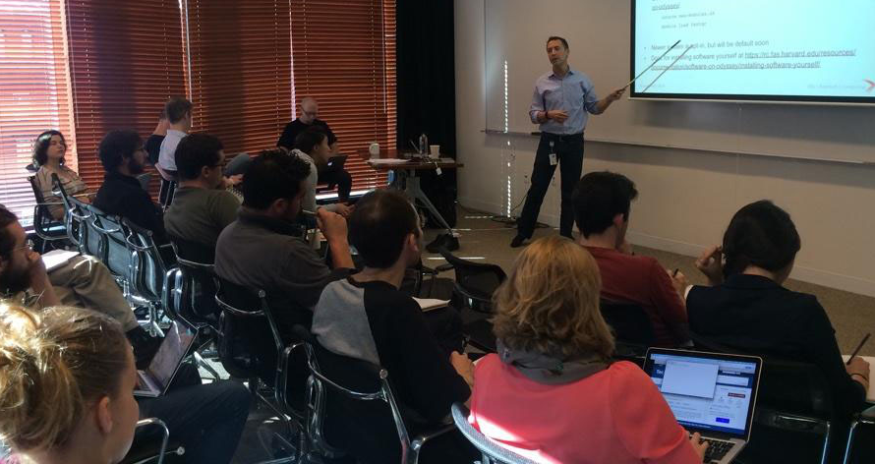
Reaching Researchers with HTC Needs

Slide 17
How to attract researchers with HTC needs.
Notes:
This is the WRONG angle.

Slide 18
How to attract researchers with HTC needs.
Just help researchers with
COMPUTING
(not “HTC” or “HPC”, etc.)
Promote AWARENESS

Slide 19
Identifying HTC-able Research Problems
n processors
time

Slide 20
Observables of
HTC-able workloads
long for-loops
numerous similar files per job
file system performance issues?
numerous similar jobs in the queue
single-server, multi-core software
Matlab’s “parfor”, OpenMP, etc.

Slide 21
Researcher indicators
of potential HTC
“model optimization”
“parameter sweep”
“text analysis”
“image analysis”
“library” “database for output”
More: http://research.cs.wisc.edu/htcondor//HTCondorWeek2016/presentations/ThuKoch_Taxonomy.pdf

Slide 22
Facilitating Researchers with HTC Needs

Slide 23
Teach Key Components
of Executing HTC Work
Breaking Up Workloads
Data Management
Software Portability
Automation
Long-Term Pay-Offs

Slide 24
Breaking Up Workloads
Discuss conceptually
for programs AND files
Plan programming and/or
execution modifications
Batch multiple very short tasks
together in each “job”
Test small, understand resource
requirements, optimize, scale up
Checkpointing!
data prep
process
combine results

Slide 25
Data Management
(beyond typical management of metadata, paths, etc.)
scalable file-naming and organization
organize “shared” data and job-specific data
separately, avoiding unnecessary duplicates
compression for file transfers
stage large files off of the submit server
organize software files, too

Slide 26
Teach Researchers
How Software Works (!!!)

Slide 27
Teach Researchers
How Software Works (!!!)
Portability is a must for HTC scalability
Empower full control over versions
reproducibility! experimentation!
Reduce researcher dependency on staff and specific, local configurations
extensibility for future work and compute systems
Acknowledge licensing limitations to inform software selection

Slide 28
Encourage Automation
data prep
(manual)
DAG
data prep
process
process
combine
(manual)
combine

Slide 29
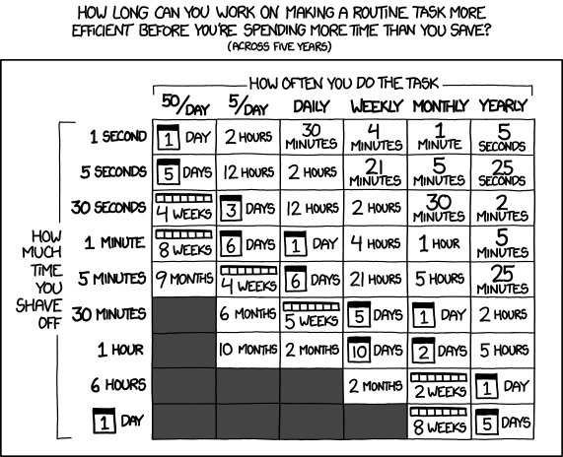
Help Researchers to
See Big Picture Payoffs
xkcd.com/1205

Slide 30
Infrastructure
= Technology + People
“Lauren Michael’s value to the overall enterprise is hard to overestimate. Putting someone so capable of explaining procedures in simple but powerful terms greatly enhances the effective power and utility of the millions invested in the hardware.”
-Tom Givnish, Botany
Compute Hours Delivered at UW-Madison
“With extensive help from [RCFs] we adapted our workflow to run seamlessly on the HTC platform and have now utilized these resources to construct the largest computed diffusion database in the world.”
-Dane Morgan,
Materials Science and Engineering

Slide 31
Facilitating Researchers with HTC Workloads
Lauren Michael, Research Computing Facilitator
Center for High Throughput Computing
22 Mar 2016

