Slide 1
Priority and Provisioning Greg Thain HTCondorWeek 2015

Slide 2
Overview
Important HTCondor architecture bits
Detour to items that doesn’t fit elsewhere
Groups and why you should care
User priorities and preemption
Draining

Slide 3
Provisioning vs. Scheduling
HTCondor separates the two
Very important
Central Manager (negotiator) provisions
Schedd schedules

Slide 4
Provisioning
Negotiator selects a slot for a USER
Based on USER attributes (and machine)
With some small thought to the users’s job
At slower frequency: the negotiation cycle
Don’t obsess about negotiation cycle time

Slide 5
Scheduling
Schedd takes that slot for the user
And runs one or more jobs on it
For how long?
CLAIM_WORKLIFE = some_seconds

Slide 6
Consequences
May take much longer to start 1st job
The central manager responsible for users
The central manager responsible for groups
Accounting happens in the CM

Slide 8
Now, for the detour…

Slide 9
Schedd Policy: Job Priority
Set in submit file with: JobPriority = 7
… or dynamically with condor_prio cmd
Integers, larger numbers are better priority
Only impacts order between jobs for a single user on a single schedd
A tool for users to sort their own jobs

Slide 10
Schedd Policy: Job Rank
Set with
RANK = Memory
In condor_submit file
Not as powerful as you may think:
Negotiator gets first cut at sorting
Remember steady state condition

Slide 11
Concurrency Limits
Useful for globally (pool-wide):
License limits,
NFS server overload prevention
Limiting database access
Limits total number jobs across all schedds

Slide 12
Concurrency Limits (2)
In central manager config
MATLAB_LICENSE_LIMIT = 10
In submit file
concurrency_limits = matlab

Slide 13
Rest of this talk: Provisioning, not Scheduling
schedd sends idle users to the negotiator
Negotiator picks machines (idle or busy) to send to the schedd for those users
How does it pick?

Slide 14
What’s a user?
Bob in schedd1 same as Bob in schedd2?
If have same UID_DOMAIN, they are.
Default UID_DOMAIN is FULL_HOSTNAME
Prevents cheating by adding schedds
Map files can redefine the local user name

Slide 15
Or, a User could be a “group”

Slide 16
Accounting Groups (2 kinds)
Manage priorities across groups of users Can guarantee maximum numbers of computers for groups (quotas)
Supports hierarchies
Anyone can join any group

Slide 17
Accounting Groups as Alias
In submit file
Accounting_Group = group1
Treats all users as the same for priority
Accounting groups not pre-defined
No verification – condor trusts the job
condor_userprio replaces user with group

Slide 18
Accounting Groups w/ Quota aka: “Hierarchical Group Quota”

Slide 19
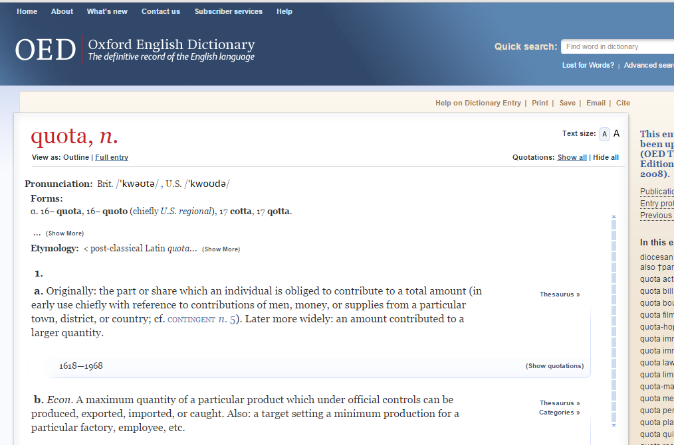
Maximum

Slide 20
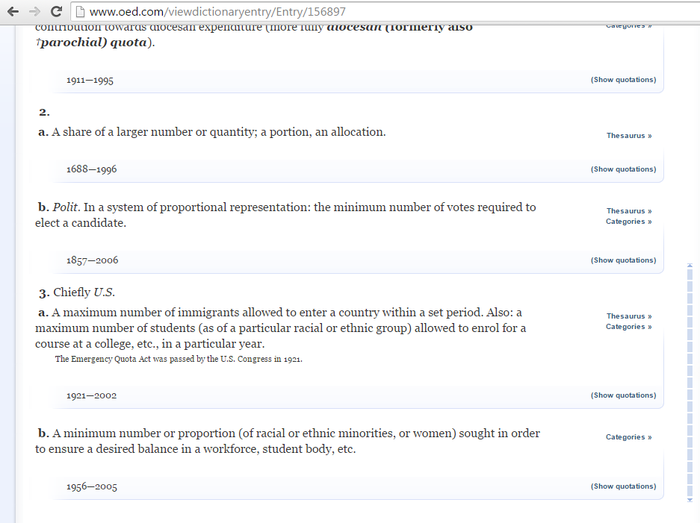
Minimum

Slide 21
HGQ: Strict quotas
“a” limited to 10
“b” to 20,
Even if idle machines
What is the unit?
Slot weight.
With fair share of users within group

Slide 22
Group_accept_surplus
Group_accept_surplus = true
Group_accept_surplus_a = true
This is what creates hierarchy
But only for quotas

Slide 23
GROUP_AUTOREGROUP
Allows groups to go over quota if idle machines
“Last chance” wild-west round, with every submitter for themselves.

Slide 24
Hierarchical Group Quotas
700
200
physics
CompSci
100
600
100
100
string theory
particle physics
architecture
DB
200
200
100
CMS
ATLAS
CDF

Slide 25
Hierarchical Group Quotas
700
GROUP_QUOTA_physics = 700
GROUP_QUOTA_physics.string_theory = 100
GROUP_QUOTA_physics.particle_physics = 600
GROUP_QUOTA_physics.particle_physics.CMS = 200
GROUP_QUOTA_physics.particle_physics.ATLAS = 200
GROUP_QUOTA_physics.particle_physics.CDF = 100
physics
100
600
string theory
particle physics
200
200
100
group.sub-group.sub-sub-group…
CMS
ATLAS
CDF

Slide 26
Hierarchical Group Quotas
700
Groups configured to accept surplus will share it in proportion to their quota.
physics
100
600
string theory
particle physics
Here, unused particle physics surplus is shared by ATLAS and CDF.
200
200
100
CMS
ATLAS
CDF
2/3 surplus
1/3 surplus
GROUP_ACCEPT_SURPLUS_physics.particle_physics.ATLAS = true
GROUP_ACCEPT_SURPLUS_physics.particle_physics.CDF = true

Slide 27
Hierarchical Group Quotas
700
Job submitters may belong to a parent group in the hierarchy.
physics
100
600
string theory
particle physics
1/4 surplus
Here, general particle physics submitters share surplus with ATLAS and CDF.
200
200
100
CMS
ATLAS
CDF
2/4 surplus
1/4 surplus

Slide 28
Hierarchical Group Quotas
700
Quotas may be specified as decimal fractions.
physics
100
600
string theory
particle physics
Here, sub-groups sum to 1.0, so general particle physics submitters get nothing.
0.40
0.40
0.20
CMS
ATLAS
CDF
0.40*600=240
0.40*600=240
0.20*600=120
GROUP_QUOTA_DYNAMIC_physics.particle_physics.CMS=0.4

Slide 29
Hierarchical Group Quotas
700
Quotas may be specified as decimal fractions.
physics
100
600
600-180-180-90=150
string theory
particle physics
Here, sub-groups sum to 0.75, so general particle physics submitters get 0.25 of 600.
0.30
0.30
0.15
CMS
ATLAS
CDF
0.30*600=180
0.30*600=180
0.15*600=90

Slide 30
Hierarchical Group Quotas
700
Static quotas may be combined with dynamic quotas.
physics
100
600
600-200-200-100=100
string theory
particle physics
Here, ATLAS and CDF have dynamic quotas that apply to what is left over after the CMS static quota is subtracted.
200
0.5
0.25
CMS
ATLAS
CDF
0.5*(600-200)=200
0.25*(600-200)=100

Slide 31
Gotchas with quotas
Quotas don’t know about matching
Assuming everything matches everything
Surprises with partitionable slots
Managing groups not easy
May want to think about draining instead.

Slide 32
Enough about Groups
Remember: group quota comes first!
Groups only way to limit total running jobs per user/group
Haven’t gotten to matchmaking yet

Slide 33
Negotiation Cycle
Gets all the slot ads from collector
Based on new user prio, computes submitter limit for each user
Foreach user, finds the schedd, gets a job
Finds all matching machines for job
Sorts the machines
Gives the job the best machine (may preempt)

Slide 34
Negotiator metric: User Priority
Negotiator computes, stores the user prio
View with condor_userprio tool
Inversely related to machines allocated (lower number is better priority)
A user with priority of 10 will be able to claim twice as many machines as a user with priority 20

Slide 35
User Priority
(Effective) User Priority is determined by multiplying two components
Real Priority * Priority Factor

Slide 36
Real Priority
Based on actual usage, starts at .5
Approaches actual number of machines used over time
Configuration setting PRIORITY_HALFLIFE
If PRIORITY_HALFLIFE = +Inf, no history
Default one day (in seconds)
Asymptotically grows/shrinks to current usage

Slide 37
Priority Factor
Assigned by administrator
Set/viewed with condor_userprio
Persistently stored in CM
Defaults to 1000 (DEFAULT_PRIO_FACTOR)
Allows admins to give prio to sets of users, while still having fair share within a group
“Nice user”s have Prio Factors of 1,000,000

Slide 38
condor_userprio
Command usage:
condor_userprio –most
Effective Priority
User Name Priority Factor In Use (wghted-hrs) Last Usage
---------------------------------------------- --------- ------ ----------- ----------
lmichael@submit-3.chtc.wisc.edu 5.00 10.00 0 16.37 0+23:46
blin@osghost.chtc.wisc.edu 7.71 10.00 0 5412.38 0+01:05
osgtest@osghost.chtc.wisc.edu 90.57 10.00 47 45505.99 <now>
cxiong36@submit-3.chtc.wisc.edu 500.00 1000.00 0 0.29 0+00:09
ojalvo@hep.wisc.edu 500.00 1000.00 0 398148.56 0+05:37
wjiang4@submit-3.chtc.wisc.edu 500.00 1000.00 0 0.22 0+21:25
cxiong36@submit.chtc.wisc.edu 500.00 1000.00 0 63.38 0+21:42

Slide 39
Prio factors with groups
condor_userprio –setfactor 10 group1.wisc.edu
condor_userprio –setfactor 20 group2.wisc.edu
Note that you must get UID_DOMAIN correct
Gives group1 members 2x resources as group2

Slide 40
Sorting slots: sort levels
NEGOTIATOR_PRE_JOB_RANK =
RemoteOwner =?= UNDEFINED
JOB_RANK = mips
NEGOTIATOR_POST_JOB_RANK =
(RemoteOwner =?= UNDEFINED) * (KFlops)

Slide 41
Power of NEGOTIATOR_PRE_JOB_RANK
Very powerful
Used to pack machines
NEGOTIATOR_PRE_JOB_RANK = isUndefined(RemoteOwner) * (- SlotId)
Sort multicore vs. serial jobs

Slide 42
More Power of NEGOTIATOR_PRE_JOB_RANK
Best fit of multicore jobs:
NEGOTIATOR_PRE_JOB_RANK =
(1000000 * (RemoteOwner =?= UNDEFINED)) - (100000 * Cpus) - Memory

Slide 43
If Matched machine claimed, extra checks required
PREEMPTION_REQUIREMENTS and PREEMPTION_RANK
Evaluated when condor_negotiator considers replacing a lower priority job with a higher priority job
Completely unrelated to the PREEMPT expression (which should be called evict)
43

Slide 44
A note about Preemption
Fundamental tension between
Throughput vs. Fairness
Preemption is required to have fairness
Need to think hard about runtimes, fairness and preemption
Negotiator implementation preemption
(Workers implement eviction: different)

Slide 45
PREEMPTION_REQUIREMENTS
MY = busy machine // TARGET = job
If false will not preempt machine
Typically used to avoid pool thrashing
Typically use:
RemoteUserPrio – Priority of user of currently running job (higher is worse)
SubmittorPrio – Priority of user of higher priority idle job (higher is worse)

Slide 46
PREEMPTION_REQUIREMENTS
Replace jobs running > 1 hour and 20% lower priority
StateTimer = \
(CurrentTime – EnteredCurrentState)
HOUR = (60*60)
PREEMPTION_REQUIREMENTS = \
$(StateTimer) > (1 * $(HOUR)) \
&& RemoteUserPrio > SubmittorPrio * 1.2

Slide 47
Preemption with HQG
By default, won’t preempt to make quota
But, “there’s a knob for that”
PREEMPTION_REQUIREMENTS = (SubmitterGroupResourcesInUse < SubmitterGroupQuota) && (RemoteGroupResourcesInUse > RemoteGroupQuota) && ( RemoteGroup =!= SubmitterGroup

Slide 48
PREEMPTION_REQUIREMENTS is an expression
( MY.TotalJobRunTime > ifThenElse((isUndefined(MAX_PREEMPT) || (MAX_PREEMPT =?= 0)),(72*(60 * 60)),MAX_PREEMPT) )
&& RemoteUserPrio > SubmittorPrio * 1.2

Slide 49
PREEMPTION_RANK
Of all claimed machines where PREEMPTION_REQUIREMENTS is true, picks which one machine to reclaim
Strongly prefer preempting jobs with a large (bad) priority and a small image size
PREEMPTION_RANK = \
(RemoteUserPrio * 1000000)- ImageSize

Slide 50
Better PREEMPTION_RANK
Based on …
Runtime?
Cpus?
SlotWeight?

Slide 51
MaxJobRetirementTime
Can be used to guarantee minimum time
E.g. if claimed, give an hour runtime, no matter what:
MaxJobRetirementTime = 3600
Can also be an expression

Slide 52
Partitionable slots
What is the “cost” of a match?
SLOT_WEIGHT (cpus)
What is the cost of an unclaimed pslot?
The whole rest of the machine
Leads to quantization problems
By default, schedd splits slots
“Consumption Policies”: some rough edges

Slide 53
Draining and defrag
Instead of preemping, we can drain
Condor_drain command initiates draining
Defrag daemon periodically calls drain

Slide 54
Defrag knobs
DEFRAG_MAX_WHOLE_MACHINES = 12
DEFRAG_DRAINING_MACHINES_PER_HOUR = 1
DEFRAG_REQUIREMENTS = PartitionableSlot &&
TotalCpus > 4 && …
DEFRAG_WHOLE_MACHINE_EXPR=
PartitionableSlot && cpus > 4

Slide 55
Summary
Many ways to schedule
Knobs: We got ‘em!

