Slide 1
No Idle Cores
Dynamic Load Balancing in ATLAS & Other News
William Strecker-Kellogg <willsk@bnl.gov>

Slide 2
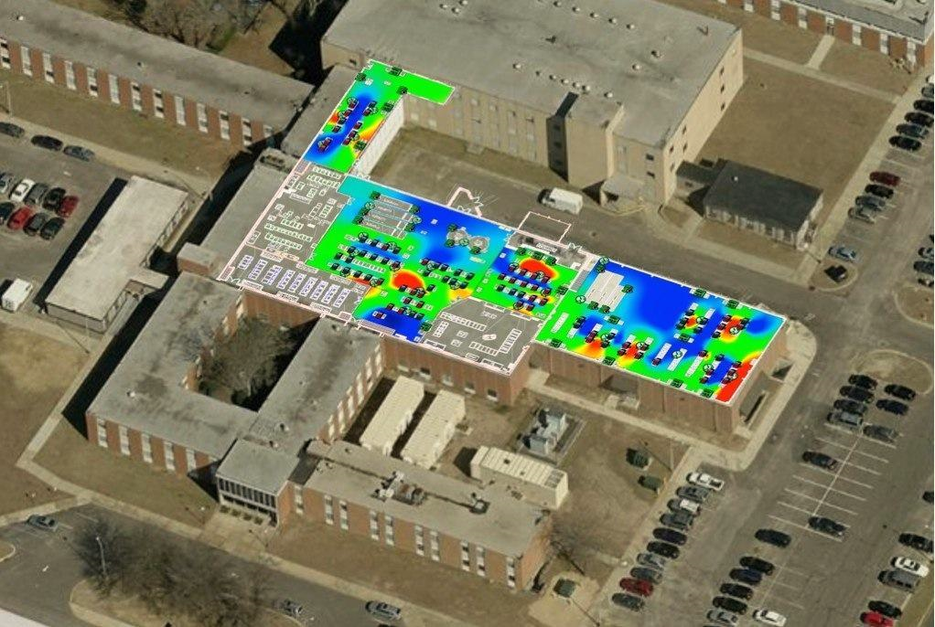
RHIC/ATLAS Computing Facility Overview
Main HTCondor Pools
STAR, PHENIX, ATLAS
Each just over 15kCPU
Running stable 8.2.7
RHIC Pools
Individual+Special Users
Workload management done by experiments
ATLAS: Focus of this talk
Local batch systems driven by external workload manager (PANDA)
Jobs are pilots
Scheduling→provisioning
Sigma-7
BCF
CDCE

Slide 3
ATLAS Configuration
Use Hierarchical Group Quotas + Partitionable Slots
My HTCondor Week talk last year was all about this
A short recap:
PANDA Queues map to groups in a hierarchical tree
Leaf-nodes have jobs
Surplus-sharing is selectively allowed
Group allocation controlled via web-interface to DB
Config file written when DB changes
All farm has one STARTD config
SLOT_TYPE_1=100%
NUM_SLOTS=1
NUM_SLOTS_TYPE_1=1
SLOT_TYPE_1_PARTITIONABLE=True
SlotWeight=Cpus

Slide 4
Partitionable Slots
Each batch node is configured to be partitioned into arbitrary slices of CPUs
Condor terminology:
Partitionable slots are automatically sliced into dynamic slots
Multicore jobs are thus accommodated with no administrative effort
Only minimal (~1-2%) defragmentation necessary
Empirically based on our farm—factors include cores/node, job sizes & proportions, and runtimes. Something like
draining=(job-length*job-size^2)/(machine-size*%mcore*occupancy)

Slide 5
Defragmentation Policy
Defragmentation Daemon
Key change: Negotiator Policy
Start Defragmentation
(PartitionableSlot && !Offline && TotalCpus > 12)
End Defragmentation
(Cpus >= 10)
Rate: max 4/hr
Setting NEGOTIATOR_POST_JOB_RANK
Default policy is breadth-first filling of equivalent machines
(Kflops – SlotId)
Depth-first filling preserves continuous blocks longer
(-Cpus)

Slide 6
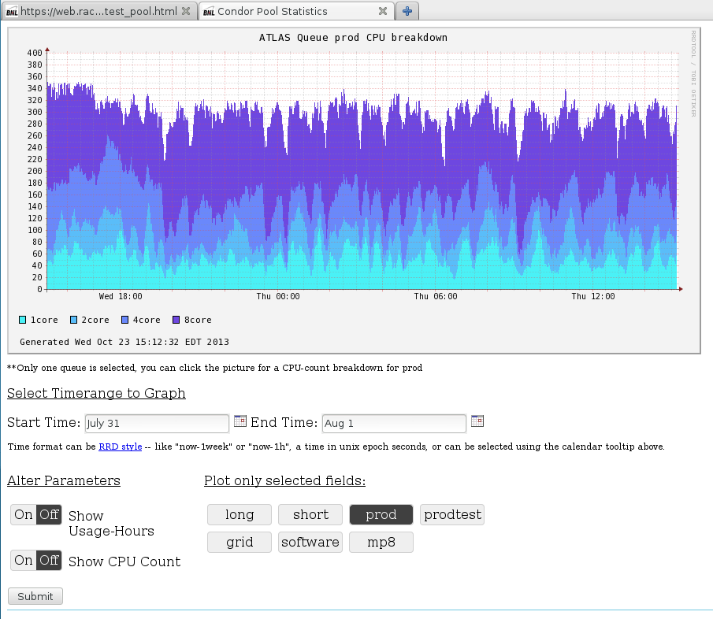
PANDA Queues
PANDA Queues
One species of job per-queue
Map to groups in our tree
Currently two non-single-core queues
8-core ATHENA-MP
2-core (Actually high-memory)
No support yet for SlotWeight!=cpus
Have 2Gb/core, so 4Gb jobs get 2 cores

Slide 7
ATLAS Tree Structure
<root>
atlas
grid
prod
sw
analysis
himem
mcore
single
short
long

Slide 8
Surplus Sharing
Surplus sharing is controlled by boolean accept_surplus flag on each queue
Quotas are normalized in units of SlotWeight (CPUs)
Groups with flag set to True can take unused slots from their siblings
Parent groups with flag allow surplus to “flow down” the tree from their siblings to their children
Parent groups without accept_surplus flag constrain surplus-sharing to among their children

Slide 9
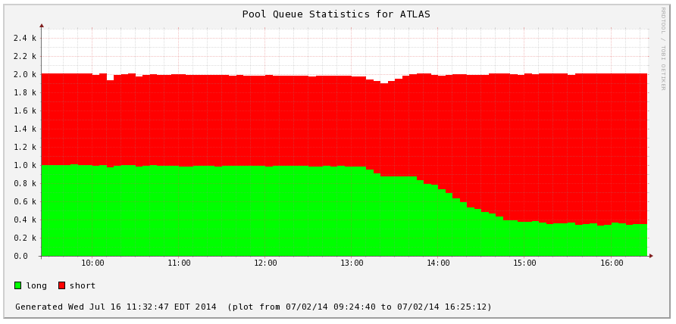
Surplus Sharing
Scenario: analysis has quota of 2000 and no accept_surplus; short and long have a quota of 1000 each and accept_surplus on
short=1600, long=400…possible
short=1500, long=700…impossible (violates analysis quota)

Slide 10
Where’s the problem? (it’s starvation)
Everything works perfectly with all single-core, just set accpet_surplus everywhere!
However… Multicore jobs will not be able to compete for surplus resources fairly
Negotiation is greedy, if 7 slots are free, they won’t match an 8-core job but will match 7 single-core jobs in the same cycle
If any multicore queues compete for surplus with single core queues, the multicore will always lose
A solution outside Condor is needed
Ultimate goal is to maximize farm utilization—No Idle Cores!

Slide 11
Dynamic Allocation
A program to look at the current state of the demand in various queues and set the surplus-flags appropriately
Based on comparing “weight” of queues
Weight defined as size of jobs in queue (# cores)
Able to cope with any combination of demands
Prevents starvation by allowing surplus into “heaviest” queues first
Avoids both single-core and multicore queues competing for the same resources
Same algorithm is extensible up the tree to allow sharing between entire subtrees
Much credit to Mark Jensen (summer student in ‘14)

Slide 12
Balancing Algorithm
Groups have the following properties pertinent to the algorithm
Surplus flag
Weight
Threshold
Demand
If Demand > Threshold a queue is considered for sharing

Slide 13
Balancing: Demand
PANDA Queues are monitored for “activated” jobs
Polling every 2 minutes
Last hour is analyzed
Midpoint sampling
Moving average
Spikes smoothed out
Queue considered “loaded” if calculated demand > threshold

Slide 14
Extending Weight & Demand
Leaf groups’ weights are the cores they need (8, 2, 1)
How to extend beyond leaf-groups?
Define in custom priority order
Define as sum() or avg() of child groups’s weights
Problem with 1. is you can’t guarantee starvation-free
For now, manually set weights to match what would be the case for 2.
For demand and threshold: easy—sum of child-groups values

Slide 15
Balancing: Weight
<weight>/<threshold>
<root>
2/1105
atlas
1/1
grid
3/300
1/5
prod
sw
2/800
analysis
himem
mcore
2/100
8/50
single
short
long
1/150
1/600
1/200

Slide 16
Balancing: Weight
<weight>/<threshold>
<root>
Priority order == desired order
2/1105
atlas
1/1
grid
3/300
1/5
prod
sw
2/800
analysis
himem
mcore
2/100
8/50
single
short
long
1/150
1/600
1/200

Slide 17
Algorithm
The following algorithm is implemented
For each sibling-group in DFS order:
For each member in descending weight order
Set to TRUE unless it does not have demand and lower-weight groups do
Break if set to TRUE
In other words…
In each group of siblings, set accept_surplus to TRUE for all the highest-weighted groups that have demand

Slide 18
Balancing: All Full
<root>
Surplus ON
2
atlas
1
This is the same as having no surplus anywhere!
grid
3
1
prod
sw
2
analysis
2
8
himem
mcore
1
1
1
single
short
long

Slide 19
Balancing: No mc/hi
<root>
Surplus ON
2
atlas
1
grid
3
1
prod
sw
2
analysis
2
8
himem
mcore
1
1
1
single
short
long

Slide 20
Balancing: No prod
<root>
Surplus ON
2
atlas
1
grid
3
1
prod
sw
2
analysis
2
8
himem
mcore
1
1
1
single
short
long

Slide 21
Results
Wasted Slots

Slide 22
Results & Context
Multicore is ready to take slack from other production queues
Spotty analysis-demand the past few months has allowed many millions of CPU-hours to go unwasted
If all ATLAS has a lull in demand, OSG jobs can fill the farm
Caveat: Preemption!
Fast Negotiation
Averages for last 3 days:
Who is this useful for?
Algorithm works for any tree
Extensible beyond ATLAS where work is structured outside of batch system
A multi-tenant service provide with a hierarchy of priorities
Really a problem of efficient provisioning, not scheduling
Constraints
Workflow defined outside of HTCondor
Segregation of multicore in separate queues for scheduling
Matches | 14.99
Duration | 7.05s

Slide 23
Desired Features & Future Work
Preemption
SlotWeight != CPUs
Wish to maintain reasonably minimum-runtime to grid jobs
When ATLAS demand comes back, need OSG jobs to be evicted
Require preempting the dynamic slots that are created under the partitionable one
Work is progressing along these lines, although final state is not clear
Would like to “value” RAM less than CPUs for jobs
High-memory kludge is inelegant
Not extensible to different shaped jobs (high-RAM/low-CPU, vice versa)
Tricky because total slot-weight of the farm needs to be constant to give meaning to quota allocation

Slide 24
The End
Questions? Comments?
Thanks to Mark Jensen, and The HTCondor Team!

