Slide 1
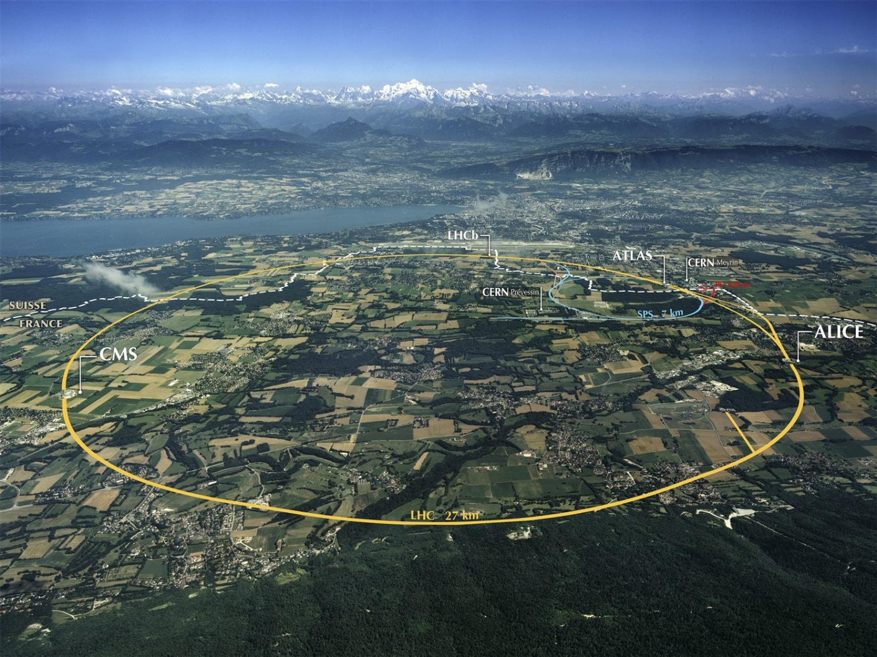
Batch Services at CERN: Status and Future Evolution
Helge Meinhard, CERN-IT Platform and Engineering Services Group Leader
HTCondor Week 20 May 2015

Slide 2
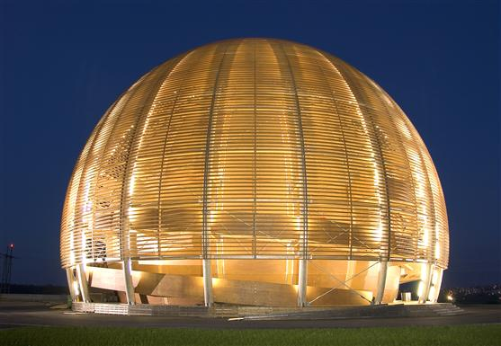
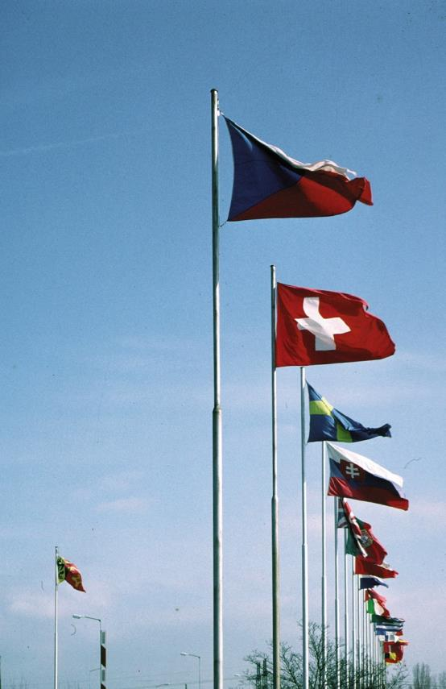
CERN
“Science for peace”
International organisation close to Geneva, straddling Swiss-French border, founded 1954
Facilities for fundamental research in particle physics
21 member states, 1 B CHF budget
3’581 staff, fellows, students, apprentices, …
11’000 users
1954: 12 Member States
Members: Austria, Belgium, Bulgaria, Czech republic, Denmark, Finland, France, Germany, Greece, Hungary, Israel, Italy, Netherlands, Norway, Poland, Portugal, Slovak Republic, Spain, Sweden, Switzerland, United Kingdom Candidate for membership: Romania
Associate member: Serbia
Observers: European Commission, India, Japan, Russia, Turkey, UNESCO, United States of America
Numerous non-member states with collaboration agreements
2’513 staff members, 566 fellows, 481 students, 21 apprentices
6’700 member states, 1’800 USA, 900 Russia, 230 Japan, …

Slide 3
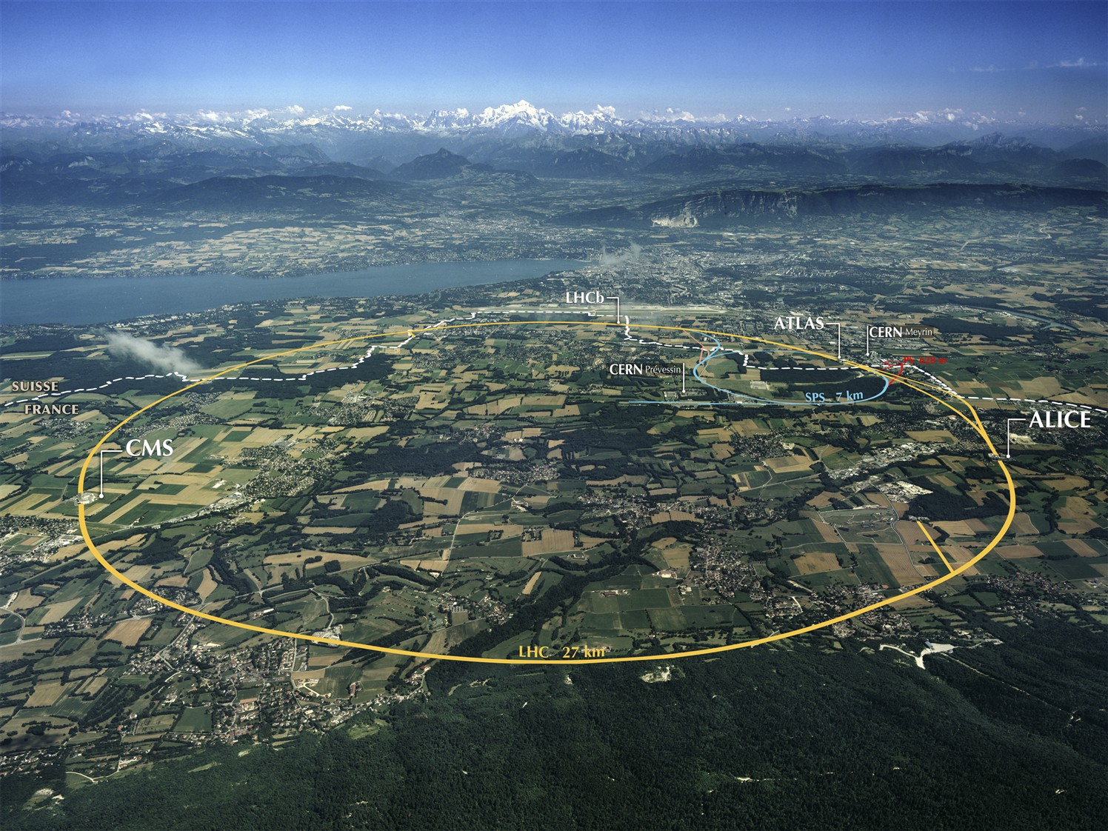
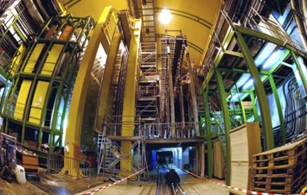
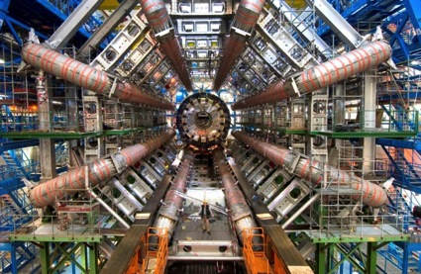
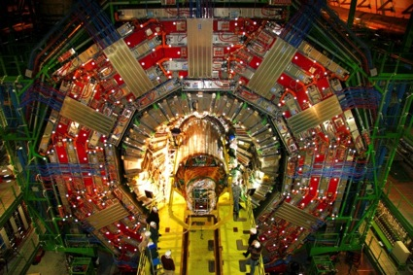
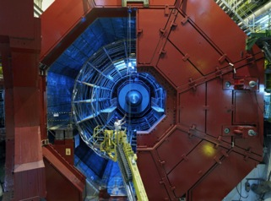
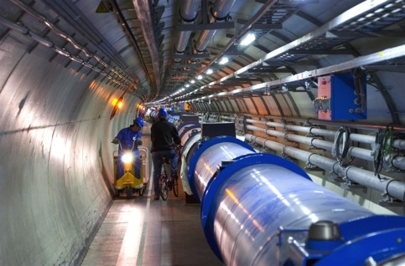
Tools: LHC and Detectors
pp, B-Physics, CP Violation
(matter-antimatter symmetry)
LHCb
CMS
ATLAS
General Purpose, proton-proton, heavy ions
Discovery of new physics:
Higgs, SuperSymmetry
Exploration of a new energy frontier
in p-p and Pb-Pb collisions
ALICE
LHC ring:
27 km circumference
Heavy ions, pp
(state of matter of early universe)
Notes:
3

Slide 4
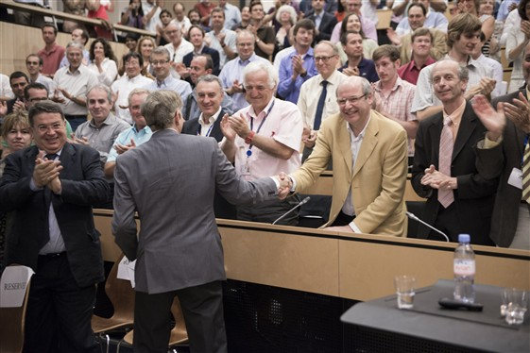
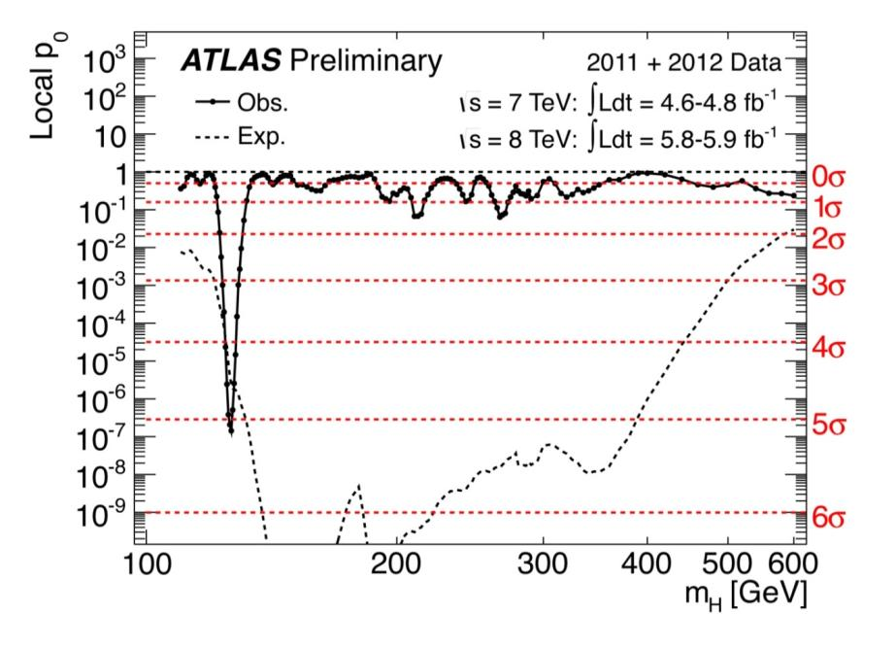
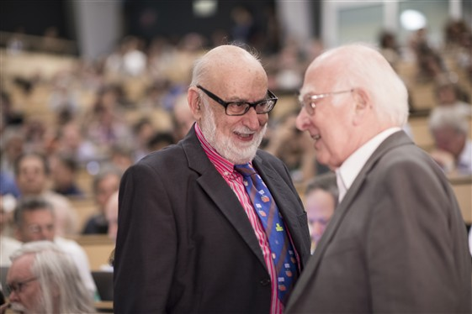
Results so far
Many… the most spectacular one being
04 July 2012: Discovery of a “Higgs-like particle”
March 2013: The particle is indeed a Higgs boson
08 Oct 2013 / 10 Dec 2013: Nobel price to Peter Higgs and François Englert
CERN, ATLAS and CMS explicitly mentioned

Slide 5
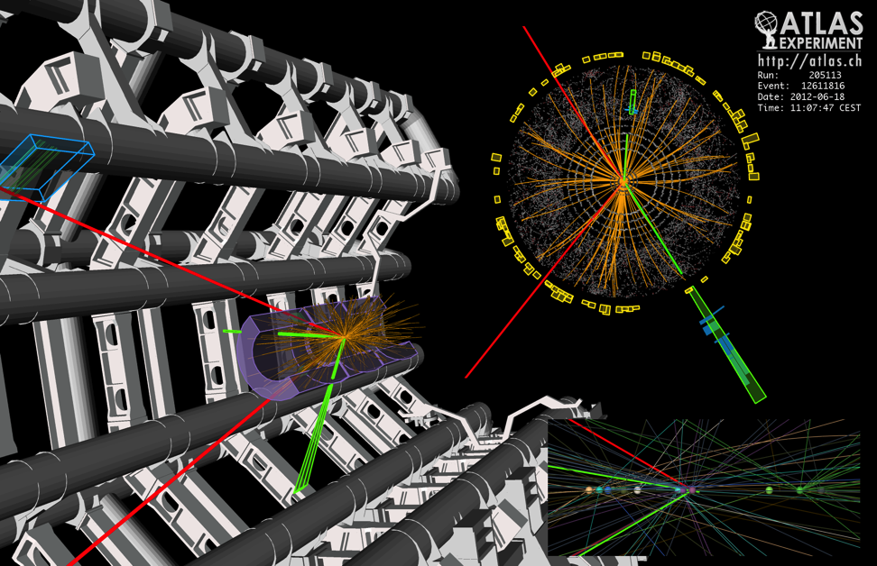
What is the data?
150 million sensors deliver data …40 million times per second
Up to 6 GB/s to be permanently stored after filtering
Almost 30 PB/y in Run 1
Expect ~50 PB/y in Run 2

Slide 6
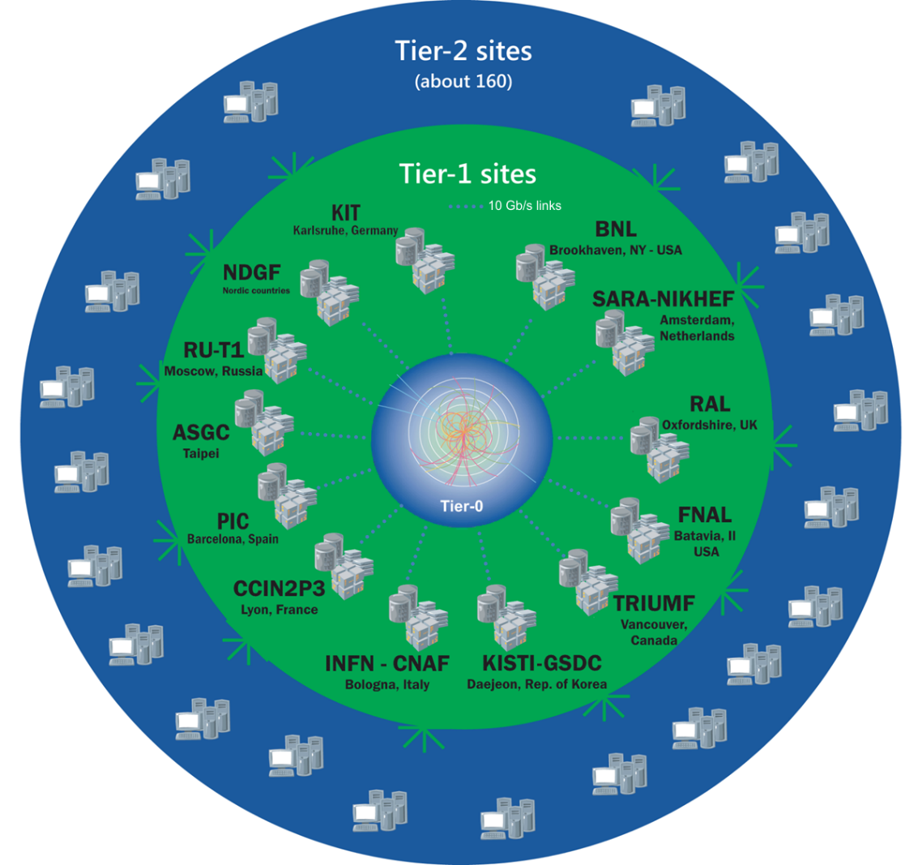
The Worldwide LHC Computing Grid
An International collaboration to distribute and analyse LHC data
Integrates computer centres worldwide that provide computing and storage resource into a single infrastructure accessible by all LHC physicists
Tier-0 (CERN): data recording, reconstruction and distribution
nearly 170 sites, 40 countries
~350’000 cores
Tier-1: permanent storage, re-processing,
analysis
500 PB of storage
> 2 million jobs/day
Tier-2: Simulation,
end-user analysis
10-100 Gb links

Slide 7
WLCG Resources
[kHS06] | 2014 |  | 2015 |  | 2016
 | Tier-0 | All | Tier-0 | All | Tier-0 | All
ALICE | 90 | 366 | 175 | 495 | 215 | 609
ATLAS | 111 | 856 | 205 | 1’175 | 257 | 1’343
CMS | 121 | 738 | 271 | 1’071 | 317 | 1’417
LHCb | 34 | 218 | 36 | 240 | 51 | 315
Total | 356 | 2’178 | 687 | 2’981 | 840 | 3’684
One x86 core: 6…15 HS06
At CERN:
Some capacity provided in addition for analysis (Tier-3)
Experiments choose to split pledge across batch, cloud, and service nodes

Slide 8
Current Situation – Batch at CERN
Currently (08 May) deployed:
4’058 worker nodes (of which 3’669 virtual)
58’488 cores
530 kHS06
Some 400’000 jobs per day, mostly single-threaded (one core)
Mix of local and Grid submission
Grid: Experiment frameworks submit to Cream CEs
Grid amounts to 20…40% of submissions at CERN
Some 25’000 more cores to come before Run 2 physics

Slide 9
Workload Management
Since the late 1990s, CERN has been using a commercial product: Platform Inc.’s Load Sharing Facility LSF
Platform Inc. was acquired by IBM in 2011/2012
CERN’s licence is perpetual, maintenance is currently covered until November 2017
We are running release 7.0.6
Releases 8 and 9 are out; no significant advantages for CERN

Slide 10
Pain Points with LSF (1)
Goal | LSF constraint
30’000…50’000 worker nodes | Max. ~ 6’500 worker nodes
Dynamic cluster | Adding/removing worker nodes requires cluster reconfiguration
10…100 Hz dispatch rate | Transient dispatch problems – sometimes difficult to ensure 1 Hz
100 Hz query scaling | Slow query / submission response times, queries affect submissions
Licence-free system | Licensed product

Slide 11
Pain Points with LSF (2)
Worker node scaling:
Needed as resources grow by more than 100% from 2014 to 2016; unclear what future distribution of batch vs. cloud resources will be
Limit appears architecture-related (some central processes single-threaded)
Limit already constrains us to use unnaturally large VMs (whole hypervisor)
Limit not changed significantly with LSF 8/9
Can set up multiple instances that can submit to each other

Slide 12
Pain Points with LSF (3)
Cluster dynamism:
LSF reconfigurations are expensive – at least some 10 minutes of unresponsiveness
We are running it once per day
Sometimes reconfiguration fails, leading to loss of queues etc.
Some operations require two reconfigurations, hence up to 48 hours of delay to become effective

Slide 13
Pain Points with LSF (4)
Query rate:
LSF is not (cannot be) protected against users hammering the system with expensive queries
Number of cases in the past where submissions and job dispatch were seriously affected by query activity
For ATLAS Tier-0 processing for Run 2, separate LSF instance established

Slide 14
Alternatives to LSF 7 (1)
LSF 8 or 9
Not really addressing any one of our pain points
PBS offsprings
Way too much trouble reported by other LCG sites
SLURM
Considered because of claimed scalability
Good for many cores for massively parallel computing, serious scaling limits on worker nodes and job slots
Grid Engine
Univa Grid Engine is the only serious contender left
Commercial, similar architecture to LSF

Slide 15
Alternatives to LSF 7: HTCondor
Open-source, academic environment
Already in widespread use in WLCG, e.g. FNAL, BNL, RAL – good experience
CERN’s requirements are different: CERN cluster already largest and growing; CERN needs to also support local job submission with AFS token passing/extension
HTCondor also used in experiment frameworks (and even as a CE…), can be used as cloud scheduler
Potential for future further integration
Tests so far very successful
Adding/removing worker nodes
Failing central manager/submission nodes unproblematic
Query scaling revealed an issue, fixed by developers very soon after
Scaling test (shadows on LSF worker nodes) looked promising
2 central managers, 20 schedulers/submission nodes, 1’300 worker nodes with 62’500 job slots
Architecture promises to support further scale-out (unlike LSF, GE, SLURM etc.)

Slide 16
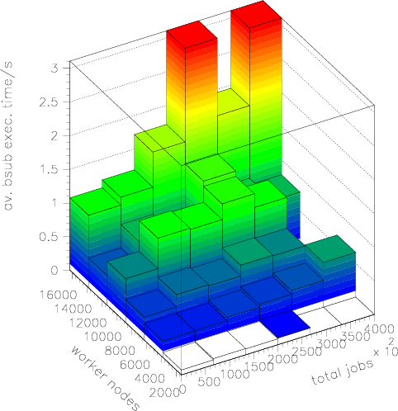
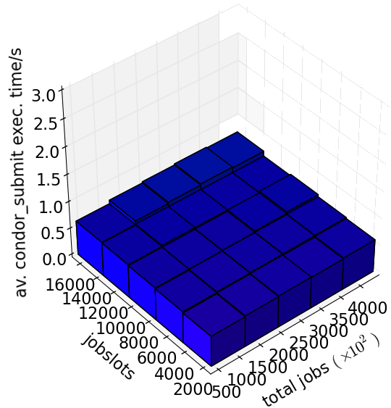
HTCondor Scaling Behaviour
Job submission time as function of number of worker nodes and total number of jobs
LSF
HTCondor

Slide 17
HTCondor Deployment Steps (1)
Start with a (small) service offering Grid submission only
Mostly transparent to users
Doesn’t require AFS token passing and extension
Grow that service (up to taking all Grid submissions)
Overflowing into LSF part via condor_glidein possible
Done – see following talk by Iain Steers

Slide 18
HTCondor Deployment Steps (2)
Once necessary developments done, open small service for local job submissions
Still to be seen to what extent we can (and wish!) to make condor submission look like LSF submission, idem for queries
User support (documentation, handholding, tutorials etc.) will be integral part of deployment (and take significant resources!)
Grow to full size, reducing LSF capacity
Close interaction with user community

Slide 19
HTCondor Deployment Timescale
Grid submissions: see Iain’s talk
Timescale for local submission developments and service to be defined
Hoping for pilot by end 2015, but…
Priority is on full scale and production quality service for Grid submissions
Target: Terminate LSF service by end of Run 2

