Slide 1


Gondor :
Making HTCondor DAGman Groovy
Jim White
Department of Linguistics
University of Washington
jimwhite@uw.edu
github.com/jimwhite
Copyright 2012-2014 by James Paul White.
This work is licensed under a Creative Commons Attribution-NonCommercial-NoDerivs 3.0 Unported License.

Slide 2
Computational Linguistics @ UW
http://www.compling.uw.edu/
Computational Linguistics Masters program est. 2001
Department of Linguistics established in 1963
25 ~ 30 new CLMS students each Fall
Classes can be attended on-line
Departmental cluster (~100 nodes) runs Condor (7.8.8)
Most class assignments and projects must use Condor

Slide 3
CLMS Courses using Condor
LING 473: Computational Linguistics Fundamentals
LING 570: Shallow Processing Techniques for Natural Language Processing
LING 571: Deep Processing Techniques for Natural Language Processing
LING 572: Advanced Statistical Methods in Natural Language Processing
LING 573: Natural Language Processing Systems and Applications
Notes:
All but the last tend to be relatively simple jobs running a single program but the last (573) tends to be a more complex with multiple stages

Slide 4
LING 573 - Natural Language Processing Systems and Applications
Knowledge Base Population Task
Text Analysis Conference (NIST.gov)
TAC 2010

Slide 5
LING 473, 57{0-2} Programs
$ condor_submit myjob.cmd
The system will send you email when your job is complete.
universe = vanilla
executable = /usr/bin/python
getenv = true
input = myinput.in
output = myoutput.out
error = myerror.err
log = mylogfile.log
arguments = "myprogram.py -x”
transfer_executable = false
queue

Slide 6
Grading Student Programs
Issues
  Student programs must run using Condor as another user (TA)
  Rubric points for “Runs as-is” and related requirements
  Students don’t have a way to run their job that way
Solutions
  Dedicated grading user accounts
  Scripts to run the jobs
  Student accessible checking program
CheckIt!
$ ~ling572_00/bin/check_it project1 <project1.tar >results.html
$ lynx results.html

Slide 9
Writing Condor Programs
flexible.job
$ condor_submit -append "depth=20" -append "gain=4" flexible.job
versus
$ mono myprog.exe model_file.20_4 sys_file.20_4 >acc_file.20_4
file_ext = $(depth)_$(gain)
universe = vanilla
executable = /opt/mono/bin/mono
getenv = true
output = acc_file.$(file_ext)
error = q4.err
log = q4.log
arguments = "myprog.exe model_file.$(file_ext) sys_file.$(file_ext)"
transfer_executable = false
queue

Slide 10

Gondor v1
http://groovy.codehaus.org/

Slide 11
Gondor v1

Slide 12
Generated Submit Description
_home2_jimwhite_workspace_parsers_base_bllip-parser_second-stage_programs_features_best-parses.condor
####################
#
# James White (mailto:jimwhite@uw.edu)
#
####################
Universe = vanilla
Environment= PATH=/usr/local/bin:/bin:/usr/bin:/opt/git/bin:
/opt/scripts:/condor/bin;LC_COLLATE=C
Executable = /home2/jimwhite/workspace/parsers/base/bllip-parser/
second-stage/programs/features/best-parses
Arguments = -l $(_features) $(_weights)
Log = jimwhite__home2_jimwhite_workspace_parsers_base_bllip-
parser_second-stage_programs_features_best-parses.log
Input = $(_MyJobInput)
Output = $(_MyJobOutput)
Error = $(_MyJobError)
Request_Memory=5*1029
Notification=Error
Queue

Slide 13
Gondor v1

Slide 14
Generated DAGman DAG File
JOB _home2_jimwhite_..._parseIt_J1 _home2_jimwhite_..._parseIt.condor
VARS _home2_jimwhite_..._parseIt_J1
_model="/workspace/ensemble/parser_19/first-stage/DATA/EN/"
_input="/workspace/ycorpus/brown-train.mrg.sent"
_MyJobOutput="/workspace/parser_19/tmp/parsed/brown-train.mrg.nbest"
_MyJobError=”ensemble_parse_jobs/_home2_jimwhite_..._parseIt_J1.err"
JOB _home2_jimwhite_..._best-parses_J2 _home2_jimwhite_..._best-parses.condor
VARS _home2_jimwhite_..._best-parses_J2
_features=”…/parser_19/…/ec50spnonfinal/features.gz"
_weights=”…/parser_19/…/ec50spnonfinal/cvlm-l1c10P1-weights.gz"
_MyJobInput=”…/parser_19/tmp/parsed/brown-train.mrg.nbest"
_MyJobOutput=“…/parser_19/tmp/parsed/brown-train.mrg.best"
_MyJobError=“ensemble_parse_jobs/_home2_jimwhite_..._best-parses_J2.err"
... MANY MORE LIKE THAT ...
PARENT _home2_jimwhite_..._parseIt_J1 CHILD _home2_jimwhite_..._best-parses_J2
PARENT _home2_jimwhite_..._parseIt_J3 CHILD _home2_jimwhite_..._best-parses_J4
PARENT _home2_jimwhite_..._parseIt_J5 CHILD _home2_jimwhite_..._best-parses_J6
...

Slide 15
Gondor v1

Slide 16
My Development Principles
Work Independently
  Hip, Hip, Hooray for Leo Singer and LIGO!
  HTCondor MacPort:
    sudo port install htcondor
    sudo port load htcondor
Brevity is Beautiful
Don’t Repeat Yourself (DRY)
Integrate with Other Current and Future Compute Systems
Compile-time Provenance

Slide 17
DRMAA Java Binding
Been Around a Long Time
Supported by Many Systems
Constrain the Design to Ease Future Interoperability
New Implementation for Condor sans JNI
https://github.com/jimwhite/condor-jrmaa
  Generates Submit Description Files and uses condor_submit
DAGman Workflow Extension
  Generates DAGman DAG File (and Submit Files)
  Uses DRMAA and pretends all jobs succeed
  Add Dependency Method:
  void addToParentJobIds(String childJobId, String parentJobId);

Slide 18
Gondor v3

Slide 19
The Road Ahead for Gondor
Self-describing Command Line Scripts
Dynamic SubDAG Workflow Scripts
Persistent Workflow Results
Workflow Reduction
Provenance
Reproducible Research
Code in Development
  https://github.com/jimwhite/Gondor

Slide 20
Annotation-based CLI

Slide 21
Workflow Persistence & Reduction
Put Everything in Git
All Intermediate Artifacts including Condor Control Files
Previous Results Reused If Desired Based on Object IDs
  See for example Nix – The Functional Package Manager
  https://nixos.org/nix/
    Eelco Dolstra. Secure Sharing Between Untrusted Users in a Transparent Source/Binary Deployment Model. In 20th IEEE/ACM International Conference on Automated Software Engineering (ASE 2005), pages 154–163, Long Beach, California, USA. ACM Press, November 2005.
File Transfer via Pull or Push As Desired
git-annex (or similar) for very big blobs

Slide 22
Provenance
Git2PROV.org
  Generates PROV-O (and –N, -JSON, and SVG) from Git commits
Git2PROV: Exposing Version Control System Content as W3C PROV
by Tom De Nies, Sara Magliacane, Ruben Verborgh, Sam Coppens, Paul Groth, Erik Mannens, and Rik Van de Walle

Slide 23
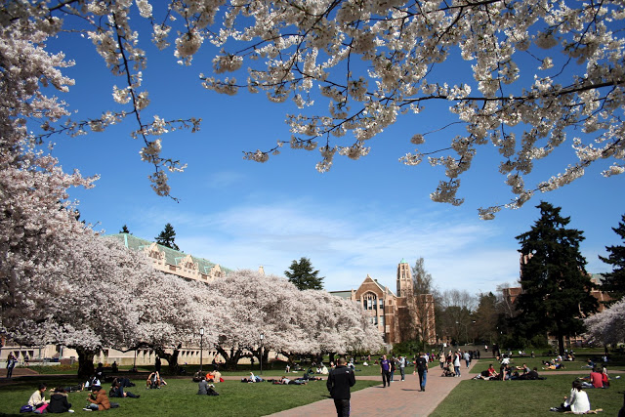
Thank You!
http://depts.washington.edu/newscomm/photos/the-spring-cherry-blossoms-in-the-quad/

