Slide 1
How High Throughput was my cluster? Greg Thain Center for High Throughput Computing

Slide 2
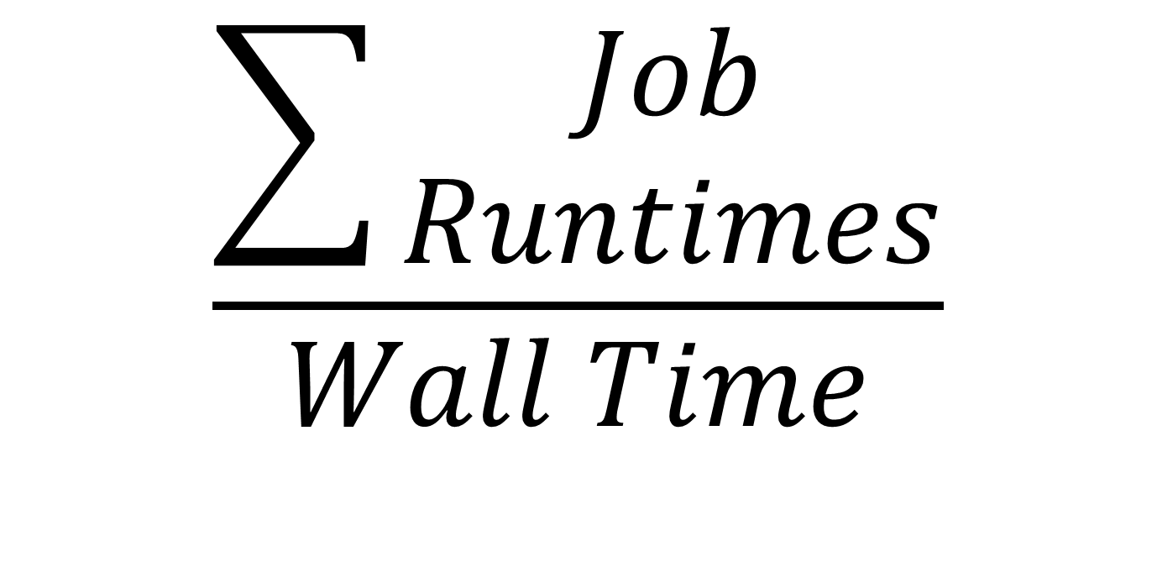
High Throughput Defined
$$\frac{\sum{\begin{aligned}Job \\ Runtimes\end{aligned}}}{Wall Time}$$

Slide 3
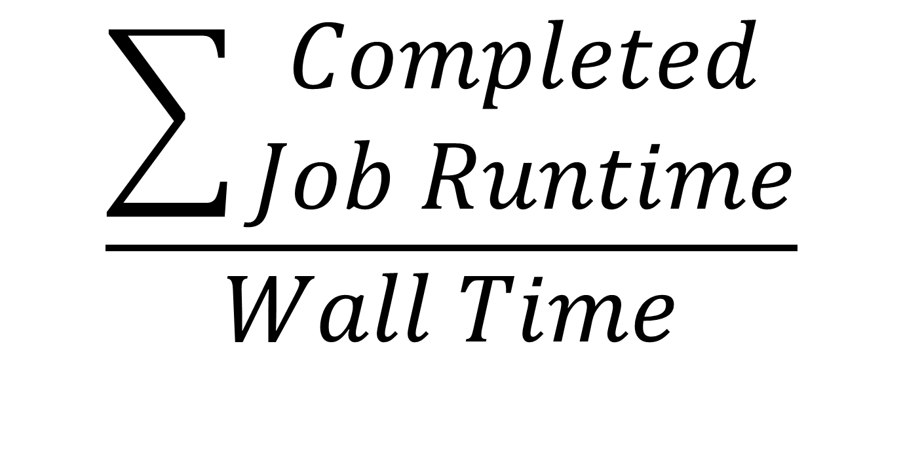
More Correctly
$$\frac{\sum{\begin{aligned}Completed \\ Job Runtime\end{aligned}}}{Wall Time}$$

Slide 4
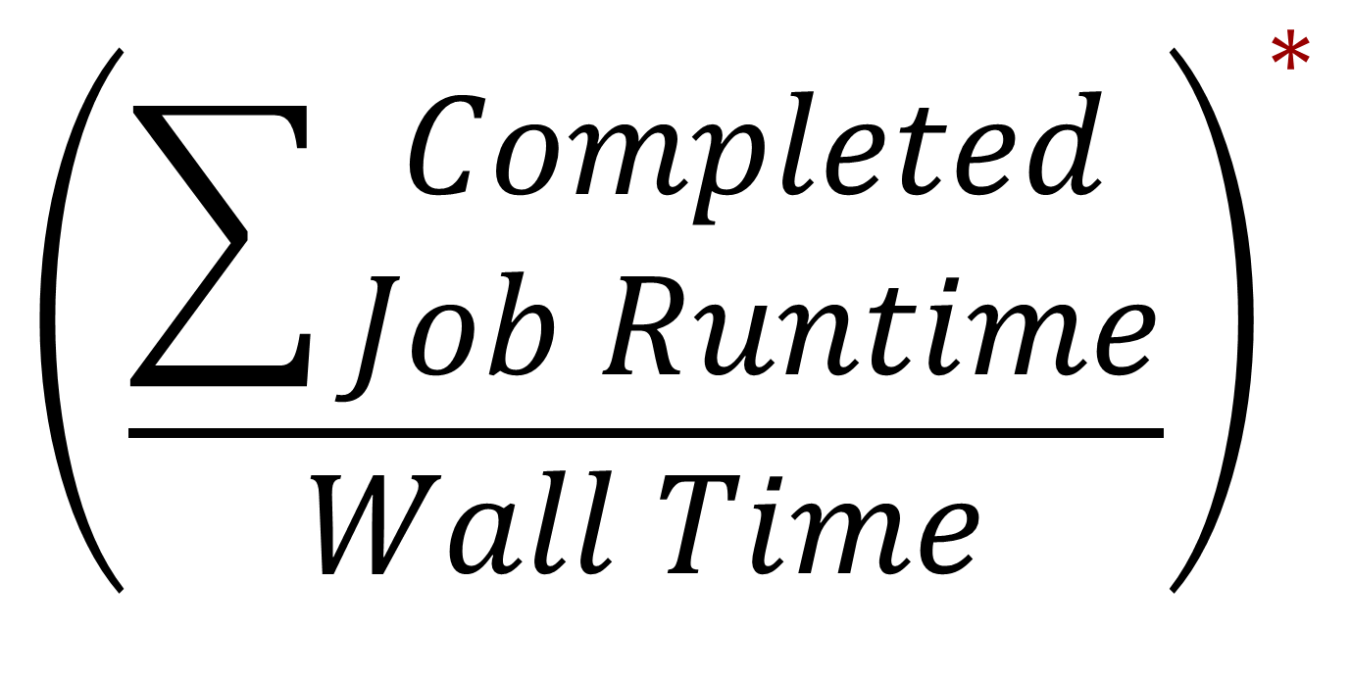
Even more Correctly
$${\left(\frac{\sum{\begin{aligned}Completed \\ Job Runtime\end{aligned}}}{Wall Time}\right)}^{∗}$$
*
Subject to some notion of fairness

Slide 5
There’s always fine print
Optimize goodput subject to following
“Subject to some notion of fairness”
Recent usage
Machine ownership
Real world urgency
Temporary or otherwise
Group membership
Etc, etc.

Slide 6
What’s your policy?
Are you sure you know?
We’d like to know.
We’ve got lots of mechanisms
We would really like to know if sufficient
Please talk to me!

Slide 7
Example policy
Global limit on job from each group
Also limit on sum of sub-groups
One Free-for-all group, can use whole pool
Maybe not such a good idea
If any job runs longer than two days:
It’s drunk, send it home

Slide 8
Policy for CHTC pools
Big question:
Longest allowable job runtime
Currently 72 hours. Good? Bad?
Policy note: set with negotiator, not startd

Slide 9
Why do we care?
condor_status -tot
Total Owner Claimed Unclaimed Matched
INTEL/LINUX 1 0 1 0 0
X86_64/LINUX 6639 63 6141 435 0
Total 6640 63 6142 435 0
$\frac{72 \frac{hours}{job}∗ \frac{3600 seconds}{hour}}{6000 machines}=$ 43 secs

Slide 10
Problem: draining
With homogenous slots, wait time a function of pool size, which is big
Assuming no checkpointing
If draining needed, job wait time a function of longest job. ☹
More demand for HTPC jobs.

Slide 11
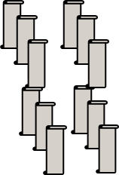
CHTC: A Flocking Nightmare
6,000 cores CHTC
3
CHTC
Schedds
2,000 cores CS
80
UW
Schedds
Infolab pool
Glidein!
CAE Pool
Non-UW
Schedds
ACI Pool

Slide 12
Negotiator Records
“The Accountant”
Access via
condor_userprio
Records matches,
Not jobs – e.g. glidein problem

Slide 13
Negotiator Reporting

Slide 14
Schedd Records
“Event Log”: enable in config file
“History file”: condor_history
We don’t control them all

Slide 15
Startd also keeps history
This is the one we use
condor_history –f startd_history
Enable by setting
STARTD_HISTORY = /path/to/file

Slide 16
condor_pool_job_report
The following users have run vanilla jobs that have hit the MaxJobRetirementTime (72) hour limit in CHTC yesterday.
# of User
Jobs
---- ----
3 jchen48@submit.chtc.wisc.edu
79 dschultz@skua.icecube.wisc.edu
81 yqzhao@submit.chtc.wisc.edu
353 jsebald@skua.icecube.wisc.edu
= 31 K hours badput!

Slide 17
What is/isn’t a job “completion”?
Strict definition: job exits of own accord
Two problems:
Very, very short jobs
Self checkpointable jobs
How to ID?
When_to_transfer_output = on_exit_or_evict
Adding explicit flag – requires a carrot
+is_resumable = true
All this requires understanding users

Slide 18
Then, on to runtimes.
Averages can be deceiving
User | Starts | Total Hours | Mean
gthain | 8442 | 8427 | 00:59

Slide 19
What about quartiles?
1st quartile | 00:01 (One Minute)
2nd quartile | 00:12
3rd quartile | 00:42
4th quartile | 68:41

Slide 20
“Jobs” vs “Execution attempts”
If 25% of runs less than one minute
Is that just one bad job?
Or all of the jobs are bad?

Slide 21
Added new columns to report
“Restarted jobs”
Quartiles
Short jobs (less than minute)
Removed hours
Mean, Median, SD
Requires a lot of user facilitating

Slide 22
Problem: Zoo of a pool
Order of magnitude different speeds in pool
Naïve Solution:
Create scaled performance numbers
Actual solution
Remove very slow machines from pool
Require users to ask for fast machines

Slide 23
Results of looking at data
Can lower 72 hour limit to 24
Probably need “escape hatch” for some
Can drastically improve draining response

Slide 24
Future Work
Support for slot-based scheduling?
Support for mixed HPC / HTC submissions/

Slide 25
Thank you!
Please talk to me about pool policy
We’d love to hear from you!
Important to know the shape of jobs
Pure hours consumed not important metric
Preempt-Resume right the first time!

