Slide 1
What’s new in HTCondor? What’s coming? HTCondor Week 2014
Todd Tannenbaum
Center for High Throughput Computing
Department of Computer Sciences
University of Wisconsin-Madison

Slide 3
Release Situation
Development Series
HTCondor v8.1.6 frozen (release candidate for v8.2.0), in beta test, release to web 5/20/14.
Development on series v8.1.x over, v8.3.x release scheduled for 7/1/14.
Stable Series
June 5th: HTCondor v8.2.0
v8.0.6 will likely be the last v8.0.x released
Last Year: Condor v8.0.0 (June 6th 2013)
Since HTCondor Week 2012: 14 releases, 3375 commits by 32 contributors, resolved tickets: 170 stable series, 397 dev series
New RPM
Packaging!

Slide 4
Platforms tested with v8.2.0
32bit Debian 6 32bit Scientific Linux 5 32bit Scientific Linux 6 64Bit Debian 6 (squeeze), 64Bit Debian 7 (wheezy), 64Bit Fedora 19 64Bit Fedora 20 64Bit MacOSX 8 64Bit MacOSX 9
64Bit Red Hat 5 64Bit Red Hat 6 64Bit Red Hat 7 64Bit Scientific Linux 5 64Bit Scientific Linux 6 (and 7 when it becomes available) 64Bit Ubuntu 12.04 LTS 64Bit Ubuntu 14.04 LTS 64Bit Windows 7 SP1 64Bit Windows 8.1
Continue to push into distro repositories

Slide 5
New goodies with v8.0
HTCondor-CE
Bosco
DAGMan additions
EC2 Spot, OpenStack
Several new tools
ClassAd Compression
Generic Slot Resources
Python Interfaces
Job Sandboxing
Interactive jobs
Open development process progress
Security policy maturation
Many more…
Last Year's News

Slide 6
Challenge Areas
“...we have identified six key challenge areas that we believe will drive HTC technologies innovation in the next five years.”
Evolving resource acquisition models
Hardware complexity
Widely disparate use cases
Data intensive computing
Black-box applications
Scalability

Slide 7
EC2 Grid job improvements
Hardening, better failure handling
Especially for spot instances
Errors used to result in orphaned instances
Reduced calls to service EC2 jobs
Better support for OpenStack
Recognize and handle protocol changes
Recognize API differences from Amazon
condor_ssh_to_job supports EC2 jobs

Slide 9
Google Compute Engine Jobs
New grid-type “gce”
Similar to EC2 support
Basic instance parameters
GCE zone
Machine type
VM Image
Instance-specific data

Slide 10
A Brief History of BOINC
Berkeley Open Infrastructure for Network Computing
Grew out of SETI@Home, began in 2002
Middleware system for volunteer computing

Slide 11
Previous Work
Previous work
Backfill state and Work-Fetch Hooks
HTCondor execute machine becomes a BOINC client when otherwise idle
Now, we’re doing the reverse…

Slide 12
HTCondor submitting jobs to BOINC
New grid universe type: boinc
Submit file format very similar to other job types
Application must be described to BOINC server first
Manual step at present
Why?
Easy accessibility for campus users, OSG VOs
“Submit locally, run globally”
Use in workflows

Slide 13
Scalability

Slide 14
Improve matchmaking protocol esp over slow links
“…CMS has stood up a new submit machine in Switzerland, trying to connect to a central manager in the US. Round trip ping time is on the order of 200 ms, and they see that the negotiation is much slower to those schedds, topping at 5Hz”

Slide 15
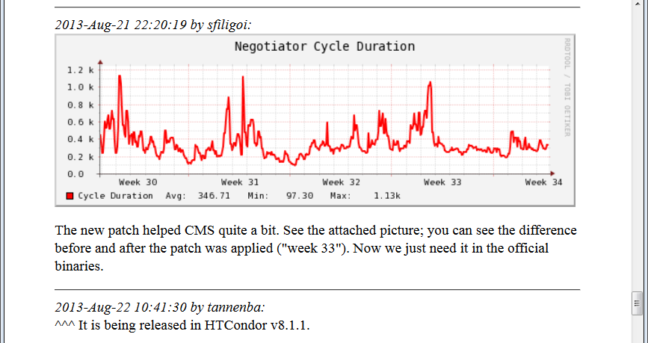
Improve matchmaking protocol esp over slow links, cont

Slide 16
US CMS Scale Work
Currently in production with ~50k slots
Testing now for a target of 250k slots
Glidein nodes around the world
Network latency
CCB / shared_port
Strong security (GSI)
Knocking over bottlenecks
“Collector only handling 100 updates/sec!”
“Collector only handling 100 updates/sec!”

Slide 17
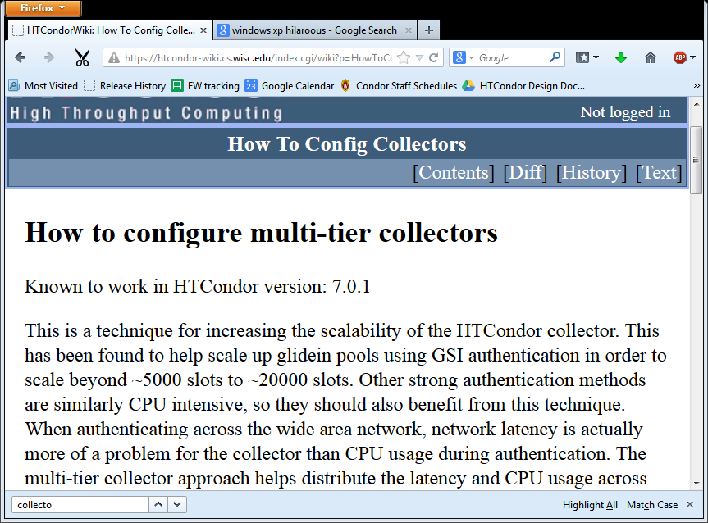

Slide 18
Collector Update Rate

Slide 19
Update w/ jumbo UDP datagrams

Slide 20
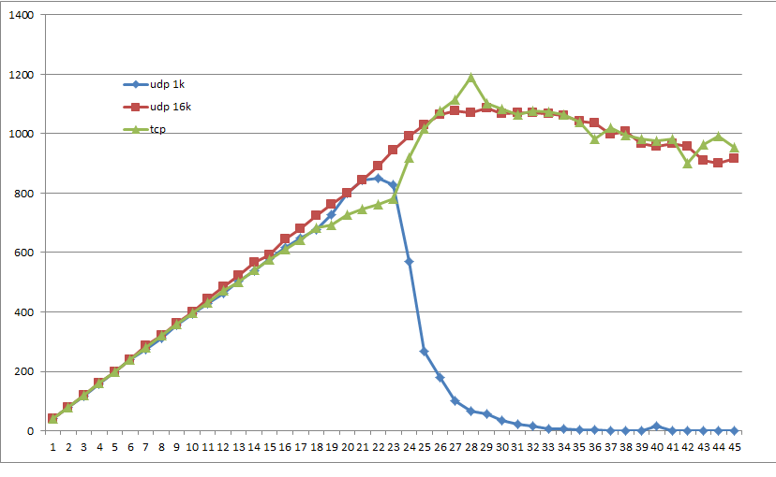
Jumbo UDP datagrams

Slide 21
More scalability changes
Schedd restart time improved
Reduced max time to detect a disappeared node now 6 minutes, was 2 hours.
Non-blocking I/O
Do not fork schedd to process condor_q
Why? Observed schedd child process grow at ~500MB/sec
Do not fork to process incoming connections to condor_shared_port

Slide 22
HTCondor Configuration File
Backward compatible
Less surprising
Small
More powerful

Slide 23
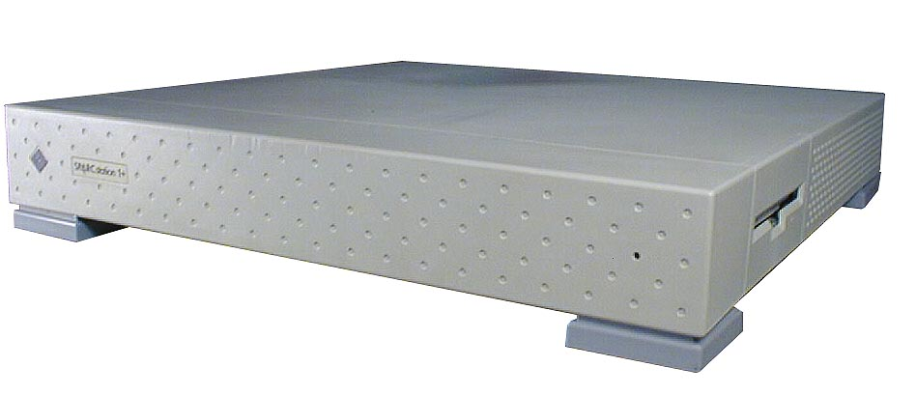
More power
New configuration language constructs
$(<knob>:<default>)
include
if, else, elif, endif
use <category>:<option>
Use meta-knobs
See categories and options with condor_config_val
Examples:
use role:execute
use policy:always_run_jobs
use feature:gpus

Slide 24
GPU Support
HTCondor can now automatically
Discover, Bind, Sandbox, Monitor, and Manage GPUs
CUDA and OpenCL
Both static slots and partitionable slots supported!
How?
Add to config file
use feature:gpus
Sample submit file
request_cpus = 1
request_gpus = 1
executable = hola_gpus.exe
queue

Slide 25
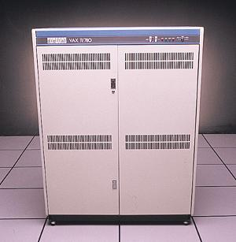
Data Intensive Computing

Slide 26
ASYNC_STAGEOUT
What is it?
Allows the execution of a job to be overlaid with the transfer of output files of a different job
Conditions apply:
Both jobs must be from the same user
Submitted from the same submit point
Jobs must explicitly choose to participate

Slide 27
ASYNC_STAGEOUT, cont
Normal HTCondor operation for a single compute slot has three phases. Several consecutive jobs look like this:
time
job1
input
execute
output
job2
input
execute
output
job3
input
execute
output

Slide 28
ASYNC_TRANSFER
The “input/execute” phase and the “output” phase can be done concurrently, also known as “pipelining”:
time
job1
input / execute
output
job2
input / execute
output
job3
input / execute
output

Slide 29
ASYNC_STAGEOUT
How does it work?
The schedd can now tell a startd to move a job from one slot to another.
The execute node is configured to create dedicated “transfer slots” for each traditional execute slot.
The transfer slot will not run jobs
Jobs are moved into the transfer slot when they signal the phase transition, but only if the transfer slot is idle.
Typically, transfer slots are not visible, but like everything in HTCondor, there’s a knob for that!

Slide 30
ASYNC_STAGEOUT
A single core machine (with the transfer slot configured to be visible):
% condor_status
Name OpSys Arch State Activity LoadAv Mem ActvtyTime
slot1@ingwe.cs.wis LINUX X86_64 Unclaimed Idle 0.250 15816 0+00:00:11
xfer2@ingwe.cs.wis LINUX X86_64 Unclaimed Idle 0.000 124 0+00:00:10
Total Owner Claimed Unclaimed Matched Preempting Backfill
X86_64/LINUX 2 0 0 2 0 0 0
Total 2 0 0 2 0 0 0

Slide 31
ASYNC_STAGEOUT
To work, the submit node, execute node, and the job itself must participate.
If any party does not participate, normal job execution results. (i.e. no overlay)
The job explicitly signals the transition to output phase using a chirp command:
condor_chirp phase output

Slide 32
ASYNC_STAGEOUT
What does it look like from the user perspective?
Example executable file:
#!/bin/sh
echo “Executing...”
sleep 120
echo “Transferring...”
condor_chirp phase output
sleep 120

Slide 33
ASYNC_STAGEOUT
What does it look like from the user perspective?
Normal job execution for first 120 seconds:
% condor_q
-- Submitter: ingwe.cs.wisc.edu : <128.105.121.64:56450> : ingwe.cs.wisc.edu
ID OWNER SUBMITTED RUN_TIME ST PRI SIZE CMD
1255.0 zmiller 4/29 11:26 0+00:01:29 R 0 0.0 async.sh 120
1255.1 zmiller 4/29 11:26 0+00:00:00 I 0 0.0 async.sh 120
1255.2 zmiller 4/29 11:26 0+00:00:00 I 0 0.0 async.sh 120
1255.3 zmiller 4/29 11:26 0+00:00:00 I 0 0.0 async.sh 120
1255.4 zmiller 4/29 11:26 0+00:00:00 I 0 0.0 async.sh 120
5 jobs; 0 completed, 0 removed, 4 idle, 1 running, 0 held, 0 suspended

Slide 34
ASYNC_STAGEOUT
What does it look like from the user perspective?
After 120 seconds another job starts:
% condor_q
-- Submitter: ingwe.cs.wisc.edu : <128.105.121.64:56450> : ingwe.cs.wisc.edu
ID OWNER SUBMITTED RUN_TIME ST PRI SIZE CMD
1255.0 zmiller 4/29 11:26 0+00:02:09 R 0 0.0 async.sh 120
1255.1 zmiller 4/29 11:26 0+00:00:03 R 0 0.0 async.sh 120
1255.2 zmiller 4/29 11:26 0+00:00:00 I 0 0.0 async.sh 120
1255.3 zmiller 4/29 11:26 0+00:00:00 I 0 0.0 async.sh 120
1255.4 zmiller 4/29 11:26 0+00:00:00 I 0 0.0 async.sh 120
5 jobs; 0 completed, 0 removed, 3 idle, 2 running, 0 held, 0 suspended

Slide 35
ASYNC_STAGEOUT
What does it look like from the user perspective?
You can see the first job has moved:
% condor_q -run
-- Submitter: ingwe.cs.wisc.edu : <128.105.121.64:56450> : ingwe.cs.wisc.edu
ID OWNER . SUBMITTED RUN_TIME HOST(S)
1255.0 zmiller 4/29 11:26 0+00:02:44 xfer2@ingwe.cs.wisc.edu
1255.1 zmiller 4/29 11:26 0+00:00:38 slot1@ingwe.cs.wisc.edu

Slide 36
ASYNC_STAGEOUT
What does it look like from the user perspective?
Eventually first job finishes:
% condor_q
-- Submitter: ingwe.cs.wisc.edu : <128.105.121.64:56450> : ingwe.cs.wisc.edu
ID OWNER SUBMITTED RUN_TIME ST PRI SIZE CMD
1255.1 zmiller 4/29 11:26 0+00:02:01 R 0 0.0 async.sh 120
1255.2 zmiller 4/29 11:26 0+00:00:00 I 0 0.0 async.sh 120
1255.3 zmiller 4/29 11:26 0+00:00:00 I 0 0.0 async.sh 120
1255.4 zmiller 4/29 11:26 0+00:00:00 I 0 0.0 async.sh 120
4 jobs; 0 completed, 0 removed, 3 idle, 1 running, 0 held, 0 suspended

Slide 37
ASYNC_STAGEOUT
What does it look like from the user perspective?
And another job starts… and so on…
% condor_q
-- Submitter: ingwe.cs.wisc.edu : <128.105.121.64:56450> : ingwe.cs.wisc.edu
ID OWNER SUBMITTED RUN_TIME ST PRI SIZE CMD
1255.1 zmiller 4/29 11:26 0+00:02:07 R 0 17.1 async.sh 120
1255.2 zmiller 4/29 11:26 0+00:00:05 R 0 0.0 async.sh 120
1255.3 zmiller 4/29 11:26 0+00:00:00 I 0 0.0 async.sh 120
1255.4 zmiller 4/29 11:26 0+00:00:00 I 0 0.0 async.sh 120
4 jobs; 0 completed, 0 removed, 2 idle, 2 running, 0 held, 0 suspended

Slide 38
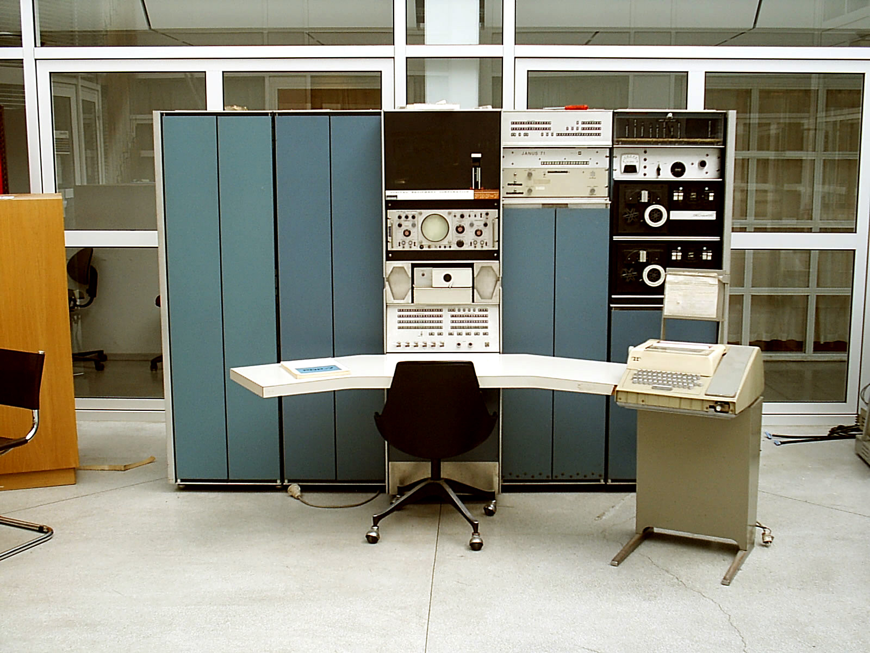
ASYNC_STAGEOUT
To enable on your cluster, just use the meta-knob:
use EXPERIMENTAL:ASYNC_STAGEOUT
See ticket #4291

Slide 39
Is my pool healthy?
We added a lot of metrics in HTCondor v7.9.x, but how to spot trends?

Slide 40
Operational monitoring over time with condor_gangliad
Monitor your cluster with familiar tools
Measure utilization
Diagnose problems
View usage over time
Easy to configure
Esp if already using ganglia

Slide 41
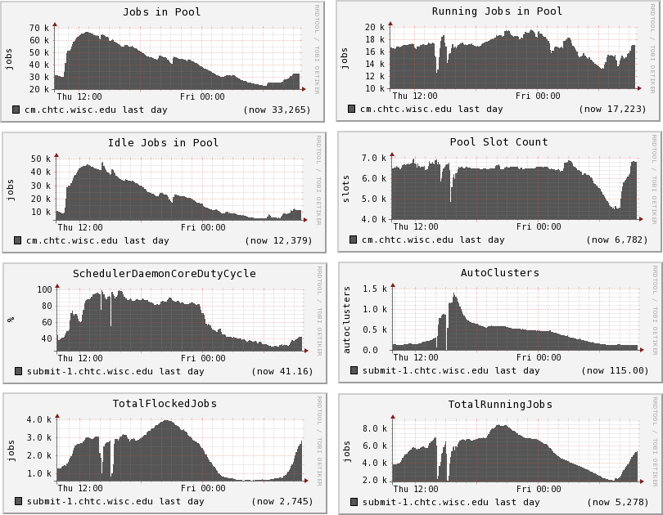

Slide 44
File Transfer Management
Could always configure max # of concurrent file uploads and downloads.

Slide 45
File Transfer Management
Could always configure max # of concurrent file uploads and downloads.
New configuration variable
FILE_TRANSFER_DISK_LOAD_THROTTLE
enables dynamic adjustment of the level of file transfer concurrency in order to keep the disk load generated by transfers below a specified level.

Slide 46
Schedd overloaded, now what?
condor_sos <whatever….>, eg
condor_sos condor_q
condor_sos condor_hold toddt
condor_sos –schedd –direct my_schedd
Every superuser command is an SOS
Save Our Schedd!

Slide 47
condor_job_report script
New script in ~condor/bin
Email report shows preempted jobs:
The following users have run vanilla jobs without +is_resumable = true, that have hit the MaxJobRetirementTime yesterday.
# of User Jobs
---- ----
3 wbrooks2@submit.chtc.wisc.edu
6 quefeng@submit.chtc.wisc.edu
7 davisa@submit.chtc.wisc.edu
44 asiahpirani@discovery.wisc.edu

Slide 48
condor_job_report script
Shows statistics about job runtimes
Short jobs
Quartiles
mean runtime
restarts of same job

Slide 49
More monitoring
Monitoring jobs via BigPanDAmon
Publication of useful metrics, such as
Number of job preemptions (by startd)
Number of autoclusters (by schedd)
condor_status -defrag

Slide 50
New DAGMan features
More info and improved structure in node status file
Metrics reporting (used by Pegasus)
DAG files can now be > 2.2 GB
DAGMAN_DEFAULT_NODE_LOG has been made more powerful, so that it can be defined in HTCondor configuration files
Non-workflow log mode is now deprecated
Node retry number is now available as VARS macro

Slide 51
startd RANK for pslots
Startd RANK expressions for pslots now works
Pslot slot ads now have info about dslots
In new classad arrays:
If startds has four dslots running, looks like
childCpus = { 1,1,4,1 }
childCurrentRank = { 0.0,0.0,0.0,0.0 }
childState = {"Claimed","Claimed","Claimed","Claimed“
But not user prio yet
Future work: no dslots in collector!

Slide 53
VM Universe enhancements for admins
Test a VM on start-up. (#3789)
Test VM networking on start-up. (#3960)
And periodically re-check both.
Advertise health of VMU on a host. (#3976)
Include testing results and job attempts.
Notes:
Debugging and/or maintaining a VM universe infrastructure can be a little troublesome, so we had a few thoughts about things HTCondor could do to help. It should be possible to construct tiny VMs that don’t do anything interesting except indicate that they’ve started, and with these, HTCondor could check to see if it can actually start VMU jobs. It’s probably harder to check if networking for a VM works, but the same general approach probably applies. Since our experience suggests that the health of VMU decays over time, we should periodically recheck both and make sure they’re still OK. Reporting that status where the users can see it benefits them because it may help analyze / improve VMU error reporting. (e.g., did my job hang, or was that hypervisor’s networking broken?)

Slide 54
VM Universe enhancements for users
Clean up submission problems
vm_memory vs RequestMemory (#3907)
file transfer
spurious (?) warnings (#3908)
doesn’t play well with file-transfer plugins (#4167)
interaction with vm_no_output_vm (#2556)
Support an exit status code (#3961)
Notes:
The effect of addressing the first set of issues should be to make the virtual machine universe easier to user and/or more-consistent with how you do vanilla universe submission and file-transfer. In particular: the user will not know how much overhead the particular hypervisor will need, but the startd will and can infer a good guess from vm_memory. It should do so, and condor_submit should not warn about RequestMemory being missing for VMU submits. Condor_submit also emits what appears to be spurious warnings about when_to_transfer_output and should_transfer_files. As of 8.0.x, this behavior contradicts the manual, which states HTCondor must be explicitly told about file transfer. Similarly, the VMU assumes that disk entries in vm_disk must appear in the transfer_input_files list, but they may be encoded or embedded in the file-transfer URLs (e.g., compressed VM images, a VM-image-generation service). This causes grief. Finally, vm_no_output_vm deletes the output disk images rather than removing them from the file transfer list. This makes it impossible to say “don’t send me any output except this particular one,” which is counter-intuitive at best.
Supporting an exit status code is going to be tricky but make a lot of our users happy.

Slide 55
KVM-Enabled Checkpointing of vanilla universe jobs
Swap standard universe’s constraints for the constraints of VMs
Moves some burdens from user to admin
Transparent to application and user?
Admin could set default VM to one that looks like the host OS
Combine vanilla and VM universe
Notes:
For instance, you don’t have to recompile your binaries, or run only single-process single-threaded statically-linked jobs; but you (or somebody who likes you) has to provide and maintain the VM, you can’t use remote IO, your disk and memory limits are strictly enforced, and your application will probably run more slowly and certainly create larger checkpoints.
Ideally, we can simplify the user’s end of things to a single line in their submit file (WantCheckpointing = TRUE). But then the administrator has to provide a VM that looks a lot like the machine(s) the job would have normally run on. OTOH, the administrator should have an easier time maintaining that VM than the user. By pushing this as the canonical default, we also minimize the issues with respect to matchmaking, since the simple case’s startd will obviously advertise attributes appropriate for the VM.

Slide 56
Original Plan
VM
shared folder
starter
starter
user job
Notes:
Our original plan was to use the ‘shared folder’ support in KVM. This would allow us to transfer files in and out of the VM in a very natural way, and since we already had a starter mode which only communicated through files, we wouldn’t have to do much to get things to work. Another advantage of this approach is that it doesn’t assume anything about the networking availability for the VM; no network communication that wasn’t already occurring for vanilla universe jobs is necessary. As well, because the physical starter is the only one communicating with the rest of HTCondor, we don’t have to make any other changes. Unfortunately, KVM’s current implementation of ‘shared folder’s simply does not function after saving and restoring the (rest of) the VM’s state. (Probably because the state of the file server on the hypervisor is not preserved.) We’re working on alternate implementations and considering other approaches.

Slide 57
Native OpenStack Support
Speak OpenStack’s NOVA protocol
Better supported than EC2 compatibility interface
Allows better error handling
Provides richer set of controls on instances
Potential to obtain and manage resources beyond servers

Slide 58
Continue to push on…
Network enhancements
Zhe Zhang’s talk yesterday (LARK)
Alan DeSmet’s talk tomorrow (source routing, IPv6)
First-class facility in HTCondor for caching job input data sets on execute nodes
Give feedback on our design! See http://goo.gl/8sxQJb
HTPC scheduling mechanisms
Built-in vs expressions
Less tuning out of the box (think Skype…)
shared_port and collector hierarchy on by default, …
Grouping of jobs (and machines?)
Horizontal scaling
Provide operators more visibility into their pool

Slide 59
Thank You!

