Slide 1
HTCondor and Beyond: Research Computer at Syracuse University
Eric Sedore
ACIO – Information Technology and Services

Slide 2
HTCondor @ Syracuse (OrangeGrid)
Scavenging compute time from ~3000 desktops on campus
Virtual machines running in the background on idle desktops with HTCondor running inside the VM – tunneled to a private HTCondor network via VPN
Condor Virtual Machine Coordinator (CVMC) – interfaces with HTCondor to launch and manage virtual machines
Grown from 6000 to 10000+ cores over the last year
Added ~1000 dedicated cores

Slide 3
Updates to OrangeGrid
Campus backbone upgrade to 40Gb and building links upgraded to 10Gb where node density is significant
Methodology to support large VM’s (20GB+) on desktop clients
Dynamically build virtual machine based on job requirements (CPU(s), memory)
New controls to manage how many of a job type (with it’s associated VM) may run on each client (due to VM/jobs requiring heavy disk I/O or larger VM’s introducing memory pressure)

Slide 4
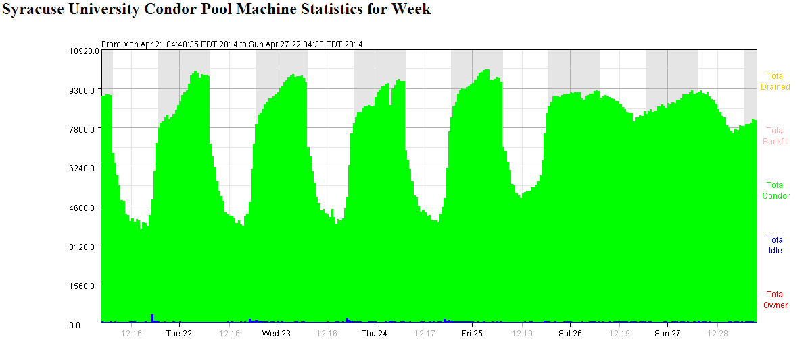

Slide 5
Focus Areas
Bridging the gap with the researcher
Better understand the researcher’s tool
Assist with scripting the “last mile” - finding the right level of investment
Does more assistance = more scholarly output?
Dynamically provision hardware resources
Researchers coming in all shapes and sizes
Compute resources are available to meet most needs, however given the diversity of research and the need for custom environments it is often in the wrong form
Focus on a virtualized research cloud

Slide 6
Chaos!

Slide 7
Research Cloud – backfill, priority, and oversubscription
Attempting to blend single large machines, small clusters of largish machines (100’s), then typically smaller compute nodes to fill in the “cracks”
Resource caps, pools, and weighting to try and place and manage load effectively
Provide “hints” about what work should be prioritized and/or we can let the workloads “fight it out” controlled by the scheduler
“flock of birds” when a large virtual machine (32 cores / 128 GB) goes active on a host as “load balancing” kicks in
Current oversubscription is 3:1 – 4:1 or 5:1 appears possible though contention will become more likely (can we identify who cares if they run a little slower?)

Slide 8
An old, somewhat painful story - VM Management
Three different hypervisors
Oracle VirtualBox - OrangeGrid
VMware ESX – research cloud
Microsoft Hyper-V – research cloud
Four research VM’s distributed across the hypervisors (with multiple versions)
Default Linux node (Ubuntu)
LIGO (SL6)
3D Render Node (Ubuntu)
BLAST Search (Ubuntu)

Slide 9
The Wonderful, Unpredictable World of Research Computing
System Administrator
How many CPU’s, how much memory, how many IOPS, and what type of networking? Give me your requirements…
Do you need backups, how often, is there a time when load is low?
What kind of uptime do you need?
Just 60 terabytes?
Researcher
I’d like to transform my research, how much can I have?
You do backups? Yes, of course I want backups. No, it is unpredictable and might be busy at any time
If it is up when I need it that is fine
Just 60 terabytes

Slide 10
Questions?

