Slide 1
Welcome to HTCondor Week #15 (year #30 for our project)

Slide 2
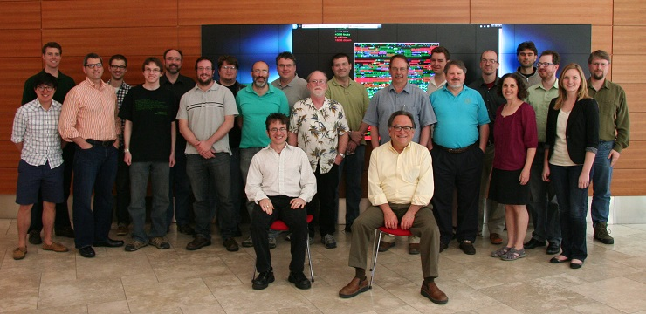
HTCondor Team 2013
Established 1985

Slide 3
The HTC community continues to expend – new platforms, new applications, new users and higher expectations

Slide 4
Subject: Meeting request
From: Michael Gofman <michael.gofman@gmail.com>
Date: Thu, 16 May 2013 11:47:50 -0500
To: MIRON LIVNY <MIRON@cs.wisc.edu>
Dear Miron,
I am an assistant professor of finance at UW-Madison. I did my Phd at the University of Chicago and master degrees at the Tel Aviv University.
In the last couple months I was using HTC resources that you developed to compute optimal financial architecture.
I would like to meet with you and tell you more about my project as well to thank you personally for developing this amazing platform.
Yours,
Michael

Slide 5
In 1996 I introduced the distinction between High Performance Computing (HPC) and High Throughput Computing (HTC) in a seminar at the NASA Goddard Flight Center in and a month later at the European Laboratory for Particle Physics (CERN). In June of 1997 HPCWire published an interview on High Throughput Computing.

Slide 6
High Throughput Computing is a 24-7-365 activity and therefore requires automation
FLOPY ≠ (60*60*24*7*52)*FLOPS

Slide 7
In July 2013 we renewed our contract with the HTC community for another five years

Slide 8
“Over the last 15 years, Condor has evolved from a concept to an essential component of U.S. and international cyberinfrastructure supporting a wide range of research, education, and outreach communities. The Condor team is among the top two or three cyberinfrastructure development teams in the country. In spite of their success, this proposal shows them to be committed to rapid development of new capabilities to assure that Condor remains a competitive offering. Within the NSF portfolio of computational and data-intensive cyberinfrastructure offerings, the High Throughput Computing Condor software system ranks with the NSF High Performance Computing centers in importance for supporting NSF researchers.”
A recent anonymous NSF review

Slide 9
“… a mix of continuous changes in technologies, user and application requirements, and the business model of computing capacity acquisition will continue to pose new challenges and opportunities to the effectiveness of scientific HTC. … we have identified six key challenge areas that we believe will drive HTC technologies innovation in the next five years.”
Evolving resource acquisition models
Hardware complexity
Widely disparate use cases
Data intensive computing
Black-box applications
Scalability

Slide 11
Obstacles to HTC
(Sociology)
(Robustness)
(Portability)
(Technology)
Ownership Distribution
Size and Uncertainties
Technology Evolution
Physical Distribution

Slide 12
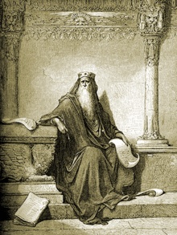
The words of Koheleth son of David, king in Jerusalem ~ 200 A.D.
Only that shall happen
Which has happened,
Only that occur
Which has occurred;
There is nothing new
Beneath the sun!
Ecclesiastes Chapter 1 verse 9
Ecclesiastes, (קֹהֶלֶת, Kohelet, "son of David, and king in Jerusalem" alias Solomon, Wood engraving
Gustave Doré (1832–1883)

Slide 13
1992

Slide 14
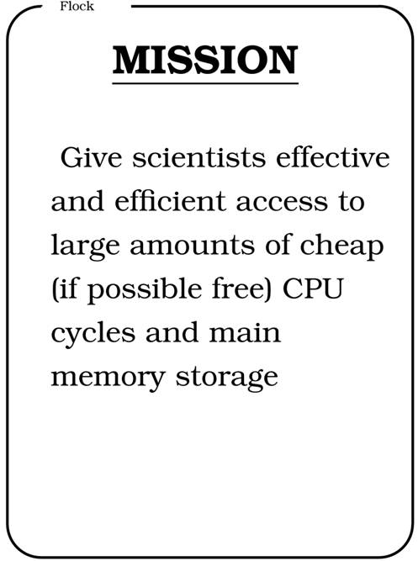
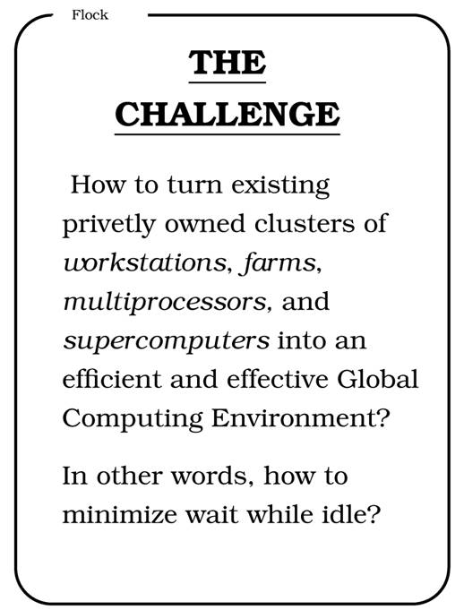
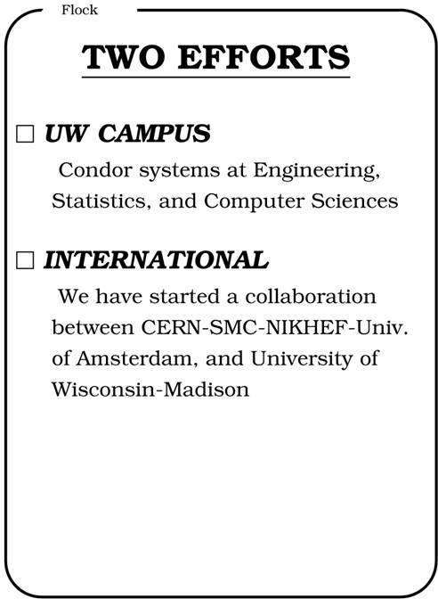
CERN 92

Slide 15
Dear Miron, I'm contacting you to follow up on an e-mail exchange you have recently had with Frederic Hemmer, IT Department head at CERN. Not sure you remember me, but we have met a few times. Around the mid 90s I set up a small Condor pool for the Chorus experiment at CERN, and we met in Bologna, where courses and discussions were held. … We haven't tested XXXX at great length, but as the architecture looks similar to XXXX, we don't think we would get much further. Very positive experience reported by RAL as well as by the US Tier-1s and the sufficiently different architecture have hence made us interested in Condor. … ---------------------------------------------------------------------------- Helge MEINHARD CERN, IT Department, CH-1211 Geneve 23, Switzerland Phone: +41 22 76-76031, Fax: +41 22 76-69935 E-mail: Helge.Meinhard@cern.ch

Slide 16
Usability (Simpler to install/use/operate and easier to understand)

Slide 17
periodic_remove = JobStatus == 2 && (CurrentTime-JobCurrentStartExecutingDate) > 3600 VS. MaxRunTime = 3600

Slide 18
Why are my jobs not running? It is the DNS at psychiatry!

Slide 19
Thank you for building such
a wonderful HTC community

