Slide 1
HTCondor at the RAL Tier-1
Andrew Lahiff,
Alastair Dewhurst, John Kelly, Ian Collier, James Adams
STFC Rutherford Appleton Laboratory
HTCondor Week 2014

Slide 2
Outline
Overview of HTCondor at RAL
Monitoring
Multi-core jobs
Dynamically-provisioned worker nodes

Slide 3
Introduction
RAL is a Tier-1 for all 4 LHC experiments
Provide computing & disk resources, and tape for custodial storage of data
In terms of Tier-1 computing requirements, RAL provides
2% ALICE
13% ATLAS
8% CMS
32% LHCb
Also support ~12 non-LHC experiments, including non-HEP
Computing resources
784 worker nodes, over 14K cores
Generally have 40-60K jobs submitted per day

Slide 4
Migration to HTCondor
Torque/Maui had been used for many years
Many issues
Severity & number of problems increased as size of farm increased
Migration
2012 Aug Started evaluating alternatives to Torque/Maui
(LSF, Grid Engine, Torque 4, HTCondor, SLURM)
2013 Jun Began testing HTCondor with ATLAS & CMS
2013 Aug Choice of HTCondor approved by management
2013 Sep HTCondor declared production service
Moved 50% of pledged CPU resources to HTCondor
2013 Nov Migrated remaining resources to HTCondor

Slide 5
Experience so far
Experience
Very stable operation
Staff don’t need to spend all their time fire-fighting problems
Job start rate much higher than Torque/Maui, even when throttled
Farm utilization much better
Very good support

Slide 6
Status
Version
Currently 8.0.6
Trying to stay up to date with the latest stable release
Features
Partitionable slots
Hierarchical accounting groups
HA central managers
PID namespaces
Python API
condor_gangliad
In progress
CPU affinity being phased in
cgroups has been tested, probably will be phased-in next

Slide 7
Computing elements
All job submission to RAL is via the Grid
No local users
Currently have 5 CEs, schedd on each:
2 CREAM CEs
3 ARC CEs
CREAM doesn’t currently support HTCondor
We developed the missing functionality ourselves
Will feed this back so that it can be included in an official release
ARC better
But didn’t originally handle partitionable slots, passing CPU/memory requirements to HTCondor, …
We wrote lots of patches, all included in upcoming 4.1.0 release
Will make it easier for more European sites to move to HTCondor

Slide 8
HTCondor in the UK
Increasing usage of HTCondor in WLCG sites in the UK
2013-04-01: None
2014-04-01: RAL Tier-1, RAL Tier-2, Bristol, Oxford (in progress)
The future
7 sites currently running Torque/Maui
Considering moving to HTCondor or will move if others do

Slide 9
Monitoring

Slide 10
Jobs monitoring
Useful to store details about completed jobs in a database
What we currently do
Nightly cron reads HTCondor history files, inserts data into MySQL
Problems
Currently only use subset of content of job ClassAds
Could try to put in everything
What happens then if jobs have new attributes? Modify DB table?
Experience with similar database for Torque
As database grew in size, queries took longer & longer
Database tuning important
Is there a better alternative?

Slide 11
Jobs monitoring
CASTOR team at RAL have been testing Elasticsearch
Why not try using it with HTCondor?
Elasticsearch ELK stack
Logstash: parses log files
Elasticsearch: search & analyze data in real-time
Kibana: data visualization
Hardware setup
Test cluster of 13 servers (old diskservers & worker nodes)
But 3 servers could handle 16 GB of CASTOR logs per day
Adding HTCondor
Wrote config file for Logstash to enable history files to be parsed
Add Logstash to machines running schedds
HTCondor history files
Logstash
Elastic
search
Kibana

Slide 12
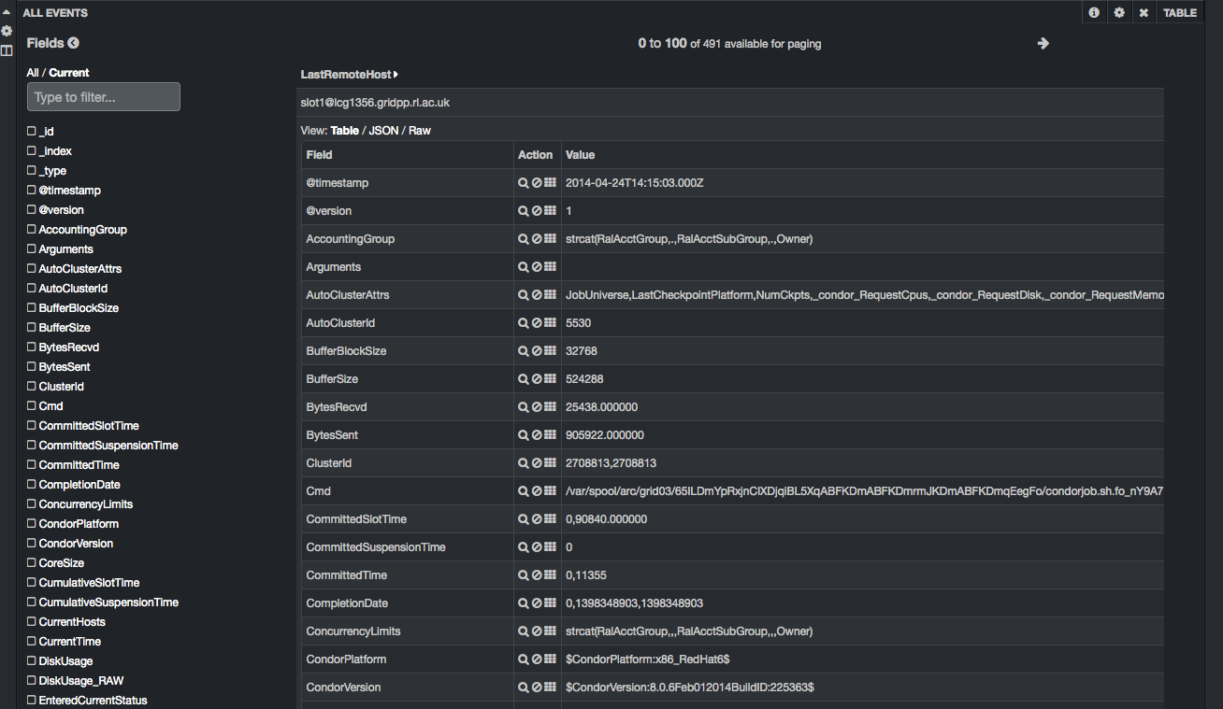
Jobs monitoring
Can see full job ClassAds

Slide 13
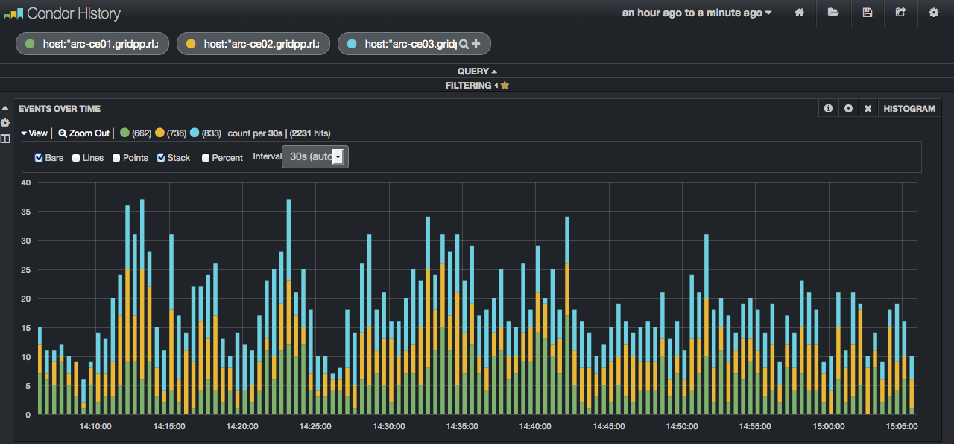
Jobs monitoring
Custom plots
E.g. completed jobs by schedd

Slide 14
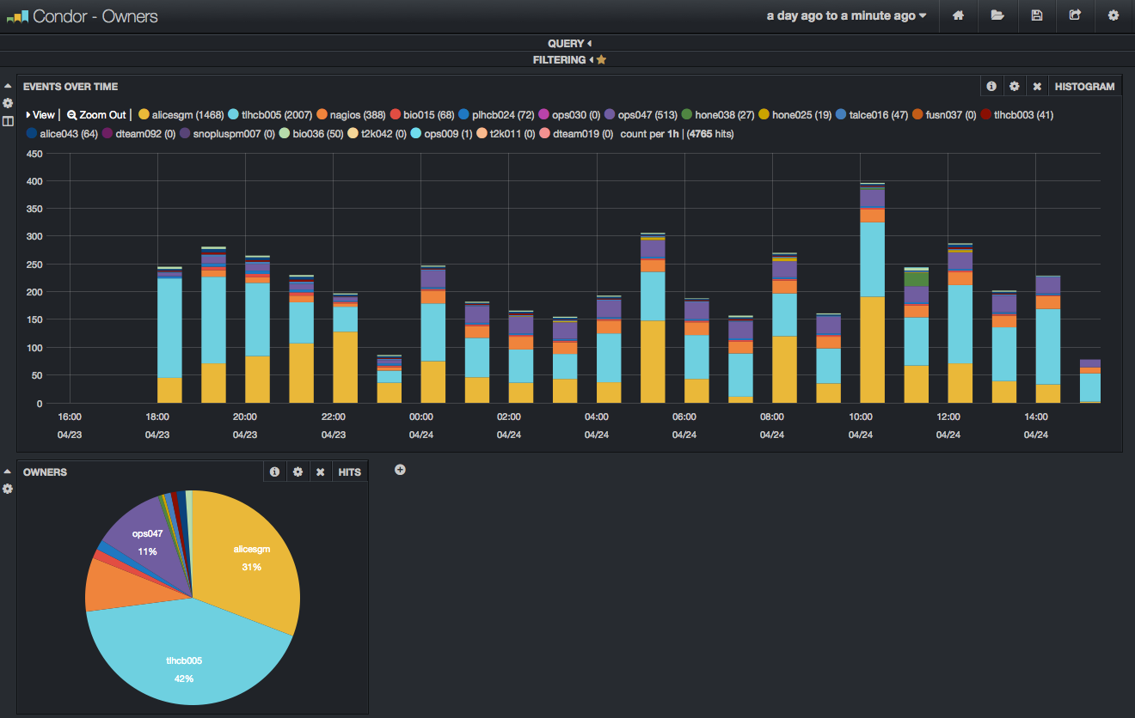
Jobs monitoring
Custom dashboards

Slide 15
Jobs monitoring
Benefits
Easy to setup
Took less than a day to setup the initial cluster
Seems to be able to handle the load from HTCondor
For us (so far): < 1 GB, < 100K documents per day
Arbitrary queries
Queries are faster than using condor_history
Horizontal construction
Need more capacity? Just add more nodes

Slide 16
Multi-core jobs

Slide 17
Multi-core jobs
Situation so far
ATLAS have been running multi-core jobs at RAL since November
CMS submitted a few test jobs, will submit more eventually
Interest so far only for multi-core jobs, not whole-node jobs
Only 8-core jobs
Our aims
Fully dynamic
No manual partitioning of resources
Number of running multi-core jobs determined by group quotas

Slide 18
Multi-core jobs
Defrag daemon
Essential to allow multi-core jobs to run
Want to drain 8 cores only. Changed:
DEFRAG_WHOLE_MACHINE_EXPR = Cpus == TotalCpus && Offline=!=True
to
DEFRAG_WHOLE_MACHINE_EXPR = (Cpus >= 8) && Offline=!=True
Which machines more desirable to drain? Changed
DEFRAG_RANK = -ExpectedMachineGracefulDrainingBadput
to
DEFRAG_RANK = ifThenElse(Cpus >= 8, -10, (TotalCpus - Cpus)/(8.0 - Cpus))
Why make this change?
With default DEFRAG_RANK, only older full 8-core WNs were being selected for draining
Now: (Number of slots that can be freed up)/(Number of needed cores)
For us this does a better job of finding the “best” worker nodes to drain

Slide 19
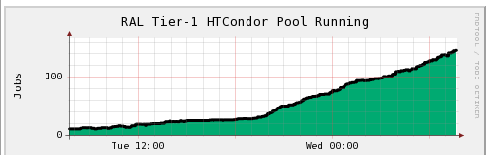
Multi-core jobs
Effect of changing DEFRAG_RANK
No change in the number of concurrent draining machines
Rate in increase in number of running multi-core jobs much higher
_{Running multi-core jobs}

Slide 20
Multi-core jobs
Group quotas
Added accounting groups for ATLAS and CMS multi-core jobs
Force accounting groups to be specified for jobs using SUBMIT_EXPRS
Easy to include groups for multi-core jobs
AccountingGroup =
…
ifThenElse(regexp("patl",Owner) && RequestCpus > 1, “group_ATLAS.prodatls_multicore", \
ifThenElse(regexp("patl",Owner), “group_ATLAS.prodatls", \
…
SUBMIT_EXPRS = $(SUBMIT_EXPRS) AccountingGroup
Negotiator
Modified GROUP_SORT_EXPR so that the order is:
High priority groups (Site Usability Monitor tests)
Multi-core groups
Remaining groups
Helps to ensure multi-core slots not lost too quickly

Slide 21
Multi-core jobs
Defrag daemon issues
No knowledge of demand for multi-core jobs
Always drains the same number of nodes, irrespective of demand
Can result in large amount of wasted resources
Wrote simple cron script which adjusts defrag daemon config based on demand
Currently very simple, considers 3 cases:
Many idle multi-core jobs, few running multi-core jobs
Need aggressive draining
Many idle multi-core jobs, many running multi-core jobs
Less agressive draining
Otherwise
Very little draining
May need to make changes when other VOs start submitting multi-core jobs in bulk

Slide 22
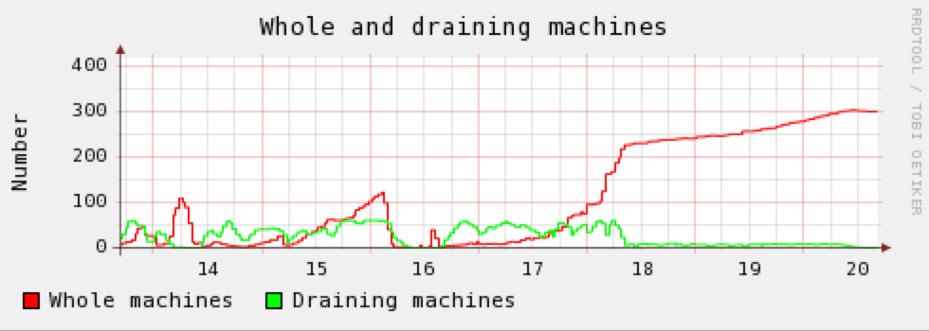
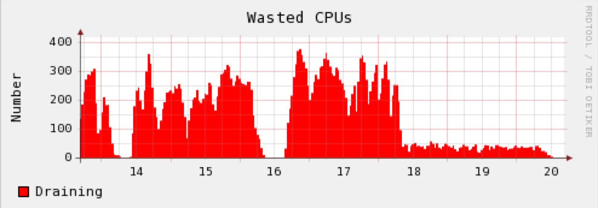
Multi-core jobs
Recent ATLAS activity
Running & idle multi-core jobs
Gaps in submission by ATLAS results
in loss of multi-core slots.
Number of “whole” machines
& draining machines
Data from condor_gangliad
Significantly reduced CPU wastage
due to the cron

Slide 23
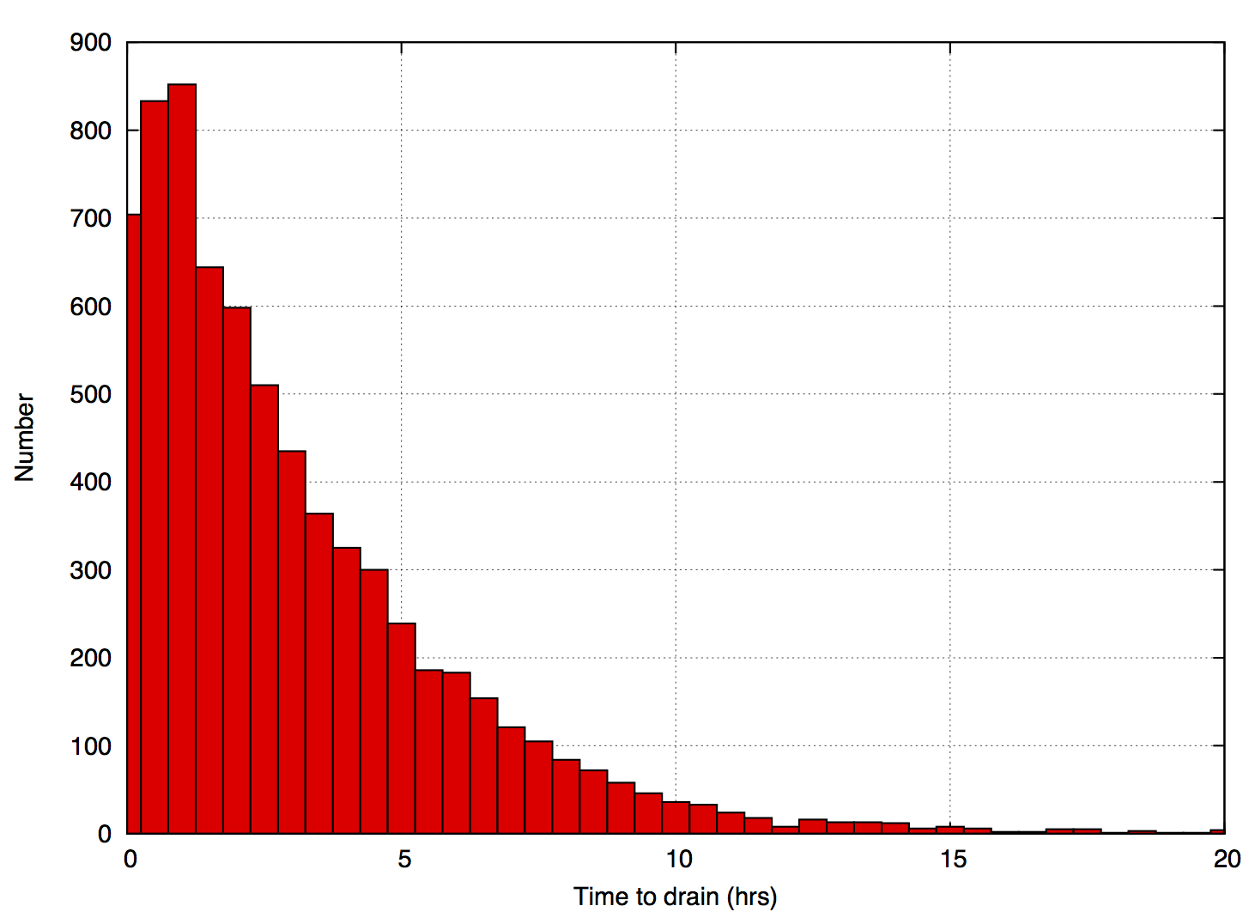
Multi-core jobs
Other issues
Defrag daemon designed for whole-node, not multi-core
Won’t drain nodes already running multi-core jobs
Ideally may want to run multiple multi-core jobs per worker node
Would be good to be able to run “short” jobs while waiting for slots to become available for multi-core jobs
On other batch systems, backfill can do this
Time taken for 8 jobs to drain
- lots of opportunity to run short jobs

Slide 24
Multi-core jobs
Next step: enabling “backfill”
ARC CE adds custom attribute to jobs: JobTimeLimit
Can have knowledge of job run times
Defrag daemon drains worker nodes
Problem: machine can’t run any jobs at this time, including short jobs
Alternative idea:
Python script (run as a cron) which plays the same role as defrag daemon
But doesn’t actually drain machines
Have a custom attribute on all startds, e.g. NodeDrain
Change this instead
START expression set so that:
If NodeDrain false: allow any jobs to start
If NodeDrain true: allow only short jobs under certain conditions, e.g. for a limited time after “draining” started
Provided (some) VOs submit short jobs, should be able to reduce wasted resources due to draining

Slide 25
Dynamically-provisioned worker nodes

Slide 26
Private clouds at RAL
Prototype cloud
StratusLab (based on OpenNebula)
iSCSi & LVM based persistent disk storage (18 TB)
800 cores
No EC2 interface
Production cloud
(Very) early stage of deployment
OpenNebula
900 cores, 3.5 TB RAM, ~1 PB raw storage for Ceph
Aims
Integrate with batch system, eventually without partitioned resources
First step: allow the batch system to expand into the cloud
Avoid running additional third-party and/or complex services
Use existing functionality in HTCondor as much as possible
Should be as simple as possible

Slide 27
Provisioning worker nodes
Use HTCondor’s existing power management features
Send appropriate offline ClassAd(s) to the collector
Hostname used is a random string
Represents a type of VM, rather than specific machines
condor_rooster
Provisions resources
Configured to run appropriate command to instantiate a VM
When there are idle jobs
Negotiator can match jobs to the offline ClassAds
condor_rooster daemon notices this match
Instantiates a VM
Image has HTCondor pre-installed & configured, can join the pool
HTCondor on the VM controls the VM’s lifetime
START expression
New jobs allowed to start only for a limited time after VM instantiated
HIBERNATE expression
VM is shutdown after machine has been idle for too long

Slide 28
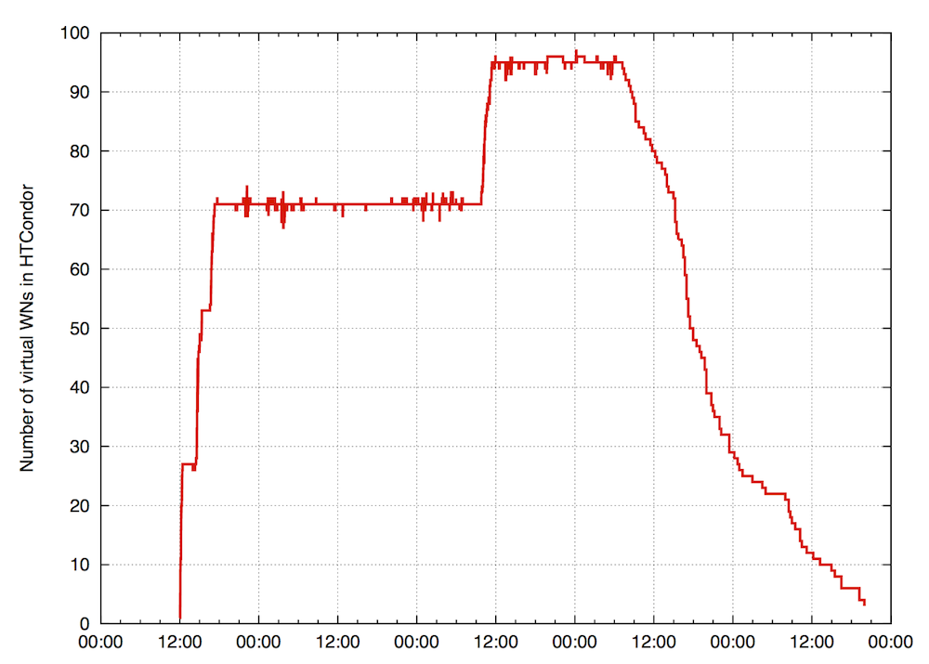
Testing
Testing in production
Initial test with production HTCondor pool
Ran around 11,000 real jobs, including jobs from all LHC VOs
Started with 4-core 12GB VMs, then changed to 3-core 9GB VMs
Hypervisors enabled
Started using 3-core VMs
condor_rooster disabled

Slide 29
Summary
Due to scalability problems with Torque/Maui, migrated to HTCondor last year
We are happy with the choice we made based on our requirements
Confident that the functionality & scalability of HTCondor will meet our needs for the foreseeable future
Multi-core jobs working well
Looking forward to more VOs submitting multi-core jobs
Dynamically-provisioned worker nodes
Expect to have in production later this year

Slide 30
Thank you!

