Slide 1
Putting Eggs in Many Baskets:
Data Considerations in the Cloud
Rob Futrick, CTO

Slide 2
We believe utility access to technical computing power accelerates discovery & invention

Slide 3
The Innovation Bottleneck:
Scientists/Engineers
forced to size their work to the
infrastructure their organization bought

Slide 4
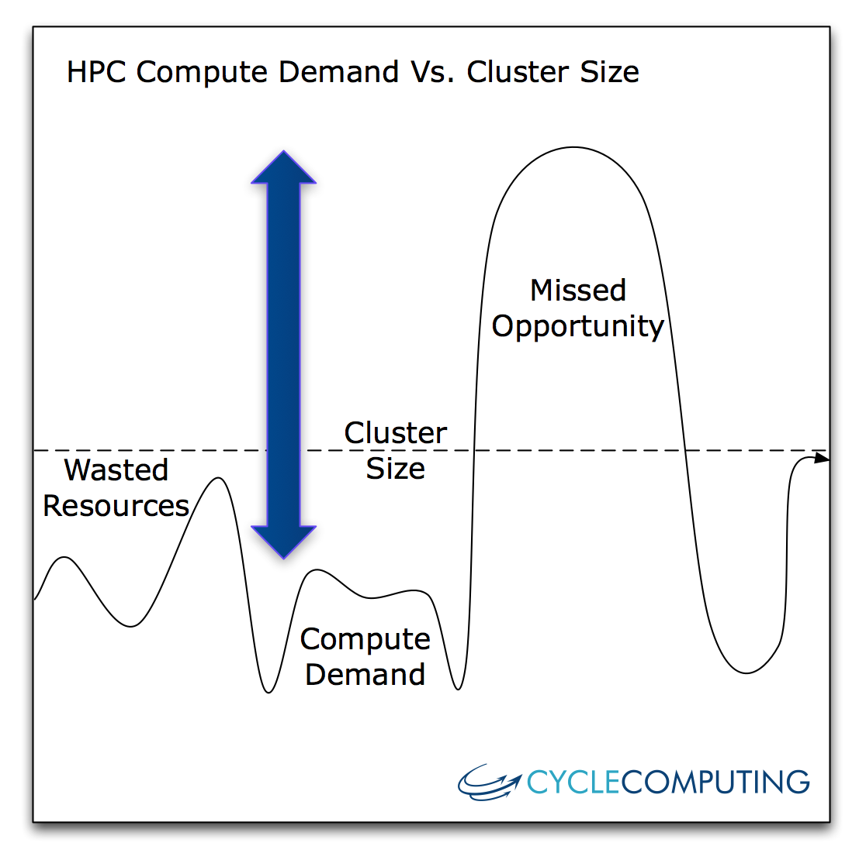
Limitations of fixed infrastructure
Too small when needed most,
Too large every other time…
Upfront CapEx anchors you to aging servers
Costly administration
Miss opportunities to do better risk management, product design, science, engineering

Slide 5
Our mission:
Write software to make utility technical computing easy for anyone, on any resources, at any scale

Slide 6
As an example…

Slide 7
Many users use 40 - 4000 cores, but let’s talk about an example:
World’s first PetaFLOPS
((Rmax+Rpeak)/2)
Throughput Cloud Cluster

Slide 8
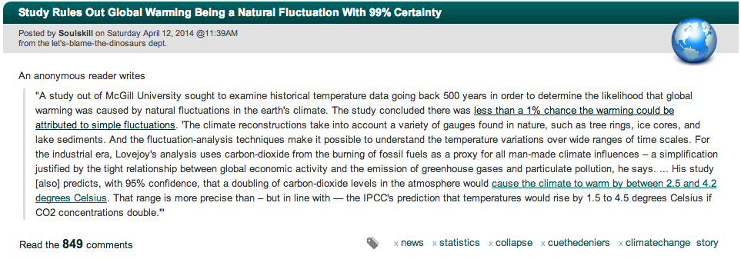

Slide 9
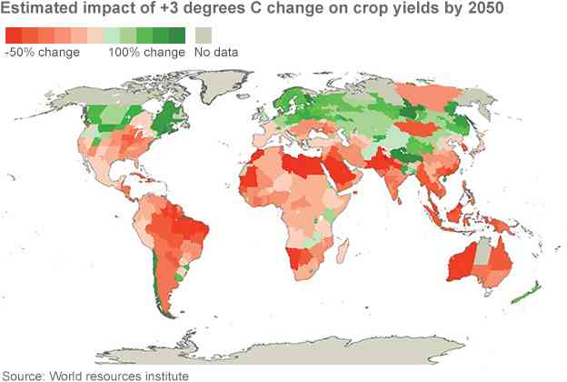
What do you think?
Much of the worlds “bread basket” land will be hotter and drier
Ocean warming is decreasing fish populations / catches

Slide 10

First, buy land in Canada?

Slide 11
Sure! But there have to be engineer-able solutions too.
Solar Energy
Wind power
Nuclear Fission energy
GeoThermal
Climate Engineering
Nuclear Fusion
BioFuels

Slide 12
Designing Solar Materials
The challenge is efficiency - turning photons to electricity
The number of possible materials is limitless:
Need to separate the right compounds from the useless ones
Researcher Mark Thompson, PhD:
“If the 20th century was the century of silicon, the 21st will be all organic. Problem is, how do we find the right material without spending the entire 21st century looking for it?”

Slide 13
Needle in a Haystack Challenge:
205,000 compounds totaling 2,312,959 core-hours or 264 core-years

Slide 14
16,788 Spot Instances,
156,314 cores
205,000 molecules
264 years of computing

Slide 15
156,314 cores =
1.21 PetaFLOPS (~Rpeak)
205,000 molecules
264 years of computing

Slide 16

8-Region Deployment
US-West-2
EU
US-East
Tokyo
US-West-1
Singapore
Brazil
Australia

Slide 17
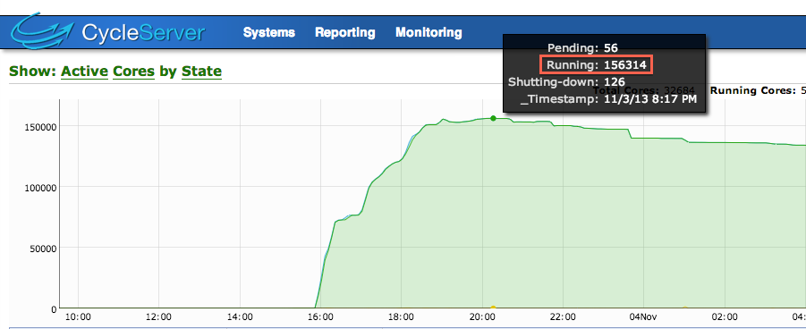
1.21 PetaFLOPS (Rmax+Rpeak)/2, 156,314 cores

Slide 18
Each individual task was MPI, using a single, entire machine

Slide 19
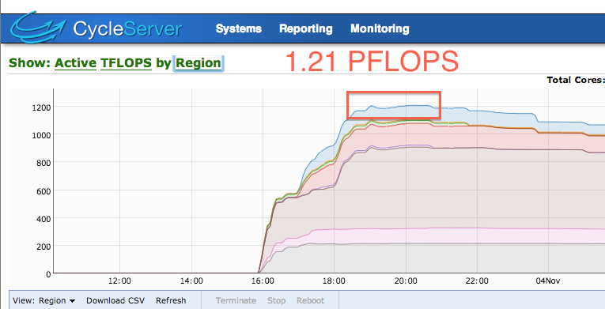
Benchmark individual machines

Slide 20
Done in 18 hours
Access to $68M system for $33k
205,000 molecules
264 years of computing

Slide 21


How did we do this?
Automated in 8 Cloud Regions,
5 continents, double resiliency
…
JUPITER
Distributed Queue
Auto-scaling
Execute Nodes
14 nodes controlling 16,788
Data

Slide 22
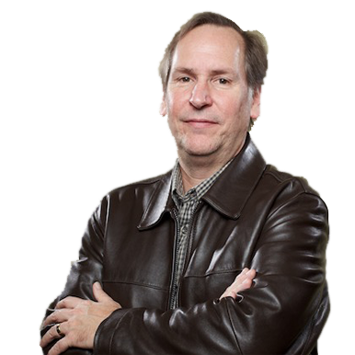
Now Dr. Mark Thompson
Is 264 compute years closer to making efficient solar a reality using organic semiconductors

Slide 23
Important?

Slide 24
Not to me anymore ;)

Slide 25
We see across all workloads
Large Memory
Interconnect Sensitive
Whole sample set analysis
Large Grid MPI Runs
Needle in a Haystack runs
Hi I/O
Big Data runs
Interactive, SOA

Slide 26
Users want to decrease
Lean manufacturing’s ‘Cycle time’
=
(prep time + queue time + run time)

Slide 27



























Everyone we work with faces this problem
SLED/PS | Insurance | Financial Services | Life Sciences | Manufacturing & Electronics | Energy, Media & Other

Slide 28
External resources
(Open Science Grid, cloud) offer a solution!

Slide 29

How do we get there?

Slide 30
In particular how do we deal with data in our workflows?

Slide 31
Several of the options…
Local disk
Object Store / Simple Storage Service (S3)
Shared FS
  NFS
  Parallel file system (Lustre, Gluster)
NoSQL DB

Slide 32
Let’s do this through examples

Slide 33
Compendia BioSciences
(Local Disk)

Slide 34
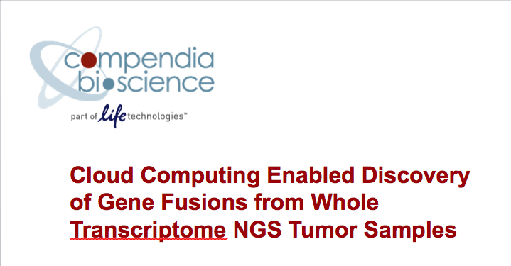
The Cancer Genome Atlas

Slide 35
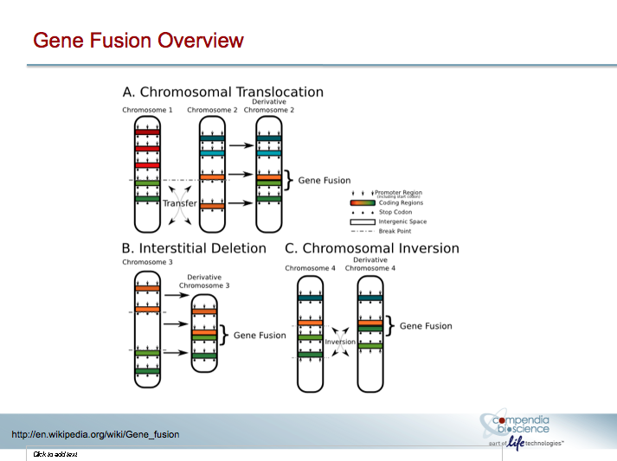
G

Slide 36
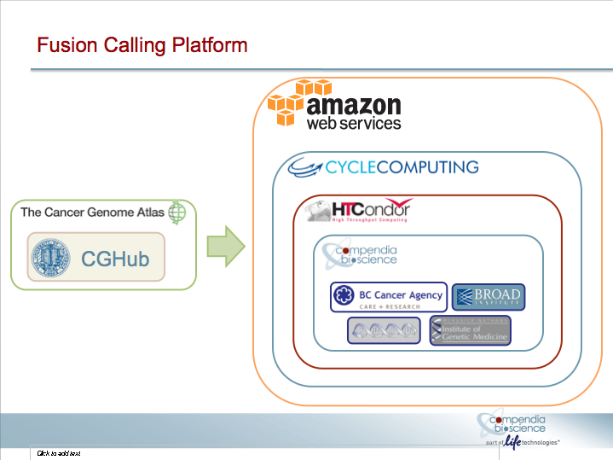
G

Slide 37
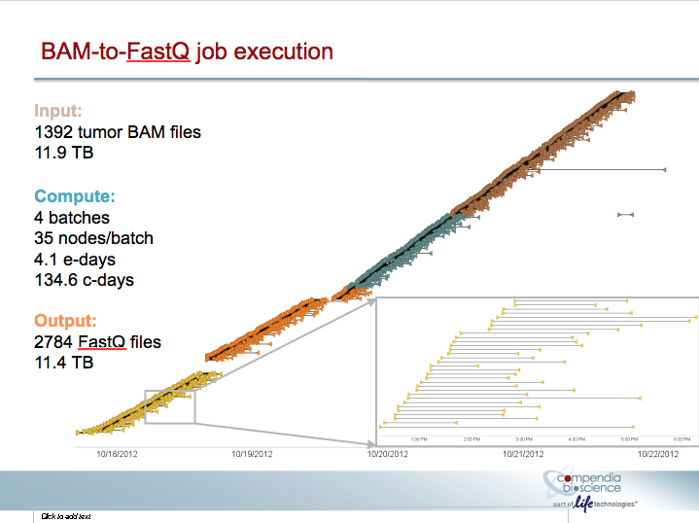
As described at TriMed Conference
Stream data out of TCGA into S3 & Local machines (concurrently on 8k cores)
Run analysis and then place results in S3
No Shared FS, but all nodes are up for a long time downloading (8000 cores * xfer)

Slide 38
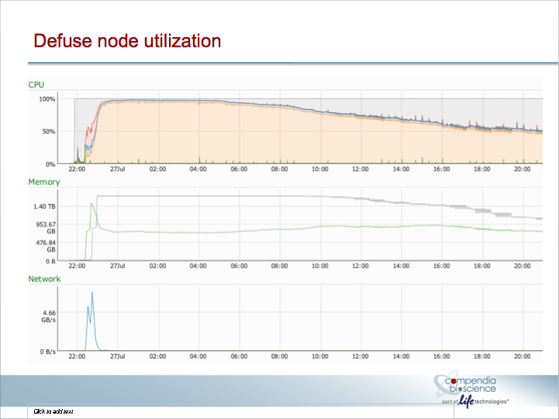
G

Slide 39
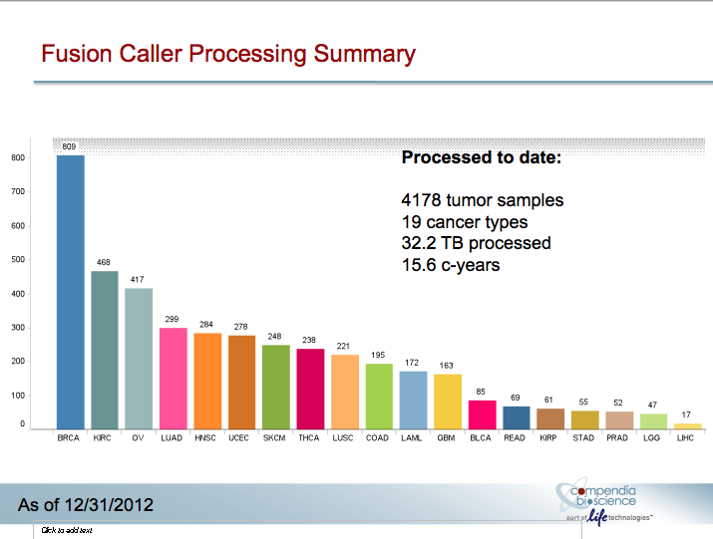
G

Slide 40
Pros & Cons of Local Disk
Pros:
Typically no application changes
Data encryption is easy; No shared key management
Highest speed access to data once local
Cons:
Performance cost/impact of all nodes downloading data
Only works for completely mutually exclusive workflows
Possibly more expensive;
Transferring to a shared filer and then running may be cheaper

Slide 41
Novartis
(S3 sandboxes)

Slide 42
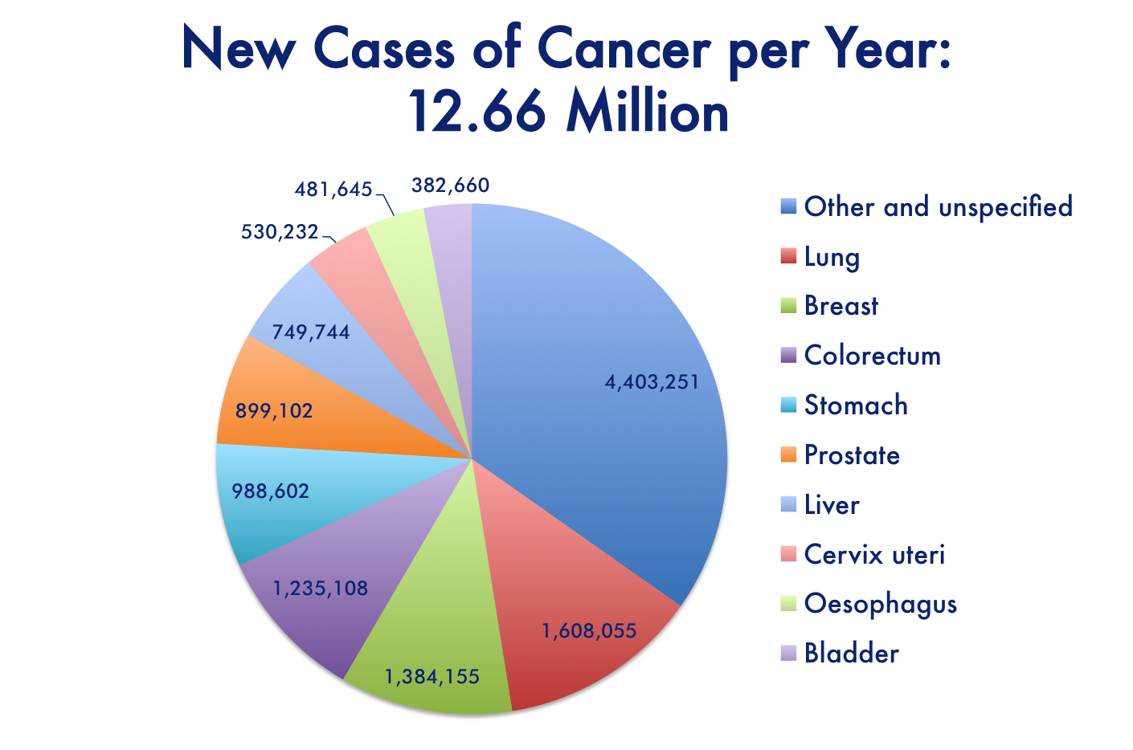
(W.H.O./Globocan 2008)

Slide 43
Every day is crucial and costly

Slide 44
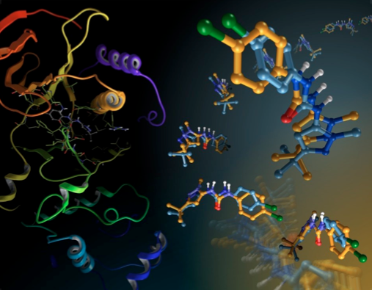
Challenge: Novartis run 341,700 hours of docking
against a cancer target; impossible to do in-house.

Slide 45

Most Recent Utility Supercomputer server count:

Slide 46

AWS Console view
(the only part that rendered):

Slide 47
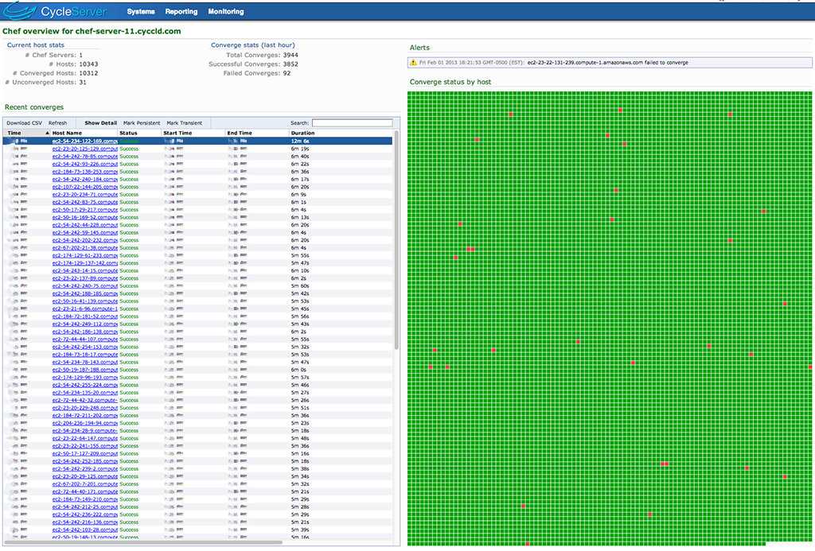
Cycle Computing’s cluster view:

Slide 48
CycleCloud, HTCondor, & Cloud finished impossible workload,
$44 Million in servers, …
Metric | Count
Compute Hours of Science | 341,700 hours
Compute Days of Science | 14,238 days
Compute Years of Science | 39 years
AWS Instance Count | 10,600 instances

Slide 49

39 years of drug design in 11 hours on 10,600 servers for < $4,372

Slide 50
Does this lead to new drugs?

Slide 51
Novartis announced
3 new compounds going into screening based upon this 1 run

Slide 52
Pros & Cons of S3
Pros:
Parallel scalability; high throughput access to data
Only bottlenecks occur on S3 access
Can easily and greatly increase capacity
Cons:
Only works for completely mutually exclusive workflows
Native S3 access requires application changes
Non-native S3 access can be unstable
Latency can affect performance

Slide 53
Johnson & Johnson
(Single node NFS)

Slide 54
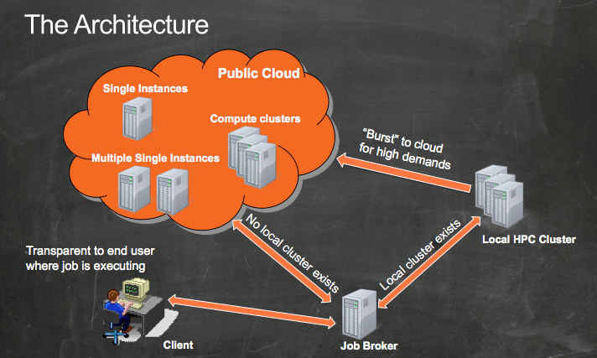
JnJ @ AWS re:Invent 2012

Slide 55
JnJ Burst use case
Internal & external
CFD/Genomics/etc.
Submission APIs
Cloud Filer
Internal Cluster
Scheduled
Data
HPC
Cluster
Auto-scaling
Secure
environment
File System
Glacier
(Patents Pending)

Slide 56
Pros & Cons of NFS
Pros:
Typically no application changes
Cheapest at small scale
Easy to encrypt data
Performance great at (small) scale and/or under some access patterns
Great platform support
Cons:
Filer can easily become performance bottleneck
Not easily expandable
Not fault tolerant; Single point of failure
Backup and recovery

Slide 57
Parallel Filesystem
(Gluster, Lustre)

Slide 58
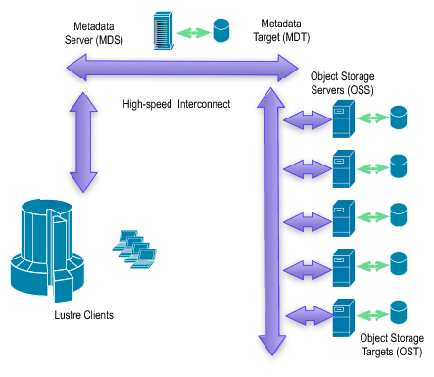
(http://wiki.lustre.org)

Slide 59
Pros & Cons of Parallel FS
Pros:
Easily expand capacity
Read performance scalability
Data integrity
Cons:
Greatly increased administration complexity
Performance for “small” files can be atrocious
Poor platform support
Data integrity and backup
Still has single points of failure

Slide 60
NoSQL DB
(Cassandra, MongoDB)

Slide 61
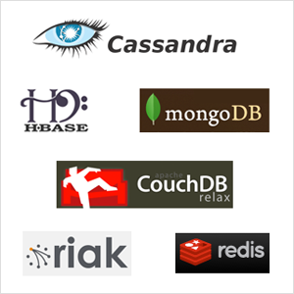
(http://strata.oreilly.com/2012/02/nosql-non-relational-database.html)

Slide 62
Pros & Cons of NoSQL DB
Pros:
Best performance for appropriate data sets
Data backup and integrity
Good platform support
Cons:
Only appropriate for certain data sets and access patterns
Requires application changes
Application developer and Administration complexity
Potential single point of failure

Slide 63
That’s a survey of different workloads
Large Memory
Interconnect Sensitive
Whole sample set analysis
Large Grid MPI Runs
Needle in a Haystack runs
Hi I/O
Big Data runs
Interactive, SOA

Slide 64
Depending upon your use case
Jobs & data
Internal TC
Cloud Filer
Faster interconnect capability machine
Scheduled
Data
Cloud Filer
Cloud Filer
HPC Cluster
Auto-scaling
external
environment
TC
Cluster
Auto-scaling
external
environment
File System (PBs)
Blob data (S3)
HPC Cluster
Auto-scaling
external
environment
Blob data (S3)
Blob data
Glacier
Glacier
Cold Storage

Slide 65


There are a lot more examples…
Life Sciences
Rocket Design & Simulation
39.5 years of drug compound computations in 9 hours, at a total cost of $4,372
10,000 server cluster seamlessly spanned US/EU regions
Advanced 3 new otherwise unknown compounds in wet lab
Moving HPC workloads to cloud for burst capacity
Amazon GovCloud, Security, and key management
Up to 1000s of cores for burst / agility
Life Sciences
Asset & Liability Modeling (Insurance / Risk Mgmt)
156,000-core utility supercomputer in the Cloud
Used $68M in servers for 18 hours for $33,000
Simulated 205,000 materials (264 years) in 18 hours
Completes monthly/quarterly runs 5-10x faster
Use 1600 cores in the cloud to shorten elapsed run time
from ~10 days to ~ 1-2 days
Nuclear engineering Utilities / Energy
Manufacturing & Design
Approximately 600-core MPI workloads run in Cloud
Ran workloads in months rather than years
Introduction to production in 3 weeks
Enable end user on-demand access to 1000s of cores
Avoid cost of buying new servers
Accelerated science and CAD/CAM process

Slide 66
Hopefully you see various data placement options

Slide 67
Each have pros and cons…
Local disk
Simple Storage Service (S3)
Shared FS
  NFS
  Parallel file system (Lustre, Gluster)
NoSQL DB

Slide 68
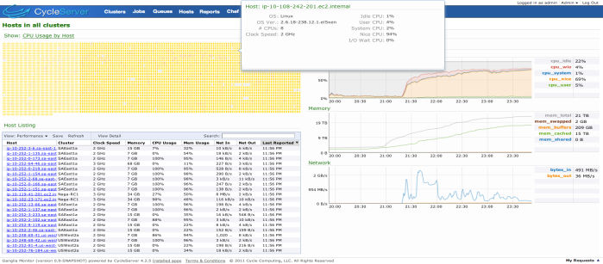
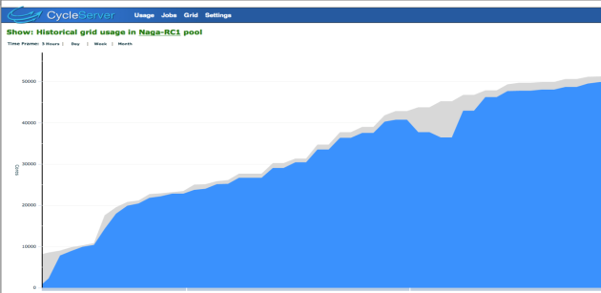
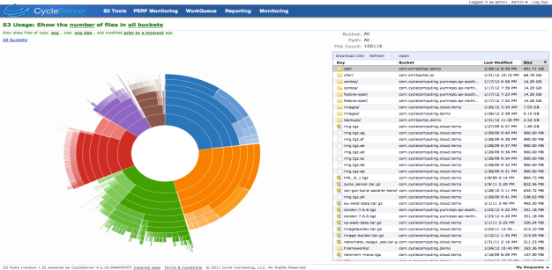
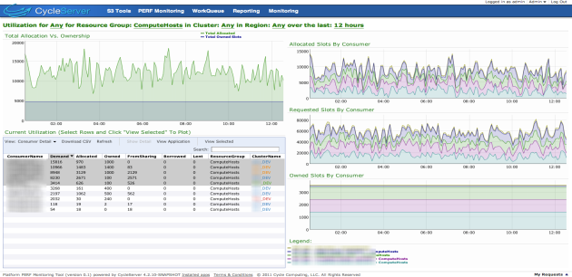
We write software to do this…
Cycle easily orchestrates workloads and data access to local and Cloud TC
Scales from 100 - 100,000’s of cores
Handles errors, reliability
Schedules data movement
Secures, encrypts and audits
Provides reporting and chargeback
Automates spot bidding
Supports Enterprise operations

Slide 69

Does this resonate with you?
We’re hiring like crazy: Software developers, HPC engineers, devops, sales, etc.
jobs@
cyclecomputing.com

Slide 70
Now hopefully…

Slide 71
You’ll keep these tools in mind

Slide 72
as you use HTCondor

Slide 73
to accelerate your science!

