Slide 1
Connecting Campus Infrastructures with HTCondor Services
Lincoln Bryant
Computation and Enrico Fermi Institutes
University of Chicago
Condor Week 2014

Slide 2
Outline
The need for connective services for cyber infrastructure
Technical approaches using HTCondor
Example deployments: ATLAS Connect, Duke CI Connect
Next steps

Slide 3
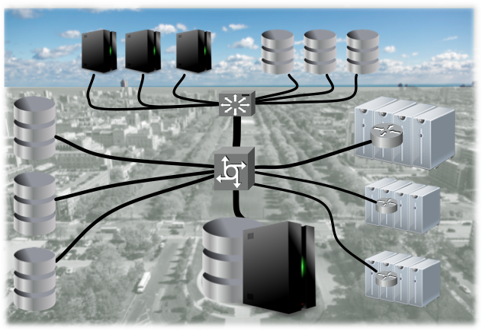
Resources are distributed
cloud resources + WAN resources
Legacy
campus
clusters
Colleges &
divisions
Distributed
storage
resources
Centralized campus clusters
(condo and hotel models in campus HPC centers)

Slide 4
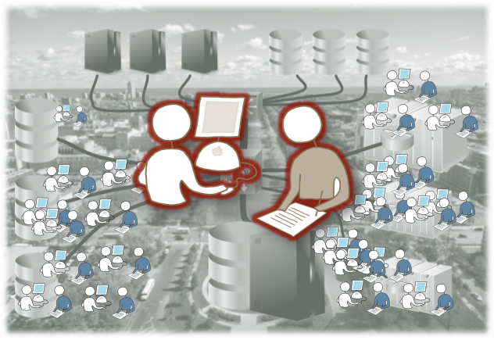
How can we transparently connect them to users?
Approach: work from the campus perspective
considering both users and resource providers

Slide 5
Providers: accountable to investors
The BIG problem:
  Resource providers must first meet campus investor requirements
    Sometimes with little effort to worry about connectivity to the national ecosystem
    They are typically slow to open up resources for sharing
But computers depreciate in value really fast!
  Shouldn’t we obligate ourselves to make the most out of these machines?
Can we do the heavy lifting for them?

Slide 6

Bring services directly to campus
As value added
services for
the campus
computing
center
Tightly coupled ←→ serial high throughput
Minimize environment differences for users
Virtually extend capacity

Slide 7
Connecting Cluster Resources
There's a large barrier to entry when we aren't even running the same scheduler software.
The solution: Bosco
  http://bosco.opensciencegrid.org/
Bosco provides an HTCondor interface to PBS, SGE, SLURM, etc., via BLAHP^{[1]}
Has end-user and multi-user (service) modes
We can provide transparent user access to multiple resources using Bosco and direct flocking
  ^{[1]} see BLAHP presentation at HTCondor Week 2013

Slide 8
Advantages of the Bosco approach
From the admin perspective, we only need a user account and SSH key on the remote machine.
Since our Bosco service appears a normal user, it's trivial to apply local policy.
If jobs get killed, we can handle that.
  All the better if we can use an opportunistic queue!
Bosco also lets us have pre-job wrappers that allow us to build a comfortable nest

Slide 9
Bosco as a standard tool for HTC
In the reverse direction, we want users of remote clusters to be using our resources for spillover.
This is an especially nice value-added service for HPC environments
  We don't require allocations. We'll process your pleasingly parallel workloads for free.
Everyone in HPC-land seems to be using Modules, so we have done some work to provide a Bosco module.

Slide 10
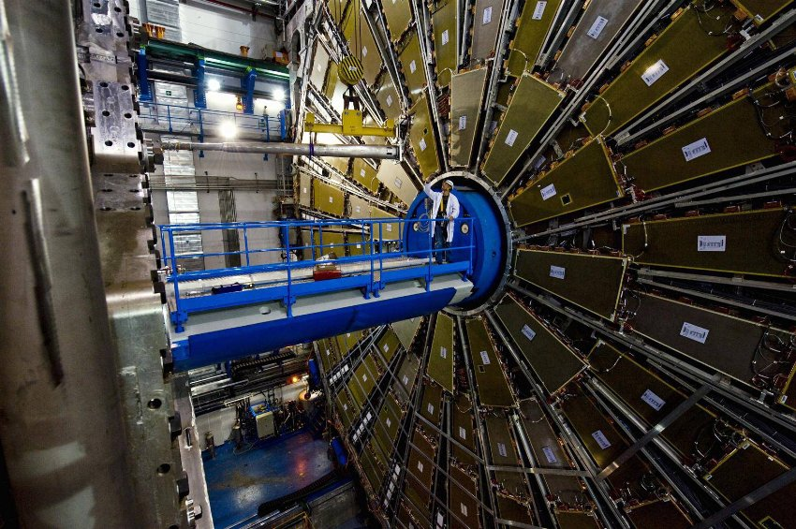
Example use case:

Slide 11





ATLAS Connect Service Components
Globus Platform
  Reliable file transfer to ‘scratch’ endpoints
  Identity management
  Groups, Projects
Login host
  Auto-provisioning, quickly validating users
Bosco-based Glidein Factories
  “Remote Cluster Connect Factories” (RCCF)
  One instance per resource target
Gratia accounting & Cycle Server monitoring
FAXbox storage service
  POSIX, http, XRootD, Globus access

Slide 12
Three Service Types for ATLAS
ATLAS Connect User
  HTCondor-based login machine for US ATLAS physicists to reach cycles at dedicated datacenters as well as departmental clusters.
ATLAS Connect Cluster
  Send jobs from local departmental cluster to ATLAS Connect infrastructure using HTCondor’s flocking mechanism
ATLAS Connect Panda
  Integration with ATLAS “Panda” job workflow manager.
  Opportunistically send simulation jobs to clouds, campus clusters, HPC resource centers

Slide 13
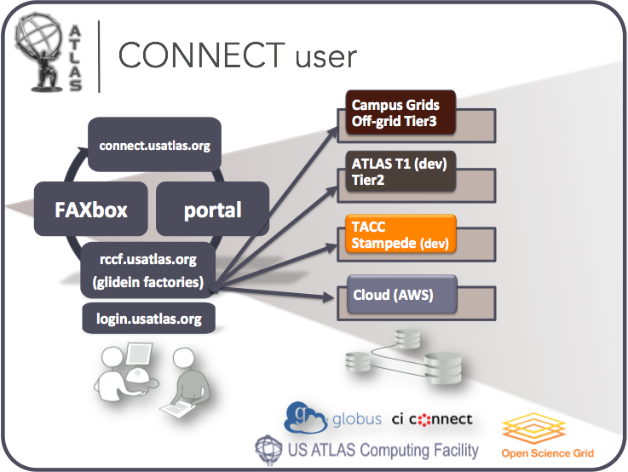
ATLAS Connect User
users
from 44
institutions
various
campus
resources
XSEDE
cloud

Slide 14
Looks like a very large cluster
Users want to see quick, immediate “local” batch service
Most Tier 3 batch use is very spikey
Use opportunistic resources to elastically absorb periods of peak demand
Easily adjust virtual pool size according to US ATLAS priorities

Slide 15
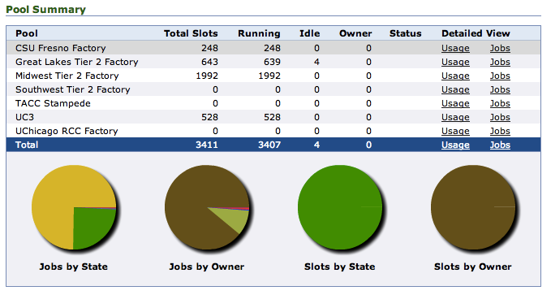
Current resource targets
Pool size varies depending on demand, matchmaking, priority at resource

Slide 16
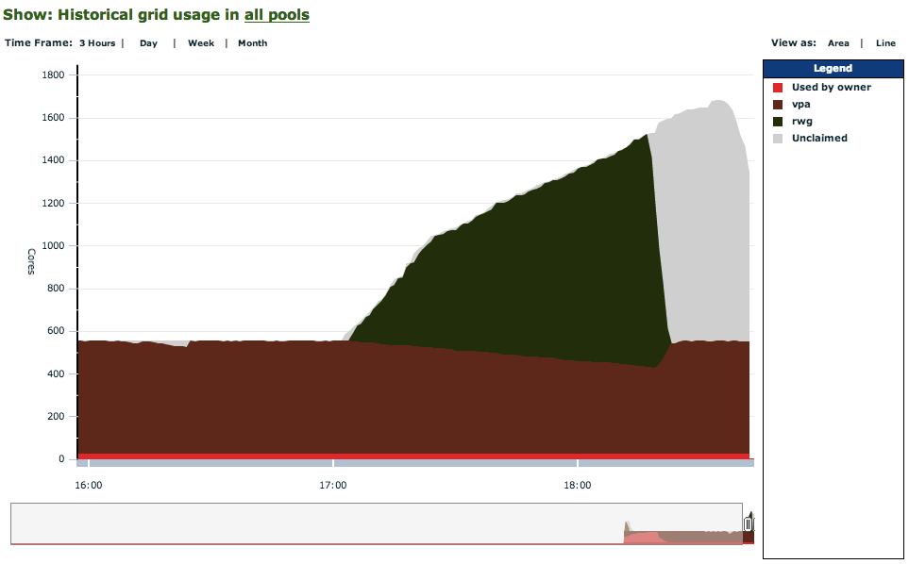
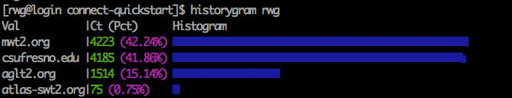
Connect is very quick relative to grid
Flock then
glide
Unclaimed
glideins
Throughput:
10000 5 min jobs
In 90 minutes
Condor
direct
Site distribution

Slide 17
ATLAS Connect Cluster
ATLAS physicists on their institution’s “Tier 3” cluster can submit into ATLAS Connect without ever leaving home.
  Submissions can be overflow or targeted using HTCondor class ads.
Admins configure HTCondor to flock to the Remote Cluster Connect Factories (RCCF)
  Configuration happens on the local HTCondor schedd
  Firewall rules etc. opened as necessary.
The RCCF service can reach any of the targets in the ATLAS Connect system
  Easily reconfigured for periods of high demand

Slide 18

Tier 1
connect.usatlas.org
Tier 2s
FAXbox
Cloud
RCC Factory
rccf.usatlas.org
Campus Grids
xrd globus
Local Tier3 Center
Local Tier3 Center
Local Tier3
Centers

Slide 19
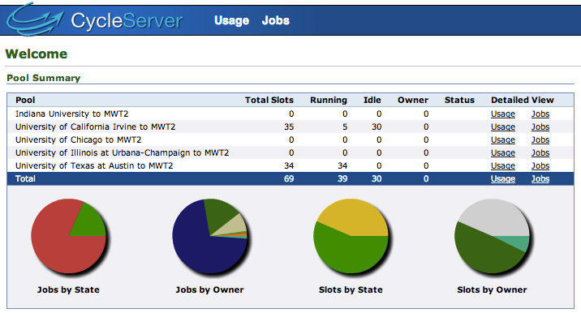
ATLAS Connect Cluster in use
Five clusters configured in this way so far
Works well, very low maintenance

Slide 20
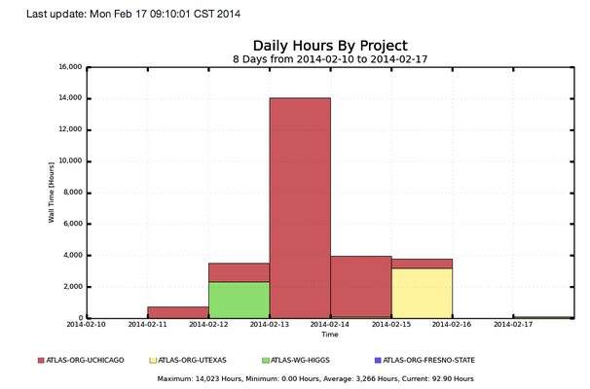
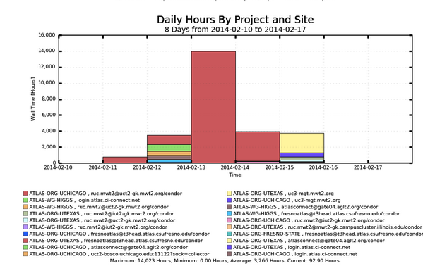
Early adopters ramping up
by group
By group and site

Slide 21
Extending ATLAS Connect to more resources
Some of our colleagues have access to “off-grid” resources such as supercomputers and campus clusters.
We can’t expect any of these resources to have our software prerequisites.
By combining HTCondor and Parrot^{[2]}, we can run ATLAS jobs on these kinds of resources.
Parrot allows us to:
  Access our ATLAS software repositories
  Play some LD_PRELOAD tricks to access system dependencies that we need
  ^{[2]} see the Parrot homepage

Slide 22
ATLAS Connect Panda
We’ve been able to integrate ATLAS Connect with Panda (ATLAS grid workflow manager)
  ATLAS production (simulation) jobs are fairly well understood in terms of requirements.
  A new opportunistic queue is created in the workflow system and pointed at HPC resources
  Jobs come through AutoPyFactory^{[3]}, and get locally submitted as HTCondor jobs
  Pre-job wrappers use Parrot to set up an environment that looks like an ATLAS worker node for the jobs.
  ^{[3]} AutoPyFactory paper

Slide 23
Analysis queue
Tier1
connect.usatlas.org
Tier2 USERDISK
LOCALGROUPDISK
Tier2s
SE
Faxbox
faxbox.usatlas.org
Optional user inputs
XSEDE cluster
RCC Factory
rccf.usatlas.org
+ autopyfactory
Off-grid
pilot
xrd http globus
pilot
Campus Grids
pilot
pilot
pilot
pilot
pilot
pilot
pilot
pilot
pilot
pilot
ANALY
CONNECT
Local Tier3 Center
prun
dq2

Slide 24

Back to Campuses
We’re also providing value-added services for existing campus clusters (ci-connect.net)
One of our early adopters: Duke University
  Login node and scratch storage provisioned for Duke users
  Integrated into Duke “BlueDevil Grid” campus grid.
  Also provides a submit interface into the Open Science Grid
  Bridged to opportunistic resources at the University of Chicago

Slide 25
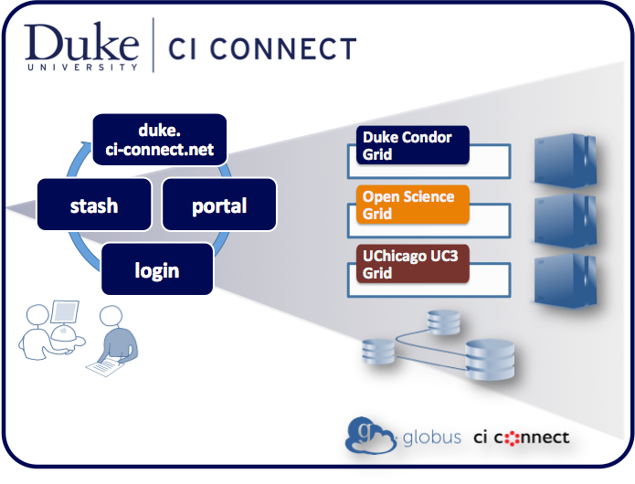

Slide 26
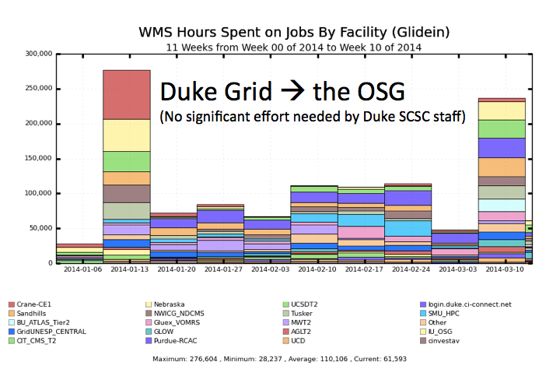

Slide 27
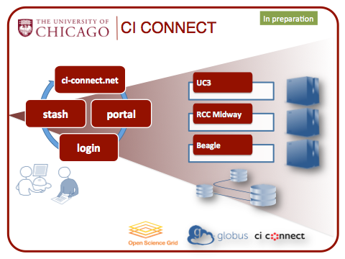
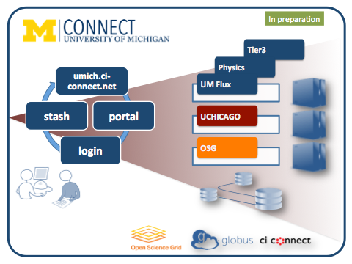
CI Connect Services in Preparation

Slide 28
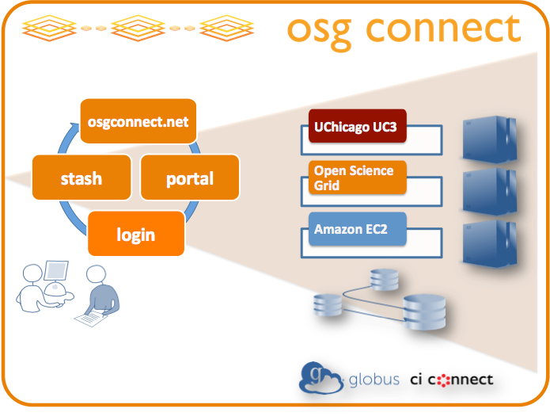
Where it started: a login service for OSG

Slide 29
What does the next-generation look like?
Why can't identity behave more like eduroam?
  I want my login account to be my campus identity. Period. No new accounts.
Can we take a hard look at solving some of the problems with software distribution?
  Are virtual machines the way forward? What about containers?
  We can play games with static compilation and LD_PRELOAD, but it sure would be nice to have something that looks like your home environment!
Data access is still not dead simple
  Focus on data delivery, not data management

Slide 30
Thank you!

Slide 31

Acknowledgements
Dave Lesny – UIUC (MWT2)
David Champion – UChicago (MWT2)
Steve Tuecke, Rachana Ananthakrishnan – (UChicago Globus)
Ilija Vukotic (UChicago ATLAS)
Suchandra Thapa (UChicago OSG)
Peter Onysis – UTexas
Jim Basney (CI-Logon) & InCommon Federation
& of course the HTCondor and OSG teams

