Slide 1
IceCube, HTCondor, and GPUs
Steve Barnet
University of Wisconsin – Madison
Condor Week 2014

Slide 2
Overview
The Basics of IceCube
GPUs – The Motivation
Evolution
Summary

Slide 3
The IceCube Neutrino Observatory
A kilometer scale neutrino detector
Located at geographic South Pole
Detects Cherenkov light from neutrino interactions

Slide 4
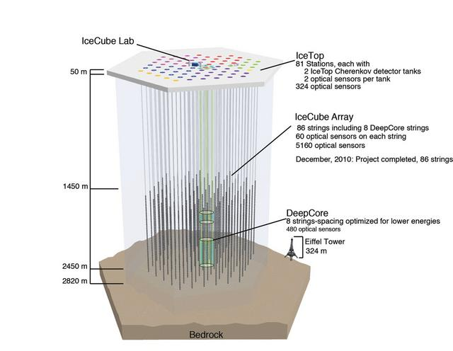

Slide 5
Location, Location, Location
Why the South Pole?
Lots of ice – a great detection medium
The ice is very clear
Thick ice sheet – sensors deep enough to provide significant background reduction

Slide 6
Propagation of Light
A particle creates light when it interacts with the ice
At what time did light hit a module?
How much light hit the module?
Shows us the track of the particle
Provides information about the energy of the particle
Clues as to the type of particle

Slide 7
Need to Model the Ice
Given an interaction point, how does the light propagate through the ice?
Ice scatters and absorbs light, so do a bit of math – voila!
Actually, rather a lot of math (or a little math a lot of times)
Early efforts (starting 15 years ago) – approximate and create lookup tables

Slide 8
Problems
The ice has structure
Dust layers
Tilt
Each parameter adds complexity/size to the tables
Tables introduce (large) systematic errors

Slide 9
Solution – Direct Propagation
Simulate the track of each photon through the ice
Computationally intensive
Even a low energy event generates a few million photons
Event rate is ~ 3000 events/s
Serious efforts in this direction began in 2009

Slide 10
The Story So Far
Can we do this with CPUs?
Yes! Early code written in C++ ~ 2009
Also assembly (1.25x-.1.37x speed-up)
Followed closely by GPU implementations
nVidia/CUDA based
150x initial speed-up vs CPU versions

Slide 11
Version 1
Initial system – consumer GPUs
Custom-built gamer desktops
Proof of concept
No HTCondor

Slide 12
Version 2
GZK-9000 cluster
Commercial GPUs
48x nVidia M2070 GPUs
High density, increased scale
Hosted at CHTC
HTCondor managed

Slide 13
Version 3
Consumer grade GPUs
Cheaper (*much* cheaper – 4x)
Split pool – 32x nVidia GTX-690, 32x ATI Radeon 7970
SuperMicro based – integrated by re-seller
HTCondor managed

Slide 14
Cheap GPUs – What you lose
No Free Lunch …
… or ECC either (maybe)
… and limited Double Precision performance
Detailed monitoring
Temp & Fan speed mostly
No direct utilization reporting

Slide 15
Experiences
Getting these stable takes time
For us, true for commercial & consumer alike
Another software stack to manage
GPU drivers
SDK & execution libraries
Consumer card market extremely variable
Availability
Many card vendors (eVGA, Asus, XFX, PNY, …)
AMD (ATI) is not as “into it” as nVidia

Slide 16
HTCondor Config
Start with static config
STARTD config:
SLOT_TYPE_3 = cpus=1, mem=2000
NUM_SLOTS_TYPE_3 = 1
SLOT3_HAS_GPU = TRUE
SLOT3_GPU_NAME = "nVidia GeForce GTX 680"
SLOT3_GPU_DEV = 1
SLOT3_STARTD_ATTRS = HAS_GPU GPU_DEV GPU_NAME
USER_JOB_WRAPPER = /etc/condor/gpu_job_wrapper.sh

Slide 17
HTCondor Config
STARTD cont’d:
Wrapper script:
#!/bin/bash
gpu_dev=$(awk -F ' = ' '/^GPU_DEV = /{print $2}' $_CONDOR_MACHINE_AD)
if [ -n "$gpu_dev" ]; then
export CUDA_VISIBLE_DEVICES=$gpu_dev
export COMPUTE=:0.$gpu_dev
export GPU_DEVICE_ORDINAL=$gpu_dev
fi
exec "$@"

Slide 18
Submit side
GPU allocation is managed with Accounting Groups
A job requests the GPU accounting group
+AccountingGroup="gpu.$ENV(USER)”
CUDA jobs must require CUDA:
requirements = HAS_CUDA
OpenCL jobs can run anywhere, so no special requirements

Slide 19
Future
It’s hard to make predictions, especially about the future – Yogi Berra
Upgrade HTCondor to development series (as we speak)
Use TJ’s new detection features

Slide 20
Credits
Juan Carlos Diaz-Velez, David Schultz – IceProd framework
Dmitry Chirkin, Claudio Kopper – GPU simulation development
Vladimir Brik– GPU wrangling
CHTC – Hosting the GZK cluster, OSG support, HTCondor GPU efforts (TJ!)
UW Madison – Fast networks
NSF – IceCube M&O funding

Slide 21
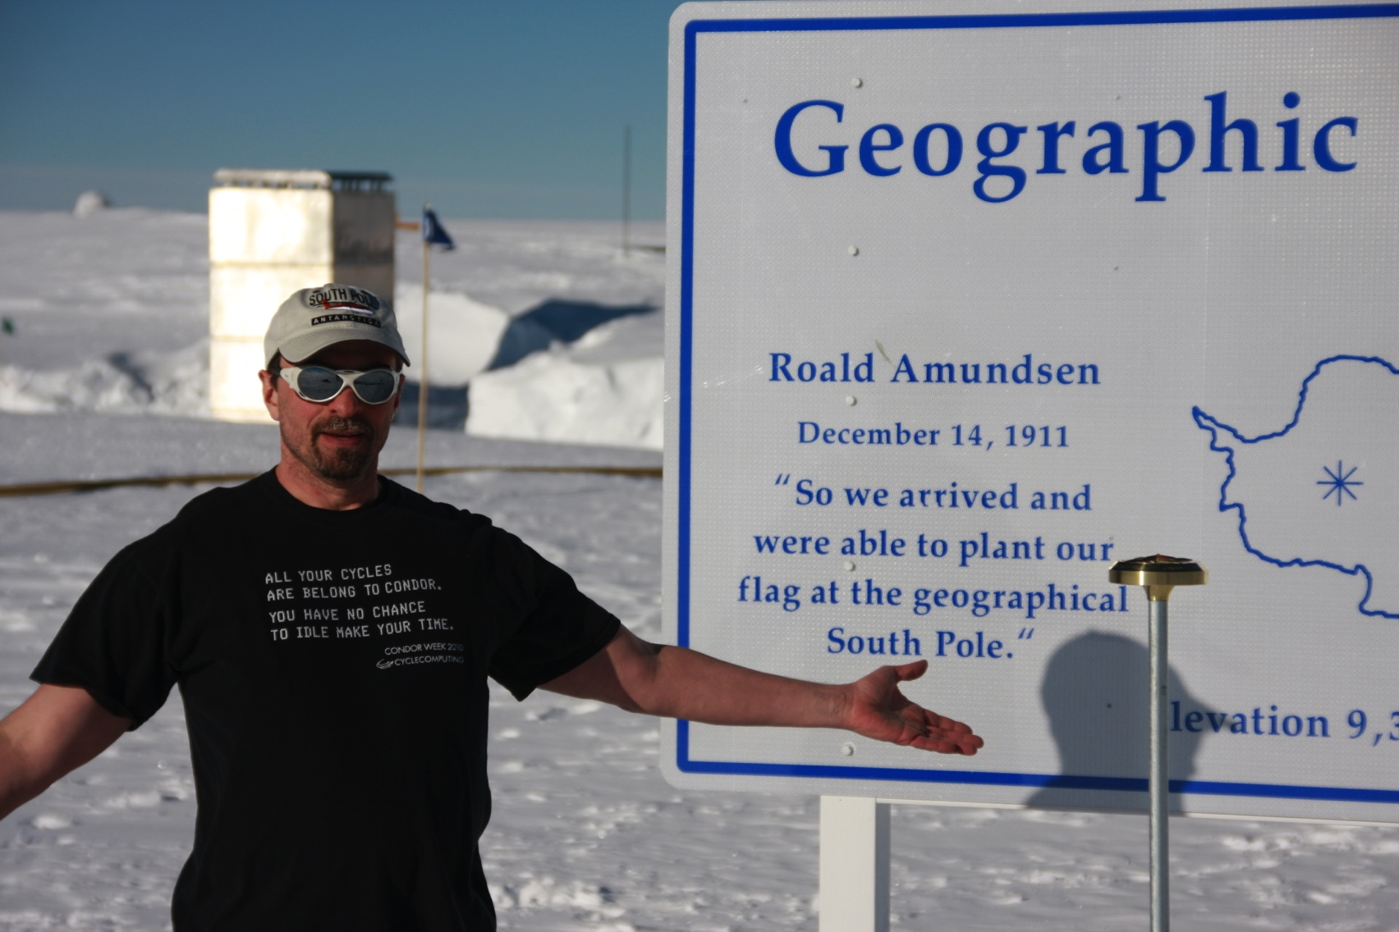
Questions?

