Slide 1
Managing a growing campus pool
Eric Sedore
essedore@syr.edu

Slide 2
Quick context
Scavenging CPU time from 2000 desktops on campus
Growth from 3000 to 6000+ cores over the last year
Varied types of research (in all dimensions, run time, data needed per job, data access type (HTCondor transfer/NFS))
Challenge feeding data to the compute nodes
VPN tunnel bandwidth
SAN Storage / Virtual server environment
Campus network
Exploring steering jobs via average availability of each node

Slide 3
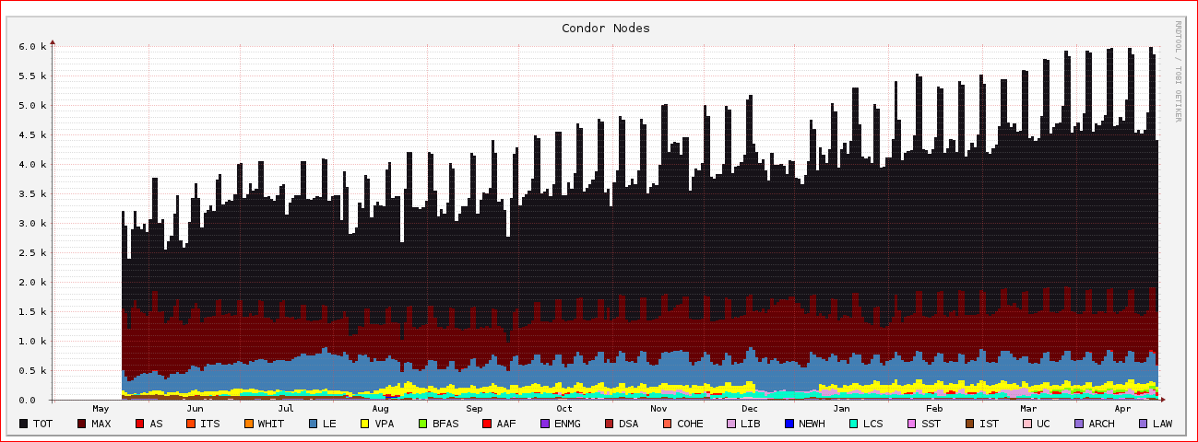

Slide 4
Steering jobs
More Traditional – CPU/Memory/Application requirements
Jobs that are not easily checkpointed and have longer run times
Dynamic average giving the job a view into the amount of scavenging time (in hours) of a node – publish via classad
sessionlength = "44"
sessionlength = "9"
sessionlength = "10"
sessionlength = "41"
Add to job requirements or ranking: TARGET.sessionlength >= "4“
Data gathered through parsing logs from the last seven days (from Condor VM Coordinator)

Slide 5
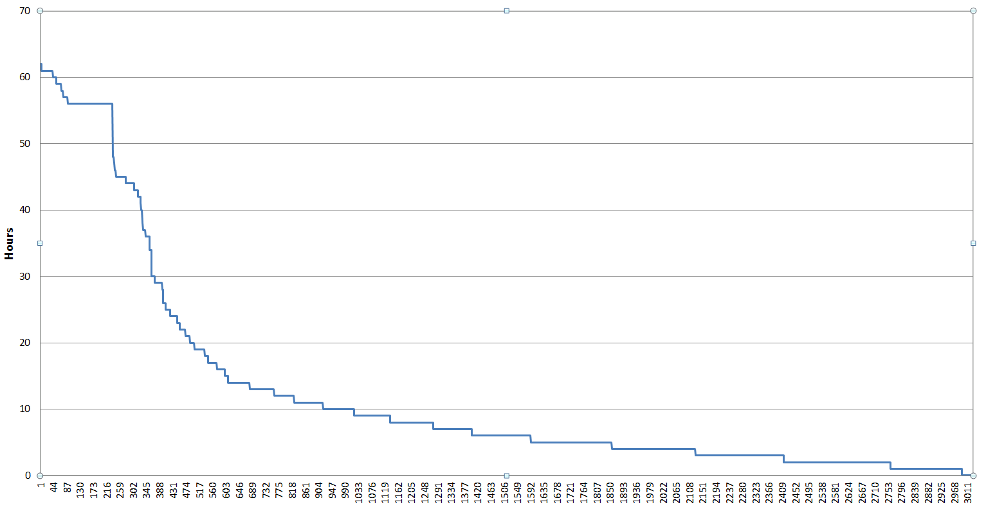

Slide 6
Dealing with growth
Data delivery infrastructure - horizontal and vertical scaling
Network infrastructure upgrades – upgrading 1 Gb links to 10 Gb links
Scaling out VPN end points – working toward a model, 1000-1500 per endpoint
Throttling vs. bottleneck (protecting network links where there are high compute node populations)

Slide 7
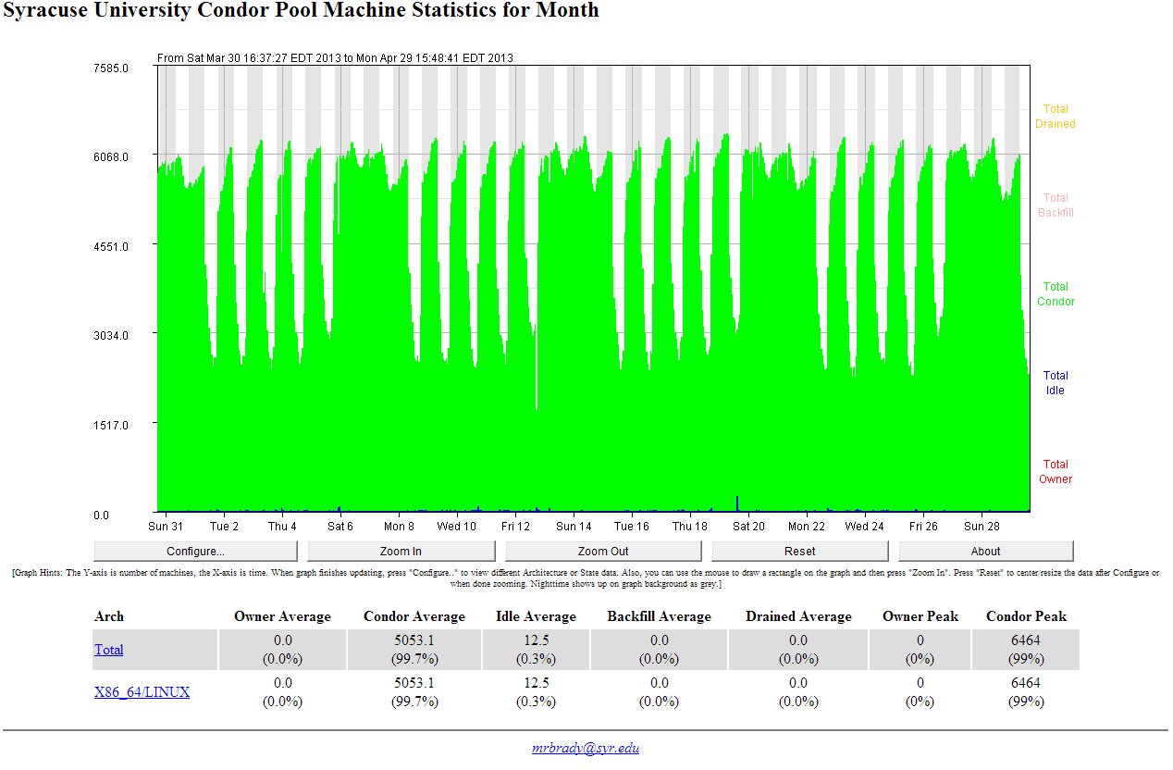

Slide 8
Pushing NFS
~6300 nodes supported on a single NFS server (65000+ open files)
Can run out of CPU at peak times (current server has 16 cores) – context switching / I/O wait
Virtual Machine running in ESX 5.x – SAN storage (15K spindles on an IBM 5300)
3.0.0-21-virtual #35-Ubuntu SMP Fri May 25 18:35:12 UTC 2012 x86_64 x86_64 x86_64 GNU/Linux

Slide 9
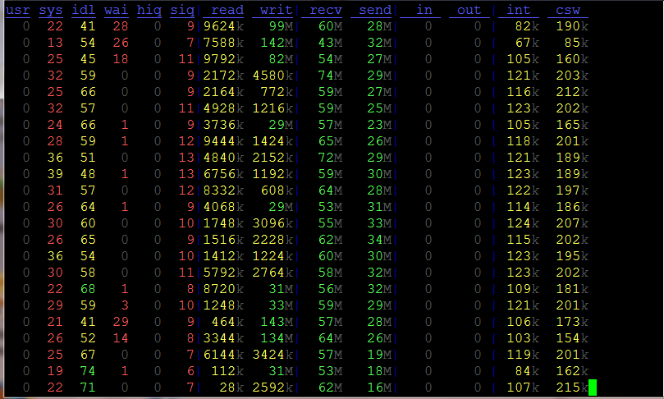
Pool up and running – supporting the load

